Slide 1
Where do potatoes come from?

Slide 2
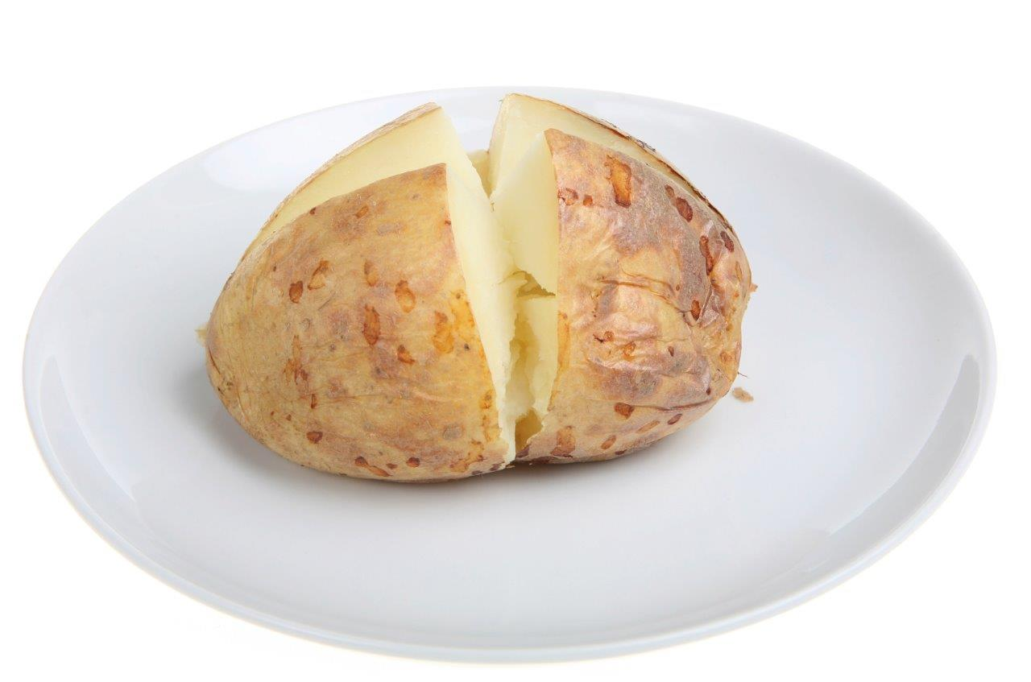
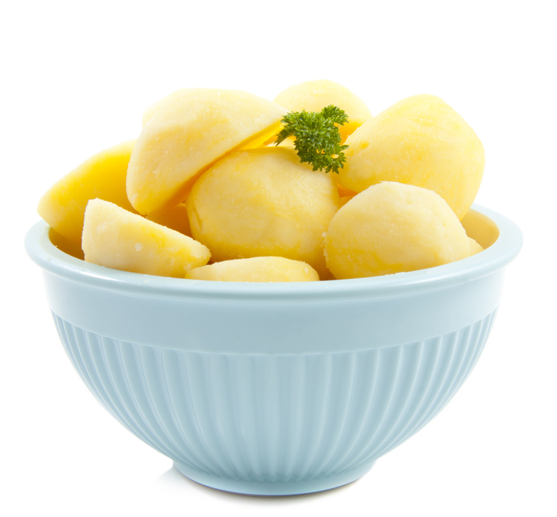
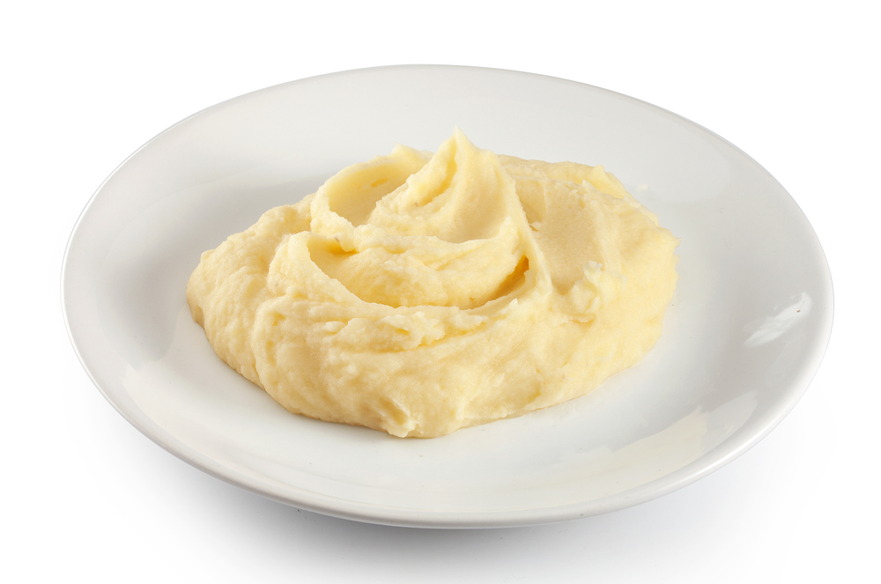
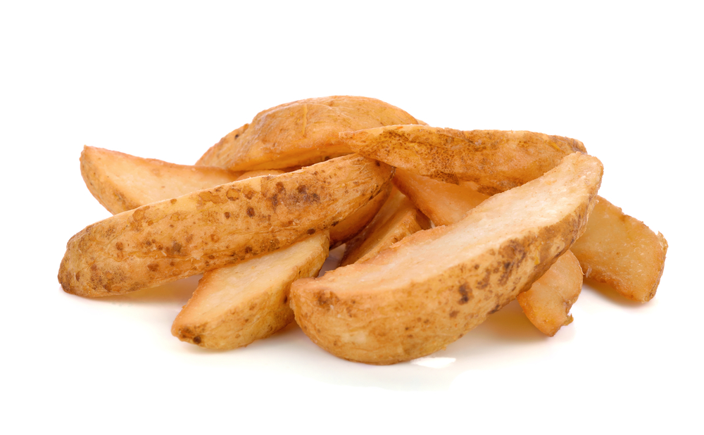
What are these?
They are food that we have with our meals.

Slide 3
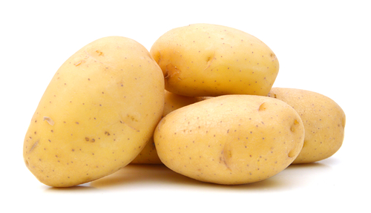
These are food that we have with our meals.
What are they made from?
They are all made from potatoes.

Slide 4
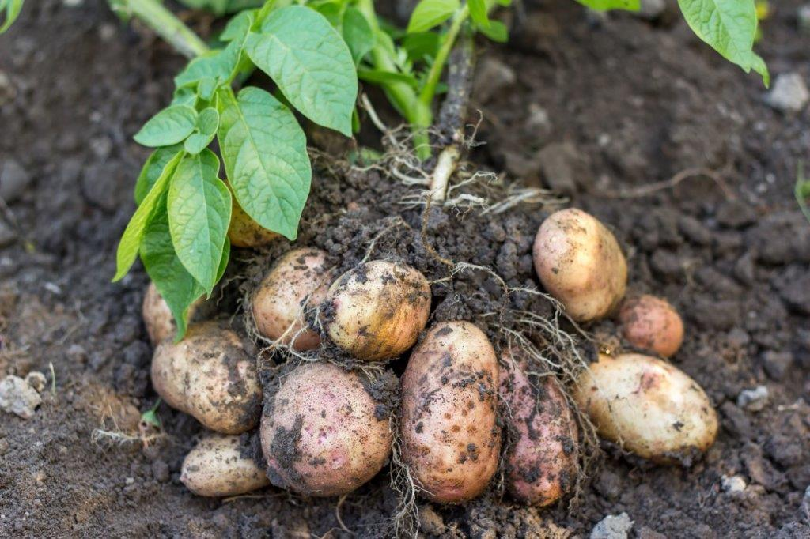
Where do potatoes come from?
Potatoes are a plant.
They grow under the ground.

Slide 5
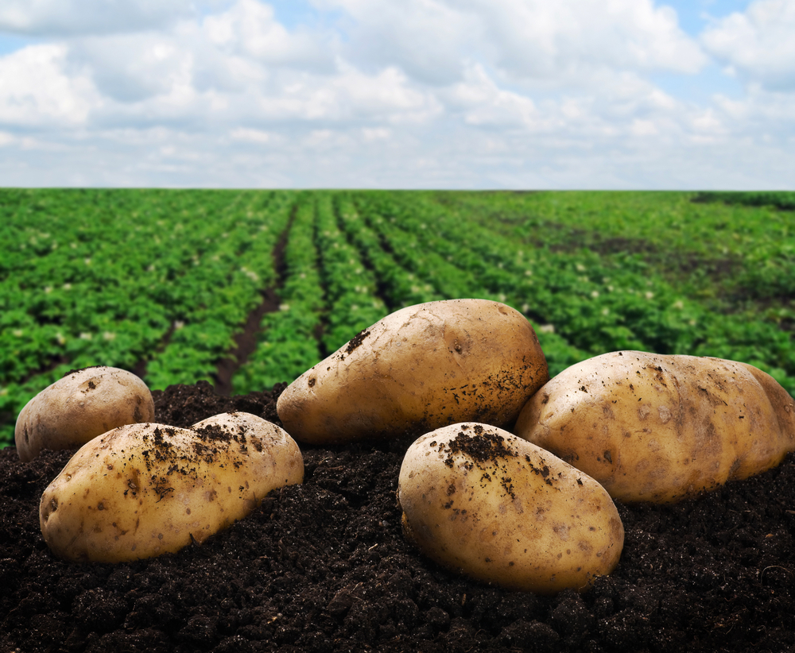
Where do potatoes come from?
They are grown by farmers in the UK.
Have you seen potatoes growing before?

Slide 6
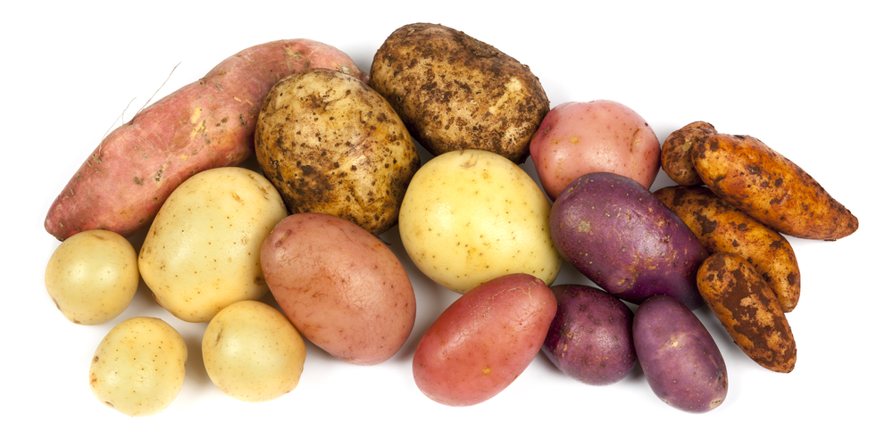
Potato types
There are lots of different types potato.
They have different names, such as:
Maris piper;
Charlotte;
Desiree.

Slide 7
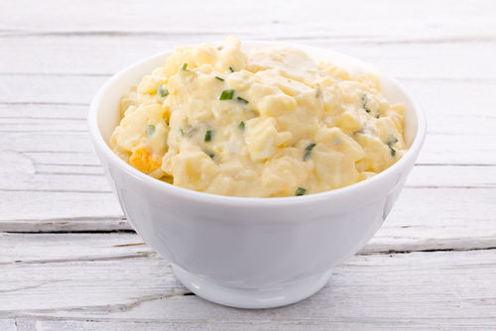
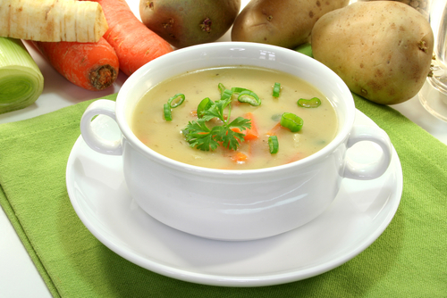
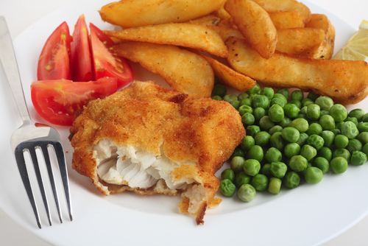
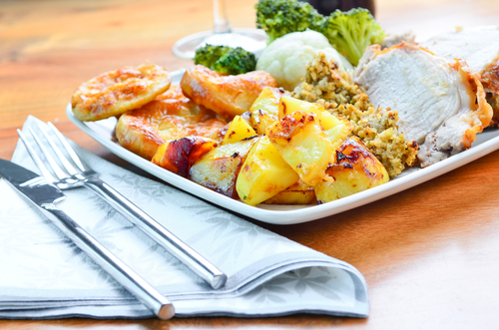
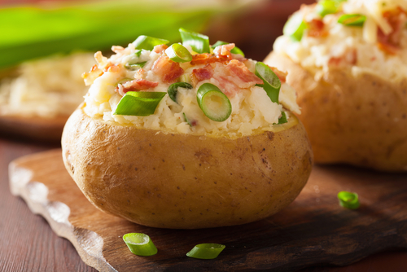
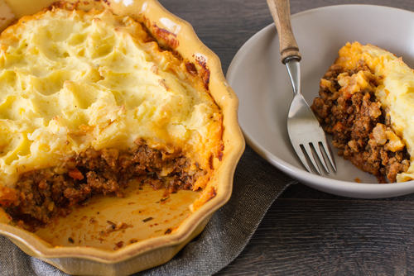
Meals
Potatoes can be used in lots of meals.

Slide 8
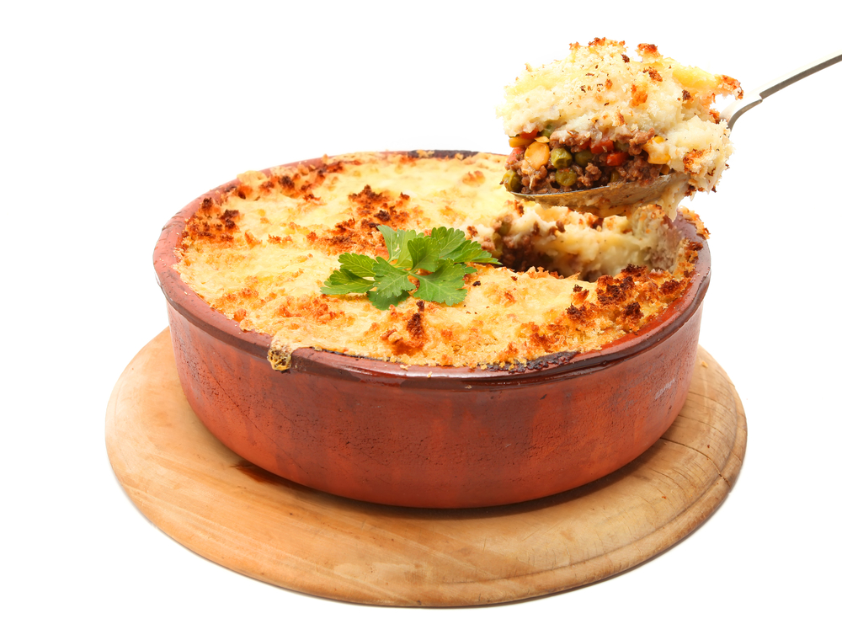
Summary
Potatoes are grown for our food.
Potatoes
Lots of meals are made with potatoes.

Slide 9
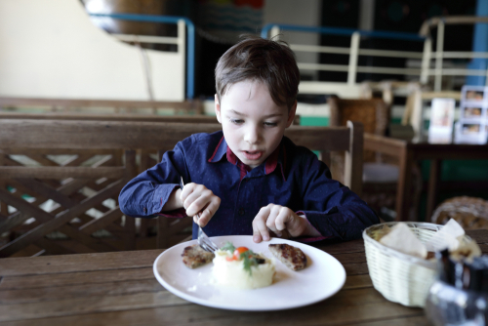
Do you like potatoes?

Slide 10
For further information, go to:
www.foodafactoflife.org.uk

