Slide 1
Growing potatoes

Slide 2
Potatoes come from a plant
Where are the potatoes?

Slide 3
Potatoes are tubers
Here are the tubers.

Slide 4
Different parts of a potato plant
stem
leaves
tubers
roots

Slide 5
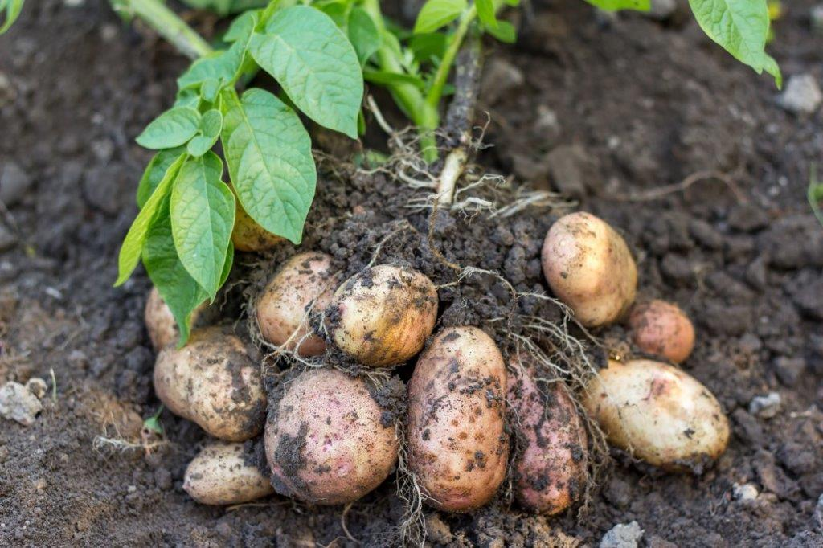
Let’s find out how potatoes grow!

Slide 6
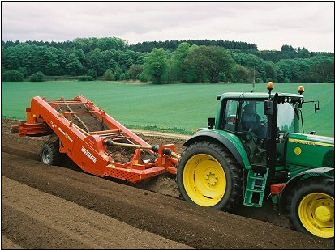
Preparing the ground
This is a destoner. It is removing stones from the soil so the potatoes have more room to grow.
This also stops the harvester collecting stones when it collects the potatoes later on.
As the destoner does its job, it makes long tunnels of soil. These are called beds.

Slide 7
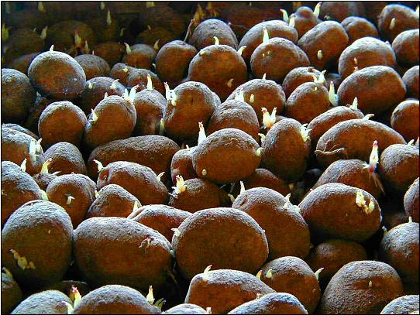
Chitting
These are potatoes (tubers). They are left to sprout before they are planted.
This is called chitting, and it helps the tubers grow faster and produce a bigger crop.
If they are not left to sprout they will grow slowly when they are planted.

Slide 8
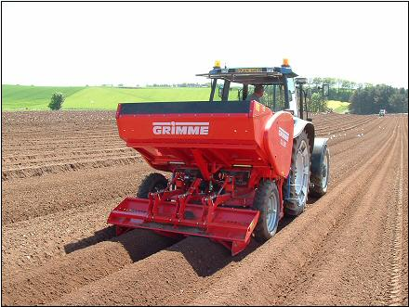
Planting
Potatoes are usually planted in April into warm, loose soil.
The planter moves along the beds planting the potatoes in rows.

Slide 9
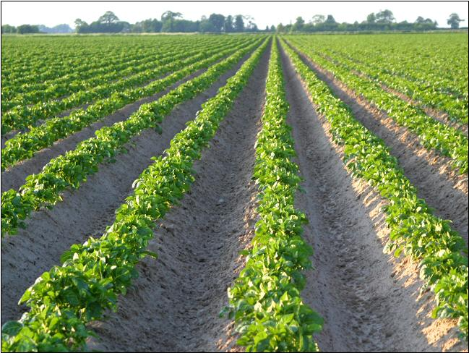
Growing
Here are the potato plants.
As they grow, the soil is ‘earthed up’. This means it is pulled up around them – a bit like a blanket.
This protects them against frost and weeds and stops the potatoes going green.

Slide 10
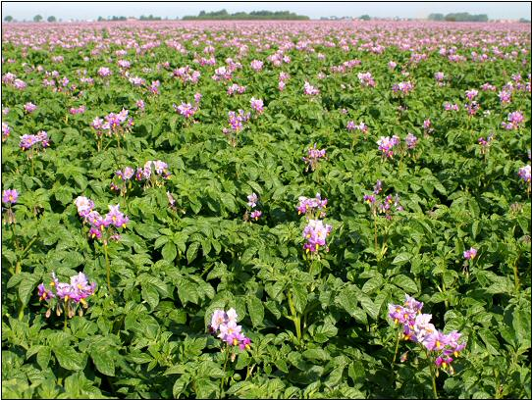
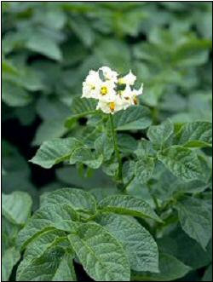
Flowering
The potatoes plants have a small white or pink flower.
They also grow a small green tomato-like fruit that is poisonous to eat.

Slide 11
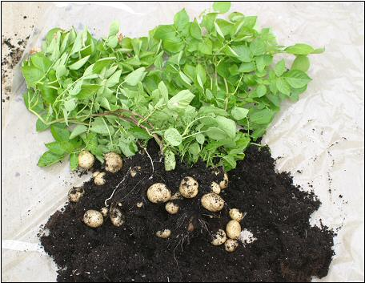
Under the soil
By the middle of July, the first potatoes are ready to be harvested.
They are called the first earlies. In August the second earlies are harvested.
Earlies are small potatoes often called ‘new’ potatoes.
The main crop are ready in September.

Slide 12
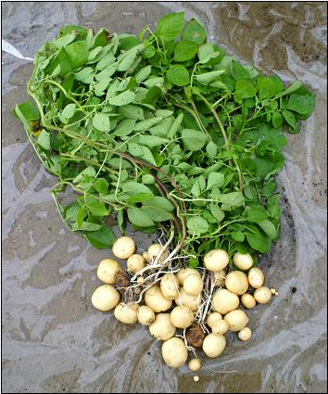
Potato plant
Can you remember what all the parts of the potato plant are called?

Slide 13
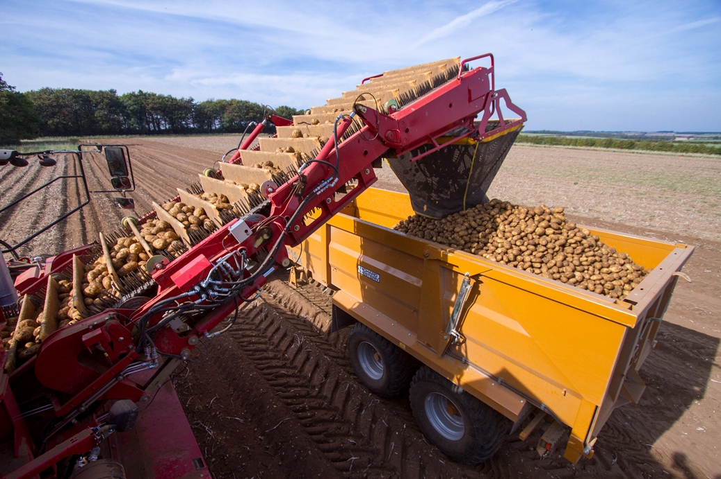
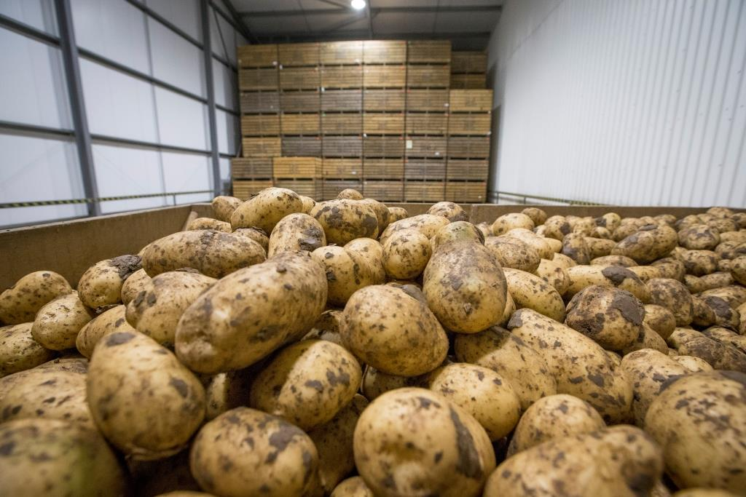
Harvesting
Here is the a harvesting machine. It lifts and separates the potatoes from the soil.
Some of the harvested potatoes will be eaten straight away but some will be stored and eaten later in the year.

Slide 14
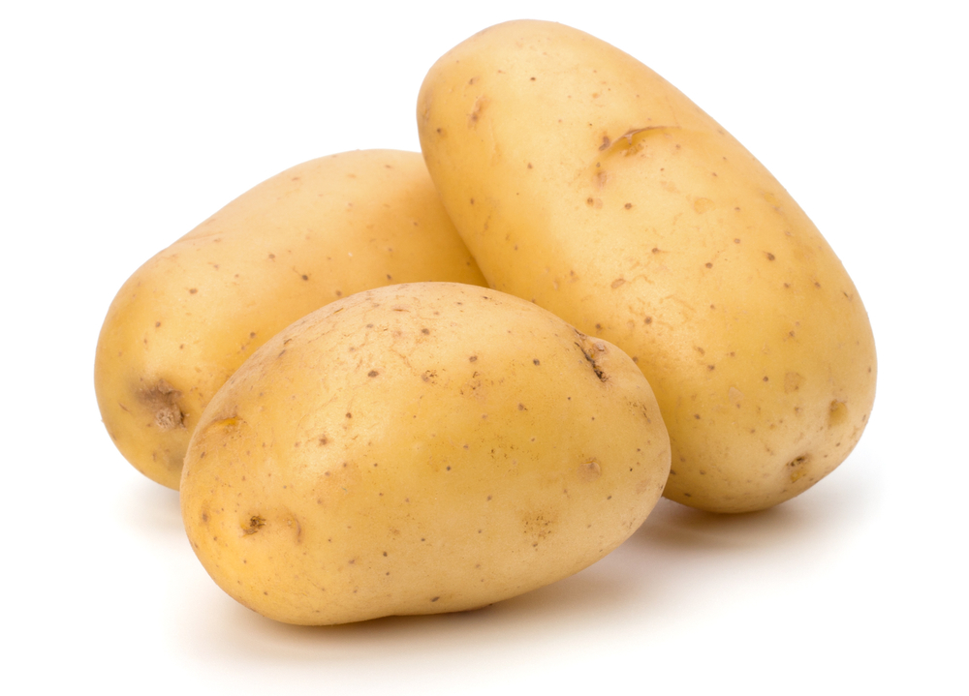
Potatoes

Slide 15
For further information, go to:
www.foodafactoflife.org.uk

