Slide 1
Types of potatoes

Slide 2
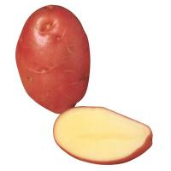
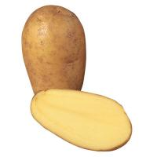
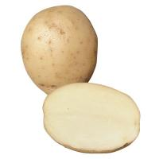
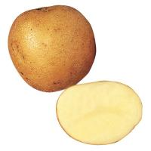
Potatoes
There are lots of different varieties of potato.
Explain how these potatoes look different from each other.

Slide 3
Did you know potatoes have different names?
Desiree
Charlotte
Estima
Maris Piper

Slide 4



Fluffy, salad and smooth
Potatoes come in three types: Fluffy, Salad and Smooth.
Maris Piper
Charlotte
Desiree

Slide 5
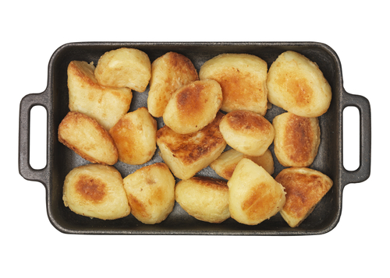
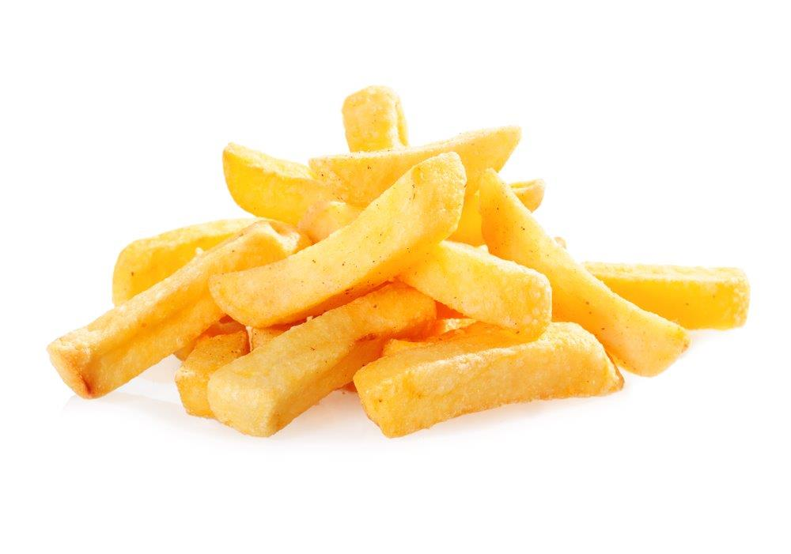
Fluffy potatoes
Fluffy potatoes go crumbly round the edges when cooked.
Maris Piper potatoes are fluffy.
They are good for roasting, baking and making chips.

Slide 6
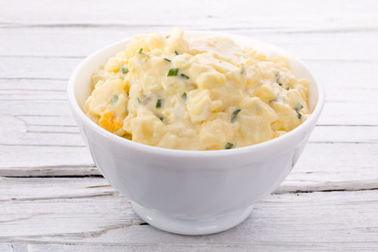
Salad potatoes
Charlotte potatoes are a salad type.
They are good for steaming, roasting and making potato salads.

Slide 7
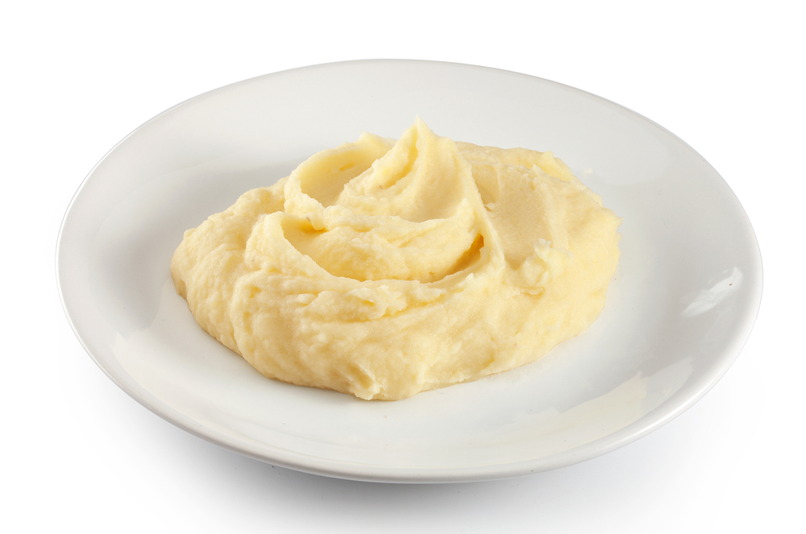
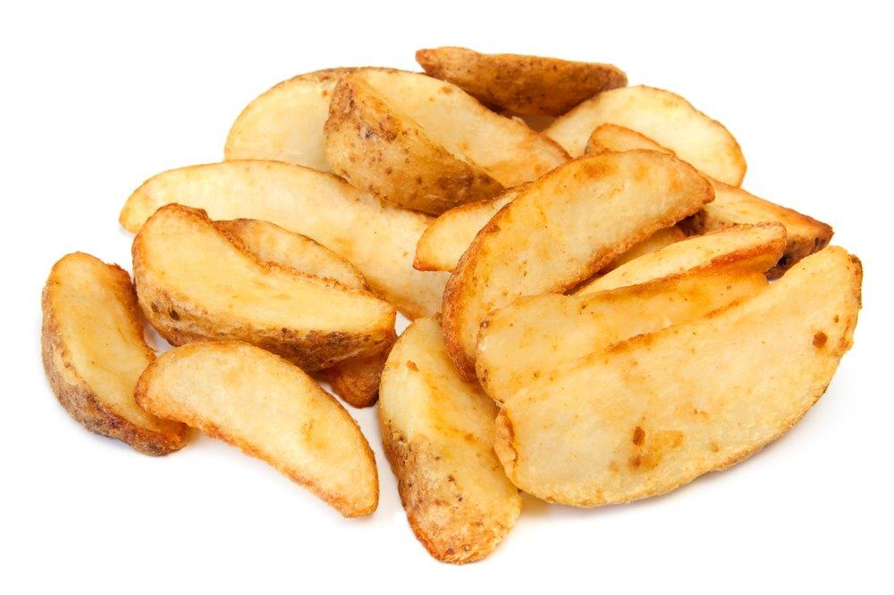
Smooth potatoes
Desiree potatoes are smooth.
They are good for boiling, mashing and making potato wedges.

Slide 8
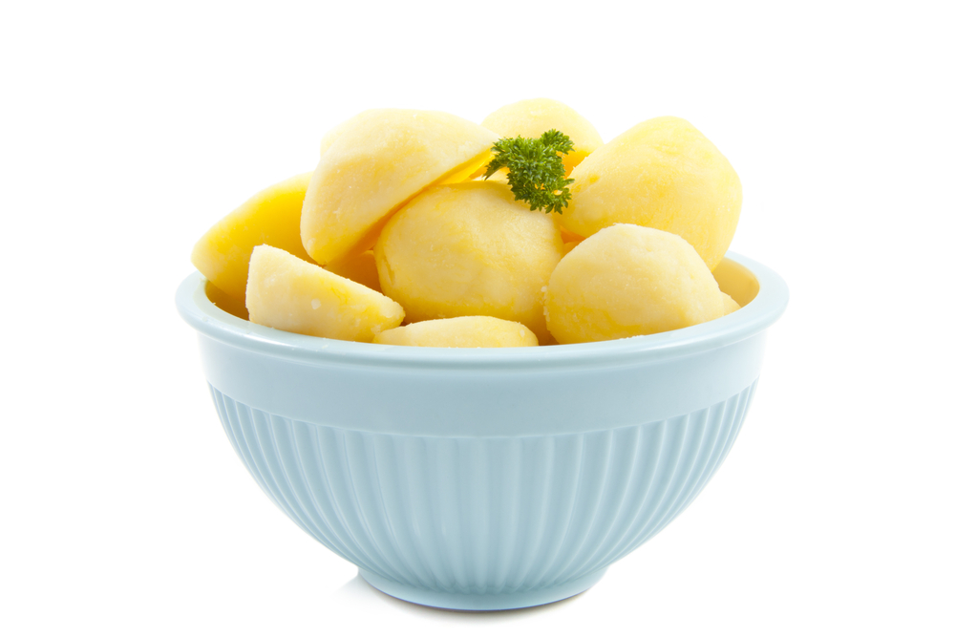
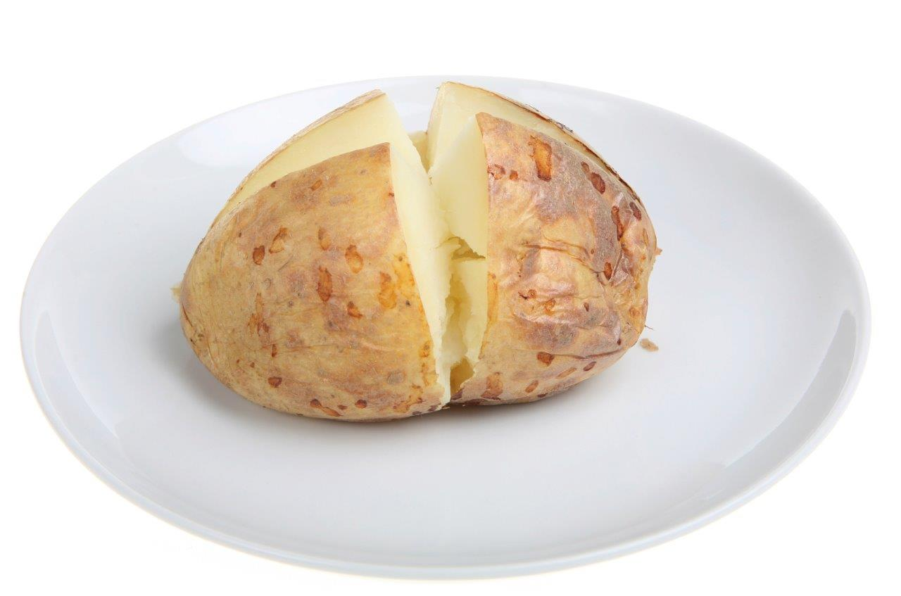
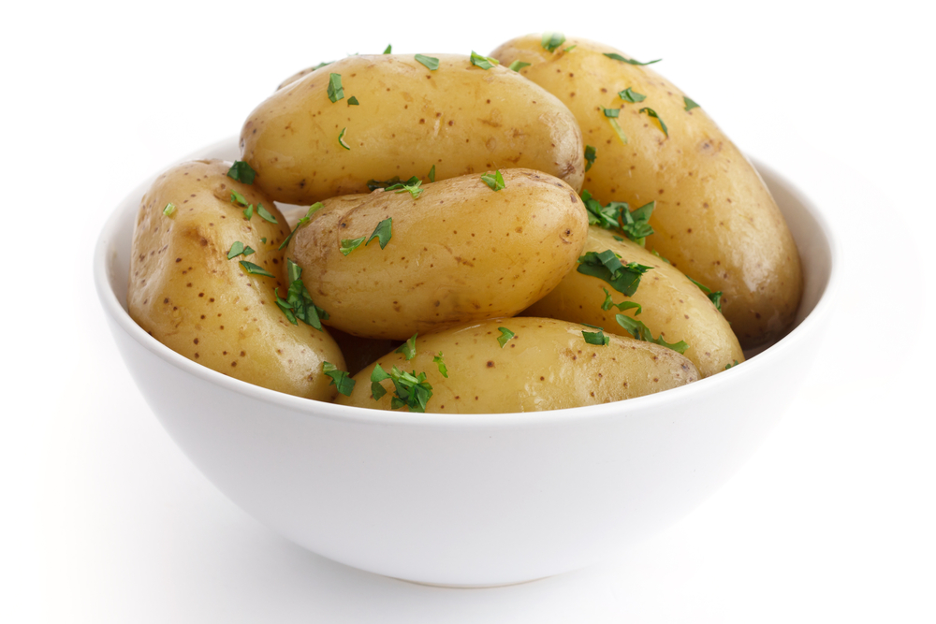
Cooking potatoes
boiled
Here are six ways potatoes can be cooked:
baked
roasted
microwaved
fried
mashed

Slide 9
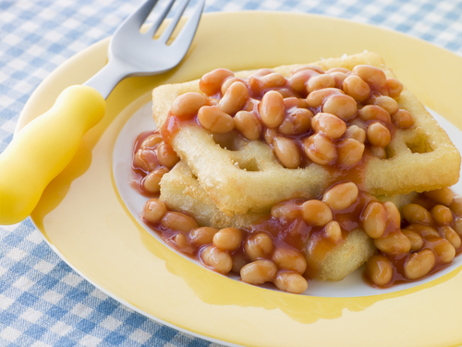
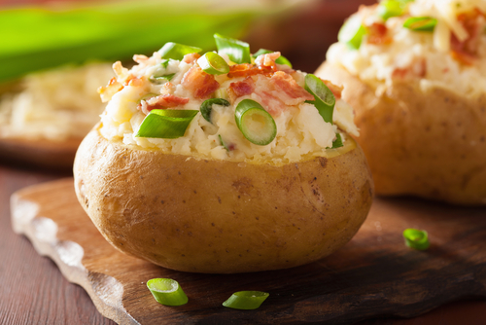
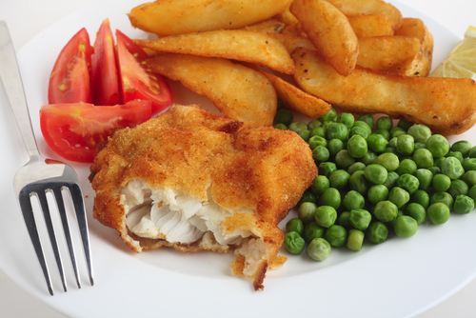
Have you tried…
… potato waffles?
… a jacket potato?
… potato wedges?

Slide 10
For further information, go to:
www.foodafactoflife.org.uk

