Slide 1
Field to fork

Slide 2
Here is the a harvesting machine.
It lifts and separates the potatoes from the soil.

Slide 3
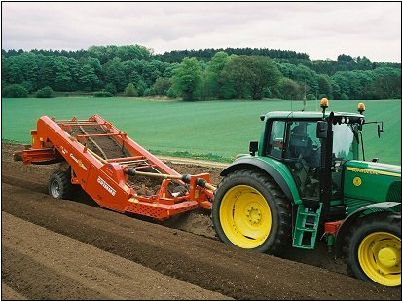
Preparing the ground
This is a destoner. It is removing stones from the soil so the potatoes have more room to grow.
This also stops the harvester collecting stones when it collects the potatoes later on.
As the destoner does its job, it makes long tunnels of soil. These are called beds.

Slide 4
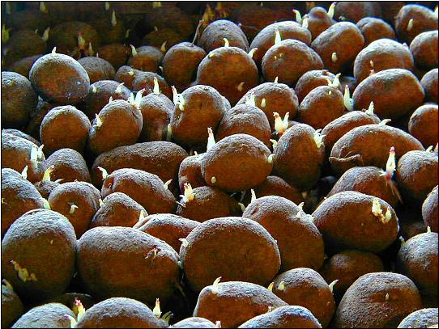
Chitting
These are potatoes (tubers). They are left to sprout before they are planted.
This is called chitting, and it helps the tubers grow faster and produce a bigger crop.
If they are not left to sprout they will grow slowly when they are planted.

Slide 5
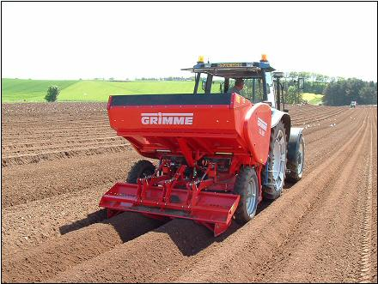
Planting
Potatoes are usually planted in April into warm, loose soil.
The planter moves along the beds planting the potatoes in rows.

Slide 6
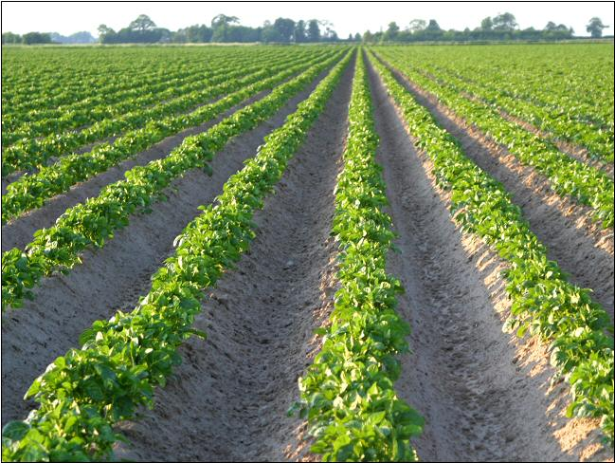
Growing
Here are the potato plants.
As they grow, the soil is ‘earthed up’. This means it is pulled up around them – a bit like a blanket.
This protects them against frost and weeds and stops the potatoes going green.

Slide 7
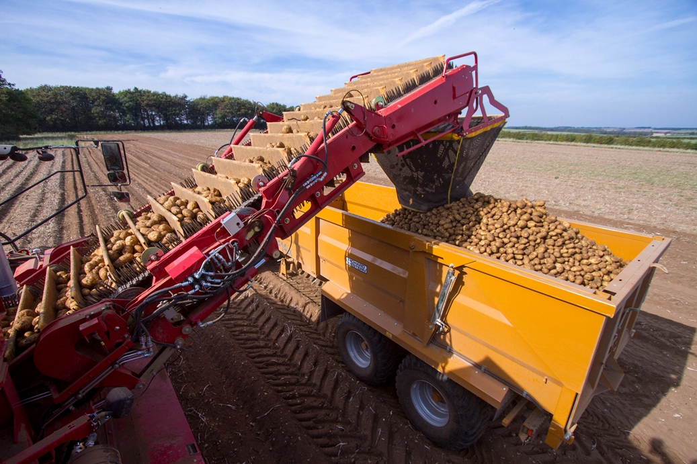
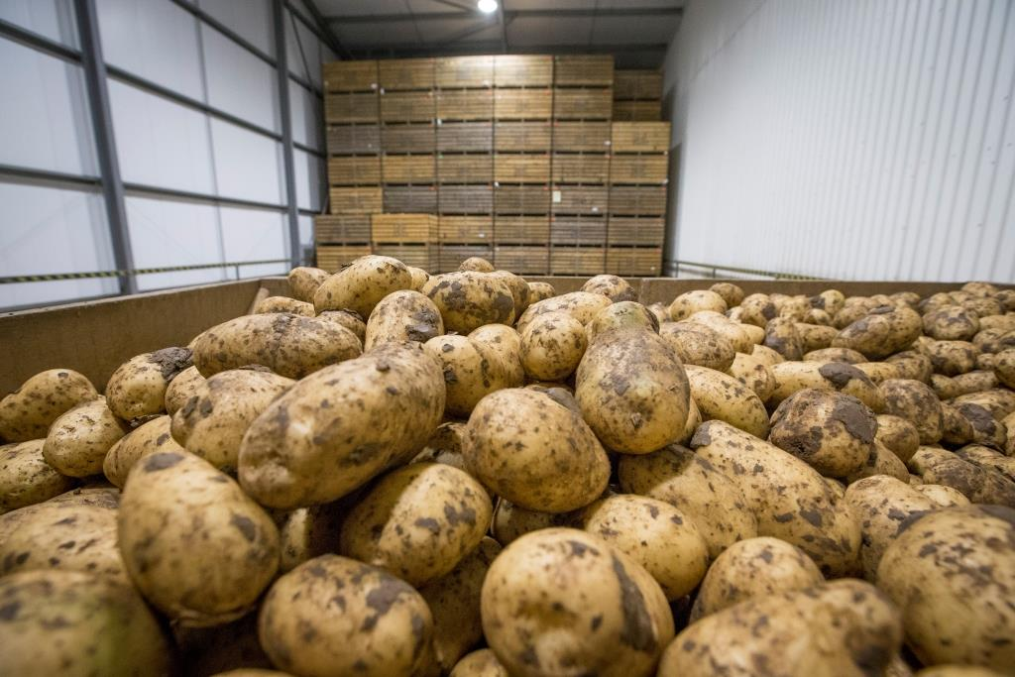
Harvesting
Here is the a harvesting machine. It lifts and separates the potatoes from the soil.
Some of the harvested potatoes will be eaten straight away but some will be stored and eaten later in the year.

Slide 8
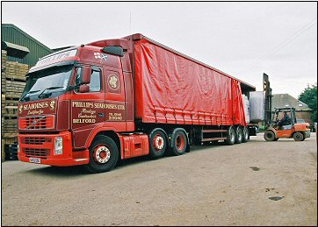
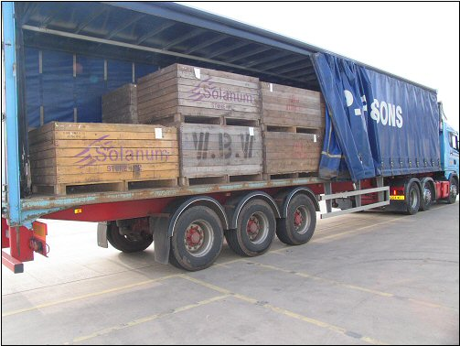
Delivery
The harvested potatoes are loaded onto lorries and taken to the processing centre.

Slide 9
Washing
The soil is washed from the potatoes.
Then they go on to be sorted into different sizes for use as baking, roasting, salad or general purpose potatoes.

Slide 10
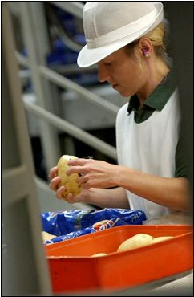
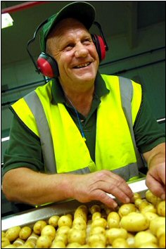
Checking
All of the potatoes are checked before they go to be weighed and packed.
This is to make sure they are good enough to be sold.

Slide 11
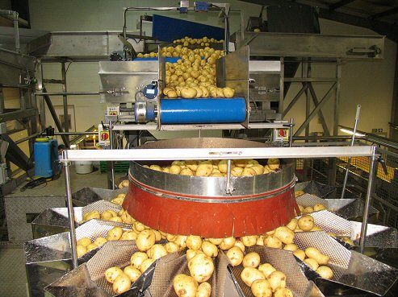
Washing
After washing and sizing, the potatoes are weighed into the right amounts ready for packing.

Slide 12
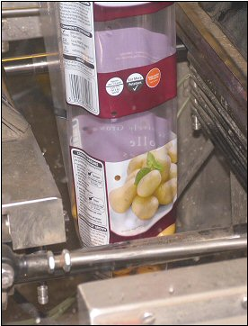
Bagging
The potatoes are now placed in bags
ready to be taken to different shops and supermarkets.

Slide 13
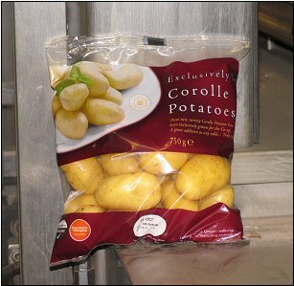
Labelling
The bags show the weight and variety of the potatoes.
They also show where the potatoes were grown, nutritional information and serving suggestions.

Slide 14
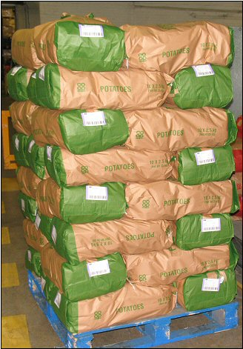
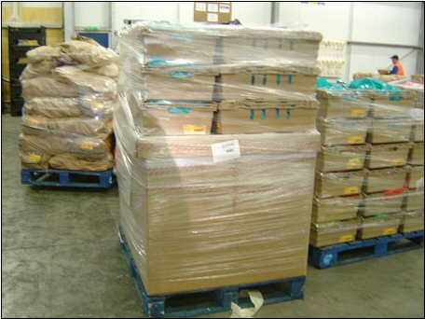
Ready to go!
Finally, the potatoes are packed into big bags and placed onto pallets.
Placing the packed potatoes onto pallets allows a forklift truck to easily load the potatoes onto containers ready to be taken to shops and processing centres.

Slide 15
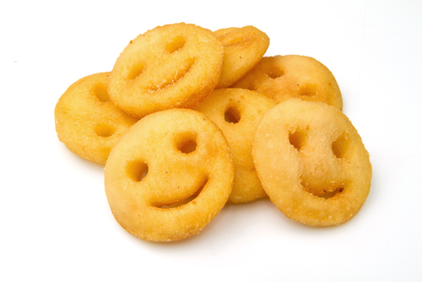
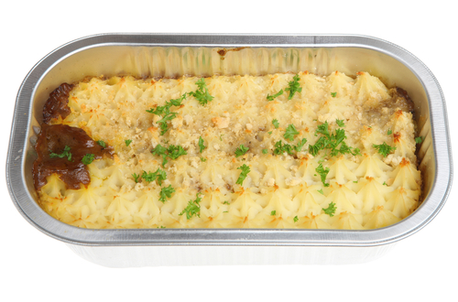
Potato products
Potatoes that are sent to the processing centre are used to make lots of potato dishes.
Some of them are cooked and then frozen, others are made into fresh ready meals, and some are added to other ingredients to make meals.

Slide 16
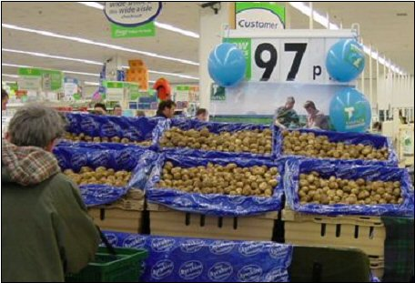
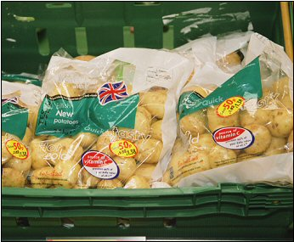
In the shops
In the shops, the potatoes are displayed in different ways to attract the shopper.

Slide 17
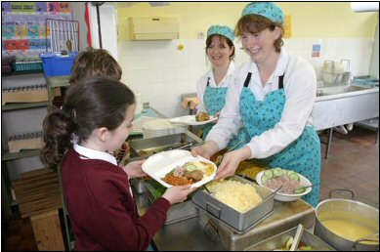
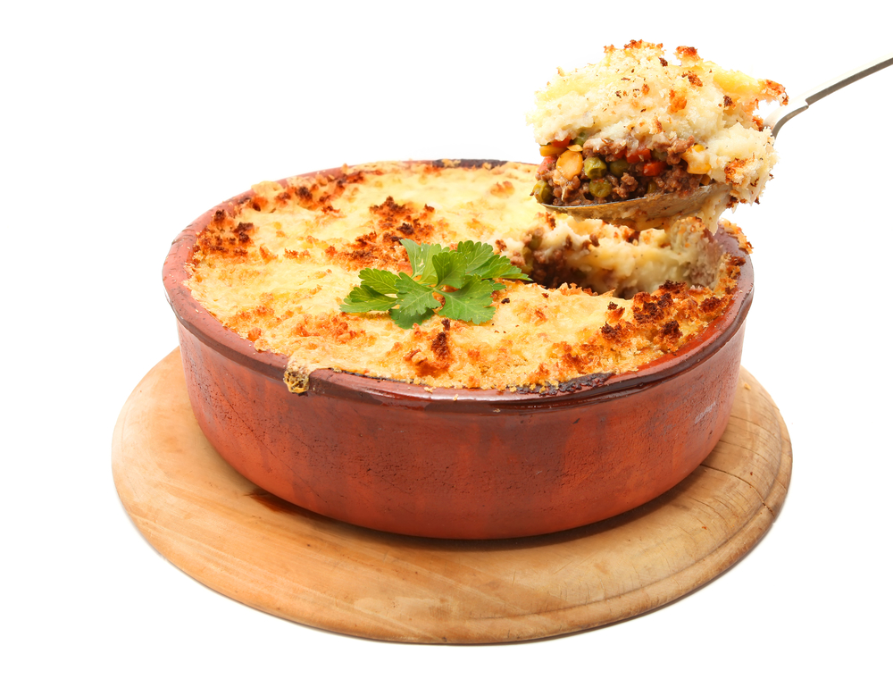
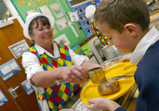
Schools
Potatoes are used to make lots of different dishes in schools.

Slide 18
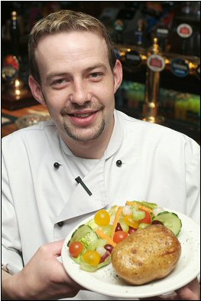
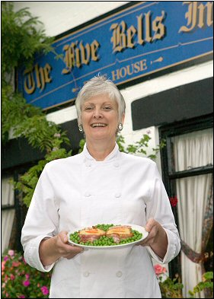
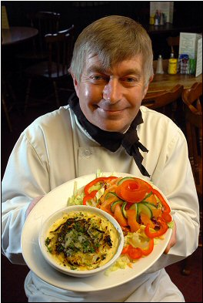
Restaurant
Restaurants use potatoes to make different dishes for
their customers.

Slide 19
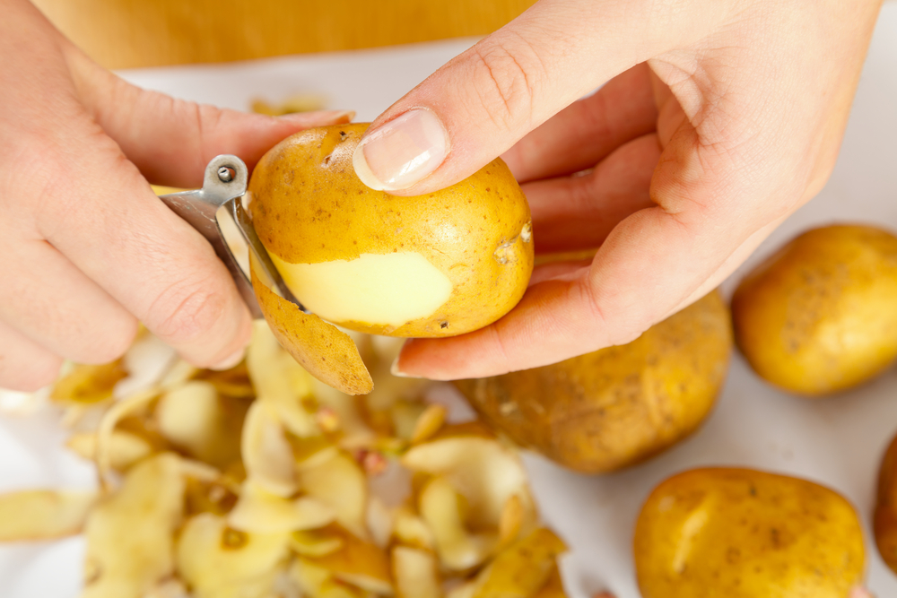
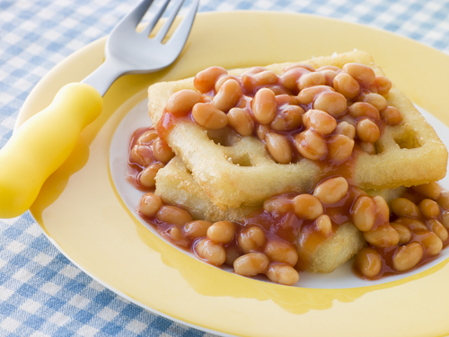
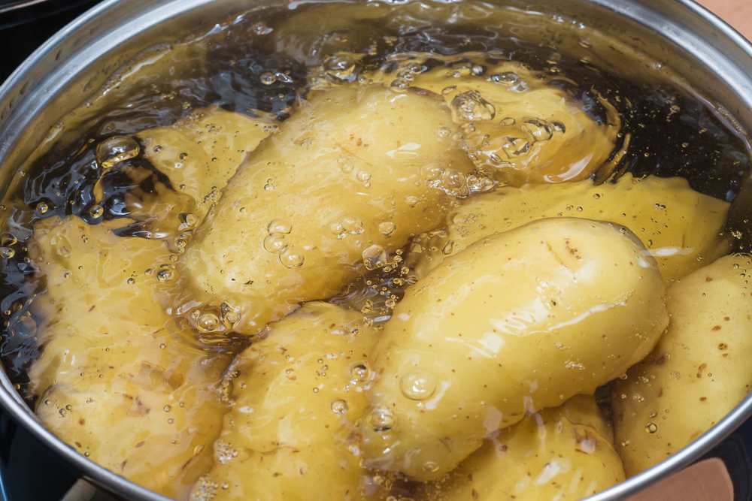
At home
Potatoes can be used in lots of different ways to make tasty dishes and meals at home.

Slide 20
For further information, go to:
www.foodafactoflife.org.uk

