Slide 1
The milling process

Slide 2
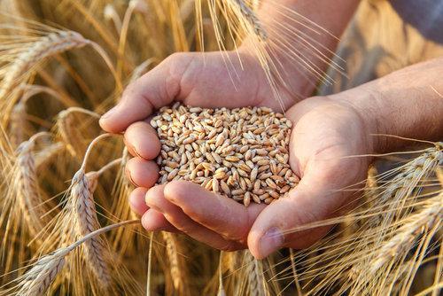
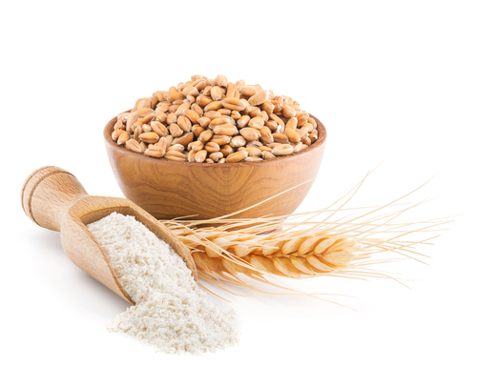
The milling process
Grain needs to be milled into flour before it can be used to make different foods.
Let’s find out more…

Slide 3
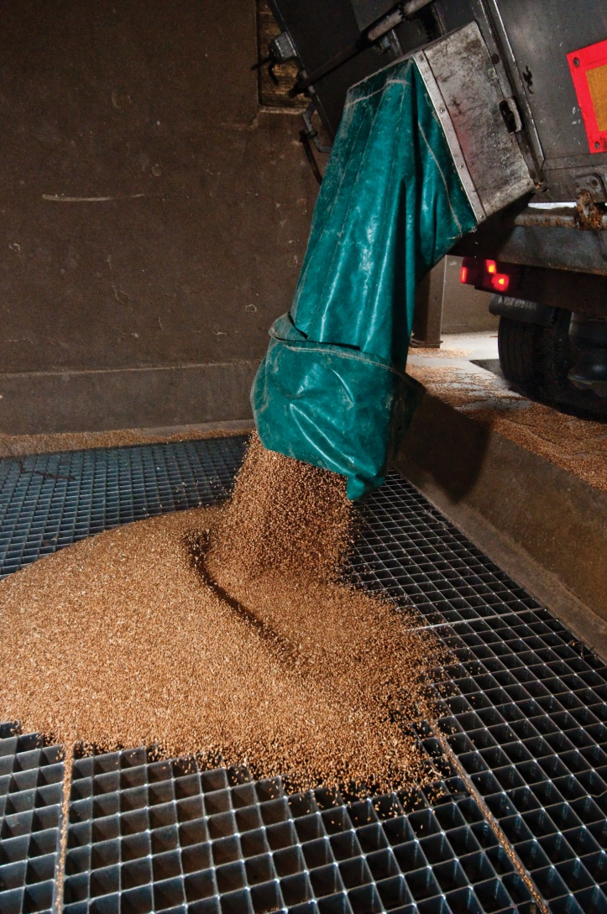
Cleaning
On arrival at the mill, the wheat grain is cleaned to remove dust, straw, stones and other things in the wheat grain that we do not want to eat.
Magnets are used to remove any metal objects.

Slide 4
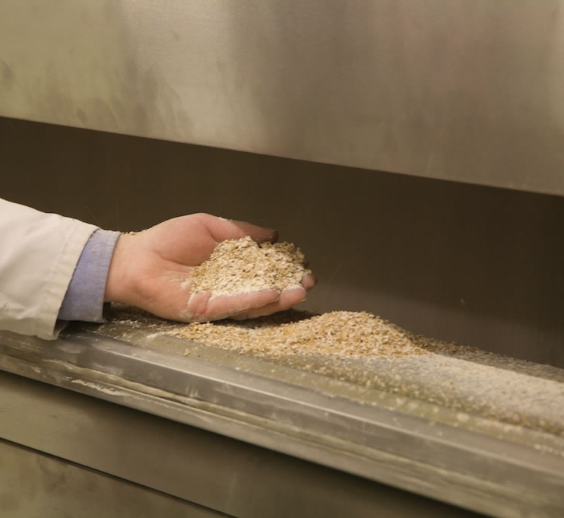
Milling
The grain is then ground through steel rollers with teeth that break the grains open.
This is called the ‘first break’.

Slide 5
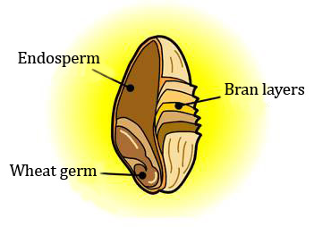
Milling
The grains are then sieved and ground to separate:
the endosperm (the white flour);
the bran layers (outside case of the grain);
the wheat germ (part that grows a new plant).
A grain of wheat

Slide 6
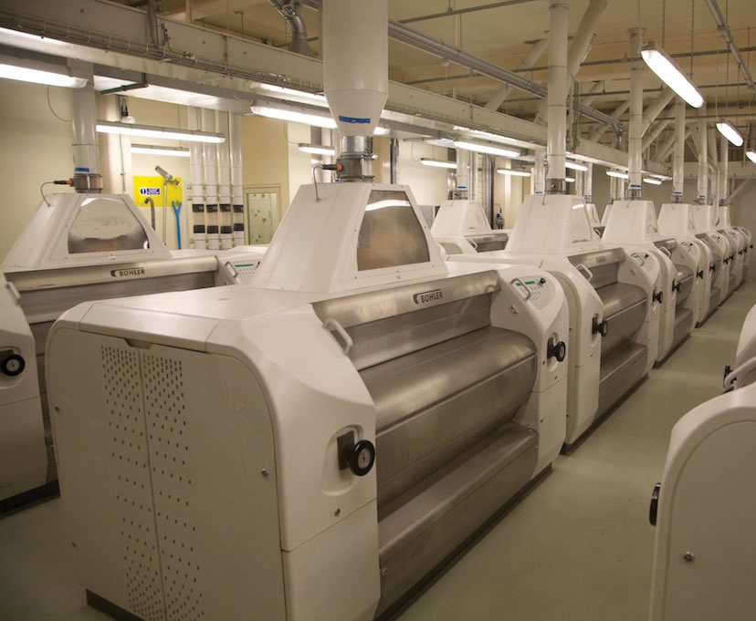
Flour
The miller will keep grinding and sieving the flour until it is very smooth.

Slide 7
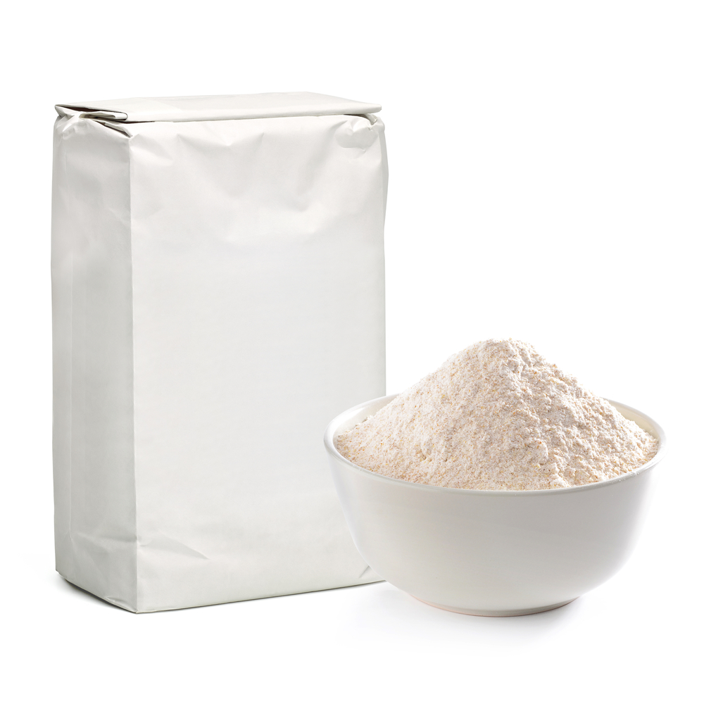
White flour
White flour is created when the bran and wheat germ have been removed.

Slide 8
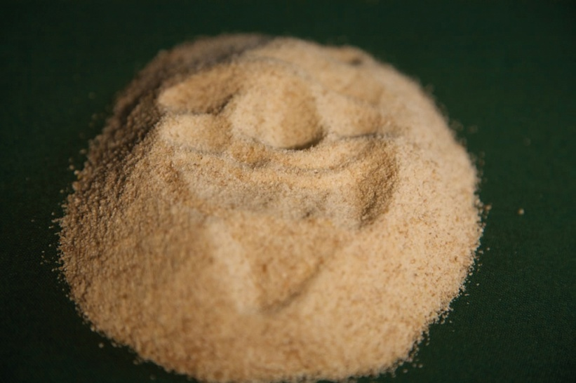
Brown flour
Brown flour is created when some of the bran and wheat germ are added back to the white flour.

Slide 9
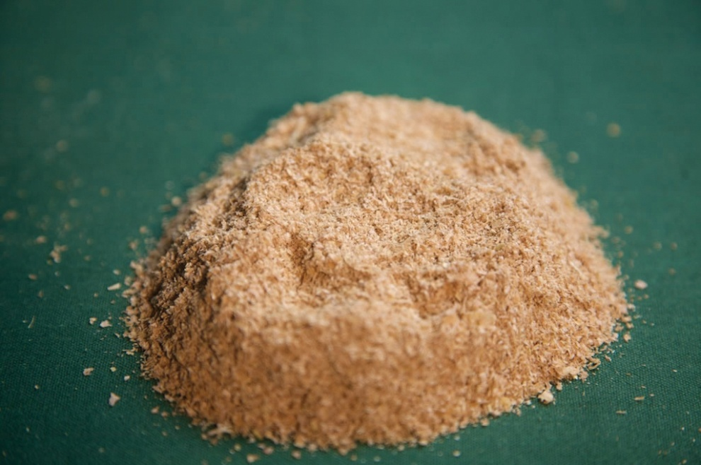
Wholemeal flour
Wholemeal flour is created when all of the bran and wheat germ are added back to the white flour.
The name ‘wholemeal’ is given because the flour is made from the ‘whole’ of the ‘meal’.
‘Meal’ means coarsely ground grain!

Slide 10
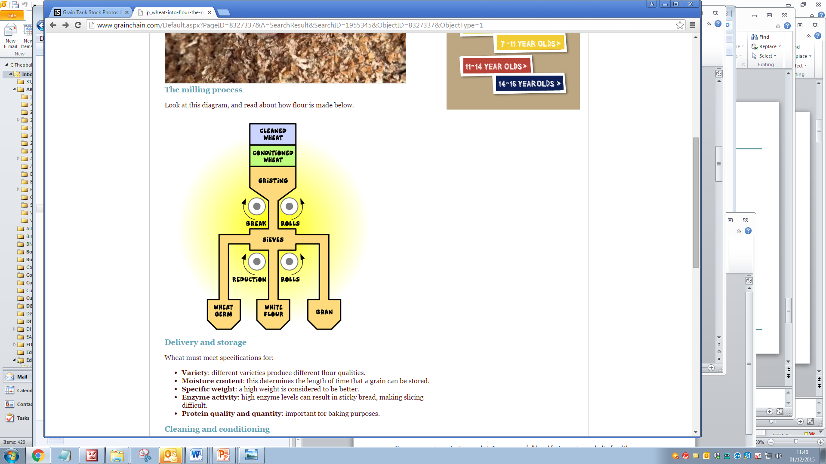
Milling diagram
Here is a diagram showing how wheat is milled.
Find out what conditioned wheat is and what gristing mean.

Slide 11
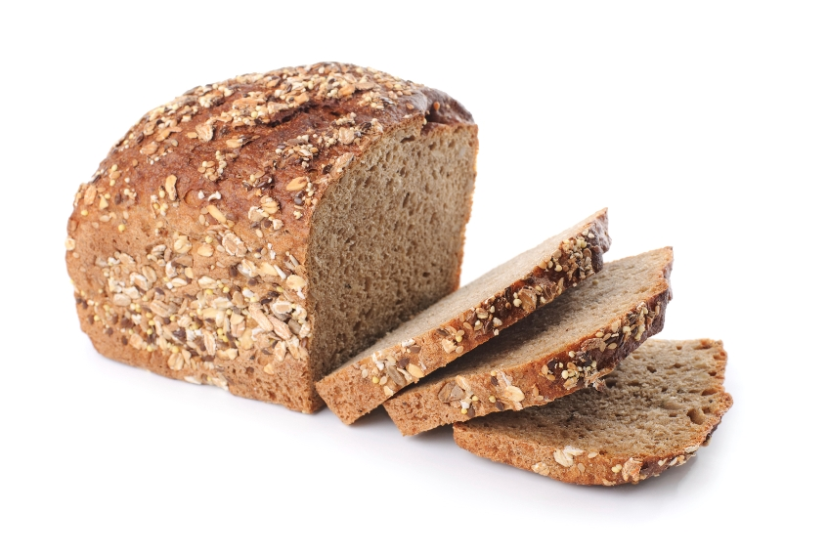
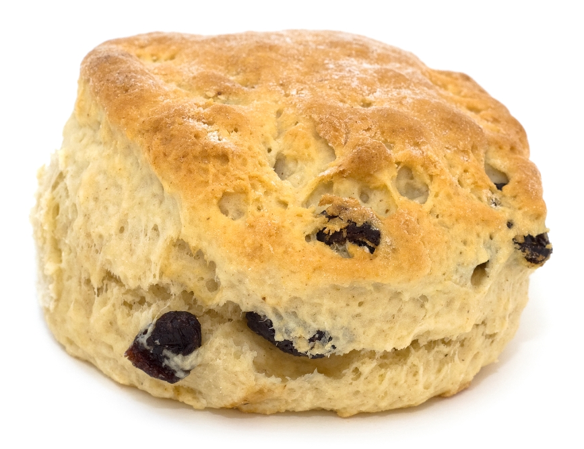
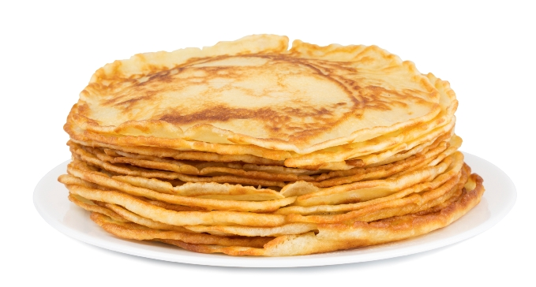
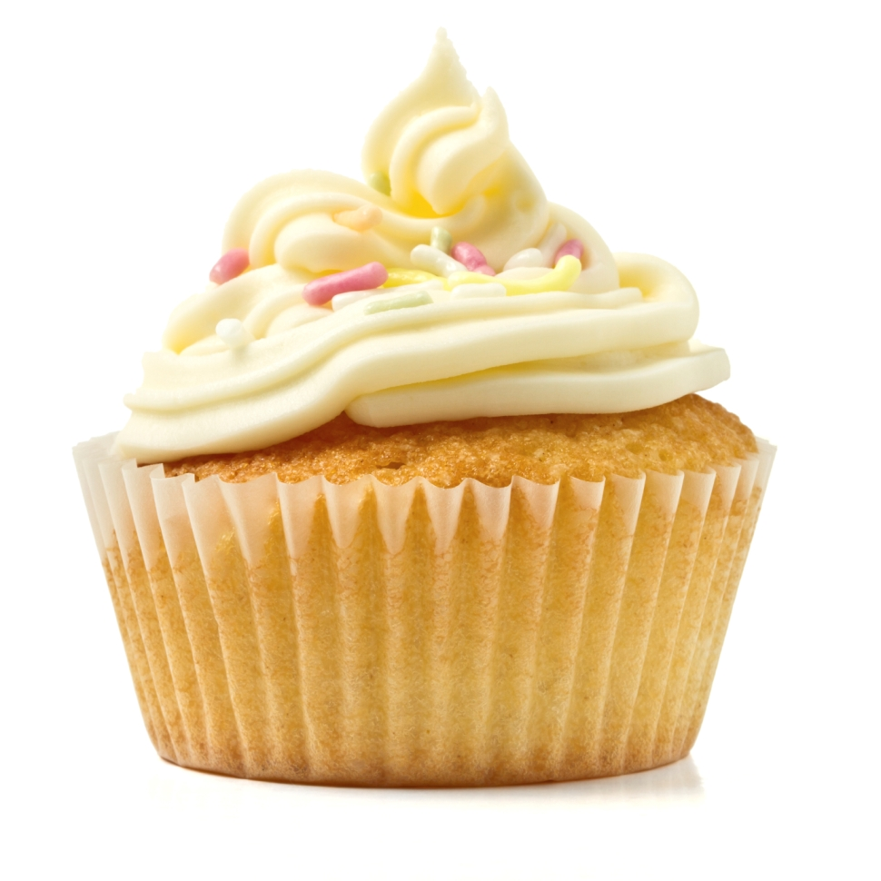
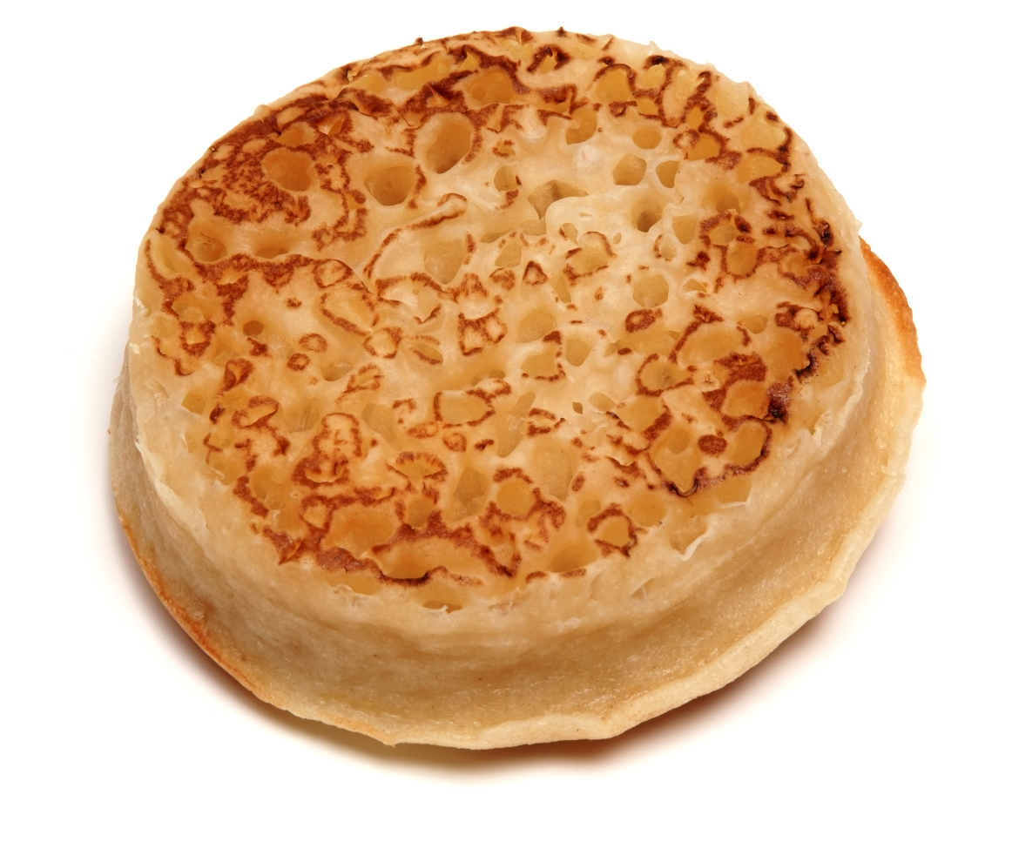
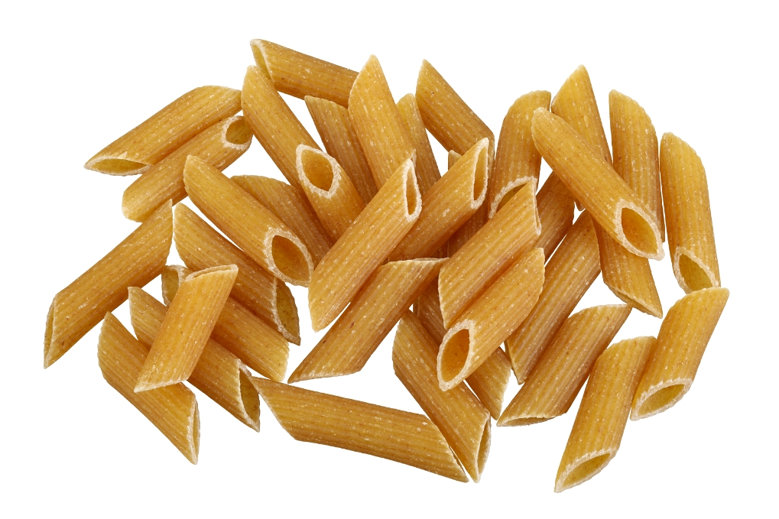
Food from flour
Here are some examples – what others can you name?

Slide 12
For further information, go to:
www.foodafactoflife.org.uk

