Slide 1
Milk production – main stages

Slide 2
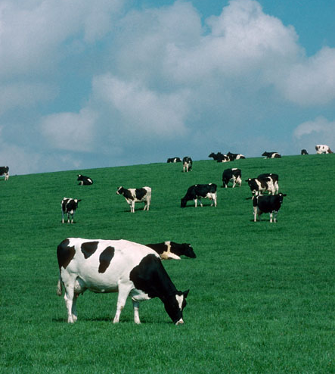
Where does milk come from?
Milk is from a dairy cow.
Dairy cows are reared by farmers around the UK.
Have you seen a dairy cow before?

Slide 3
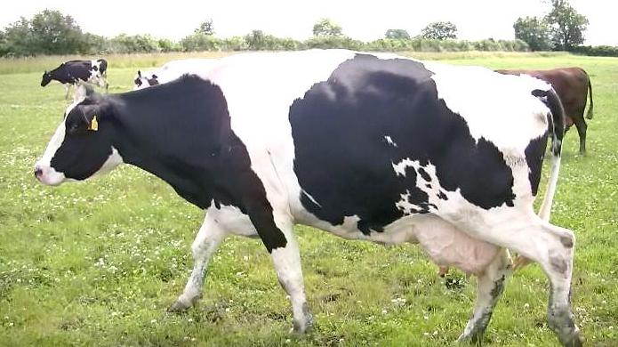
The dairy farm
There are thousands of dairy farms in the UK. Dairy farms are all different shapes and sizes, with small herds to farms with more than 1000+ cows.
The majority of farms are located in the western parts of the British Isles where the warm, wet climate gives ideal conditions for grass growth.

Slide 4
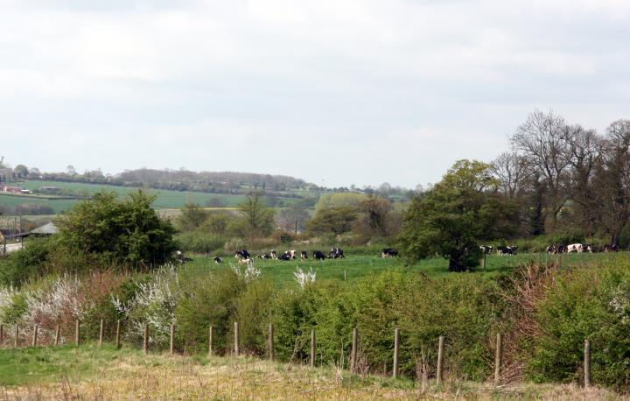
The dairy farm
The farmer’s most important job is to look after the health and welfare of the cows.
Farmers also look after the countryside, maintaining hedgerows, planting trees and establishing new ponds.

Slide 5
Farmers look after the environment
There are many ways in which dairy farmers are working to improve and sustain the environment.
Some farmers will plant clover in fields. This promotes reduces the use of artificial fertilisers.

Slide 6
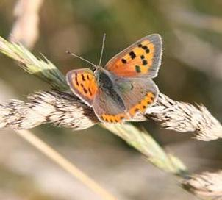
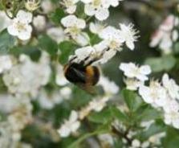
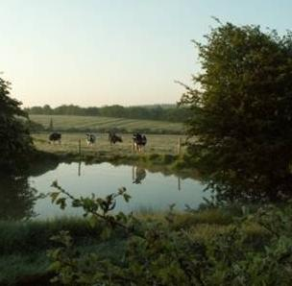
Farmers look after the environment
Britain's hedgerows are regularly maintained by farmers to provide a breeding ground for birds and other wildlife.
Many dairy farmers leave a strip of grass around the edge of the pastures for planting trees and establishing ponds to attract wildlife.

Slide 7
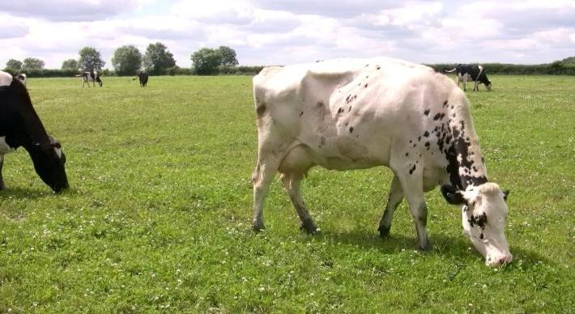
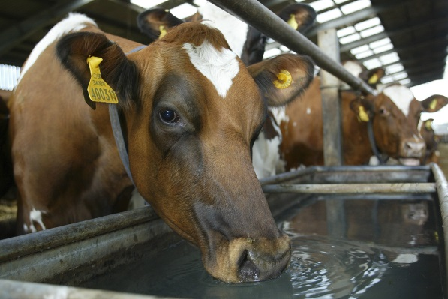
The cow
Most British dairy cows eat grass in the field during the summer and silage (pickled grass or maize) in the winter – around 25-50kg a day.
They drink around 60-80 litres of water, although some drink more if they produce more milk.

Slide 8
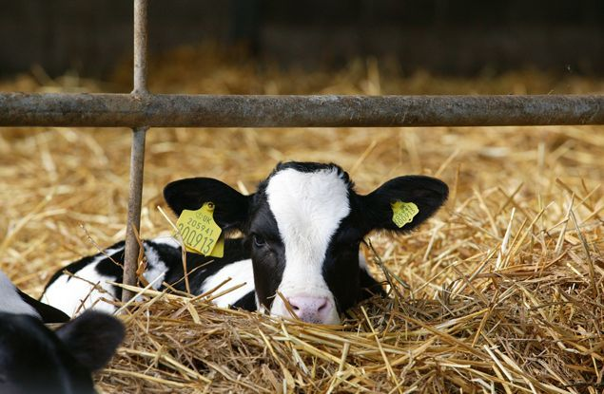
The cow
Each cow wears ear tags with a unique number – this is also on their cattle passport.

Slide 9
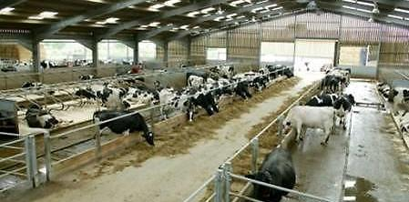
Where do cows live?
Most dairy cows are housed during the winter and bad weather.
The cows can move freely, socialise and eat and drink when they want in sheds that have natural light.

Slide 10
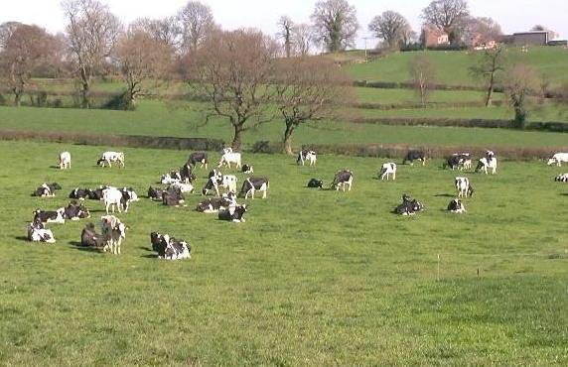
Where do cows live?
Dairy cows mostly graze outdoors during the summer, moving from indoor housing.
Outside they can easily graze at their own leisure, exercise, get fresh air and natural light.

Slide 11
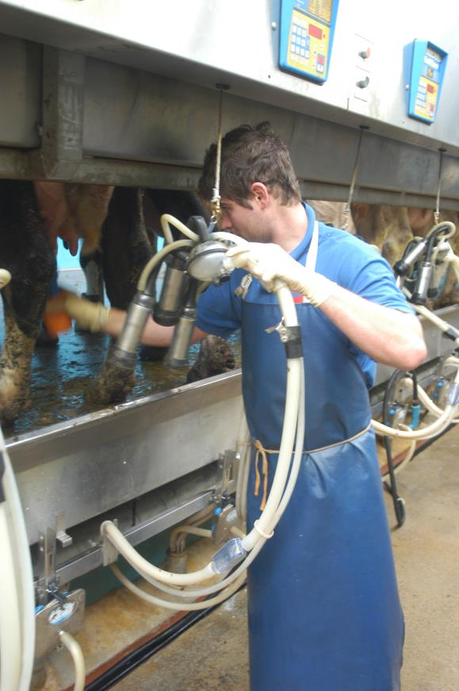
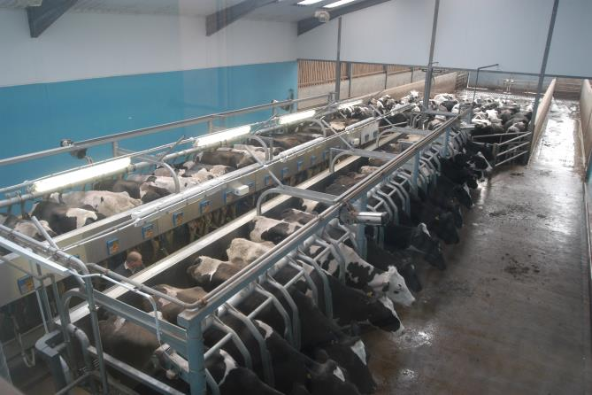
Milking
Cows are milked on average 2-3 times a day.
Milking is not painful or uncomfortable, it is like the cow feeding its baby calf.

Slide 12
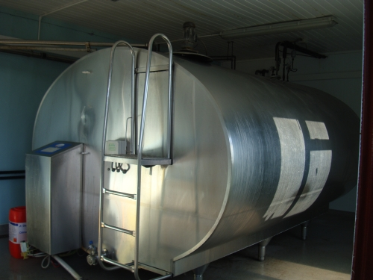
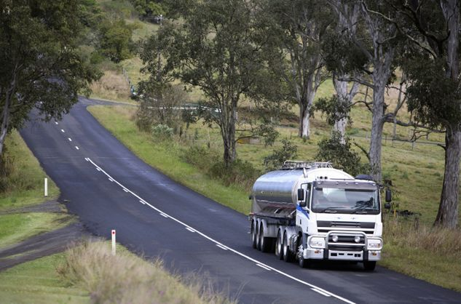
Milking
Once the cows have been milked the milk is chilled and stored.
A milk tanker calls at the farm to collect the milk.
It is then taken to be processed.

Slide 13
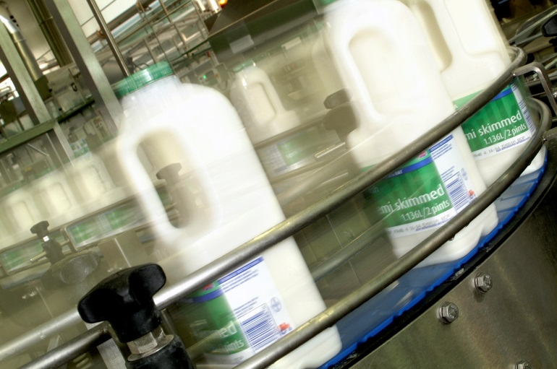
Processing
The raw milk from the farm is treated to stop any naturally occurring bacteria turning it sour. This process is called pasteurisation.
Some types of milk have some of the fat removed, e.g. semi-skimmed milk. The milk is put into bottles or cartons and is sent to different places for sale.

Slide 14
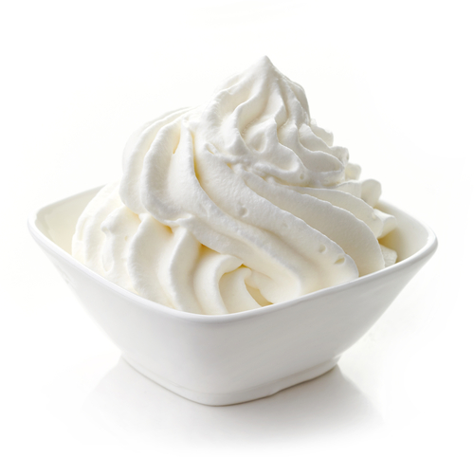
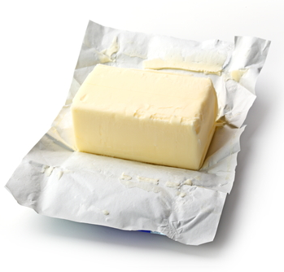
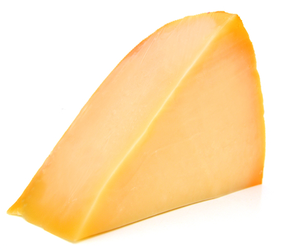
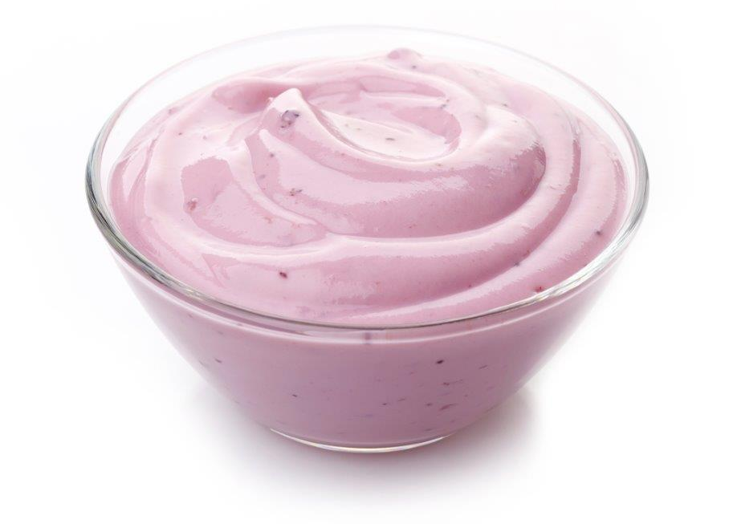
Processing
Milk is also used to make cheese, yogurt, cream and butter.

Slide 15
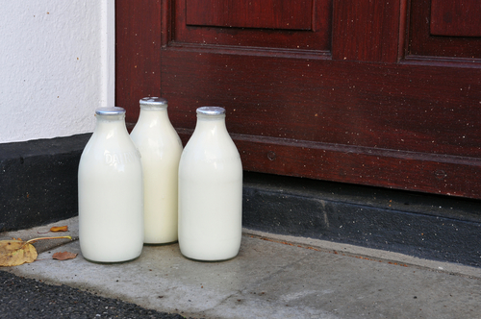
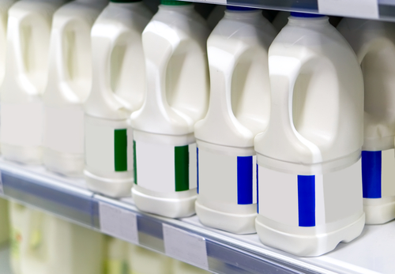
In the shops
The fresh milk is available for sale. It is kept cold to keep at its best.
Some people have milk delivered to their home, others buy it from local shops or supermarkets.
Many school children have milk at school as a drink.

Slide 16
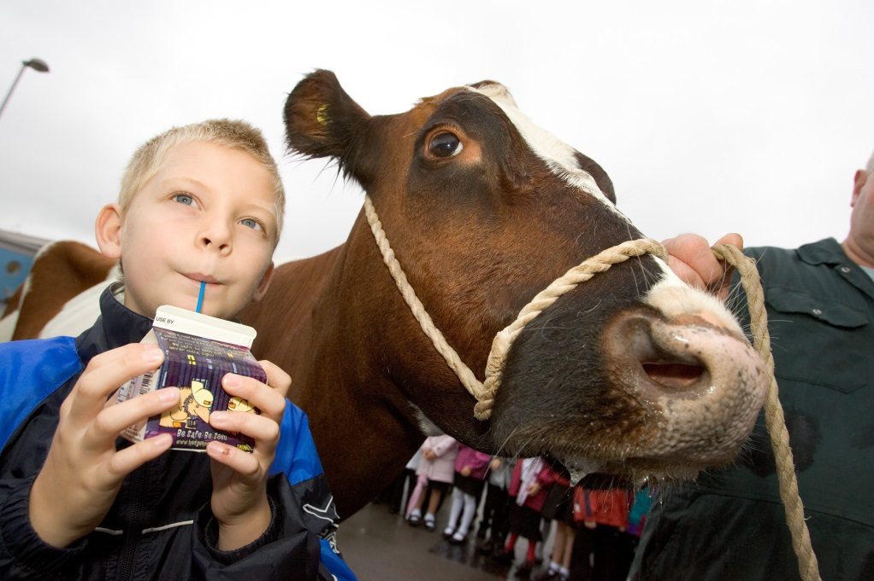
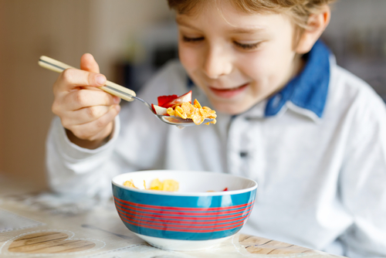
Drink and enjoy
Milk can be enjoyed as a drink, poured on breakfast cereal or used in many different recipes.

Slide 17
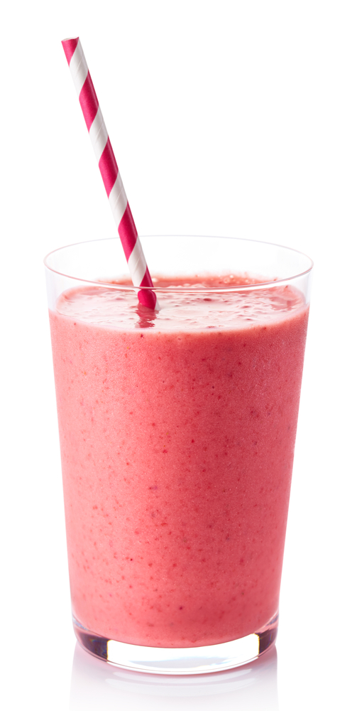
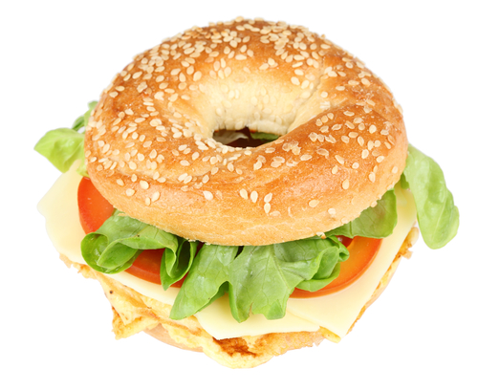
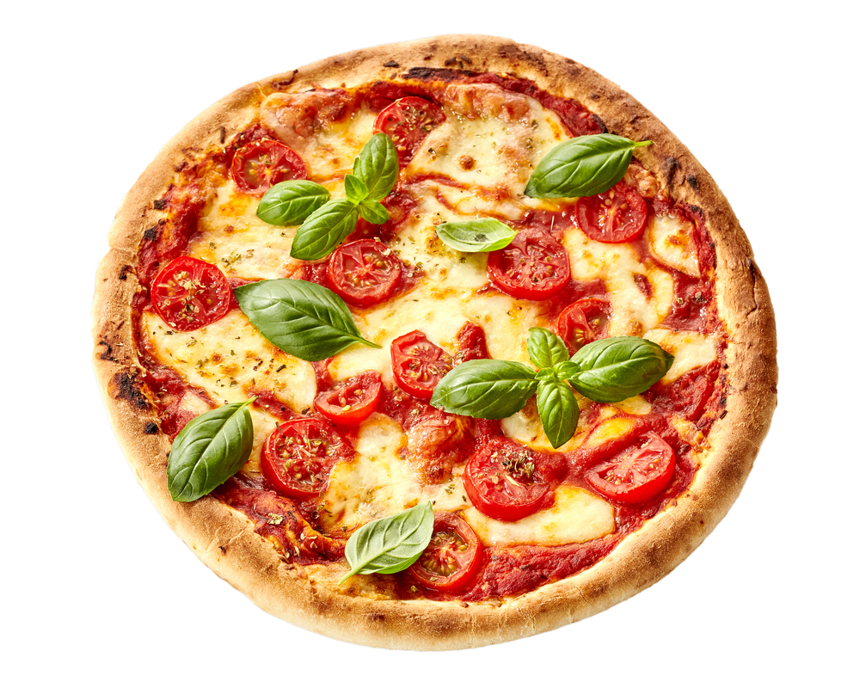
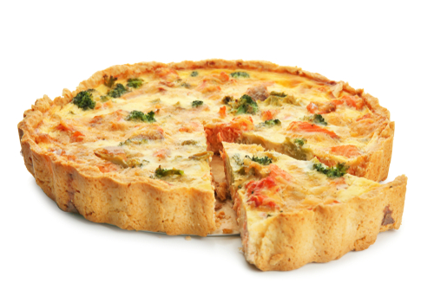
Dishes
Milk, yogurt and cheese are also used in many dishes.

Slide 18
For further information, go to: www.foodafactoflife.org.uk

