Slide 1
Religion and food choice

Slide 2
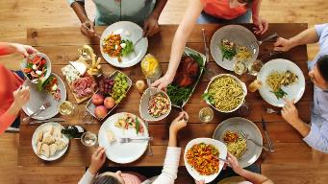
Religion and food choice
Around the world, people choose to eat or avoid certain foods depending on their religious belief.
Some beliefs have been followed for centuries and are well established as part of life.
A healthy and varied diet is important for good health.

Slide 3
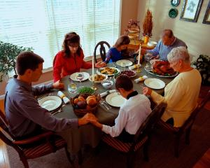
Roles of food in religion
These include:
to communicate with God (e.g. saying thanks and blessing);
to demonstrate faith through following religious rites concerning diets;
to develop discipline through fasting.

Slide 4
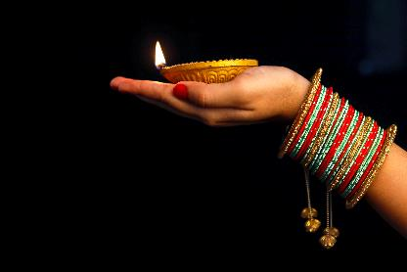
Religions around the world
Religions which require particular food rules include:
Islam;
Hinduism;
Judaism;
Sikhism;
Buddhism (strict);
Seventh-day Adventist Church;
Rastafari Movement.
Diwali

Slide 5
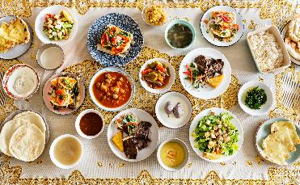
Islam
Prohibited animal flesh: pork.
The Koran outlines the foods which can be eaten (halal) and those forbidden (haram).
Haram are foods which are forbidden. Examples include pork, blood, alcohol and meat sacrificed to idols.
Beef, lamb and chicken can only be eaten if the animal has been slaughtered by the halal method.

Slide 6
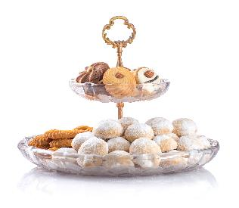
Islam
The following Islamic occasions have certain associated food rituals:
Ramadan - a month of fasting from dawn to sunset.
Eid - Eid-ul-Fitr – day celebrating end of Ramadan.
Eid ul-Adha – day that celebrates the end of the Hajj.
Eid can be celebrated with special foods shared with friends and family, such as Eid sweets.
Eid holiday sweets

Slide 7
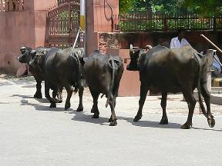
Hinduism
Prohibited animal flesh: all, except lamb, chicken and fish.
Strict Hindus are vegetarian. The cow is held in high regard and a symbol of abundance, therefore Hindus do not eat beef.
Some Hindus may also avoid certain foods, such as domestic fowl, salted pork, milk, ghee, onions, garlic, eggs and coconut.

Slide 8
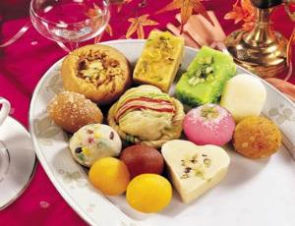
Hinduism
Some devout Hindus observe fasting on special occasions, or on certain days of the week or month, as a mark of respect to personal Gods or as part of their penance.
The religious festival Diwali marks the end of the Hindu year and the start of a new. Special Diwali sweets are eaten.

Slide 9
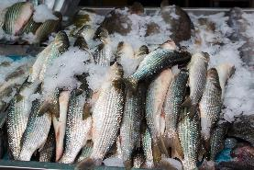
Judaism
Prohibited animal flesh: pork and non-kosher beef, lamb and chicken.
The Torah outlines which foods are allowed for Jews to eat. Permissible foods are called Kosher and forbidden foods are called Trefa.
Kosher animals have a completely split hoof and chew cud, e.g. cows, goat and sheep. Horses and pigs are not Kosher animals. Kosher fish must have fins and scales.
All plant foods are Kosher, unless damaged by rot or insects.

Slide 10
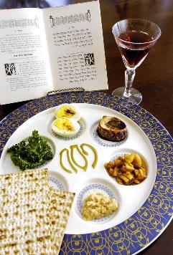
Judaism
Jews should not prepare food on the Sabbath, (sundown on Friday to sundown on Saturday).
Meat is killed and prepared in a kosher way.
Meat and dairy cannot be consumed in the same meal or prepared with the same utensils.

Slide 11
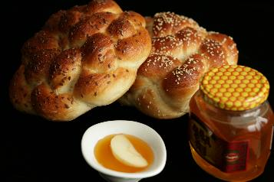
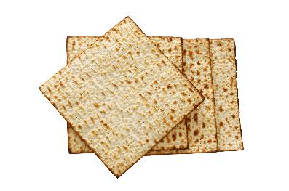
Judaism
There are a number of Jewish festivals which have particular associated food customs.
Rosh Hashanah (Jewish New Year) - sweet foods are eaten to symbolise a sweet new year. The traditional plaited challot is replaced by round ones, to symbolise the cycle of a the year.
Yom Kippur (Day of Atonement) - a day of fasting.
Pesach (Passover) - no food which contains yeast can be eaten for the week. A special unleavened bread called matzah is eaten.

Slide 12
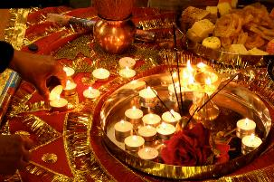
Sikhism
Prohibited animal flesh: pork, beef, halal and kosher.
Sikhs cannot eat ritually killed meat. There are no other restrictions on what Sikhs can eat.
Sikhs believe in sharing food. Every gurdwara (place of worship) has a langar (common kitchen). The congregation eats together here after the service.
Sikhs also celebrate the festival Diwali.

Slide 13
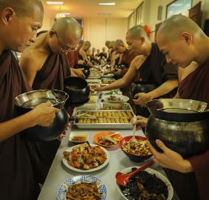
Buddhism (strict)
Prohibited animal flesh: all.
Buddhists believe they should not be responsible for the death of any other living organism.
Many, but not all, Buddhists follow a strict vegetarian, if not vegan diet.
Wesak is a festival celebrating the birth, enlightenment and death of Siddhartha (who some people believe to be Buddha). Foods such as eight treasure rice can be eaten on Wesak.

Slide 14
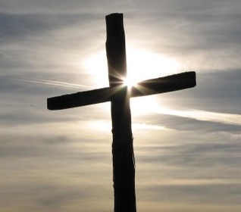
Christianity
The general beliefs in Christianity are that there is no restriction on kinds of animals that can be eaten.
Some Christians may choose to follow a vegetarian or vegan diet.

Slide 15
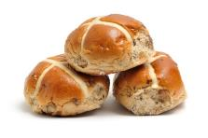

Christianity
There are a number of occasions in the Church year where special food may be eaten. This includes:
Christmas – a day celebrating the birth of Jesus;
Easter – celebrates Jesus’ resurrection from the dead;
Shrove Tuesday – Shrove Tuesday is the Tuesday prior to Lent, where Christians remember the time Jesus fasted in the desert. They often give up certain food during this period. Shrove Tuesday was traditionally the last chance to use up the foods Christians would not be eating during Lent (e.g. eggs, fats).
Simnel cake eaten during the Easter period

Slide 16
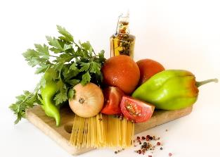
Seventh-Day Adventist Church
Many Adventists are ovo-lacto vegetarians, which means they do not consume animal flesh of any kind, but will consume dairy and egg products.
Some Adventists avoid food and drinks which contain caffeine, therefore they do not consume tea and coffee. They also avoid alcohol.

Slide 17
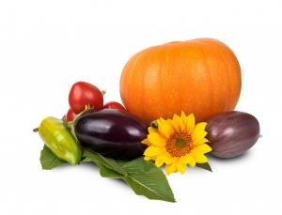
Rastafarian movement
Prohibited animal flesh: all.
Most Rastafarians are vegetarians or vegans.
Foods approved for Rastafarians are called Ital, which should be natural or pure, without the addition of artificial colours, flavourings or preservatives.
Rastafarians avoid alcohol and some also avoid tea, coffee and other caffeinated drinks because these are considered to confuse the soul.

Slide 18
Foods avoided by different religions
Religion | Pork | Beef | Lamb | Chicken | Fish
Islam | ✖ | Halal only | Halal only | Halal only | ✔
Hinduism | ✖ | ✖ | ✔ | ✔ | ✔
Judaism | ✖ | Kosher only | Kosher only | Kosher only | ✔
Sikhism | ✖ | ✖ | ✔ | ✔ | ✔
Buddhism (strict) | ✖ | ✖ | ✖ | ✖ | ✖
Seventh-day Adventist Church | ✖ | ✖ | ✖ | ✔ | ✔
Rastafari movement | ✖ | ✖ | ✖ | ✖ | ✖

Slide 19
Religion and food choice
For further information, go to:
www.foodafactoflife.org.uk
This resource meets the Guidelines for producers and users of school education resources about food.

