Slide 1

Food skills, recipes and diversity Caribbean Islands cuisines 4 May 2022
@foodafactoflife

Slide 2
Housekeeping and overview
Good food hygiene and safety practices - are you ready to cook?
Long hair tied up.
Jumpers removed/long sleeves rolled up.
Nail varnish and jewellery/watches removed.
Thoroughly washed and dried hands.
Clean apron on.
Turn off mobile phone (pop on vibrate)
You should have all your equipment and ingredients ready/handy
Get ready to cook!
Chat box – feel free to use to ask questions and share info/links and ideas
Camera on – we want to see your food skills
Help and direction (please don’t take as criticism!)
Feel free to ask questions and engage!
Feedback – it’s good to get your views!
Tweet or post on Facebook!
Enjoy!
@foodafactoflife

Slide 3
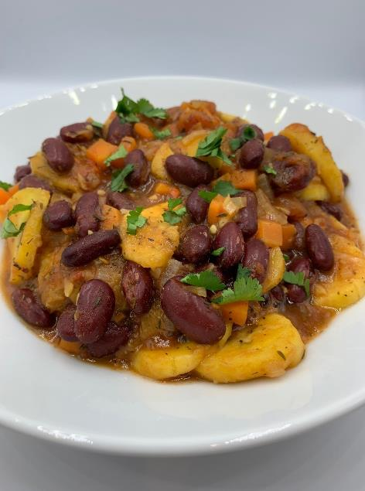
Welcome
As part of the British Nutrition Foundation’s work around a ‘modern, diverse food and nutrition education’ we asked students what was important to them about the recipes they cooked at school.
Students responded that they want dishes that are:
tasty, healthy, family/everyday recipes;
most significantly they want them to be dishes from around the world that are - modern, diverse and reflect different cultures.
Please say hello in the chat box!
The British Nutrition Foundation is grateful for the support from the All Saints Educational Trust for this work.

Slide 4
Session aims
During the session we will:
make two recipes from around the world that are new to Food – a fact of life;
use traditional ingredients and consider alternatives;
develop, acquire and secure practical food skills using recipes that are suitable and practical for schools and their budgets, promote healthier eating, reflect more global cuisine, and encourage dialogue around culture and inclusivity;
consider planning and implementing practical activities in the secondary classroom;
demonstrate good food hygiene and safety practices;
provide links to Food – a fact of life.

Slide 5
Programme
16.45 Registration
17.00 Welcome
Practical food skills, recipes and diversity – Caribbean cuisines
17.15 Quick Jamaican coco bread – activity and review
17.55 Bean and plantain stew – activity and review
18.25 Review and next steps
18.30 Finish – Evaluation, certificate and voucher

Slide 6
Diversity and inclusion in Schemes of Work
Know your pupils!
Know and understand the local community, e.g. what are the challenges that young people are facing?
Understand what young people (and their families) want to make in food lessons. Not just cakes though!
Ensure recipes and practical activities build on knowledge and skill.
Incorporate different flavours, ingredients and culinary techniques and experiences to widen young people’s understanding of food and cultures around the world.
Encourage pupils to share their personal experiences around food culture, ingredients and recipes with the class or school community.
Consider healthy, sustainable diets – nutrition.org.uk
Did you know?
Some food and drink-related traditions are currently recognised by UNESCO and its Representative List of the Intangible Cultural Heritage of Humanity

Slide 7
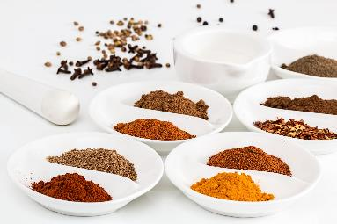
In the classroom
Consider the following:
time and budget available;
pupils - practical skills;
equipment available;
provision/availability of ingredients e.g. spices or herbs that may not be used often, vegetables that might not be readily available in your area;
involving the school/local community – there may be an ‘expert’ in a particular cuisine that could offer guidance and/or input to the lesson;
sharing the success of your pupils work through school social media, newsletters and special events such as open evening and options.

Slide 8
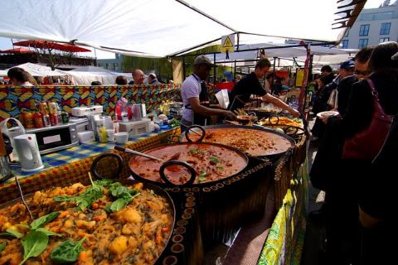
Generation Z and food culture
Globalisation has been changing the food we eat and the ways we eat those foods. But it is not new!
Food cultures are moving, and globalisation has made a wide range of cuisines more accessible.
Food culture is no longer tied down to where it originated from and can spread far and wide.
Trends:
Street food
Fusion food
Travel – trying a wider variety of cuisines
Notes:
Gen Z = born in 1997 or later - makes up a quarter of all the people going out to eat – high spending power. Organics/sustainability/plant based all feature.
A strong theme in Gen Z eating habits is authenticity and exploring exciting flavours from all over the world. Some of this may come from growing up in the same households as Gen X and Millennial foodies.
Gen Z brought up as 'digital natives' - they see and experience food around the globe – heritage and authenticity are key words.
Food trade has played a significant role in the history of globalisation, as it has allowed for cultural exchange for thousands of years. From the transporting of spices along the Silk Road, to the potatoes being imported from the Andes to Ireland in 1589 by Sir Walter Raleigh.
e.g. Italian coffee culture – worldwide verses local culture e.g. snakes, spiders
The economic and cultural boundaries between countries are becoming less rigid and the gradual diffusion of different elements of national culture such as food and cuisine are some examples of this trend.

Slide 9
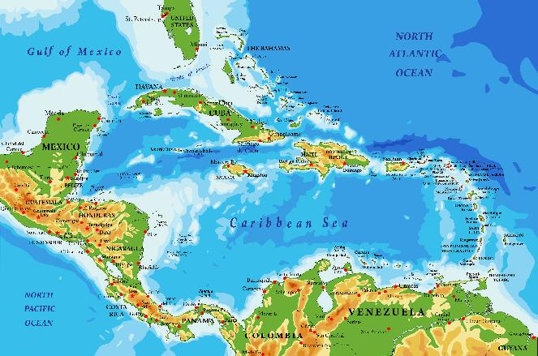
Caribbean cuisine
The Caribbean Islands is a large archipelago located in the Caribbean Sea, that can be subdivided into different regions: the Lucayan Archipelago, the Greater Antilles, the Lesser Antilles and the ABC Islands.
The Caribbean covers more than 1.06 million square miles and is primarily located between North America and South America.
Caribbean culture has been heavily influenced by the culture and traditions of Europe, together with African culture and others that have come to the islands through immigration.
The islands generally have a very separate and distinct cuisine from each other, depending on who they were colonised by.

Slide 10
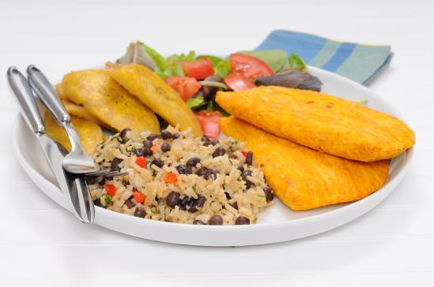
History
The Arawak, Carib, and Taino people were the first dwellers in the Caribbean Islands. Their daily diet consists of vegetables and fruits such as papaya, yams, guavas, and cassava. The Taino began the process of preparing meat and fish in large clay pots; the Carib Indians introduced spices and lemon juice to their meat and fish recipes.
The Caribbean has seen migration from different continents for centuries, one of the greatest cultural impacts of this migration has been on the food. The islands in the Caribbean have been fought over and owned by various European countries in the past, mainly the British, French, and Spanish.
All these cultures, as well as their respective culinary traditions, have played a role in forming the multi-national cuisine of the Caribbean.

Slide 11
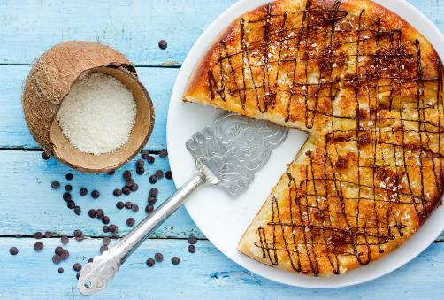
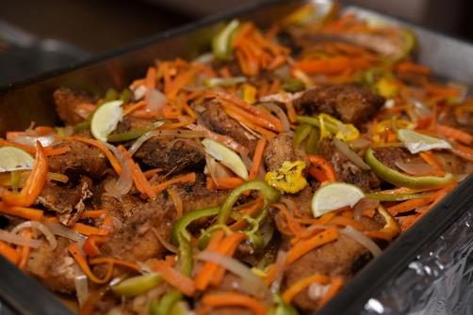
European flavours
The French brought pâtisserie, stuffed crab back, tomato and herb fish stews reminiscent of Provence, escargots in garlic, and frogs’ legs (called mountain chicken in Dominica).
Jug Jug, a Christmas dish of pigeon peas, guinea corn flour, salt meat, and herbs, a type of Scottish haggis, was introduced to Barbados by the Scots when they were exiled there after the Monmouth Rebellion of 1685.
The Spanish left Trinidad dishes such as: pastelles (meat and grated corn steamed in a banana leaf), escoviche (pickled fish), buljol (salt fish, tomato, lime, pepper, garlic, and avocado).

Slide 12
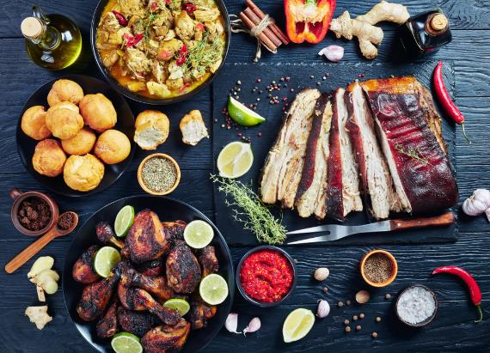
History
The key moment in the evolution of Caribbean cuisine was the Europeans bringing African enslaved people to the islands - in effect, the Caribbean became the crossroads to the rest of the world.
They blended traditional African foods with staple foods found on the islands, introducing okra, callaloo, fish cakes, saltfish, ackee, pudding, and mangos.
When slavery was abolished owners had to look elsewhere, bringing in help from India and China. Different types of dishes using rice or curry were introduced and blended into mainstream Caribbean cuisine.
Notes:
Over 36, 000 indentured workers arrived in Jamaica between 1845 and 1911. These Indians worked on sugar plantations, after the abolition of slavery. Naturally, they brought their traditions with them including their cuisine.
For the most part, laborers working on plantations ate inexpensive meals based on pulses seasoned with curry powder; these dishes soon became a part of the Caribbean food tradition.
Between the imported spices and locally available ingredients like goat, allspice, and Scotch bonnet peppers, curry in the Caribbean has developed a unique identity and flavor profile, with individual islands maintaining their own recipes and styles.

Slide 13
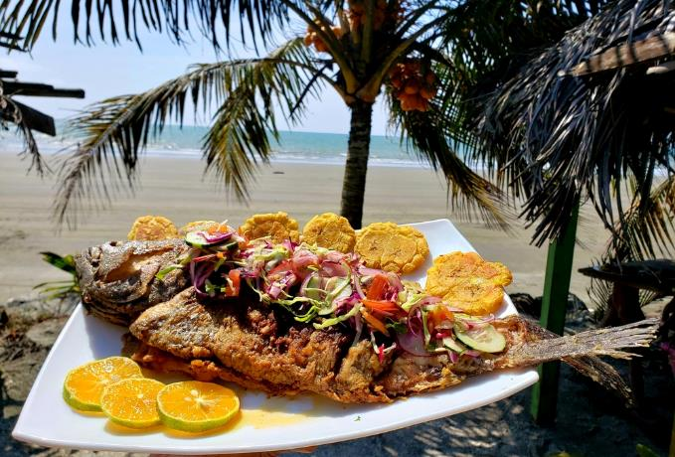
Modern cuisine
Caribbean cuisine therefore is a fusion of African, Amerindian, European, East Indian, Arab and Chinese cuisine.
These global influences, combined with indigenous Caribbean ingredients and techniques have defined modern Caribbean cuisine.
Common ingredients in Caribbean food are rice, plantains, beans, cassava, coriander, peppers, chickpeas, tomatoes, sweet potatoes, and coconut milk.
Food is not often fried - grilling, barbeque, roasting and stewing are popular methods of cooking.
Burghul
Freekeh
Notes:
Marinating is used extensively – not all dishes are 'spicy' - using a blend of native herbs and spices.

Slide 14
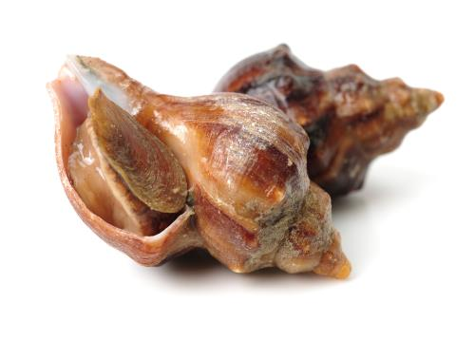
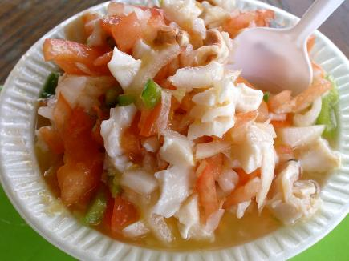
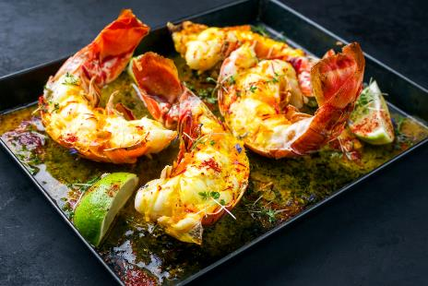
The islands
The Lucayan Archipelago also known as the Bahama Archipelago, is an island group comprising the Commonwealth of The Bahamas and the British Overseas Territory of the Turks and Caicos Islands.
A popular dish in the Bahamas is conch (edible sea snail). It is often made into a salad or a popular fast food - cracked conch (fritters).
Spiny lobster is another favourite on the islands and is also an important export.

Slide 15
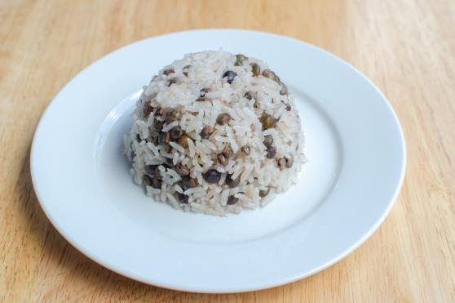
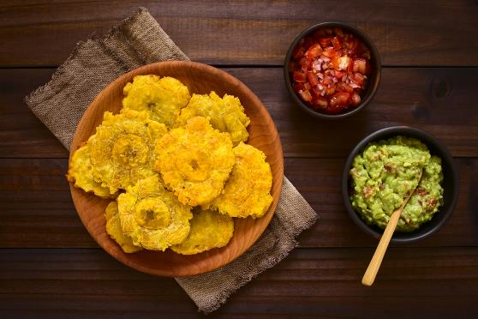
The islands
The Greater Antilles is a grouping of the larger islands in the Caribbean Sea, including Cuba, Hispaniola (Haiti and Dominican Republic), Puerto Rico, Jamaica, and the Cayman Islands.
They make up nearly 90 percent of the total land area of the entire West Indies.
In Puerto Rico the cuisine is known as cucina criolla – reflecting the mix of native Taino Arawak, African, Spanish, and American influences.
The most popular Puerto Rican dishes include arroz con gandules (rice with pigeon peas), pasteles (plantain cakes), tostones (twice fried plantain slices), cuchifritos (fried appetizers), and arroz con dulce (sweet rice).

Slide 16
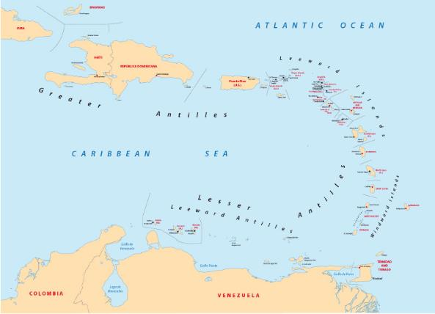
The islands
The Lesser Antilles form long arc of small islands in the Caribbean Sea extending in a north-south direction from the Virgin Islands to Grenada.
The Lesser Antilles consists of three smaller island groups - the Windward Islands, the Leeward Islands, and the Leeward Antilles.
The cuisine on the Leeward Islands is influenced by local seafood, including prawns, crab, lobster, mahi mahi, marlin and many other kinds of fish.
Goat meat is popular, a legacy of the animals left behind by early seafarers.
St Kitts & Nevis has good rich soil for growing fresh produce and is sometimes known as the breadbasket of the Caribbean.
Notes:
The Windward Islands are so called because they were more windward to sailing ships arriving in the New World than the Leeward Islands, given that the prevailing trade winds blow east to west. The trans-Atlantic currents and winds that provided the fastest route across the ocean brought these ships to the rough dividing line between the Windward and Leeward Islands.

Slide 17
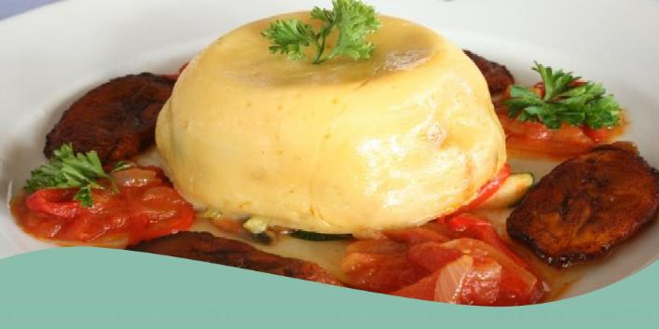
The islands
The ABC Islands (Leeward Antillies) are the group of Aruba, Bonaire, and Curaçao, the three westernmost islands of the Leeward Antilles in the Caribbean Sea.
The ABC islands share a similar European heritage (Dutch) and because of this they share similar dishes.
The local cuisines on the Leeward islands also have a lot in common with South American cuisine as most of their fresh vegetables and fruits are imported from Venezuela.
On special occasions dishes such as weddings, Keshi Yená, stobá and bolo pretu are served. Keshi Yená is a dish made from a hollowed out Edam cheese that is filled with a mixture of meat with raisins, plums, capers and olives.

Slide 18
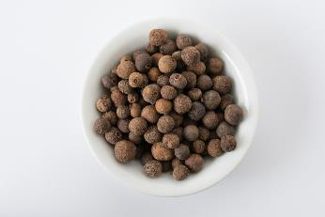
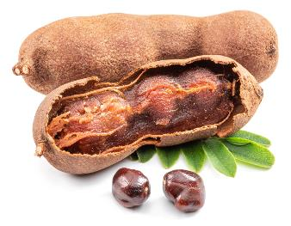
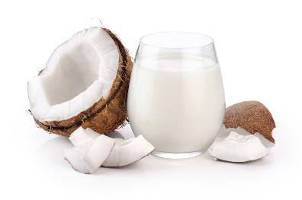
Ingredients
Pimento (Allspice) - dried pimento berries look like large dark peppercorns and are used in jerk cooking. Pimento wood is often used to smoke jerked meat, the sticks are placed over the heat, the meat (usually chicken or pork) sits on top of the wood and is sealed by a metal lid, thus infusing the meat. The berries are also used to make jerk seasoning or rub.
Tamarind - a sticky sweet made of balls of tamarind flesh rolled in sugar is common across the Caribbean where the season is usually around March. Tamarind is used to flavour sauces, and to make tamarind balls.
Coconut milk - milk is made by grating fresh coconut flesh and blending that with water, traditionally by hand. With little or no water added, rich coconut cream is obtained, adding more water and further blending results in a thinner milk.
Check the list of ingredients for any potential allergens and consider alternatives. For more information on allergens.
Notes:
Coconut milk is not the slightly opaque liquid that flows from a freshly opened coconut – that is coconut water.
A seasoning tradition used in the region is based on green herbs and oil-based marinades called Mojo. Ingredients may include garlic, onions, scotch bonnet peppers, celery, green onions, and herbs like coriander, marjoram, rosemary, tarragon and thyme. Used for many dishes, this Mojo is popular in Caribbean cuisine
The 14 allergens are: celery, cereals containing gluten (such as barley and oats), crustaceans (such as prawns, crabs and lobsters), eggs, fish, lupin, milk, molluscs (such as mussels and oysters), mustard, peanuts, sesame, soybeans, sulphur dioxide and sulphites (at a concentration of more than ten parts per million) and tree nuts (such as almonds, hazelnuts, walnuts, brazil nuts, cashews, pecans, pistachios and macadamia nuts).

Slide 19
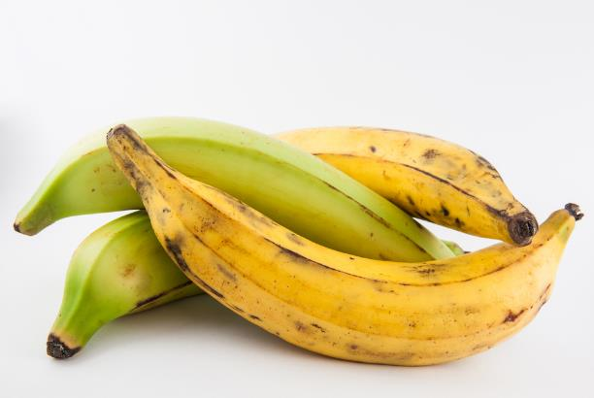
Plantains
Plantains can be found all over the Caribbean and Central America, but they were not always native to these areas. Plantains are indigenous to the tropical regions of Southeast Asia.
They made their way along trade routes to Africa and then were brought to the Caribbean by the Spanish and African slave traders. The plantain eventually became a staple ingredient in the Caribbean.
Plantains can be used in both sweet and savoury dishes. They can be boiled, baked, fried, or mashed, and depending on the colour of their skin, they can be mild and savoury or lovely and sweet.

Slide 20
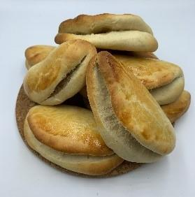

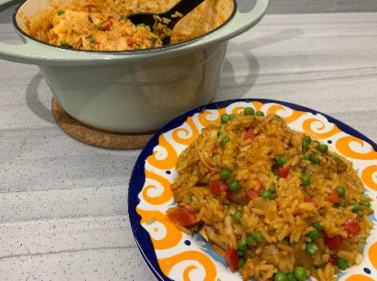
The recipes
Recipes that will be available on the Food – a fact of life website:
Bean and plantain stew
Caribbean style turkey curry
Cuban arroz con pollo
Jerk chicken traybake
Jerk potato and black bean curry
Picadillo
Quick Jamaican coco bread
Rice and peas

Slide 21
Quick Jamaican coco bread
Why are we doing this?
Learning in lesson: focus on skill/knowledge, not recipe.
A quick to prepare, medium complexity recipe. Uses the quick/cold oven method.
Demonstrates a wide range of basic food skills but can be extended to allow for differentiation and inclusion.
Uses ingredients that are easy to source, inexpensive and mostly stored at ambient temperatures.
Nutrition science: Starchy carbohydrates in the diet.
Food science: Gluten formation (discussion around gluten content in the different types of flour), the effect of cooking (coagulation, dextrinisation), Maillard reaction.
Sensory science: Testing, tasting and evaluation.
Maths: Weighing, measuring, time, temperature.
English: Reading and following a recipe, following written and verbal instructions.

Slide 22
Quick Jamaican coco bread
Ingredients
Spray oil
120ml light coconut milk
1 x 15ml spoon sugar
25g butter or reduced fat spread
½ x 5ml spoon salt
1 sachet fast action yeast
1 small egg
250g plain flour
Method
Line a large baking tray with greaseproof paper, spray with spray oil.
In a medium bowl, combine coconut milk, sugar, salt and butter/reduced fat spread. Heat in a microwave for about 30 seconds or more, until the fat melts. Do not let it boil or overheat. If the liquid becomes too hot, it will kill the yeast. Alternatively, heat gently in a small saucepan.
Pour the warm liquid into large mixing bowl.
Crack the egg into a small bowl and beat with a fork. Add most of the beaten egg to the mixing bowl. Retain a small amount of the egg to glaze the bread with before baking.
Mix the yeast into the liquid.
Stir in three quarters of the flour at first, to form a soft dough. Add more flour if need be. Do not add too much flour as a soft dough results in tender coco bread.
Turn dough onto a lightly floured surface and knead gently for 3-4 minutes.
Divide the dough into eight equal pieces.
Roll each piece with a rolling pin to about 10-12cm diameter and about ½-1cm thick.
Fold a dough circle in half and place on the prepared baking tray, repeat with remaining pieces. Brush the tops with the remaining beaten egg.
Place the baking tray into a COLD oven and turn up the temperature immediately to the highest setting.
Remove from oven after approximately 15 minutes and cool on a cooling rack.

Slide 23
Quick Jamaican coco bread - review
Skills and knowledge developed and demonstrated | Practicalities in the secondary classroom | Alternatives – ingredients, cooking methods …
Practical food skills: Weigh
Measure, Melt, Mix, Stir, Knead, Divide, Roll-out, Shape, Bake
Nutrition science: Starchy carbohydrates in the diet.
Food science: Gluten formation (discussion around gluten content in the different types of flour), the effect of cooking (coagulation, dextrinisation), Maillard reaction.
Sensory science: Testing, tasting and evaluation.
Maths: Weighing, measuring, time, temperature.
English: Reading and following a recipe, following written and verbal instructions.
Do not let the coconut milk, sugar, salt and butter/reduced fat spread boil or overheat. If the liquid becomes too hot, it will kill the yeast.
Soak mixing bowl in cold water
Divide the mixture into equal sized pieces to ensure even cooking.
If time allows, leave the dough to rest for an hour before shaping and then again for 10-15 minutes before baking.
Notes:
Named after the coconut milk used in making. Served split in half and filled to make a 'sandwich' patty – sweet or savory – or eat with soup.

Slide 24

Bean and plantain stew
Why are we doing this?
Learning in lesson: focus on skill/knowledge, not recipe.
A quick to prepare, medium-high complexity recipe.
Demonstrates a wide range of basic food skills but can be extended to allow for differentiation and inclusion.
Uses ingredients that are easy to source (depending on location, but substitutes can be used), stored at ambient temperatures and traditional to Caribbean cuisines.
Nutrition science: Vegetables in the diet.
Food science: Heat transfer.
Sensory science: Testing, tasting and evaluation.
Maths: Weighing, measuring, time, temperature.
English: Reading and following a recipe, following written and verbal instructions.

Slide 25
Bean and plantain stew
Ingredients
1 small onion
1 carrot
1 celery stick
1 clove garlic
1/8th scotch bonnet chilli or ½ x 5ml spoon chilli flakes
1 plantain
400g canned kidney beans
spray oil
200g canned chopped tomatoes
1 vegetable stock cube
125ml water
1 x 15ml spoon dried thyme
½ x 15ml spoon All purpose seasoning
Black pepper
Optional - garnish
25g parsley
Method
Prepare the ingredients:
peel and finely dice the onion;
peel and finely dice the carrot;
finely dice the celery;
peel and finely chop or crush the garlic;
deseed and finely chop the scotch bonnet, if using;
peel and slice the plantain;
drain and rinse the kidney beans;
roughly chop the parsley, if using.
Spray the saucepan with oil and add the onion, carrot, celery, garlic and the fresh or dried chilli.
Fry gently for 3-4 minutes.
Add the plantain, kidney beans and chopped tomatoes.
Crumble over the stock cube and add the water.
Bring to the boil and add the dried thyme and All purpose seasoning. Season with black pepper.
Reduce the heat and simmer for 10 minutes, until the plantain is soft.
Serve sprinkled with chopped parsley, if using.
Notes:
Preparing Plantain:
Green plantains can’t be peeled like bananas – the skin is liable to come off and leave all the inedible pith on the flesh. This pith won’t cook down, so it needs to be removed.
The easiest way to prepare a green plantain is to cut it into chunks and then slice off the skin and pith with a knife.
Work on a washable board and make sure you don’t get any sap on yourself.
Cook the plantain quickly once you’ve prepared it, as it will start to oxidise.
Yellow plantains can usually be peeled like a banana. Whatever colour of plantain you use, cut off both ends, as the flesh is usually tough.
Sofrito – used extensively, is made with onions, garlic, sweet chili peppers, and coriander, and used in beans, stews, rice, and meat dishes.

Slide 26
Bean and plantain - review
Skills and knowledge developed and demonstrated | Practicalities in the secondary classroom | Alternatives – ingredients, cooking methods …
Practical food skills:
Weigh, Measure, Peel, Dice, Chop, Slice, Drain, Fry, Boil, Simmer
Nutrition science: Vegetables in the diet
Food science: Heat transfer,
Sensory science: Testing, tasting and evaluation.
Maths: Weighing, measuring, time, temperature.
English: Reading and following a recipe, following written and verbal instructions.
Scotch bonnet chilies need very careful preparation.
Gloves and eye protection should be worn. Avoid touching the eyes and unprotected skin and thoroughly wash any surfaces or utensils that come in contact with the peppers.
**Risk assessment required.
Green plantains cannot be peeled like bananas – it leaves inedible pith on the flesh. Demonstrate preparation.
Plantains can be replaced in savoury recipes with unripe bananas, yuca roots, potatoes, yams, breadfruits, jackfruits, or sweet potatoes.
If Scotch Bonnet chilies are not available/suitable, they can be substituted with habanero peppers, serrano chilies, Thai red chilies, African bird’s eye peppers or dried chili flakes.

Slide 27

Food – a fact of life: How can we help?
Food – fact of life website.
Tried and tested recipes.
Good practice guidance for primary and secondary schools, as well as supporting pupils with additional needs.
Resources to support pupils with additional needs
Whole school support
Guidelines for school education resources around food
My dashboard – store collections of recipes and resources in your own online area.
Personal and professional development (PPD) for teachers. PPD newsletter – sign up!
www.foodafactoflife.org.uk

Slide 28
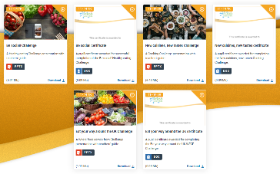
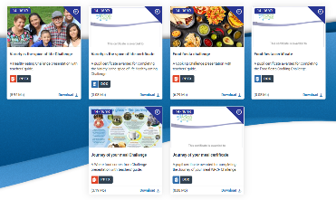
Challenge activities
The Challenges cover Healthy eating, Cooking and Where food comes from and provide a wide range of activities that teachers can select depending on their pupils’ needs, age and abilities, and the time available.
there are 12 Challenges developed to be used with nursery, primary or secondary pupils;
each Challenge presentation comprises:
slides to present the Challenge to the class, including images, information and questions/tasks to stimulate pupil discussion and planning;
a teachers' guide with opportunities for learning and a variety of pupil activities that can be completed individually or in groups.
11-14 years and 14-16 years

Slide 29
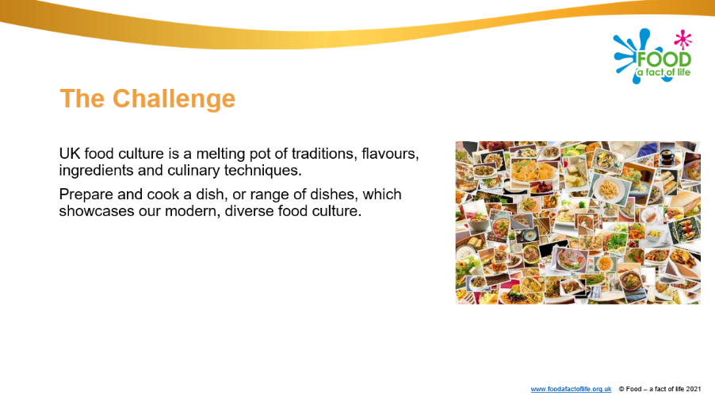
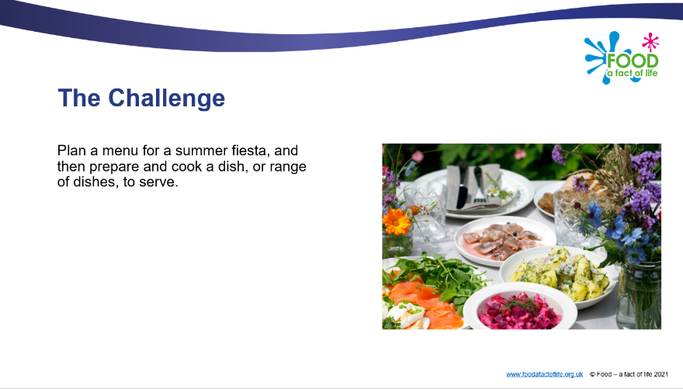
Diverse food culture Challenges
11-14 years and 14-16 years

Slide 30
Other FFL resources
Classroom resources and activities | Teaching and learning | Personal and professional development (PPD)
Bread activity pack Fibre activity pack Harvest activity pack Knowledge organisers 11-14 and 14-16 Nutritional analysis Quizzes 11-14 Quizzes 14-16 Remote learning resources Videos – cooking Videos – where food comes from | Good food hygiene and safety practices Planning sheets Resources and presentations Resources to support UK examination specifications Schemes of Work Teaching and learning videos Practical food skill progression and complexity rating | FFL training PPD toolkit Schemes of Work and lesson planning – advice and support Teacher knowledge and skills
Links to resources that focus on topics covered in today’s workshop can be found in your joining instructions.

Slide 31
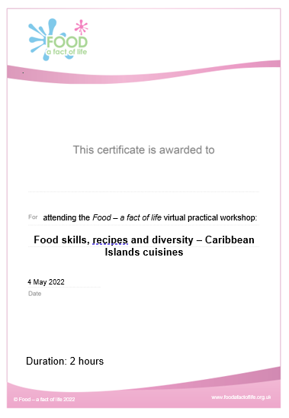
Last words ...
Review of training – ‘bright spots’?
Evaluation – a link will be sent to you. When completed …
Personalised certificate – will be emailed to you
Voucher – will be sent to you

Slide 32
Thank you for joining!
For further information, go to:
www.foodafactoflife.org.uk

