Slide 1
Poultry farming

Slide 2
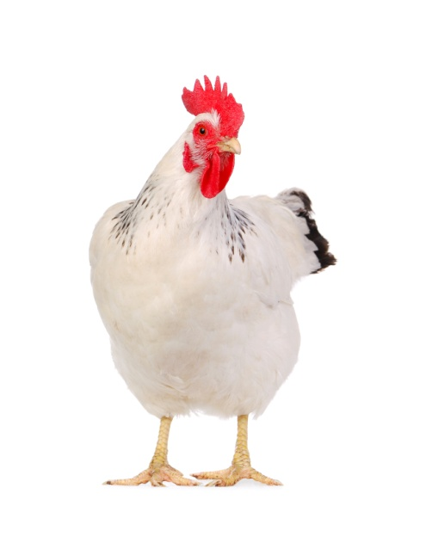
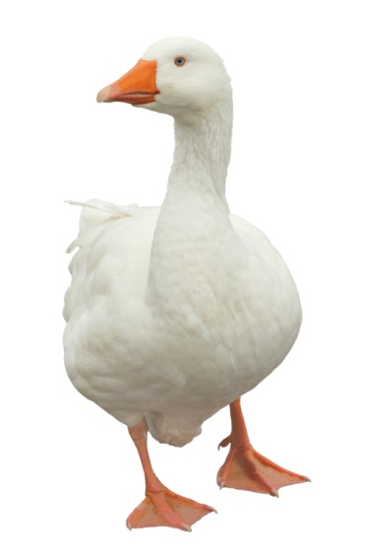
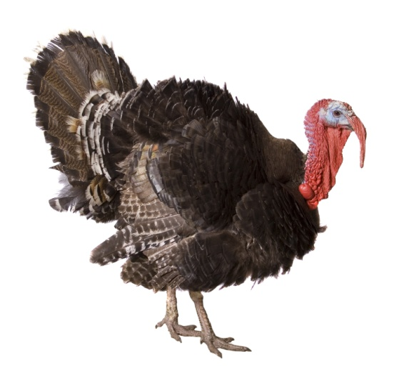
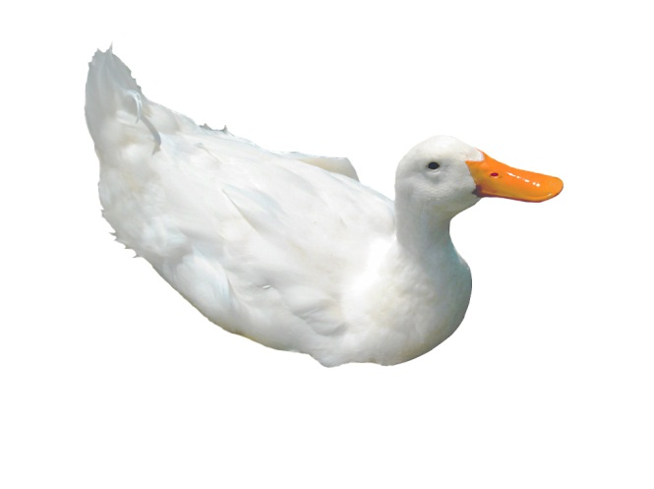
Introduction
Chicken, turkey, duck and goose are all types of birds called poultry.
They are reared for meat.

Slide 3
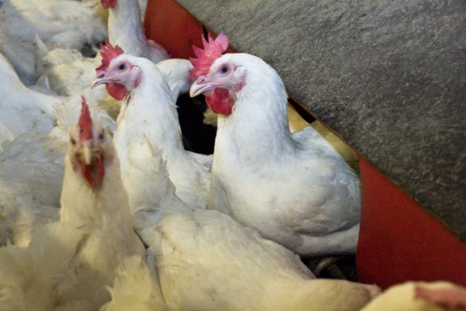
Introduction to chicken farming
Chickens farmed for meat are called broiler chickens.
A group of chickens is called a flock.

Slide 4
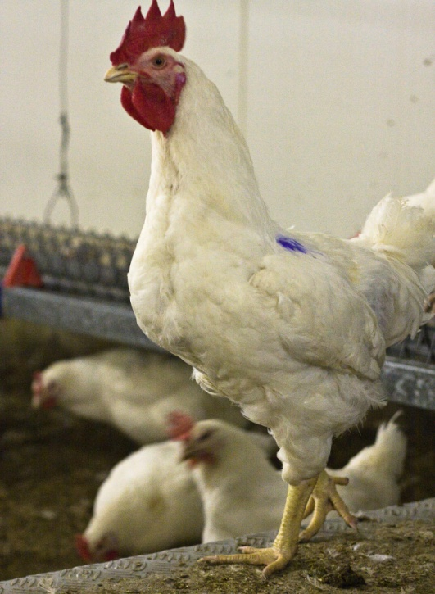
Breeder farm
Eggs are laid by broiler hens (parent flock).
Male chickens are called cockerels and female chickens are called pullets or hens.
Male turkeys are called stags and female turkeys are called hens.
The eggs are collected and sent to the hatchery.

Slide 5
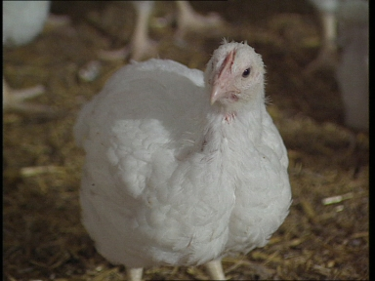
Did you know?
At any one time there are approximately 7 million broiler chicken hens laying eggs for hatching in the UK.

Slide 6
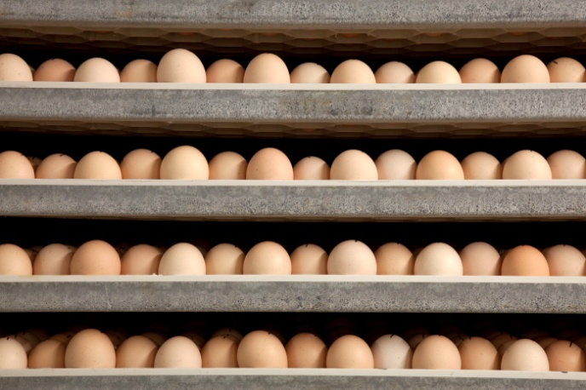
Hatchery
The eggs are incubated at the hatchery. They are kept warm, until the chicks start to hatch out of their shells.
Chickens hatch at around 20 days and turkeys hatch at around 27 days.
Baby chickens are called chicks.
Baby turkeys are called poults.
The hatched birds are then sorted and transported to Rearing farms.

Slide 7
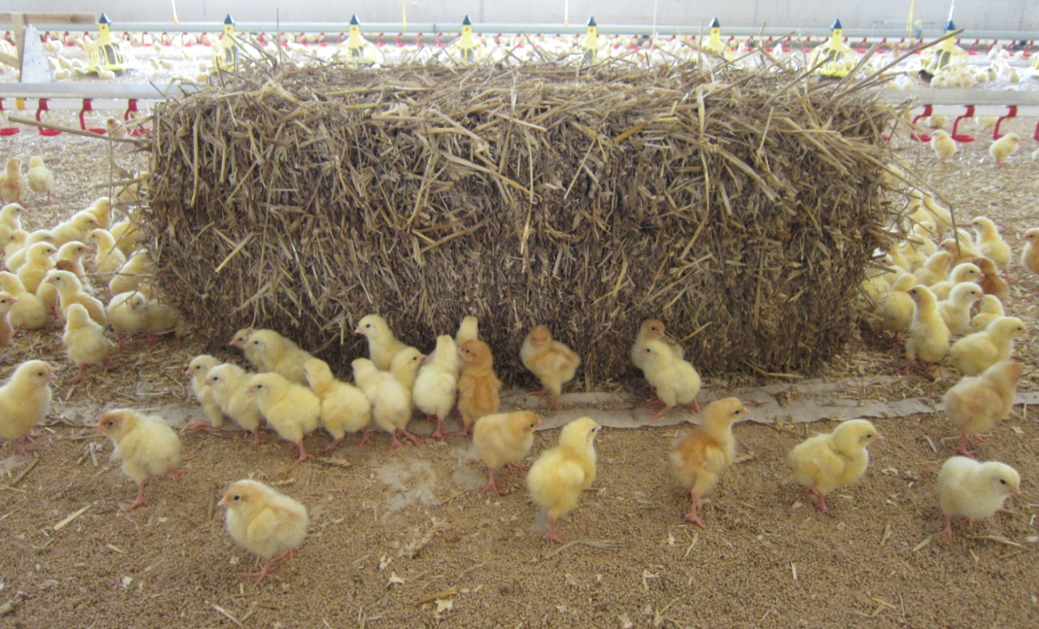
Do you know what a group of chicks is called?
A group of chicks (baby chickens) is called a clutch or peep.

Slide 8
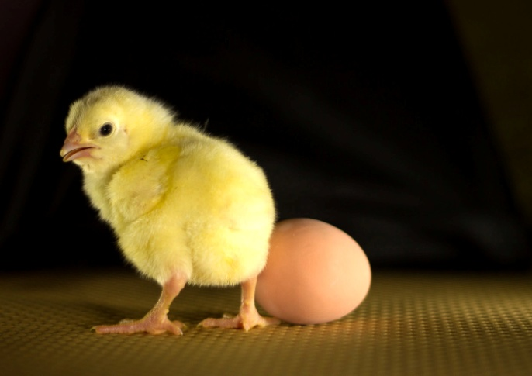
Did you know?
When a chick hatches it can live healthily for up to two days without being given any food or water. This is because it still has nutrients in its stomach from when it was inside the egg.
This is why chicks do not need food or water when they are being moved to the rearing farm.

Slide 9
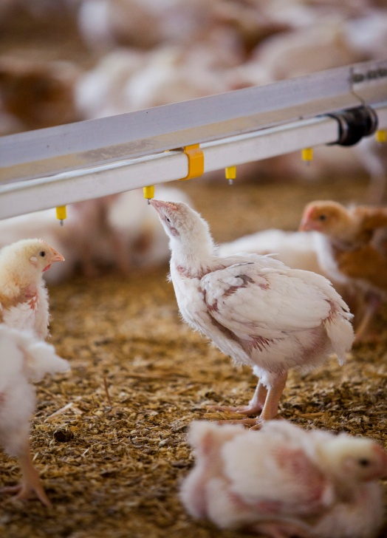
Rearing farms
The baby birds are reared in special large houses, which provide them with water and a special diet.
These houses are cleaned before each new arrival of baby birds.
Trained staff look after the birds in the houses every day.
If the birds are ill, special medicines are given in their food or water.
The birds are reared until they reach their required weight.

Slide 10
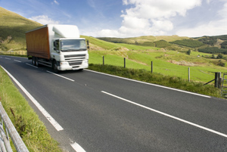
Catching
Once the birds reach their required weight they are transported to the processing plant.
Trained staff called ‘catchers’ catch the birds and put them in special containers called modules.
Catching is carried out quietly and with care to avoid unnecessary stress and to prevent injury to the birds.
The modules are then loaded into lorries and taken to the processing plant.

Slide 11
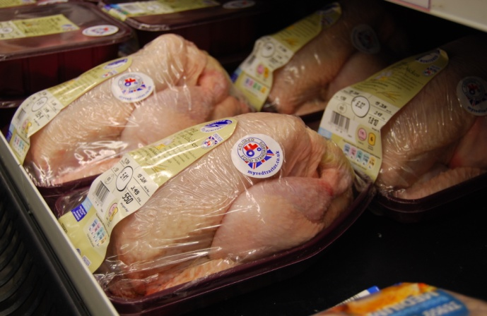
Processing Plant
Here the birds are processed and packaged.
After the birds have been processed they are weighed, and then either left whole or portioned.
The meat is then packaged and labelled ready to be delivered to restaurants, shops and supermarkets.

Slide 12
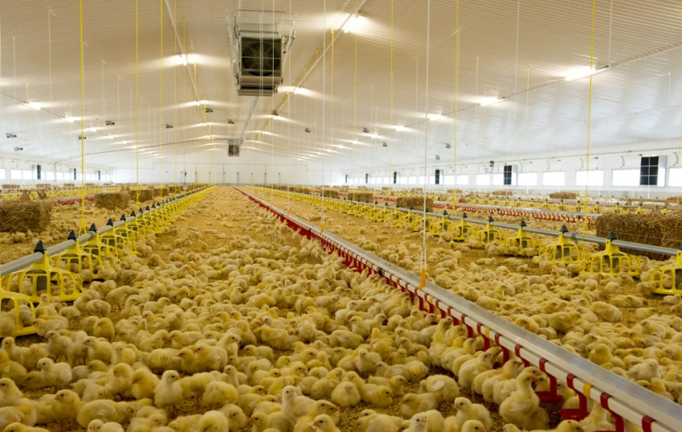
Summary
Poultry includes birds such as chicken, turkey, duck and goose.
A breeder farm, hatchery and rearing farm are all involved in the life cycle of poultry birds.
Hygiene is very important during all parts of poultry farming to prevent diseases.

Slide 13
For further information, go to:
www.foodafactoflife.org.uk

