Slide 1
Poultry Quiz

Slide 2
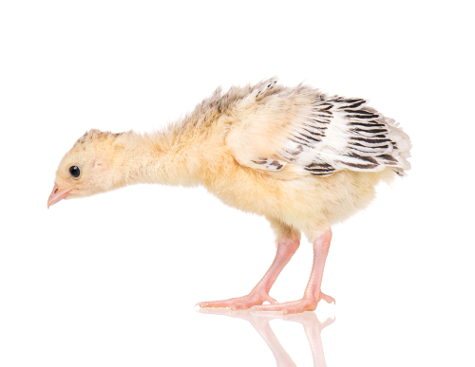
What is a baby turkey called?
Gosling
Duckling
Poult
Chick

Slide 3
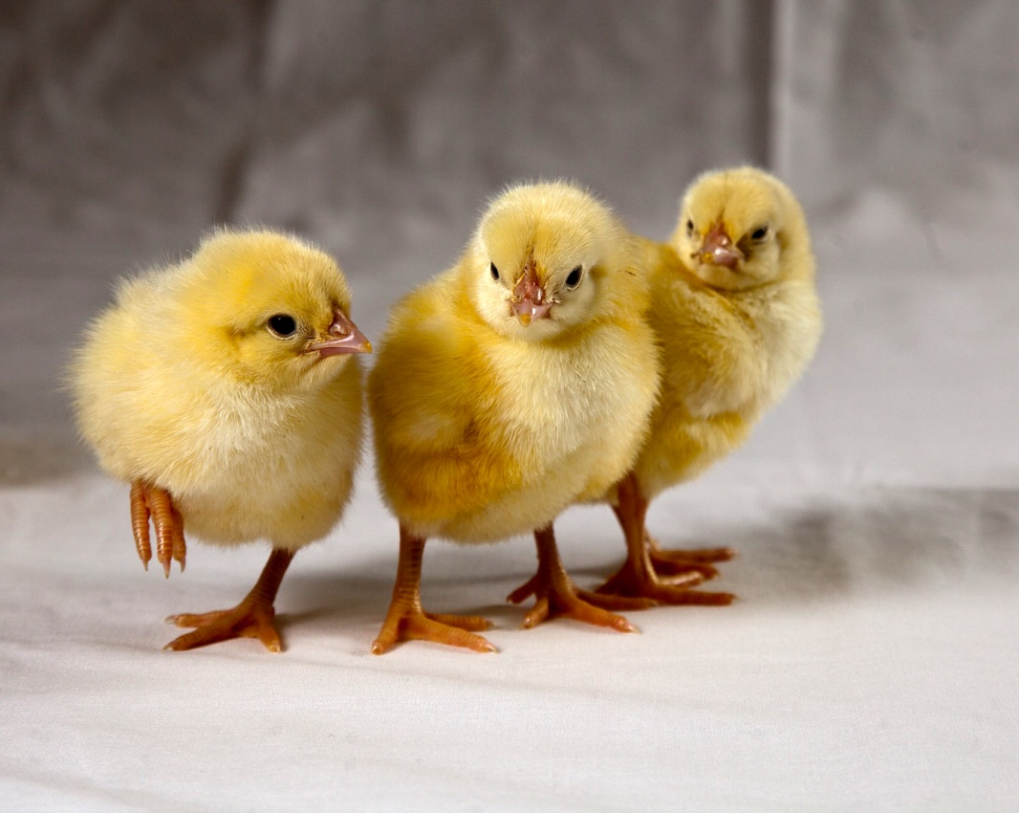
What is a group of chicks called?
Herd
Flock
Clutch/peep
Crowd

Slide 4
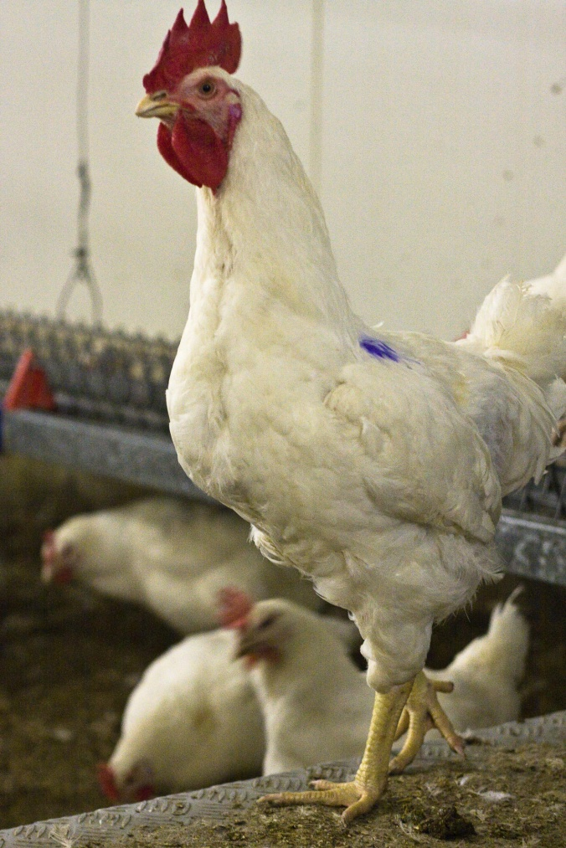
What is a male chicken called?
Cockerel
Pullet
Hen
Chick

Slide 5
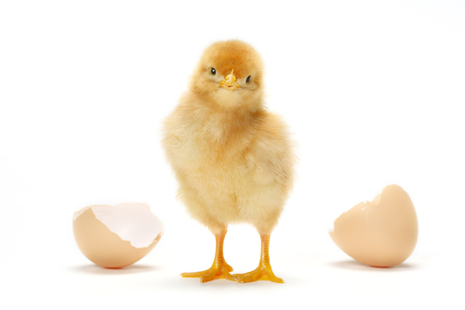
How many days does it take for a chicken to hatch?
10 days
20 days
30 days
40 days

Slide 6
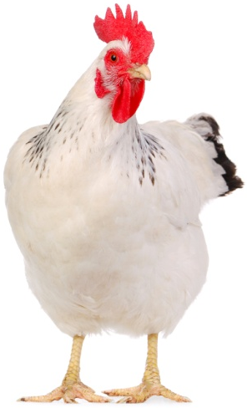
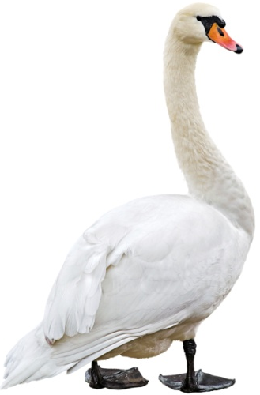
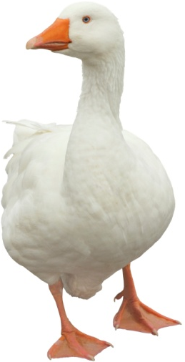
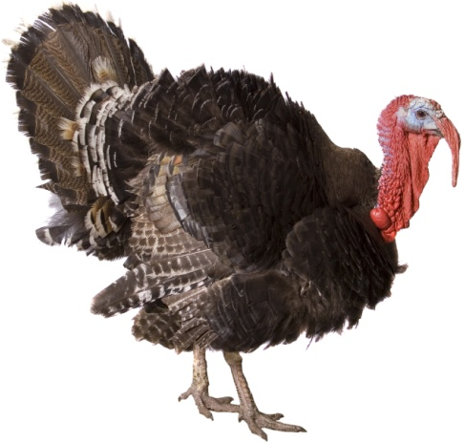
Which of these is not classed as poultry?
Chicken
Swan
Turkey
Goose

Slide 7
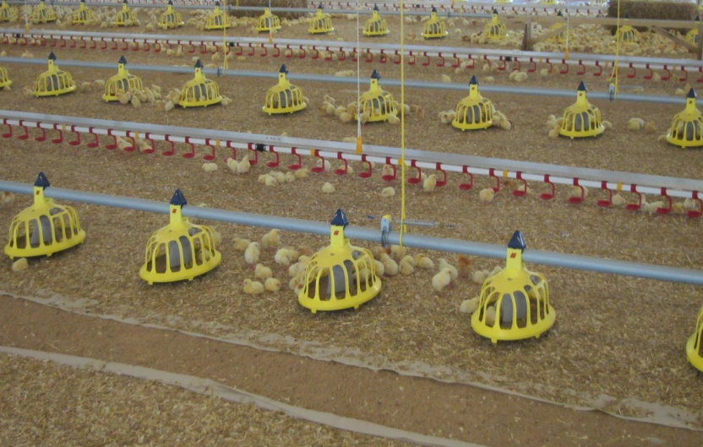
Which of these makes up the main part of poultry feed?
Cereals
Meat
Vegetables
Dairy

Slide 8
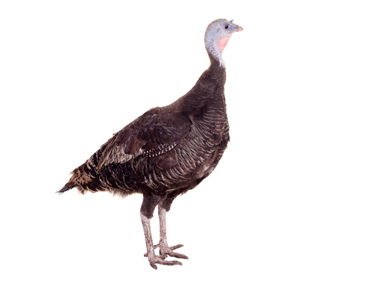
What is a female turkey called?
Poult
Hen
Chick
Peep

Slide 9
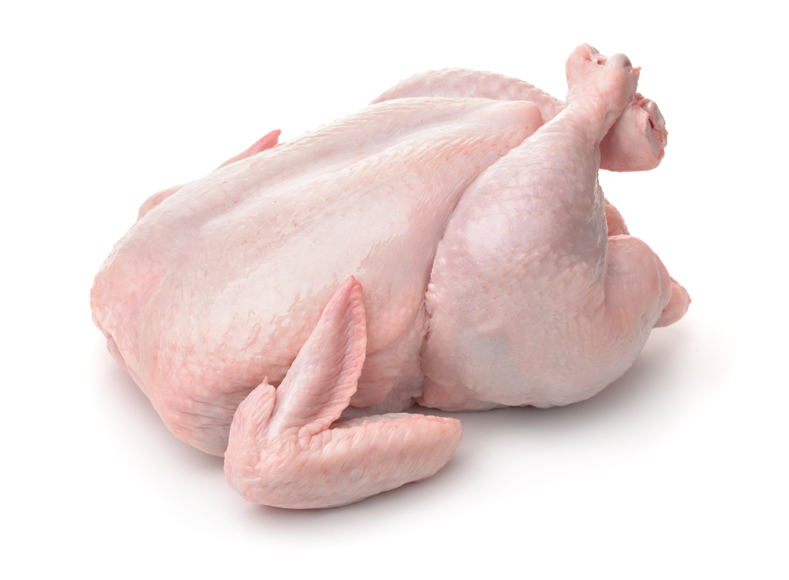
How many poultry birds/chickens are reared in the UK each year for meat?
100 million
300 million
600 million
900 million

Slide 10
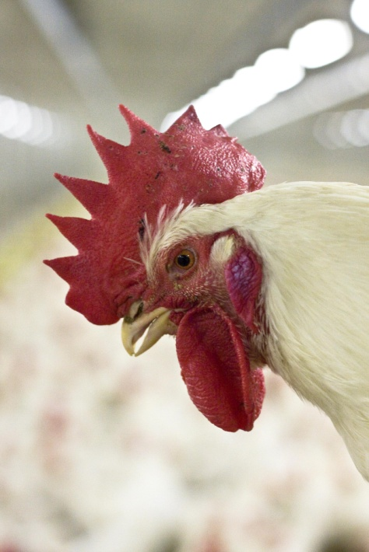
How did you do?

Slide 11
For further information, go to:
www.foodafactoflife.org.uk

