Slide 1
Plants

Slide 2
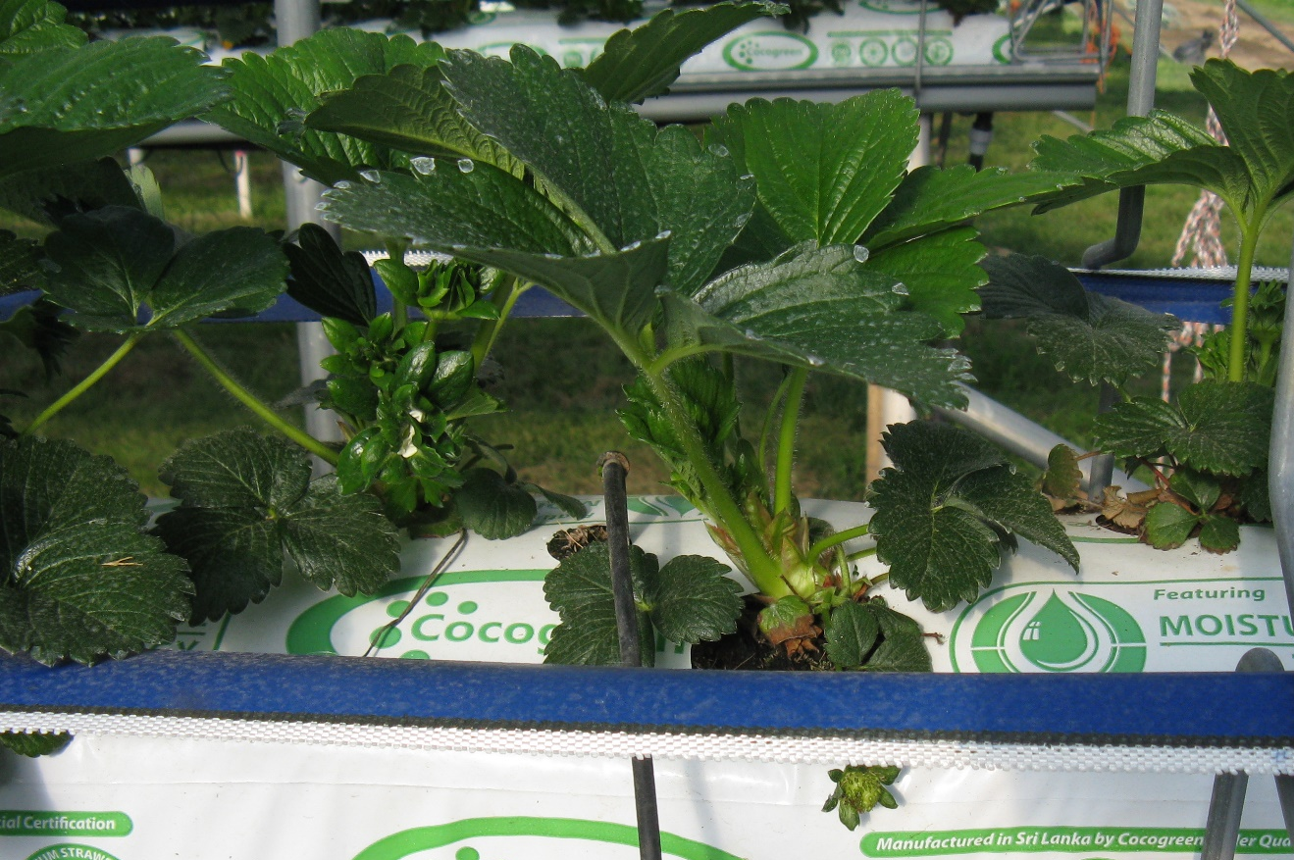
What food comes from this plant?

Slide 3
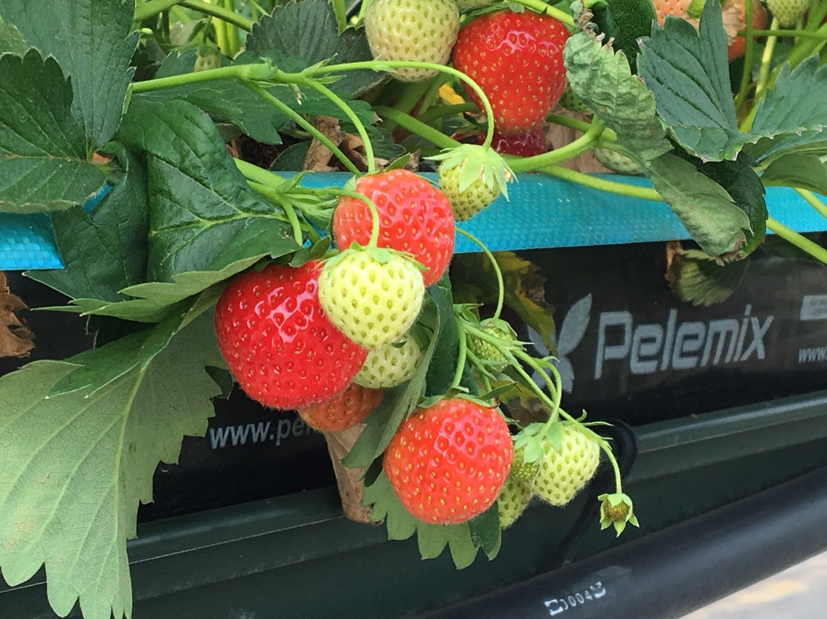
Can you tell now?
Strawberries

Slide 4
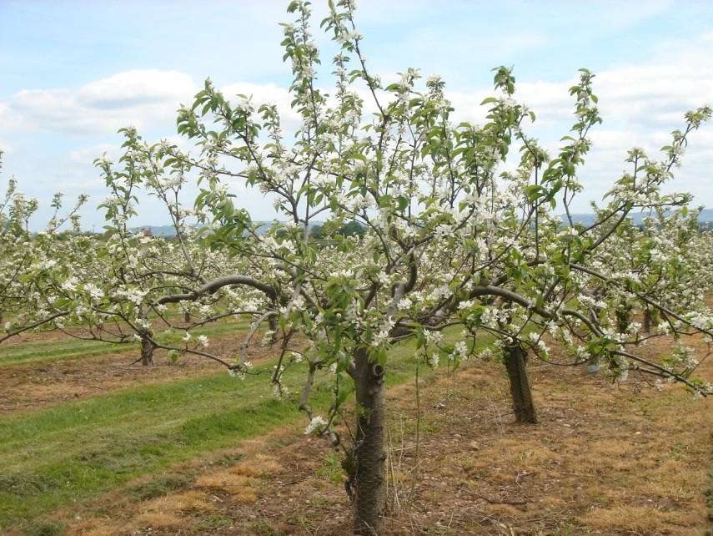
What food comes from this plant?

Slide 5
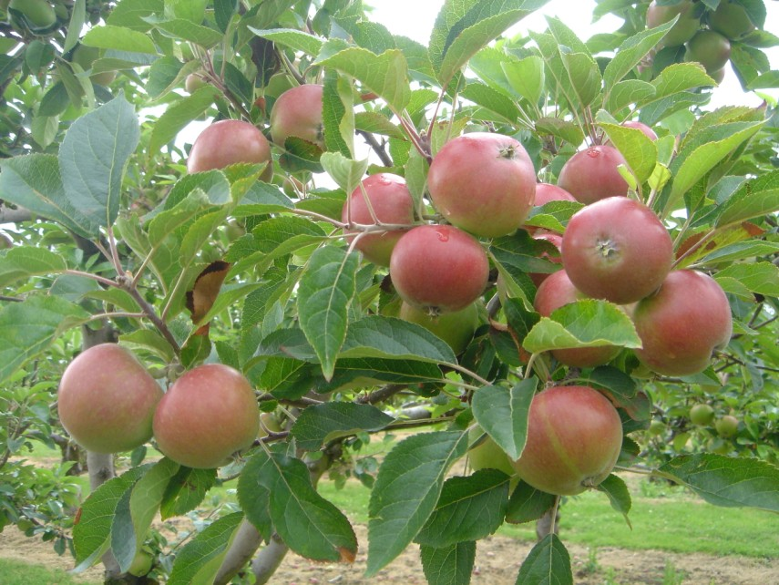
Can you tell now?
Apples

Slide 6
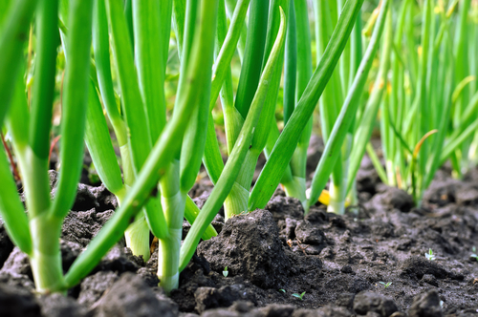
What food comes from this plant?

Slide 7
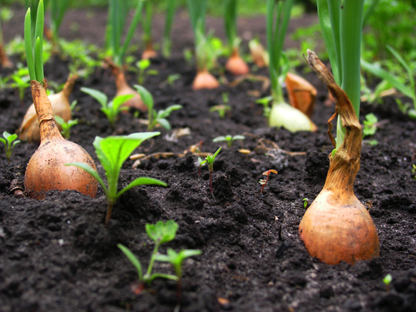
Can you tell now?
Onions

Slide 8
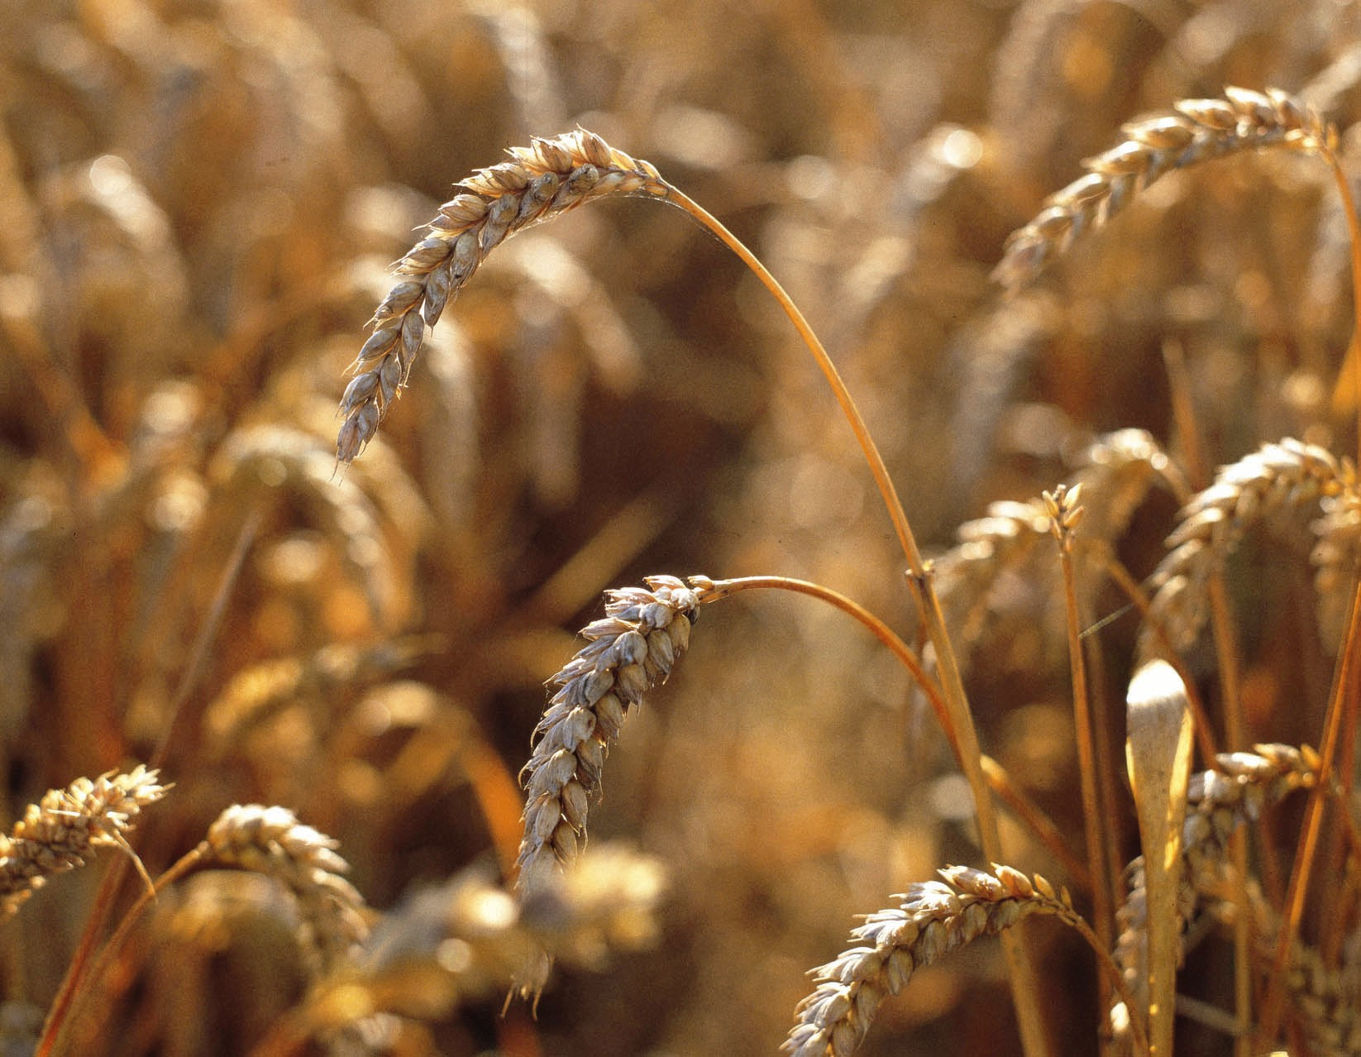
What food comes from this plant?

Slide 9
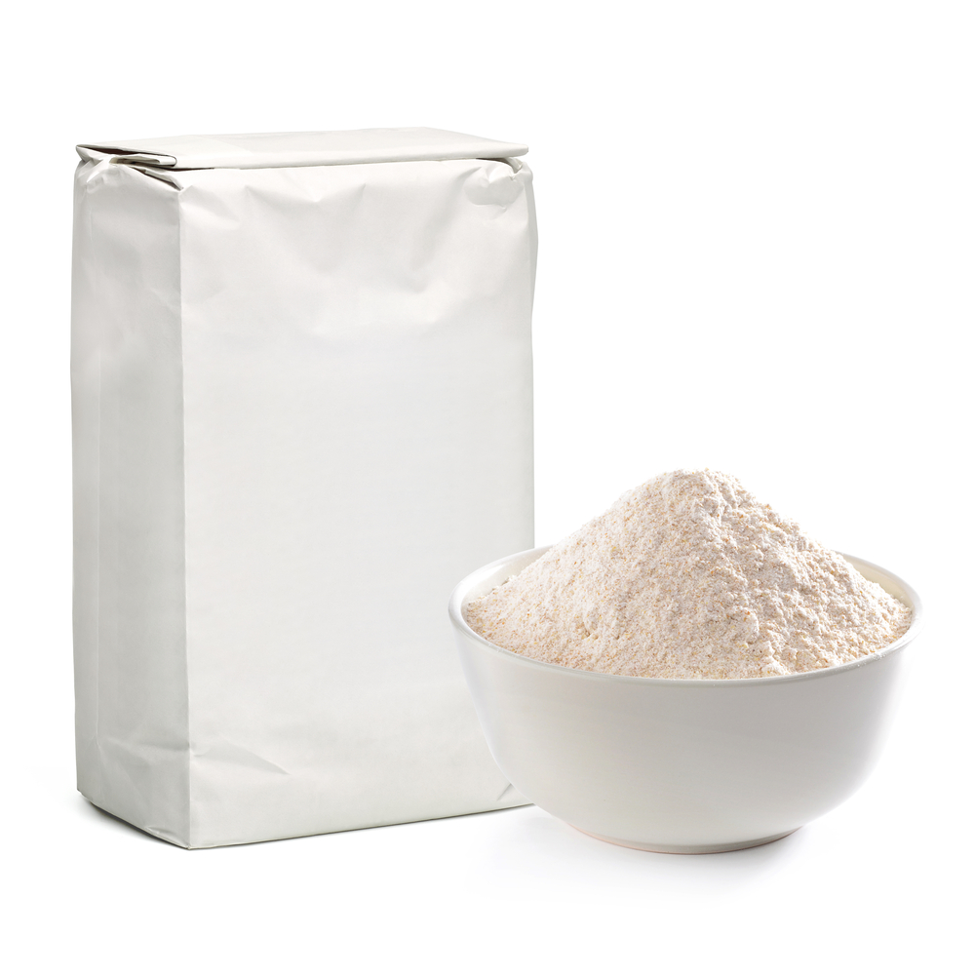
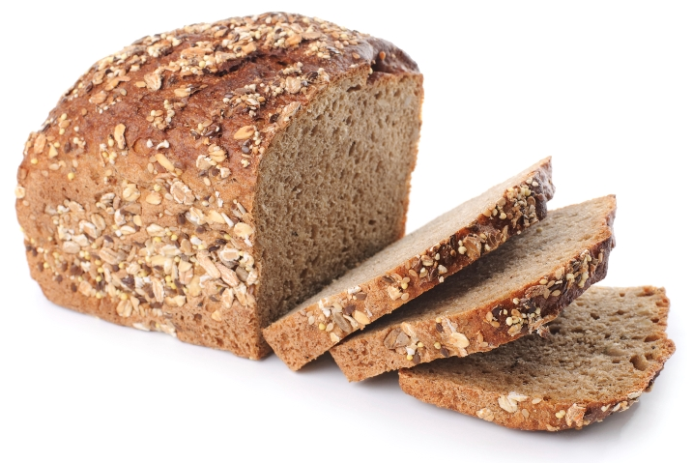
Can you tell now?
Which can be used to make…
Flour
Bread

Slide 10
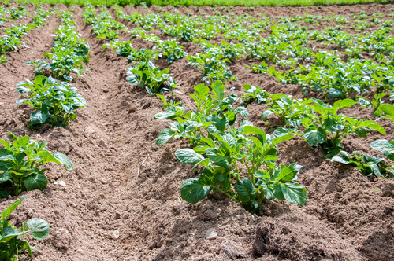
What food comes from this plant?

Slide 11
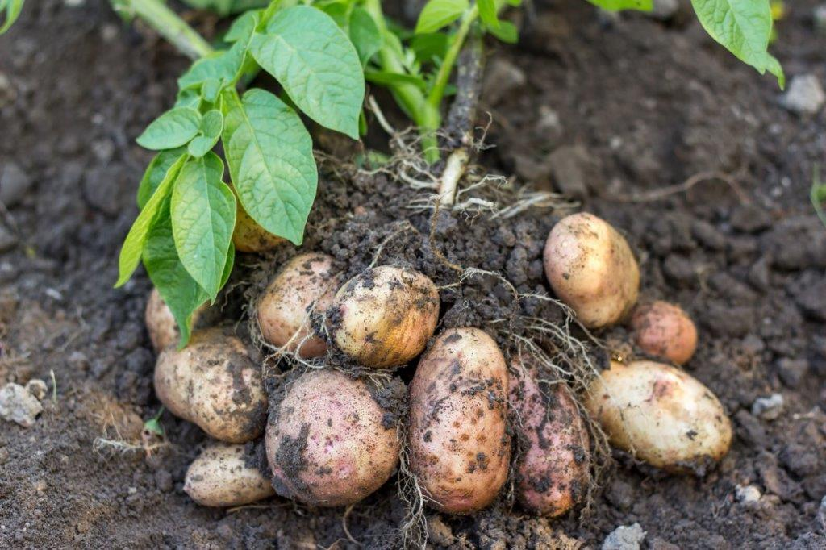
Can you tell now?
Potatoes

Slide 12

Lots of our food comes from plants.
Can you think of any more?

Slide 13
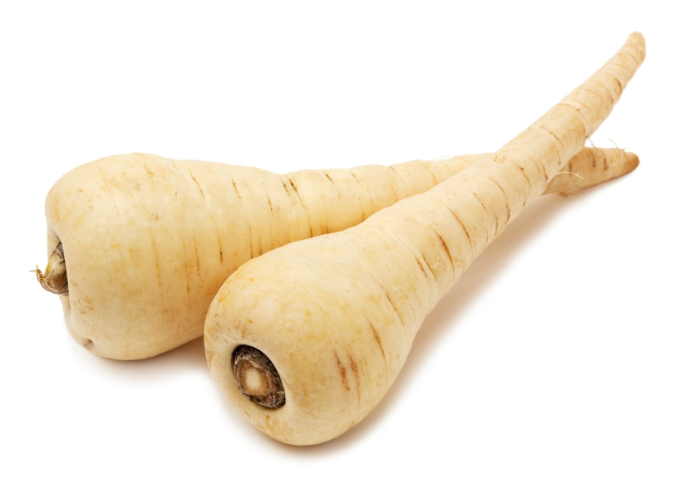
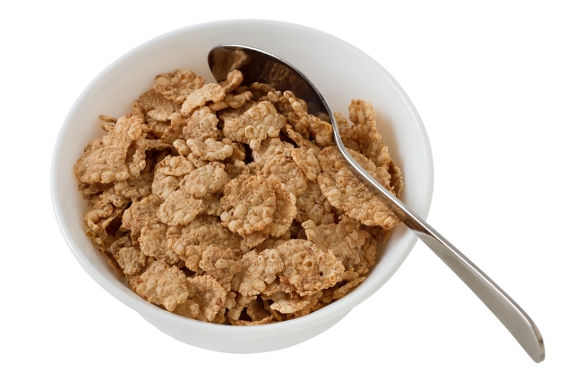
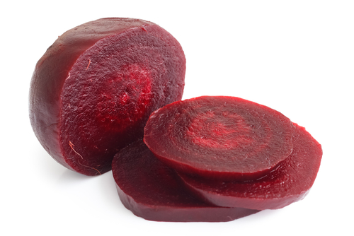
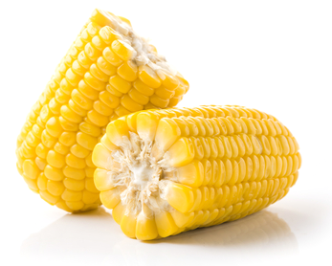
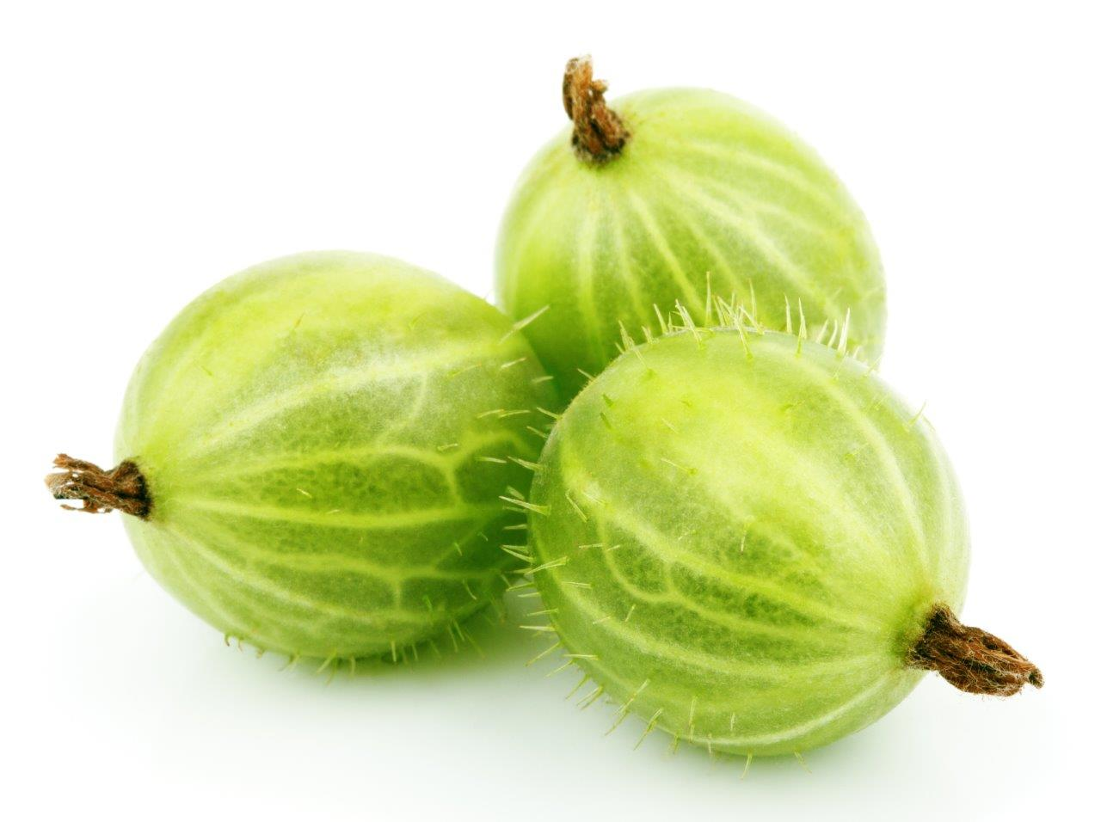
Can you name this food that comes from plants?

Slide 14
Plants
For further information, go to:
www.foodafactoflife.org.uk

