Slide 1
Using your senses

Slide 2
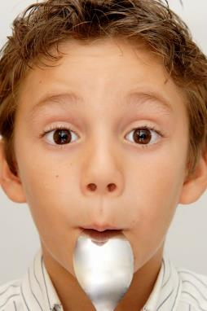
Which senses do we use?
A range of senses are used when eating food.
These senses are:
sight;
smell;
hearing;
taste;
touch.
A combination of these senses enables you to evaluate a food.

Slide 3
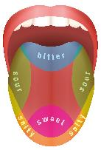
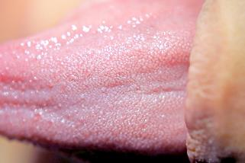
Taste receptors
The classical "taste map" is an over simplification.
Sensitivity to all tastes is distributed across the whole tongue (and indeed other regions of the mouth where there are taste buds), but some areas are more responsive to certain tastes than others.
Our tongues are covered with taste buds, which are designed to sense chemicals in the mouth. Most taste buds are located in the top outer edges of the tongue, but there are also receptors at the back of the tongue as well as on the walls of the mouth and at the back of the throat. As we chew food, it dissolves and enters the taste buds, triggering nerve impulses that are transmitted to the brain.

Slide 4
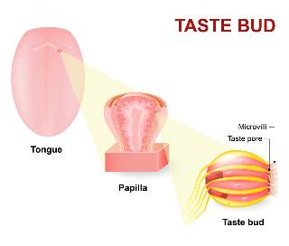
Taste receptors
Human tongues are covered with 2,000 to 10,000 taste buds, and each bud contains between 50 and 100 taste receptor cells. Taste buds are activated very quickly; a salty or sweet taste that touches a taste bud for even one tenth of a second will trigger a neural impulse.
On average, taste buds live for about 5 days, after which new taste buds are created to replace them.
As we get older, the rate of creation decreases making us less sensitive to taste.

Slide 5
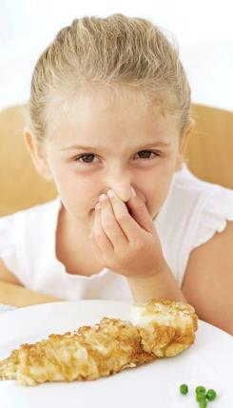
Taste receptors
The area of the sensory cortex that responds to taste is in a very similar location to the area that responds to smell, a fact that helps explain why the sense of smell also contributes to our experience of the things we eat.

Slide 6
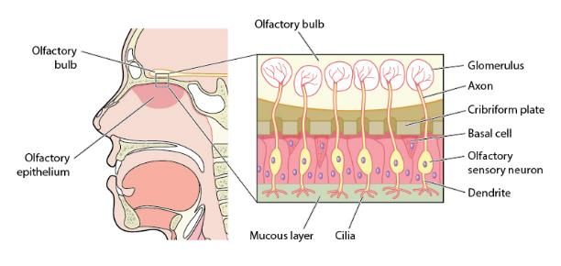
The olfactory system
The olfactory system is the sensory system used for olfaction, or the sense of smell.

Slide 7

The olfactory system
As we breathe in air through our nostrils, we inhale airborne chemical molecules, which are detected by the 10 million to 20 million receptor cells embedded in the olfactory membrane of the upper nasal passage.
The olfactory receptor cells are topped with tentacle-like protrusions that contain receptor proteins.
When an odour receptor is stimulated, the membrane sends neural messages up the olfactory nerve to the brain

Slide 8
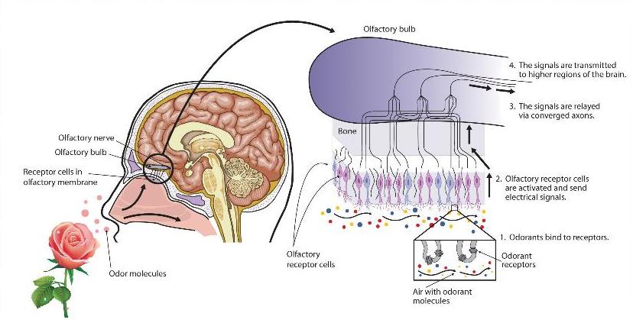
The olfactory system
Notes:
http://catalog.flatworldknowledge.com/bookhub/127?e=stangor-ch04_s04

Slide 9
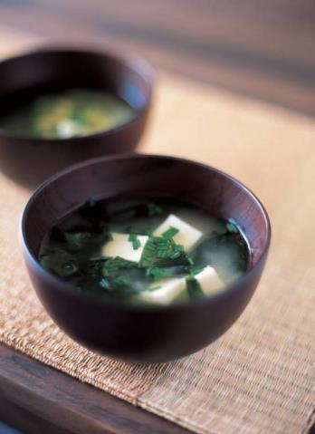
What is umami?
Umami is a savoury taste, often known as the fifth taste. It is a subtle taste and blends well with other tastes. Most people do not recognise the taste unless attention is especially drawn towards it.
After eating Cheddar cheese or tomatoes, there may be a ‘savoury’ taste lingering - this is umami.
Have you tasted umami?

Slide 10
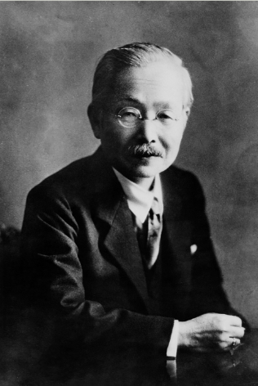
How was it discovered?
Umami was discovered by Dr Kikunae Ikeda, from Tokyo Imperial University, Japan, in 1908.
He undertook research into Dashi, a traditional Japanese stock made from kombu (kelp). His research lead to describing the savoury taste as ‘umami’.
He was sure that this taste was held in common by other foods with a savoury flavour, including those used in Western meals such as tomatoes and meat. Upon investigation it was discovered that these foods also had ‘umami’.

Slide 11
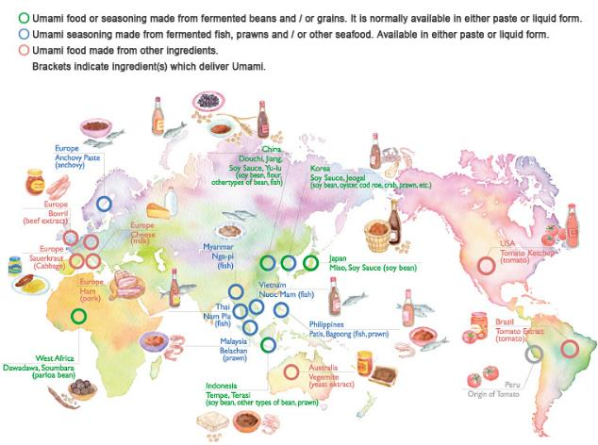
Umami around the world

Slide 12
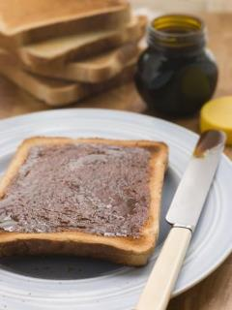
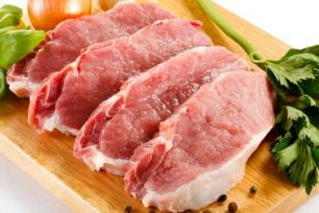
Familiar foods with a umami taste
These are foods which all have an umami taste:
tomatoes;
cured pork, e.g. ham, sausage, bacon;
cheddar cheese;
parmesan;
meat, e.g. beef;
anchovies;
yeast extract.

Slide 13
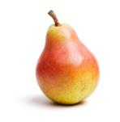
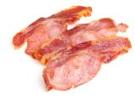
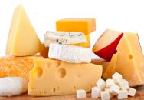
Activities – Taste and flavour
Hold your nose!
When eating food the odour combines with the taste to give flavour.
The texture, or mouthfeel, of a food may also help us recognise what it is.
An experiment to test the difference between taste and flavour involves eating a pear.
Alternatively, you could use cooked bacon, cheese or cooked sausage.
1. Wash the pear and cut into bite sized pieces.
2. Give each student two pieces of pear.

Slide 14
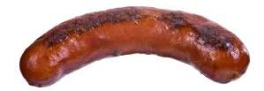
Activities – Taste and flavour
Hold your nose! continued
3. Ask the students to hold their noses tightly, close their eyes and eat the piece of food. Ask them if they can tell what the item is?
4. Ask the students to release their noses and then continue to chew? Can they now tell what the item is?
5. Repeat with the second sample.

Slide 15
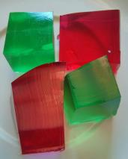
Activities – Taste and flavour
Blue jelly!
Size, shape, and colour all play an important part in helping to determine the first reaction to a food. Colour in particular gives us an indication of what flavour a food might be, e.g. a red jelly is most likely to be strawberry flavour.
Test your students’ sense of flavour through eating blue jelly.

Slide 16

Activities – Taste and flavour
Blue jelly!
Prepare a jelly using a 12g individual sachet, or four leaves of gelatine, and one pint (570ml) of water. Vegetarian jelly can also be used successfully. Add a few drops of blue liquid food colouring.
Divide the jelly mixture into five jugs and add a few drops of a different liquid flavouring, ideally colourless, into each jug.
Pour a small amount of jelly into sample pots or plastic cups and leave to set.
Once set, ask your students to identify the flavour of the jelly.

Slide 17
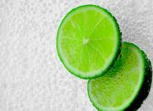
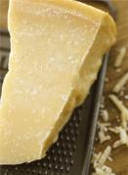
Activities – Taste and flavour
Taste sensations
We can detect five basic tastes. Provide a variety of ingredients for your students to try and see if they can identify each basic taste:
bitter - tonic water;
salty - table salt;
sour - sliced lime;
sweet - caster sugar;
umami - Parmesan cheese, umami paste mixed with low-fat mayonnaise, yeast extract on toast, cooked sausages.

Slide 18
Activities – Odour
There are a number of easy experiments through which the students learn about the sense of smell (olfaction) and how the olfactory system works.
The experiments require the students to be blindfolded, keep in mind that some people do not like to be blindfolded so they could close their eyes tightly instead.

Slide 19
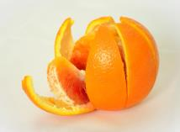
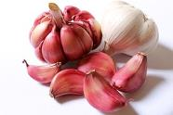
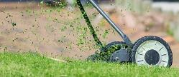
Activities – Odour
Memories
We can recognise a variety of smells, or odours. Some smells can stir up memories. To demonstrate the sense of smell, collect several items that have distinctive smells such as: peppermint, chocolate, coffee, garlic, saw dust, lemon zest, orange peel, onion, rose flowers and place them in separate containers.

Slide 20

Activities – Odour
Memories
Task the students to work in pairs and see if they can:
identify the item by smell;
describe the odour, e.g. strong, pleasant, neutral, bland or unpleasant;
describe any memories associated with the smells.

Slide 21
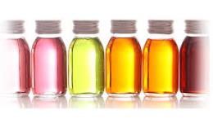
Activities – Odour
Smell detective – how many odours can you smell?
Collect a range of natural food flavourings such as raspberry, caramel, custard, strawberry, rhubarb, coconut, rose, violet, cherry, banana, lemon, orange.
Place a couple of drops of the flavouring in about 20ml of water, task a student to smell the mixture and ask them to identify the flavouring.

Slide 22
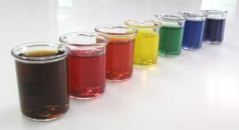
Activities – Odour
Smell detective – how many odours can you smell?
Then add one more flavour – can the student correctly identify the additional flavouring by the aroma? What if you mix three, four or more smells together?

Slide 23
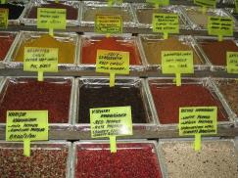
Activities – Odour
Smell cards
A bit like ‘scratch and sniff’ cards.
Collect a number of dried herbs and spices that have a strong smell and glue them to pieces of card.
These cards could be used for memory or matching type games or as a starter at the beginning of a lesson to identify the flavourings to be used in a recipe.

Slide 24
Sensory evaluation tests
Students should be taught how to set up tasting panels for preference testing.
There are a number of resources available on the Food - a fact of life website to support this including templates for preference and discrimination tests
Sensory characteristics resources

Slide 25
Sensory evaluation tests
Different tests are used in sensory analysis to obtain different kinds of information. These include:
ranking – order of preference;
rating - samples scored on a scale;
paired comparison (preference) – which product is preferred and why?

Slide 26
Sensory evaluation tests
Different tests are used in sensory analysis to obtain different kinds of information. These include:
paired comparison (discrimination) – attributes are compared;
triangle – which is the odd one out?
duo trio – which sample is the same as the control?
product profile – intensity of sensory attributes recorded, e.g. spiciness, shortness.

Slide 27
Sensory evaluation in the food industry
Sensory evaluation is used at several stages during product development and production to:
evaluate a range of existing food products;
analyse a test kitchen sample for improvements;
gauge consumer response to a product;
check that a final product meets its original specification;
detect differences between products from different runs or batches;
monitor quality control by checking regular samples against specification.

Slide 28
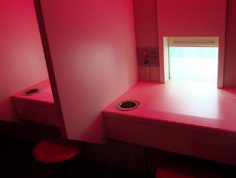
Setting up a tasting area
Everyone has different perceptions of tastes, so the tasters should understand that no-one has the ‘right’ answer.
During a tasting session, the tasters should not talk or share ideas, or look at the expressions on the faces of the other tasters. In industry, tasting booths are used to prevent this from happening.

Slide 29
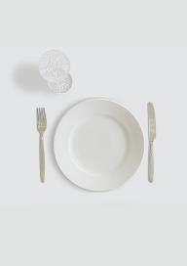
Setting up a tasting area
In order to obtain reliable results, the tests are set up in a controlled way to ensure fair testing. This could include:
a quiet environment controlled by lighting and temperature;
an atmosphere free from smells;
individual booths to reduce influence from other testers (you could ask your DT technician to make a tasting booth for you);
food samples presented on or in identical sized and shaped plain containers.

Slide 30
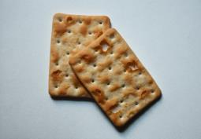
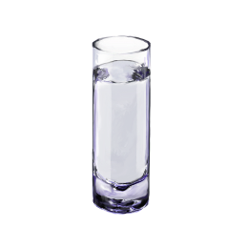
Setting up a tasting area
Continued:
all samples served in the same way, at the same temperature (appropriate to the food);
allowing each taster to sip water or eat a plain biscuit in between each tasting to clear the palate;
a small number of samples presented at one time, otherwise their taste buds get tired.

Slide 31
Setting up a tasting area
Coding the samples of food randomly to avoid the tasters having a preference – e.g. use three random numbers or letters, such as 327 or DTH. Avoid using single numbers such as 1,2,3 as these numbers can imply that the food has an order already
Clear instructions to the taster
Straight forward response sheets to record the results – make sure the tasters understand them.

Slide 32
Using your senses
For further information, go to:
www.foodafactoflife.org.uk
This resource meets the Guidelines for producers and users of school education resources about food.

