Slide 1
Food hygiene

Slide 2
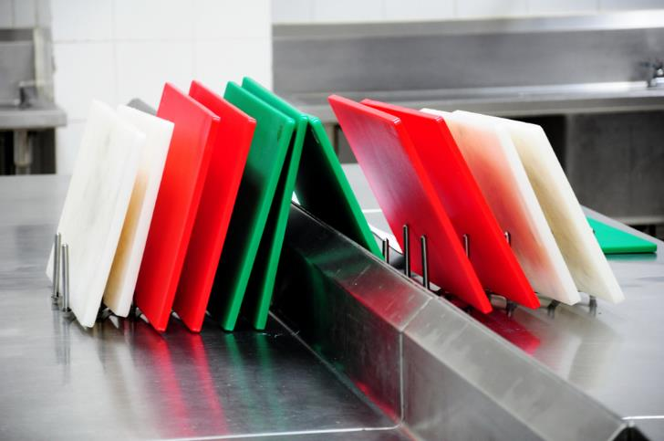
Food hygiene
Food hygiene is necessary in order to produce and supply food which is safe to eat. This involves more than just being clean. A simple way to remember is the 4 Cs:
cleaning;
cooking;
chilling;
cross contamination.

Slide 3
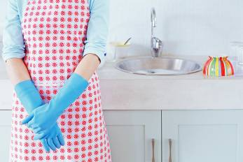
Cleaning
Cleaning the kitchen is important to keep food safe and prevent bacteria from spreading.
‘Clean as you go’ means people make sure that they clean the area and utensils they have been working in or with, as they prepare food.
This avoids build up of mess and leads to better hygienic conditions.

Slide 4
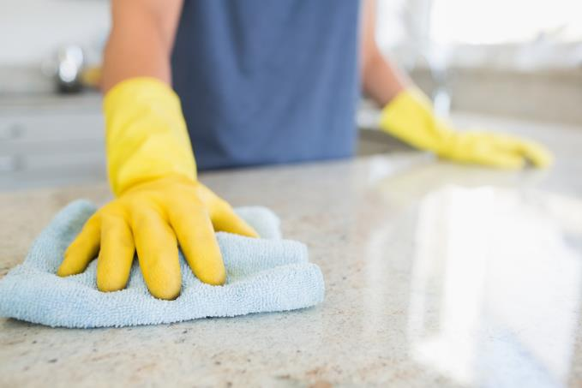
Cleaning
Cleaning worktops:
always wash worktops before food preparation begins;
wipe up any spilt food straight away;
always sanitise worktops thoroughly after they have been touched by raw meat, including poultry or raw eggs;
do not put ready to eat food, such as bread, salad or fruit on a worktop or chopping board that has been touched by raw meat, unless it has been washed thoroughly first.

Slide 5
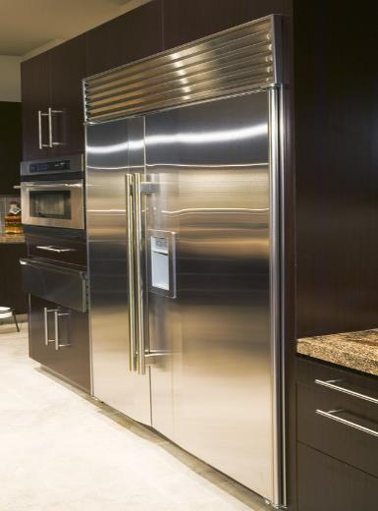
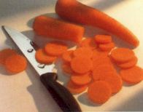
Cleaning
Areas which need particular attention are:
surfaces that come into contact with food, e.g. chopping boards, utensils;
surfaces that come into contact with hands, e.g. cupboard and fridge doors.

Slide 6
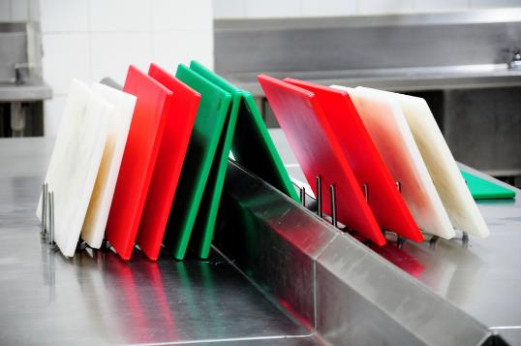
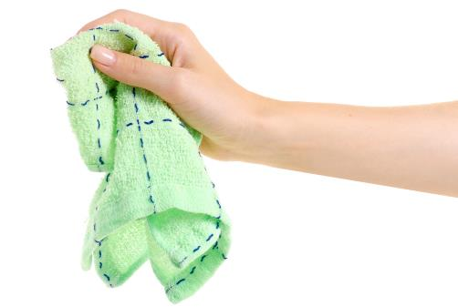
Cleaning
Chopping boards
Wash these in between preparing raw meat and raw vegetables.
Use a separate chopping board for raw meat (ideally a red one).
Use a separate chopping board for allergenic foods, such as those containing wheat.
Cloths
Use different cloths to wipe hands, worktops and dishes.
Clean or replace these cloths regularly.
Disposable paper cloths are also useful to wipe worktops or chopping boards. Throwing these towels out reduces the risk of bacteria spreading.

Slide 7
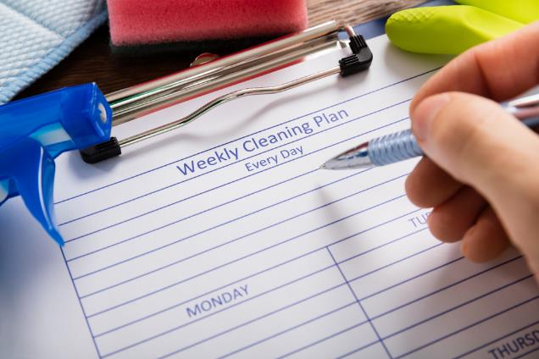
Cleaning
Knives, spoons and other utensils
Using clean utensils will prevent the spread of bacteria.
After touching raw meat, utensils should be washed thoroughly.
Cleaning schedule
Kitchens require effective cleaning and maintenance.
If a number of different people use the kitchen it helps them know exactly what to do.

Slide 8
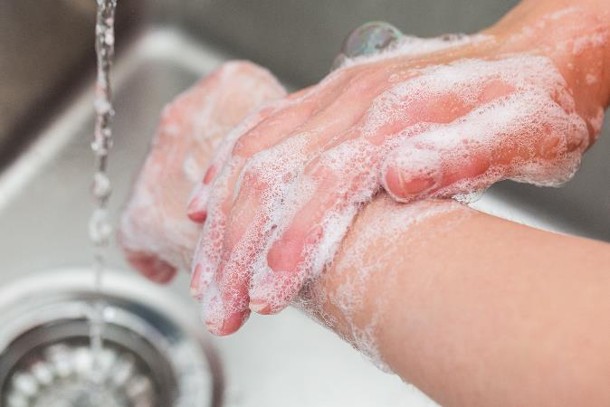
Cleaning – personal hygiene
Hands
Wash hands thoroughly with soap and warm water and dry them thoroughly at each of these times:
before starting to prepare food;
after touching raw meat, including poultry;
after touching raw egg;
after going to the toilet;
after touching the bin;
after touching pets
after touching face or hair.

Slide 9
Cleaning – personal hygiene
Hair
Long hair should be tied back and/or covered with a hair net.
Skin
Cuts and wounds should be covered with a waterproof dressing. The plasters are often blue in colour so they can be easily identified if they fall into food.
Clothing
Clean clothing should be worn.
Protective clothing such as an apron should also be worn.
Enclosed shoes should be worn in the kitchen.
All jewellery, including a watch, should also be removed (piercings should be covered if they cannot be removed).

Slide 10

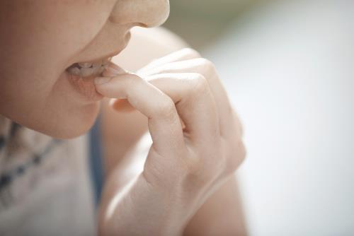
Cleaning – personal hygiene
Face
Do not cough or spit near or over food, taste food with fingers, bite nails, eat, chew or smoke, touch nose, or remove earrings.
Illness
A person who has been ill, especially with food poisoning, should not work with food or be in the food preparation area.

Slide 11
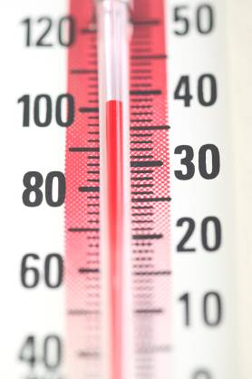
Cooking
Hot food must be served piping hot, that is above 63ºC.
Bacteria will begin to die when the temperature rises above 60ºC.
Some foods change colour when they are cooked.
Cooking food thoroughly to a minimum core temperature of 75°C will ensure most bacteria is destroyed.

Slide 12
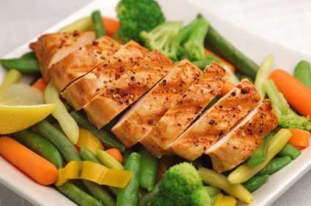
Cooking meat
When cooking burgers, sausages, portions of pork and chicken, there should be no pink meat they should also be steaming hot inside. The juices should run clear when cooked.
To check a whole chicken or other bird, pierce the thickest part of the leg with a clean knife or skewer until the juices run out. The juices should not have any pink or red in them.
Steak or other cuts of beef or lamb can be eaten less well done as long as they have been properly sealed.
Sealing the meat will kill any bacteria on the outside.

Slide 13
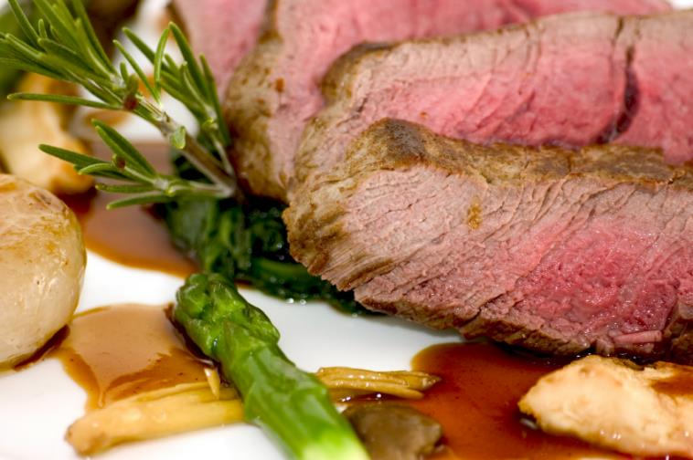
Rare meat
Some foods should not be eaten rare, because bacteria can be all the way through them. If the meat is not cooked thoroughly, any bacteria may not be killed.
The following meats should not be eaten rare:
• poultry;
• pork;
• burgers, sausages, chicken nuggets;
• rolled joints;
• kebabs.

Slide 14
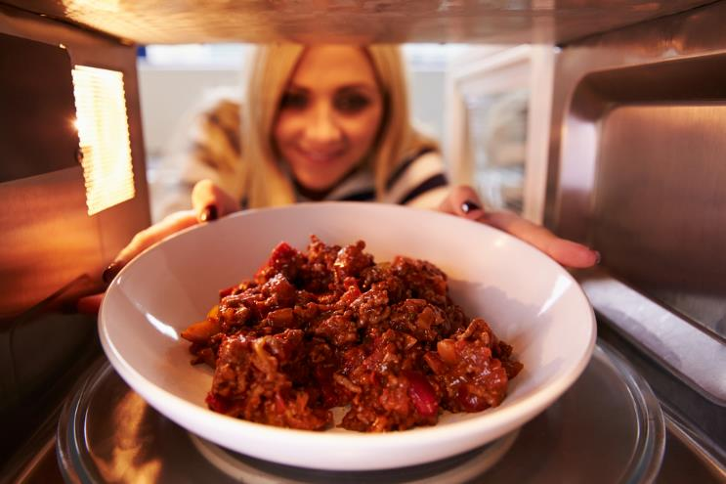
Cooking leftovers
Leftovers should be cooled as quickly as possible within two hours and then stored in the fridge below 5ºC. Separating the food into smaller containers can help.
When leftovers are reheated, they need to be steaming hot. If using a digital probe food should be reheated to a minimum of 75°C. In Scotland food must be reheated to a core temperature of 82°C.
Leftovers should not be reheated more than once and should be used within 48 hours from when it was made (24 hours for rice dishes).

Slide 15
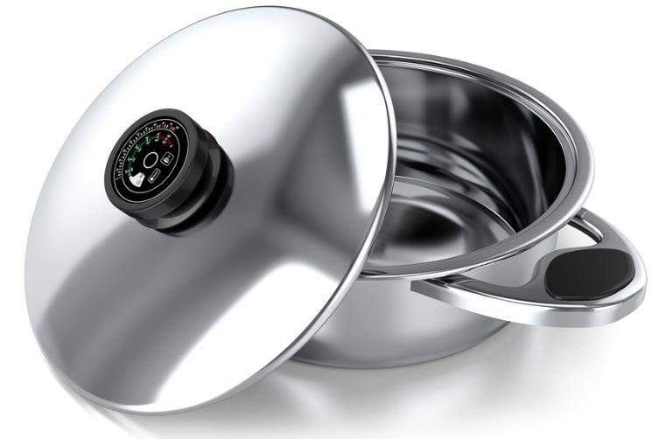
Cooking with aluminium pans
It is best not to use aluminium pans, baking trays and foil, or other cookware made of aluminium, to cook foods that are highly acidic such as:
• tomatoes;
• rhubarb;
• cabbage;
• many soft fruits.
Aluminium can affect the taste of these sorts of foods.

Slide 16
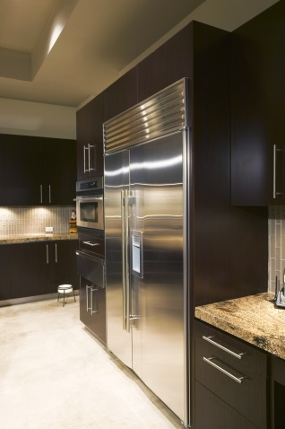
Chilling
The bacteria that cause food to deteriorate and lead to food poisoning rapidly reproduce around the temperature of 37ºC (body temperature). This is known as the ‘optimum temperature’ for bacterial multiplication.
The temperature between 5ºC– 63ºC is known as the ‘danger-zone’. Bacterial will multiply most rapidly within this temperature range.
Reducing the temperature below 5ºC slows the reproduction of micro – organisms.
Cold temperatures do not kill bacteria.

Slide 17
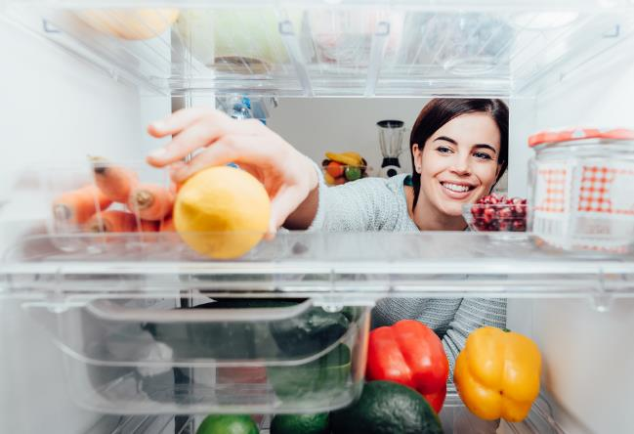
Chilling – the refrigerator
Keep it at the right temperature (below 5°C).
Keep the fridge door closed as much as possible.
Store cooked food above raw food.
Wait for food to cool down before it is placed in the fridge.
Do not overload the refrigerator. If the fridge is full, the cool air will not circulate around the food.
Food should be covered to prevent cross contamination and moisture loss.
Regular maintenance of the fridge is important.
Clean to remove spills and food deposits whenever they occur to prevent contamination of food.

Slide 18
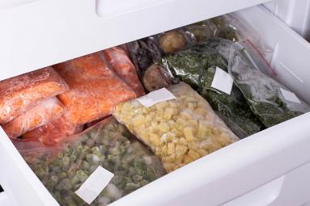
Chilling – the freezer
Ensure the freezer is working at a temperature below -18 ºC.
Do not place hot foods in the freezer or leave the door open for extended periods.
Do not overload the freezer. Cold air needs to circulate around the food.
Store food with a label showing the contents and the date. Food should be wrapped well to prevent it drying out. Only freeze food when at its best condition, to allow the food to last longer.
Keep the freezer clean by removing spills and food deposits when they occur.
Never refreeze defrosted food, as this increases the growth of bacteria.
Defrost food slowly in a fridge below 5ºC
Storing food correctly can also help to reduce food waste.

Slide 19
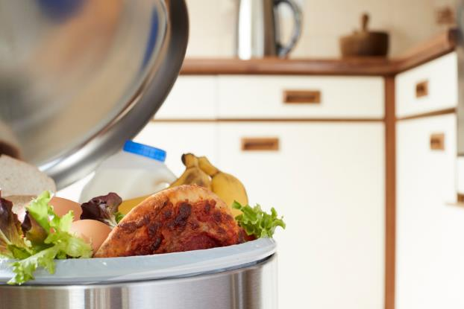
Cross contamination
The process by which bacteria are transferred from one area to another.
The main carriers of bacteria and causes of cross contamination are:
• humans;
• rubbish;
• pets and other animals;
• food, e.g. raw meat or poultry.

Slide 20
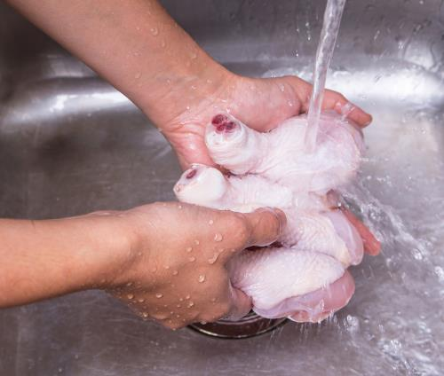

Cross contamination
Keep raw meat separate from ready – to eat food.
Do not let raw meat drip onto other food – keep it in sealed containers at the bottom of the fridge.
Never use the same chopping board for raw meat and ready-to-eat food without washing the board (and knife) thoroughly in between. Ideally use a red board to prevent the risk of bacterial cross contamination.
Do not wash meat before cooking it, this will not remove harmful bacteria and may spread bacteria to work surfaces and utensils.

Slide 21
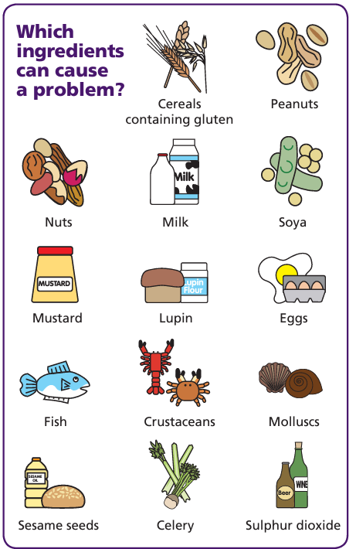
Cross contamination – allergenic ingredients
Allergenic ingredients can cause severe adverse reactions to those people who are sensitive to the ingredients.
Allergic reactions can be caused by cross contamination of ingredients or food that contains an allergen.
Food can be contaminated due to poor cleaning of utensils or cross-contact during preparation.
Separate utensils, and areas, should be used when preparing and cooking foods containing allergens.
All food should be clearly labelled with allergen information.
FSA Think Allergy
FSA allergen information for businesses

Slide 22
Food hygiene
For further information, go to:
www.foodafactoflife.org.uk
This resource meets the Guidelines for producers and users of school education resources about food.

