Slide 1
Sustainable healthy food

Slide 2
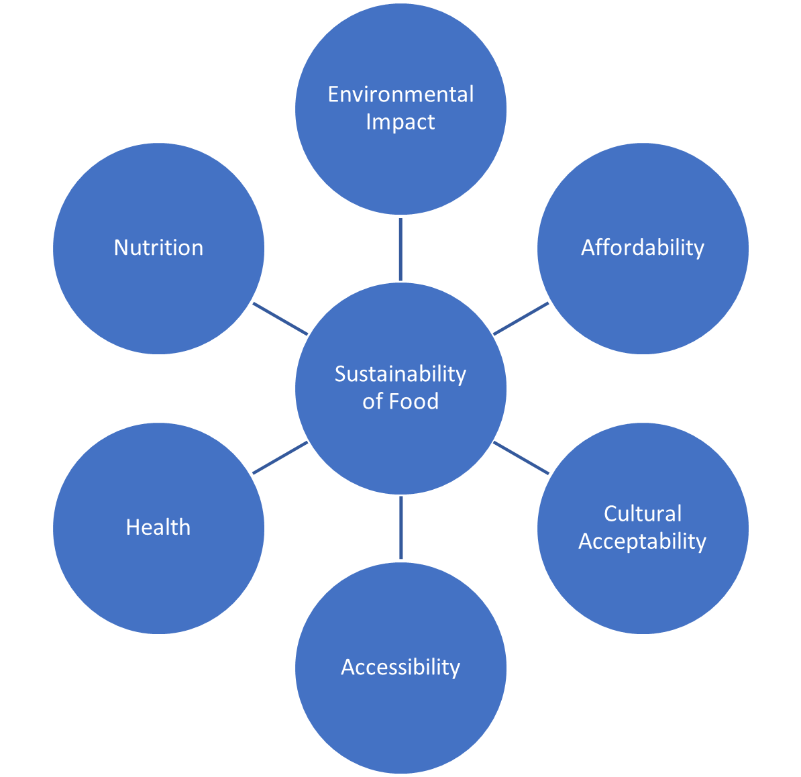
Introduction
This presentation is an introduction to sustainable, healthy food.
The diagram on the right shows the factors that make up a sustainable diet.
This presentation is aimed at children aged 5-7 years and will focus on some of these factors, as appropriate for the age group.
(including safety)

Slide 3

Sustainability
Sustainability is a complex topic and must consider both the planet and people.
Balance is important to consider. For example, a food might be affordable, but not nutritious or produced with care for the environment.
Another food might be produced with care for the environment and nutritious but not be affordable or accessible.

Slide 4
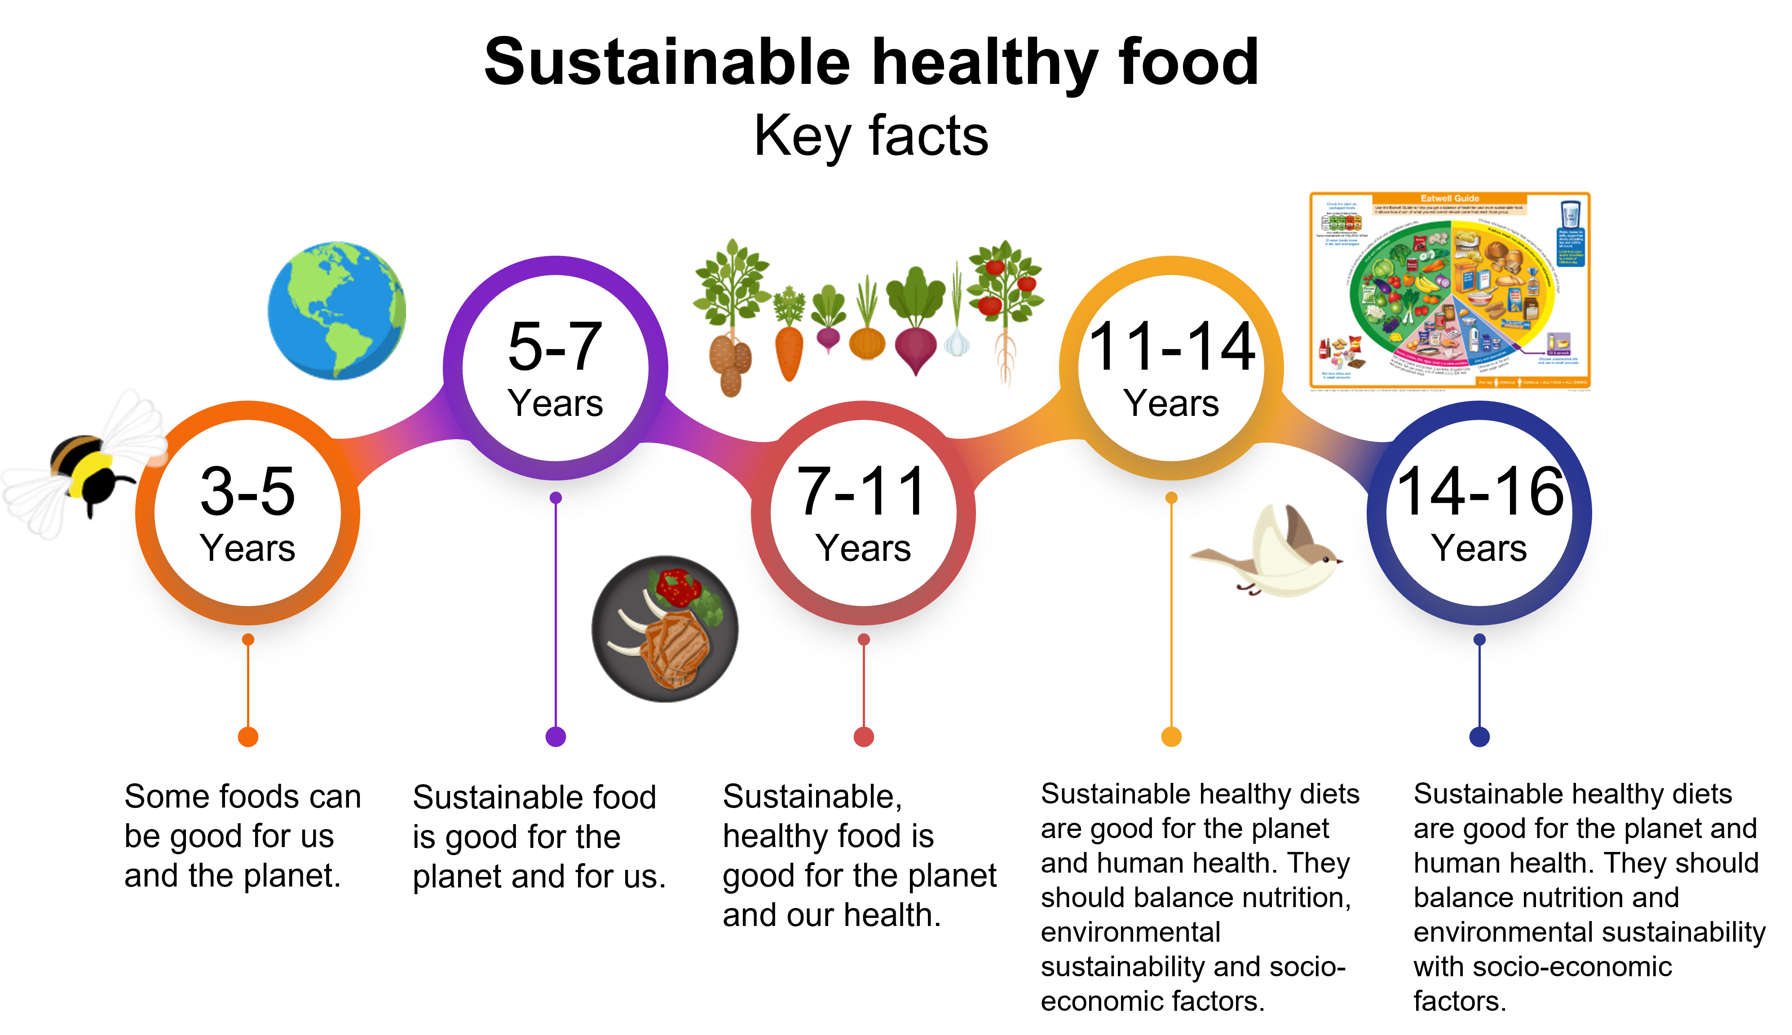
Sustainable healthy food
Key Facts
The Food – a fact of life resources covering the topic of sustainable healthy food are built around Key Facts, which progress through the age phases.
See our Curriculum roadmaps to find out more about the Key Facts.

Slide 5
Sustainable healthy food
Summarised Key Fact for 5-7 years:
Sustainable, healthy food is good for the planet and for us.
Key Facts:
Sustainable food is produced and processed with care for the environment.
A lot of food that could have been eaten is wasted for different reasons.
Sustainable and healthy food is good for our bodies.
Explanatory notes:
It is recommended to use this presentation in parts to cover the different themes within the topic of ‘Sustainable healthy food’. Some of the slides include links to the sources of information and further information and resources.
A table of the themes, and supporting content, can be found on the next slide.
For each of the main three themes, a ‘pick and mix’ sheet of activities is available for the pupils to try.

Slide 6
Summary of the presentation content
Sustainable healthy food is good for the planet and for us
Introduction | Content
Land, water and energy | An introduction to set the context, considering why we need to use land, water and energy wisely for our health and the health of the planet.
Theme | Key fact | Content
Producing food | Sustainable food is produced and processed with care for the environment. | Exploring some of the ways farmers care for land, water and energy, and what we can do to care for them too.
Food waste | A lot of food that could have been eaten is wasted for different reasons. | Looking at the impact of food waste and what we can do to help.
Our health | Sustainable and healthy food is good for our bodies. | Exploring how what we eat and drink can help keep us and the planet healthy.

Slide 7
Land, water and energy
Introduction

Slide 8

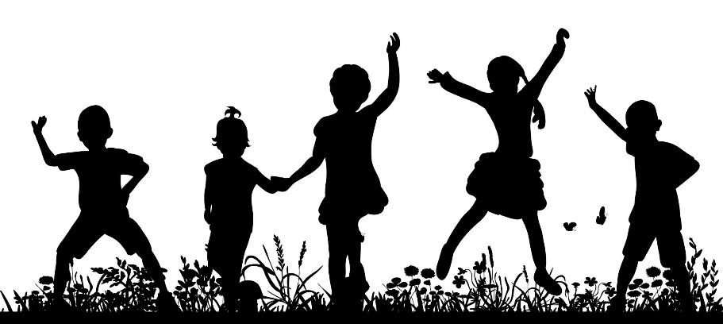
Our health and our planet
The foods and drinks we choose are important for our health and the health of the planet.

Slide 9

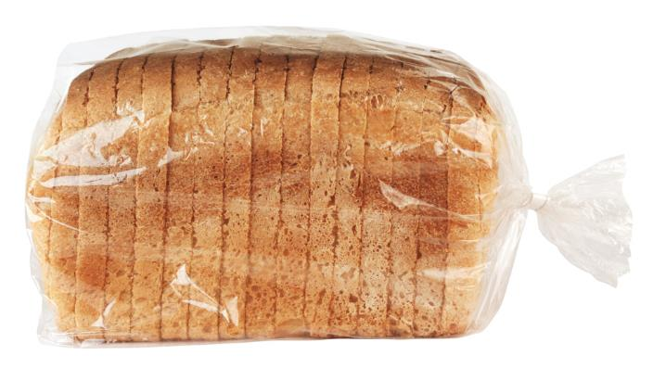
A lot goes into producing our food
Land
Water
Energy
How would land, water and energy be used to make this loaf of bread?

Slide 10
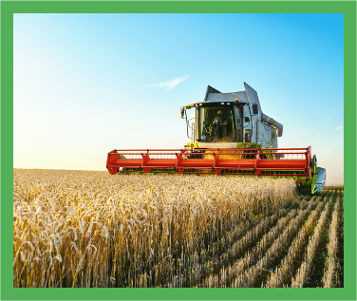
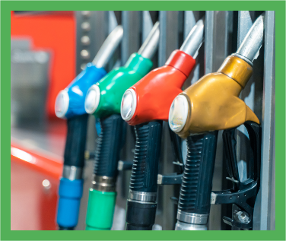
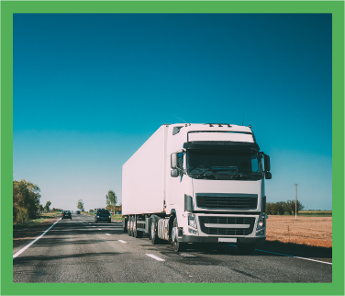
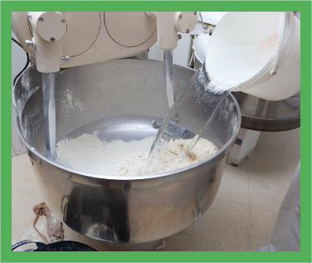
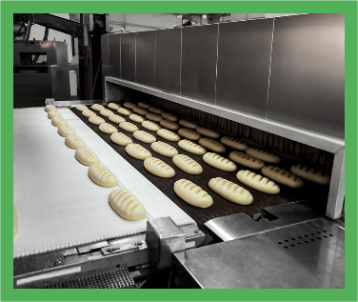
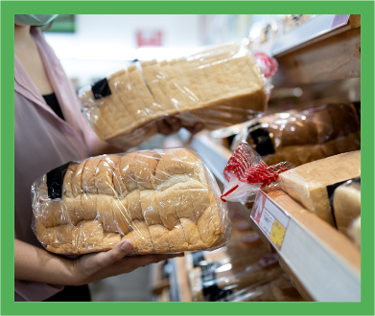

A lot goes into producing our food
Here are some of the ways land, water and energy are used to make a loaf of bread.
Land
Fuel
Transport
Can you explain why each of these is needed so we can have bread to eat?
Water
Oven
Packaging

Slide 11
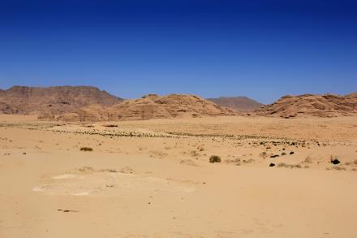
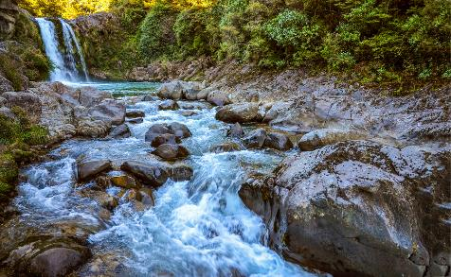
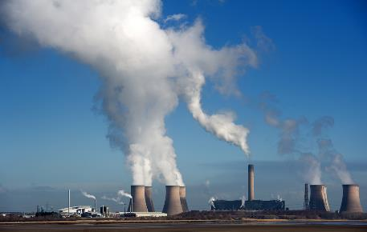
What’s the problem?
The number of people on our planet is growing. We will need to make a lot more food in the future to feed everyone.
We need to look after our land, water and energy and use them wisely.
Let’s find out why!

Slide 12
Why does it matter how much land we use?
Not all land can be used to grow crops and graze animals.
We need to use the land we have wisely.
Why do you think there isn’t much growing here?

Slide 13
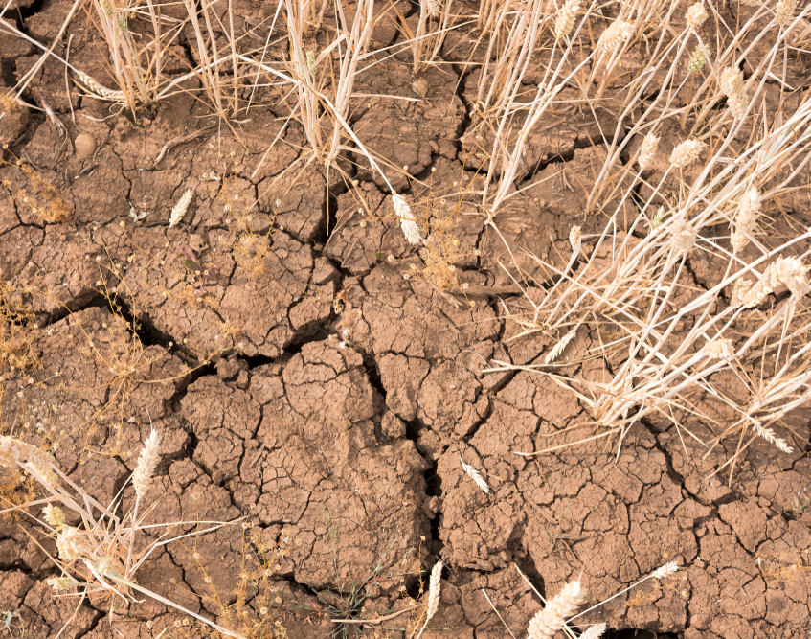
Why does it matter how much land we use?
Crops cannot grow properly in crumbly, dry soil or sand.
The soil needs to be healthy, so it can feed the plant and help it to grow and develop into a new plant.

Slide 14

Why does it matter how much water we use?
Our planet is sometimes called the ‘blue planet’ because so much of it is water.
It looks like we have lots of water, but we can’t use most of it.
Why do you think that is?

Slide 15
Why does it matter how much water we use?
We need freshwater to drink, grow our food, wash, cook and other parts of our daily life.
Our oceans are seawater, which we can’t use because it is salty.
Only around 1% of the water on our planet is freshwater, so we need to use it wisely.

Slide 16
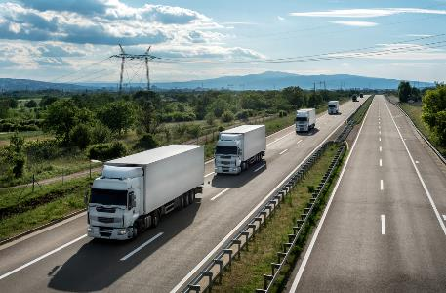
Why does it matter how much energy we use?
Energy

Slide 17
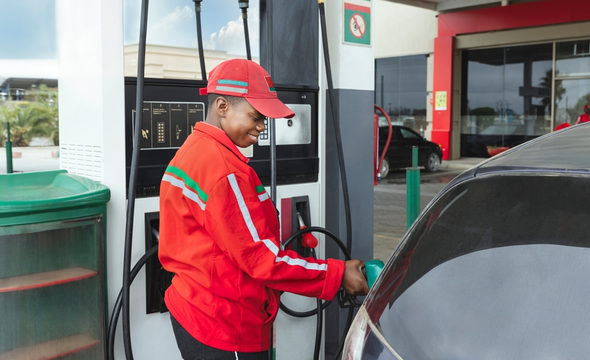
Energy
We use energy for all sorts of things.
We need energy to run cars and other vehicles.
We need energy to heat our homes.
The energy we need can create greenhouse gases which can harm our planet.

Slide 18
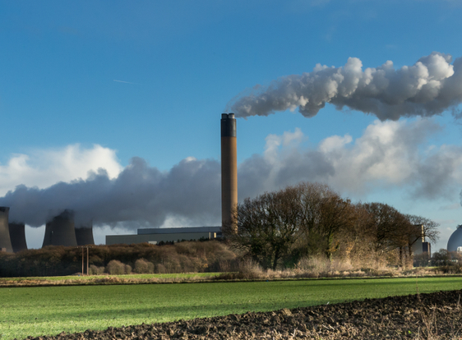
Energy
Lots of our energy is made by burning oil, coal and gas.
Burning oil, coal and gas creates greenhouse gases.
United Nations: https://www.un.org/en/climatechange/what-is-climate-change

Slide 19
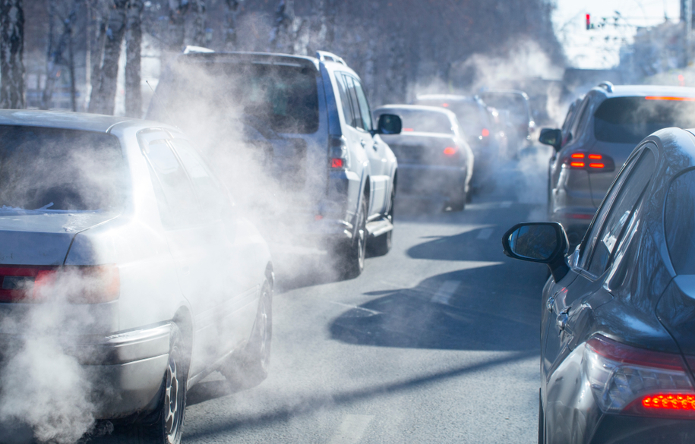
Energy
Greenhouse gasses go up into the sky and act like a blanket wrapped around the Earth.
This traps in the sun’s heat and raises temperatures on Earth.
United Nations: https://www.un.org/en/climatechange/what-is-climate-change

Slide 20
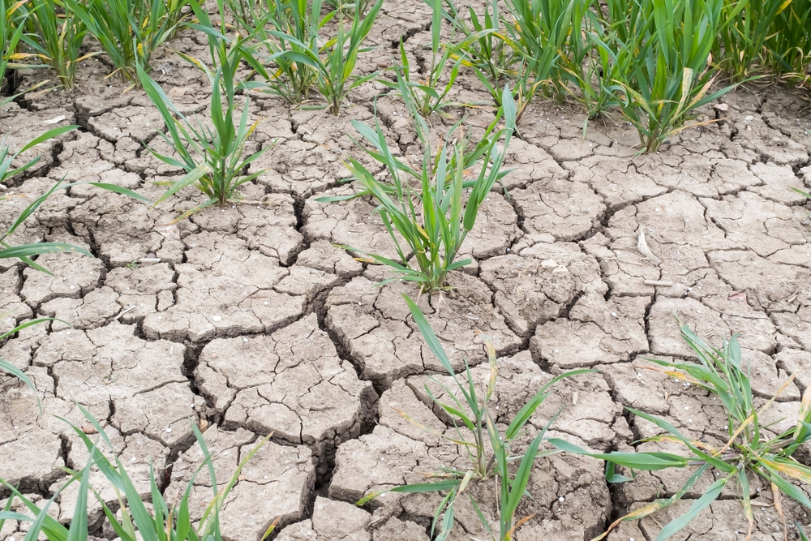
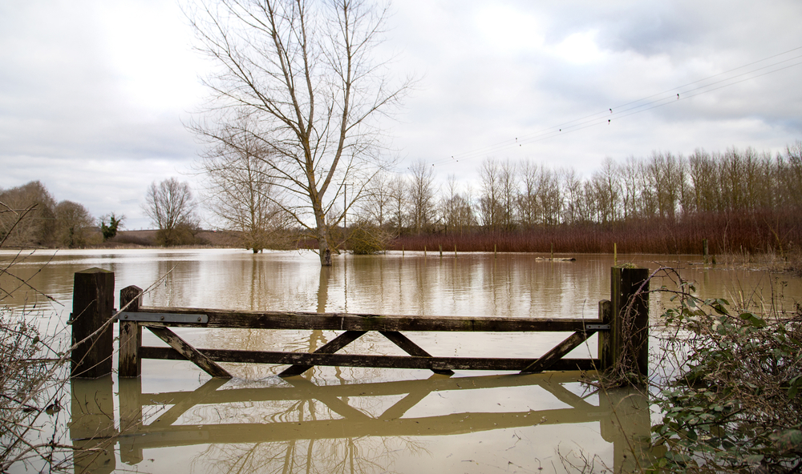
Climate change
As the Earth gets hotter over time, we get more extreme weather such as drought (not enough water) and flooding (too much water).
This makes it harder to grow food.

Slide 21
Land, water and energy
To make sure we have enough food to eat and to look after our plants, we need to…
Use land, water and energy wisely!

Slide 22
Memory quiz!
What 3 things are needed to produce food?
Why does it matter how much water we use?
How does climate change effect the Earth?

Slide 23
Memory quiz!
1. What 3 things are needed to produce food?
Land, water and energy.
2. Why does it matter how much water we use?
If we use too much water to produce food, we may not have enough freshwater to drink, grow our food, wash, cook and other parts of our daily life.
3. How does climate change effect the Earth?
Climate change causes the Earth to get hotter over time, and weget more extreme weather such as drought (not enough water) and flooding (too much water).

Slide 24
Producing food
Key fact: Sustainable food is produced and processed with care for the environment.

Slide 25
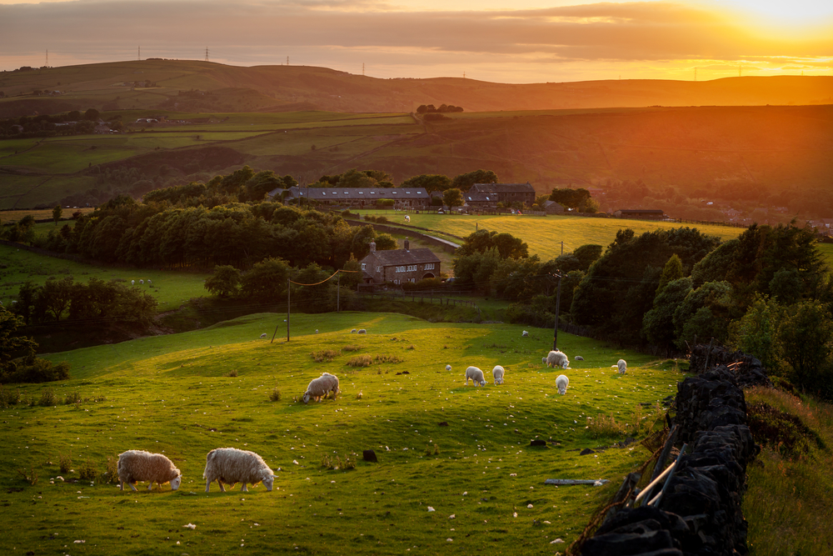
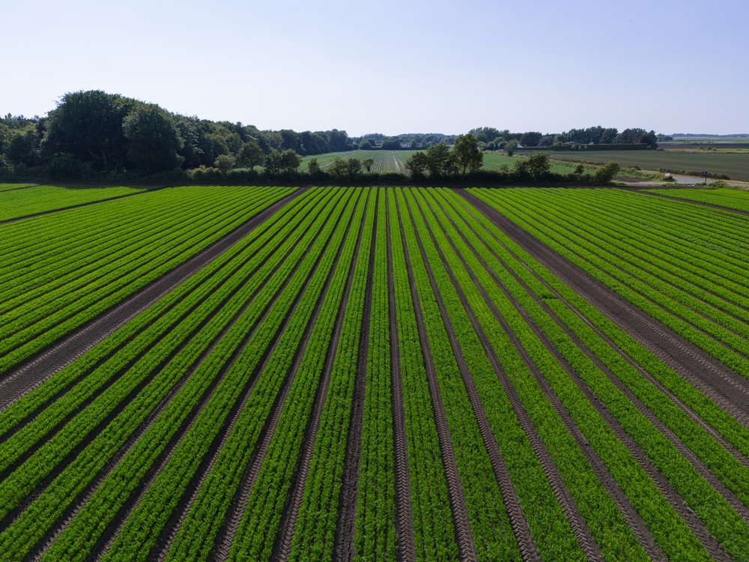
Land
Different land in the UK is good for farming different food.
Hilly, rocky land with grass can be used to rear animals.
Flat and sloped fields with the right type of soil can be used to grow crops.

Slide 26
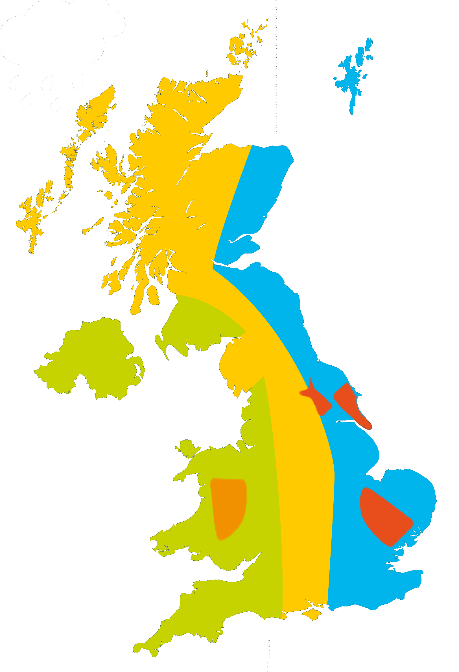
Land
Farmers make the most of the land in the UK by growing crops and rearing animals in different places.
This map shows where different food is farmed in the UK.
What is farmed near where you live?
Sheep
Dairy
Mixed
Arable
Pigs

Slide 27
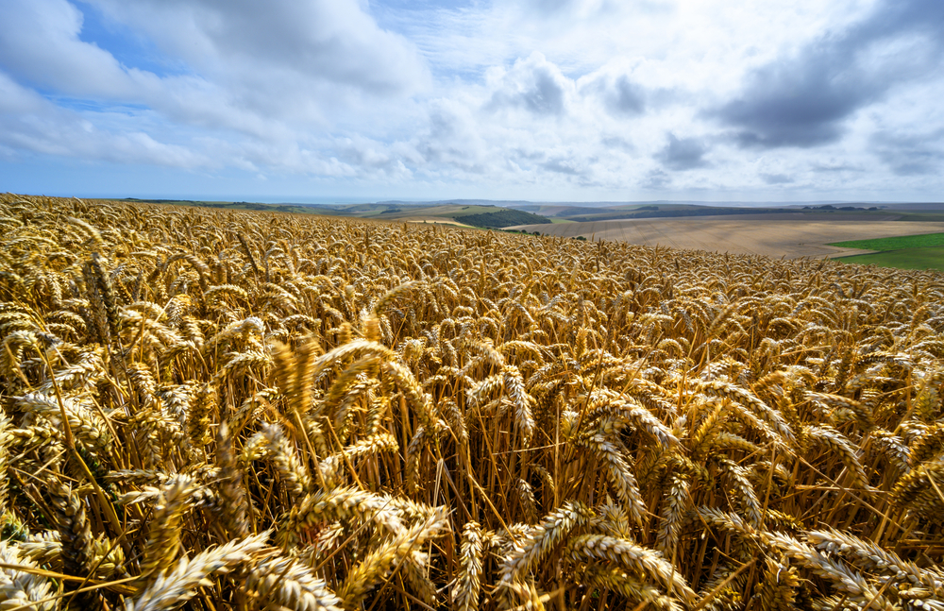
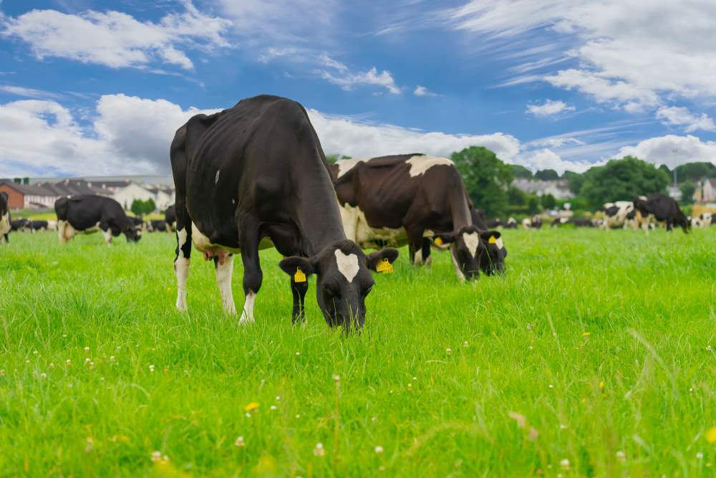
Super soil
Soil is very important.
We need healthy soil to grow healthy crops.
We need healthy crops to feed us and to feed animals.

Slide 28
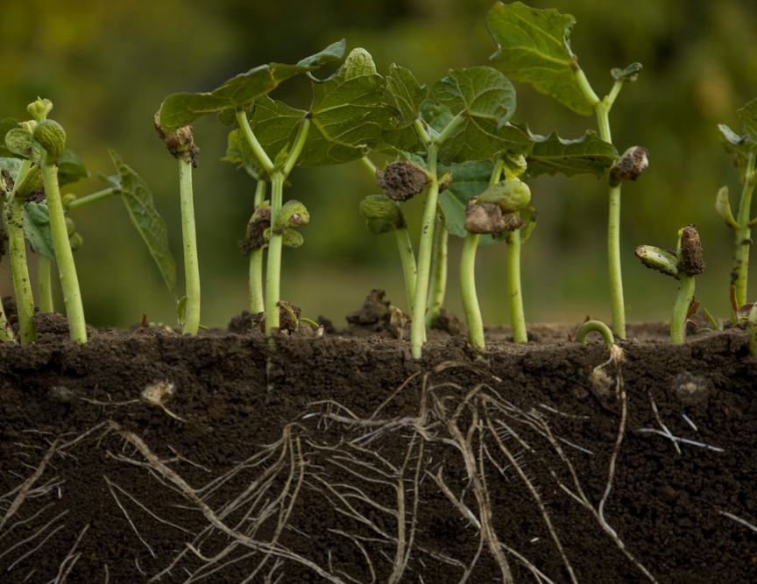
What is healthy soil?
Healthy soil has plenty of air spaces in it.
Earthworms help to make the air spaces as they crawl through the soil.
Plant roots also help to make the air spaces as they push through the soil.
These are green beans growing. Can you see the roots in the soil?

Slide 29
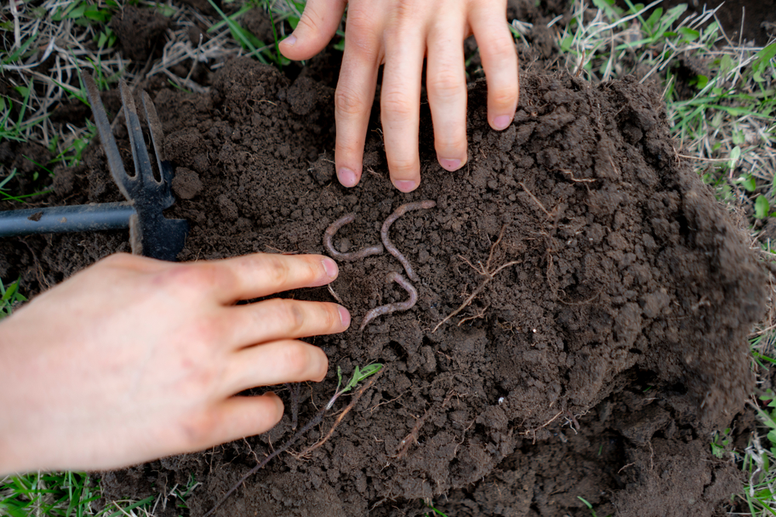
What is healthy soil?
Healthy soil is home to lots of living things such as earthworms and insects.
Soil is also home to dead leaves, roots and other plant parts. These rot into the soil, feeding the living things inside the soil, as well as the plants through their roots.
Lots of tiny living creatures that are too small to see also live in the soil!

Slide 30
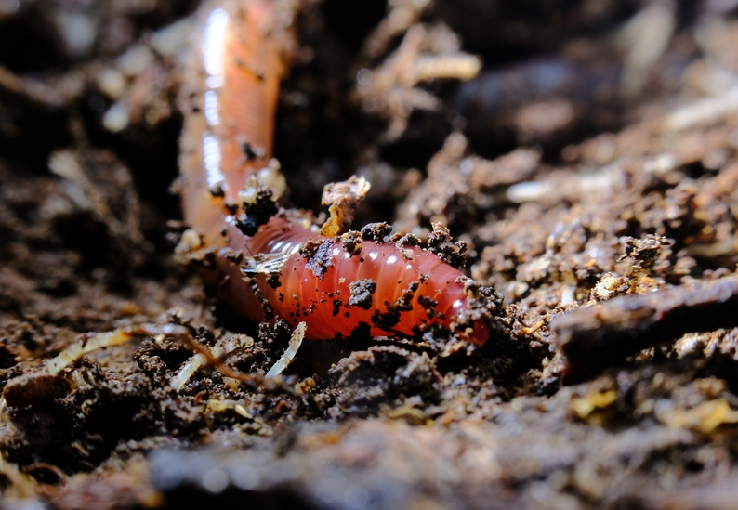
Wonderful worms!
As earthworms move through the ground, they help to pull leaves and other plant parts through the soil.
Earthworms are a bit like chefs! They help mix together all the ingredients that make soil healthy!

Slide 31
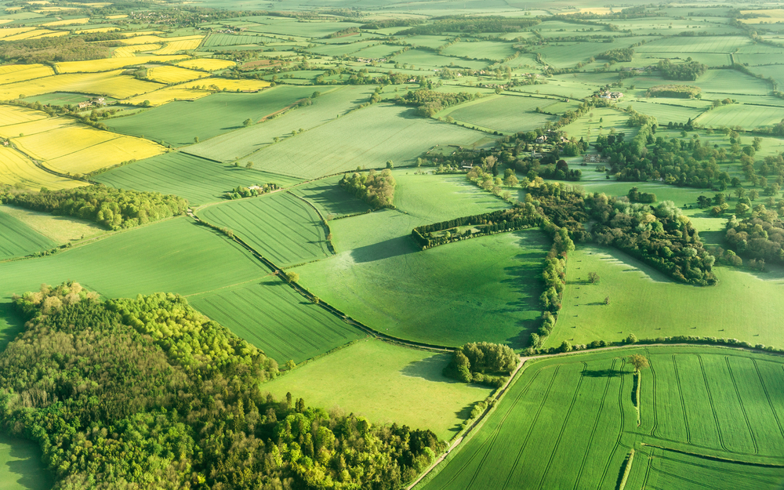
What is healthy soil?
Healthy soil stores water. It does this by soaking up rainwater which then trickles slowly through the soil.
When soil stores water, it helps to stop flooding and plants can use it to help them grow.
Did you know that soil in the UK stores more water than all the UK lakes and rivers put together?
Soil Association (soil stores water) https://www.soilassociation.org/causes-campaigns/save-our-soil/10-soil-facts/

Slide 32
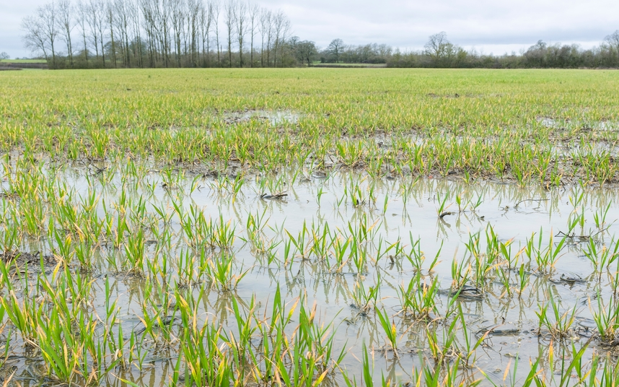
Unhealthy soil
When soil is squashed too tightly together, the air is squeezed out.
This means rainwater can’t soak into the soil properly, and this can cause flooding.
It also means crops can’t grow properly on the land because they need the right balance of air, water and food.
Natural History Museum (soil compaction): https://www.nhm.ac.uk/discover/soil-degradation.html

Slide 33
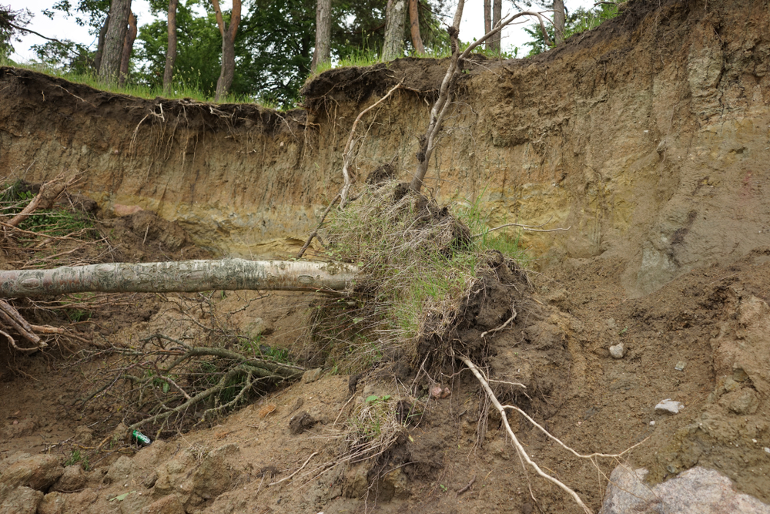
Unhealthy soil
Soil is also unhealthy when it is too dusty, flaky and weak.
Weak soil can be washed away by rainfall or blown away by wind.
This means that precious soil is lost.

Slide 34
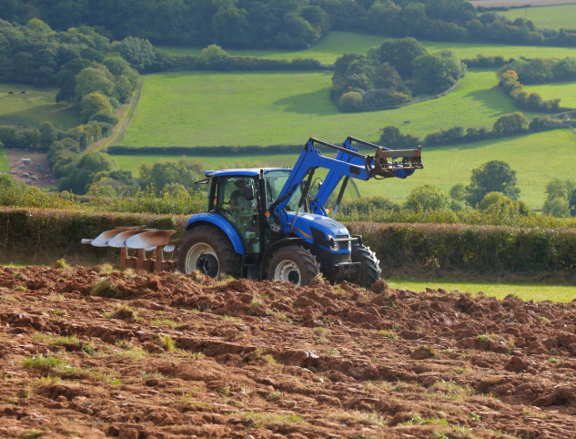
How do farmers keep the soil healthy?
Farmers try not to plough the soil too much.
They don’t want to disturb the soil and all the creatures that are keeping it healthy.
Farmers also don’t want their tractors and ploughs to squash all the air out of the soil by driving on it too much.
Soil needs to have air spaces to be healthy.

Slide 35
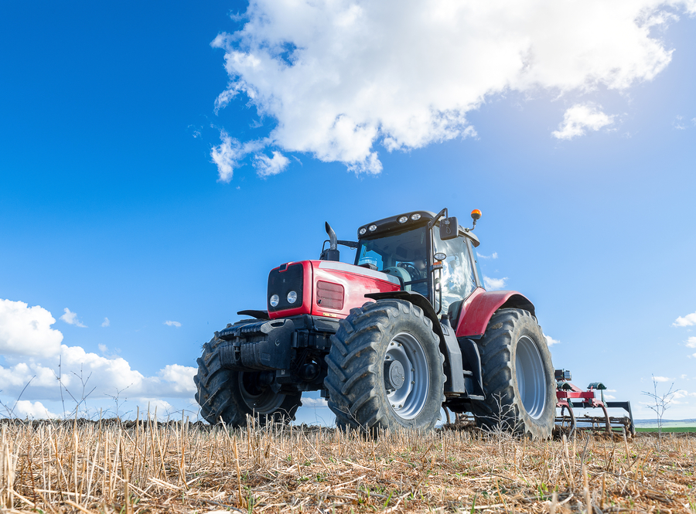
How do farmers care for the soil?
Famers plough some of their old crops back into the field.
The old crops break down into the soil which helps it to stay healthy.
Can you see some of the old crop on the ground here?

Slide 36
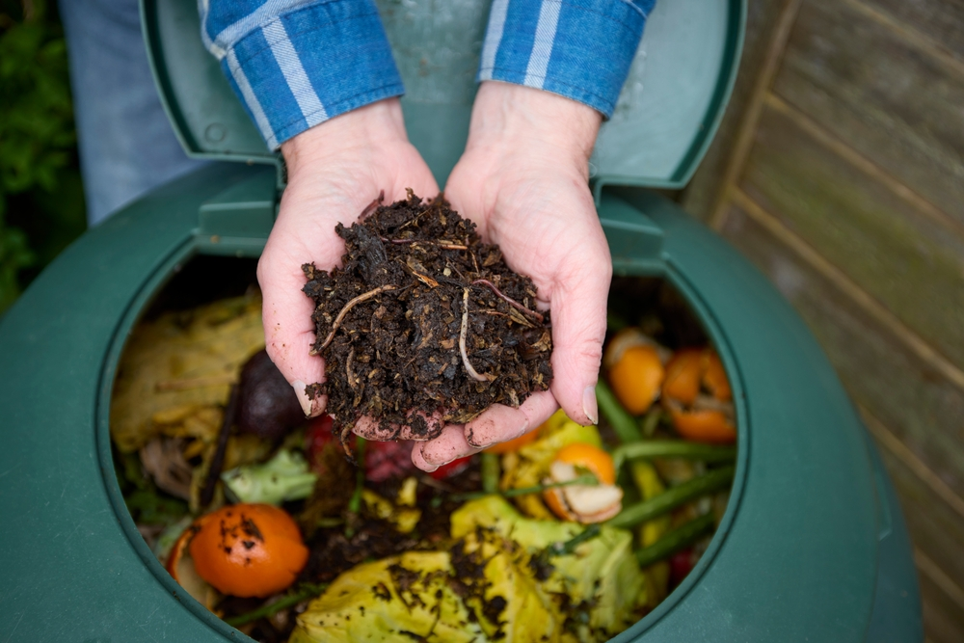
How do farmers care for the soil?
Farmers add natural materials to the soil such as compost.
Compost is made from dead plants.
It helps to feed the living things found in soil and keep the soil healthy.
What can you see in the compost bin?

Slide 37
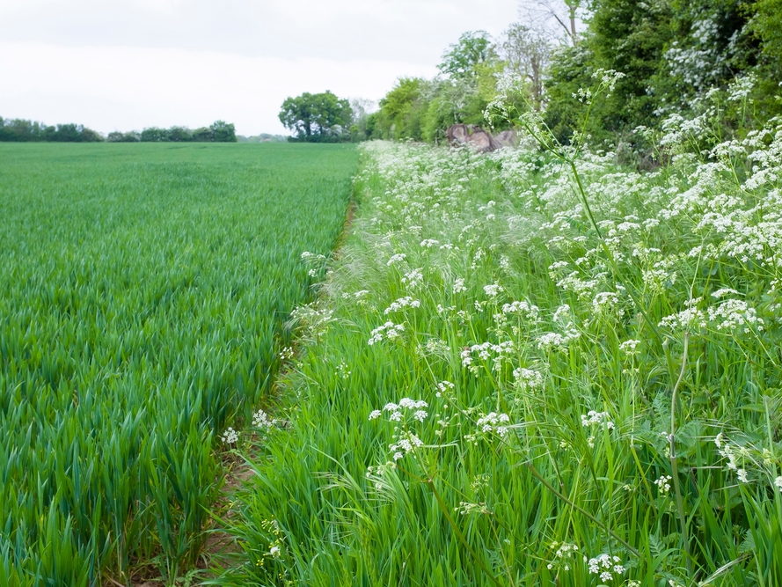
How do farmers care for their environment?
Farmers need to stop pests (certain types of insects) from destroying the crops.
Chemicals are sometimes used on crops to kill the pests, but these chemicals can cause damage to some living things in the soil.
Lots of farmers grow flowers and hedges to attract insects and birds that eat the pests, so less chemicals are needed.

Slide 38
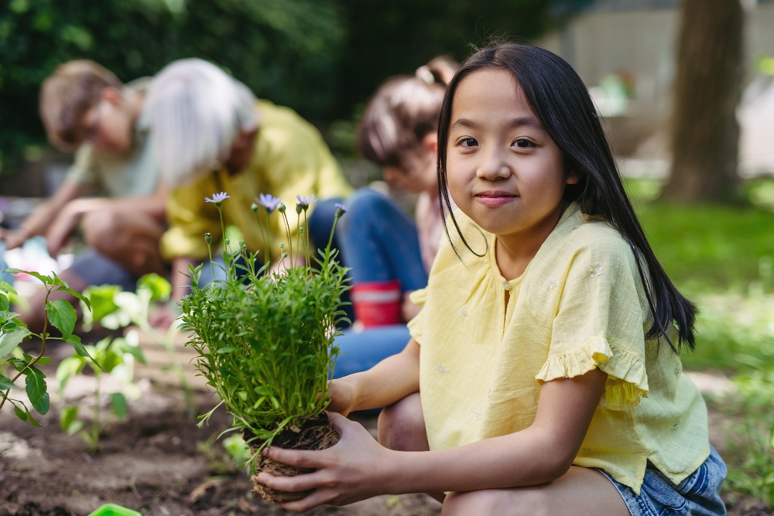
How can we help look after our soil?
We can grow plants and trees!
Plants and trees help cover the soil and stop it being washed away by rain.They also attract insects to the soil.
Have you got some bare soil in your school where you could do some growing?
Soil Association (what we can do): https://www.soilassociation.org/causes-campaigns/save-our-soil/save-our-soil-at-home/

Slide 39
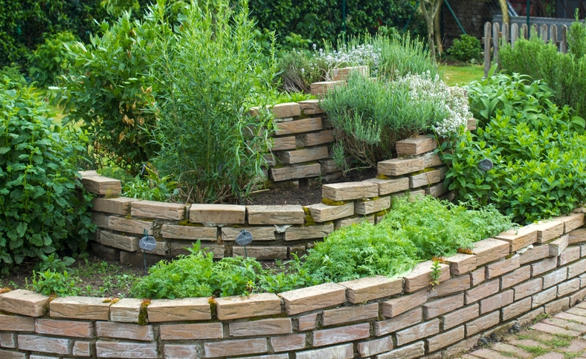
What could you grow?
You could grow your own herb garden!
You could add the herbs to food you make when you are cooking.

Slide 40
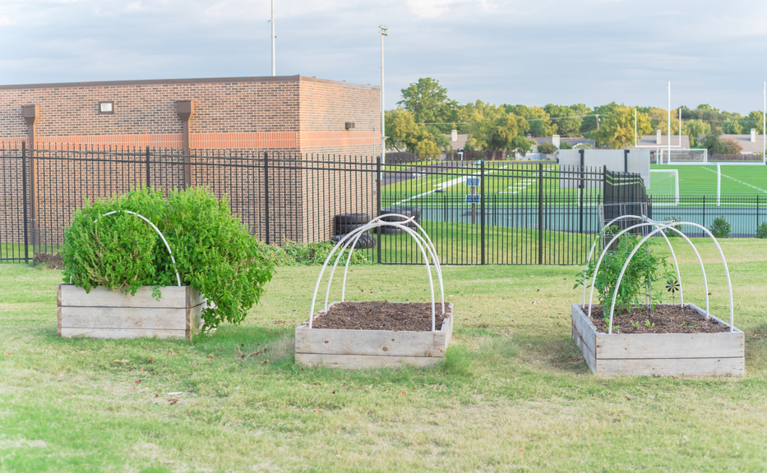
What could you grow?
You could get some raised beds and grow your own food!
How about courgettes, runner beans or potatoes?
Food – a fact of life (Start a growing club): https://www.foodafactoflife.org.uk/whole-school/whole-school-approach/growing-clubs/

Slide 41
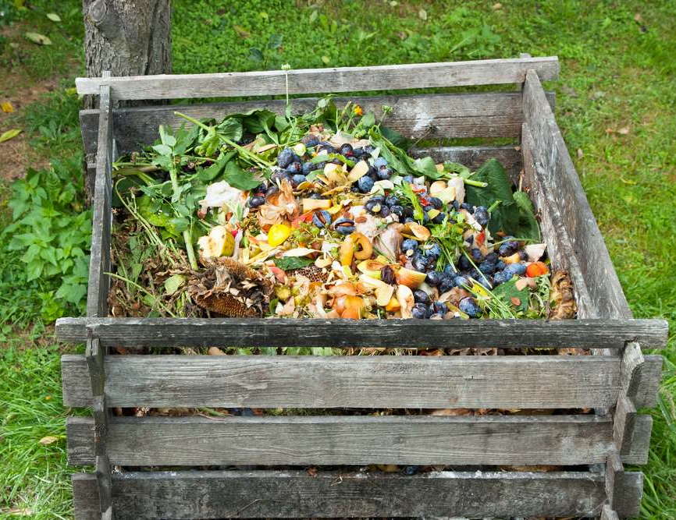
How else can you look after soil?
You could make your own compost to feed the soil.
Weeds, vegetable peelings, dead leaves and cardboard are just some of the ingredients that can be used to make compost!
Making compost is a great way to create ‘soil food’ from waste!
RHS (making compost): https://www.rhs.org.uk/soil-composts-mulches/composting
Recycle now (making compost): https://www.recyclenow.com/how-to-recycle/home-composting

Slide 42
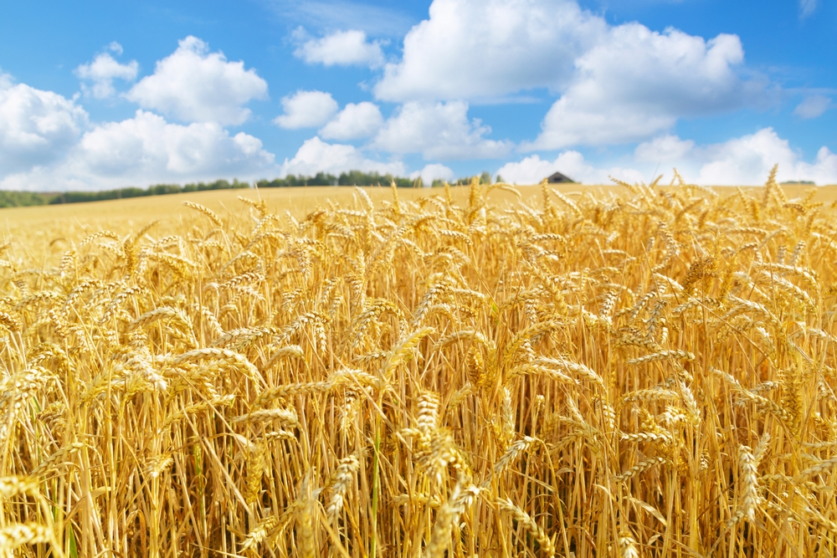
How do farmers look after water and energy?
Farmers grow crops that like the weather and seasons in the UK.
This means the crops can grow well using the land, rainwater and sunshine that is available.
Wheat is a crop that grows well in the UK because it likes plenty of rainwater.
Take a look at wheat and other cereals being farmed: https://youtu.be/LTq_86S5-nU

Slide 43
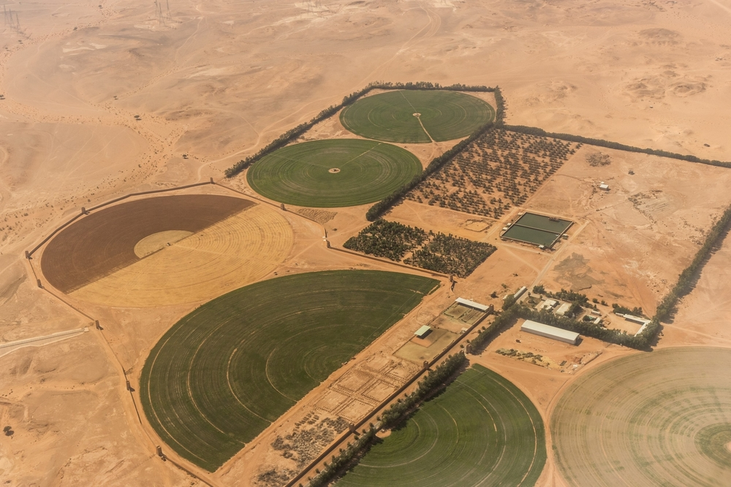
How do farmers look after water?
Wheat would not grow well in a very hot country like Saudi Arabia because there isn’t much rainwater.
Water would have to be pumped onto the crops. This would waste lots of freshwater because it would dry up quickly in the heat.
The pump would use lots of energy.
This is a farm in Saudi Arabia, their crops are grown in a circle as it makes them easier to water.

Slide 44
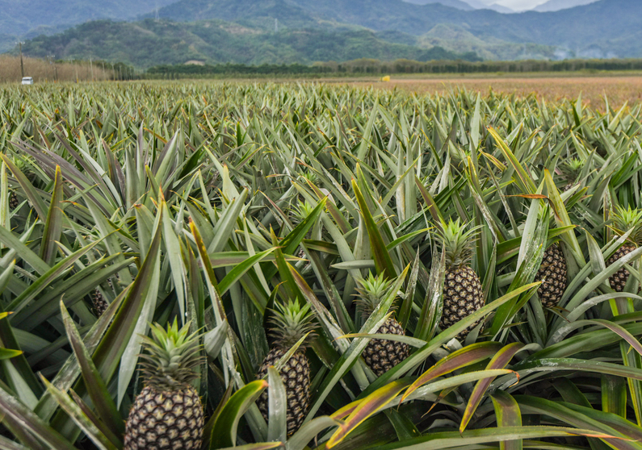
How do farmers look after water?
Some foods need lots of warm weather and sunshine to grow well.
Pineapples like lots of sunshine so they grow well in countries like Costa Rica.
If we tried to grow pineapples in the UK, we would waste a lot of energy trying to heat up a greenhouse for them to grow in!
Take a look at this video of pineapples growing in Costa Rica: https://youtu.be/AVwt1UIRGuM

Slide 45
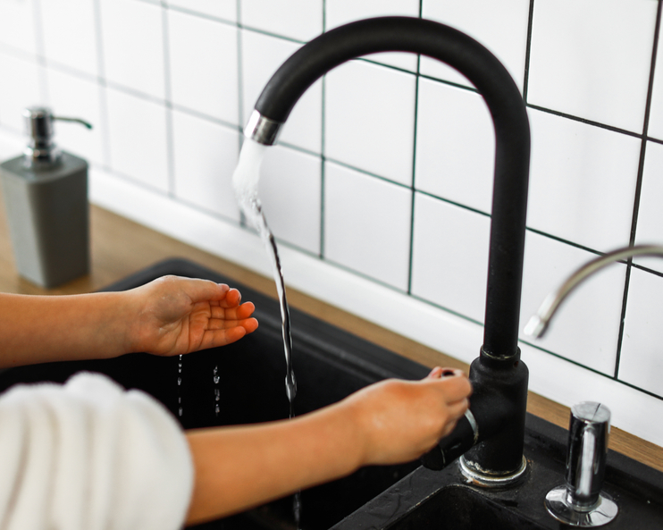
How can we look after water?
We can make sure we don’t waste water.
Turn off taps properly so they don’t drip.
Turn off the tap while you brush your teeth.
Have shorter showers.
Don’t play with sprinklers and hose pipes.

Slide 46
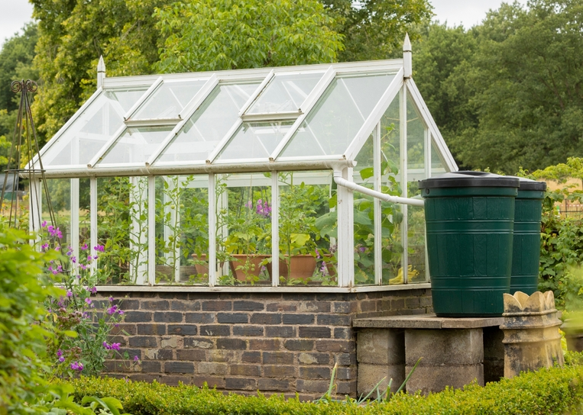
How can we look after water?
We can collect rainwater and save it to water our plants!
Can you see how water is being collected from the gutter of the greenhouse?

Slide 47
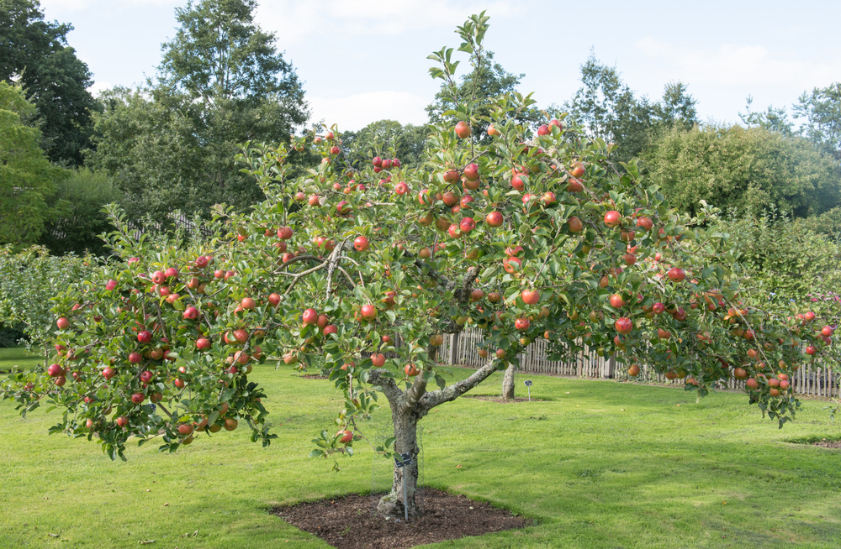
How can we look after energy?
We can try and eat foods when they are ‘in season’ in the UK.
This means eating foods when they are naturally ready to eat.
What’s growing here?

Slide 48
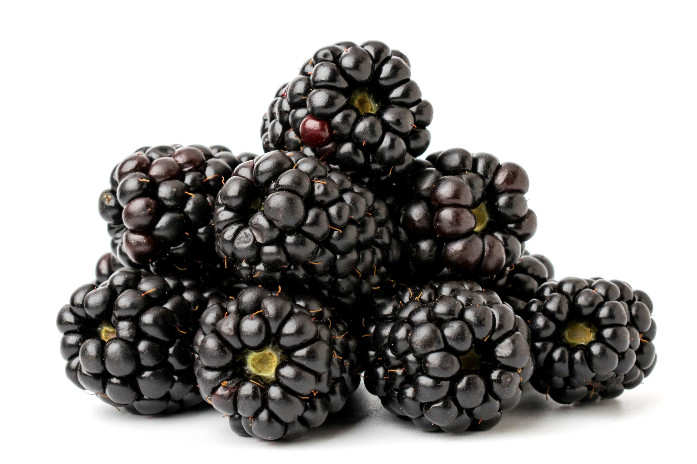
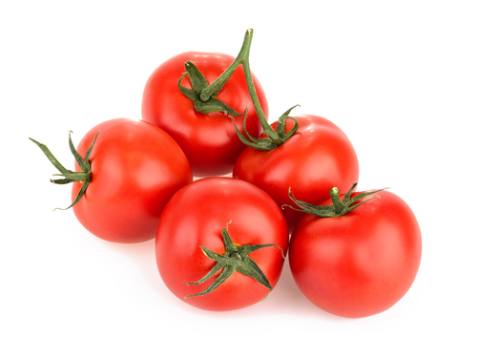
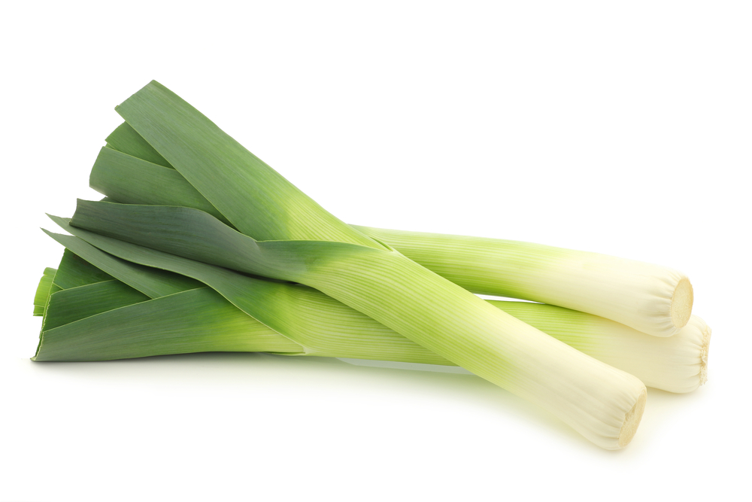
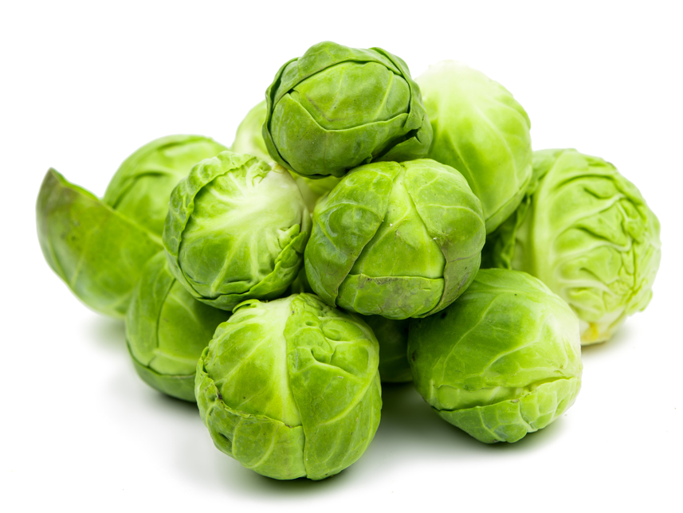
Seasonal food
Match these foods to the season when they are naturally ready to eat in the UK.
Spring | Summer
Autumn | Winter

Slide 49
Seasonal food
Spring Leeks | Summer Tomatoes
Autumn Blackberries | Winter Brussel spouts
Were you right?
Can you think of other foods that are ready in these seasons?

Slide 50
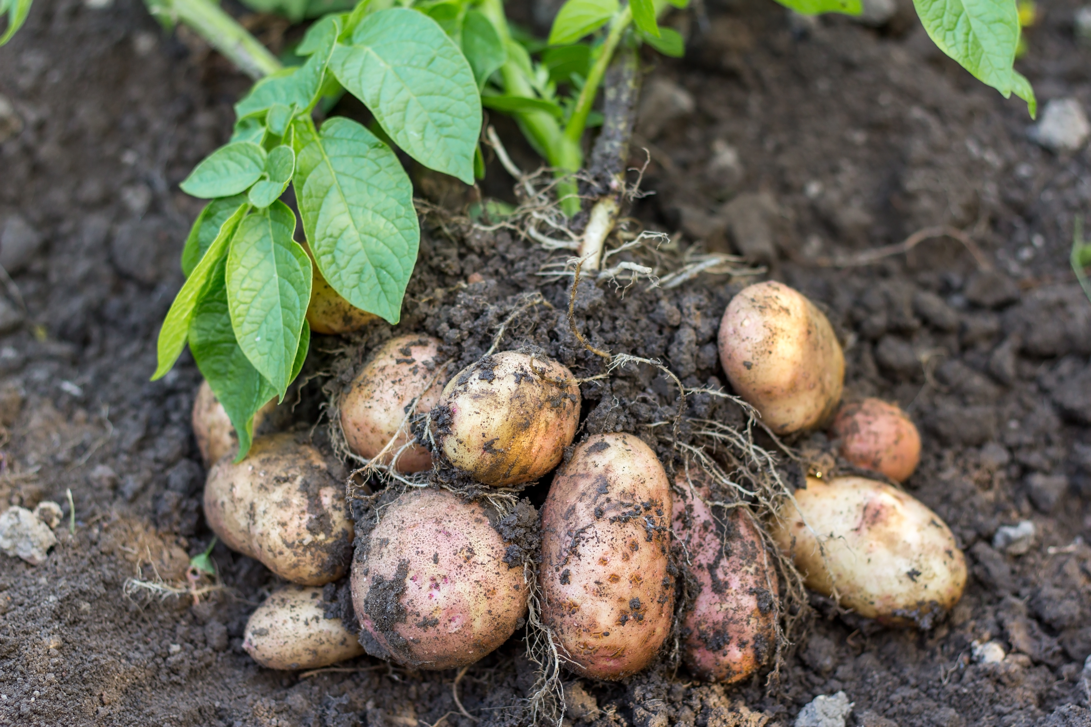
How can we look after energy?
Foods in season have used the land, rainwater and sun from nature to grow.
They haven’t had to have extra water pumped on them or be grown in a heated greenhouse.
Pumping water and heating a green house would have used energy.
Eating food in season in the country where you live can help save energy!

Slide 51
Memory quiz!
What lives in healthy soil?
What happens when the soil is unhealthy?
How do farmers take care of soil?
Name 3 ways we can save water every day.

Slide 52
Memory quiz!
What lives in healthy soil?
Healthy soil is home to lots of living things such as earthworms and insects. Soil is also home to dead leaves, roots and other plant parts.
2. What happens when the soil is unhealthy?
Crops can’t grow properly on the land because they need the right balance of air, water and food.
3. How do farmers take care of soil?
Famers plough some of their old crops back into the field. Farmers add natural materials to the soil such as compost.
4. Name 3 ways we can save water every day.
Turn off taps properly so they don’t drip. Turn off the tap while you brush your teeth. Have shorter showers.

Slide 53
Food waste
Key fact: A lot of food that could have been eaten is wasted for different reasons.

Slide 54

Food waste
When we waste food, we waste everything used to make the food.
That means the water, land and energy that has been used to make the food is wasted.

Slide 55

Food waste
If we throw food waste into our normal kitchen bin, it is taken away and buried in the ground (landfill).
The food rots and creates gases that are harmful to our planet.
If we reduce our food waste, we can help reduce the harmful gases created.

Slide 56

Real food waste
Some food is waste.
Egg shells, vegetable and fruit peelings and tea bags are real food waste, because they can’t usually be eaten.
This type of waste, and other food we don’t eat, can be put in a food waste bin.

Slide 57

Recycling food waste
If we put our food waste into a food waste bin, and recycle it properly, it can be turned into things like compost and energy!
This means it doesn’t just rot away with our other rubbish and cause gas that harms our planet.
Recycle now (video showing how food waste is recycled): https://youtu.be/WdZViehrUks

Slide 58

Food waste
Lots of food all around the world is wasted.
Here are some of the reasons why.
It gets damaged by the weather or disease on the farm.
It gets damaged traveling to our shops and supermarkets.
It is not eaten by people in cafés, schools and at home.
Source: Food Waste – 2024 Facts & Statistics

Slide 59

Food waste
Most food waste in the UK comes from our homes.
Experts think that families spend around £470 on food every year that ends up getting thrown away!
Source: Food Waste – 2024 Facts & Statistics

Slide 60

Food waste
We have all thrown food away at some time.
What food have you thrown away?
Why did you throw it away?

Slide 61

Food waste
Look at the reasons why these children have thrown food away.
I sometimes don’t like the food I’m eating, so I leave it.
When food looks like it’s going a bit bad, I throw it away.
Sometimes I put too much food on my plate and I can’t eat it all.
What could they have done instead?

Slide 62

How can we waste less food?
Take a smaller portion.
Share a portion that is too large.
Ask to try a little bit of a food if you’re not sure you will like it.
Save it for later.
Remember, saved food may need to be wrapped up or put in the fridge so it stays good to eat!

Slide 63
Memory quiz!
What is food waste?
List 2 ways food is wasted.
How can we reduce food waste?

Slide 64
Memory quiz!
1. What is food waste?
When we waste food, we waste everything used to make the food.
2. List 2 ways food is wasted.
Food can get damaged by weather or diseased at the farm. It gets damaged on the way to our supermarkets. It is not eaten by people at home, in school, at cafes.
3. How can we reduce food waste?
Take a smaller portion. Share a portion that is too large. Ask to try a little bit of a food if you’re not sure you will like it. Save it for later.

Slide 65
Our health
Key fact: Sustainable and healthy food is good for our bodies.

Slide 66
Keeping healthy
We need to keep ourselves healthy as well as looking after the planet.

Slide 67

Keeping healthy
To keep our body healthy, we need to:
eat different types of foods
drink plenty of water or milk
be active

Slide 68


What do we need to eat?
The Eatwell Guide shows us the types of foods we need to stay healthy.
What foods can you see here?

Slide 69
Food groups
Why do you think the food groups are different sizes?

Slide 70

The Eatwell Guide
Plenty
Plenty
Some
Some
It’s to show us how much of each type of food we need. Take a look!
A little

Slide 71
We need…
Foods like
Potatoes, bread, rice, pasta
with every meal
At least 5 portions of
Fruit and vegetables
everyday
Some foods like
Beans, pulses, fish, eggs, meat
everyday
Just a little of foods like these
Some foods like
Dairy and alternatives everyday

Slide 72
Eat well for you and the planet
Eating the way the Eatwell Guide shows us, helps us to stay healthy and helps the planet too!
But how?

Slide 73
Eat well for you and the planet
Different foods and drinks use different amounts of water, land and energy.
This is because they are farmed, packaged and transported to us in different ways.
By eating a good variety of foods, we can help balance the water, land and energy that is used.

Slide 74




Eat well for you and the planet
We need different types and amounts of foods to stay healthy.
If you eat a variety of different foods, like the Eatwell Guide shows us, you can get everything your body needs!

Slide 75

Why do we need to drink?
We need to drink for lots of reasons. It helps:
keep our body the right temperature
our brain to work properly
us to be active
We lose water when we go to the toilet, sweat and breathe.
We need to drink plenty to replace this lost water, so we stay hydrated.
6-8
a day

Slide 76


What should I drink?
All drinks give us water and can help us to stay hydrated.
We need to try and choose healthier drinks like water and milk.
Water is a great choice because it doesn’t contain any sugar. Make water your main drink!

Slide 77


We need to be active to stay healthy too!
How do you keep active?

Slide 78









Other food and drinks
Land, water and energy are used to make these types of foods and drink too.
The body doesn’t need these types of foods and drinks to stay healthy.
What do you think we should do about these foods?

Slide 79
Other food and drinks
Eating less, small amounts (or none at all) of these foods and drinks will mean we can save the land, water and energy that would have been needed to make them.
It will also help us to be healthier!

Slide 80
Memory quiz!
What does the Eatwell Guide show us?
Why do we need to drink?
What sort of foods and drinks should we eat in smaller amounts?

Slide 81
Memory quiz!
1. What does the Eatwell Guide show us?
The Eatwell Guide shows us the types of foods we need to stay healthy.
2. Why do we need to drink?
It helps keep our body the right temperature, keep our brain to work properly, and keep us to be active
3. What sort of foods and drinks should we eat in smaller amounts?
Crisps, chocolates, biscuits, sweets, fizzy drinks.

Slide 82
For further information, go to:
www.foodafactoflife.org.uk
This resource meets the Guidelines for producers and users of school education resources about food.

