Slide 1
Medical conditions and food choice

Slide 2
Diabetes
Type 1 diabetes
The body does not produce insulin, as pancreatic cells which normally produce insulin are missing or damaged, so blood glucose levels remain high.
Treated by daily injections of insulin.
Type 2 diabetes
The body produces insulin in the pancreas, but it is insufficient to control blood glucose effectively. This is often because the body tissues are resistant to the action of insulin.
Type 2 diabetes can be controlled or improved by diet.

Slide 3
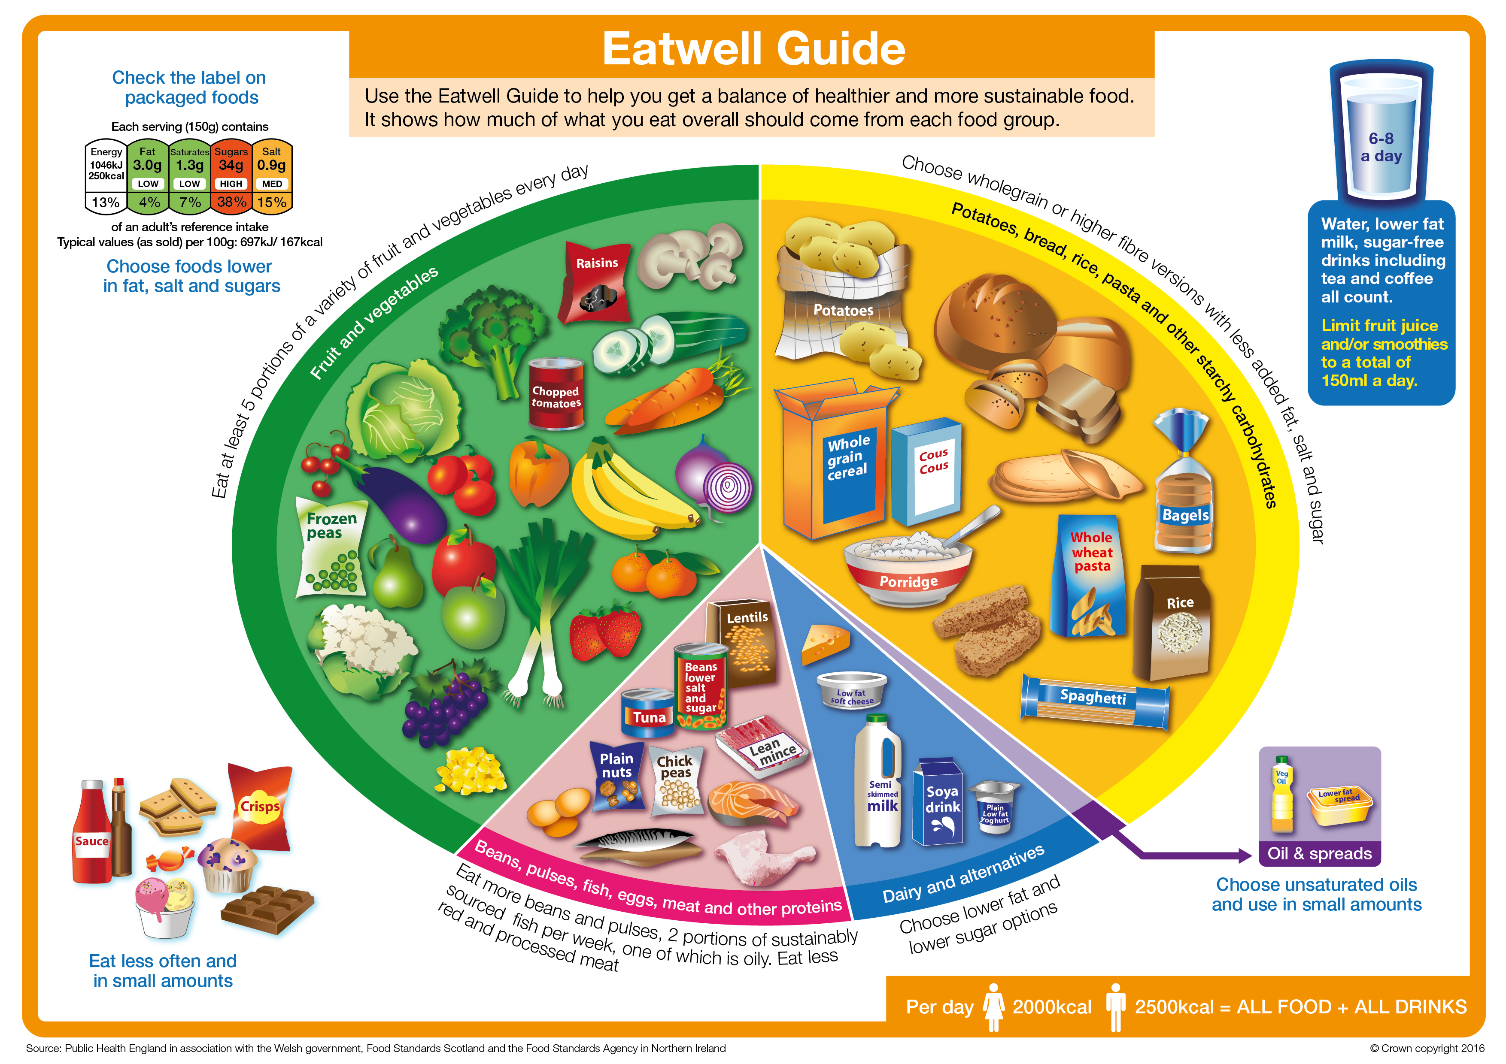
Type 2 diabetes
Most people with newly diagnosed type 2 diabetes are overweight or obese.
Prevention includes following a healthy varied diet, taking more physical activity, maintaining a healthy weight (BMI 18.5-25 kg/m squared) and avoiding weight gain (>5kg) in adult life.
Diet modification and physical activity help patients to control blood glucose levels and also to help overweight patients to lose weight.
People with type 2 diabetes should still follow the basic principles of the Eatwell Guide.

Slide 4
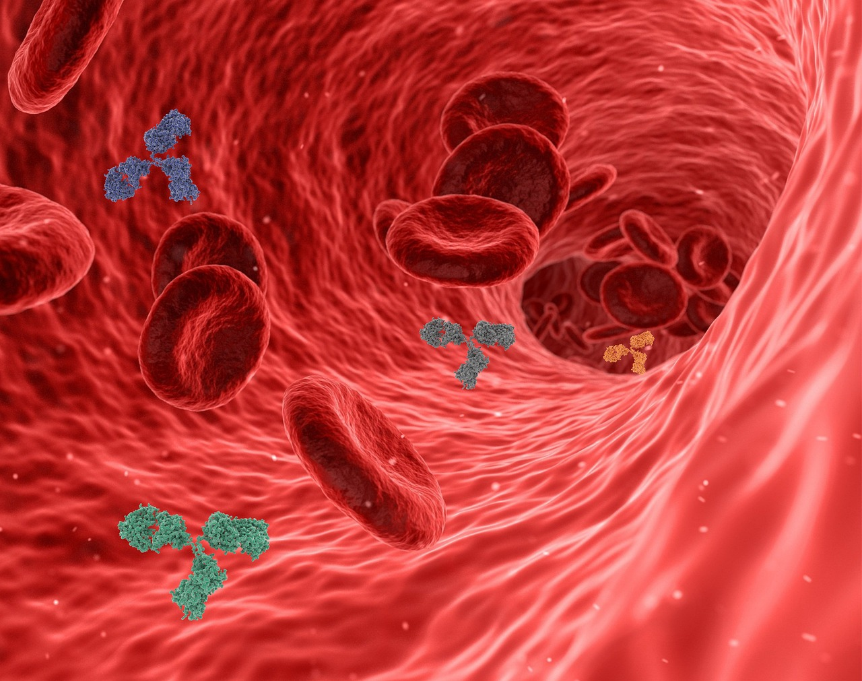
Why iron is important?
Iron helps to make red blood cells, which carry oxygen around the body. It also helps the immune system to work and helps the brain to function normally.
A lack of dietary iron depletes iron stores in the body and this can eventually lead to iron deficiency anaemia.

Slide 5
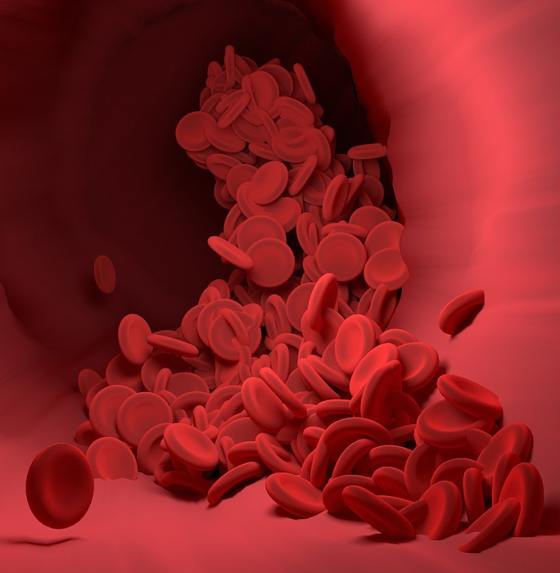
Iron deficiency anaemia
More than 2 billion people worldwide suffer from iron deficiency anaemia, making it the most common nutritional deficiency condition.
Teenage girls and women of childbearing age need more iron than males of the same age making them at increased risk of deficiency.
Symptoms can include: tiredness and lack of energy; shortness of breath; noticeable heartbeats (heart palpitations) or pale skin.
Iron deficiency anaemia is usually tested by a full blood count (FBC) test.

Slide 6
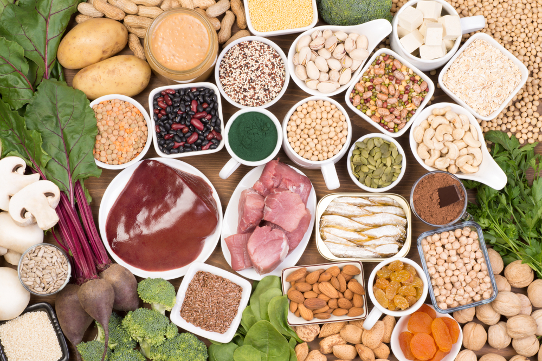
Sources of iron
Dietary iron is found in two basic forms; haem iron (from animal sources) or non-haem iron (from plant sources). Haem iron is the most bioavailable form of iron.
Although meat is the most bioavailable source of iron, other good sources of iron include:
pulses, such as beans, lentils and peas;
nuts;
dried fruit, such as raisins;
dark-green vegetables, such as watercress, broccoli and spring greens;
wholegrains, such as brown rice and brown bread;
cereals fortified with iron.

Slide 7
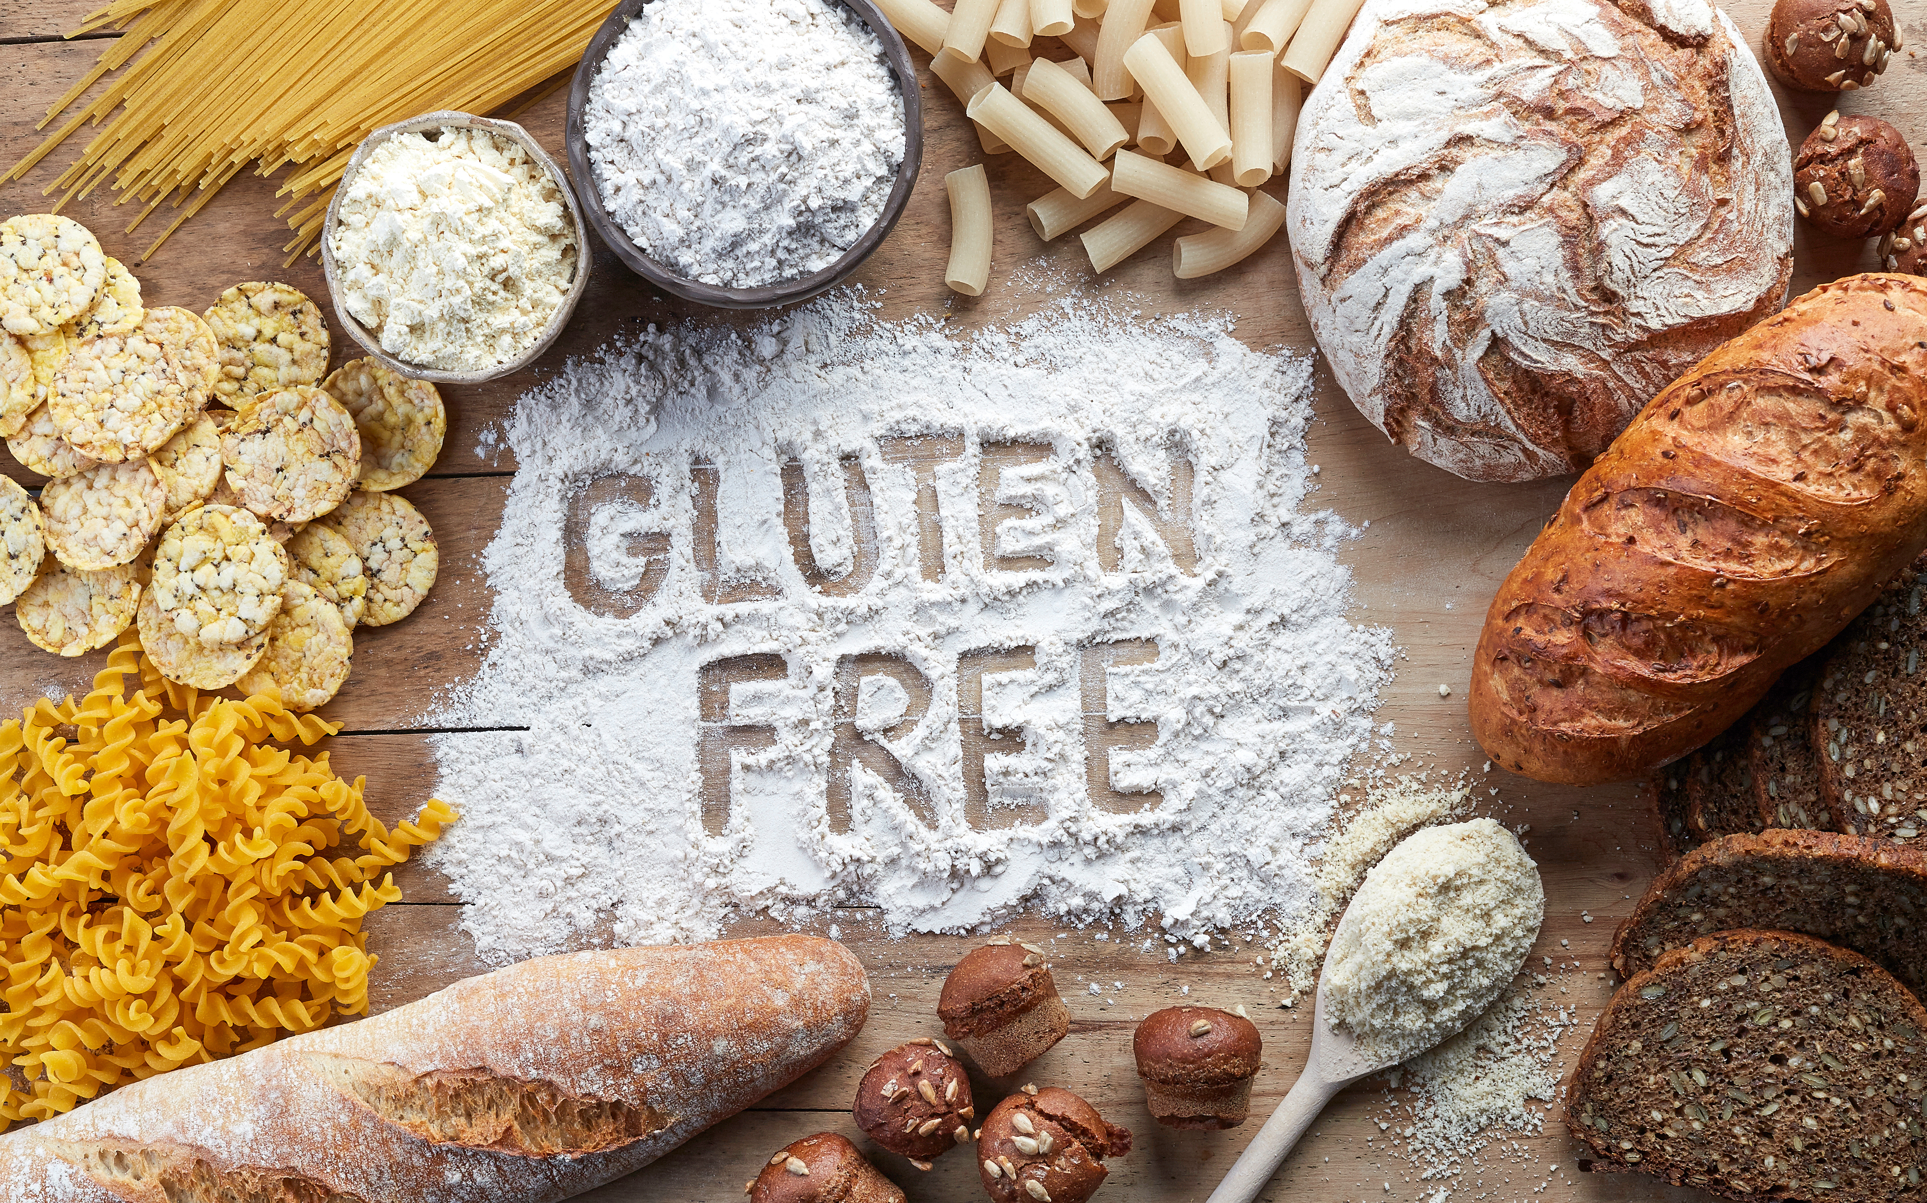
Coeliac Disease
Coeliac disease is an autoimmune disease caused by an allergic reaction to gluten.
1% of the population have coeliac disease.
There is no evidence that the true prevalence of wheat intolerance is on the increase.
There is no reason to cut out gluten in the absence of a gluten related disorder.
Gluten should not be cut out if it results in poorer nutrition (such as reduced intake of wholegrains) or delays the diagnosis of a serious illness.
Coeliac disease is more difficult to clinically diagnose if a person has eliminated gluten from their diet.

Slide 8
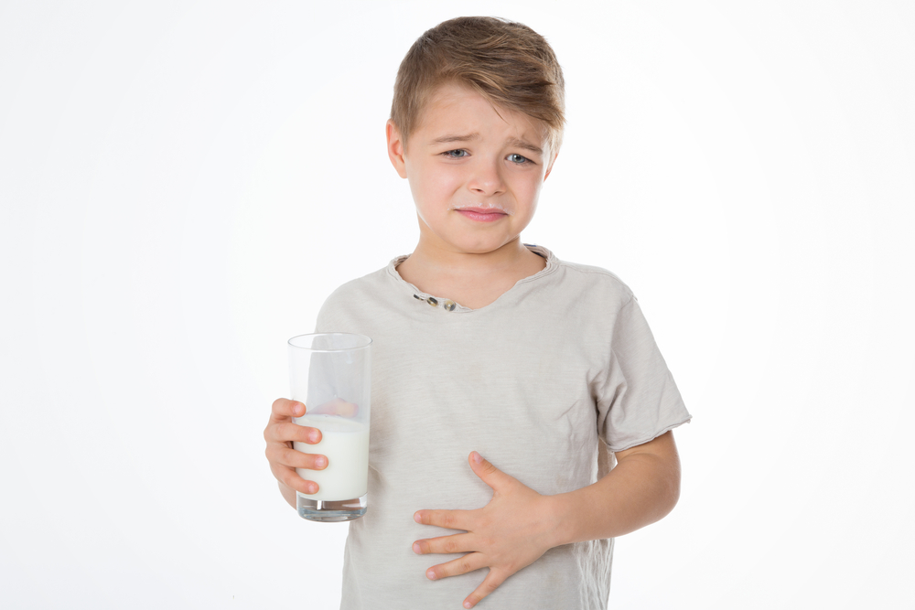
Lactose intolerance
Lactose intolerance is a common digestive problem where the body is unable to digest lactose.
This isn't the same as a milk or dairy allergy.
Symptoms include flatulence (wind), diarrhoea, bloated stomach, stomach cramps and pains and feeling sick.
Advice to control the symptoms is to limit lactose containing foods and drinks including milk and some dairy products.
People with lactose intolerance can often still consume small amounts of lactose without experiencing any problems.

Slide 9

Hypercholesterolemia
Hypercholesterolemia is the presence of high levels of cholesterol in the blood. It can be caused by an unhealthy diet, lack of exercise or physical activity, drinking excessive amounts of alcohol and smoking.
It increases the risk of; narrowing of the arteries (atherosclerosis), heart attack, stroke and peripheral arterial disease (PAD).
Blood cholesterol levels are measured with a simple blood test.
To lower cholesterol it is important to follow the basic principles of the Eatwell Guide and keep your diet low in fatty food.

Slide 10
Medical conditions and food choice
For further information, go to:
www.foodafactoflife.org.uk
This resource meets the Guidelines for producers and users of school education resources about food.

