Slide 1
Apple and sultana crumble
Complexity: low - medium

Slide 2
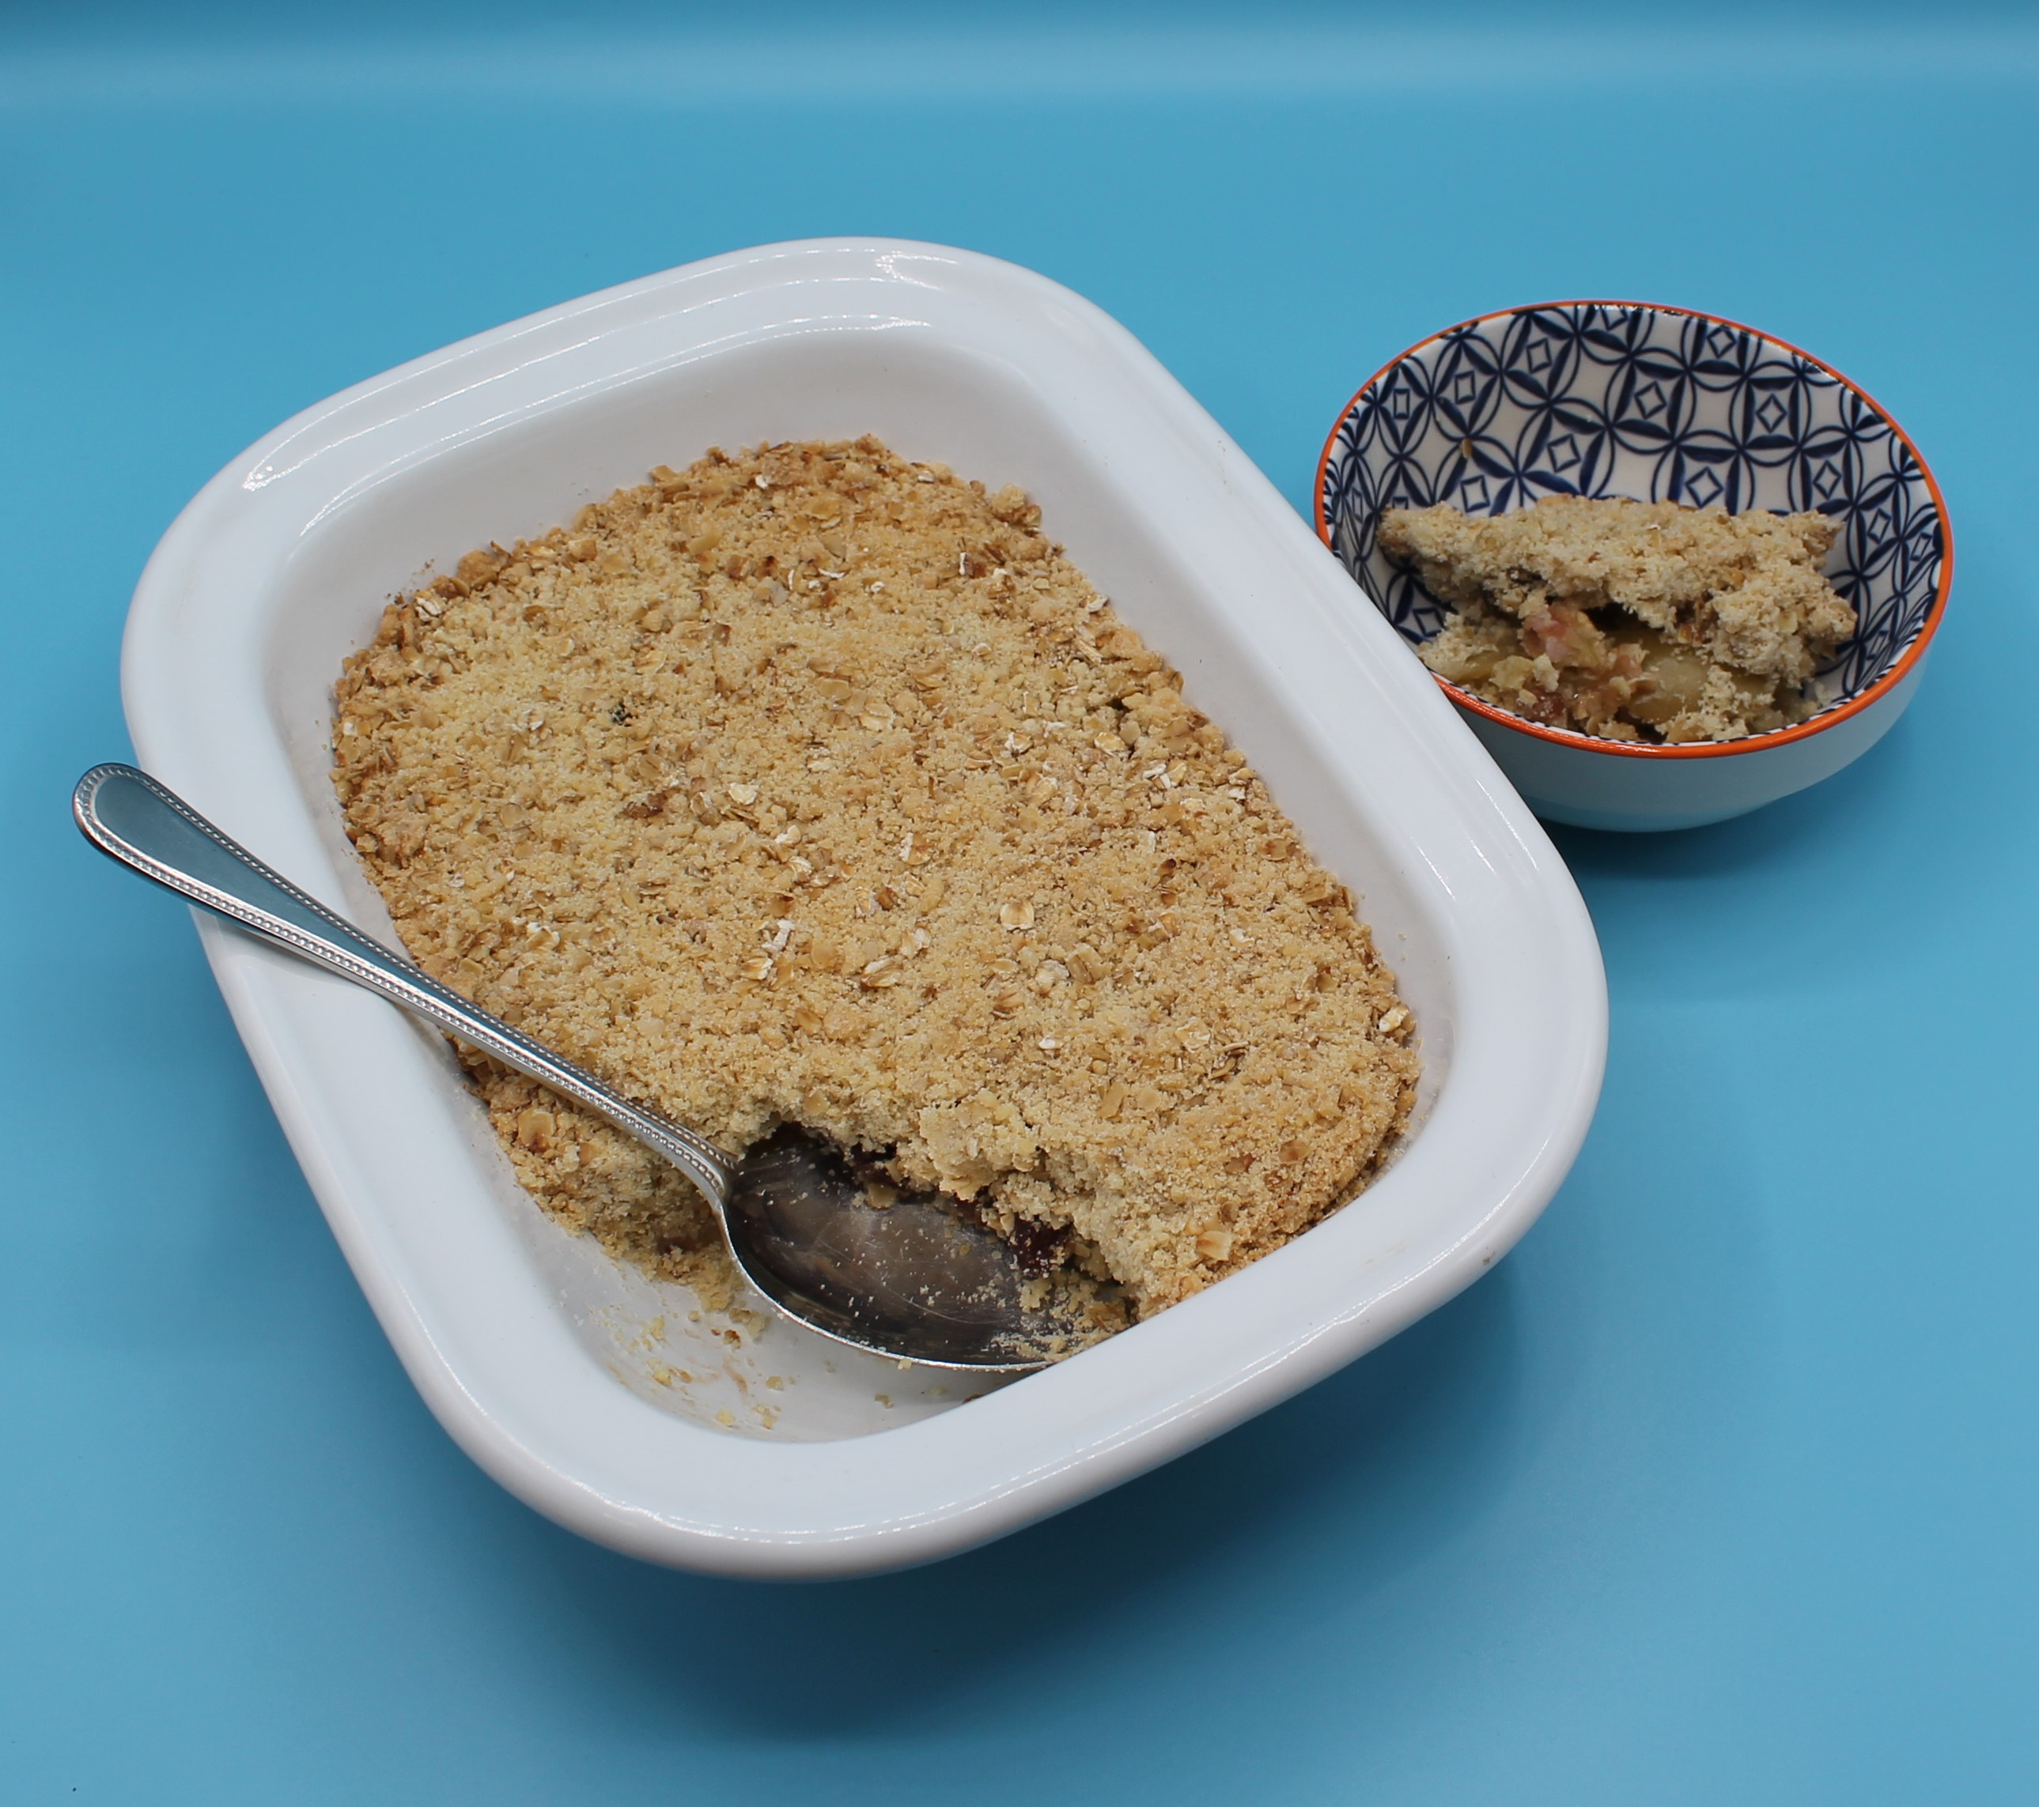
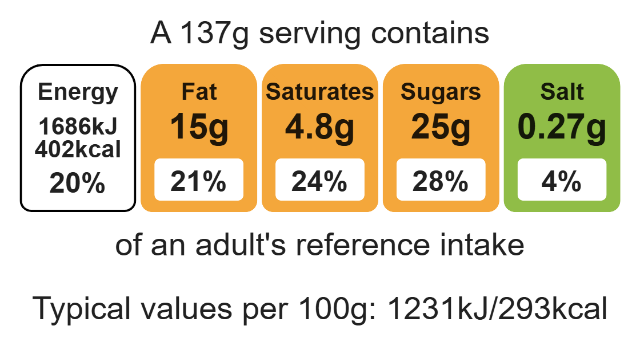
Nutritional analysis
Serves 3

Slide 3
Starter activity
What happens to apples when they are cut or damaged?
What causes this to happen?
How can we prevent it?

Slide 4
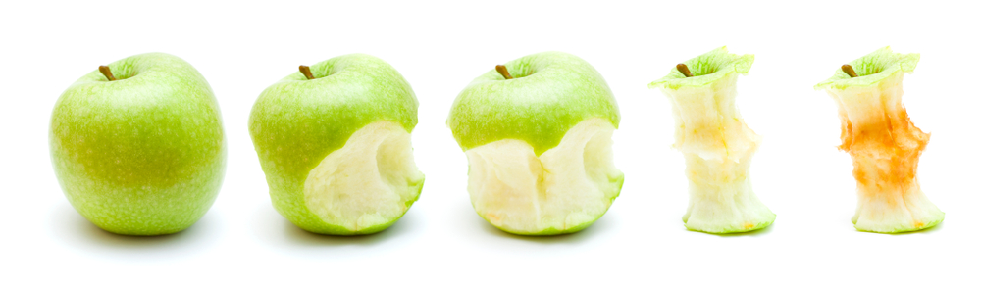
Example responses
1. What happens to apples when they are cut or damaged?
They turn brown.
2. Why?
The cells are damaged and react with the air, causing enzymic browning.
3. Top Tips.
Use a sharp knife to cut the apple, causing less damage to cells.
Prepare just before use.
Place in lemon water until required.

Slide 5
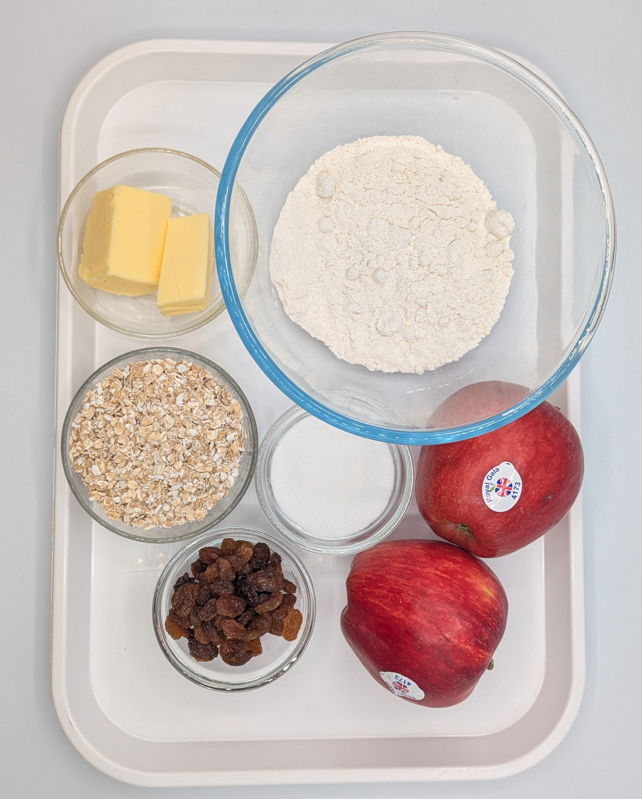
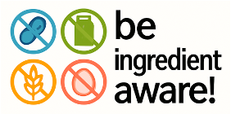
Ingredients (serves 3)
50g baking fat/block
50g plain white flour
50g plain wholemeal flour
50g oats
25g sugar
2 cooking apples
50g sultanas
Check for any food allergy, intolerance, special dietary requirement or religious/cultural reasons for not handling or eating the ingredients in this recipe.

Slide 6
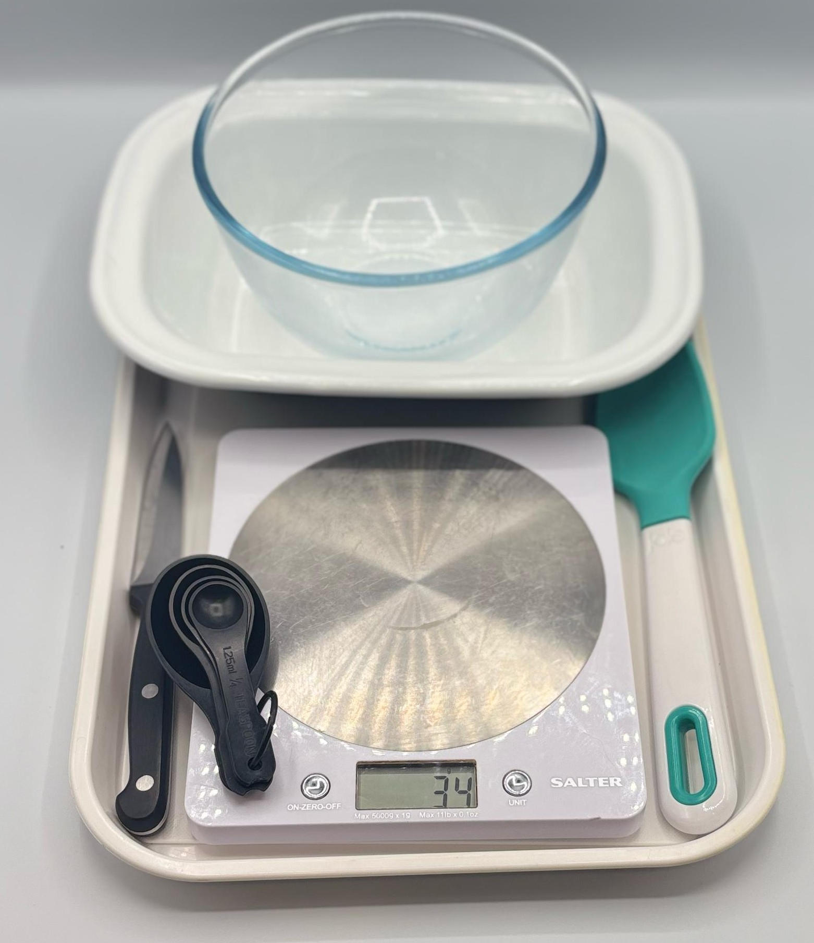
Equipment
Weighing scales
Measuring spoons
Mixing bowl
Mixing spoon
Chopping board
Sharp knife
Ovenproof dish (21cm) or foil tray
Baking tray

Slide 7
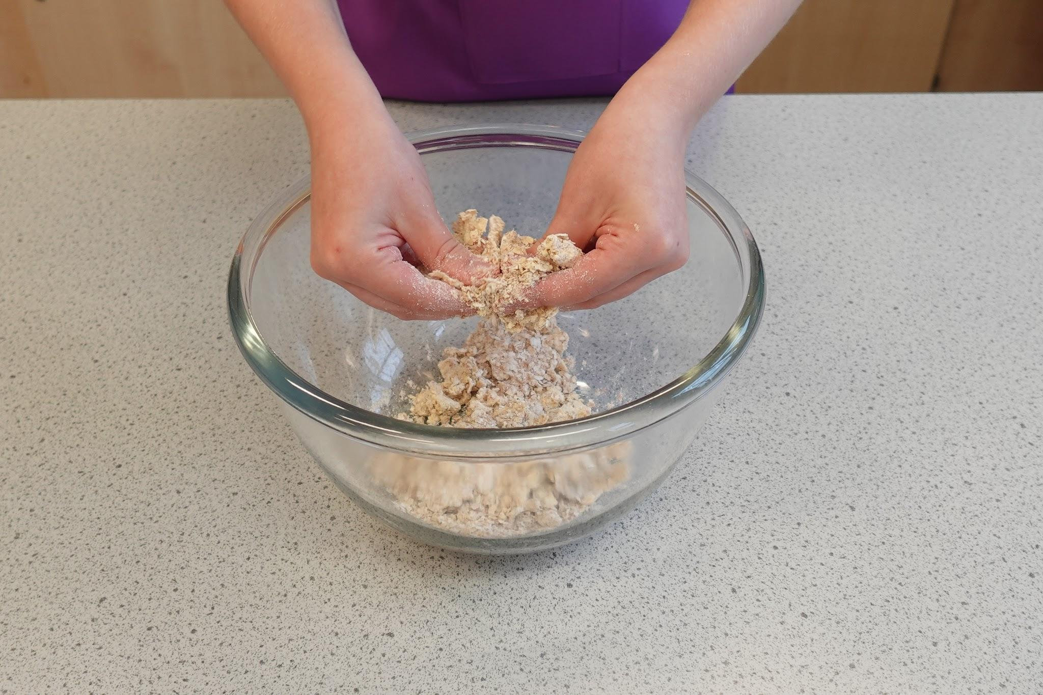
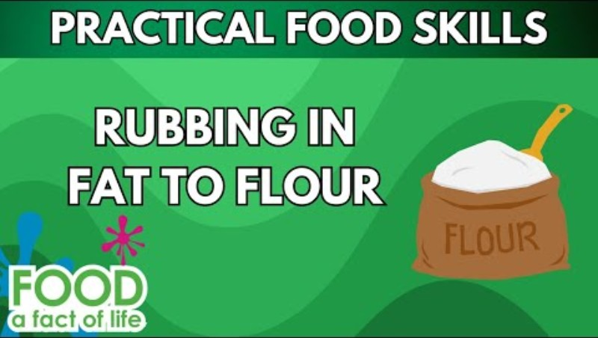
Food skills
Weigh
Rub- in
Core
Cut
Slice
Stir and combine
Layer
Bake
Click below to see the rubbing in method:

Slide 8
Method
Preheat oven to 190°C or gas mark 5.
Rub the fat into the flour using your fingertips, until it resembles breadcrumbs.
Stir in the oats and sugar.
Cut the apples into quarters and remove the core on a clean chopping board. Slice thinly.
Arrange the apple slices in an oven-proof/foil tray dish and then add the sultanas.
Sprinkle the crumble topping over the apple slices.
Place the crumble on a flat baking tray to avoid any spillages in the oven.
Bake for 25 – 30 minutes, until the apples are soft, and the crumble is golden.

Slide 9
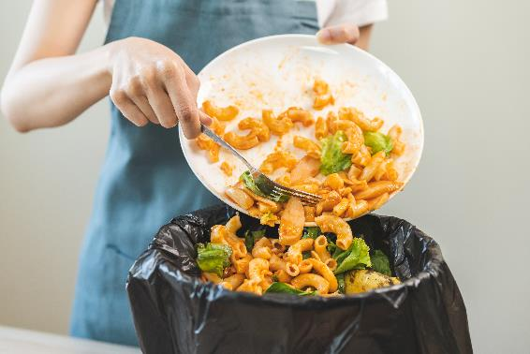
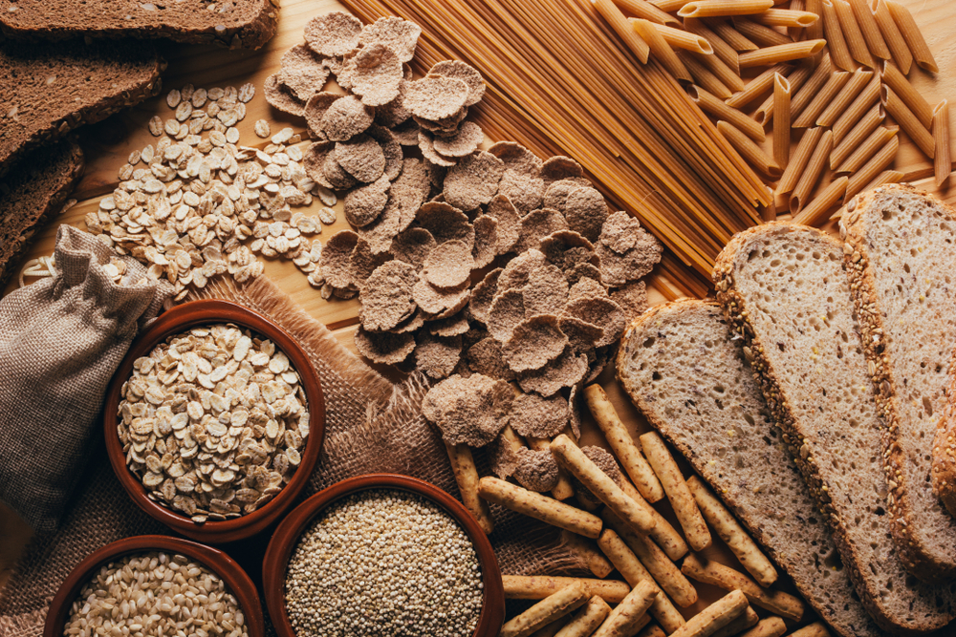
Top tips
Reduce food waste: Use up any leftover fruit such as, apricots, berries, peaches, plums or pears. The fruit can be canned, dried or frozen.
Focus on fibre: Use wholemeal flour for the crumble topping.
Turn up the flavour: Try adding ½ x 5ml spoon cinnamon to the fruit to enhance the flavour.

Slide 10
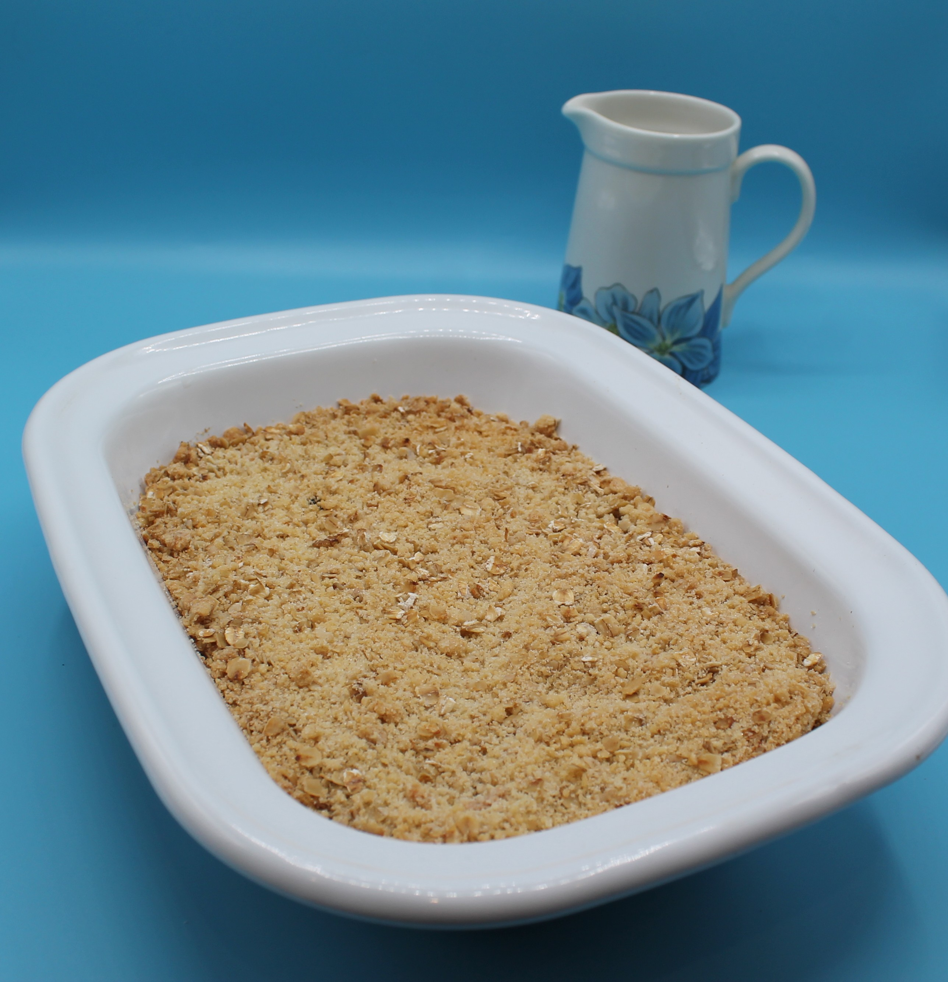
Food science
Why does the crumble turn brown?
The sugar caramelises.
The starch in the flour turns to dextrin, causing it to turn golden brown under the application of dry heat.

Slide 11
Plenary
Give some advice to a pupil who would like to make apple and sultana crumble.
How will I know the fat has been rubbed into the flour correctly?
Can I prepare my apples first?
How can I improve my dish to include more fibre?

Slide 12
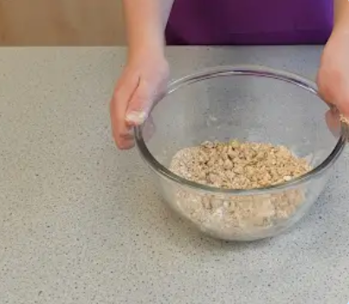
Example responses
Give some advice to a pupil who would like to make apple and sultana crumble.
How will I know the fat has been rubbed into the flour correctly?
The fat and flour should resemble breadcrumbs.

Slide 13
Example responses
Give some advice to a pupil who would like to make apple and sultana crumble.
Can I prepare my apples first?
If the apples are prepared too quickly, they will turn brown.
To avoid the apples turning brown
Use a sharp knife to cut the apple, causing less damage to cells
Prepare just before use
Place in lemon water until required

Slide 14
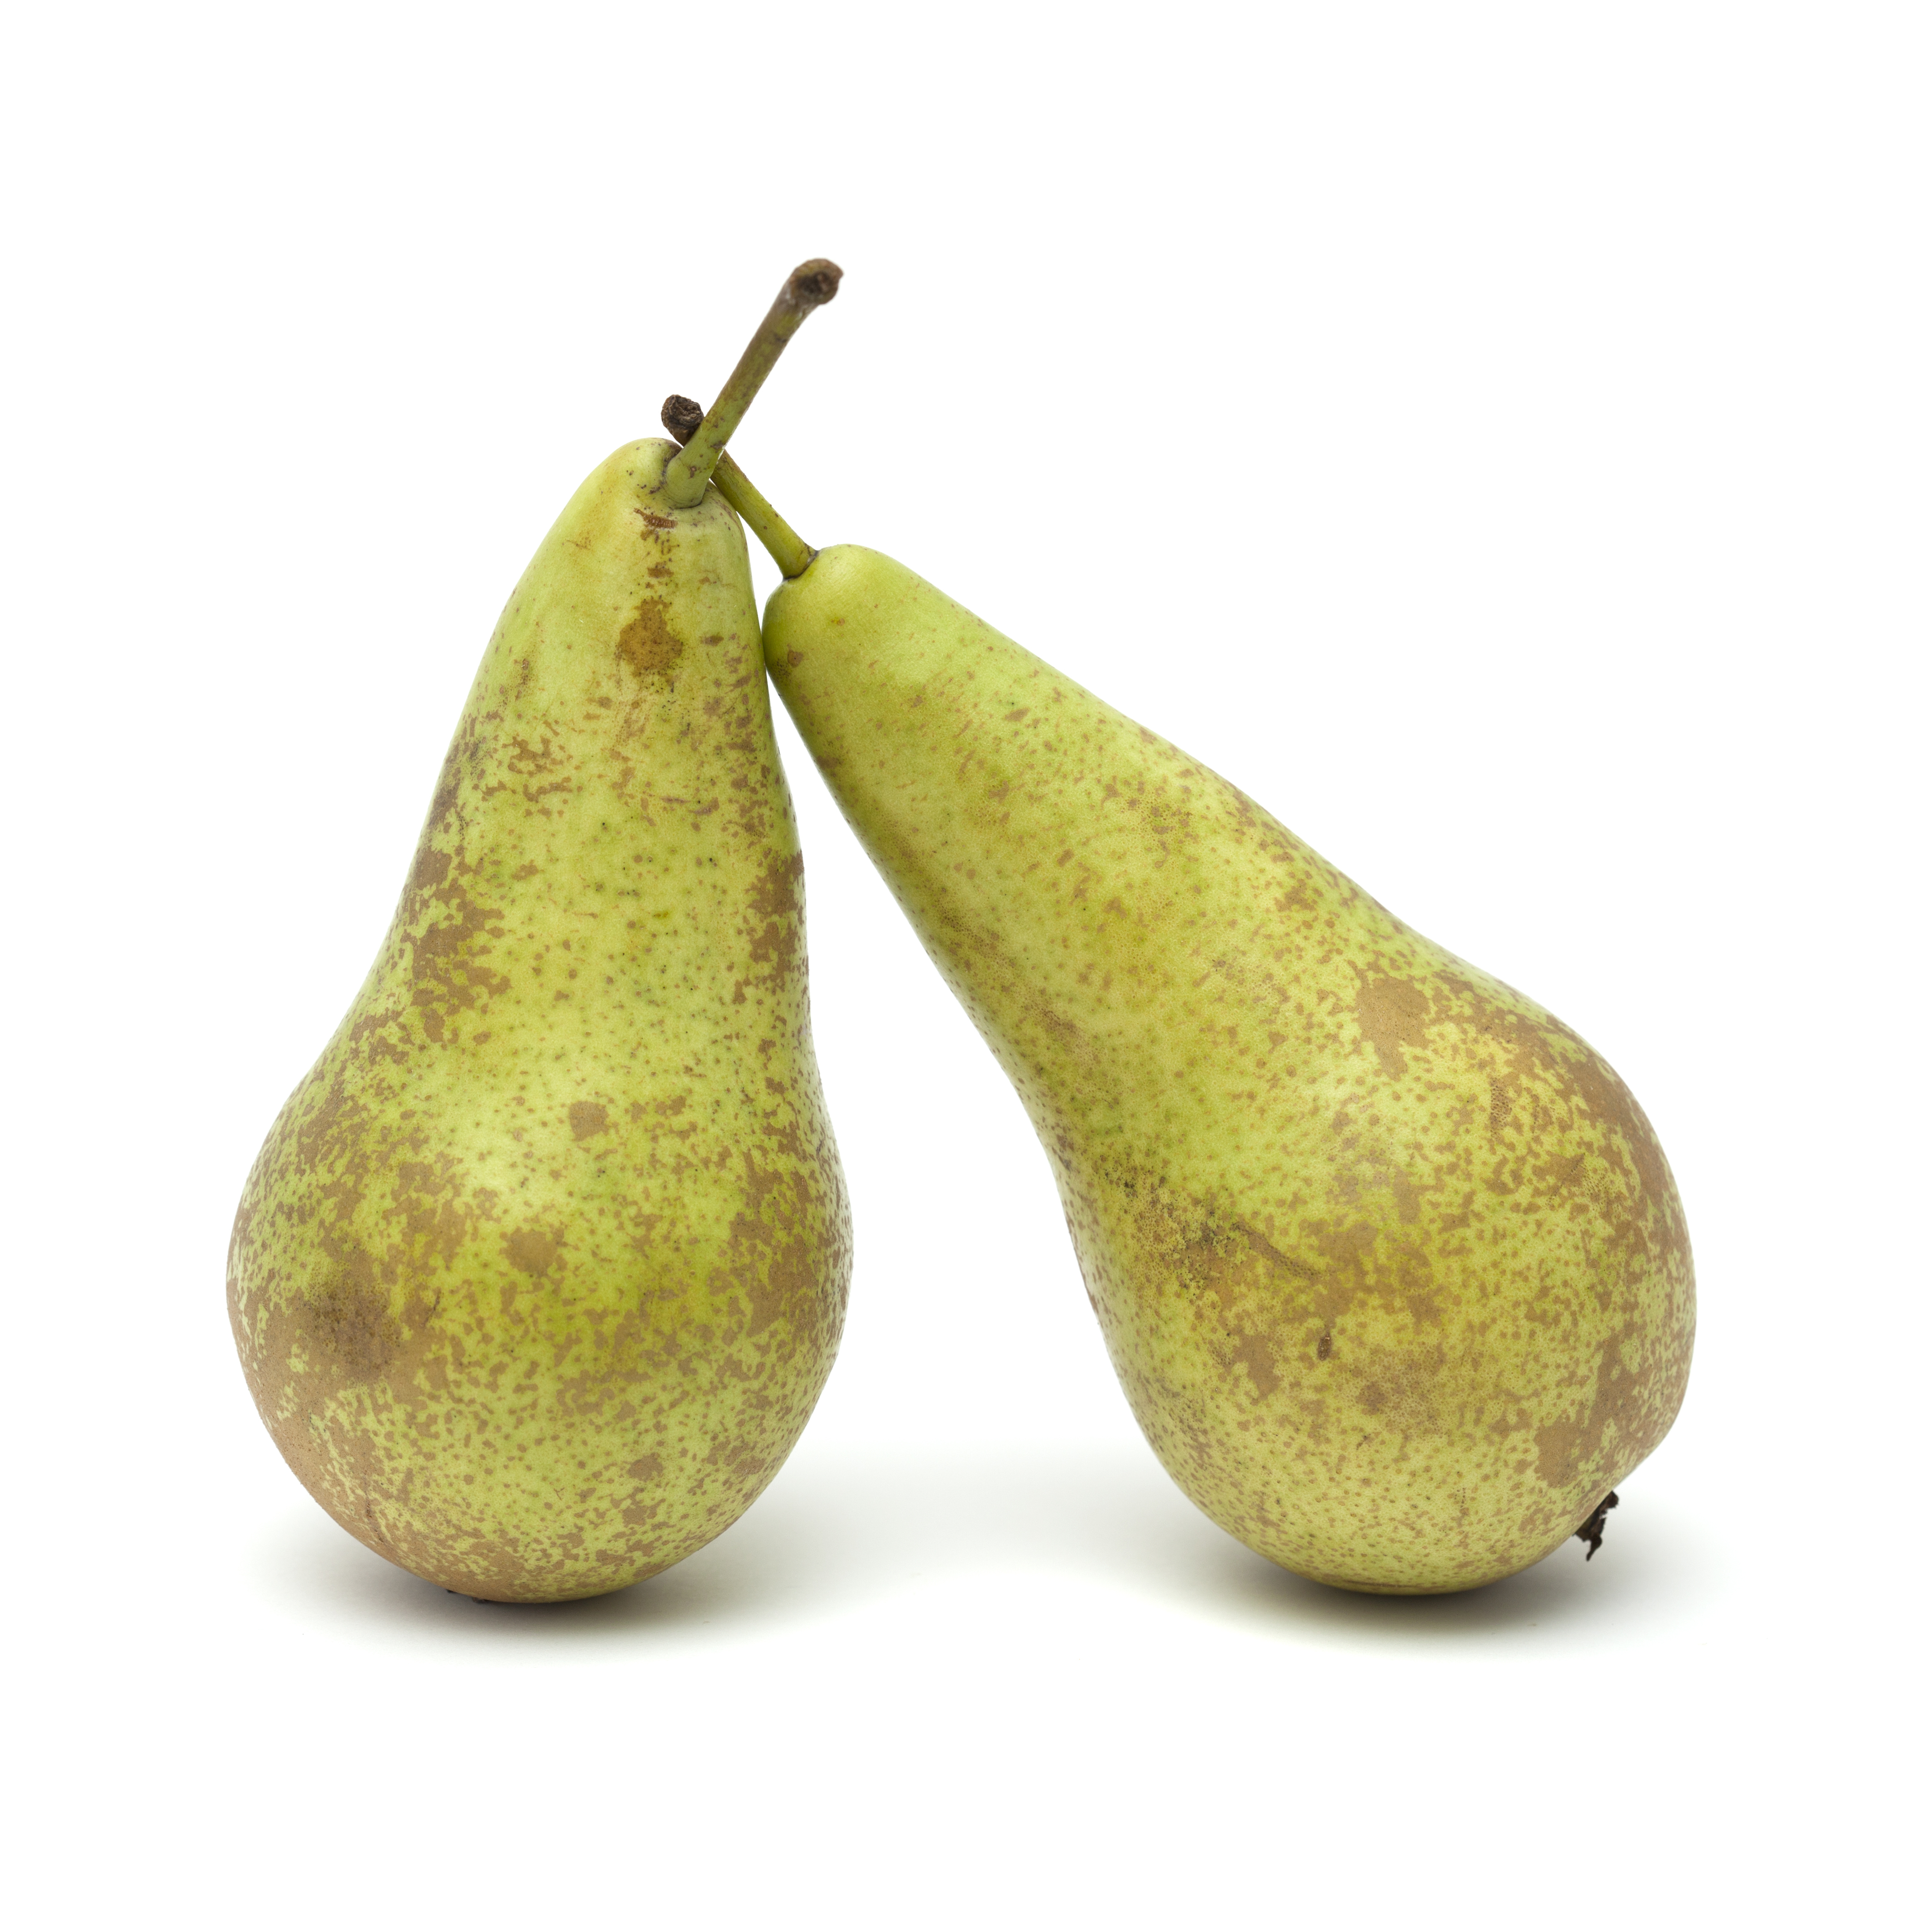
Example responses
Give some advice to a pupil who would like to make apple and sultana crumble.
How can I improve my dish to include more fibre?
Use wholemeal flour
Use other dried fruits
Leave skins on fruit e.g. pear

Slide 15
Example responses
Give some advice to a pupil who would like to make apple and sultana crumble.
How can I improve my dish to include more fibre?
Use wholemeal flour
Use other dried fruits
Leave skins on fruit e.g. pear

Slide 16
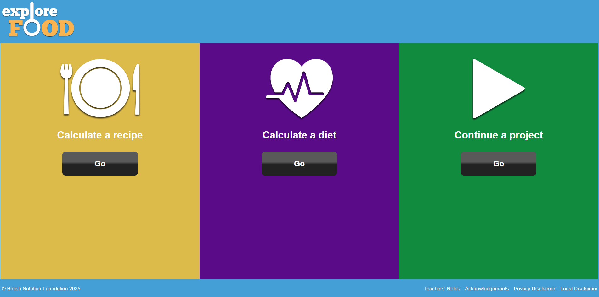
Looking for more…
Continue the learning with our modifying recipes worksheet for apple crumble. Challenge your pupils to improve the nutritional content of the crumble.
Use Explore food our nutritional analysis tool to calculate the nutritional value of their crumble once they have made their changes.
Why not try a savoury version of a crumble? This lesson from the Food – a fact of life Schemes of Work, will give you all that you need.

Slide 17
Apple and sultana crumble
For further information, go to:
www.foodafactoflife.org.uk
This resource meets the Guidelines for producers and users of school education resources about food.

