Slide 1
Food security

Slide 2
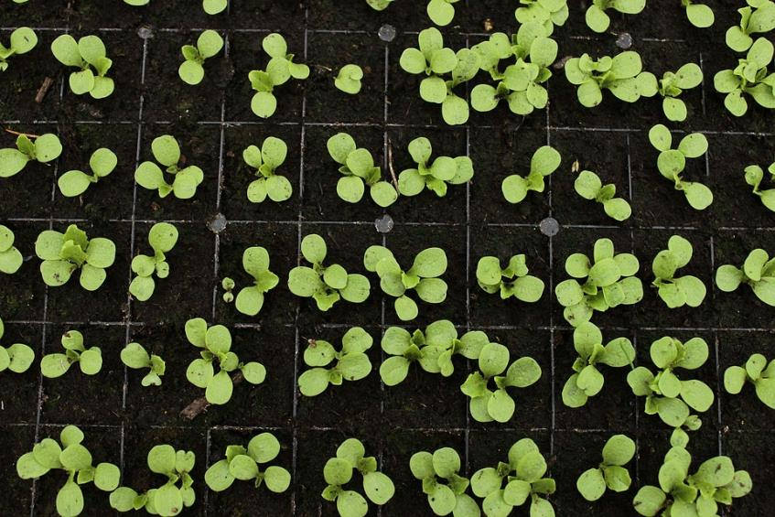
Starter
Sometimes, some areas cannot have enough food to feed the population.
List three reasons you think this might be.
Extension: What are the implications of there not being enough food to feed the population?

Slide 3
What is food security?
Food security in a population means that all people, at all times, have sufficient access to food to meet their dietary needs for a productive and healthy life.
The three main components of food security are:
availability (having sufficient quantities of appropriate food available);
access (having adequate income or other resources to access food);
utilisation/consumption (having adequate dietary intake and the ability to absorb and use nutrients in the body).
Name an example of an issue which may affect each aspect of food security.

Slide 4
Factors that impact food security
Food security is one of the biggest challenges facing humankind. There are many factors which have combined to make food security such a large issue. Food security is reduced by:
the increase in human population, as birth rates are increasing, and many people have better access to medical care;
changing diets mean scarce food resources are transported to be sold to other areas from areas which need them;
new pests and pathogens that attack crops and farm animals;
the effects of climate change are making farming more difficult in many areas;
armed conflicts.

Slide 5
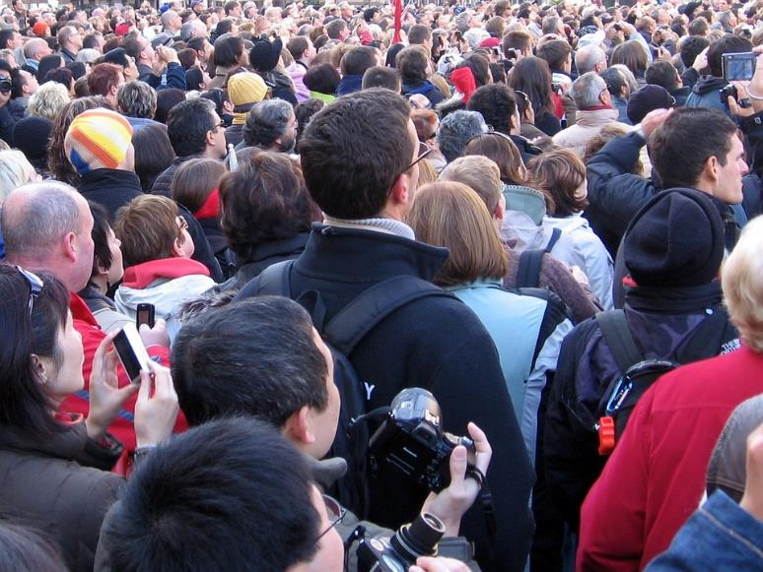
Increasing population
The world population has just passed 8 billion people. By 2055, it is predicted to reach 10 billion. Our current output of food is not enough to feed a population of 10 billion.
Although the birth rate in developed countries has been steadily declining, the birth rate in less-developed countries is still rising.

Slide 6
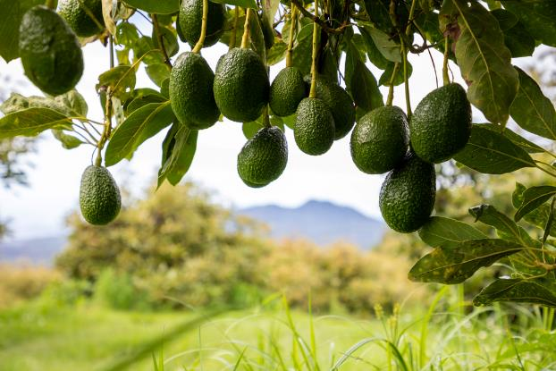
Changing diets
In developed countries, people look for new and interesting foods which means scarce food resources can be imported from around the world to allow people who have plenty of food, to have a variety of food to eat.
This can mean that local people may not have access to their traditional, staple food source. Examples of this are quinoa in Peru and Bolivia, teff in Ethiopia and avocadoes in Mexico.
As countries develop and people become richer they tend to eat a more varied diet, including more meat, which requires more energy to produce. This also means there is more competition for the same types of food.
Avocados growing on a tree. Avocados are native to The Americas.

Slide 7
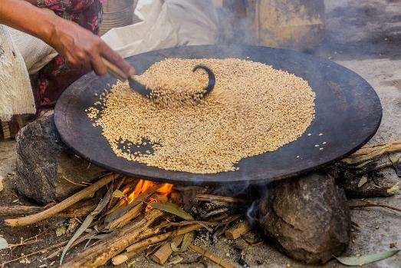
Staple foods and global demand
Global demand for staple foods can have a significant impact on local populations, especially in countries where these foods are vital for daily nutrition and local culture.
When demand for a staple food like teff rises internationally, it often drives up the price.
For local populations who rely on these foods daily, this can make their basic diet unaffordable and may push them to less-nutritious alternatives, leading to food insecurity.
Local populations may switch to more readily available but less culturally significant foods, meaning that traditional recipes and cooking methods may be abandoned or forgotten over time.
Teff grains being roasted for injera bread in Ethiopia

Slide 8
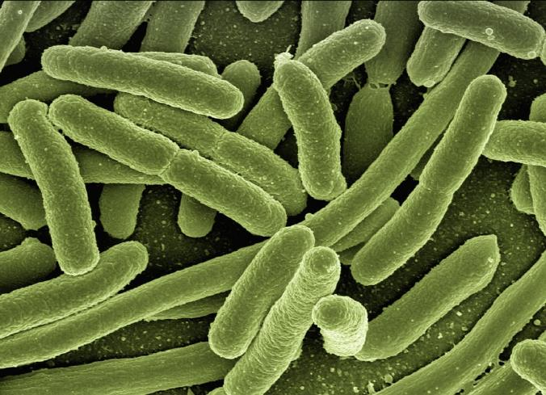
New pests and pathogens
In recent years, there has been a rise in new pests and pathogens due to movement of animals and the effects of climate change.
Pests and diseases are becoming more resistant to pesticides and sprays. The changing climate is also bringing pest and diseases into new areas where they could not previously survive.
The other concern with new pests is the difference between rich and poor countries where pesticides have increased crop yields. Farmers in wealthier countries can afford pesticides, whereas most farmers in poorer countries cannot afford them.

Slide 9
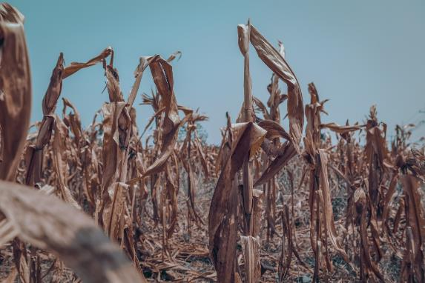
Climate change
Global warming is increasing mean global temperatures and there is also an increase in extreme weather events. Two of the most important with relation to food security are drought and flooding.
Whilst rainfall is increasing in some places, it is decreasing in others. Higher temperatures and unreliable rainfall make farming difficult, especially for those farming marginal lands, who already struggle to survive.
When there is not enough rain, drought means there is not enough water to farm some crops which can lead to crops not growing and there not being enough food to feed the population.

Slide 10

Armed conflicts
Conflict almost always leads to increased food insecurity for a number of different reasons.
Farmers can be forced to flee their land or fight in the conflict and crops or infrastructure such as water pipes can also be destroyed during fighting.
Food shortages have caused riots and conflict, or during war time, food can be used as a weapon, with enemies cutting off food supplies in order to gain ground.

Slide 11
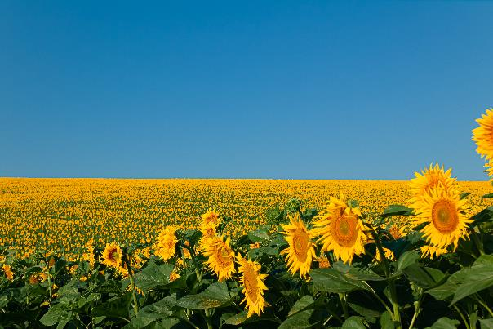
The war in Ukraine
Ukraine and Russia are major suppliers of key agricultural commodities, including wheat, corn (maize), and sunflower oil.
Disruptions to these exports have contributed to increased food prices, reduced availability, and heightened food insecurity worldwide.
The conflict has led to:
disruption of wheat and grain exports, which has significantly impacted countries in Africa, the Middle East and Asia;
increases in food prices worldwide;
a shortage of sunflower oil, in turn leading to shortages and higher prices for other vegetable oils, like palm, rapeseed and soybean oil;
limitations on fertiliser availability, due to sanctions on Russia.

Slide 12
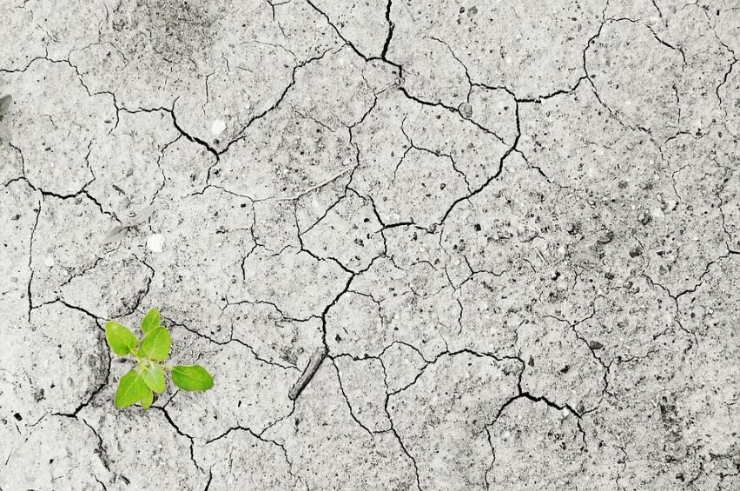
What issues may arise if food is insecure?
Consider you are in a situation where the food supply has become insecure.
Crops have not grown at the rate they were expected and yields were low.
What impacts do you think this would have on your life and the life of people within the country?

Slide 13

What issues may arise if food is insecure?
Rising food prices - due to supply and demand, when there is less food available, the prices of food increase. Poorer countries are more vulnerable to increasing food prices as a higher percentage of people’s income is spent on food.
Soil erosion - the removal of soil occurs more rapidly in areas that are very dry. Food insecurity can lead to soil erosion as farmers try to get more out of their land.

Slide 14

What issues may arise if food is insecure?
Social unrest – there is often a link between food insecurity and rioting or other forms of social unrest against the politicians in the country as everyone needs to eat so people will do what they can to get food.
Famine and starvation of the population – not enough food means that there is a risk of people starving. This can be linked to the above point, that food becomes too expensive, or it can simply be a case of there not being enough food to go around. Less food for humans also means less food for animals, which can have a further knock on effect on farming more food.

Slide 15
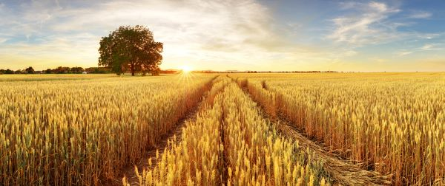
How to combat food insecurity
Due to the risks of food insecurity, there is a global effort to promote sustainable food production.
There are several ways this can be achieved, including:
maintaining soil quality;
avoiding overfishing so that fish stocks do not run out;
looking at new technologies, such as hydroponics or biotechnology.

Slide 16

Sustainable fish
Globally, average per capita fish consumption has more than doubled during the last half a century, placing pressure on our seas and oceans.
80% of the seafood we eat in the UK comes from just 5 different species – cod, haddock, salmon, tuna, and prawns
The Marine Conservation Society’s Good Fish Guide can help us make more sustainable choices. It uses a traffic light sustainability rating, with the ‘best choice’ (green) given a ‘1’, and ‘fish to avoid’ (red) given a ‘5’.
Logo© Marine Stewardship Council

Slide 17
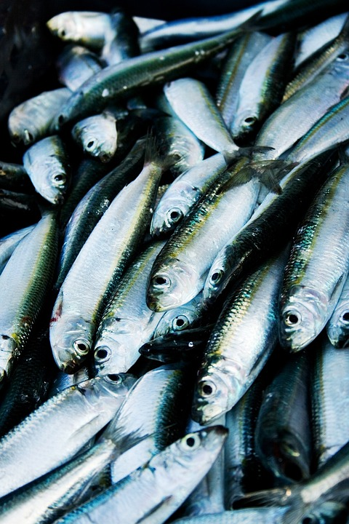
Reducing overfishing
Fish has always been a source of food around the world.
Large scale commercial fishing fleets are capable of regularly catching large quantities of fish. However, this type of fishing has been largely uncontrolled, resulting in stocks of fish diminishing.

Slide 18
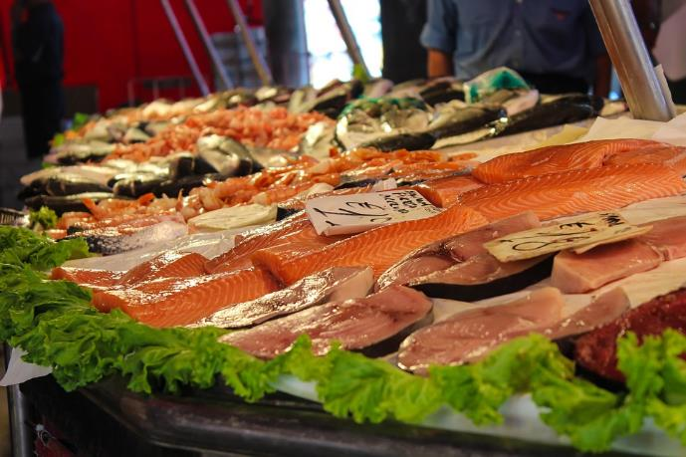
Reducing overfishing
As fish stocks have decreased to such low levels, particularly in some regions and for some fish, there has been an increased focus on ocean management to tackle the problem of overfishing.
There are a number of ways of doing this that include a focus on sustainable fish breeding, fishing restrictions in the form of fish quotas and controlling the size of holes in nets to only allow the biggest fish to be caught.
Find out more about fish and shellfish here.

Slide 19
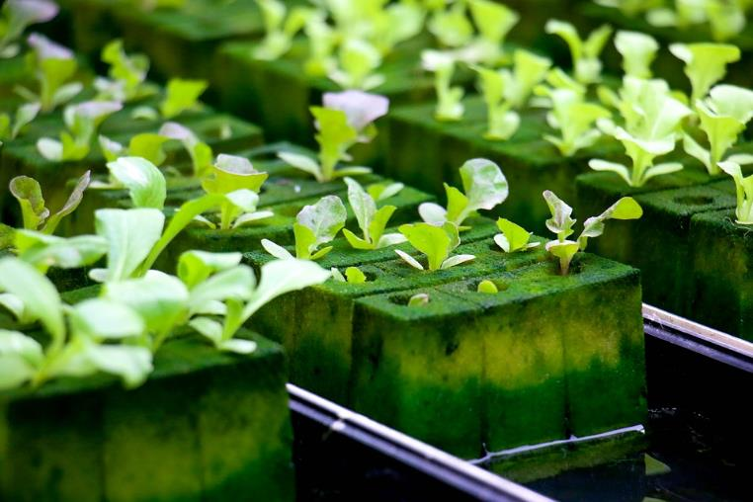
Aeroponics and hydroponics
Aeroponics and hydroponics are two ways to grow plants without soil. This is a huge technological breakthrough, and is excellent for countries where a lack of water or poor quality soil is an issue.
Aeroponics involves suspending plants in the air and spraying their roots with a fine mist of water and nutrients.
Hydroponics involves growing plants in a porous material (other than soil) and allowing water containing nutrients to filter through it. Sensors control the climate, energy, water and light in the greenhouse to support the plants’ growth.

Slide 20
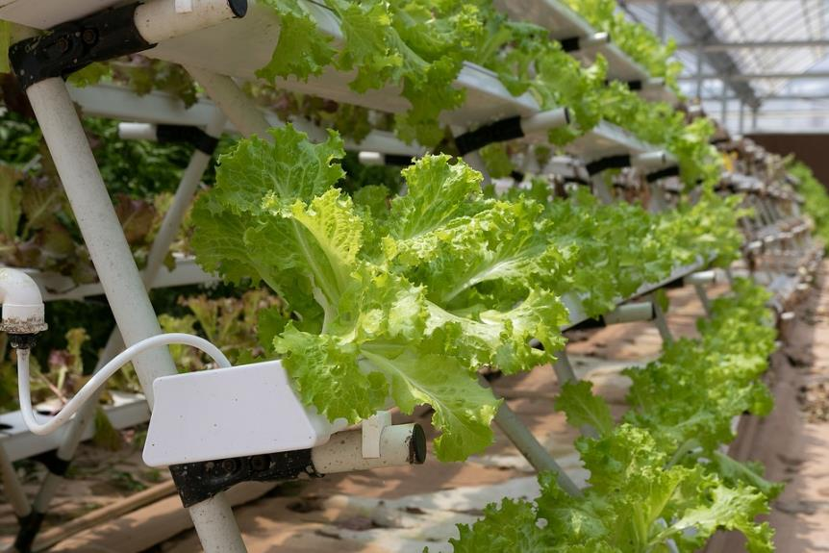
Hydroponics
Hydroponic vegetables are grown in a nutrient solution rather than soil. Lots of vegetables are increasingly grown this way, especially where they is a requirement to save water.
Growing vegetables hydroponically enables them to be grown in a controlled environment with less chance of disease, faster growth, and greater yield.

Slide 21
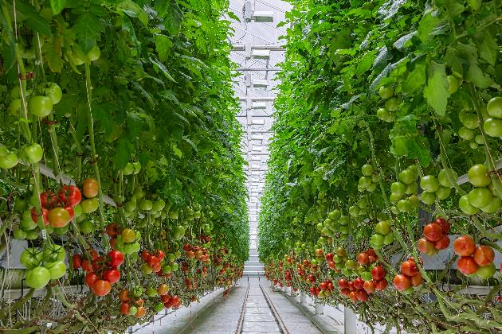
Thanet Earth – a hydroponics case study
Each year, Thanet Earth grows:
around 400 million tomatoes in a glasshouse space that would fit more than 32 football pitches;
around 24 million peppers in a greenhouse space that would fit 12 football pitches;
around 30 million cucumbers in glasshouses the size of 17 football pitches.
The tomato plants need pollination, so they introduce hundreds of UK native bumblebees to the glasshouses.
Cucumbers and peppers are self-pollinating so don’t require bees to help them.
https://www.thanetearth.com/

Slide 22
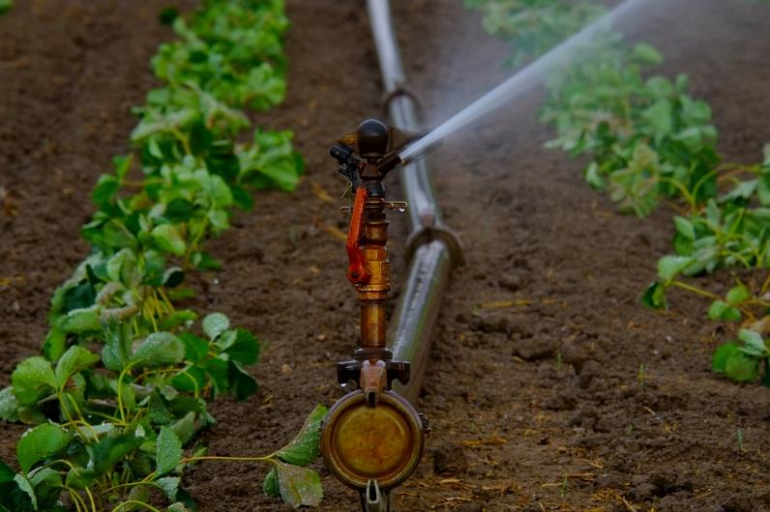
Irrigation
Water is channelled from rivers and streams to fields to help crops grow. This can help to increase the amount of food produced.
Some parts of the world still do not have irrigation systems in place. In continents such as Africa, only a small amount of food comes from irrigated crops and so there is the potential to improve yields on these continents.
Farm Africa is a charity that works in partnership with smallholder farmers and small businesses to improve the quality, quantity and value of their produce so that they can support their families with more resilient livelihoods.

Slide 23

Biotechnology
Genetic modification and biotechnology
Genetic modification of plants and crops can help:
improve crops resistance to pests, disease or drought;
extend shelf life;
improve nutrition and taste;
produce higher yields;
animals may be made more resistant to disease, produce less fatty meat, grow faster or be more fertile.

Slide 24
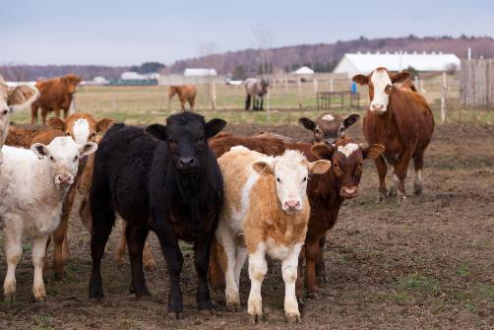
Selective breeding and Genetic modification
Selective breeding is when humans breed plants and animals for particular genetic characteristics.
Genetic engineering defined as the transfer of DNA from one organism to another using biotechnology. The organism receiving the DNA is said to be genetically modified (GM).

Slide 25
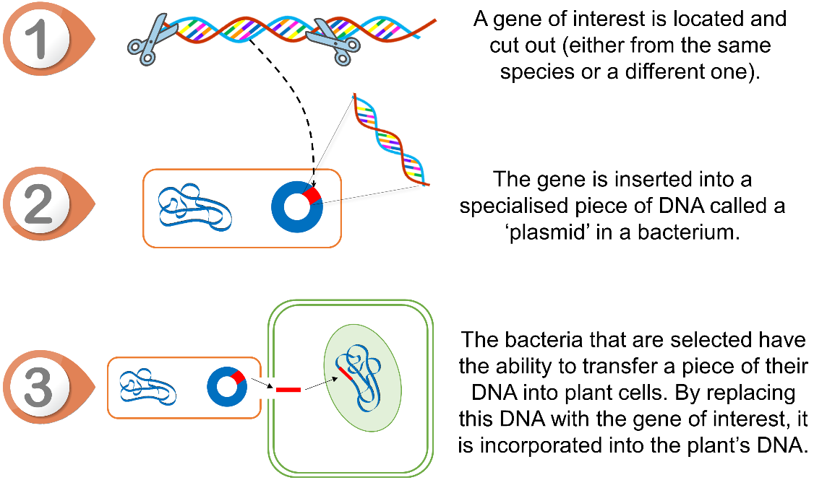
How does genetic modification work?
First, a gene of interest is selected.
This is then transferred to a plant cell, usually through one of two main methods:
being fired from a device known as a ‘gene gun’ into the cell;
being inserted into a specialised piece of DNA in bacteria that are capable of transferring this information to plants (see image).

Slide 26
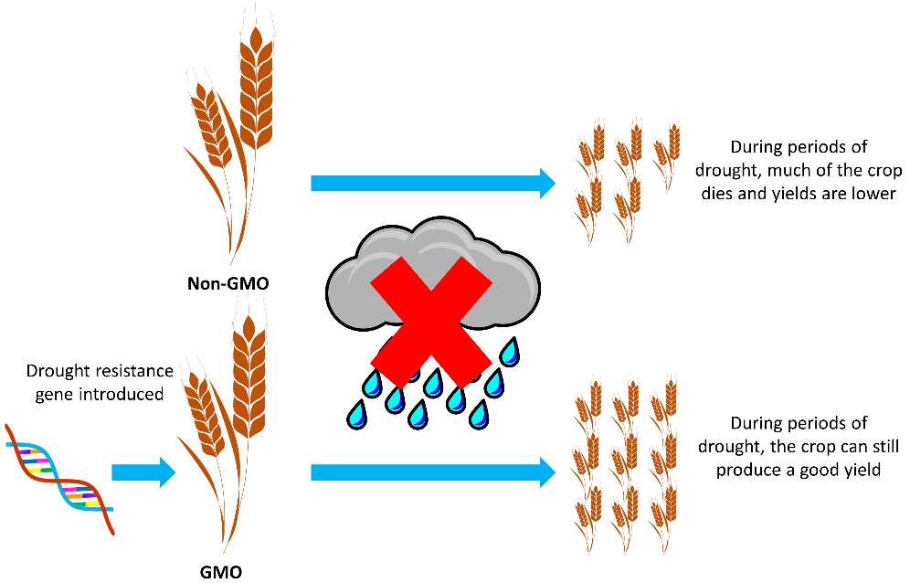
Improving crops and livestock
Improving varieties of crops or livestock by introducing and modifying specific genes is faster and more accurate than traditional breeding.
If the gene can be identified and modified, the following changes may be possible:
plant crops may have a longer shelf-life, be more resistant to pests, disease or drought, be more nutritious, have a better taste or give a higher yield;
animals may be made more resistant to disease, produce less fatty meat, grow faster or be more fertile.

Slide 27
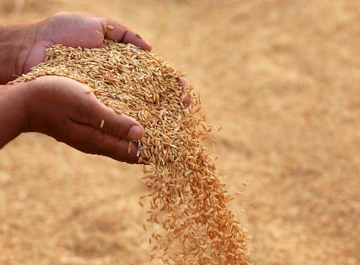
Golden rice
An example of a GM crop is Golden rice. Golden rice was created to help reduce the incidence of vitamin A deficiency in developing countries (where rice is the staple food). Vitamin A deficiency can cause blindness and death.
Genetically engineered rice which contains a gene from carrots (or other vegetable) which causes the rice to contain the building blocks for vitamin A production in the body.
This is an example of how GM food can have a large impact on the human population.
Further information - Commercial development of gene-edited food

Slide 28

Flav Savr tomato
The Flavr Savr tomato was the first genetically modified fruit/vegetable to be sold. It is a genetically engineered tomato which has a gene inserted to extend shelf-life by slowing down the rotting process.
Normally, tomatoes are picked while green and transported many miles before being sprayed with ethylene to ripen them.
Using GM in this way can help reduce food waste caused by tomatoes perishing in transit.

Slide 29
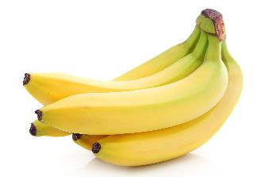
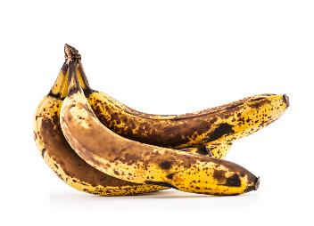
Non-browning bananas
Over 60% of exported bananas go to waste before they reach the consumer.
A UK based company has created non-browning gene edited bananas to try and combat this problem. Non-browning bananas can help to reduce food waste and CO₂ emissions by 25%.
The non-browning bananas have the same taste and texture, but they resist oxidation. They do so by disabling the genes responsible for the polyphenol oxidase, an enzyme which triggers browning.
Non-browning gene edited bananas

Slide 30
GM labelling in the UK
Foods which have been produced from genetically modified organisms (GMOs) are likely to appear no different from food produced by traditional means.
The Government has set up a series of controls to inform consumers, whilst protecting the environment and people who work with GMOs.
In the UK, foods that contain GMOs or ingredients produced from GMOs need to be labelled by law.
Foods produced with GM technology or foods sourced from animals fed on GM feed do not currently need to be labelled.
No GM food crops or animals are currently grown commercially in the UK.
Food Standards Agency, 2018

Slide 31
Issues
Genetic modification
GM crop seeds are often more expensive, meaning people in developing countries cannot afford them.
GM crops can cause allergic reactions in people.
Some people do not believe it is ethical to interfere with nature this way.
Selective breeding
A reduction in genetic variation can leave plants and animals vulnerable to attack from specific insects or diseases. This could be extremely destructive to the populations
Rare disease genes being unknowingly selected as part of a positive trait leading to problems with specific organisms.
The creation of physical problems in specific organisms.

Slide 32
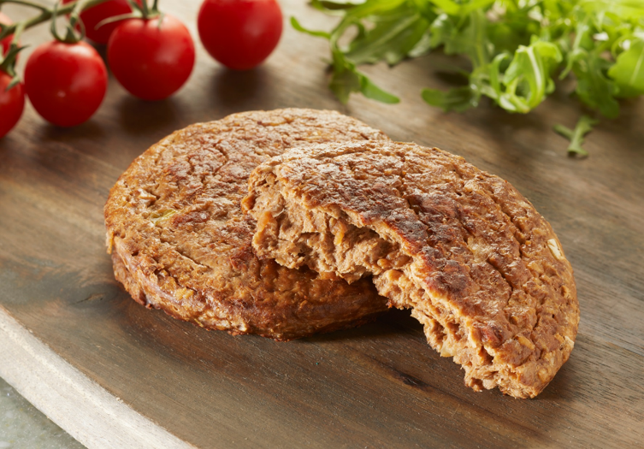
Mycoprotein
Due to the increased concern about the food security of traditional crops, there have been technological advances to create alternatives.
One of which is the food known as mycoprotein, grown from the fungus fusarium, a protein-rich food which grows and reproduces on glucose syrup.

Slide 33
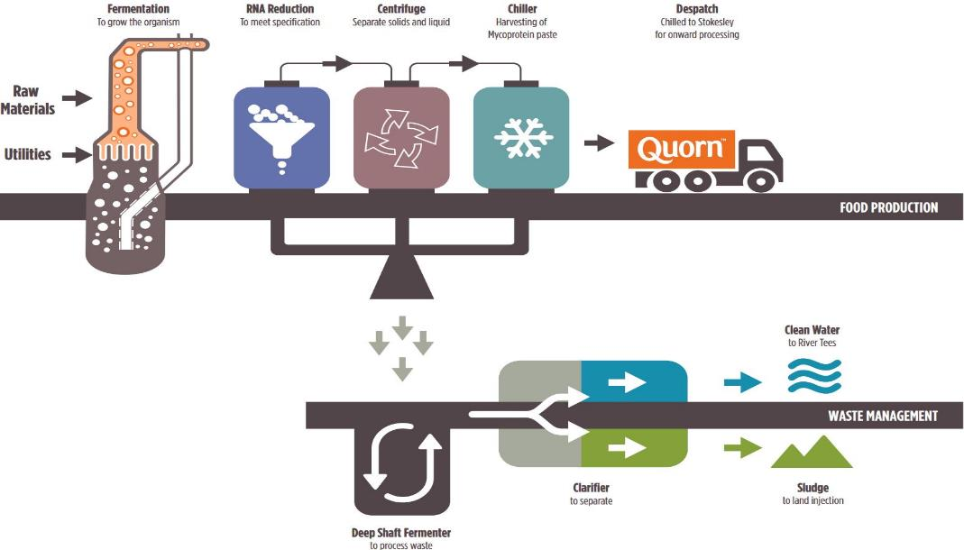
The processing of mycoprotein
The Fusarium venenatum fungus is extracted from the soil and grown via fermentation using glucose as a fuel source.
It is then exposed to steaming, chilling and freezing.
This creates the meat-like texture of mycoprotein.
Notes:
https://bit.ly/2OrcFfU

Slide 34
The processing of mycoprotein
MIX
SHAPE (fiber alignments)
COOK (heat set proteins)
FREEZE TEXTURIZATION
READY TO COOK
In the later stages of processing, egg albumin is added as a binder to help shape the product. In vegan mycoprotein products, potato extract is used as an alternative.
The product is then frozen so
it can be transported to supermarkets and sold.
Further information about mycoprotein can be found here.
Notes:
https://www.quorn.us/news/how-is-quorn-made-introduction-to-quorn-and-mycoprotein

Slide 35
Project
Group work: Research the following areas of combatting food insecurity.
Group 1 and 2: Reducing overfishing
Group 3 and 4: New technologies: aeroponics and hydroponics
Group 5 and 6: Biotechnology (Genetic modification of foods)
Group 7 and 8: Mycoprotein production (alternative foods)

Slide 36
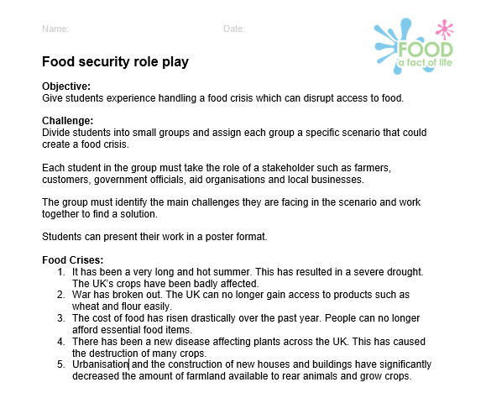
Task: Tackling food insecurity
You live in a country that is undergoing issues with food security.
As a group of different stakeholders, you must identify the main challenges you are facing and work together to find a solution.

Slide 37
Food security
For further information, go to:
www.foodafactoflife.org.uk
This resource meets the Guidelines for producers and users of school education resources about food.

