Slide 1
Growing wheat

Slide 2
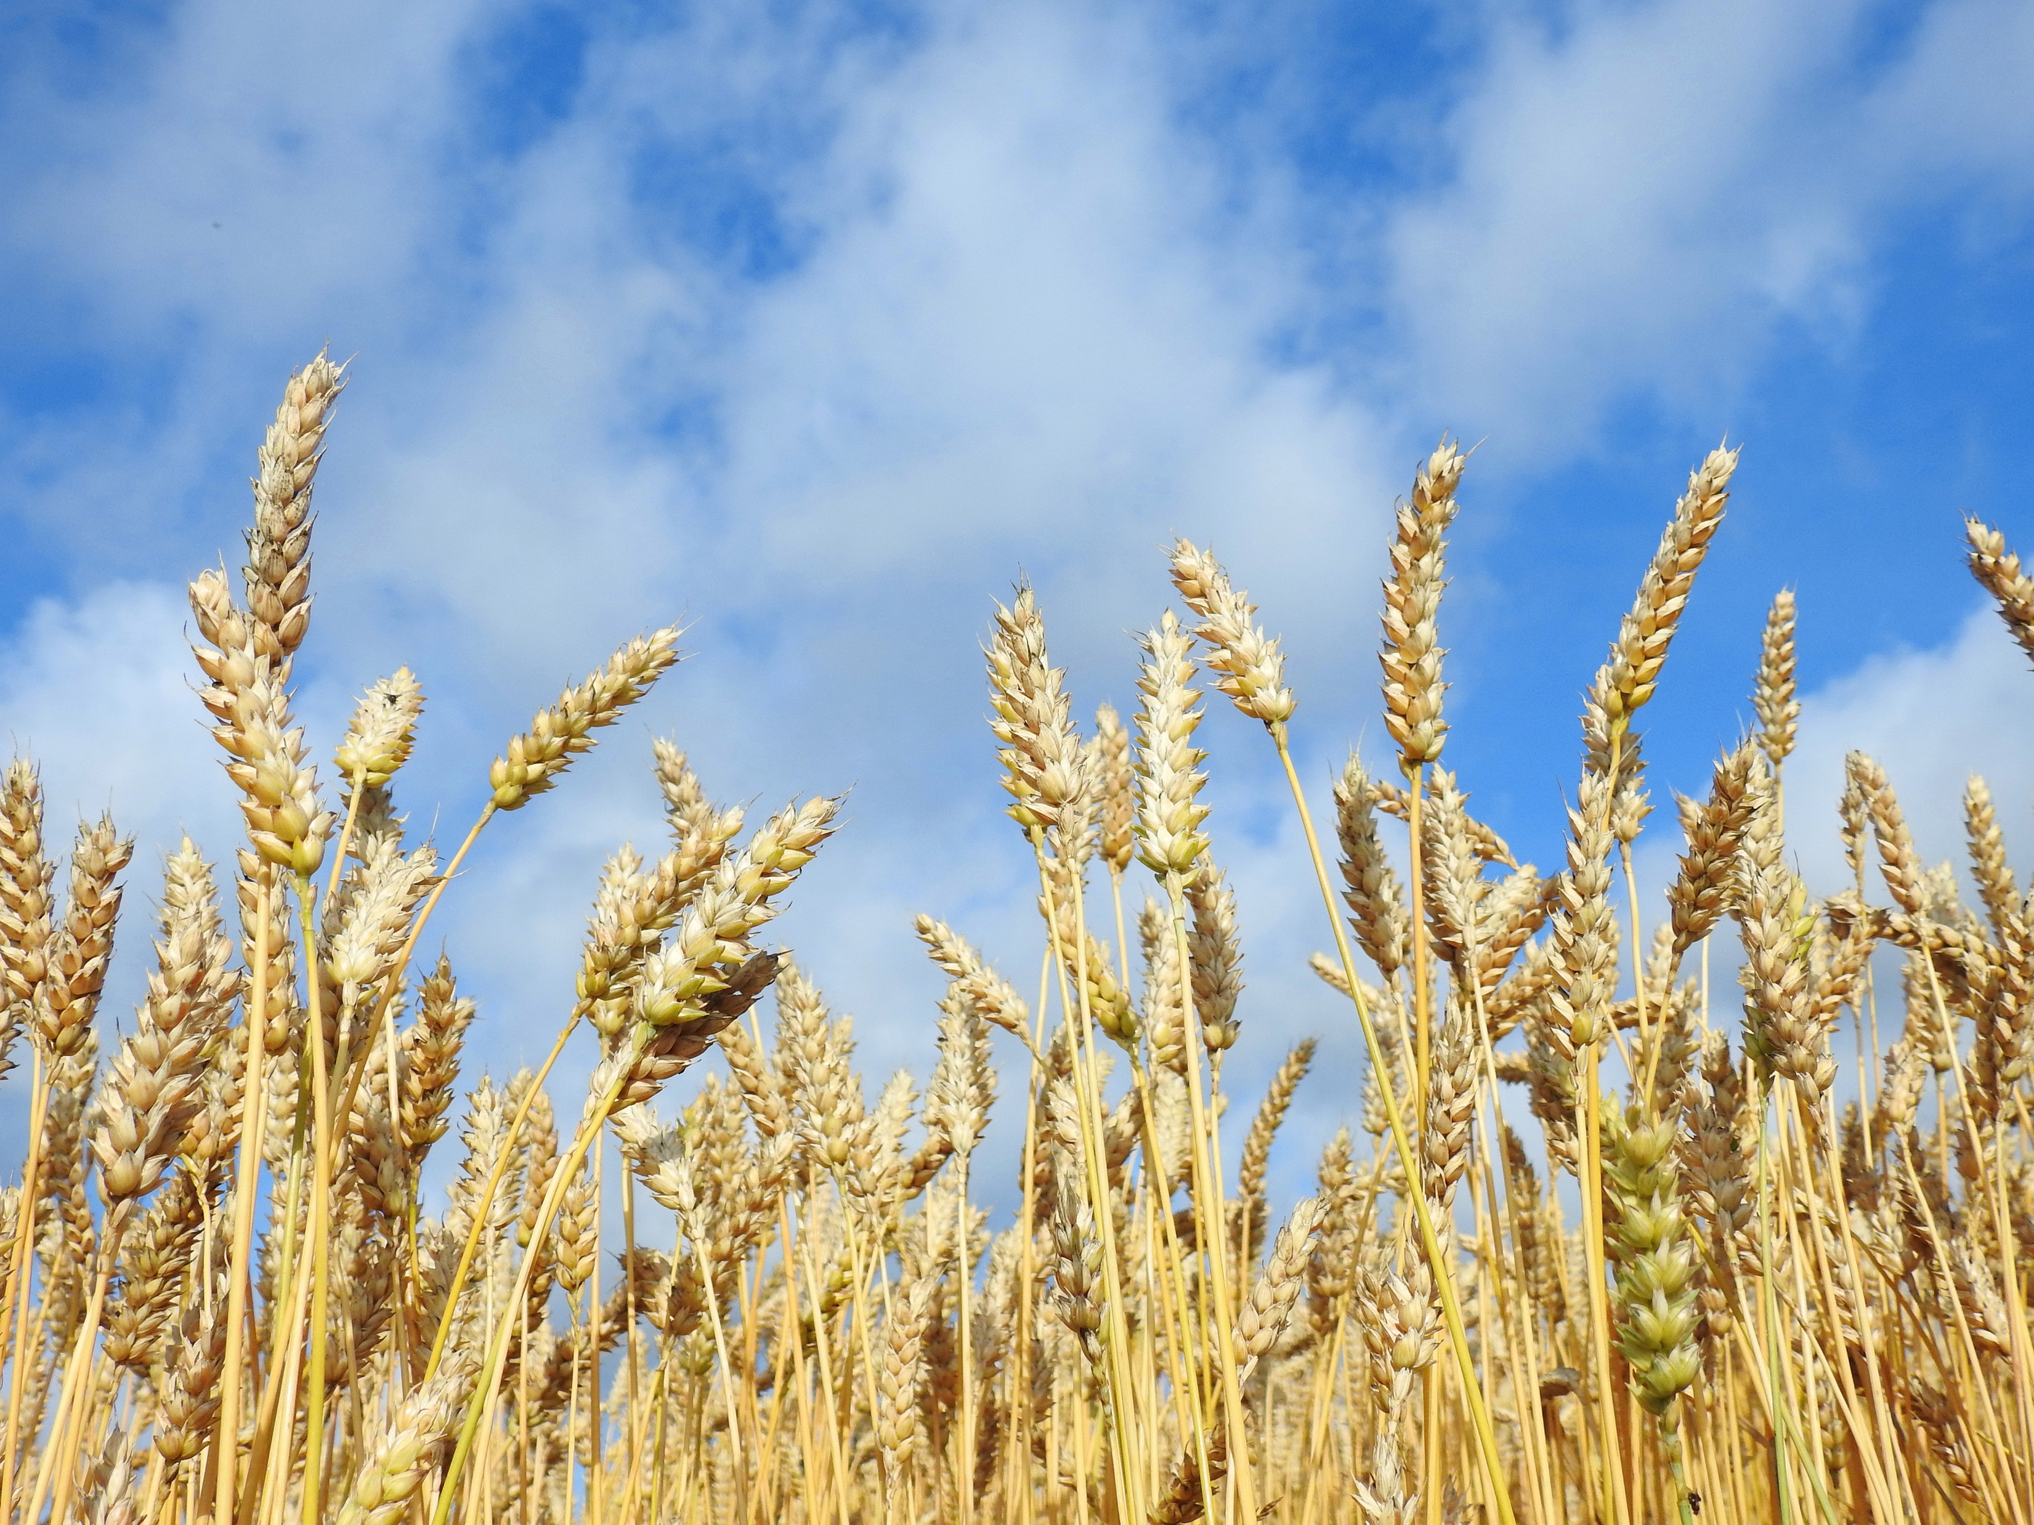
Do you know what this is?
Wheat
Wheat is a type of grass.

Slide 3
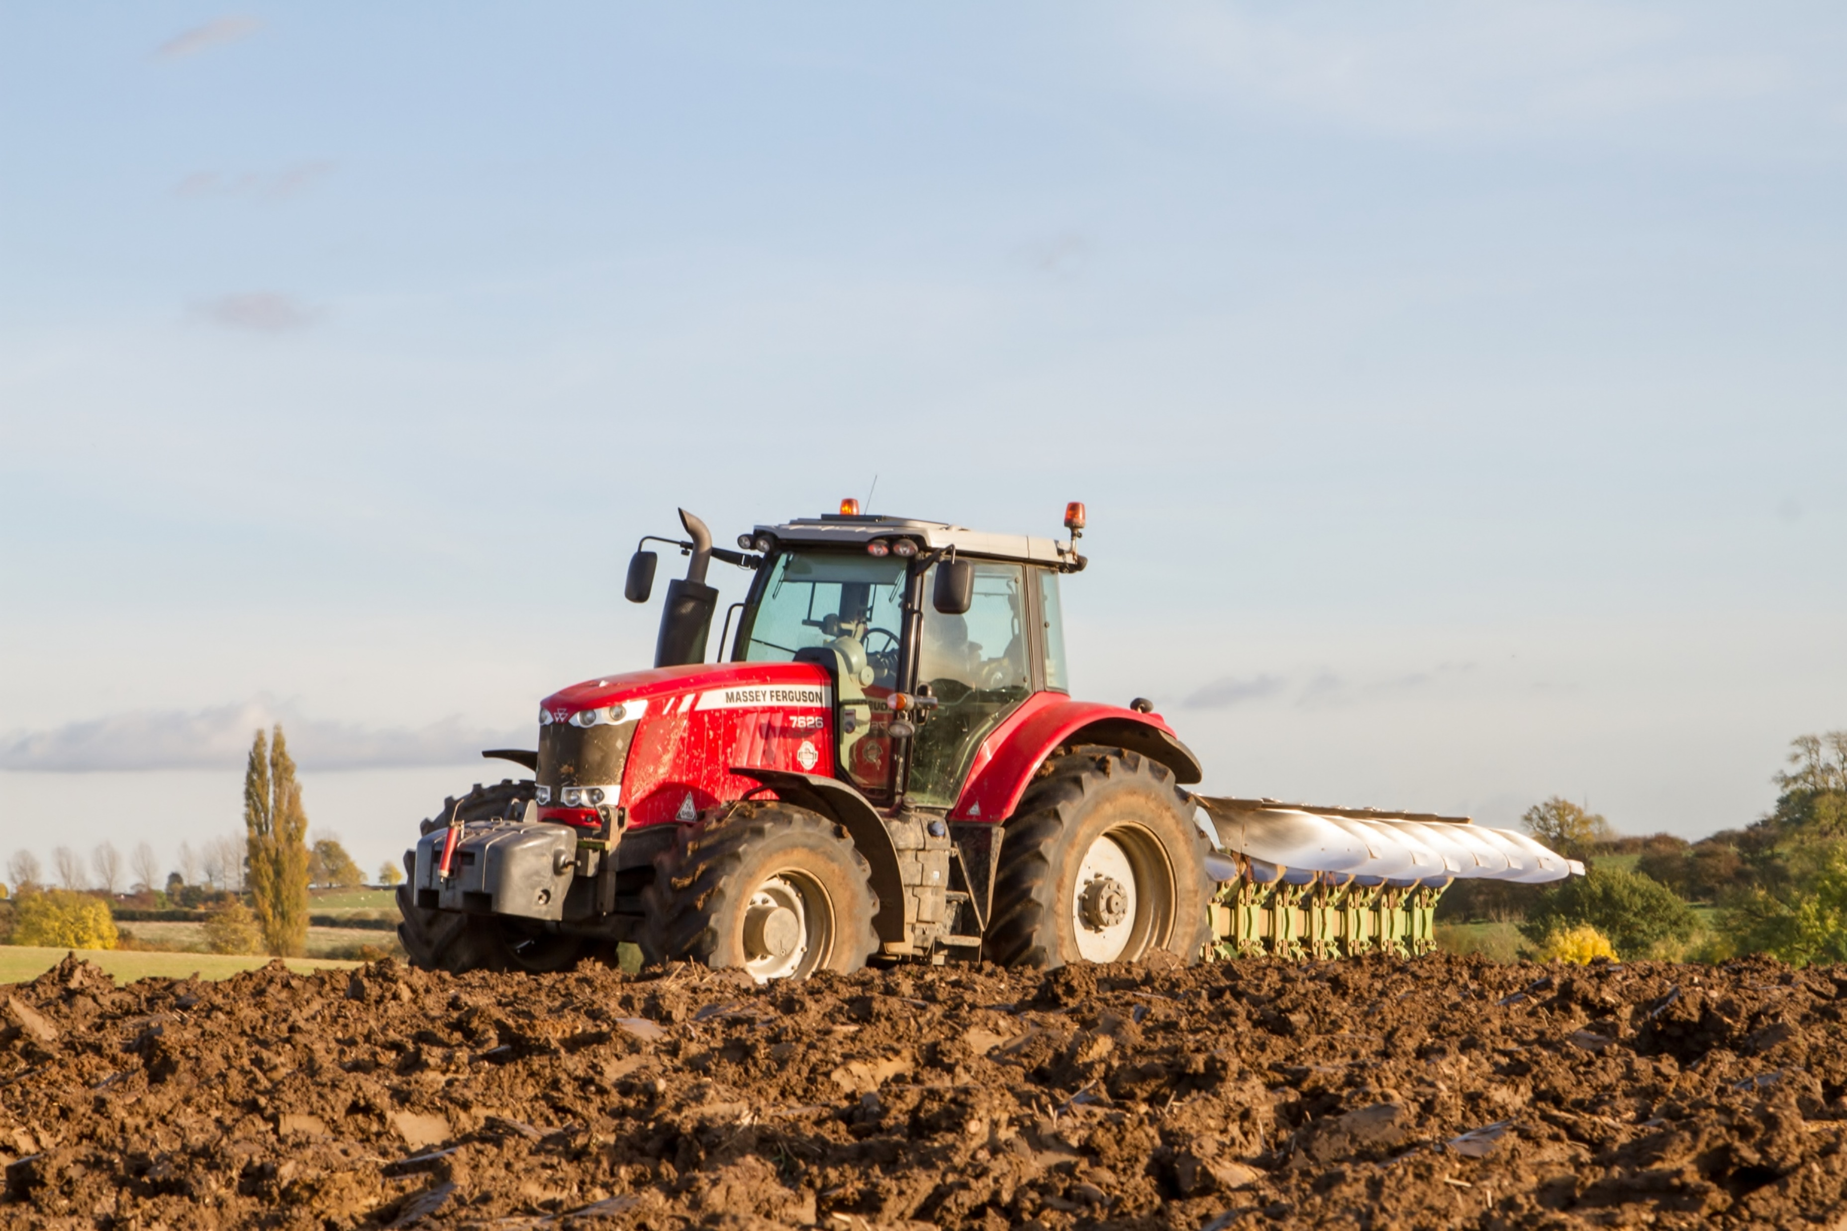
How is wheat grown?
This is a plough.
The plough is pulled along by a tractor. The plough digs the soil so the seeds can be planted.
In the late autumn to early winter, the fields are ploughed, and seeds are sown.

Slide 4
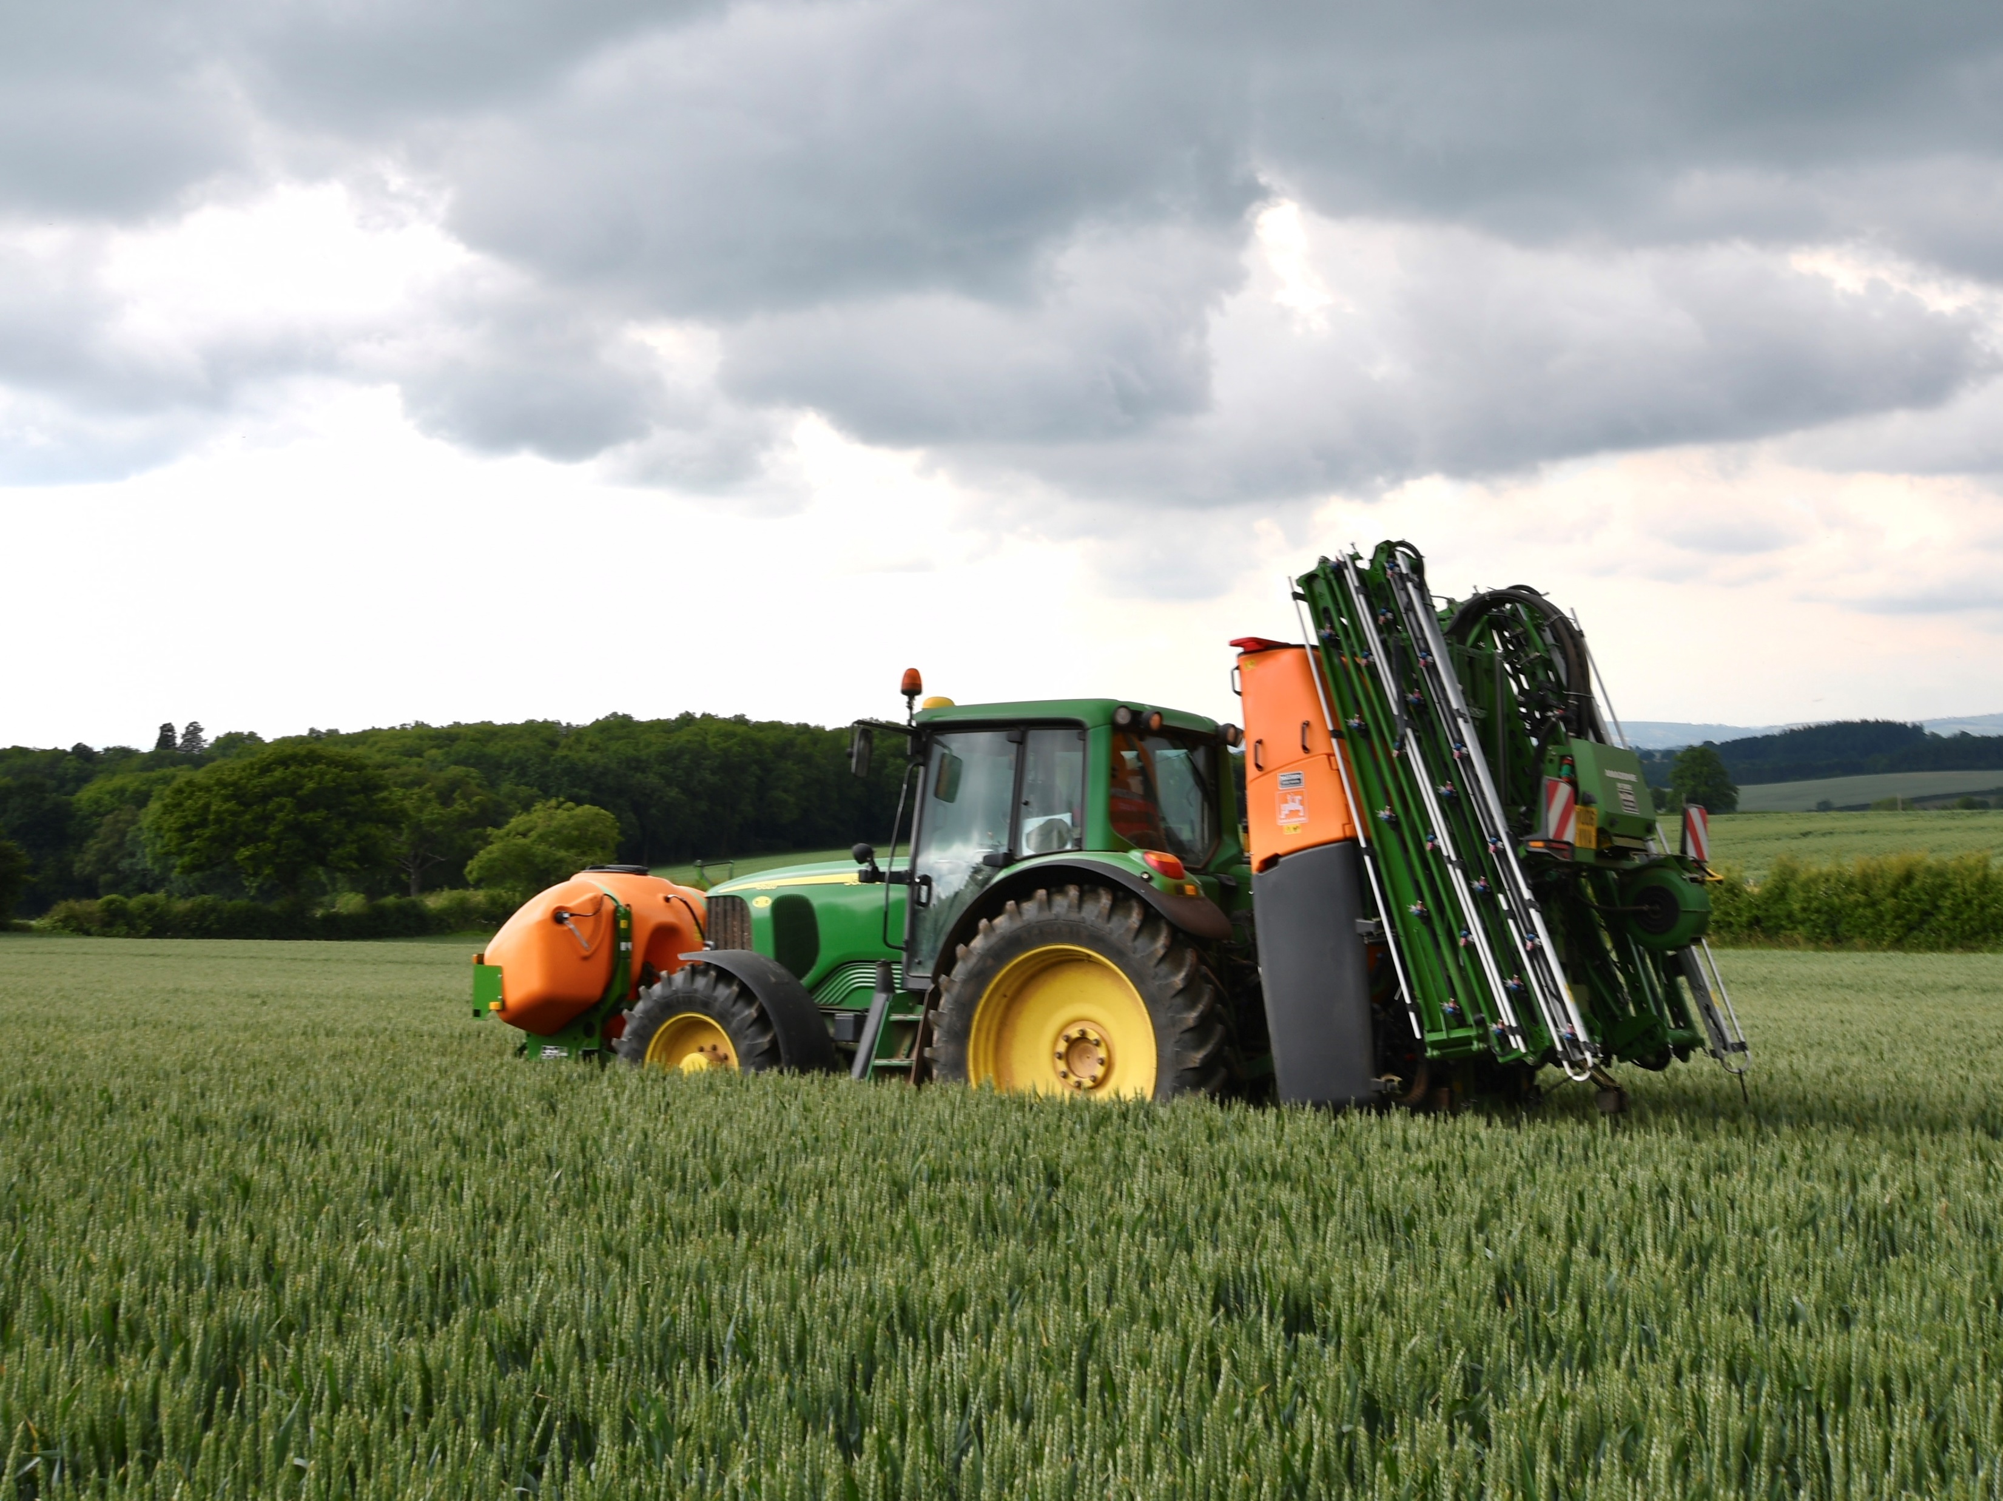
Spraying
The sprayer is attached to the tractor. When the sprayer is working, the tall parts spread out like wings so they can spray lots of the field at the same time.
In spring, the seeds begin to grow into plants. They are sprayed to help them grow and protect them from pests.

Slide 5
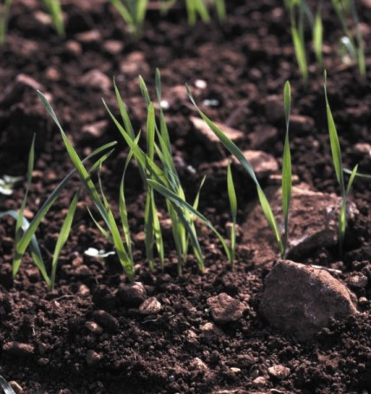
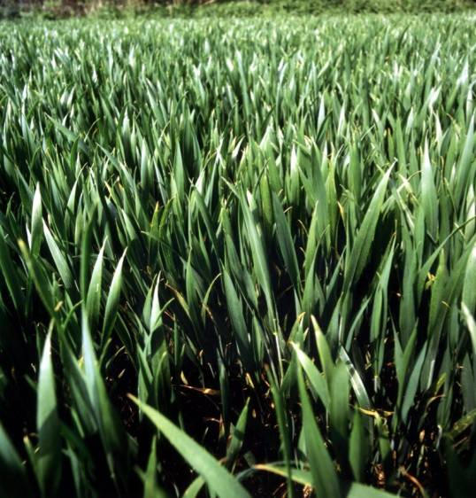

Growing
To grow, plants need light from the sun and water from the rain.
This is what wheat looks like when it is growing.
Soil gives plants the food they need to grow and stay healthy.

Slide 6
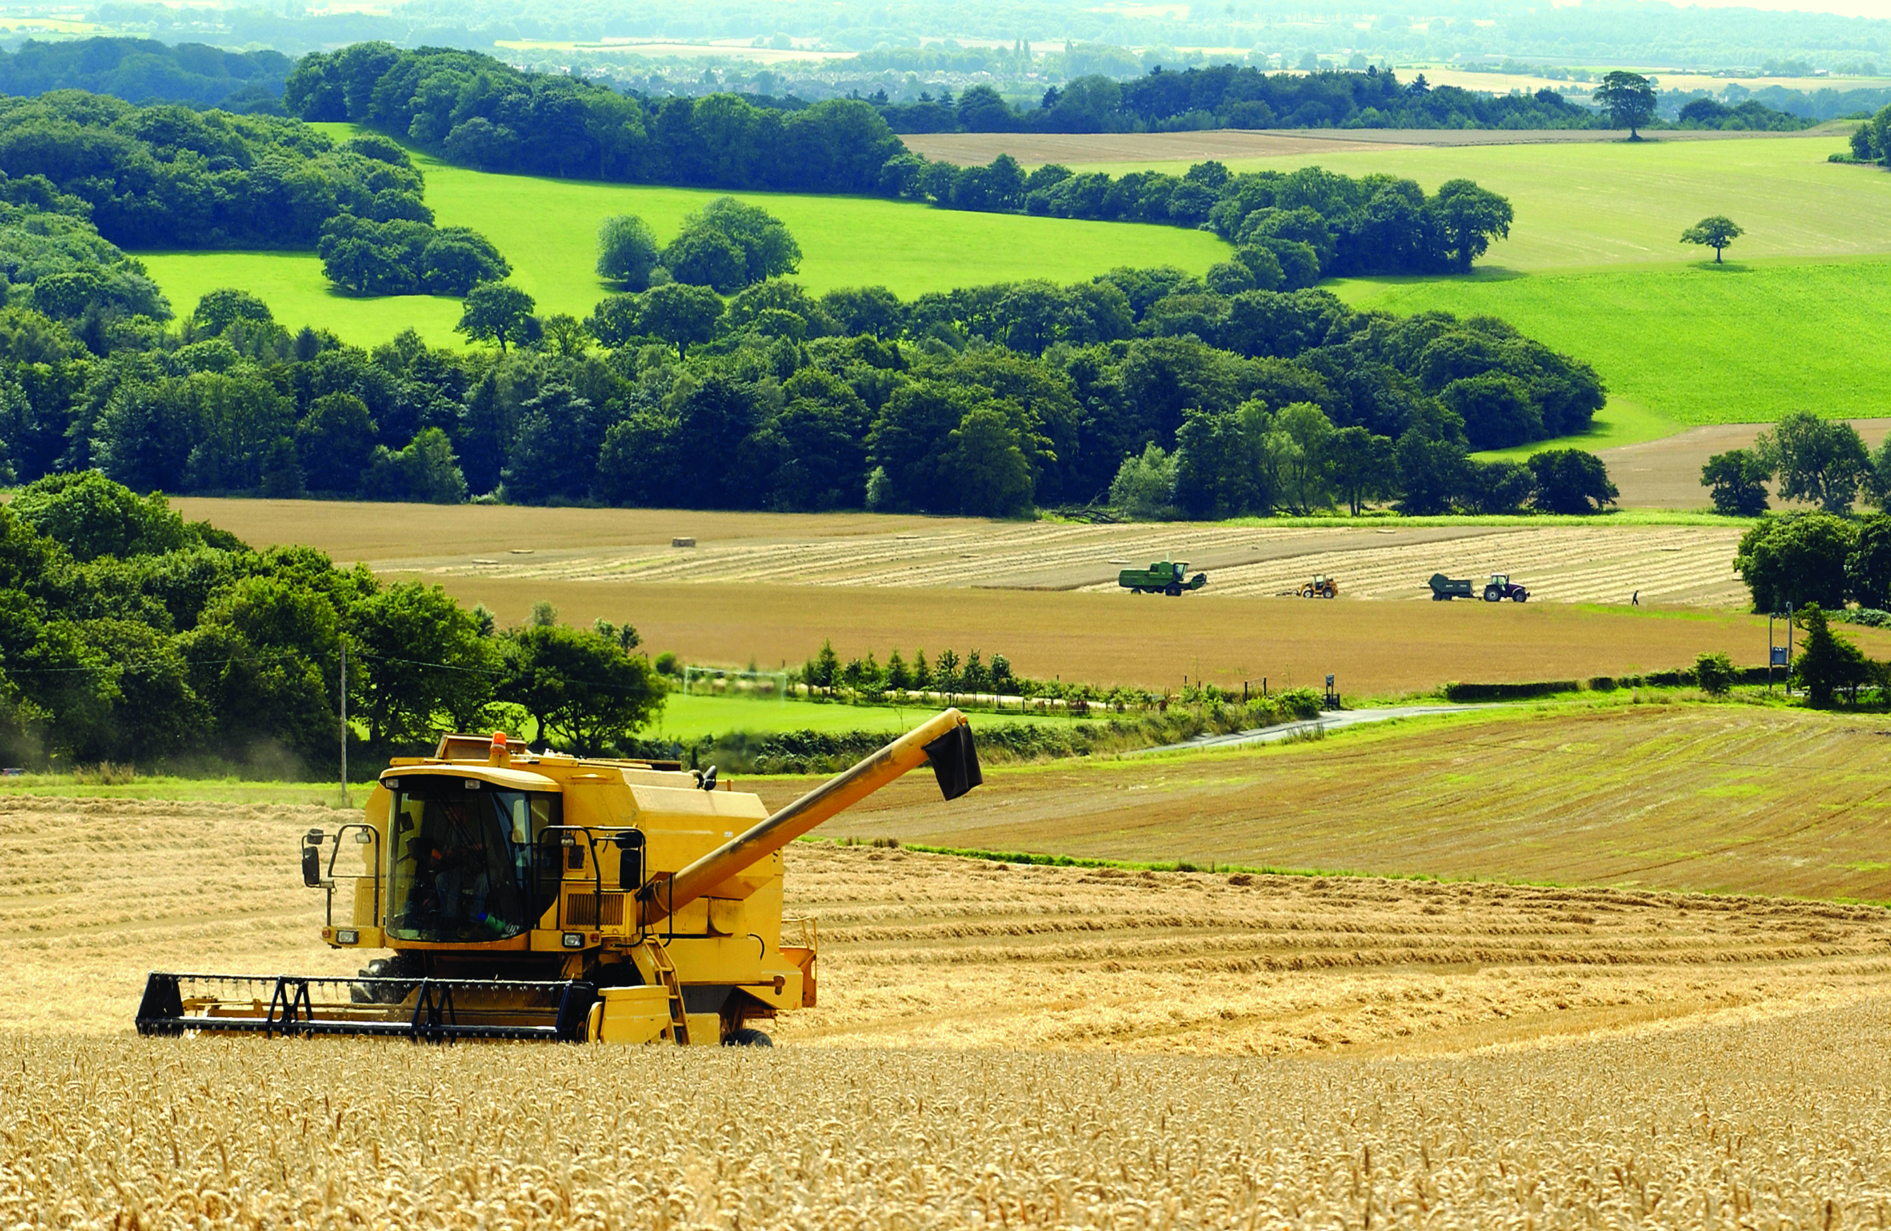
Harvesting
This is a combine harvester. The machine cuts the wheat and separates the grain, the straw and the chaff.
In the late summer the wheat is harvested.

Slide 7
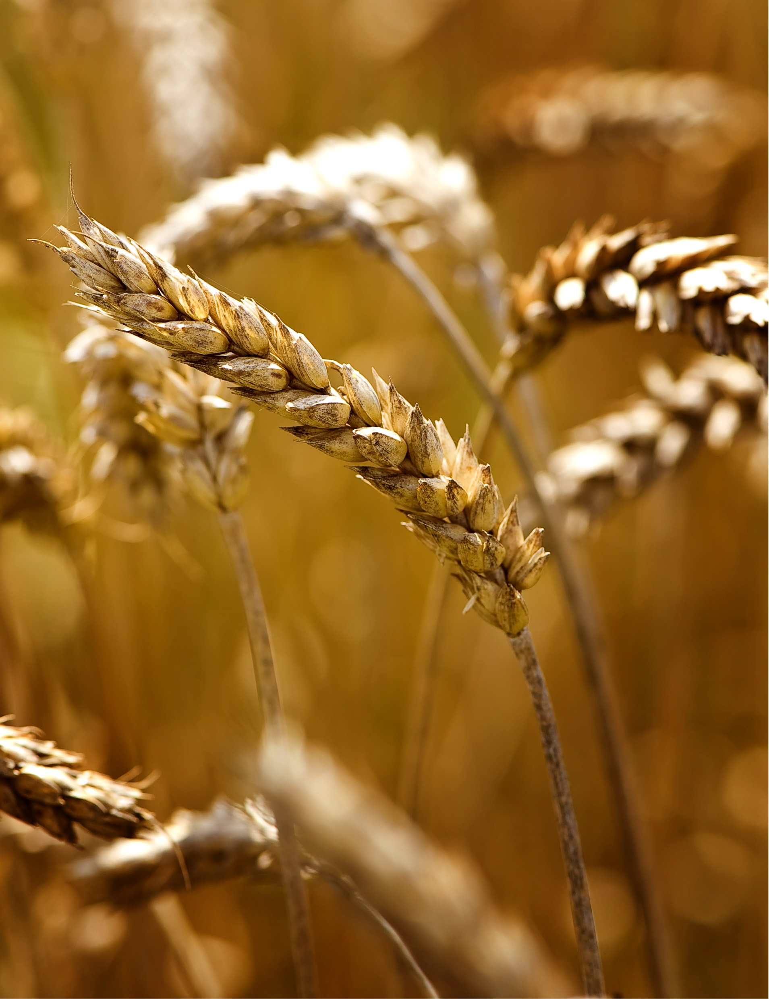
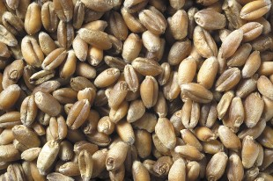
Wheat grains
These are called ears. The grain is inside the ears. The grain is the part we make into food.
This is grain.

Slide 8

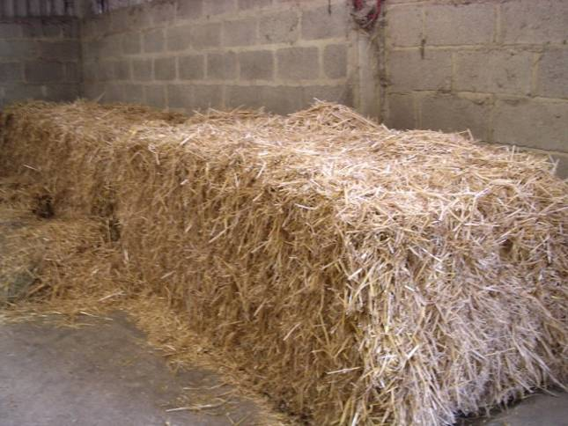
Wheat straw
These are the stalks that are made into straw.
This is straw.

Slide 9
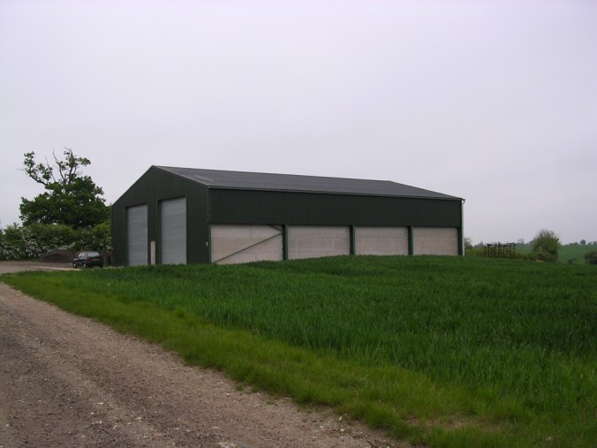
Storing the grain
This is the store where the grain is kept before it goes to be milled or used to make breakfast cereal.

Slide 10
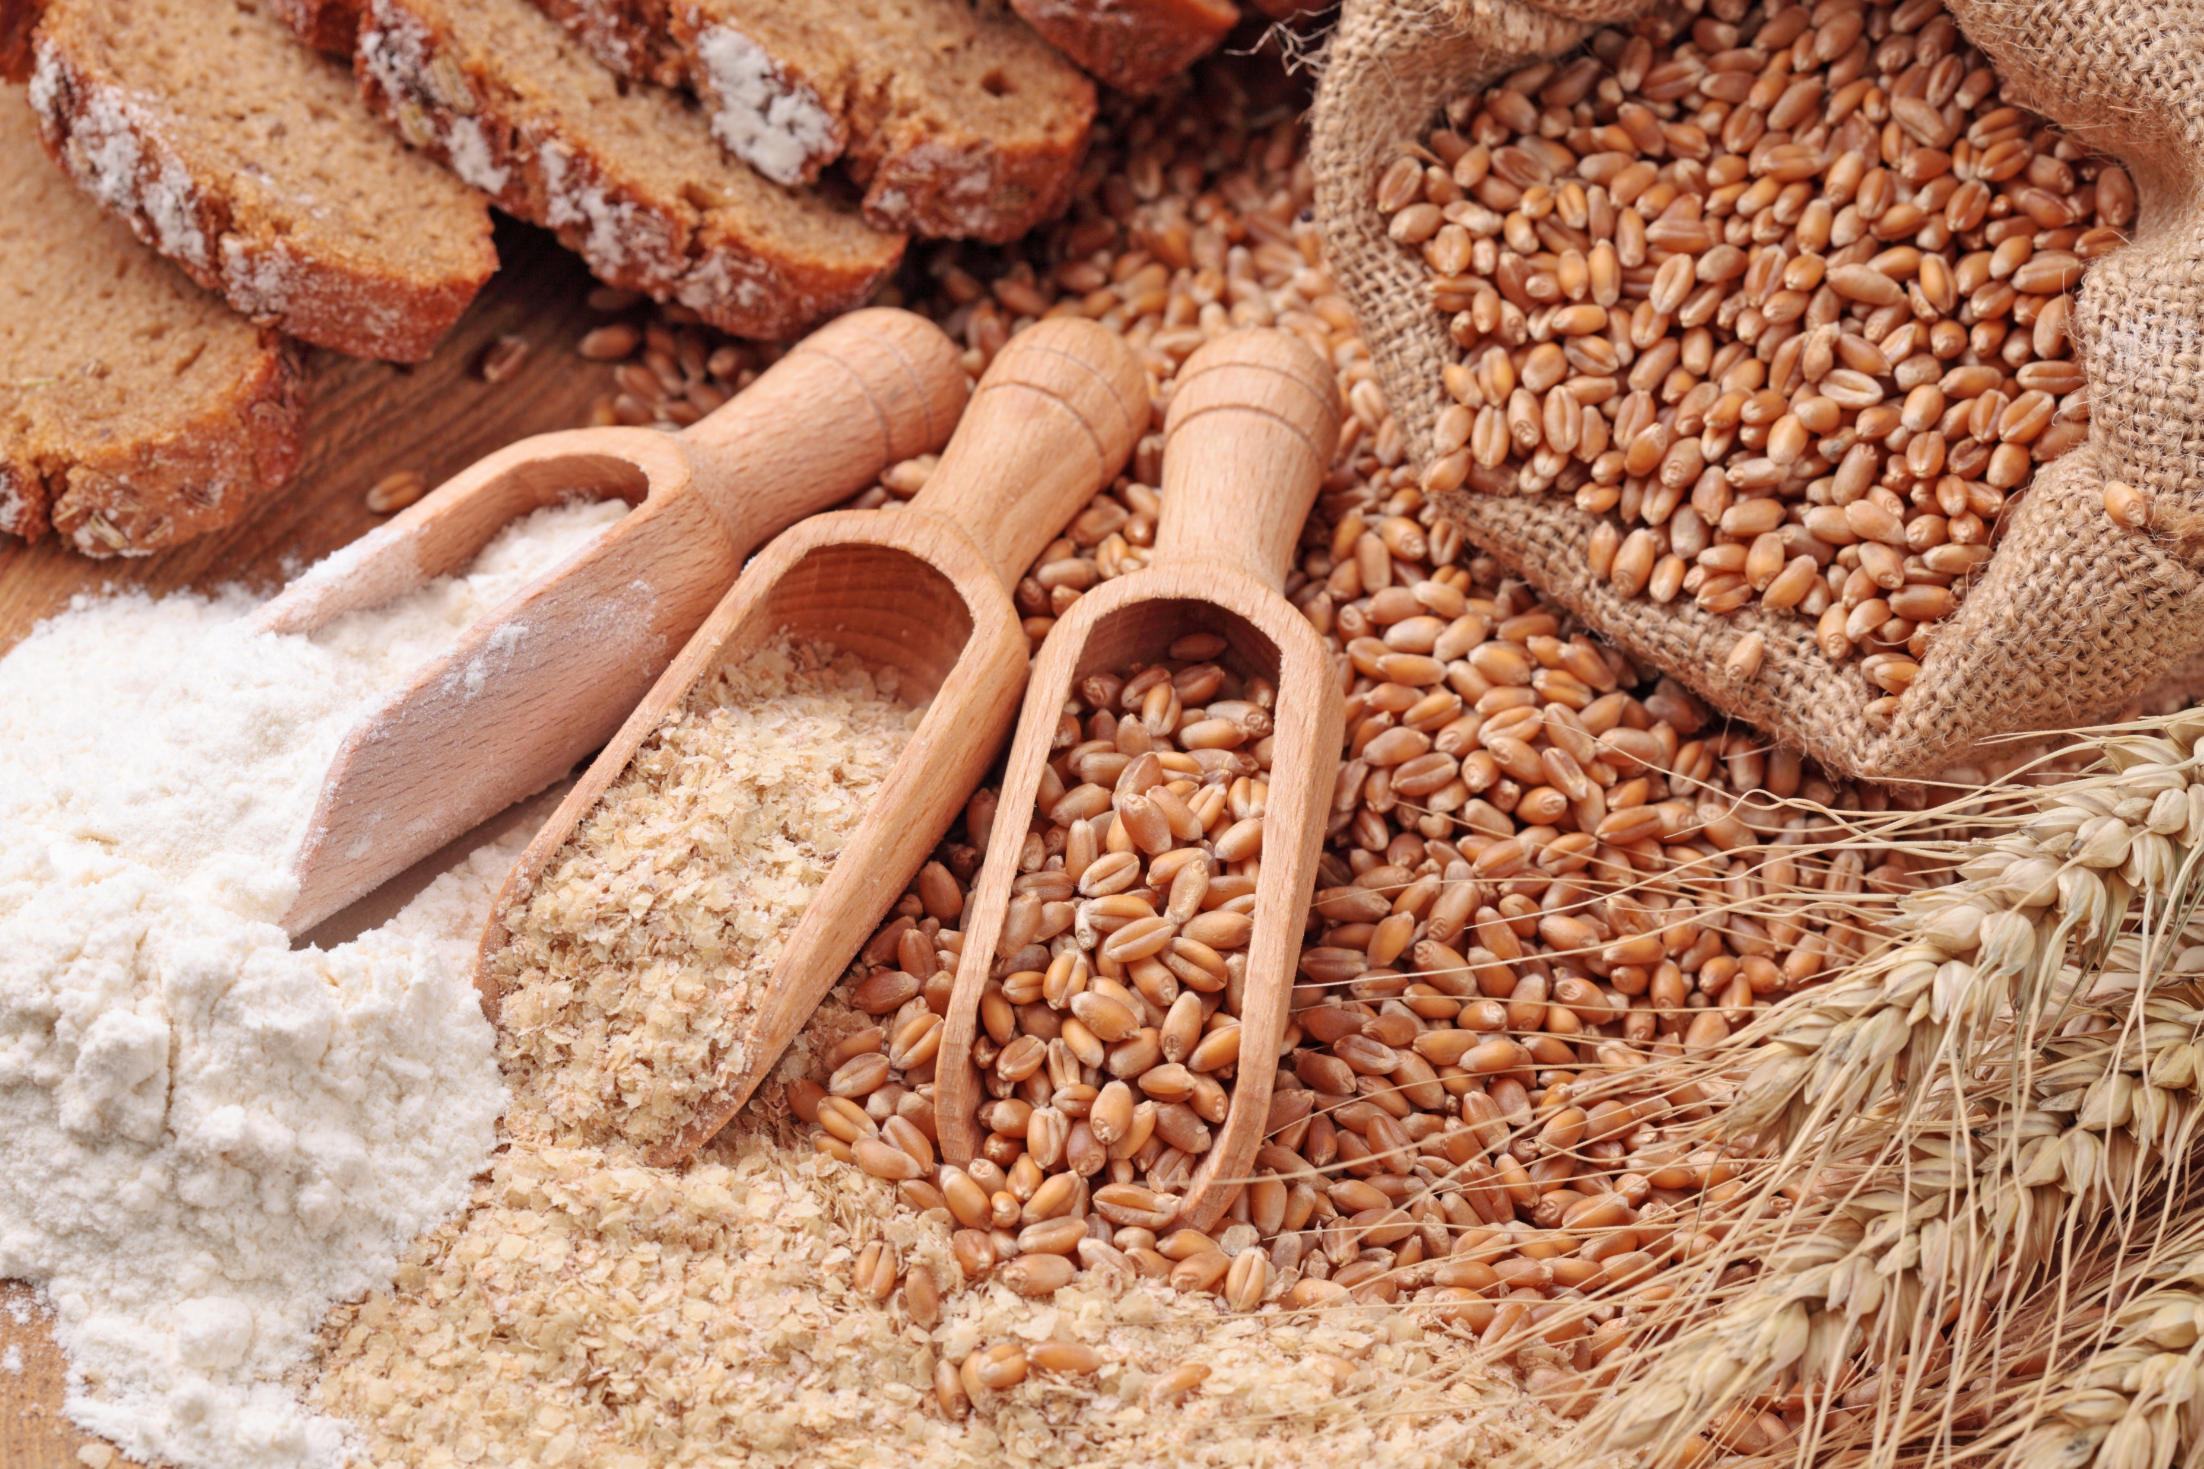
Flour
The grain is milled to make flour. Then we can use the flour to make lots of different foods.

Slide 11
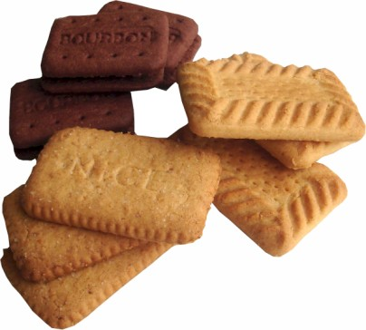
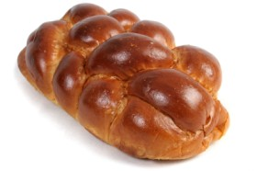
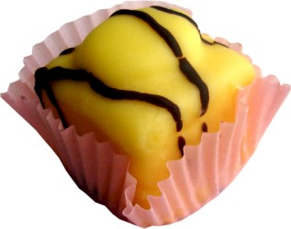
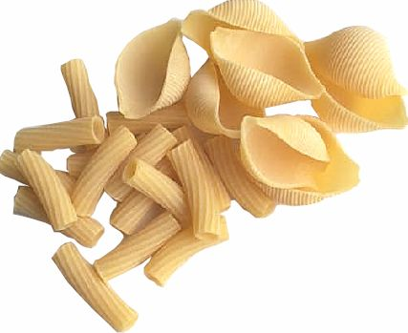
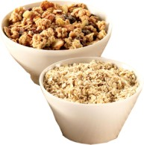
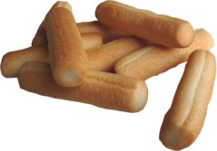
Can you name these foods made from wheat?
Biscuits
Bread
Cake
Breakfast cereal
Bread sticks
Pasta
Can you think of any others?

Slide 12
Growing wheat
For further information, go to:
www.foodafactoflife.org.uk
This resource meets the Guidelines for producers and users of school education resources about food.

