Slide 1
The effects of preparation and cooking on food

Slide 2
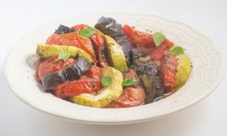
Cooking food
Some foods can be eaten raw and form an important part of the diet. However, many foods need to be prepared and cooked before they are eaten. This is for a number of reasons, including:
to make the food safe to eat by destroying pathogenic micro-organisms and toxins;
to destroy microorganisms and enzymes that cause food to deteriorate and therefore increase the keeping quality of the food;
to make the food more digestible and easier to absorb.

Slide 3
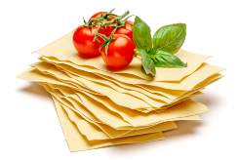
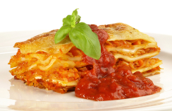
Cooking food
Food is also prepared and cooked to:
make the food more palatable – improves flavour, texture and appearance;
reduce the bulk of the food;
provide variety and interest to meals.
Hot food is also important to people, particularly in cold weather.

Slide 4
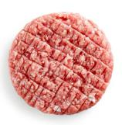
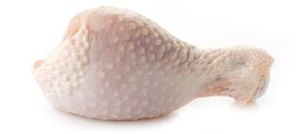
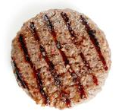
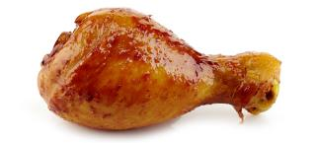
Reasons for cooking food
To destroy pathogenic microorganisms and toxins, some raw foods must be cooked to make them safe to eat.

Slide 5
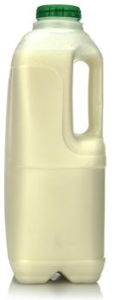
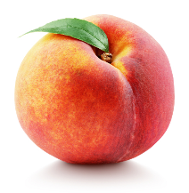
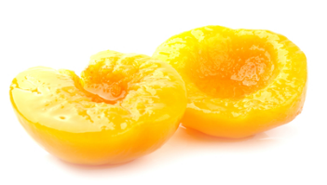
Reasons for cooking food
To improve the keeping quality of the food, microorganisms and enzymes are destroyed to help keep food longer. This is also used in heat treatment and processing methods during manufacturing (e.g. canning fruit, pasteurising milk). Pasteurisation can also destroy food poisoning bacteria.

Slide 6
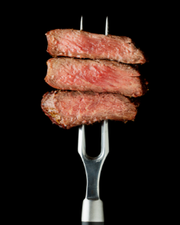
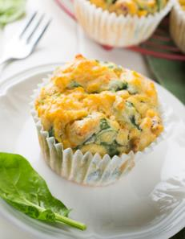
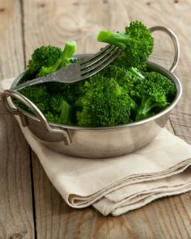
Reasons for cooking food
Preparing and cooking food helps to make it easier to digest and absorb because the structure has been changed. For example:
Meat fibres are tenderised Starch is gelatinised Cellulose is softened

Slide 7
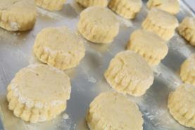
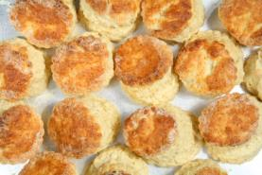
Reasons for cooking food
Cooking can improve the flavour, alter the texture and change the colour of a food, making it more appealing. Both the scones and chicken on this page are browned by the Maillard reaction, which produces characteristic browning and appetising smells and flavours. The scones are also browned by dextrinisation, which occurs when starch is heated.

Slide 8
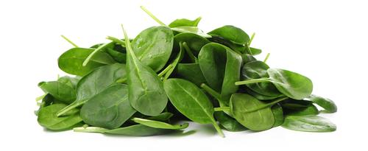
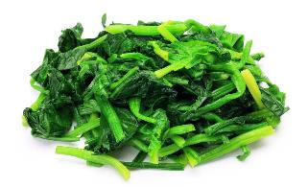
Reasons for cooking food
Preparation and cooking can reduce the bulk of some foods. For example the volume of cooked spinach is a lot less than raw spinach, allowing more to be consumed.

Slide 9
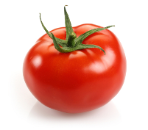
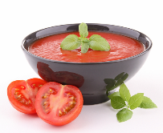
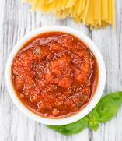
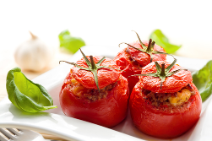
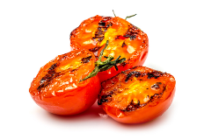
Reasons for cooking food
Cooked food in different ways can add variety to the diet. In the example below, all of the dishes are tomato based, but are distinctly different from each other.

Slide 10
Cooking food – heat transfer
Cooking requires heat energy to be transferred from the heat source, e.g. the cooker hob, to the food. This is called heat transfer or heat exchange. There are 3 ways that heat is transferred to the food. They are:
conduction;
convection;
radiation.
Many methods of cooking use a combination of these. The amount of heat and cooking time will vary according to the type of food being cooked and the method being used.

Slide 11
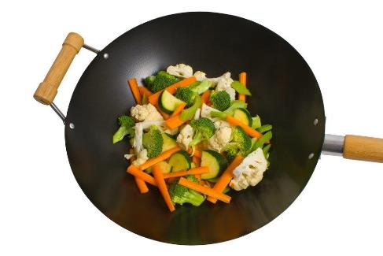
Conduction
Conduction is the exchange of heat by direct contact with foods on a surface. For example:
stir-frying vegetables in a wok;
pasteurising milk in a plate heat-exchanger;
making ice cream.

Slide 12
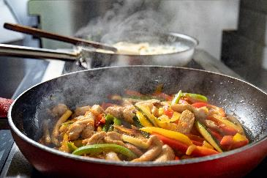
Conduction
Conduction is the direct transfer of heat energy from a hot surface. When a pan or baking tin is heated, the molecules in the metal begin to vibrate and pass the energy to neighbouring molecules.
These molecules can then directly transfer heat to the food.
Cooking by conduction depends on good contact between the:
source of heat;
cooking equipment;
food to be cooked.

Slide 13
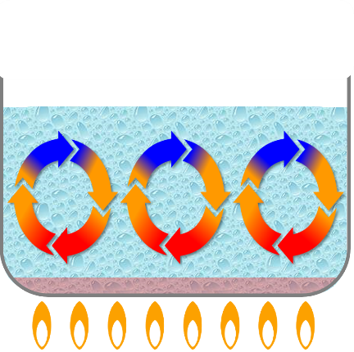
Convection
In this method of cooking, currents of hot air or hot liquid transfer the heat energy to the food. When gases (such as air) or liquids (such as water) are heated the molecules become more energetic. This makes them move around more quickly. Because of this, the molecules move further apart, making the liquid or gas less dense. This causes them to rise. Cooler liquid or gas falls to take its place. This in turn becomes heated and rises up, creating moving ‘convection currents’.

Slide 14
Convection
Food which is placed in such a liquid or gas (usually in an enclosed space) becomes cooked. This happens because the heat from the convection currents is transferred from the air or liquid to the outside of the food, then gradually through to the centre via conduction. For efficient and quicker cooking, convection currents in air need to be kept in an enclosed space, such as an oven. As hot air rises, cooler air falls – so the hottest part of an oven is at the top. Some ovens are fan assisted so that the hot air is driven around the oven to keep the temperature even from the bottom to the top.

Slide 15
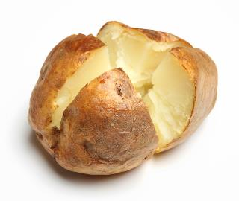
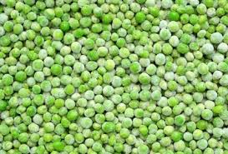
Convection
The processes of convection and conduction may work together in order to exchange heat.
For example, first the surface of a baked potato is heated by convection, then the heat is conducted through to the centre of the potato.
Convection can also be used to freeze food, e.g. blasting cold air through peas to freeze them.

Slide 16
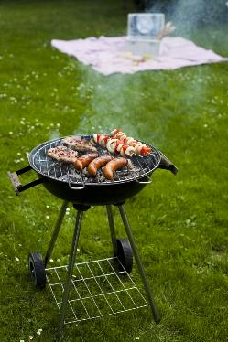
Radiation
Radiation is energy in the form of rays. The rays pass through the air until they come into contact with the food. Some are absorbed while others are reflected.
Grilling involves the use of infra-red heat rays created by gas flames, charcoal or glowing electric elements.
Heat rays from gas or electric grills travel down onto the food below.
Heat rays from a charcoal grill or barbeque travel upwards to cook the food placed above on a grid or spit.
The surface of the food nearest to the rays becomes quickly browned – and regular turning of the food is needed to ensure even cooking.

Slide 17
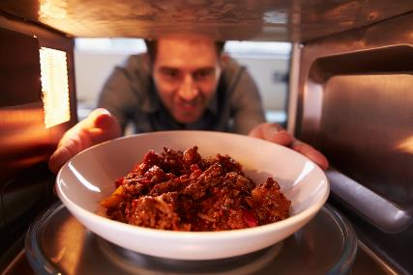
Microwave radiation
Microwaves are electromagnetic radiators of high energy and short wavelengths. They quickly heat anything containing water, by causing the water molecules to oscillate (vibrate), which produces heat.

Slide 18
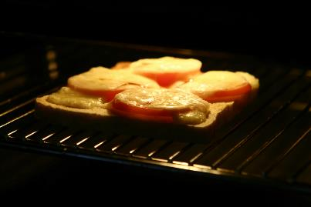
Methods of cooking food
All methods of cooking use one or more of the principles of transferring heat from the source to food. The methods of cooking are divided up into groups. These are based on the cooking medium used. They are:
moist methods of cooking;
dry methods of cooking;
fat-based methods of cooking.
Some methods use a combination, e.g. braising.

Slide 19
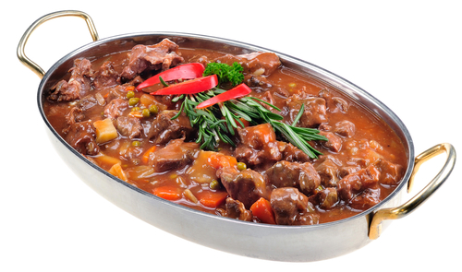
Moist methods of cooking
Heat is transferred by convection currents in the cooking liquid. Temperatures are usually lower than dry methods of cooking. Examples of moist methods of cooking are:
boiling;
braising;
poaching;
simmering;
pressure cooking;
steaming;
stewing.

Slide 20
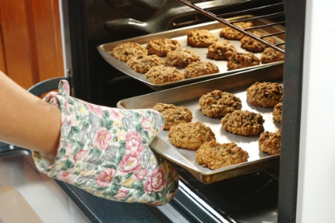
Dry methods of cooking
Heat is transferred to the surface of food by convection or radiation. The inside of the food is cooked by heat conducted through the food. Examples of dry methods of cooking are:
baking;
grilling;
roasting;
barbequing
toasting.

Slide 21
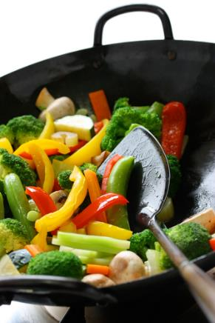
Fat-based methods of cooking
The heat is transferred by conduction (or convection in deep fat frying). Oil is heated in a pan and the heat is transferred to the food.
Examples using fat-based methods are:
stir frying;
shallow frying;
deep-fat frying.

Slide 22
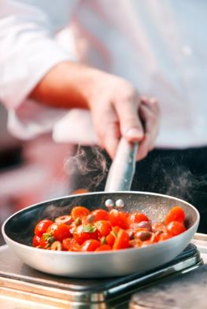
Food preparation and cooking
When food is prepared and cooked some of the processes and cooking methods used can cause changes in the food.
These changes can affect the:
nutritional value;
sensory attributes – texture, flavour, odour, visual appeal;
palatability.

Slide 23
Nutritional value
The impact of water-soluble vitamin loss can be reduced by:
Reusing cooking liquid in stocks or gravies, so vitamins are not poured away.
Steaming or microwaving vegetables instead of boiling them to reduce leaching.
If you do boil, using the minimum amount of water required.
Not overcooking the fruits and vegetables.
Selecting the most appropriate way of preparing and cooking certain foods is important to maintain or enhance their nutritional value.
Fruit and vegetables are important sources of micronutrients and require careful preparation and cooking to conserve water soluble vitamins (B vitamins and vitamin C).
These vitamins can be lost due to:
oxidation during preparation;
leaching into the cooking liquid;
prolonged cooking time;
keeping vegetables hot over a long period before serving.

Slide 24
Nutritional value
Fat-based methods of cooking increase the energy (calories) of the food.
Stir-frying uses minimal amounts of oil and therefore adds minimal excess energy.
Shallow frying uses small amounts of oil and therefore adds a little more energy.
Deep fat frying adds a large amount of energy.
Care should be taken to ensure oil is at the correct temperature. If it is not hot enough it will be absorbed by the food.
Dry frying (cooking without the addition of fat) meat allows the fat to melt which can be removed, reducing the energy.
Carbohydrate Protein Fat
4kcal per gram 4kcal per gram 9kcal per gram
Fat contains more energy (calories) than carbohydrate or protein.

Slide 25
Sensory attributes
The use of different cooking methods affects the sensory qualities of the food. These include:
texture - this is the way food or drink feels in your mouth (e.g. whether it is crisp or smooth). Cooking changes the texture of some food;
smell – cooking food can release appetising aromas and create new ones (e.g. through the Maillard reaction);
flavour - this is a combination of smell and taste. Flavour can be intensified by cooking;
visual appearance - cooking changes the visual appearance of food and can make it more attractive to eat.

Slide 26
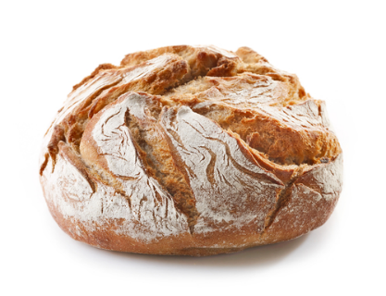
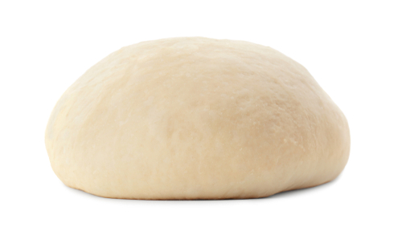
Texture
Texture changed by cooking: describe the changes you can see below.
Baking

Slide 27
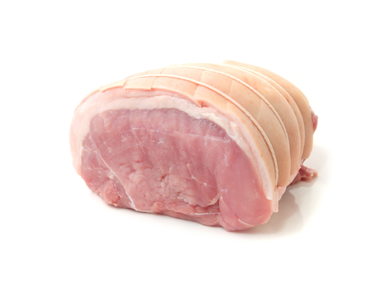
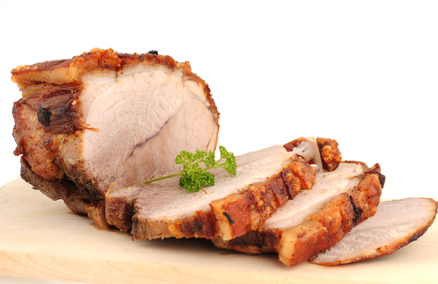
Flavour
Flavour developed and intensified by cooking. Explain what causes the meat to change colour and the flavour to intensify.
Roasting
Notes:
Teacher note:
There are many reasons that meat can turn brown. Cooking meat at a high temperature browns meat because of the Maillard reaction. The Maillard reaction is a chemical reaction between an amino acid and a reducing sugar, usually requiring the addition of heat. It is a form of non-enzymatic browning. Savoury flavours are released with a characteristic aroma.
Meat is red when the pigment myoglobin that is contained in blood is bound to oxygen. Myoglobin is related to haemoglobin, which is the iron and oxygen binding protein in blood, specifically in the red blood cells. Myoglobin breaks down during cooking and causes meat to be brownish in colour when cooked.

Slide 28
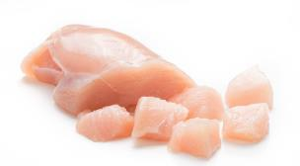
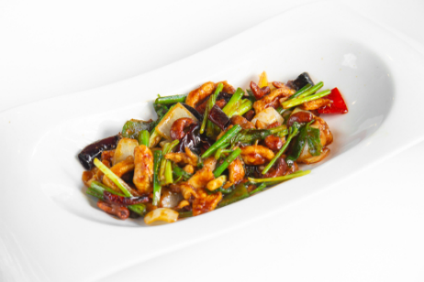
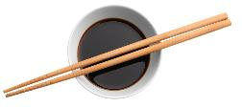
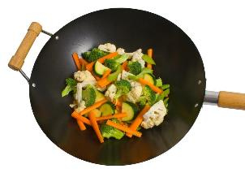
Visual appearance
Visual appearance changed by cooking. Describe how cooking has changed the visual appearance.
Stir frying

Slide 29
The effects of preparation and cooking on food
For further information, go to:
www.foodafactoflife.org.uk
This resource meets the Guidelines for producers and users of school education resources about food.

