Slide 1
Potato varieties quiz

Slide 2
Potato Challenge: How much do you know about potatoes?
How many different varieties of potato are there?
50 500 5000
On average, how many potatoes does someone in the UK eat each year?
50 500 5000
During WWII potatoes were used to make bread and cake.
True False
Which of these is not a variety of potato?
King Edward Golden Wonder White Lady Lady Balfour
Potatoes with a smooth texture like ‘Desiree’ are good for making which type of potato dish?
Mash Boiled potatoes Potato salad Chips

Slide 3
Potato Challenge: How much do you know about potatoes? Answers
How many different varieties of potato are there?
50 500 5000
On average, how many potatoes does someone in the UK eat each year?
50 500 5000
During WWII potatoes were used to make bread and cake.
True (potatoes replaced flour) False
Which of these is not a variety of potato?
King Edward Golden Wonder White Lady Lady Balfour
Potatoes with a smooth texture like ‘Desiree’ are good for making which type of potato dish?
Mash Boiled potatoes Potato salad Chips

Slide 4
Potato Challenge: How much do you know about potatoes?
Potatoes with a fluffy texture like ‘Maris Piper’ are good for making which type of potato dish?
Mash Boiled potatoes Potato salad Chips
Salad potatoes like ‘Charlotte’ are also good for making which type of potato dish?
Mash Steamed potatoes Wedges Chips
Which one of these cooking methods is not usually used for cooking potatoes?
Grilling Roasting Frying Baking
Which of these dishes usually contains potato?
Lasagne Cauliflower cheese Cottage pie Steak and kidney pie
Which of these dishes does not usually contain potato?
Fish cakes Gnocchi Frittata Spaghetti bolognaise

Slide 5
Potato Challenge: How much do you know about potatoes? Answers
Potatoes with a fluffy texture like ‘Maris Piper’ are good for making which type of potato dish?
Mash Boiled potatoes Potato salad Chips
Salad potatoes like ‘Charlotte’ are also good for making which type of potato dish?
Mash Steamed potatoes Wedges Chips
Which one of these cooking methods is not usually used for cooking potatoes?
Grilling Roasting Frying Baking
Which of these dishes usually contains potato?
Lasagne Cauliflower cheese Cottage pie Steak and kidney pie
Which of these dishes does not usually contain potato?
Fish cakes Gnocchi Frittata Spaghetti bolognaise

Slide 6
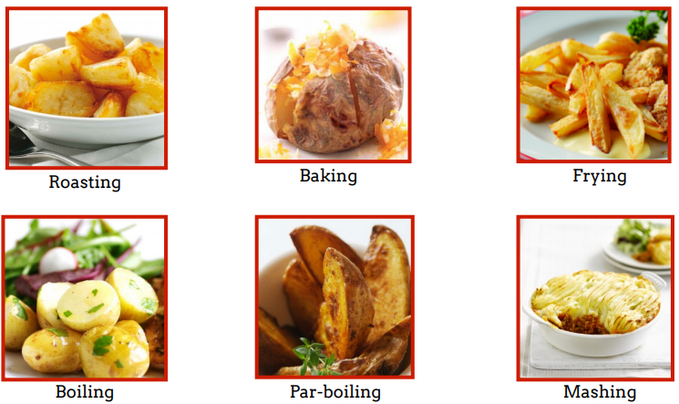
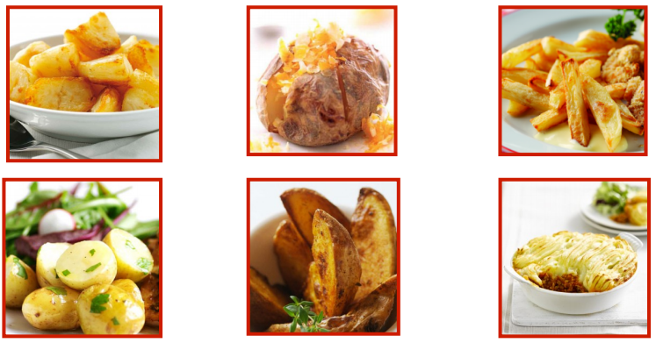
Guess the method
Match each cooking method to the correct picture.
Baking Boiling Frying Mashing Parboiling Roasting

Slide 7
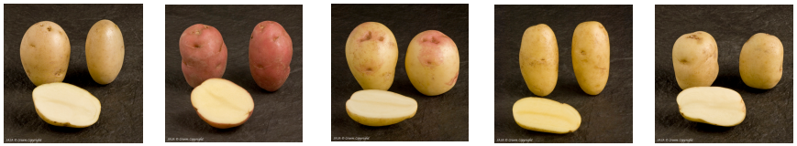
Guess the variety
Look at a range of different potatoes (real examples or pictures).
• There are three main types of potato:
– Fluffy: Fluffy in the middle when cooked. Good for roast, baked or chips
– Smooth: Smooth texture when cooked. Good for mash, boiled or wedges
– Salad: Firm to the bite when cooked. Good for boiled, steamed or roasted in skins
• Can you tell, by looking, which group each potato belongs to?
• What do you notice?

Slide 8
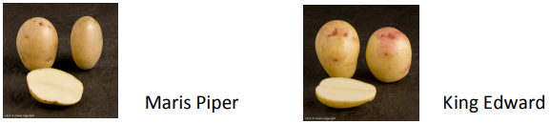
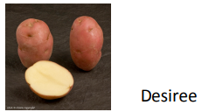
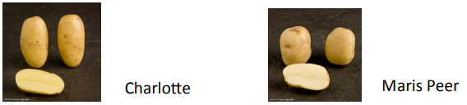
Guess the variety: Answers
Fluffy: Fluffy in the middle when cooked. Good for roast, baked or chips
Smooth: Smooth texture when cooked. Good for mash, boiled or wedges
Salad: Firm to the bite when cooked. Good for boiled, steamed or roasted in skins

Slide 9
Match the definition
Key vocabulary | Definitions
Deep Frying | Potatoes that are good for roasting, baking or chips
Steaming | Potatoes that are good for mash, boiling or wedges
Maris Peer | Potatoes that should be steamed boiled or roasted in skins
Roasting | A fluffy potato
Saute | A salad potato
Fluffy potatoes | A smooth potato
Smooth potatoes | Cooking by surrounding with heat
Salad potatoes | Cooking food in liquid over a direct heat
Desiree | Cooking food immerse in hot oil or fat
Baking | Cooking using steam from boiling water
Boiling | Reducing food to a pulpy mass by crushing
Mashing | Cooking food in the oven with the addi0on of oil or fat
King Edward | Cooking quickly in a shallow fan with a minimum of fat

Slide 10
Match the definition: Answers
Key vocabulary | Definitions
Fluffy potatoes | Potatoes that are good for roasting, baking or chips
Smooth potatoes | Potatoes that are good for mash, boiling or wedges
Salad potatoes | Potatoes that should be steamed boiled or roasted in skins
King Edward | A fluffy potato
Maris Peer | A salad potato
Desiree | A smooth potato
Baking | Cooking by surrounding with heat
Boiling | Cooking food in liquid over a direct heat
Deep Frying | Cooking food immerse in hot oil or fat
Steaming | Cooking using steam from boiling water
Mashing | Reducing food to a pulpy mass by crushing
Roasting | Cooking food in the oven with the addi0on of oil or fat
Saute | Cooking quickly in a shallow fan with a minimum of fat

Slide 11
For further information, go to:
www.foodafactoflife.org.uk

