Slide 1
Farming: Growing potatoes

Slide 2
Information, ideas and activities for lessons
Where are potatoes grown?
The journey from farm to fork:
Planting
Protecting and growing
Harvesting
Storage
To our plates

Slide 3
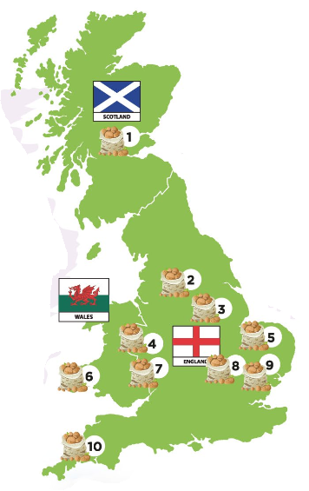
Potato Growing in Great Britain
Britain is one of the largest producers of potatoes in the world.
5.4 million tonnes produced each year
Grown on 110,000 hectares
80% of potatoes eaten in Britain, grow in Britain

Slide 4
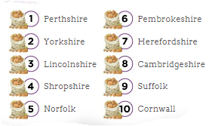
Potato Growing in Great Britain
Potatoes are grown throughout Britain.
Nearly 100 varieties grown in 50 counties.
Over 2000 specialist growers.
British potato industry employs 16,000 people.
Over 40% of planted area is in East England.
Scotland grows nearly ¼ of the GB potato crop.
40% of potatoes grown in Scotland are seed potatoes for growing rather than eating.

Slide 5
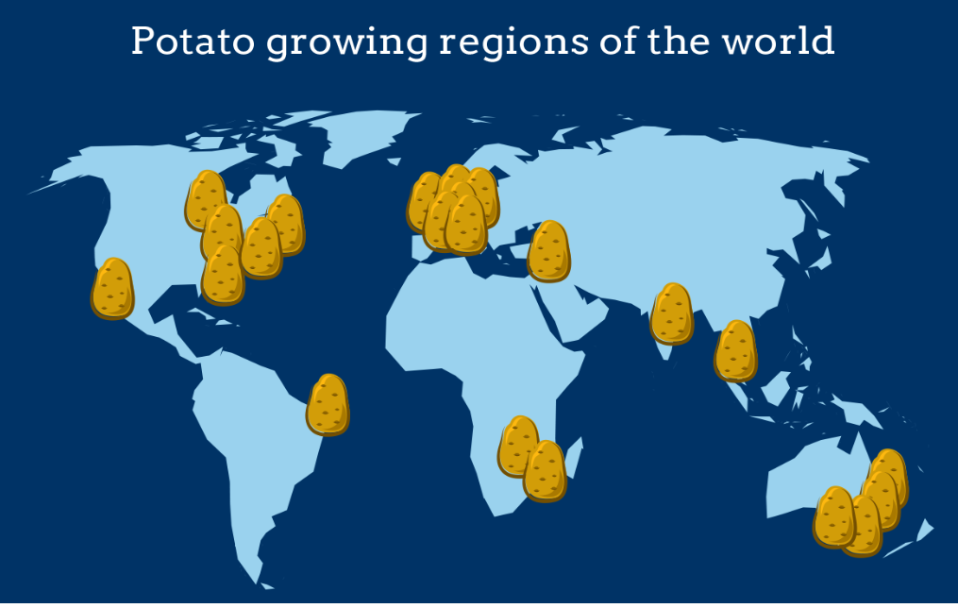
Potato growing around the world

Slide 6
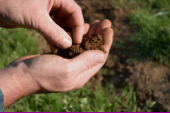
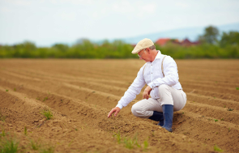
Farming: From farm to fork
1) Choosing where to plant
Soil tested for nutrients and moisture.
Rainfall replaces need for irrigation.
6 + year rotation to allow nutrients to replenish.
2) Preparing to plant
Soil is ploughed and turned.
Spread fertiliser.
Remove stones using stone separator.
Usual planting time is Spring.

Slide 7
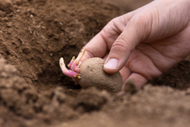
Farming: From farm to fork
3) Planting
Planted in rows 15-17cm deep.
Planted from January (Cornwall only).
Usual planting time is Spring.

Slide 8
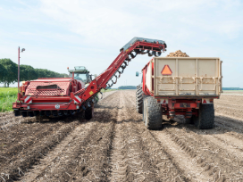
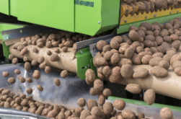
Farming: From farm to fork
4) Protecting the crop
Plant protection products used to care for crops as they grow.
Guard against insects and disease.
5) Harvesting
Ready to harvest after 5 months.
From June to end October.
Test digs before harvest.
Lift, grade and remove small and damaged potatoes.

Slide 9
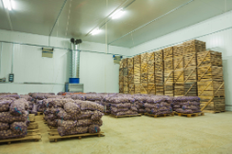
Farming: From farm to fork
6) Storage
Bulk storage or weigh and bag for distribution.
Farmers check and grade throughout storage season.

Slide 10
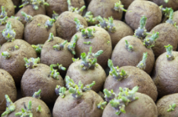
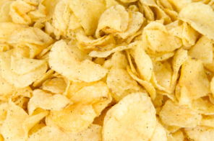
Not all potatoes go straight to the shops
1. Future Crops
Reproduced from other potatoes
Part of crop set aside for next year’s planting
2. Manufacture
Delivered to factories. Washed, peeled, sliced, fried, flavoured, packaged and sent to retailer. During harvest potatoes can become packaged crisps in one hour!
3. Ready prepared potato
British manufacturers of frozen potato products are the largest purchasers of British potatoes, e.g. chips.

Slide 11
For further information, go to:
www.foodafactoflife.org.uk

