Slide 1
Potato Varieties

Slide 2
Information, Ideas and activities for lessons
This presentation covers:
• A brief history of potatoes. Number of varieties grown worldwide
• Three main types of potato: Fluffy, Smooth and Salad.
• Matching potato types to cooking methods.
.

Slide 3
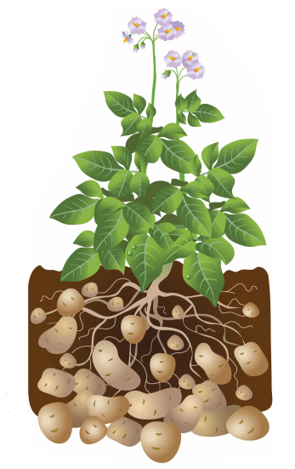
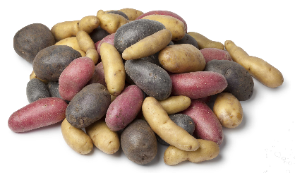
What is a potato?
A potato is definitely not ‘just a potato’.
Over 4000 edible varieties grown throughout the world.
Many different colours, shapes and sizes.
They are tubers and grow underground.

Slide 4

A brief history
4000 BC Discovered in Peru over 6,000 years ago.
1536 Brought to Europe by Spanish, having conquered Peru.
1589 Sir Walter Raleigh introduced to Ireland in 1589.
1840s The Potato Famine – 1m died in Ireland when ‘Potato Blight’ wiped out the potato crop.
1902 King Edward potato variety introduced at time of Coronation of King Edward VII.
1940’s Potato production doubled, potatoes replaced flour and other ingredients during WWII. Potato Pete promoted potatoes.
1995 Potatoes became the first food grown in space.
2016 300m tonnes potatoes grown globally.

Slide 5
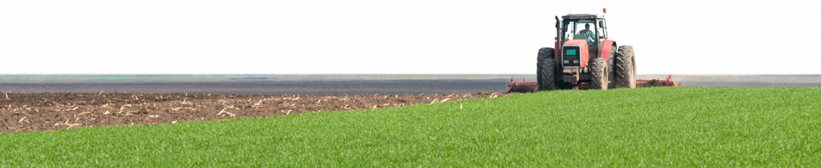
British potatoes
Britain is one of the world’s largest potato producers.
5.4 million tonnes grown every year.
100 varieties in 50 counties.
Availability depends on region and season.
80% of potatoes grown in Britain are eaten in Britain.

Slide 6
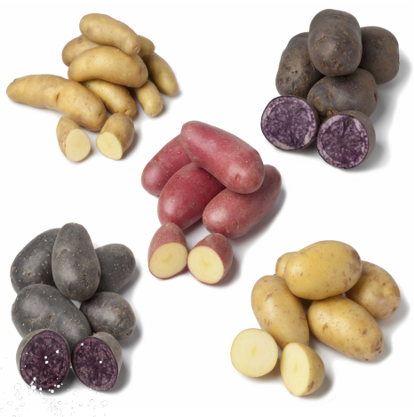
New varieties
Specialist breeders develop new, improved varieties.
Better resistance to pests and diseases.
Better storage.
Greater nutrition.
Increased yield.
Consistency for better processing.
Improved quality, appearance.
Reduced need for inputs such as water and fertiliser.

Slide 7
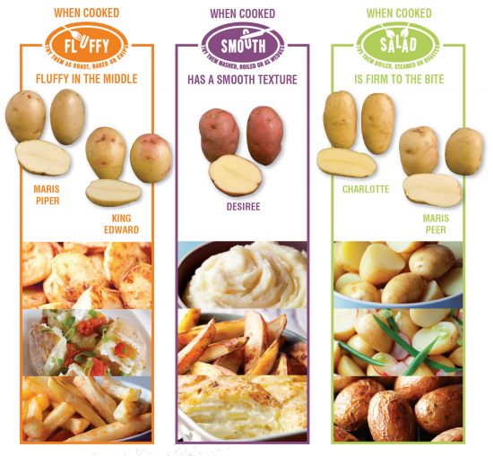
Know your potatoes
There are three different types of potato:
fluffy;
smooth;
salad.
To get the right results you need to choose the right type of potato for the cooking method you have chosen

Slide 8
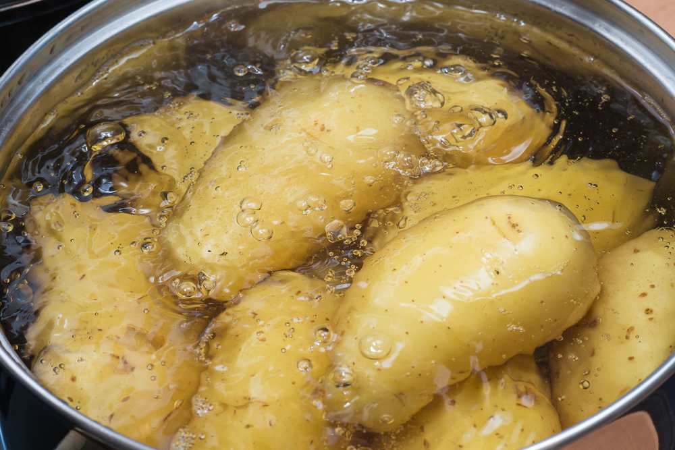
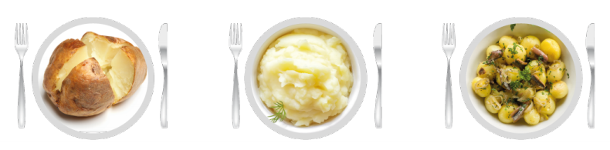
The science of potatoes
Different potatoes have different textures when cooked.
Vary from fluffy to smooth due to cell changes during cooking.
Starch absorbs water.
Starch cells swell and begin to break down.
New potatoes hold their shape best because starch cells are less mature.

Slide 9
Activity 1: Varieties Taste Test
Choose a cooking method: boiling, mashing or baking.
Take a sample of a fluffy, smooth and salad potato.
Cook each potato in the same way.
Taste test the three samples. Record findings, using 5 words to describe each type when cooked.
Which potato performed best in the test?
Compare findings with professional recommendations.
Compile a mind map to highlight the versatility of potatoes.
Discuss the properties that made the potatoes suited (or not) to the cooking method.

Slide 10
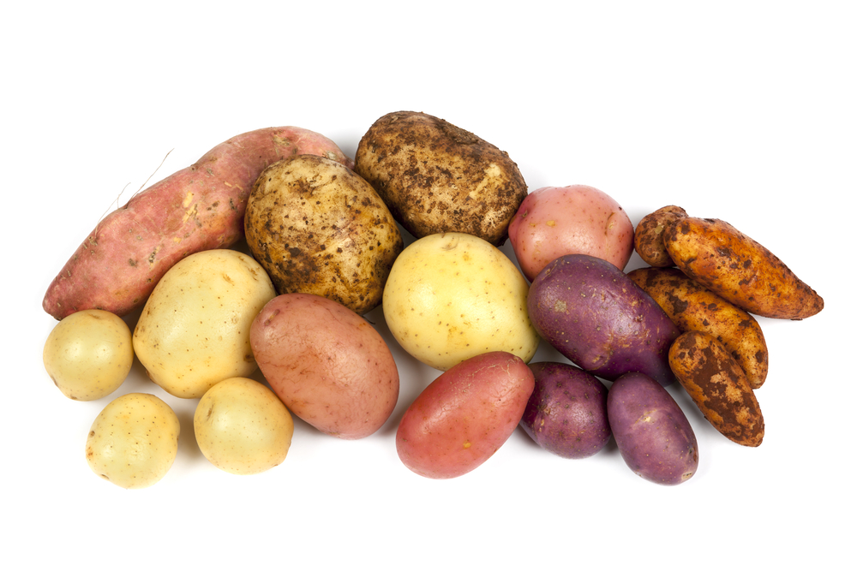
Activity 2: Invent a potato salad
Prepare: Consider the ingredients, appearance, aroma, flavour and texture.
Invent: Develop a potato salad using potatoes and four other ingredients. Cook.
Assess: Assess the dish for appearance, flavour, texture and aroma. Give a 1-5 star rating for each and record results in a table.
Next time: How could the recipe be improved? Vary the cooking time? Prepare differently? Different ingredients? Different potato? Could your recipe be healthier? How?

Slide 11
For further information, go to:
www.foodafactoflife.org.uk

