Slide 1

Cooking for Life: Encouraging a Love of Food

Slide 2
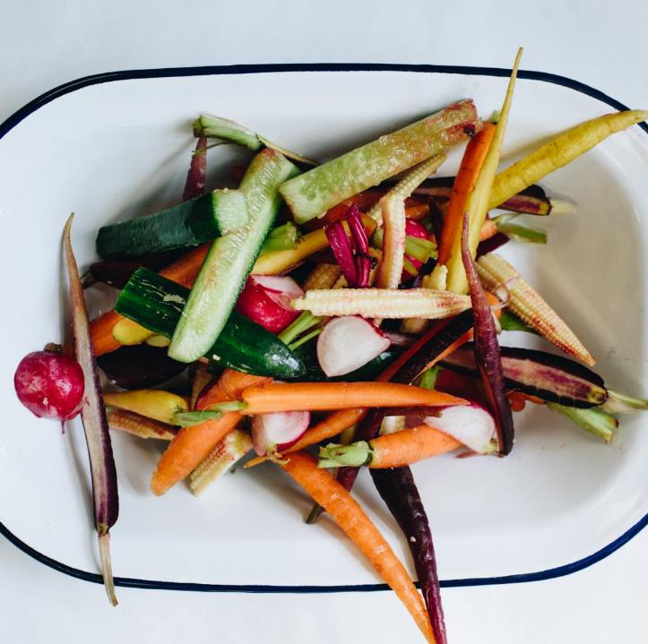
Intro: Chefs in Schools
Charity Established in April 2018
Co-founded by Henry Dimbleby, author of School Food Plan
Supported by leaders in Food and Food Education
Train chefs from the private sector to work in school kitchens, cooking the food and teaching the children to cook
Aim to be in 100 schools by 2023
6,750 children on the programme or in training 2019
Both primary and secondary schools

Slide 3
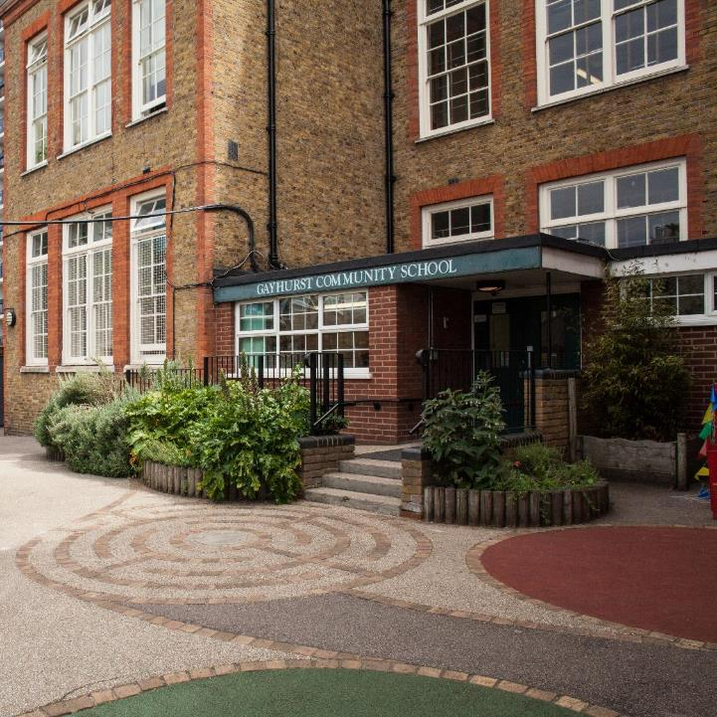
Gayhurst Community School
Our Model School
Head Chef at Nopi, Ottolenghi’s Mayfair restaurant
Tweet from Henry Dimbleby
Working with more purpose
The food when I arrived
My vision for the food and food education
Cooking from scratch, food on the tables, food appreciation in the classrooms
Now in 5 schools in Hackney including the 3 Leap Federation schools for which I am the Executive Chef
8 further schools have already signed up for 2019, including our first secondary school, EGA

Slide 4
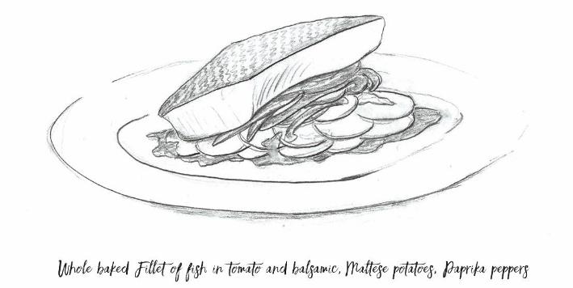
It Takes Time: How The Kids Learnt to Love Fish
Started by cooking the same menu, but from scratch
Standing by the bins
Fish was ‘orange, breaded objects’
At the same time – education
‘Naked fish’
Whole side of hake with reduced tomato and balsamic glaze
Difference in attitude from Reception through to Y6

Slide 5
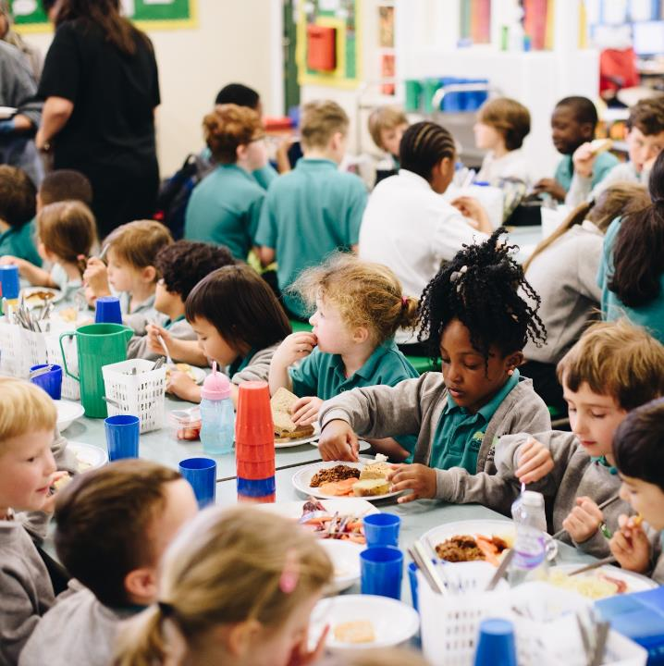
A Whole School Approach
The Whole School Approach - means treating:
Food as a vital element of school life
Dining hall as an integral part of the school
Children and adults eat together
Chefs and cooks as important staff members
Food education
Focus on the needs of the children: health, food, food education, environment, brand (see What Works Well)
Primary and secondary schools: What is the Difference?

Slide 6
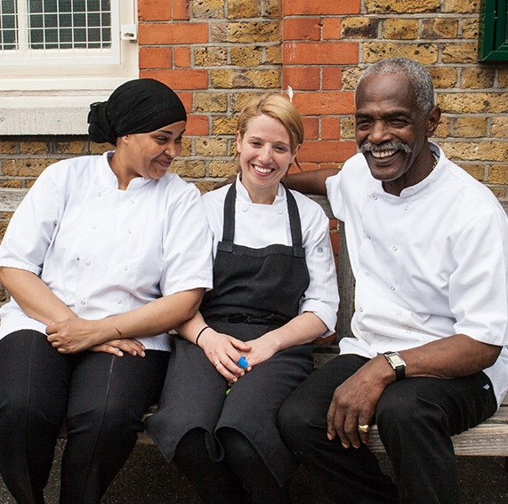
Work with the Whole School Community
The kitchen team is key to a good school food culture:
Respect - uniform
Use their names
Invite them to parent meetings
Team Building – both in dining hall & kitchen
Parents and pupils:
Child as customer
Children’s School Food Council
Parent tasting sessions
Take the kids with you – marketing
63

Slide 7
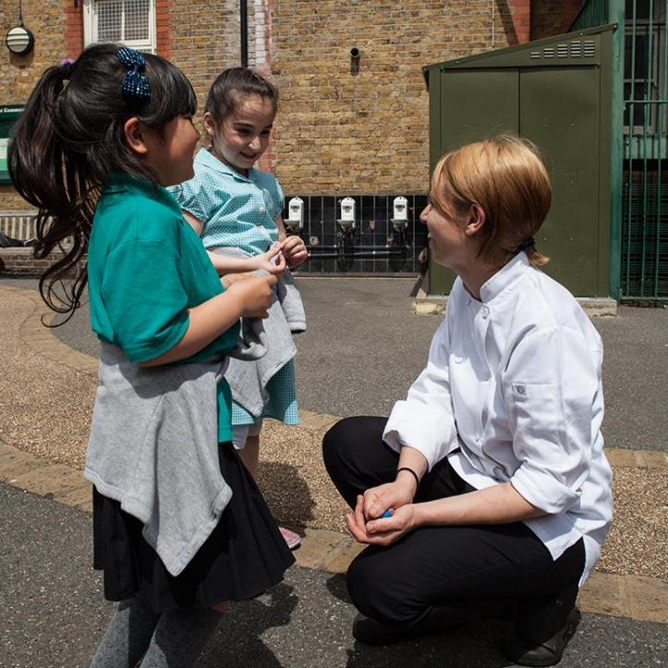
Dining Hall + Classroom
A significant part of changing the food culture at Gayhurst has been in the marrying of the food in the dining room and the cookery teaching in the classroom and kitchen.
Get experts in – invite local chefs, farmers, fishmongers, butchers to teach the children
Make food cross-curricular
‘Food Appreciation’ – take the food into the classroom
Show what food really looks like
Food assemblies
63

Slide 8
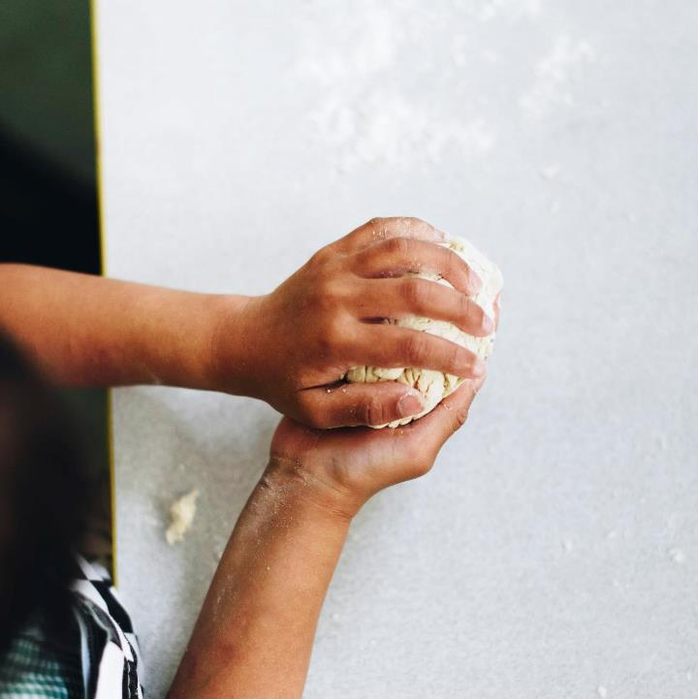
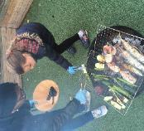
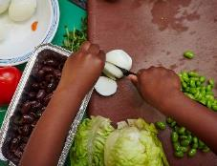
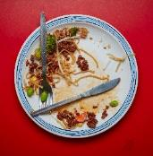
Cookery Classes at Gayhurst
Instilling a life-long love of cooking:
Engaging the children
Be bold, make it exciting
Cook with fire, use knives, be chefs
Our Primary cookery curriculum is 7 lessons: Bake bread, make soup, prepare vegetables, understand and cook eggs, cook over fire, make desserts
69

Slide 9
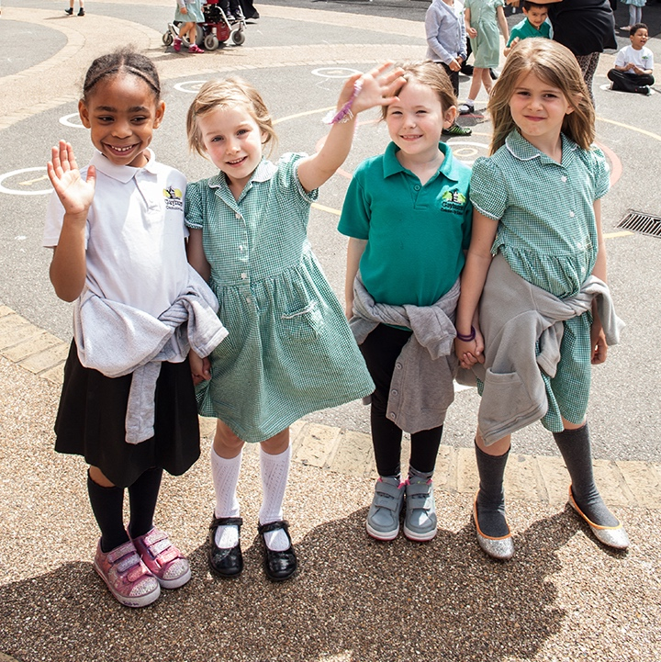
Thank You

