Slide 1
Food and nutrition in schools and child health
Roy Ballam
British Nutrition Foundation
r.ballam@nutrition.org.uk

Slide 2

The British Nutrition Foundation
Independent charity
Established in 1967
Aims to make nutrition science accessible to all
Work realised through websites; media engagement; Nutrition Bulletin; conferences and events; publications; training; work with schools; projects and collaborations; wider stakeholder engagement; awards
Patron HRH The Princess Royal
www.nutrition.org.uk

Slide 3

Health
Policy
School
Teacher
Promotion
Today
Child health and policy context
Food and nutrition education in UK schools
Food provision
The importance of training
Healthy Schools

Slide 4
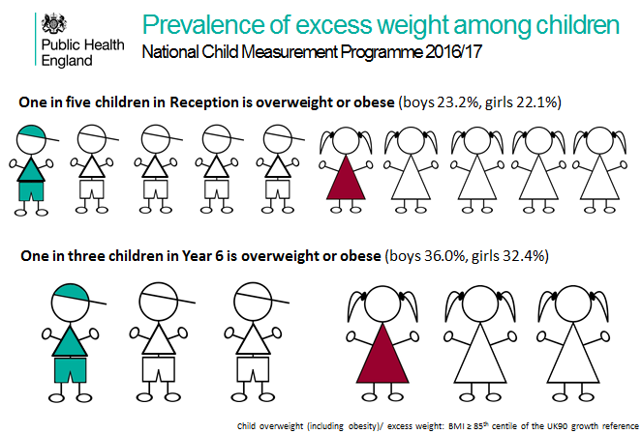
Overweight and obesity
4-5 years old
10-11 years old
https://app.box.com/s/og3q86aqejc99okxe9xyvpfvo21xai21/folder/45752848530

Slide 5
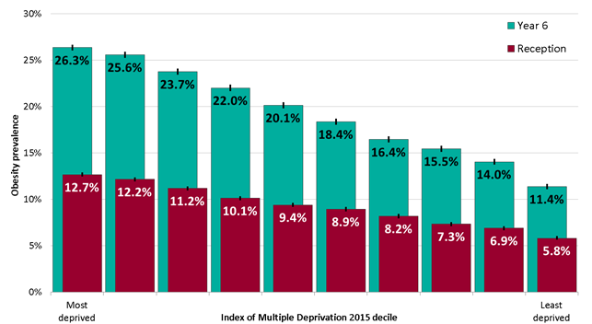
Child Measurement Programme, England 2016/17
Child obesity prevalence is closely associated with socioeconomic status.
More deprived populations tend to have higher obesity prevalence.
Obesity prevalence in the most deprived 10% of areas in England is more than twice the prevalence in the least deprived 10%.
https://digital.nhs.uk/services/national-child-measurement-programme/

Slide 6
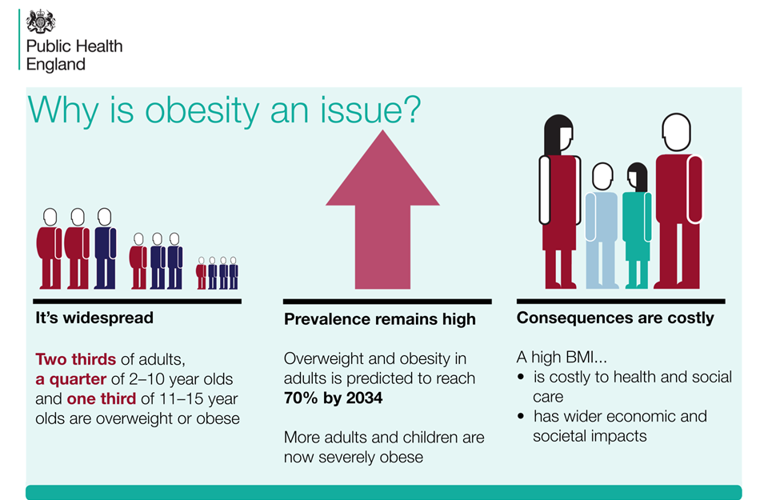
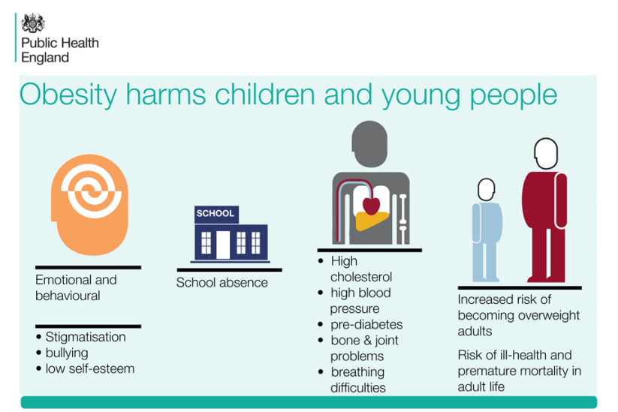
Obesity
https://www.gov.uk/government/publications/childhood-obesity-applying-all-our-health/childhood-obesity-applying-all-our-health

Slide 7
Micronutrients and fibre
Concerns over micro-nutrient deficiency in older children.
The percentage of children meeting the AOAC fibre recommendation was 10% of those aged 1.5 to 3 years and 4 to 10 years, and 4% of those 11 to 18 years.
 | % with intakes below LRNI GIRLS 11-18 years | % with intakes below LRNI BOYS 11-18 years
Vitamin A | 24 | 19
Riboflavin | 26 | 13
Folate | 15 | 3
Iron | 54 | 12
Calcium | 22 | 11
Magnesium | 50 | 27
Potassium | 38 | 18
Iodine | 27 | 14
Selenium | 45 | 26
Zinc | 27 | 18
Lower Reference Nutrient Intake (LRNI): The LRNI is the amount of a nutrient that is enough for only a small number of people in a group who have low requirements (2.5%).
https://www.gov.uk/government/statistics/ndns-results-from-years-7-and-8-combined

Slide 8

Health Survey for England 2017 (2018)
Parents perception of child’s weight: Parents of overweight and obese children often thought that their child was the right weight.
Children’s overweight and obesity was associated with that of their parents (28% of children of obese mothers were also obese).
18% of children aged between 5 and 15 ate the recommended five or more portions of fruit and vegetables a day (average 3.2 portions/day). [Adults – 29%.]
The proportion of children aged 8 to 15 who had ever smoked has decreased from 19% in 1997 to 5% in 2017.
The proportion of children aged 8 to 15 reporting ever having had a proper alcoholic drink – a whole drink, not just a sip - fell from 45% in 2003 to 14% in 2017.
https://digital.nhs.uk/data-and-information/publications/statistical/health-survey-for-england/2017#summary

Slide 9
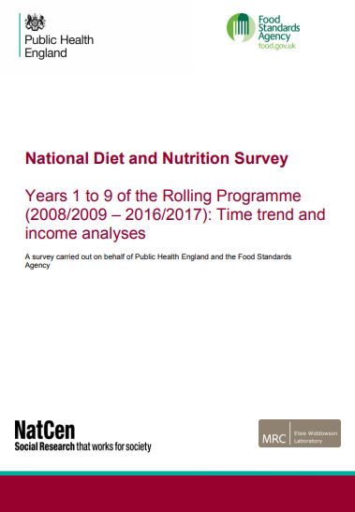
NDNS: time trend and income analyses for Years 1 to 9 (2019)
Report from Public Health England and the Food Standards Agency looks at trends over the course of the 9 years of the rolling programme in terms of food consumption, nutrient intakes and nutritional status in the UK.
Intakes of free sugars and sugary drinks down, but intakes remain well above maximum recommendation. The biggest changes to both free sugars and sugary drinks were seen in children.
No significant change to total fruit and veg intakes.
Generally little change in oily fish consumption to fish intakes.
Little change to energy and fat intakes.
Small changes to dietary fibre intakes. There were small reductions in children’s fibre intakes, which were only significant for girls aged 4-10 (0.2g/day per year).
Concerns with vitamin D status.
https://www.nutrition.org.uk/nutritioninthenews/new-reports/ndnstrends.html

Slide 10
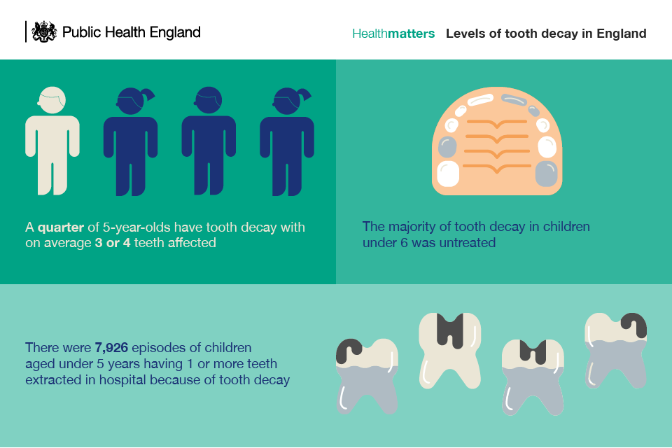
Dental health
Tooth decay is largely preventable yet it remains a serious problem.
Findings from Public Health England’s (PHE) 2015 national dental epidemiology survey of 5 year old children showed that in 2015 in England, a quarter (25%) of 5 year olds had experienced tooth decay, having on average 3 or 4 teeth affected.
The vast majority of tooth decay was untreated.
https://www.gov.uk/government/publications/health-matters-child-dental-health/health-matters-child-dental-health

Slide 11

Key policy development
Childhood obesity – a plan for action (chapters 1 and 2)
Sugar tax (drinks) – Soft Drinks Industry Levy (consult on ban on sale of energy drinks to children)
Sugar reformulation (20% reduction in the food most commonly eaten by children by 2020)
Calorie reduction programme (Plans for a programme of work with the food industry to reduce calories by 20% by 2024, in 15 savoury food categories using reformulation and /or reductions in portion sizes)
Advertising and promotions (updating current marketing restrictions to ensure they reflected the latest dietary advice)
https://www.gov.uk/government/publications/childhood-obesity-a-plan-for-action (2016)
https://www.gov.uk/government/publications/childhood-obesity-a-plan-for-action-chapter-2 (2018)

Slide 12
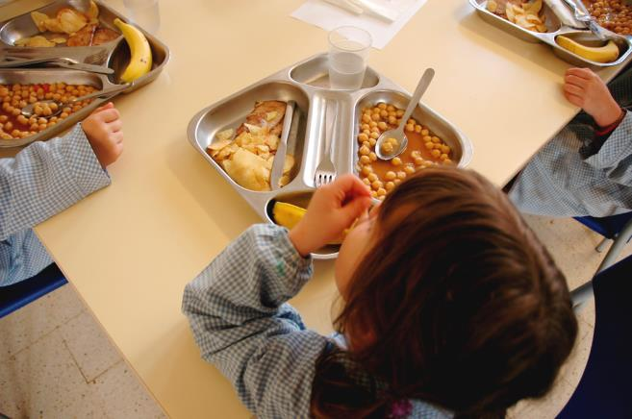
Key policy development
Childhood obesity – a plan for action (chapters 1 and 2)
Healthy rating scheme (a framework for self-evaluation for promoting healthy eating and physical activity during the school day)
School food provision – update school food standards (bring in line with current advice)
Physical activity – promote more activity; adopt an active mile
Curriculum – food education mentioned, but no specific actions
OFSTED (school inspection) – new inspection framework (consider health); research into a curriculum that supports good physical development
https://www.gov.uk/government/publications/childhood-obesity-a-plan-for-action (2016)
https://www.gov.uk/government/publications/childhood-obesity-a-plan-for-action-chapter-2 (2018)

Slide 13
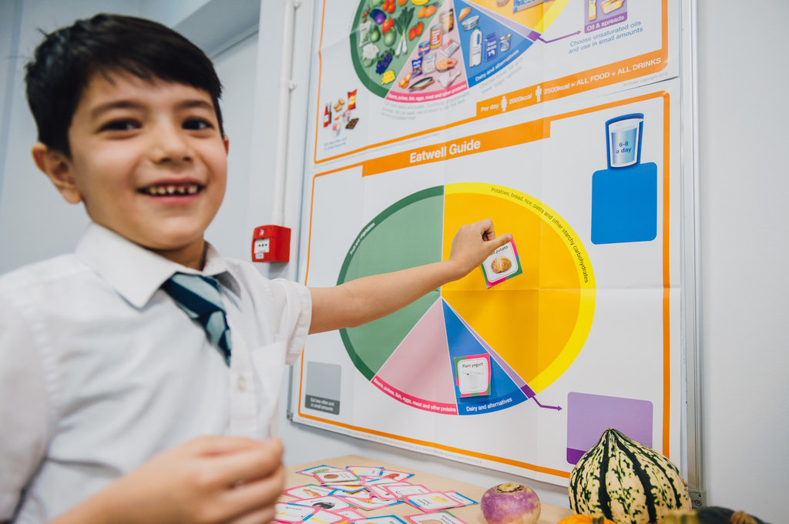
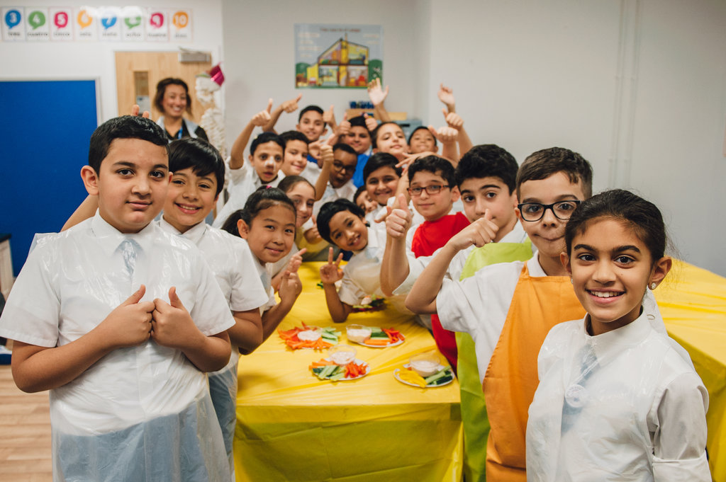
Inspection research
OFSTED – school inspection (2018)
As part of the Childhood obesity: a plan for action (2016) , Ofsted has reviewed obesity, healthy eating and physical activity in schools.
The contribution of schools is extremely important.
But it must be about doing what schools do best: education.
We should not imagine that schools alone can have a direct and measurable impact on children’s weight.
There are too many factors beyond the school gate that make this impossible for them to control.
https://www.gov.uk/government/publications/obesity-healthy-eating-and-physical-activity-in-primary-schools

Slide 14

Food provision in schools

Slide 15

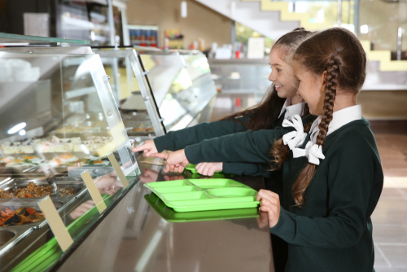
Food in schools
Breakfast: National School Breakfast Programme (DfE, Magic Breakfast and Family Action) and companies
Lunch
  School: work about to start on review and update
  Lunchbox: advice from Change4Life and British Nutrition Foundation
  School Food Plan: website to close, so download what you need!
Update needed to food and drinks standards
Monitoring required
Link provision and education – both are contexts for learning

Slide 16
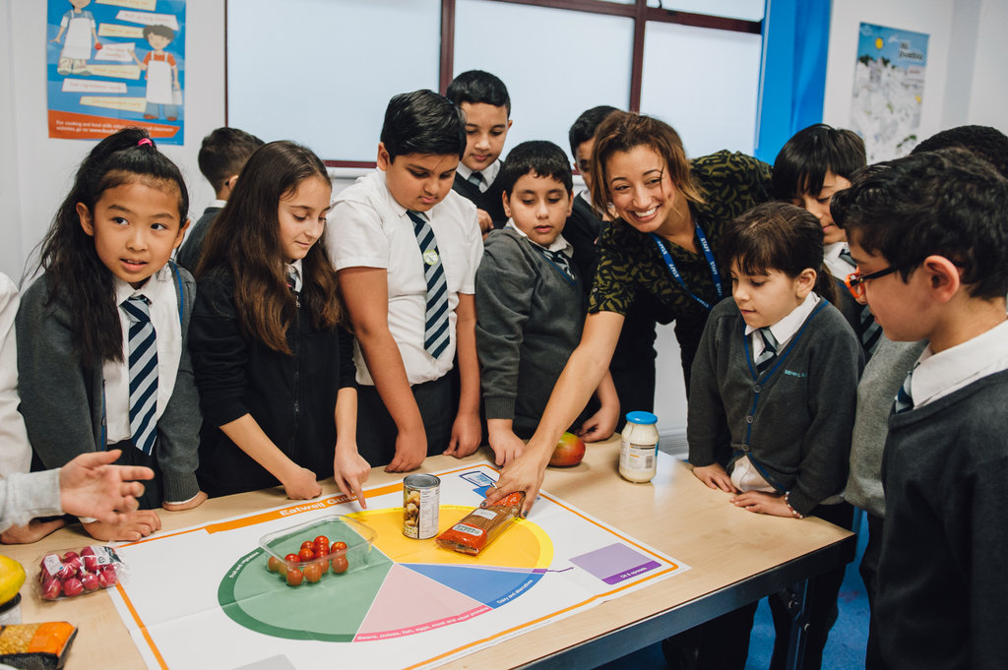
Food and nutrition education in schools

Slide 17
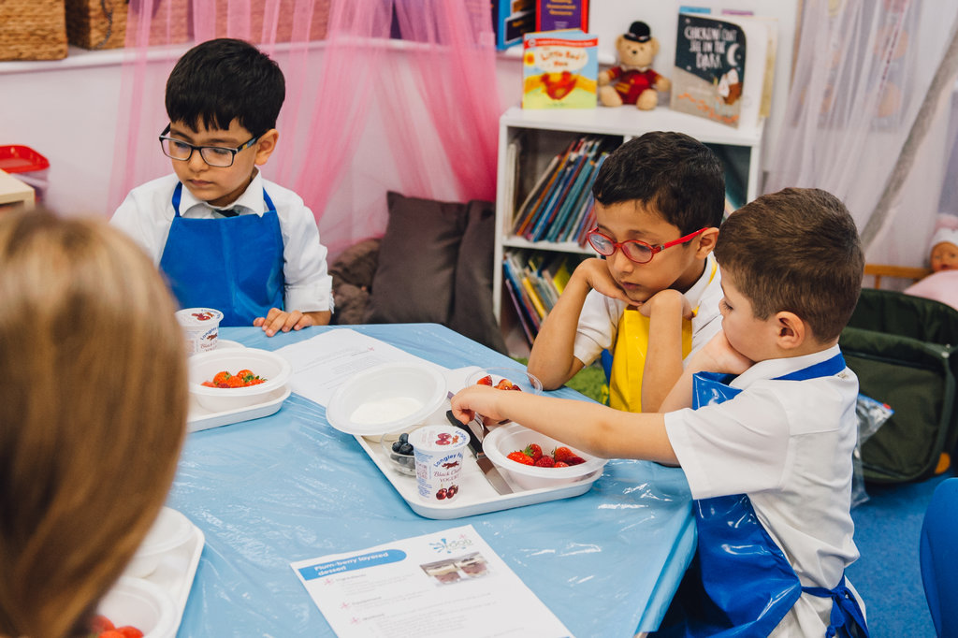
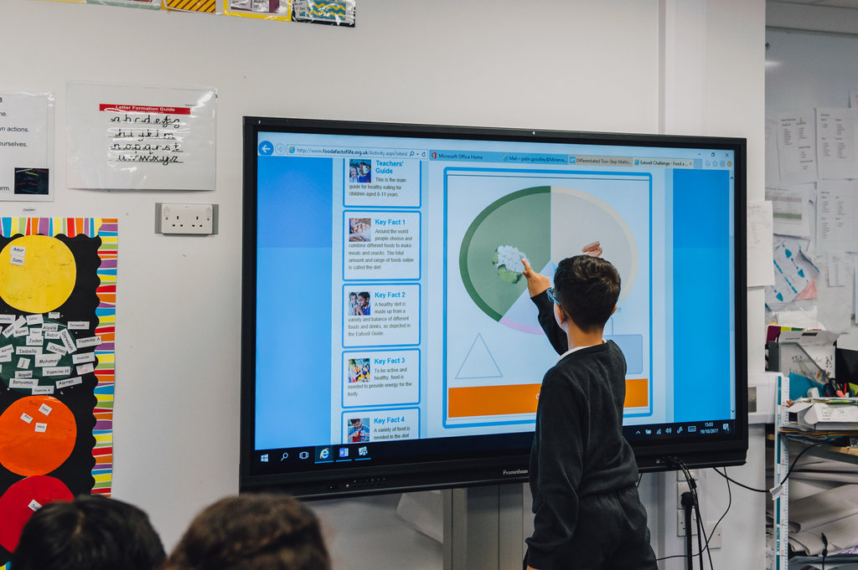
Food education in schools
UK – four different curricula
Core competences for children and young people (UK wide)
Core teaching …
  Where food comes from, inc. growing food
  Cooking
  Healthy eating
England
  What to teach?
  Time allocation
  Resources and training
  Free schools and academies
https://www.gov.uk/government/collections/national-curriculum
https://www.nutrition.org.uk/foodinschools/competences/competences.html

Slide 18
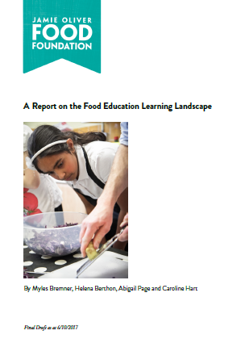
Food Education Learning Landscape Review
Cooking and Nutrition was introduced into the English national curriculum for all 5-14 year olds in 2014, but no study or evaluation has taken place.
Conducted a review to better understand …
What are pupils learning in their food education?
How are pupils learning?
How does the wider school food culture support or hinder pupils healthy eating behaviours?
What do pupils, parents, senior leaders and food teachers think can raise the quality and effectiveness of food education and food culture in schools, to enable pupils to learn about, and put into action, healthy eating behaviour?
Notes:
Today …

Slide 19
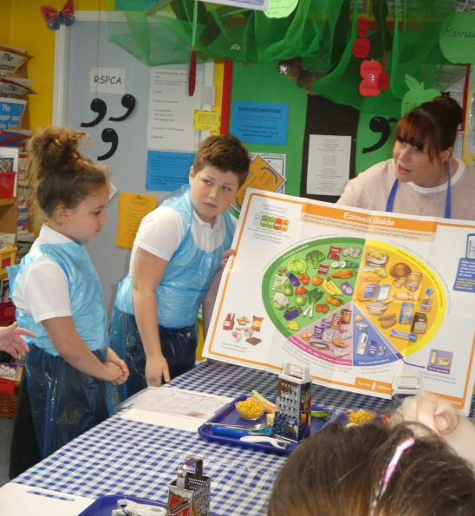
Findings
In summary, the findings showed:
a stark difference between schools doing a great job at delivering strong food education and others struggling with a lack of time, resource and support;
concerns about the food environment at secondary schools, compromising pupils’ ability to make good food choices;
a strong and clear teacher, pupil and parent voice asking for a healthier school environment.

Slide 20
Key recommendations
To address the findings, the report makes four key recommendations to ensure young people are receiving the education and start in life that they deserve:
schools should be healthy food zones;
more support should be given to the school workforce;
improvements in food education qualifications and resources are needed;
stronger reporting and evaluation needs to be in place.
For more information on the findings, and to read the full review, the report and appendices can be accessed at: http://bit.ly/2hRBhwC

Slide 21
Opportunities for learning about food and nutrition are limited

Slide 22
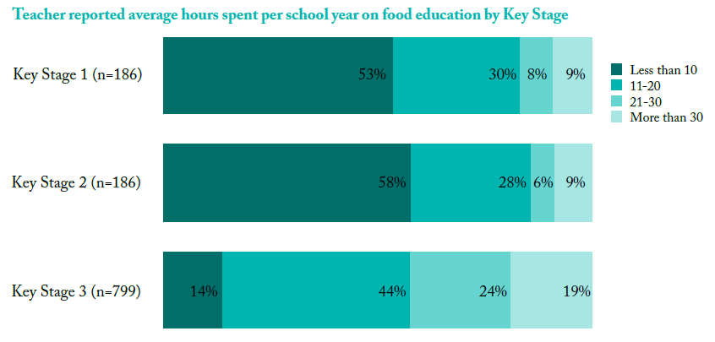
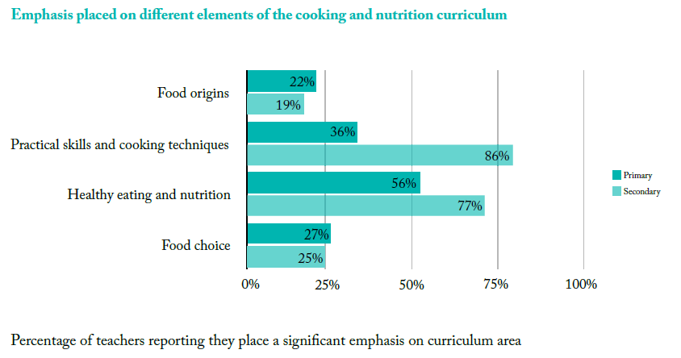
The impact of the NC
The impact of the introduction of the national curriculum in 2014
Around two-thirds of primary and secondary school teachers reported that the introduction of Cooking and nutrition in the National Curriculum led to no change or a decrease in lesson length, funding and teaching resource provision.
Just over 50% primary schools have less than 10 hours of food education a year (14% secondary schools).
The teaching emphasis varies … less teaching around food choice and food origins.

Slide 23
Teachers are constrained in their delivery of food education …
… by a lack of time, budget and resources and limited opportunities for continuing professional development

Slide 24
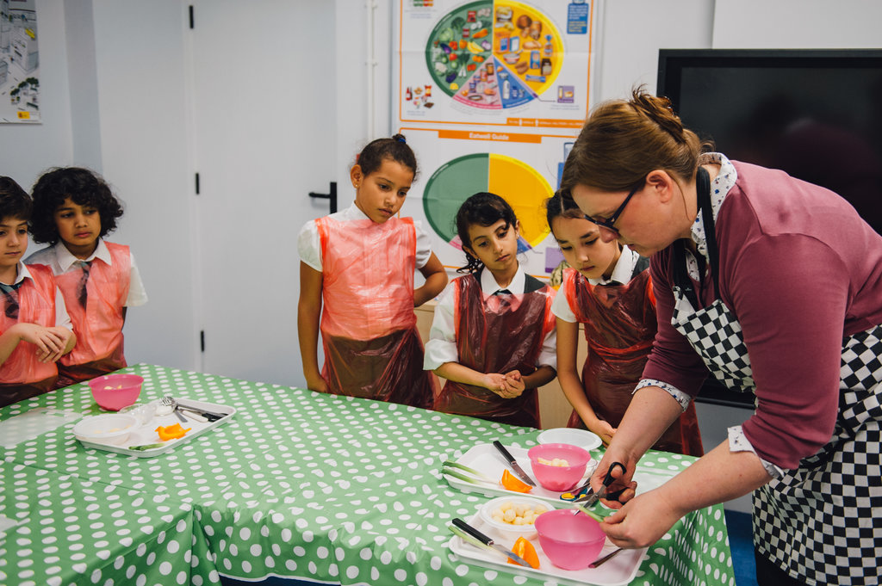
Delivery of food education
Lack of time, budget and facilities and resources are seen as barriers to teaching the content of the curriculum.
Staff training and experience is challenging, especially for secondary schools.
Recommendation: KPIs for food education (minimum standards)

Slide 25
KPIs
As a minimum, all primary school pupils should have:
• 18 hours per year on food education, of which 12 hours should be practical
• experiences in:
  • growing food and learning about food origins
  • preparing and cooking ingredients for (predominantly savoury) dishes
  • applying healthy eating in context of their health and wellbeing
• their ingredients provided for lessons
• a safe and hygienic space to learn how to cook.
As a minimum, all secondary school pupils should have:
• 24 hours per year on food education, of which 16 hours should be practical
• experiences in:
  • growing food and learning about food origins
  • preparing and cooking ingredients for dishes
  • applying healthy eating in context of their health and wellbeing
• cooking lessons that are no shorter than 60 minutes
• their ingredients provided for lessons.
Draft KPIs, provided by the BNF to the Jamie Oliver Food Foundation 2017

Slide 26
The importance of training

Slide 27
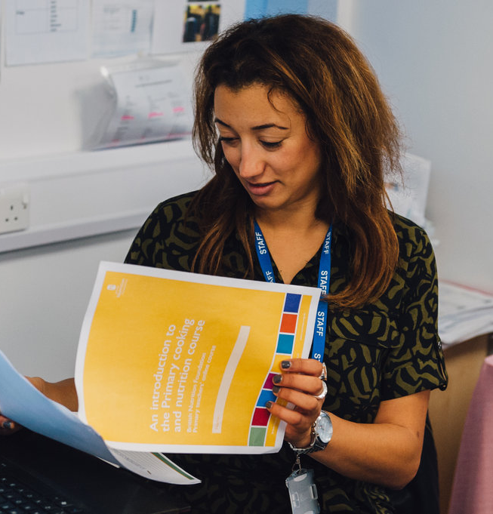
Teacher training
Food and nutrition compulsory in curriculum – yet, what support is available for the workforce?
Teachers of children aged 5 to 11 years
  Teacher feedback indicated low level of food and nutrition training and support
  1 in 3 have had food training (in food safety only)
  Design & Technology Association reports that during the training year, a trainee might receive around three hours of D&T study (with food just being one part)
Teachers of children aged 11 to 16 years
  Increasing number of non-specialist teachers
  Low level entering the profession (35 ‘food’ specific places in 2017/18 in England)
Schneider, E Theobald, C (2016) Development and evaluation of food and nutrition teaching kits for teachers of primary schoolchildren, Nutrition Bulletin 41(1): 55-66
Meek F (2016) The Food Teacher Professional Portfolio – a personal and professional development programme for secondary food teachers, Nutrition Bulletin 41(4): 365-371
Initial teacher training number census 2017 to 18, DfE 2017 https://www.gov.uk/government/statistics/initial-teacher-training-trainee-number-census-2017-to-2018

Slide 28
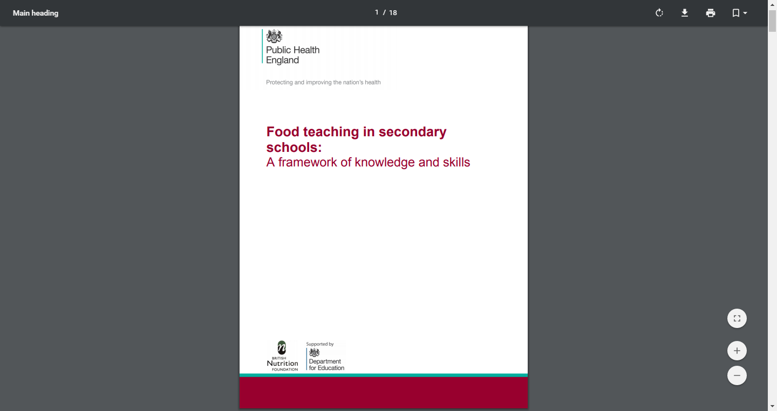
Providing support
Guidelines
BNF worked with government to develop a framework of knowledge and skills
Aimed at ‘primary’ and ‘secondary’ teachers
Indicates ‘accomplished’ practice
Used in teacher training institutes, plan courses
Used by teachers, audit professional development
https://www.gov.uk/government/publications/food-teaching-in-primary-schools-knowledge-and-skills-framework
https://assets.publishing.service.gov.uk/government/uploads/system/uploads/attachment_data/file/477936/Foodteaching_Secondaryguidelines_FINAL.pdf

Slide 29
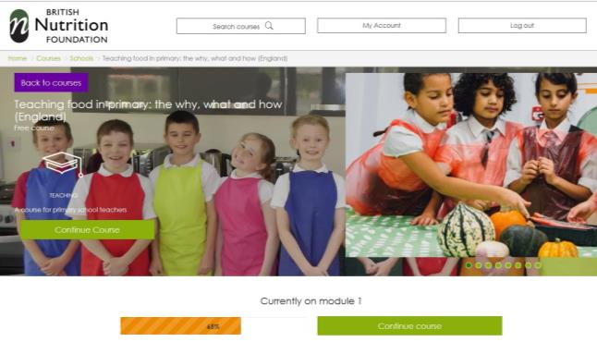
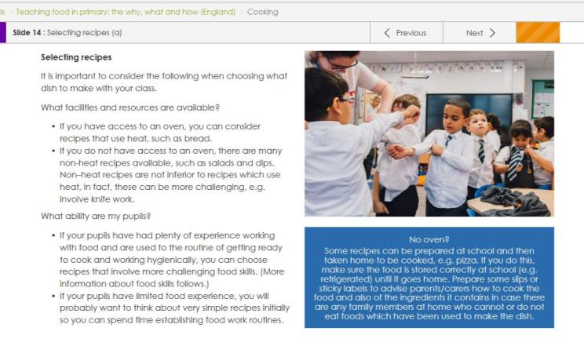
Training (primary)
Online training for all primary school teachers (from BNF)
Support the curriculum (around the UK), competences for children and teacher guidelines (knowledge and skills)
Bespoke course in England, Northern Ireland, Scotland and Wales (also in Welsh and in Gaelic)
Free for primary school teachers – register at www.foodafactoflife.org.uk
562 schools registered, with 3500 teachers wanting to undertake the training (163,000 children)

Slide 30

Training (Secondary)
Set up a professional development programme for secondary ‘food’ teachers, with the Food Teachers Centre
Over 2,255 ‘food’ teachers registered
Webinars, workshops, conferences and support materials were made available
9 in 10 of respondents indicate that the programme ensures that their practice is informed and up-to-date
Training now available from Food – a fact of life and Food Teachers Centre
Meek F (2016) The Food Teacher Professional Portfolio – a personal and professional development programme for secondary food teachers, Nutrition Bulletin 41(4): 365-371

Slide 31

Training from Food – a fact of life
Today!
Webinars
  Planning Schemes of Work and lessons, 5 Feb (8pm)
  Growing potatoes on a small and large scale, 7 Feb (4pm)
  Get portion wise! 6 March (4pm)
  Food science in action, 28 March (8pm)
Regional training (coming soon)
Online courses (nutrition and food science in development)
New ‘Training’ area on website

Slide 32
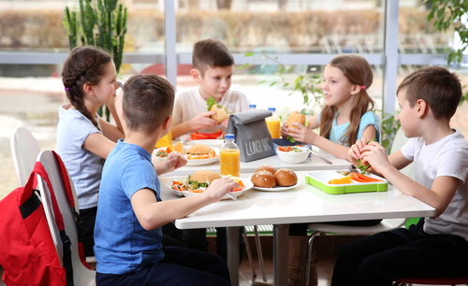
Support for schools

Slide 33


Healthier Schools
Healthy Schools – a government funded initiative from 1997 to 2011. Now funded by local authorities across England (for example, in London it is sponsored by the Mayor of London).
The Soil Association (NGO) runs the Food for Life programme, which is similar to the ‘healthy schools’ programme.
Change 4 Life – government campaign aimed at parents to get families eating better and moving more (also have a school resource website).
Magic breakfast – a charity which aims to end hunger as a barrier to education.
Number of organisations that are also involved, such as School Food Matters (London), most focused on food provision and curriculum.
http://www.healthyschools.london.gov.uk/about/background

Slide 34
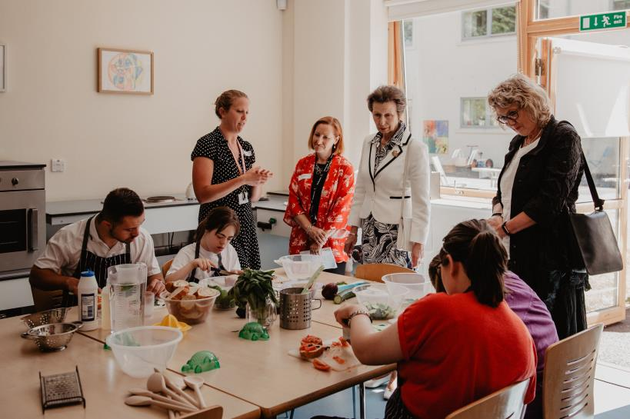





BNF Healthy Eating Week
In 2018, 4,632 schools registered, representing 2,012,261 young people, and 1,420 workplaces (representing 1,203,231 employees)
Free resources provided and online cooking
9 in 10 schools will continue ‘health’ activities started in the Week
Schools reported an increased awareness of healthy eating and drinking, and being active, through their engagement
Register to take part in 2019 – 10-14 June
www.foodafactoflife.org.uk
https://www.nutrition.org.uk/healthyliving/hew.html

Slide 35


Food – a fact of life programme
Developed with progression in mind and written by education and nutrition experts
Supports the curriculum and qualifications
Piloted in schools and checked with BNF education committees
Access is free, focusing on farming, cooking and healthy eating
Professional training provided through dedicated programmes and online platforms
500,000 resources downloaded last year
Notes:
However, materials aren’t everything …

Slide 36

A few final words …

Slide 37

Food and nutrition education
Join it up – a whole school food approach;
Advocate for compulsory food and nutrition education – equality of access, learning and skill development (minimum standards);
Remove the barriers to effective food and nutrition teaching and learning, such as insufficient time in the curriculum;
Ensure resources are relevant to the curriculum and qualifications, using appropriate media to engage young people;
Support teachers professionally through their teaching career;
Ensure pupils receive and are able to apply, relevant food skills and knowledge for them to lead healthy lives;
Champion good practice and reward excellence;
Explore parent/carer engagement opportunities;
And for all involved … be clear, consistent and evidence-based – and be there for the long term.

Slide 38
Thank you for listening
r.ballam@nutrition.org.uk
For further information, go to: www.foodafactoflife.org.uk

