Slide 1
Resources and training Claire Theobald British Nutrition Foundation

Slide 2
What should I be teaching about food in school?
 | D&T Cooking and nutrition | Science | PSHE - Core theme 1. Health and wellbeing
KS1 | Use the basic principles of a healthy and varied diet to prepare dishes Understand where food comes from | Year 2: Describe the importance for humans of exercise, eating the right amounts of different types of food, and hygiene | What constitutes a healthy lifestyle including the benefits of physical activity, rest, healthy eating and dental health To recognise what they like and dislike, how to make real, informed choices that improve their physical and emotional health, to recognise that choices can have good and not so good consequences
KS2 | Understand and apply the principles of a healthy and varied diet Prepare and cook a variety of predominantly savoury dishes using a range of cooking techniques Understand seasonality, and know where and how a variety of ingredients are grown, reared, caught and processed | Year 3: Identify that animals, including humans, need the right types and amount of nutrition, and that they cannot make their own food; they get nutrition from what they eat Year 6: Recognise the impact of diet, exercise, drugs and lifestyle on the way their bodies function Describe the ways in which nutrients and water are transported within animals, including humans | To recognise opportunities and develop the skills to make their own choices about food, understanding what might influence their choices and the benefits of eating a balanced diet

Slide 3
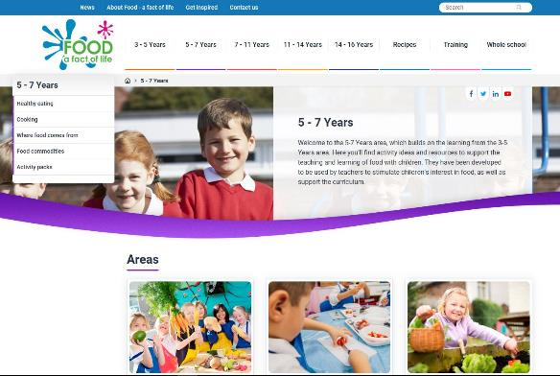
How can we help?
Food – fact of life website
Resources for 3 – 16 years
Progressive approach
Supporting teaching about healthy eating, cooking, where food comes from
Supporting Personal Professional Development (PPD) for teachers
Curriculum compliant
FREE
www.foodafactoflife.org.uk

Slide 4
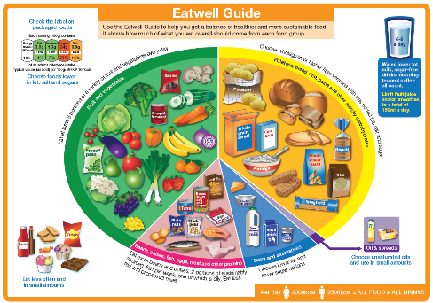
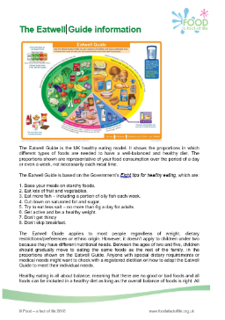
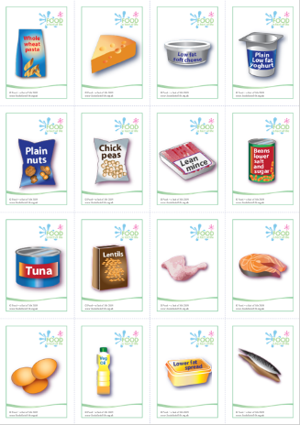
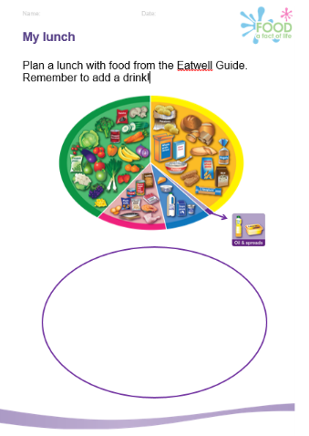
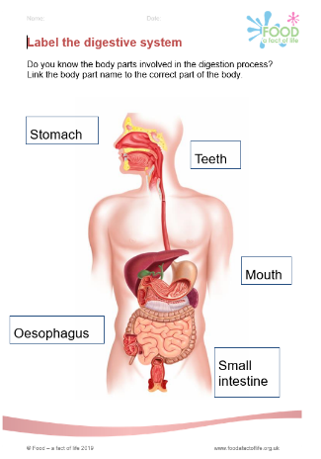
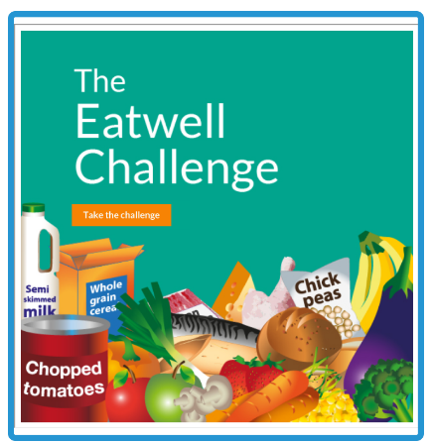
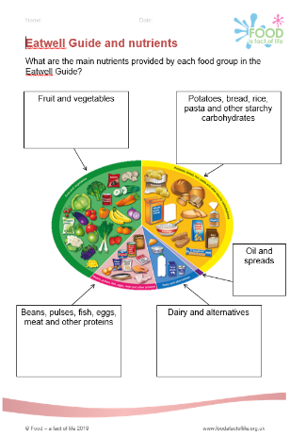
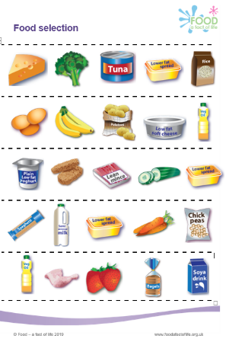
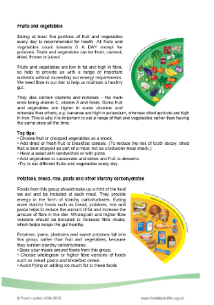
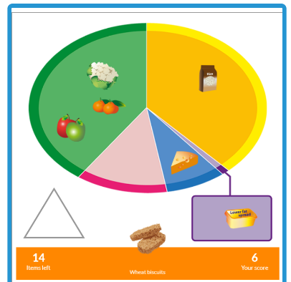

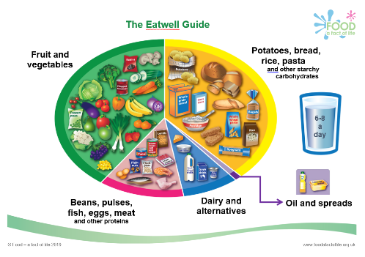
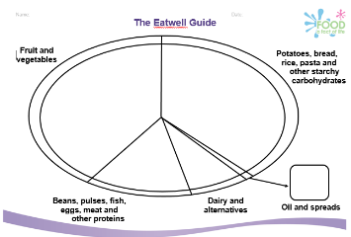
Resources to support healthy eating

Slide 5



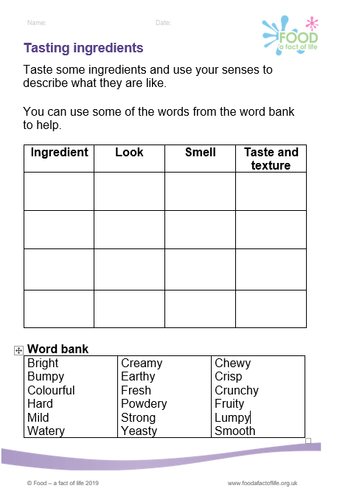
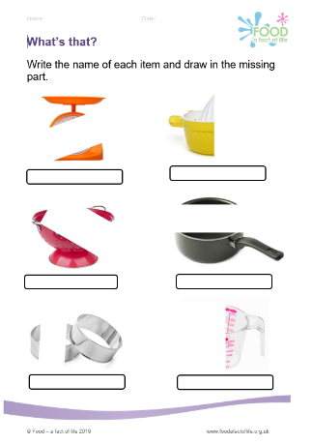
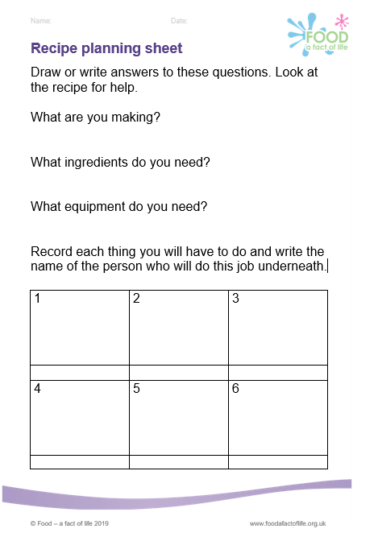
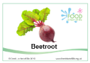
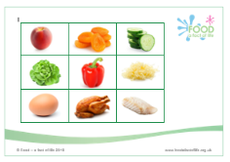
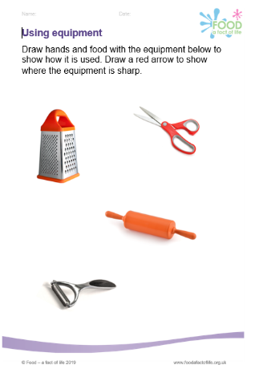
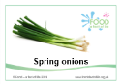
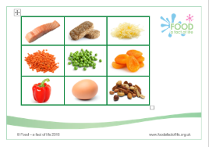
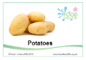
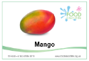
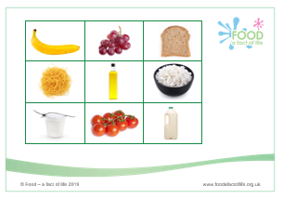
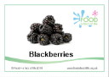
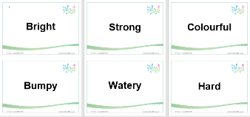
Resources to support cooking

Slide 6
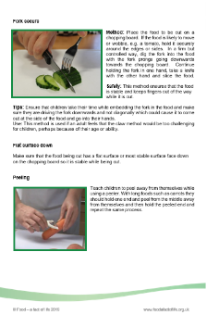
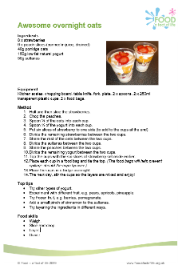
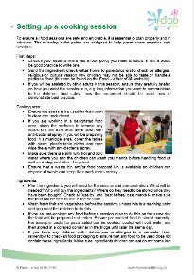
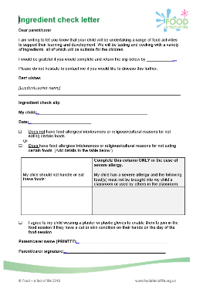
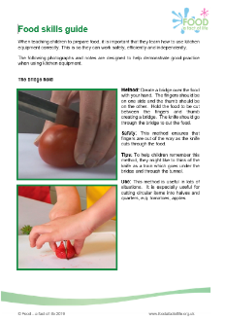
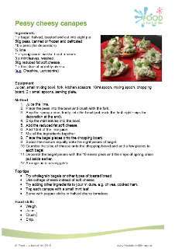
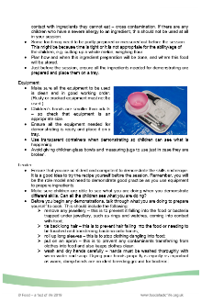
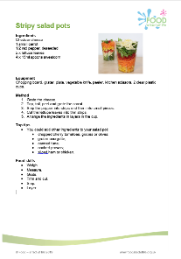
Cooking continued…

Slide 7
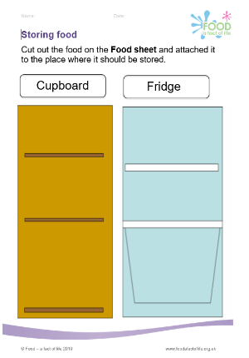
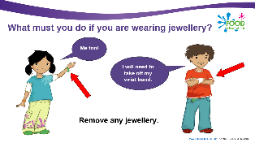
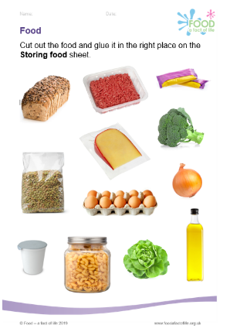
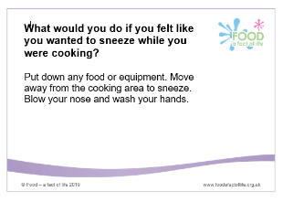

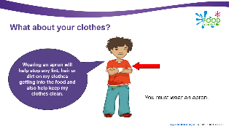

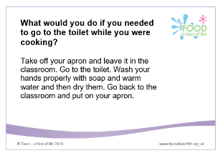
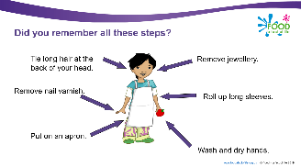
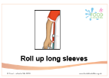
Resources to support hygiene and safety

Slide 8
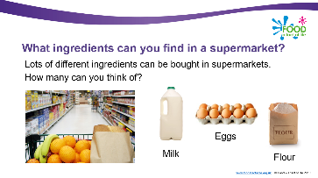
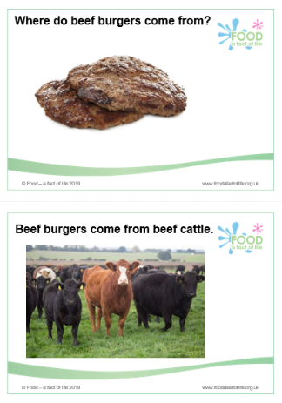
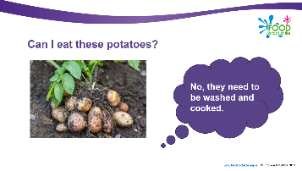
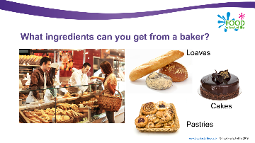
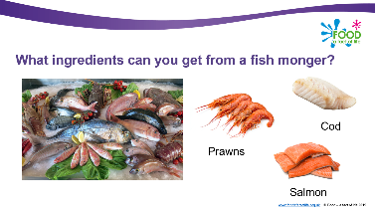
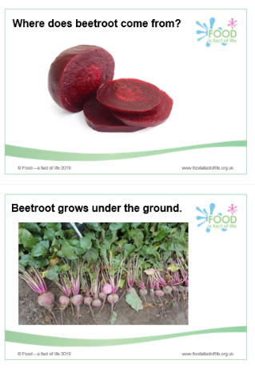
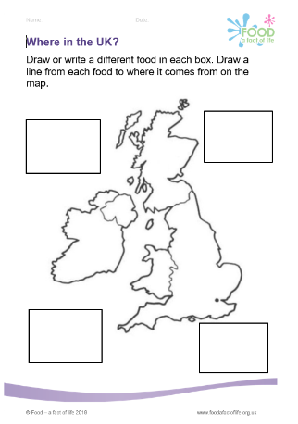
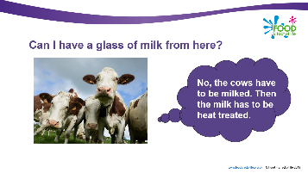







Resources to support where food comes from

Slide 9






Learn with stories...
Food themed, cross curricular stories that support literacy and numeracy.
The bucket garden

Slide 10






Learn with stories...
The bread stories

Slide 11



FREE primary online food teaching course
FREE online food training course
Provides the knowledge and skills needed to support high quality food education
Supports the curriculum
8 x modules and accompanying booklets
End of module and final assessment
Certificate on successful completion
Register at: www.foodafactoflife.org.uk
https://www.nutrition.training
bnf@adminuser.com
Modules:
Food in schools
Food origin
Healthy eating
Nutrition
Applied nutrition
Food safety
Cooking
Teaching
Notes:
bnf@adminuser.com

Slide 12







BNF Healthy Eating Week 2019
10 – 14 June 2019
Free downloadable resources and printed posters to support your week!
Register at: www.foodafactoflife.org.uk

Slide 13

Webinars
Tuesday 5 February at 8pm - Planning Schemes of Work and lessons Roy Ballam, BNF
Thursday 7 February at 4pm - Growing potatoes on a small and large scale Sue Lawton, AHDB and Claire Theobald, BNF
Wednesday 6 March at 4pm - Get portion wise! Bridget Benelam, BNF
Thursday 28 March at 8pm - Food science in action Barbara Monks, thecookeryteacher.com
Webinar recordings available soon:
Eatwell Guide – overview and use in the classroom
Food labelling - understanding front of pack nutrition labelling
For more details and to book, go to: www.foodafactoflife.org.uk

Slide 14
Resources and training - primary
For further information, go to:
www.foodafactoflife.org.uk

