Slide 1
Focus on cooking – a practical session Claire Theobald British Nutrition Foundation

Slide 2
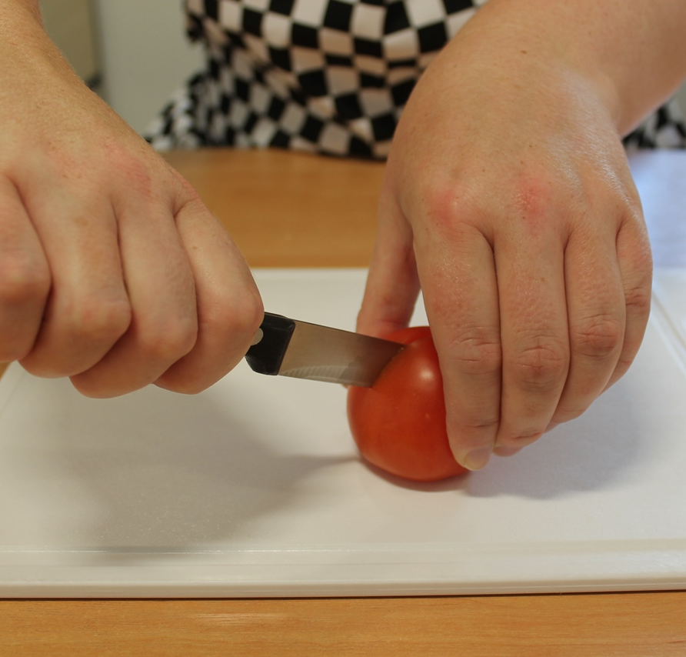
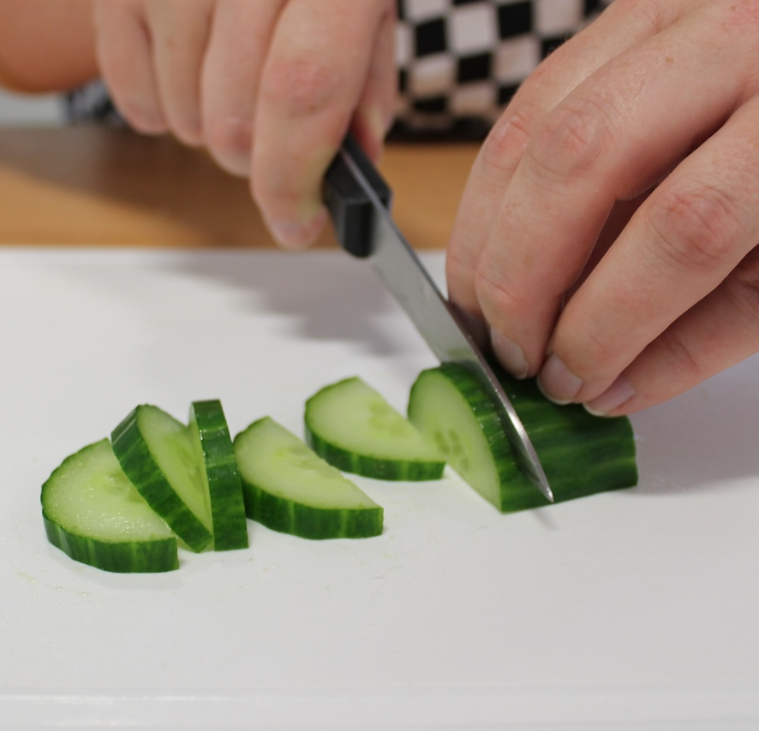
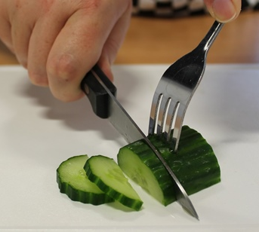
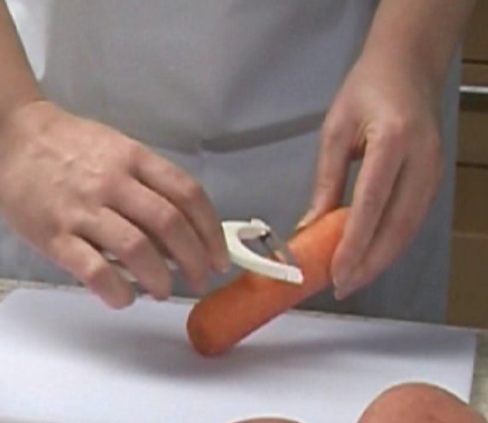
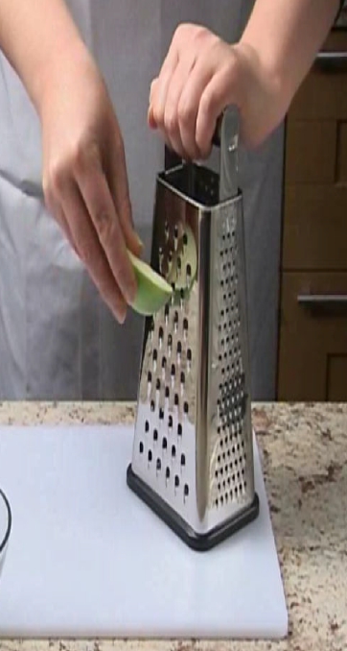
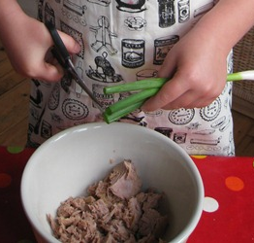
Food skills
Bridge
Claw
Fork secure
Peel
Grate
Snip

Slide 3
Your task!
Dish | Bridge | Claw | Fork secure | Scissors | Peel and Grate
Stripy salad pot layer ingredients Makes 2 pots | 8 x red grapes (halves) | Celery (small pieces) | ½ yellow pepper (small pieces) | 2 x lettuce leaves (strips) | Carrot
Salad on a stick thread ingredients Makes 2-4 sticks | 4 x cherry tomatoes (halves) | Cheese (cubes) | 1 x pineapple ring (sixths) | ½ orange pepper (2p size pieces)
 | Cucumber (cubes)
Crunchy potato salad -combine ingredients Makes 1 pot | 8 x small potatoes | 1 x stick celery & 1 x spring onion | ¼ red pepper (small pieces) | Herbs
10ml x reduced fat mayonnaise
10ml x low fat natural yogurt

Slide 4
Reflections
Would you do this with your class?
Would you/how could you adapt it?
Could it be used in a broader curriculum context?
What have you learnt anything new?

Slide 5
National nutrition education conference - primary
For further information, go to:
www.foodafactoflife.org.uk

