Slide 1
Food safety in the primary classroom
Frances Meek
British Nutrition Foundation

Slide 2
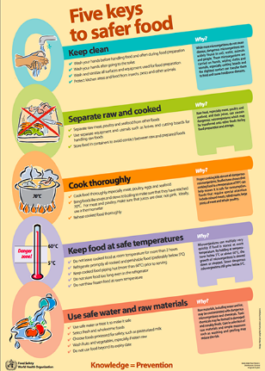
Food safety
The World Health Organisation estimates that approximately 600 million, almost 1 in 10 people in the world, fall ill after eating contaminated food and 420,000 die every year, resulting in the loss of 33 million healthy life years.
Therefore, it is essential that all food handlers, whether they are cooking and serving food for consumers to purchase or cooking for themselves or their families at home, take the steps necessary to reduce the risk of food poisoning.
This also relates to cooking in school!
www.who.int

Slide 3
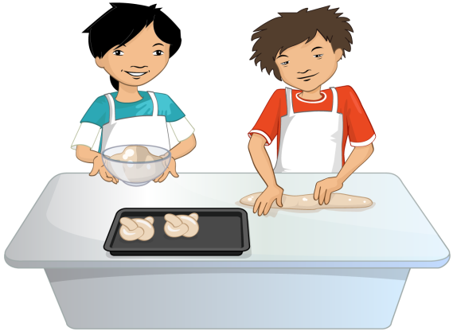
Why is good food hygiene and safety important to you?
To prevent food poisoning – pupils, parents and staff.
Teacher’s own indemnity.
Ofsted Common Inspection Framework (September 2015) – greater emphasis on healthy eating and practical cookery in the curriculum.
Interesting research from the Food Standards Agency: Food and you survey (Wave 4)

Slide 4
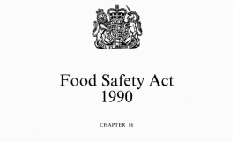
Legal requirements
For further information see the Food Standards Agency website.
When considering food safety in the classroom, teachers and schools must take into account:
The Food Safety Act 1990;
Health and safety at Work Regulations 1999;
General Food Hygiene Regulations 1995 onwards;
The Control of Substances Hazardous to Health Regulations 2002 (as amended) - Approved Code of Practice and Guidance.
Along with the recommendations from the Design and Technology Association:
BS 4163:2014 Health and safety for design and technology in schools and similar establishments. Code of practice.

Slide 5

Legal requirements
Legally, a ‘food business’ must demonstrate due diligence. In the business world this would mean:
A food business must be able to demonstrate that it has done everything within its power to safeguard consumer health.
This equates to the classroom:
A …………. must be able to demonstrate it has done everything in it’s power to safeguard ………… health.

Slide 6
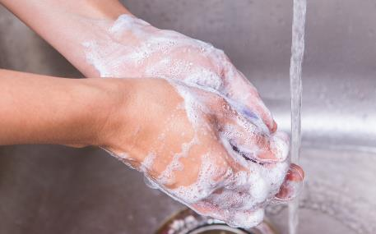
Legal requirements – food handlers
Keep yourself clean.
• Keep the workplace clean.
• Protect food from contamination or anything that could cause harm.
• Follow good personal hygiene practices e.g. hand washing.
• Wear appropriate protective clothing.
• Tell your employer (head teacher) if you are suffering from or are a carrier of a food-borne illness.

Slide 7
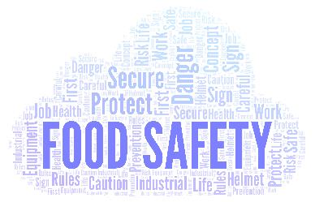
Food hygiene and safety qualifications
It is not a legal requirement for a primary food teacher to hold a recognised and up to date food hygiene/safety qualification. However, some LAs (or a school’s own policy) may ask their teachers or a teacher in the school to have this.
Having a food safety certificate can:
make you feel more confident about cooking safely in your classroom;
help ensure you have considered all possible risks;
help ensure you demonstrate best practice;
be useful to include in your risk assessment;
add to your CPD.
Look for a Level 2 Award from a reputable and recognised supplier.

Slide 8
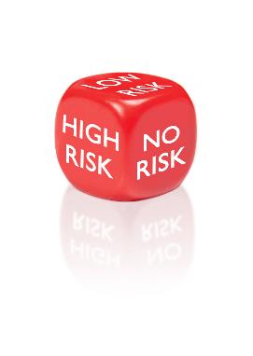
Food safety policies and risk assessments – why are these necessary?
Ofsted reviews risk assessments and health and safety qualifications as part of their safeguarding criteria. This is a limiting judgement and the school can fail if these criteria are not met.
Failure to ensure pupil or staff safety could result in criminal or civil prosecution.
Risk assessments are a legal requirement.

Slide 9
Risk assessments
In order to minimise the risks involved in Cooking and nutrition it is essential that risk assessments are undertaken. These could be for recipes, lessons and equipment.
You may think that you do a risk assessment every time you enter your classroom. However, risk assessments are formal activities and should follow five stages:
Look for the hazards.
Decide who might be harmed and how.
Evaluate the risks and decide whether the existing precautions are adequate or whether more should be done.
Record your findings.
Review your assessment and revise it if necessary.

Slide 10
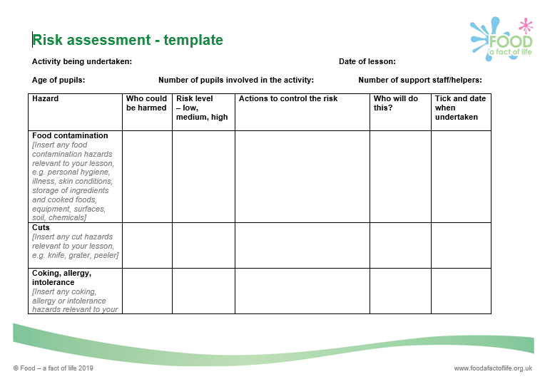
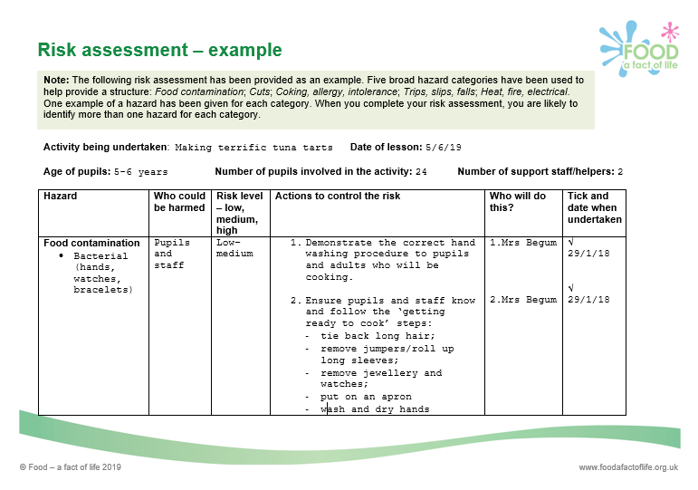
Generic risk assessments
These are usually available through Local Authorities but it is essential that schools adapt these to their own setting and account for any specific hazards.
An exemplar risk assessment for Cooking and nutrition in the primary classroom is available on www.foodafactoflife.org.uk
Support and advice is also available from CLEAPSS

Slide 11
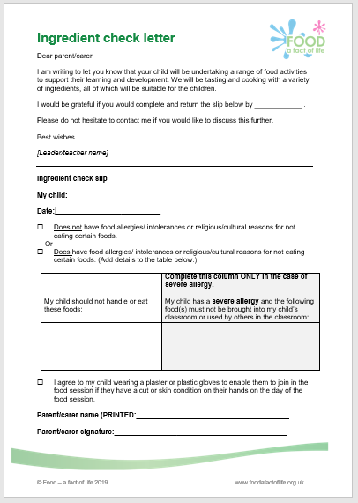
Practicalities of using a primary classroom
Check that:
An ingredient check letter has been sent home.
Ingredients checked for allergens (especially packaged foods).
Classroom furniture is in a safe, practical arrangement.
Cooking surfaces wiped with anti-bacterial spray and covered with clean plastic cloths.
Equipment is clean and ready to use (count knives and sharp tools out and in).
Ingredients are ready to use – if necessary, some have been partly prepared or weighed.

Slide 12

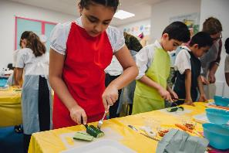
Practicalities of using a primary classroom
Check that:
All jewellery removed.
Nail varnish removed.
Long hair tied back.
Jumpers removed and long sleeves rolled up.
Hands are clean – washed with anti-bacterial soap or a sterilising rub has been used.
Clean aprons on.

Slide 13
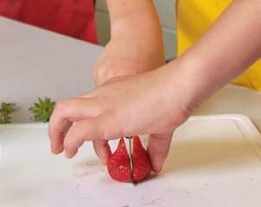
Practicalities of using a primary classroom
Check that:
Children know they must wash their hands again if they blow their nose, cough or sneeze into their hands, touch hair, cuts or spots.
Children know they must remove their apron if they go to the toilet; wash their hands afterwards and then again before starting to cook again.
Children know how to use the equipment safely (following a teacher demonstration).
Plenty of bins available for rubbish.
All adults must be a role model!

Slide 14
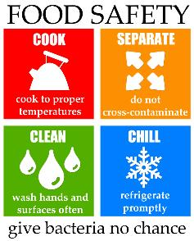
The 4 Cs……
Cleaning – what are the reasons for cleaning?
Cooking – what are safe cooking strategies?
Cross contamination – what is the impact of cross contamination?
Chilling – why is temperature control important?
A great way to teach the 4Cs is to show the Bacteria Bite Business video which is available on the FSA archive website and YouTube.
https://bit.ly/2rvYIBi

Slide 15
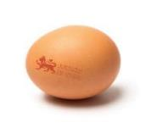
Use of eggs in primary school - good practice
Hands must be washed before and after handling eggs and egg shells.
Use hen eggs that are from a flock vaccinated against Salmonella (Lion mark) and are date stamped.
Although the date stamp is a ‘best before’ it is advised to use eggs when they are at their freshest. Eggs have a shelf life of 28 days (from the date they were laid to their ‘best before’ date).
Lion mark hen eggs can now be eaten raw or lightly cooked. However, for due diligence, it is advisable to not allow pupils to taste any mixture (such as cake mixture) containing raw egg.
Take care not to splash raw egg whilst cooking – wipe up splashes straight away.
Do not use eggs with damaged shells because dirt or bacteria might have got inside them.
Do not allow pupils to play with egg shells or to use them for art work or for activities such as growing herbs.
NHS advice

Slide 16
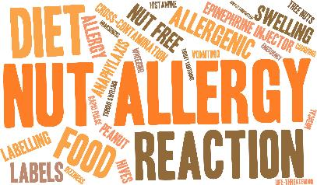
Storage of ingredients and finished dishes
In order to prevent bacterial multiplication and cross-contamination, it is important that safe storage practices are followed:
Store allergenic ingredients, such as flour and nuts, separately in lidded containers. Label with an ‘opened’ or ‘best before’ date.
Store high risk ingredients such as meat, fish and dairy in the fridge below 5°C.
Store raw ingredients below cooked or ready to eat foods in the fridge to prevent cross-contamination.
Decant part used cans into plastic containers with a lid. Label with a ‘use by’ date. Store in the fridge.

Slide 17
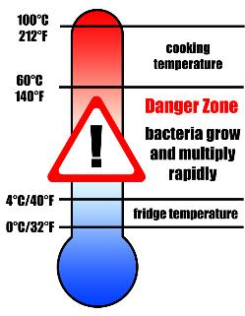
Storage of ingredients and finished dishes
Store all opened jars and bottles in the fridge and label with an ‘opened on’ or ‘use by’ date.
Cool cooked food quickly and store below 5°C within 90 – 120 minutes.
Check and record fridge temperatures regularly.
Clean fridges regularly with hot soapy water and a sanitising spray.

Slide 18
Pre-printed labels for dishes
Pre-print name labels for dishes made– this helps manage the food stored in your fridges but also gives pupils and parents important storage, cooking and allergen information.
The information on the label could include:
name, date and class/year group;
Cooking/reheating and storage instructions;
Allergens.
Name: Date: Class:
Quick lamb rogan josh: Store in a refrigerator and consume within 48 hours. To reheat, place in a pre-heated oven (200°C, gas mark 6) for 15-20 minutes until piping hot.
Allergens:
Example food labels

Slide 19
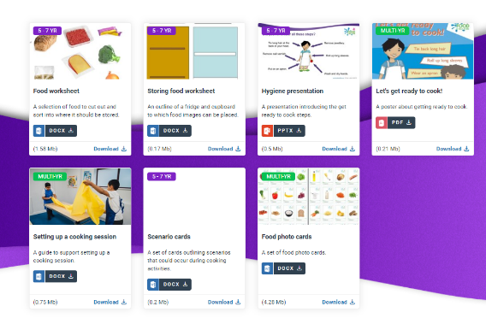
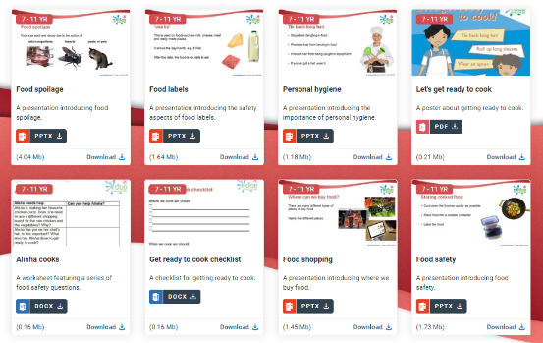
Activities and resources to support food hygiene and safety
5-7 years
7-11 years

Slide 20
Further sources of information
Food Standards Agency - www.food.gov.uk
NHS Choices - www.nhs.uk
CLEAPSS - www.cleapss.org.uk
Health and Safety Executive - www.hse.gov.uk
Design and Technology Association - www.data.org.uk

Slide 21
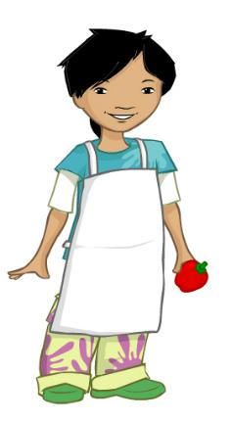
Now lets get ready to cook!
Tie long hair at the back of your head.
Roll up long sleeves.
Remove nail varnish.
Remove jewellery.
Put on an apron.
Wash and dry hands.

Slide 22
Food safety in the primary classroom
For further information, go to:
www.foodafactoflife.org.uk

