Slide 1
Healthy Eating: bringing the Eatwell Guide to life
Alex White British Nutrition Foundation

Slide 2



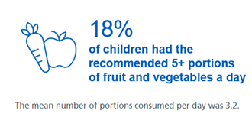


Context
Low intakes of some vitamins and minerals.
Low intake of fibre.
1 in 5 children starts school overweight or obese.
By the time children leave primary school, 1 in 3 overweight or obese.
Excess consumption of Free sugars, salt, saturated fat and energy.
NDNS 2018, Health Survey England 2017

Slide 3
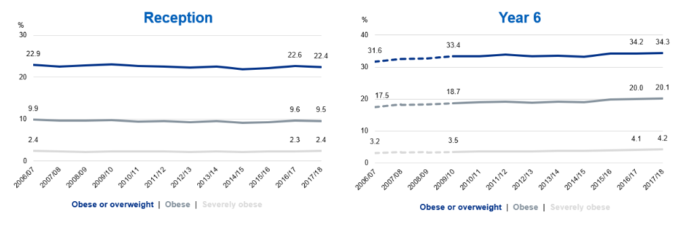
Changes in primary obesity over time
National Child Measurement Programme, England - 2017/18

Slide 4
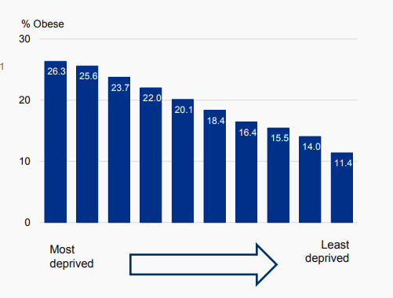
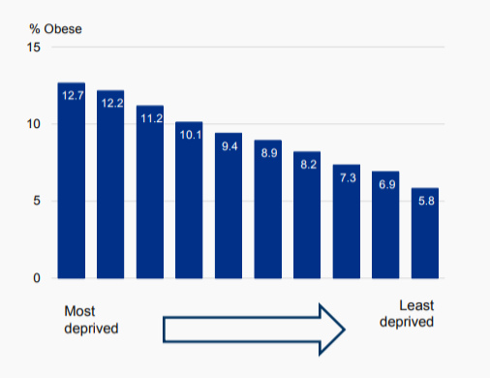
Obesity doubles in the most deprived areas compared with least deprived
RECEPTION
YEAR 6
National Child Measurement Programme, England - 2017/18

Slide 5
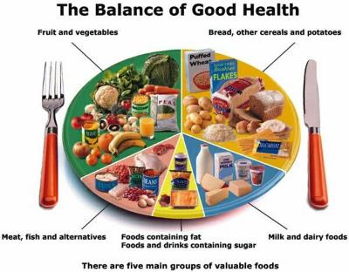
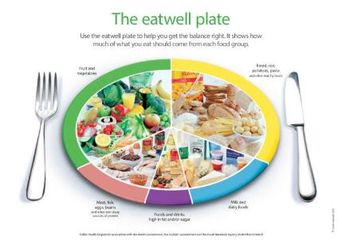
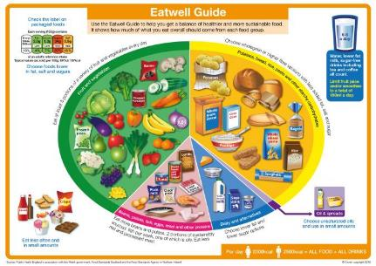
The progression of UK food based models
1994
2007
2016

Slide 6
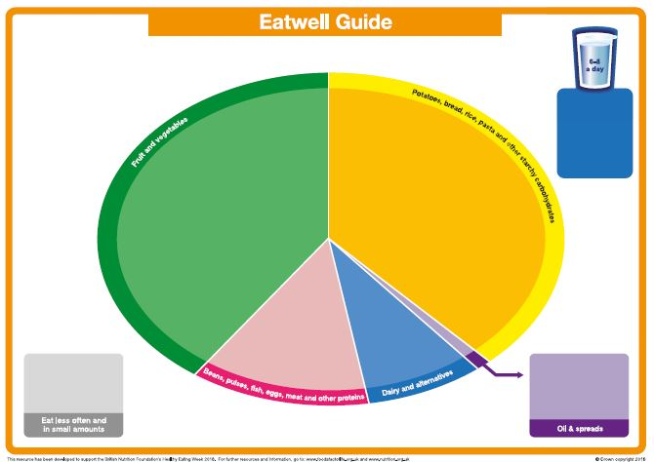
The blank Eatwell Guide
Blank Eatwell Guide

Slide 7

The Eatwell Guide
Notes:
The UK’s healthy eating model.
Shows the proportions in which different food groups are needed in order to have a well-balanced and healthy diet.
We should choose a variety of different foods from each group.
The proportions shown represent food intake over a day or a week, not necessary each meal time.

Slide 8

Who does the Eatwell Guide apply to?
Notes:
The Eatwell Guide is suitable for most of the general population in the UK, regardless of weight, dietary preferences, ethnic origin, religious or cultural beliefs.
The Eatwell Guide does not apply to children under the age of 2, as their nutritional needs are different.
Children aged between 2 and 5 should gradually begin to follow the proportions illustrated in the Eatwell Guide.
People with medical conditions may need to seek advice from their GP or health professional about their diet.

Slide 9


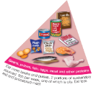
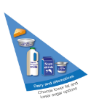

The Eatwell Guide – main groups
Fruit and vegetables
Potatoes, bread, rice, pasta and other starchy carbohydrates
Beans, pulses, fish, eggs, meat and other proteins
Dairy and alternatives
Oil and spreads

Slide 10
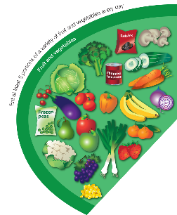
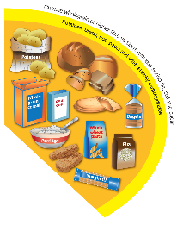
The Eatwell Guide – main groups
Fruit and vegetables
Potatoes, bread, rice, pasta and other starchy carbohydrates
Base meals on potatoes, bread, rice, pasta or other starchy carbohydrates; choosing wholegrain versions where possible
Eat at least 5 portions of a variety of fruit and vegetables every day

Slide 11
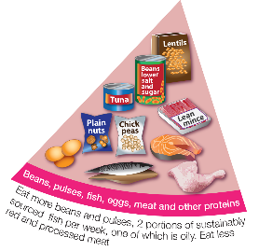
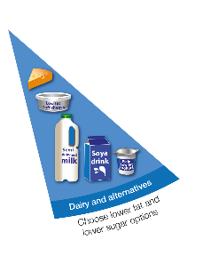
The Eatwell Guide – main groups
Beans, pulses, fish, eggs, meat and other proteins
Dairy and alternatives
Eat some beans, pulses, fish, eggs, meat and other proteins (including 2 portions of fish every week, one of which should be oily)
Have some dairy or dairy alternatives (such as soya drinks); choosing lower fat and lower sugar options.

Slide 12
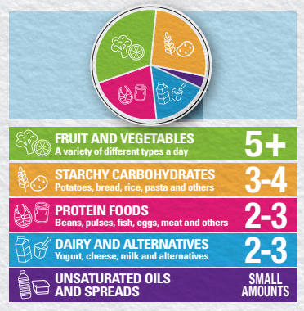
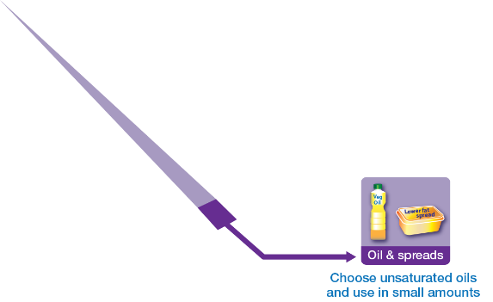
The Eatwell Guide – main groups
Oils and spreads
Choose unsaturated oils and spreads and eat in small amounts.
Find your balance - get portion wise!

Slide 13
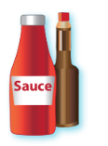









Foods high in fat, salt and sugars
Throughout the UK we consume excess amounts of:
Saturated fat;
Salt;
and Free Sugars.
If consuming foods and drinks high in fat, salt or sugar have these less often and in small amounts.

Slide 14
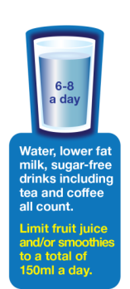



Drink 6-8 cups/glasses of fluid a day
Notes:
Aim to drink 6-8 glasses of fluid every day.
Water, lower fat milk and sugar-free drinks including tea and coffee all count.
Fruit juice and smoothies also count towards your fluid consumption, although they are a source of free sugars and so you should limit consumption to no more than a combined total of 150ml per day.
Sugary drinks are one of the main contributors to excess sugar consumption amongst children and adults in the UK.
Swap sugary soft drinks for diet, sugar-free or no added sugar varieties to reduce your sugar intake in a simple step.

Slide 15
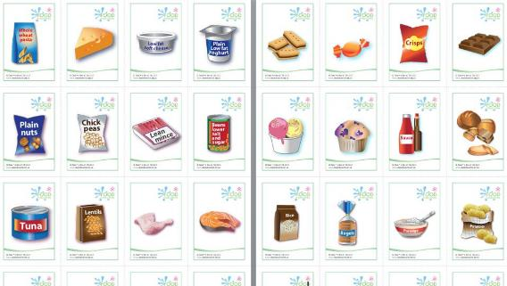
The Eatwell race

Slide 16
Energy

Slide 17
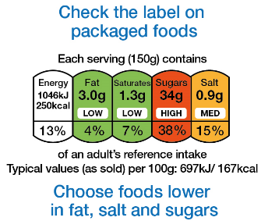

Labelling

Slide 18

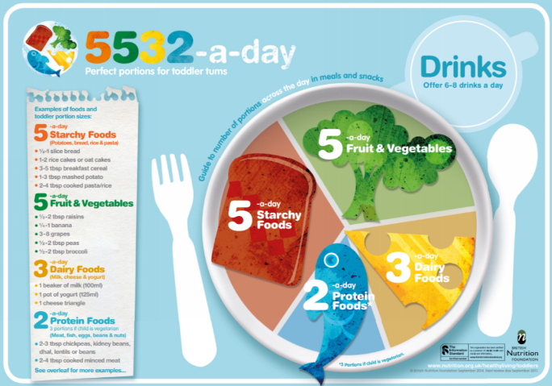
What about for children 1-3 years?
Starchy foods x 5-a-day
Fruit & vegetables x 5-a-day
Dairy foods x 3-a-day
Protein foods x 2-a-day*
=5532-a-day!
*3 portions if child is vegetarian.
5532

Slide 19
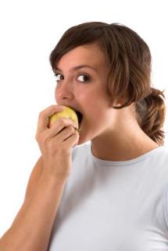


What about people who are vegetarian or vegan?

Slide 20


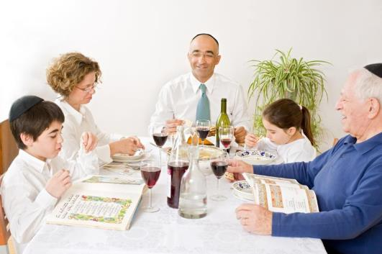
What about people with different dietary needs?

Slide 21
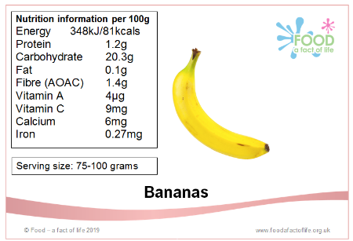
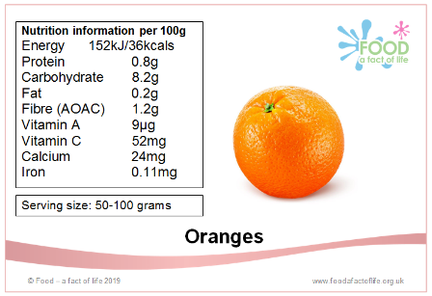
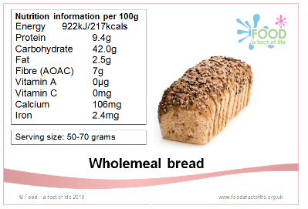
Nutrient line up!
Nutrient cards

Slide 22
Further information
Reading
Public Health England (PHE)
Food Standards Scotland (FSS)
Food Standards Agency (FSA) NI
Public Health Wales
British Nutrition Foundation (BNF)
Scientific Advisory Committee on Nutrition (SACN)
Resources
The Eatwell Challenge
Eatwell Guide videos
Eatwell Guide Kahoot quizzes
Eatwell Guide posters
Healthy eating resources 5-7 years
Healthy eating resources 7-11 years

Slide 23
Healthy Eating: bringing the Eatwell Guide to life
For further information, go to:
www.foodafactoflife.org.uk

