Slide 1
Resources and training
Frances Meek
British Nutrition Foundation

Slide 2
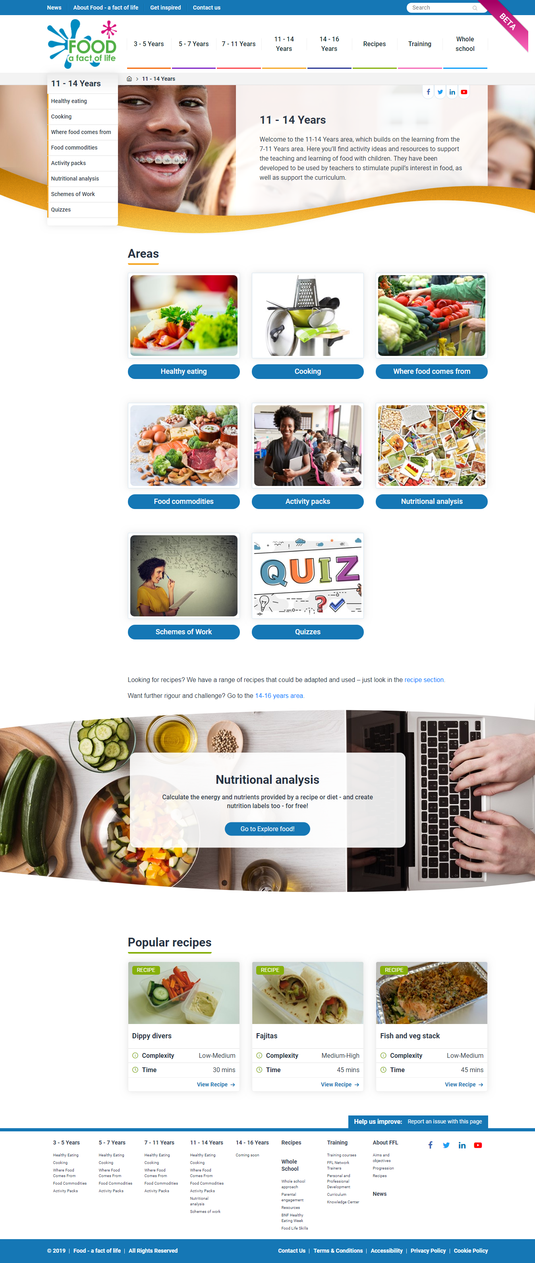
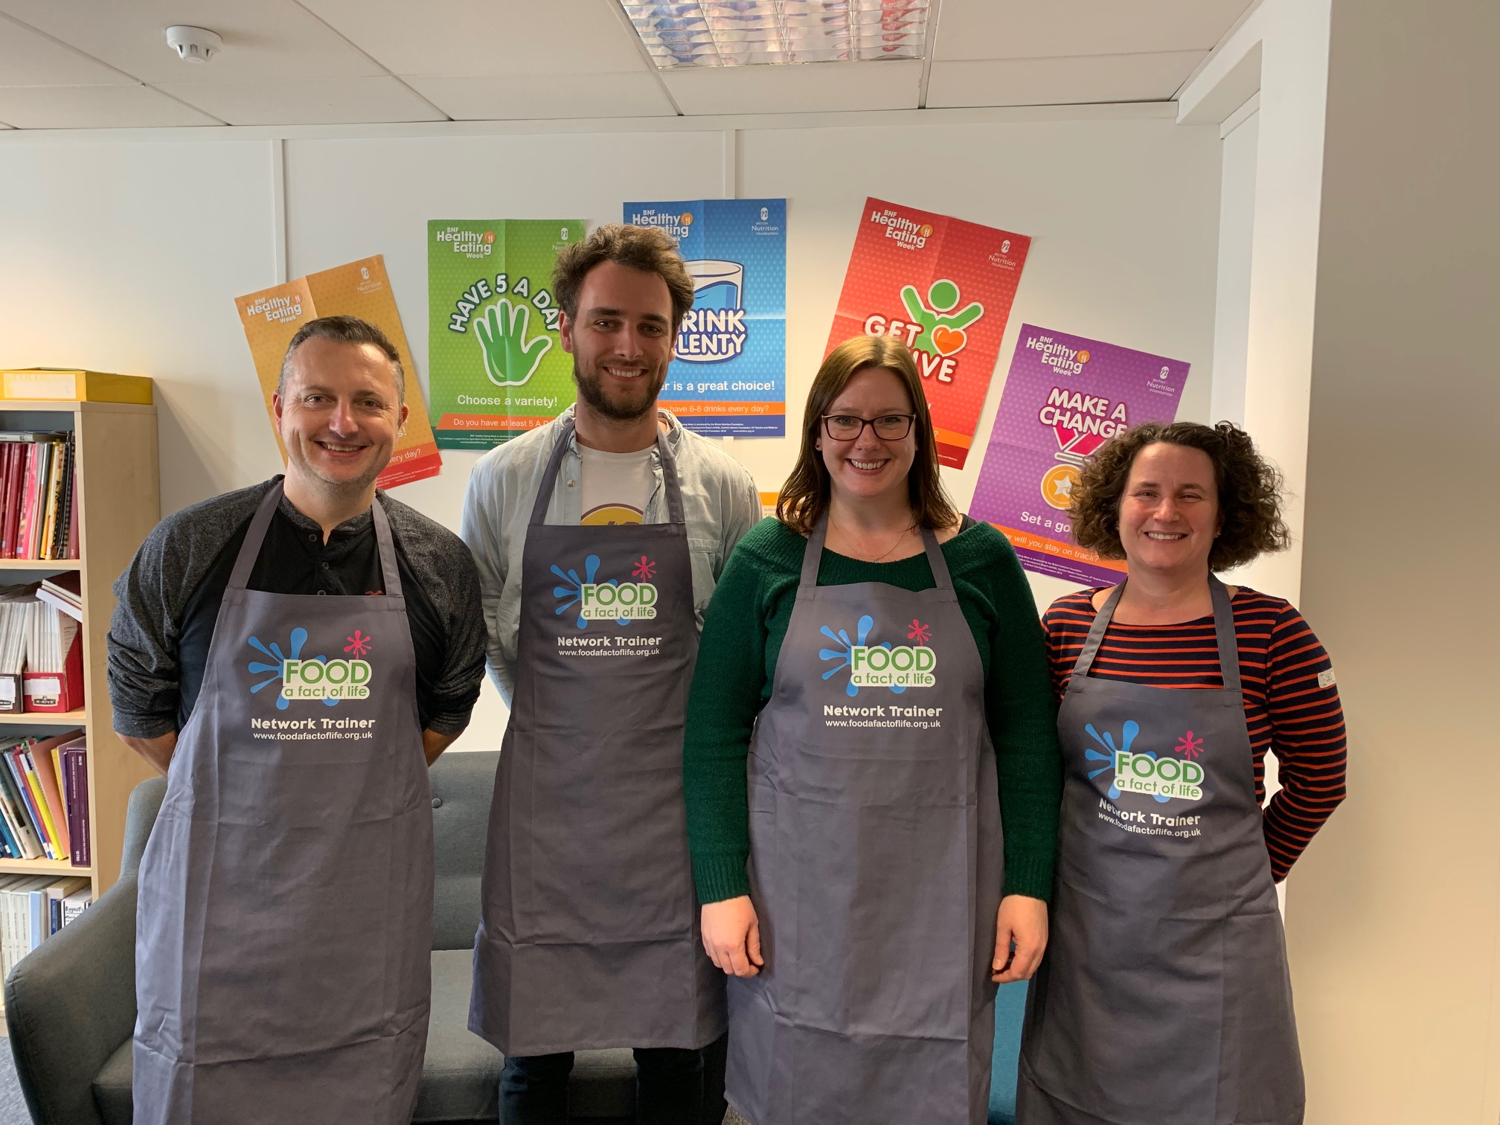
How can we help?
Food – fact of life website.
Resources for 3 – 16 years.
Progressive approach.
Supporting teaching about healthy eating, cooking, where food comes from.
Curriculum compliant.
Personal and professional development (PPD) for teachers.
www.foodafactoflife.org.uk

Slide 3
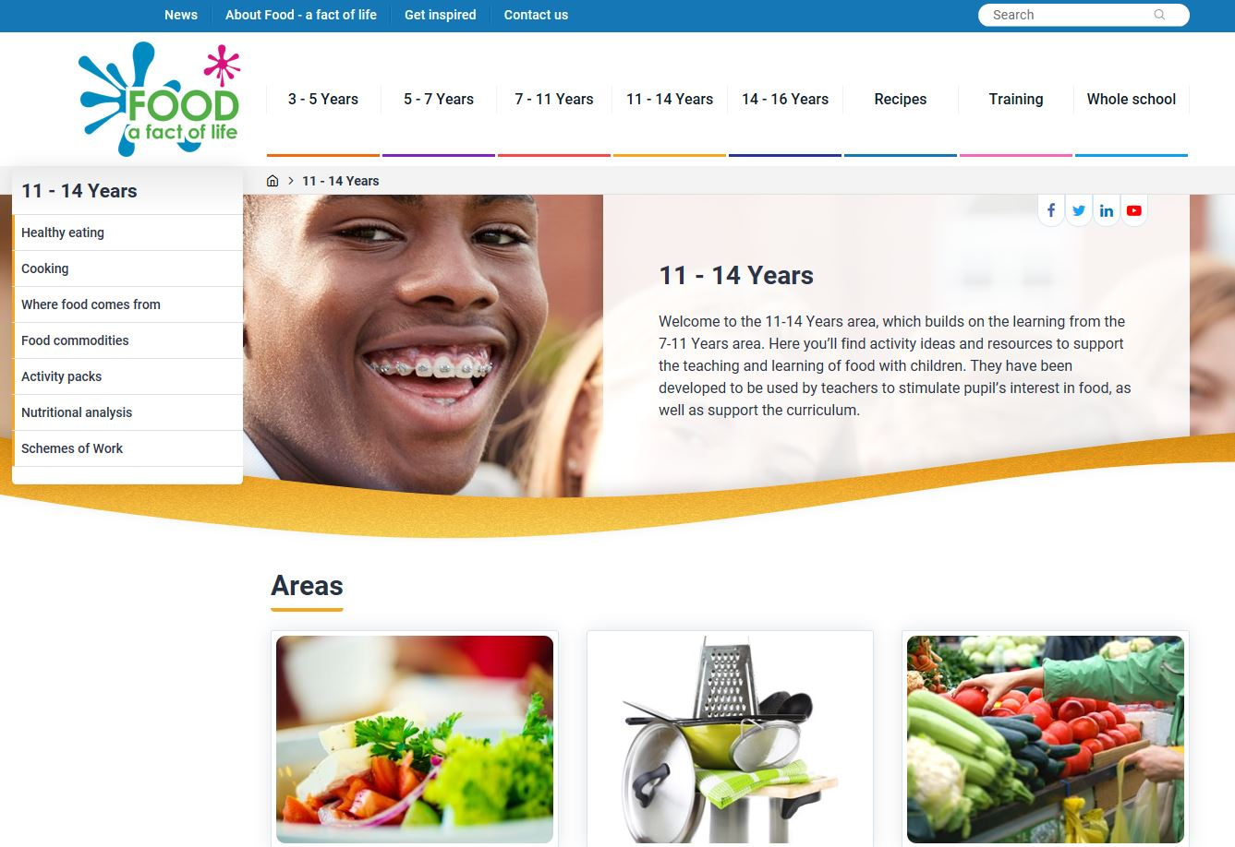
New Food – a fact of life website!
All resources for teaching pupils aged 3-16 reviewed and updated.
New resources created.
Resources from Grain Chain, Meat and Education and Cook your own potatoes reviewed and updated.
Areas of key learning identified and activities developed for each area with supporting resources.
www.foodafactoflife.org.uk

Slide 4
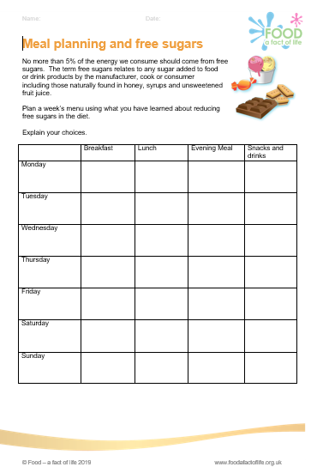
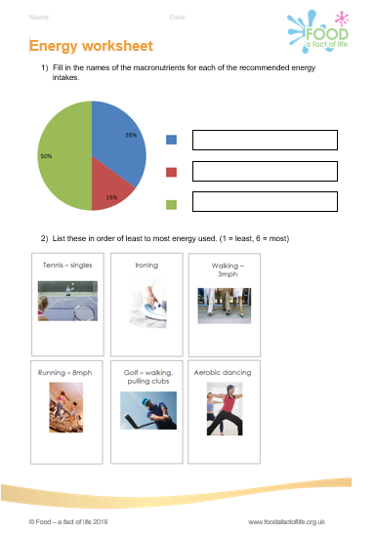
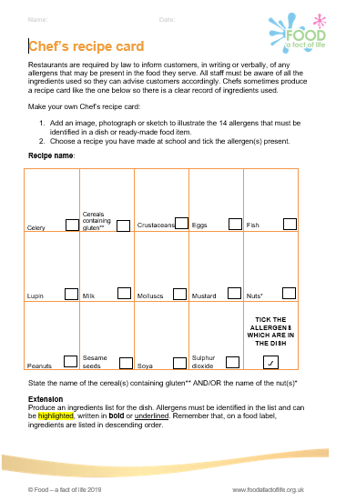
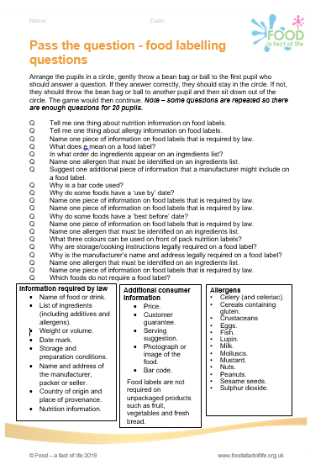
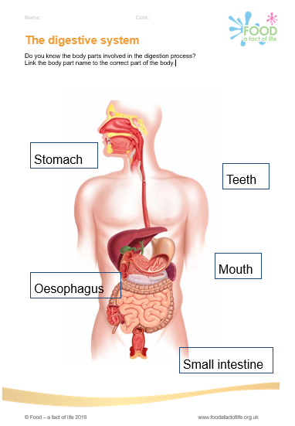

Areas of key learning – Healthy eating
Eat well
Energy and nutrients
Diet and health
Nutrition labels
Digestion
Activity

Slide 5
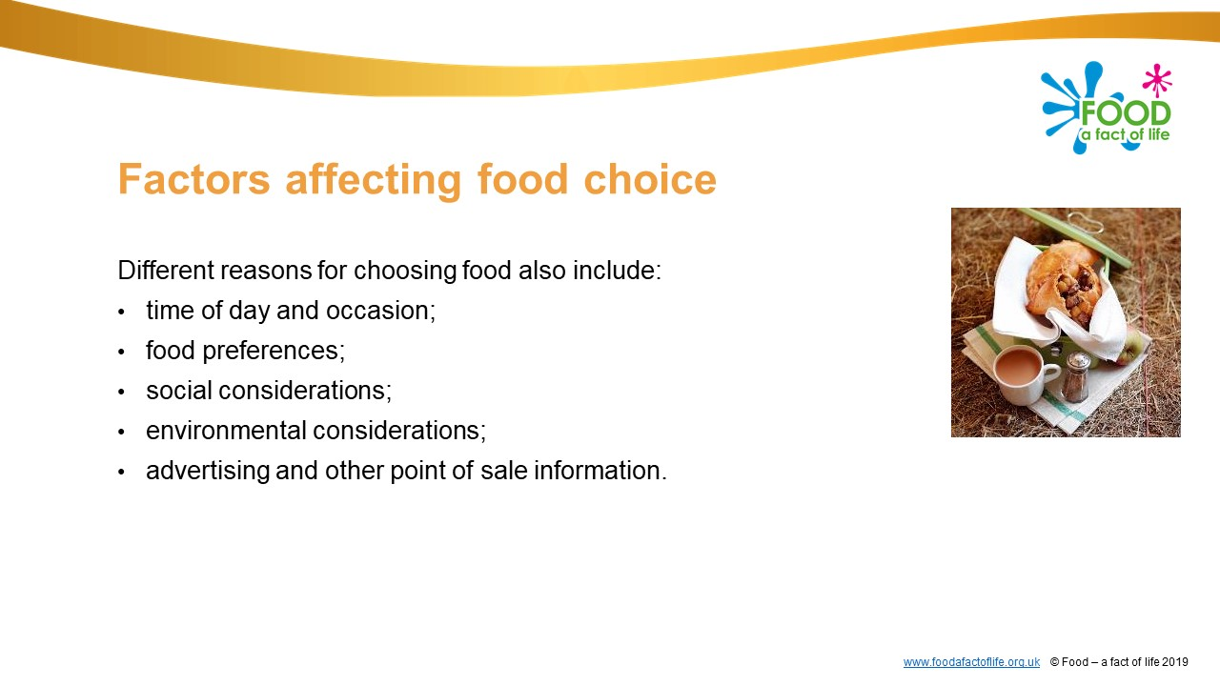
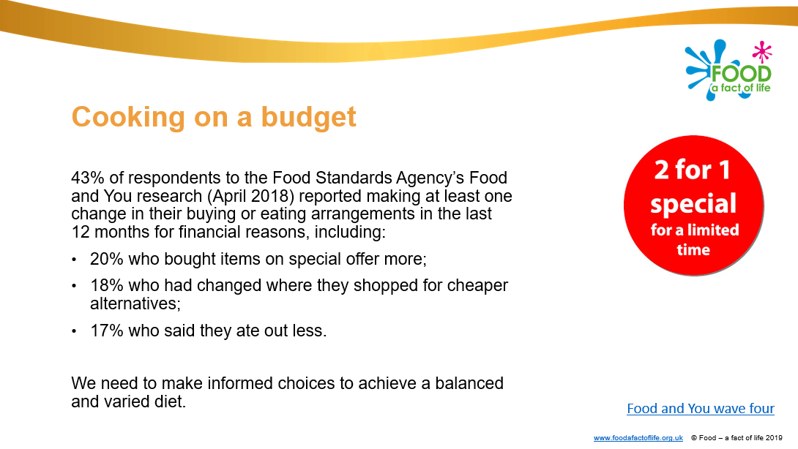
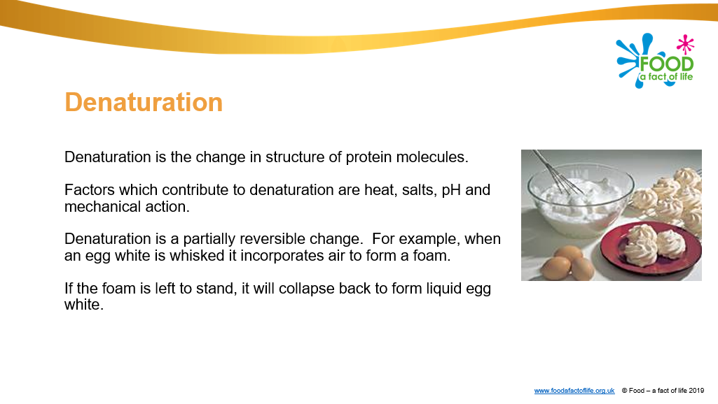
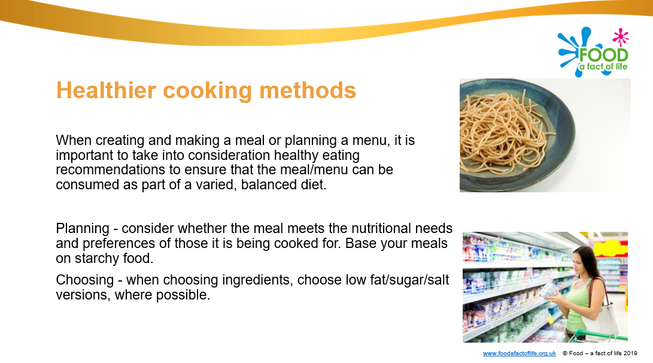
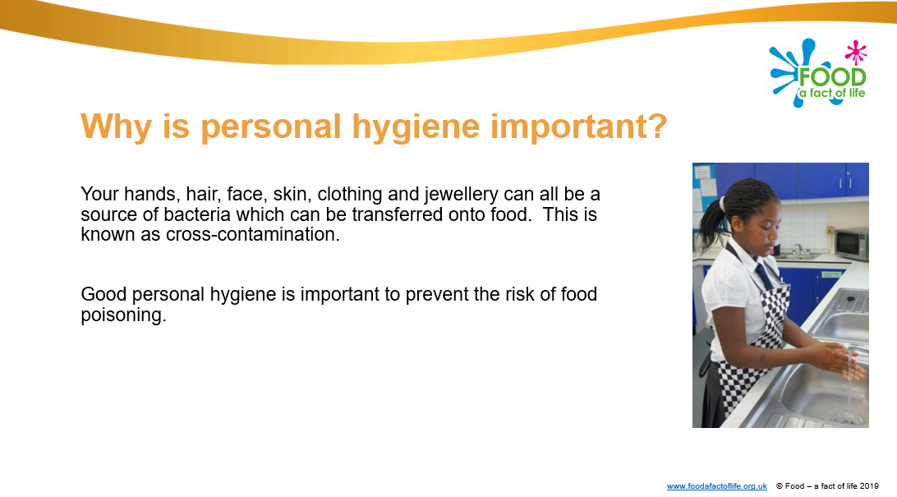
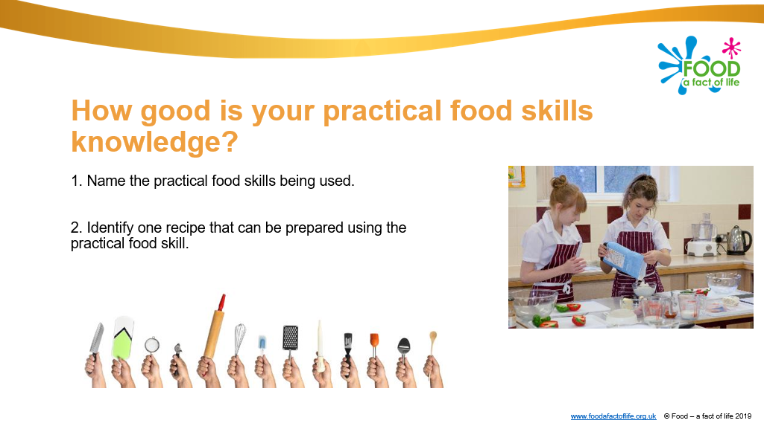
Areas of key learning – Cooking
Planning what to cook
Ingredients
Cooking for health
Hygiene and safety
Cooking

Slide 6
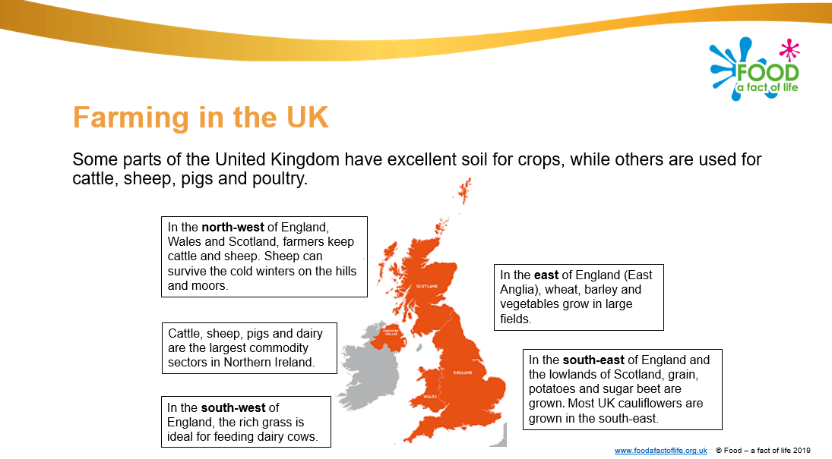
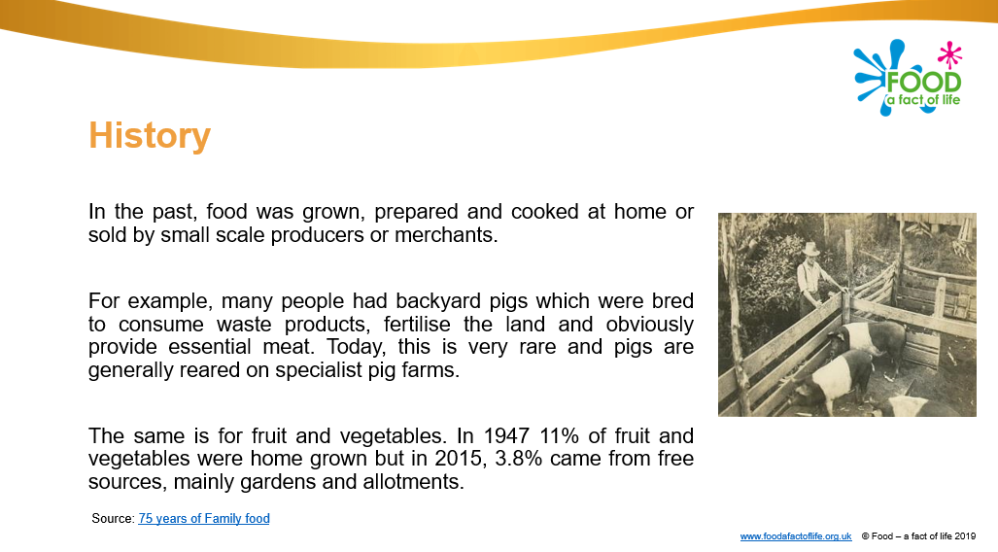
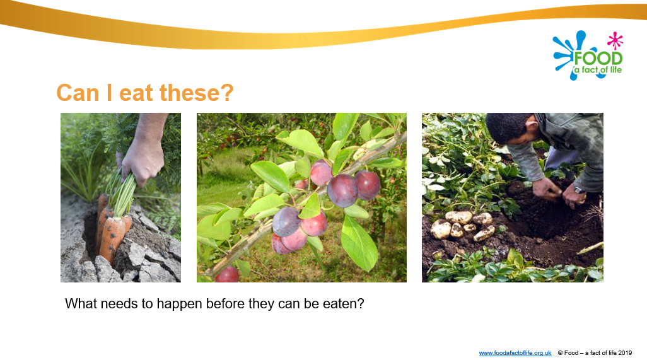
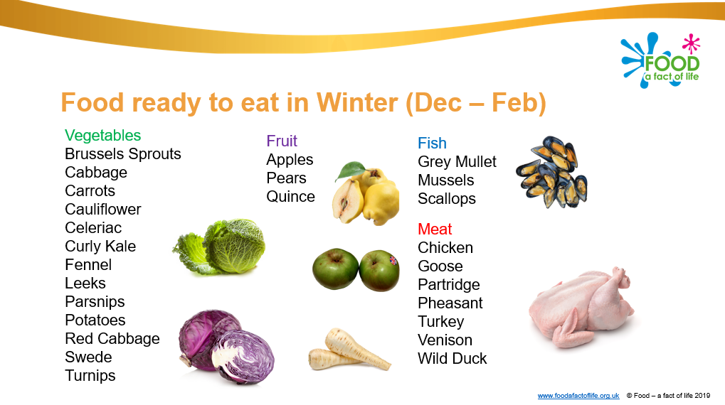
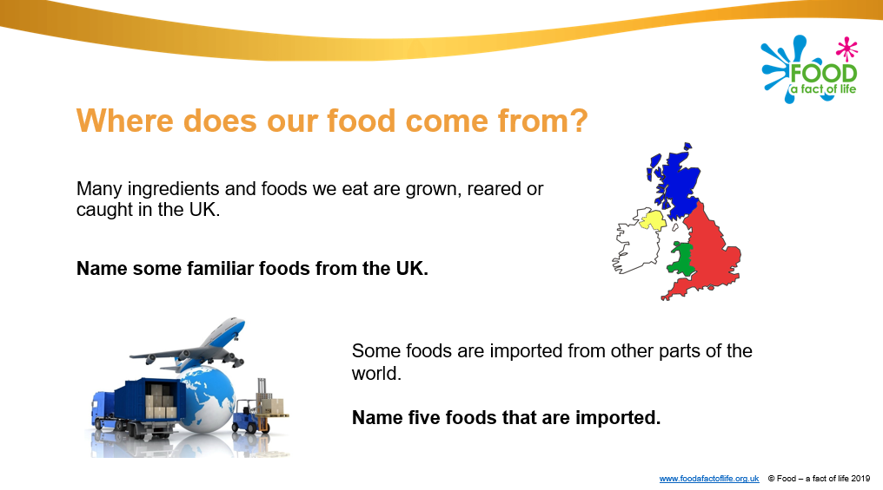
Areas of key learning – Where food comes from
Food origins
Farming and processing
Food availability

Slide 7
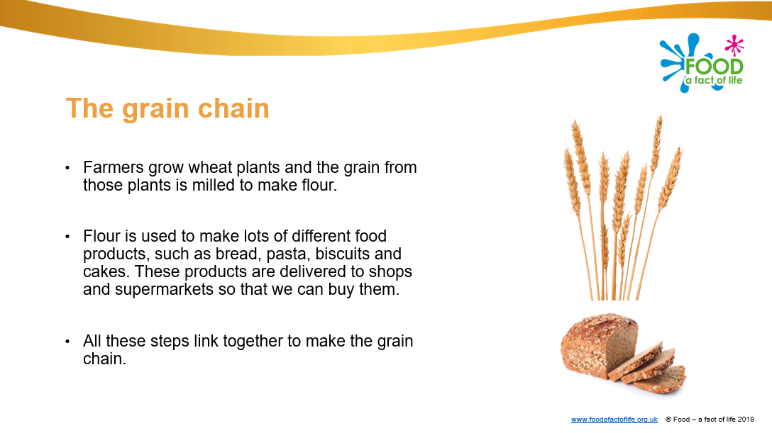
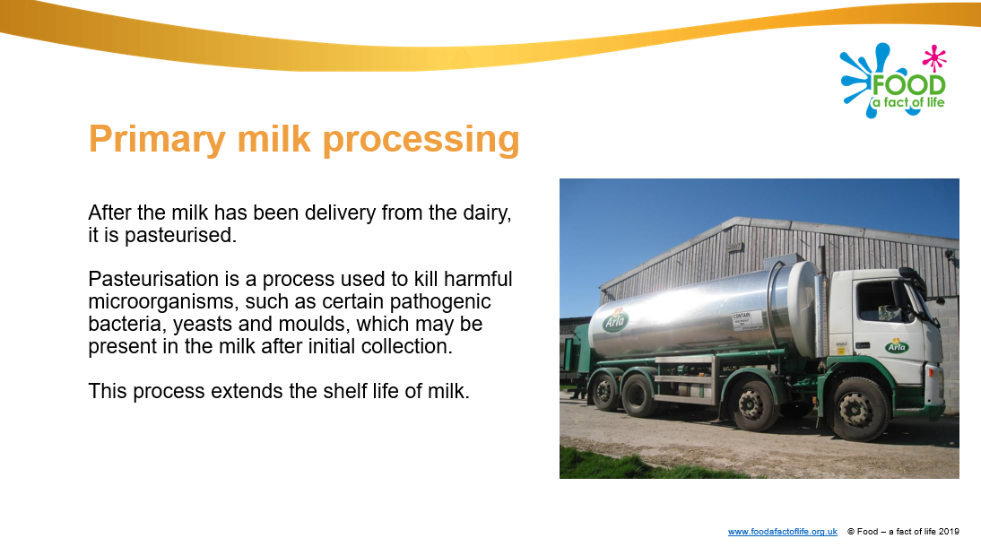
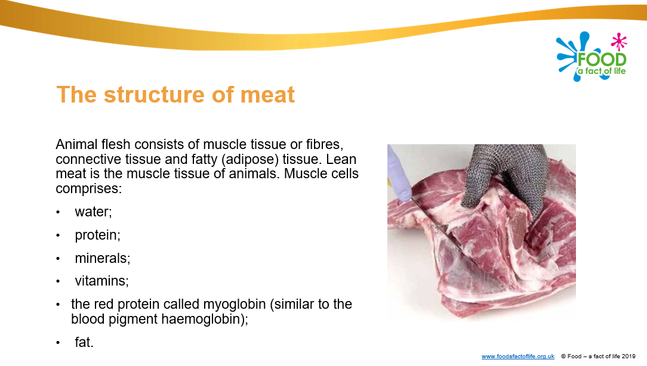
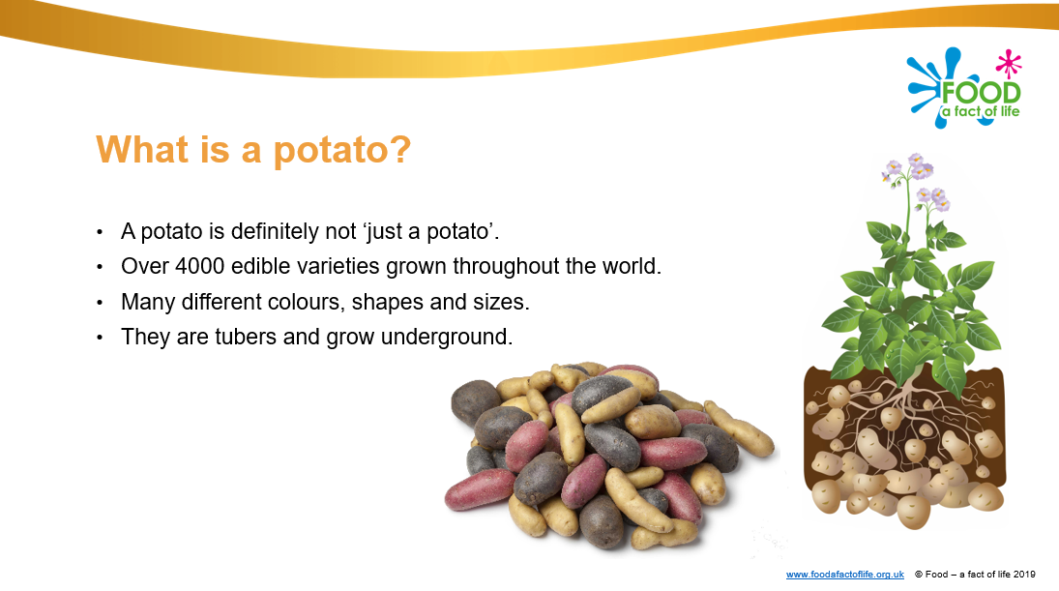
Areas of key learning – Commodities
Cereals
Dairy
Meat
Potatoes
More to come!

Slide 8


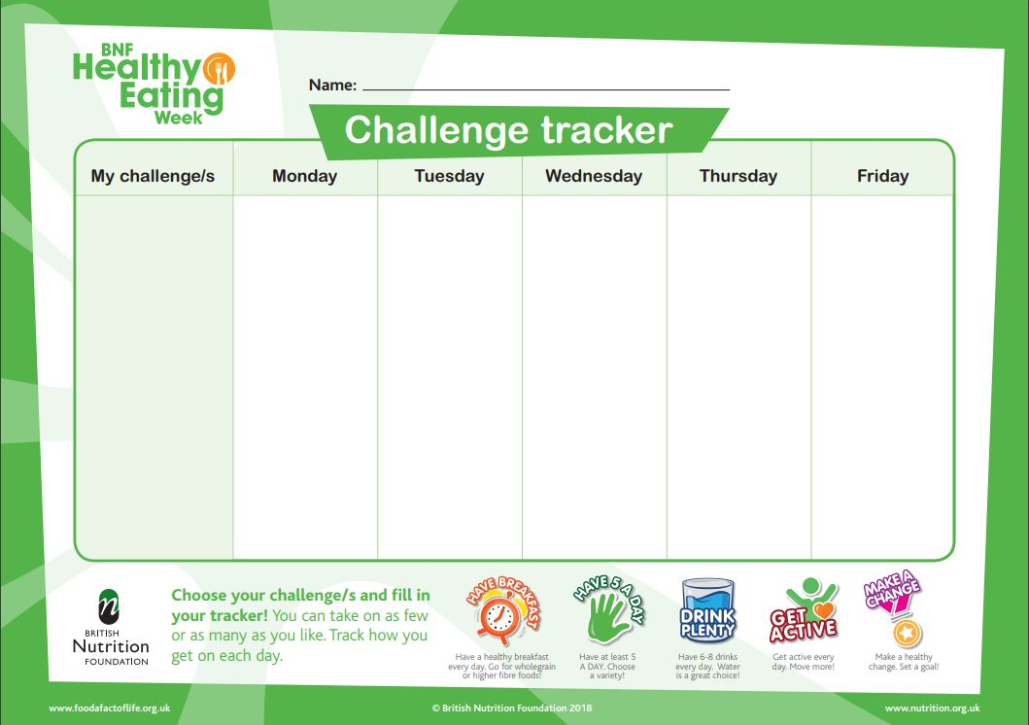
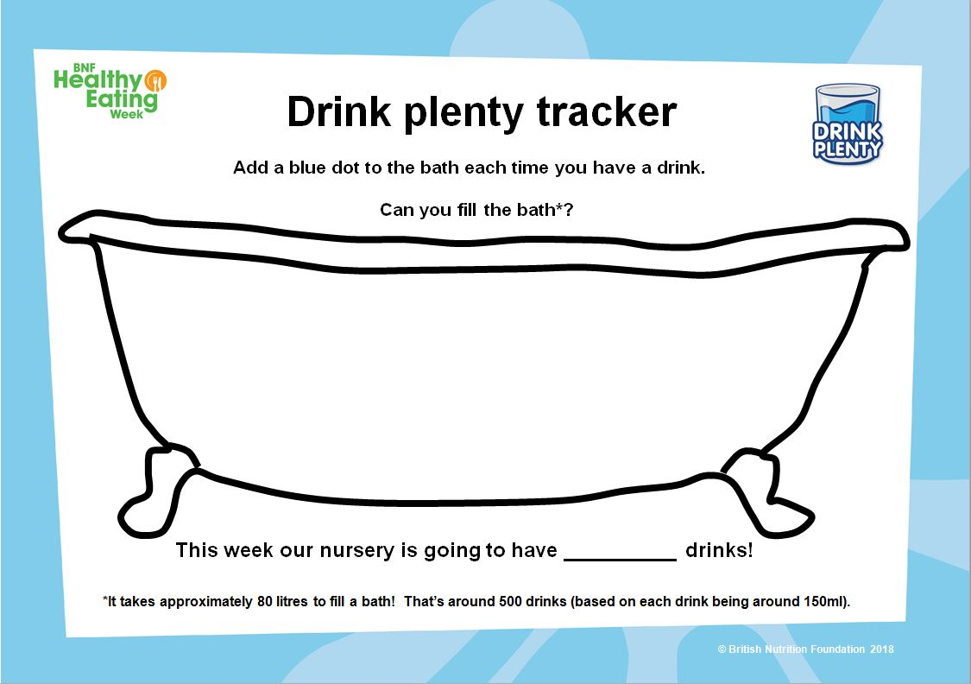
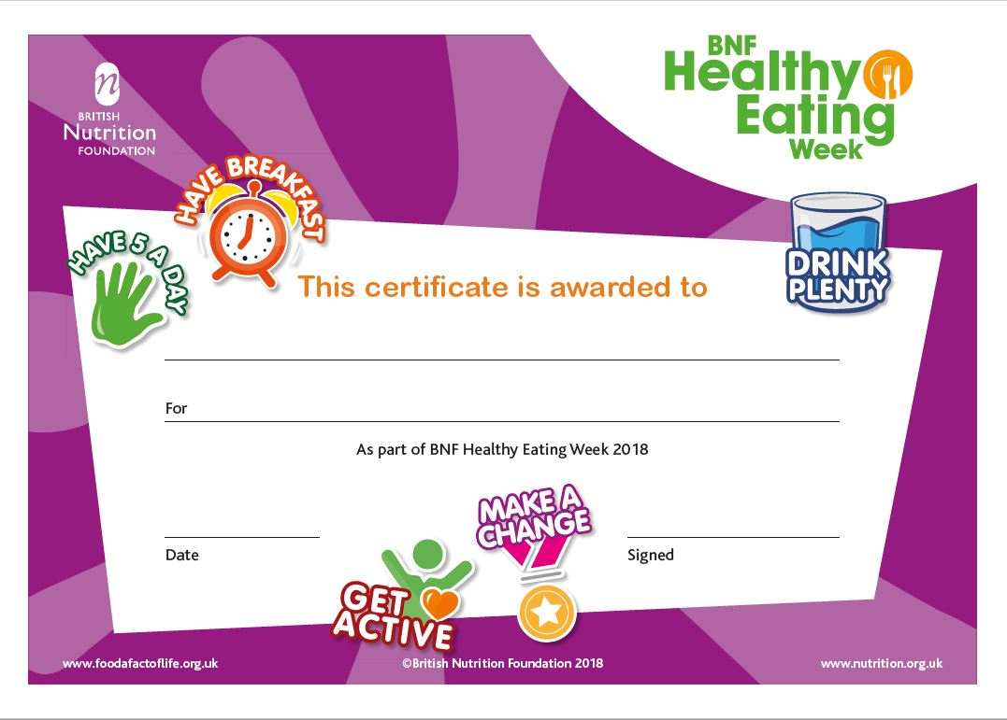
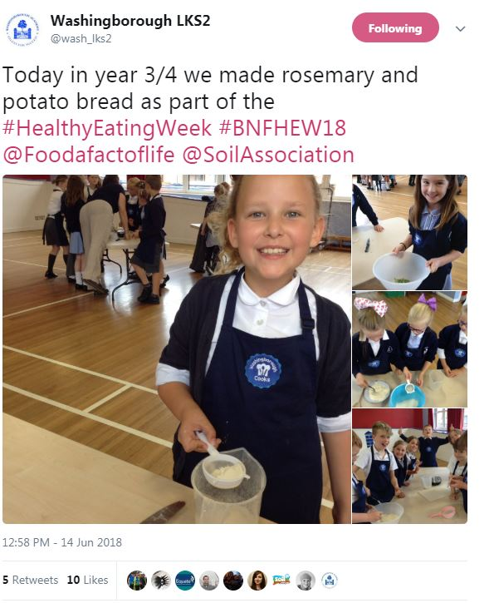
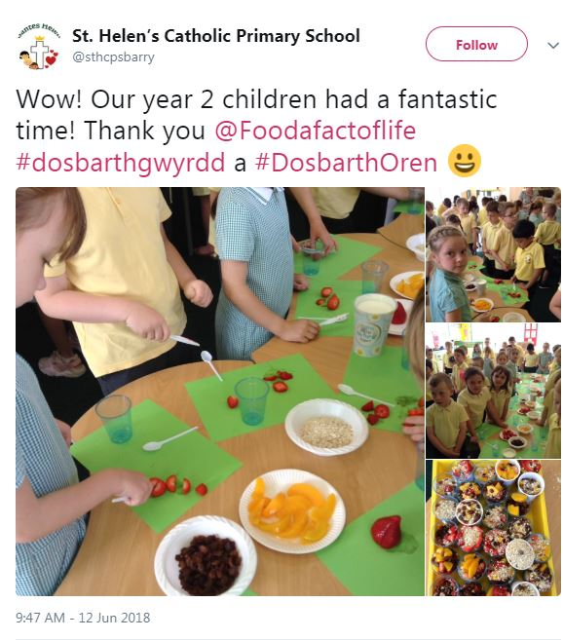
BNF Healthy Eating Week 2019
10 – 14 June 2019
Free downloadable resources and printed posters to support your week!
Register at: www.foodafactoflife.org.uk

Slide 9

Webinars
Tuesday 5 February at 8pm - Planning Schemes of Work and lessons
Roy Ballam, BNF
Thursday 7 February at 4pm - Growing potatoes on a small and large scale
Sue Lawton, AHDB and Claire Theobald, BNF
Wednesday 6 March at 4pm - Get portion wise!
Bridget Benelam, BNF
Thursday 28 March at 8pm - Food science in action
Barbara Monks, thecookeryteacher.com
Webinar recordings available soon:
Eatwell Guide – overview and use in the classroom
Food labelling - understanding front of pack nutrition labelling
For more details and to book, go to: www.foodafactoflife.org.uk

Slide 10
Regional training with our Network Trainers
A national team of practising teachers who are working in partnership with FFL to host and deliver training on a local level.
Training events will be available from April 2019 .
Depending on the topic, the training event could be a half or full day (for practical activities), an after school ‘twilight’ session, or part of a local teacher network meeting (as a ‘guest’ presenter).
All FFL Network Training events will be provided free-of-charge.
Attendees will receive refreshments, resources and links to further information.
A certificate of attendance will also be provided – useful for performance management and compiling professional development records.
For more information, training dates and how to book, go to: www.foodafactoflife.org.uk

Slide 11
National nutrition education conference
For further information, go to:
www.foodafactoflife.org.uk

