Slide 1
FOOD AND YOU
02/02/2019
Ely Mirzahosseinkhan
& Lucy King
Understanding UK Consumers’ Attitudes, Behaviour and Knowledge Surrounding Food

Slide 2
Overview
Who we are
About Food and You
Methodology
Key findings
How the findings are used
Questions

Slide 3
Who are we?

Slide 4
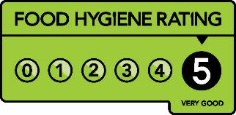
The Food Standards Agency (FSA)
The independent Government department responsible for food
safety and hygiene across the UK.
We ensure that:
All food produced or sold in the UK is safe to eat.
All consumers have access to the information they need to make choices about where and what they eat.
Regulation and enforcement is risk-based and focused on improving public health.

Slide 5

Social Science Team
Provide research advice, design and management
Collect primary data and use secondary data sources
Inform development, implementation, review and evaluation of policy
Ensure what people throughout the food chain think, feel and do informs risk assessment and management
Food and You is one of many tools we use
Notes:
We provide research advice, design and management to inform the development, implementation, review and evaluation of government policy. We ensure that the understanding of what people throughout the food chain think, feel and do informs our risk assessment and our risk management. We do this by collecting primary data as well as using secondary data sources.
One tool we use to understand the attitudes, knowledge and behaviours of consumers is Food and You…

Slide 6
About FOOD AND YOU

Slide 7
Background
Topics covered:
Food hygiene and safety
Food shopping
Eating out
Food security
Allergies and intolerances
Trust in food and the FSA
FSA’s flagship consumer survey, developed in 2008
Measures self-reported attitudes, behaviour and knowledge relating to food safety and other food-related issues

Slide 8
methodology

Slide 9

Methodology
Conducted biennially
Approx. 3,000 adults (16+) randomly selected to take part each wave
Includes England, Wales and Northern Ireland
Administered face-to-face (45-55 min interview)
Primary and secondary analysis
Since 2014 results published as an Official Statistic
Four waves completed to date, Wave 5 results will report in Spring 19
Notes:
More detail can be found in the technical report on our website.

Slide 10
Key Findings FROM wave 4 (2016)

Slide 11
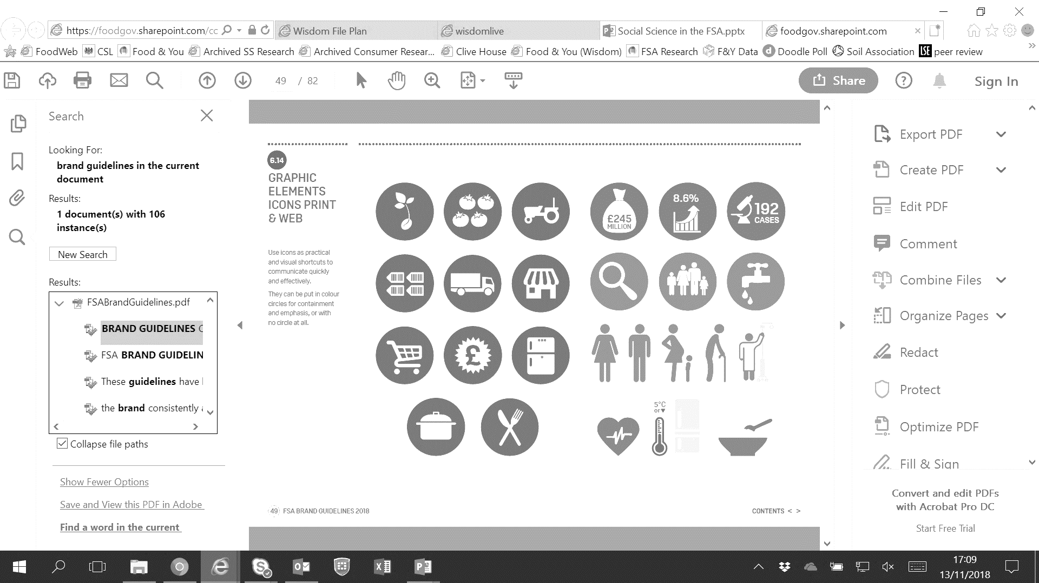
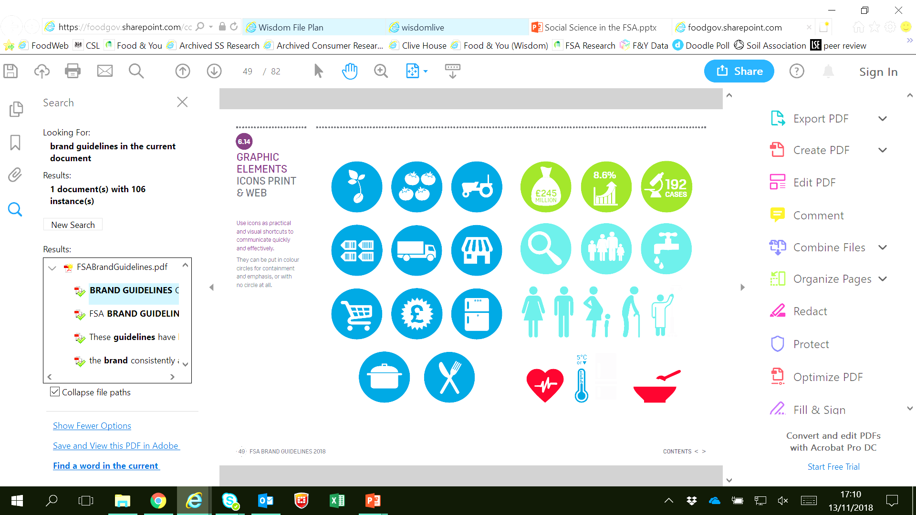

Food Safety – The 4 Cs
Cleanliness
Cooking
Chilling
Avoid Cross-Contamination
Notes:
Using Wave 4 data

Slide 12








Self-Reported vs Actual Behaviour
✓
Potential issues
Social desirability bias
Inaccurate recall

Slide 13
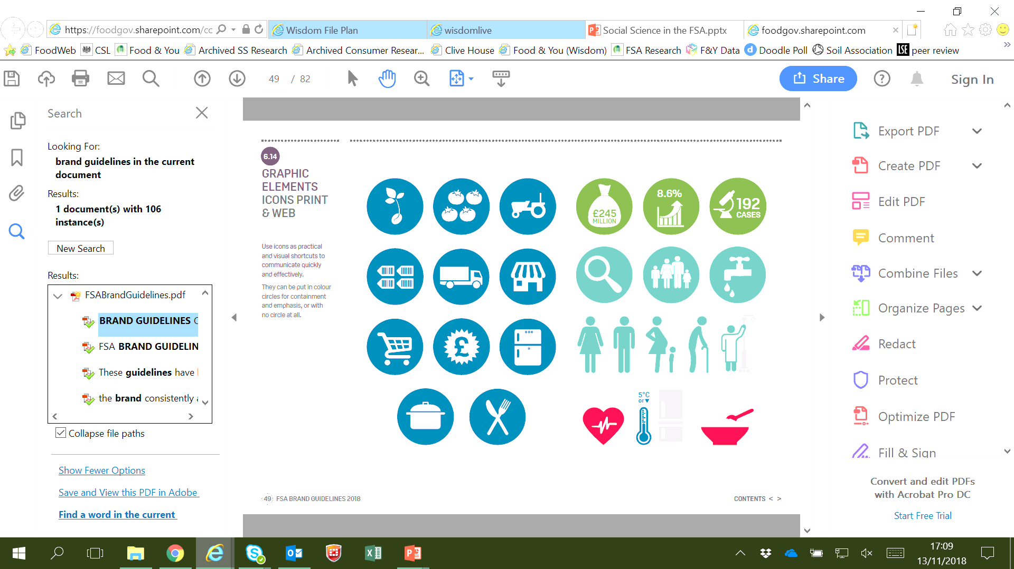
Cleanliness
FSA recommends… | Reported behaviour
Washing hands thoroughly with soap and warm water before cooking and after touching the bin, going to the toilet, handling pets or handling raw food. | 86% reported always washing their hands before starting to prepare or cook food.

Slide 14
Cooking
FSA recommends… | Reported behaviour
Poultry and other meats should be cooked all the way through until there is no pink meat and any juices run clear. Raw meat and fish should not be washed prior to cooking. | The proportions of respondents who reported that they never ate meat or meat products if the meat was pink or had pink/red juices varied by food type (from 60% for burgers to 89% for chicken or turkey). 40% reported washing raw chicken at least sometimes (54% in Wave 3).
Notes:
Cooking food thoroughly kills any harmful bacteria that may be present
due to the risk of cross contamination from water splashing on the sink, surrounding surfaces, and utensils which may then come into contact with ready-to-eat food.

Slide 15
Chilling
FSA recommends… | Reported behaviour / knowledge
Setting fridge temperatures to below 5°C to help stop food poisoning bacteria from growing in food. Defrosting food slowly overnight in the refrigerator or using a microwave oven. | The majority of respondents thought a fridge should be between 0 and 5°C. The method for defrosting meat reported by the majority of respondents was leaving meat or fish at room temperature.

Slide 16
Avoiding Cross Contamination
FSA recommends… | Reported behaviour
Using different chopping boards for raw and ready-to-eat foods. Storing raw meat separately from ready-to-eat food and in sealed containers at the bottom of the fridge, to avoid dripping onto other food. | 46% said they always used different chopping boards for different foods. 60% reported that they stored raw meat and poultry on the bottom shelf of the fridge.
Notes:
Cross contamination occurs when harmful bacteria or viruses are spread between food, surfaces and equipment.

Slide 17

Use-by dates
FSA recommends… | Reported behaviour
Food is not eaten after the use-by date (this is the best indicator of whether food is safe to eat). | 70% of respondents reported that they always checked use-by dates when buying food, regardless of food type. 61% of respondents reported that they always checked the date when cooking/preparing food.

Slide 18
Food Safety – Index of Recommended Practice (IRP)
Overall measure of food hygiene knowledge & behaviours.
Each item scores 1 (in line with recommended practice) or 0 (not in line with recommended practice).
Overall score converted to a score out of 100.
Higher score = more reported behaviours in line with recommended food safety practice.

Slide 19






Food Safety – Findings
In wave 4 the average IRP score was 67 (64 in wave 1).
Women had a higher IRP than men.
Lower IRP scores were seen in the oldest age group (75+) and men aged 25-34.
Single / separated / divorced / widowed people had lower IRP than those married / in a civil partnership / living with partner.
Those living on their own (particularly men) had a lower IRP than those living with others.
Those who were unemployed had the lowest IRP score.
Those who were in work had the highest.

Slide 20



Food Safety – Sources of Information
Family and friends
Product’s packaging
The internet

Slide 21



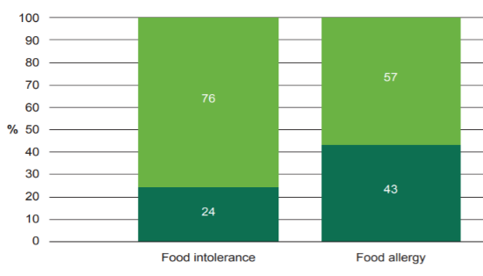

Food Allergies & Intolerance
Common foods people had an adverse reaction to were:
Cows’ milk and cows’ milk products
Cereals containing gluten
Molluscs e.g. mussels, oysters
15% had suffered an adverse reaction when eating certain foods.
Majority not been clinically diagnosed.

Slide 22
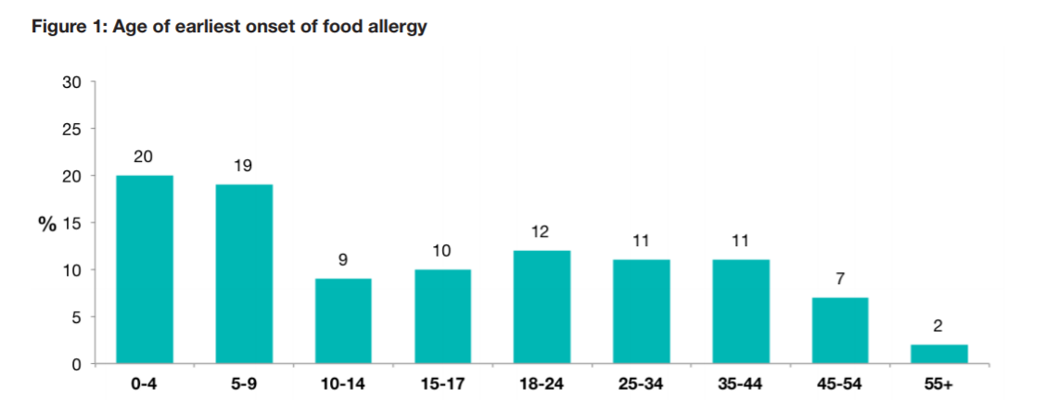
Food Allergies & Intolerance
58% of those with an allergy said it had started before the age of 18.

Slide 23





Food Provenance
Half of respondents prefer to buy food produced in Britain/the UK & Ireland.
89% agreed supporting farmers is important
39% agreed food produced in Britain tends to be more expensive than food imported from overseas - 47% prepared to pay more for it
Most neither agreed nor disagreed that food produced in Britain tastes better than imported food
Half had greater trust in the quality of food produced in Britain

Slide 24





Food Provenance – Group differences
Women more likely to check where food produced & prefer to buy food produced in Britain.
Lowest income households less prepared to pay more for food and drink produced in Britain.
Compared to 16-24 yr olds, those over 65 prefer to buy, are prepared to pay more, and have greater trust in the quality of, food produced in Britain.
Households with young children less prepared to pay more for food/drink produced in Britain.

Slide 25

Food Security – Measurement
Measured using 10 items, such as:
How often worry about running out of food
Whether they have cut size of meals / skipped meals; gone hungry; lost weight because there wasn’t enough money for food
Households categorised as: high, marginal, low or very low food security
“Having access at all times to enough food that is both sufficiently varied and culturally appropriate to sustain an active and healthy life”.
Notes:
From US Household Food Security Survey Module

Slide 26
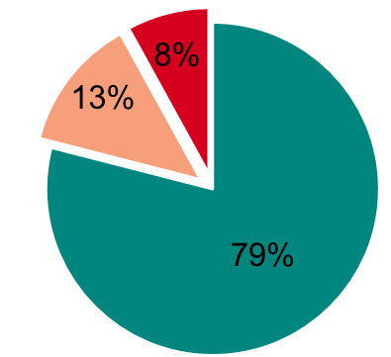

Food Security – Findings
Those in insecure households more likely to be:
Female
Under 35 years
Low income
Unemployed

Slide 27
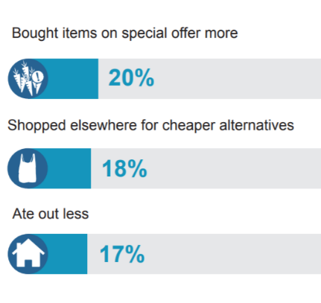
Food Security – Findings
43% made at least one change in their buying/eating arrangements in the last year for financial reasons.

Slide 28
Using the findings

Slide 29




How do we use the findings?
Identifying Key Issues
Inform content of public awareness campaigns or new policies
Evaluation
Monitor & evaluate success of campaigns
Targeting Messaging
Identify vulnerable groups so we can target our messages
Horizon Scanning
Spot emerging trends / areas where more focus or resource is required

Slide 30

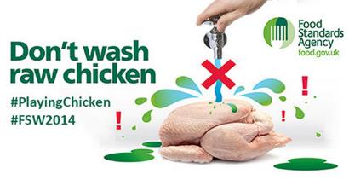
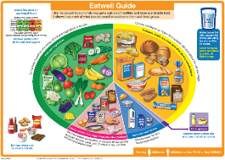

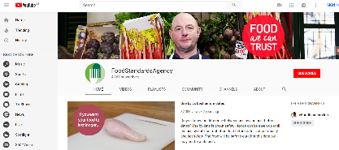
How do we use the findings?

Slide 31
Questions?
More information: https://www.food.gov.uk/research/food-and-you
Contact:
lucy.king@food.gov.uk

