Slide 1

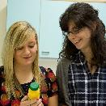
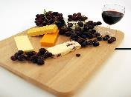
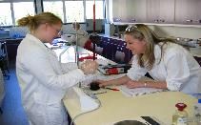
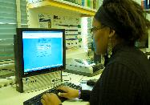
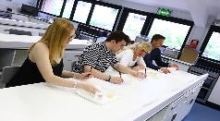
British Nutrition Foundation:
National food and nutrition education conference
Food Science in Action
Dr Anil de Sequeira, BSc (Hons), MSc, PhD, FIFST, CSci, FHEA,
Vice Chair Education and Careers Forum, Institute of Food Science and Technology (IFST) ; External Affairs Co-ordinator (Biology) and Course Leader BSc (Hons) Food with Nutrition, Bath Spa University, UK
E mail: a.desequeira@bathspa.ac.uk , Tel: 01225 875 737

Slide 2
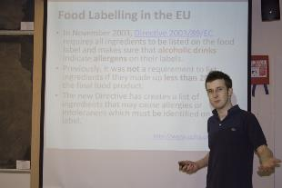
What do Scientists Do?
We ask a Question and then seek to answer the question
Can be in the form of a Hypothesis which we then seek to test
We seek to test in order to ascertain level of risk

Slide 3
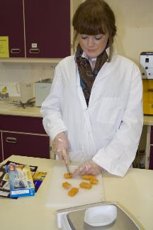
Why should we learn more about our food?
We as consumers want our food to be fresher, more “natural” with minimal packaging and of high quality in terms of flavour, texture, appearance, safety and nutritional value.
We want our food to be convenient and require minimal preparation and have a good shelf life.

Slide 4
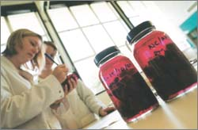
What do we mean when we refer to 'food science' or 'food technology'?
Food science -- is a coherent and systematic body of knowledge and understanding of the nature and composition of food materials, and their behaviour under the various conditions to which they may be subject.
Food technology -- is the application of food science to the practical treatment of food materials so as to convert them into food products of the kind, quality and stability, and so packaged and distributed, as to meet the needs of consumers for safe, wholesome, nutritious and attractive foods.

Slide 5
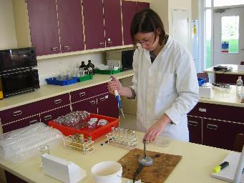
We need to understand
What causes food spoilage
What are the types of food spoilage
What are the factors that affect growth
What affects enzyme activity
How to control Food Spoilage

Slide 6
Traditional and Modern Food Processing Technologies
Traditional Processes
(prehistoric)
Sun drying
Oven drying
Smoking
Salting
Pickling
Fermentation
(Freezing)
Modern Processes
In-container sterilization (retorting)
Aseptic (UHT) processing
Pasteurisation (HTST)
Irradiation
Spray drying
Freeze drying
Extrusion cooking
Freezing and chilling
Membrane processing
Modified atmosphere processing
Microwave and radiofrequency heating
Use of fluidised beds for freezing and drying
High Pressure Processing

Slide 7
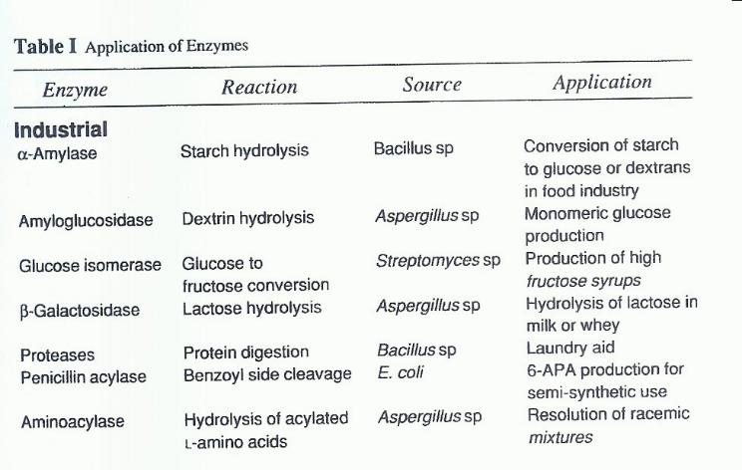

Slide 8
Enzymatic browning
The browning that develops when cut or bruised surfaces of fruits, vegetables and shellfish are exposed to air is called ezymatic browning.
The enzyme is present in both plants and animals.

Slide 9
Phenol oxidase catalysed oxidation of catechol

Slide 10
Time-Temperature Indicator
A Time-Temperature Indicator (TTI) is a smart label that monitors the temperature history of a product and exhibits an irreversible change in colour or shape in response to the cumulative effect of time and temperature.

Slide 11
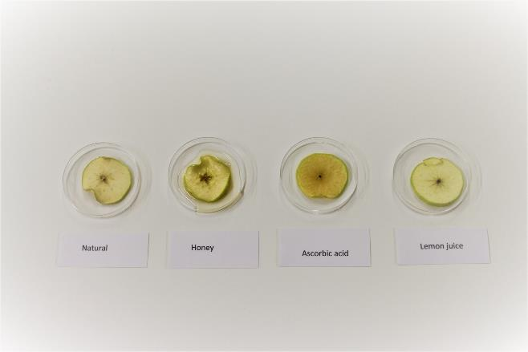
Browning

Slide 12
Control of enzymatic browning
Inactivation of PPO with heat
Chemical inhibition of PPO
Reducing agents
Exclusion of oxygen
Proteolytic enzymes
Treatment with honey

Slide 13
Fruit Juices
Though less specific and less potent, the organic acids citric acid (6.17) and malic acid (6.18) do have advantages.
Not only are they common components of fruit juices but also their acidity helps to keep the pH well below the optimum for phenolase action (approx. pH 6.5).
Immediately after being peeled or sliced, fruit such as peaches are often immersed in baths containing dilute solutions of these acids, frequently supplemented with ascorbic acid or sulphite

Slide 14
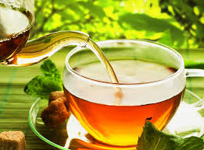
Tea
The enzymic oxidation of polyphenolic substances is a highly desirable feature of one particular foodstuff- tea.
The tea we drink is a hot-water infusion of the leafy shoots of the tea plant, Camellia sinensis, which has been processed in various ways depending on the type of tea to be produced. The type of tea that most of us drink is known as 'black tea', to distinguish it from the 'green tea' we usually call 'China tea'

Slide 15
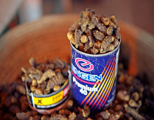
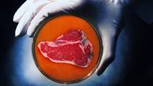
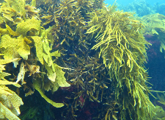
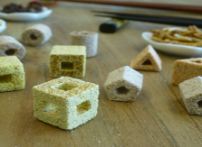
Food of the future?
Insects
Artificial meat
Seaweed
3D printed food

Slide 16

  VISUAL ILLUSION

Slide 17

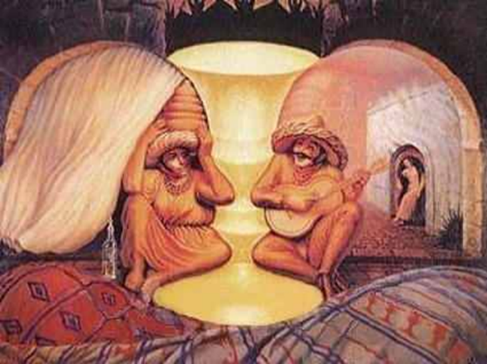

Slide 18
Tasting of Flavoured Waters –
a practical activity in school
Colour summer fruits flavoured water with green food dye.
Colour strawberry flavoured water with red food dye.
Pour 10ml of each drink into a small cup.
Label each sample, e.g. 512, 886.
Ask the pupils to taste the samples in turn and describe the flavour of each.
They should drink some plain water between each sample.

Slide 19
Some useful resources
IFST - Love Science The Love Food
The Science of Cooking – Peter Barham

Slide 20
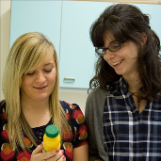

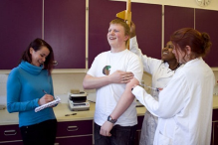
FOOD/NUTRITION AT BATH SPA UNIVERSITY
BSc (Hons) Human Nutrition
Accredited by the Association for Nutrition.
Main foci nutritional science and biological sciences
Complementary themes in food quality and safety and in health
Sandwich Year Optional
BSc (Hons) Food with Nutrition
Students do not need a traditional science background to be accepted onto the course
Extensive links with Food industry.
Focus on the food supply chain, food quality, food safety and product development
Our students are eligible to become IFST student members and Graduates from this programme can go on to secure professional membership with IFST
Sandwich Year Optional

Slide 21

All day some of you dream about sports
All day some of us dream about Science, trying to gain improved knowledge that will improve our understanding of food science, technology and nutrition

Slide 22
Thank you for taking part
Any questions?

