Slide 1
Bone health through life

Slide 2
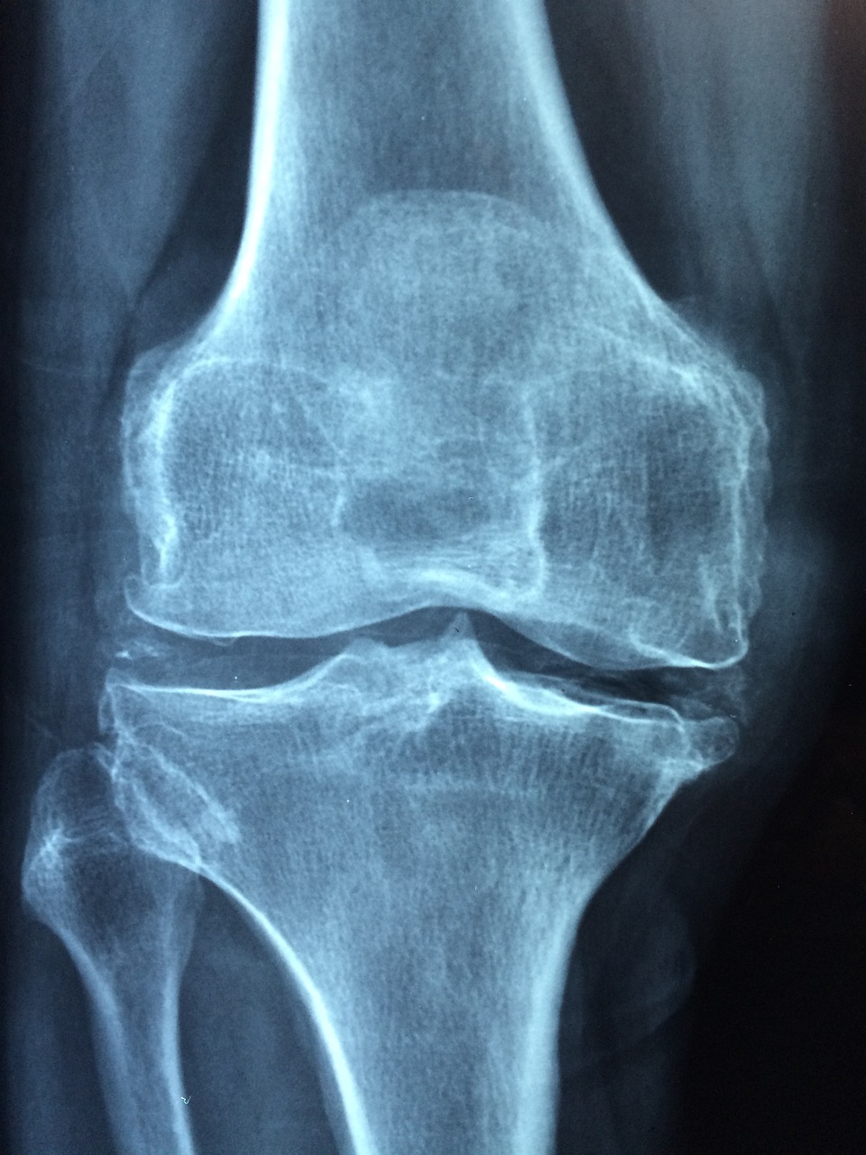
Osteoporosis
Osteoporosis affects 3.5 million people in the UK. It is a condition in which bones lose their strength and are more likely to break (fracture), usually following a minor fall.
Fractures caused by osteoporosis can happen in various parts of the body, they occur most often in the wrists, hips and spine.
Half of women and 1 in 5 men (20%) over the age of 50 years experience fractures, mostly because of low bone strength.
Osteoporosis - British Nutrition Foundation

Slide 3
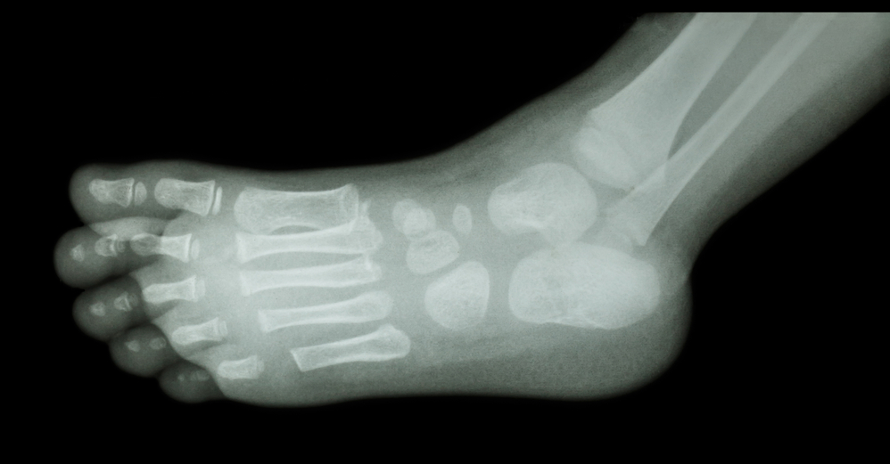
Bone health through life
Bone is a living tissue from which substances are constantly being removed and replaced.
Healthy bone is strong and does not break easily.
During childhood, adolescence and early adulthood, large amounts of calcium and other substances are added to the bone, strengthening the skeleton as it develops. Bone acts as a reserve for calcium in the body.

Slide 4
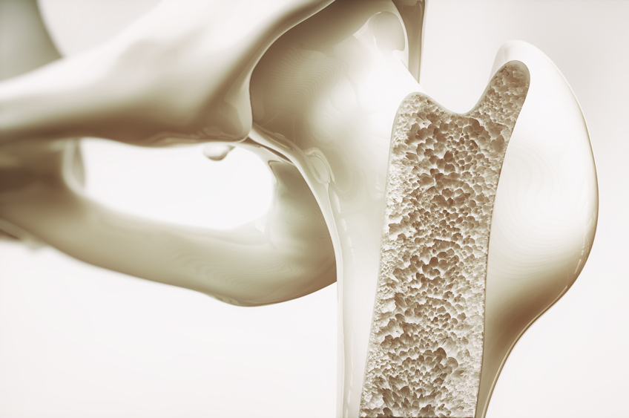
Bone health through life
Bone is continuously being remodelled - old bone tissue is replaced by new.
Bone formation and bone resorption (replacement of old bone tissue) take place throughout life, although at different rates at different times. In childhood the process enables the bone to grow; in adulthood the purpose is to maintain bone strength.

Slide 5
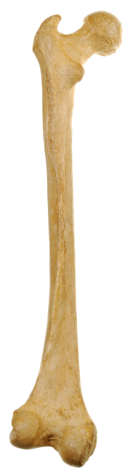
What is peak bone mass?
Bone formation and bone resorption are influenced by a variety of factors including diet and physical activity.
Peak bone mass is reached when someone is in their mid twenties. Around this age bone is at its strongest. After this age, bone mass gradually decreases.
Achieving a good peak bone mass is important in reducing the risk of osteoporosis in later life. This is because bones are strong before bone loss begins.

Slide 6
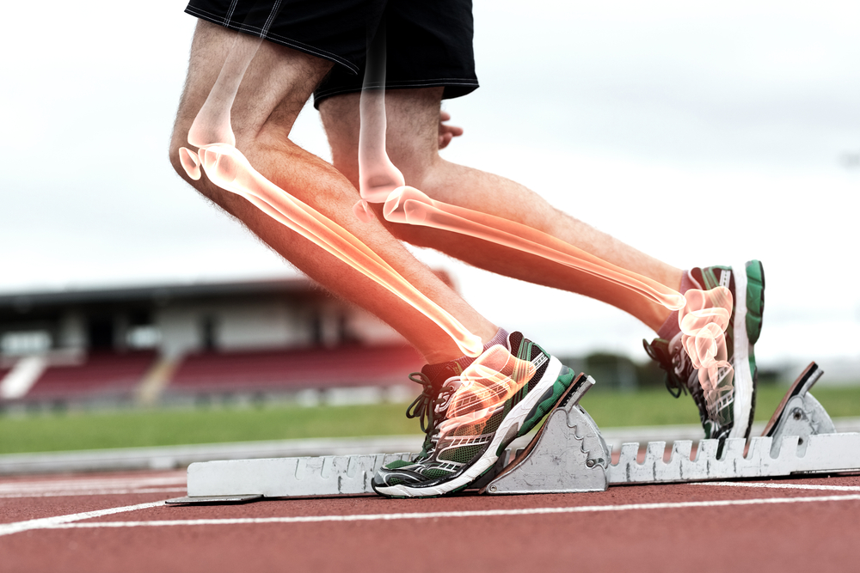
Peak bone mass
Peak bone mass can be increased by ensuring that the diet contains adequate amounts of vitamin D and calcium during childhood, adolescence and early adulthood, and by regular activity especially weight-bearing activities such as brisk walking, running, dancing and climbing stairs (in which the bones bear body weight).
Peak bone mass is influenced by genetic factors such as build and ethnic group.

Slide 7
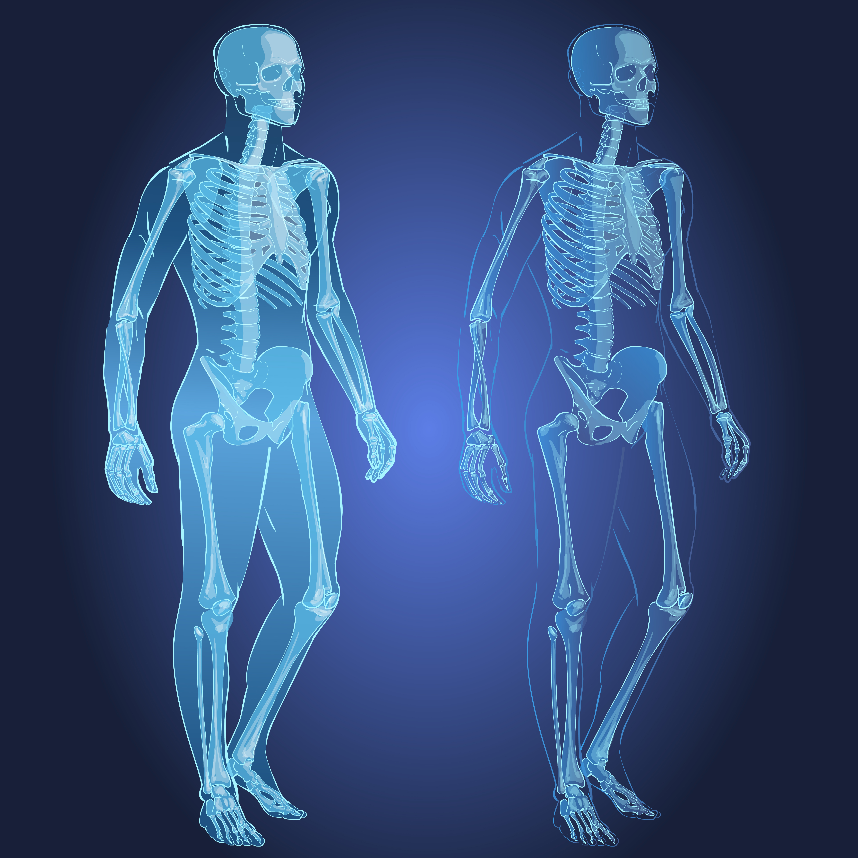
Healthy bones
Strong bones that contain plenty of calcium are less likely to become weak and break in old age.
Bone strength is affected by:
Genetic factors - some ethnic groups may have stronger bones in general than others;
Gender - men tend to have a greater bone mass than women.

Slide 8
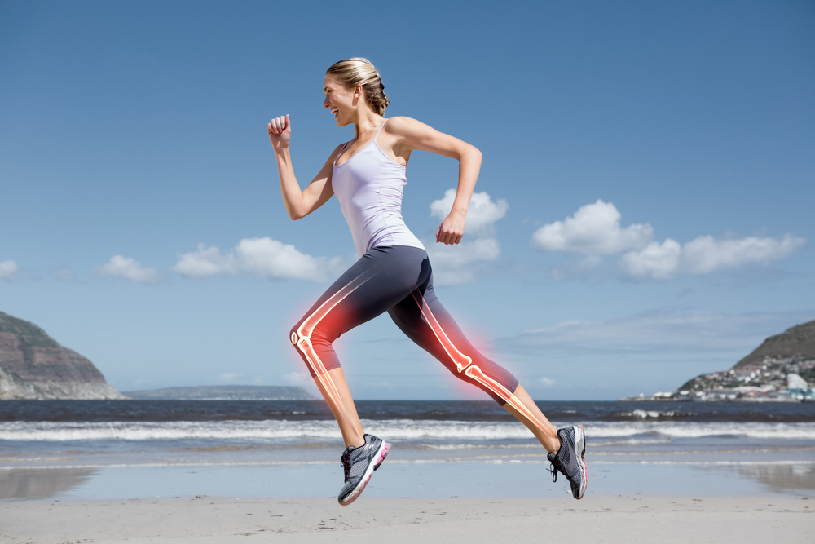
Healthy bones
Bone strength is affected by:
diet – calcium, vitamin D and vitamin K, in particular, are important for strong bones;
physical activity - regular exercise (especially weight bearing exercise) is important for strong bones;
body weight - heavier people have stronger bones (the bones respond to the weight that they have to carry);
hormones - irregular or loss of menstrual periods can cause bone loss, e.g. during menopause.

Slide 9
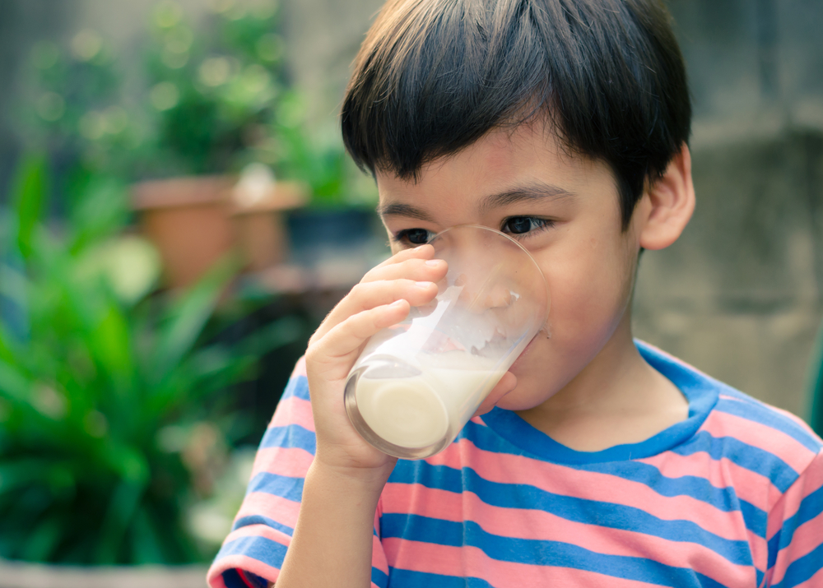
Diet and bone health
Diet is an important factor in forming healthy bones.
An adequate calcium intake at all stages of life (coupled with an active lifestyle) helps to ensure that bones are as strong as possible.
It is particularly important during childhood, adolescence and early adulthood when bones are developing. The richest sources of calcium in the UK diet are milk and dairy products.

Slide 10
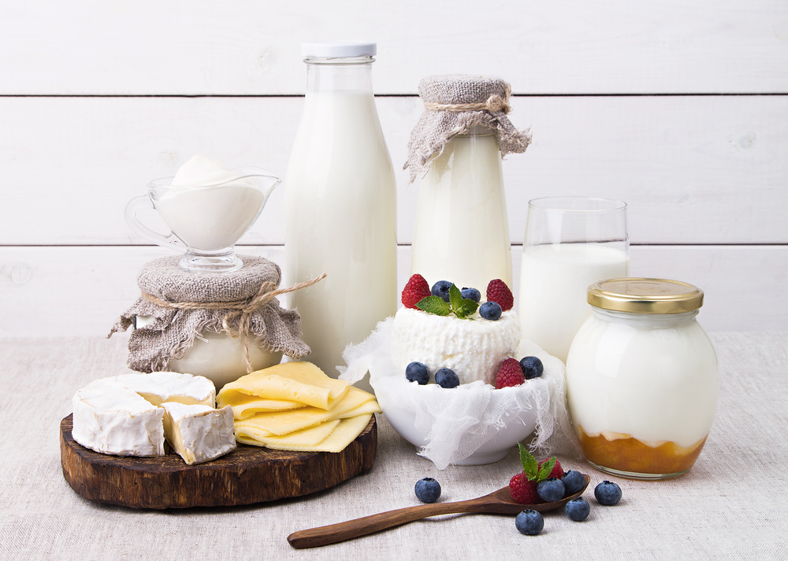
Calcium
An adequate intake of calcium is important throughout life. Dairy products such as milk, yogurt and cheese are all sources of calcium.
In the UK, white and brown flour must be fortified with calcium, so bread made from these flours is a significant source for many people.
Pulses, nuts, dried fruit and green vegetables, such as spinach, provide calcium, as does fish which is eaten with the bones, such as canned sardines.

Slide 11
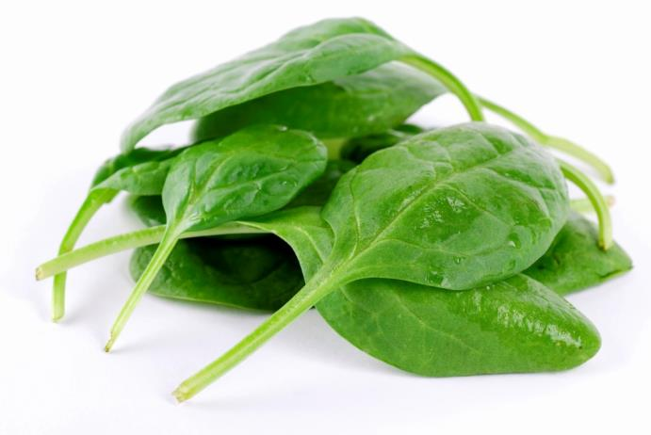
Calcium
Some foods may provide significant amounts of calcium, but also contain substances that reduce the amount that can be absorbed by the body.
Examples of these substances include phytates in wholegrain cereals and pulses, and oxalate in spinach and rhubarb.

Slide 12
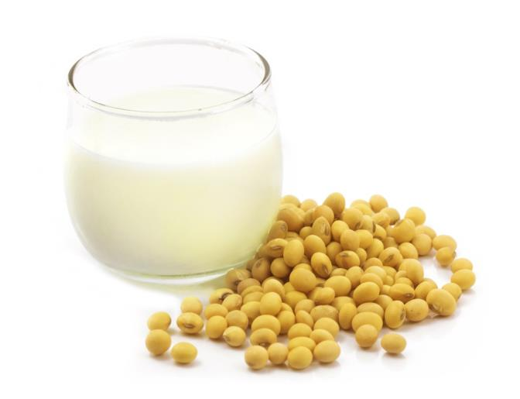
Calcium
As vegans do not eat dairy products, they should make sure that their diet contains sufficient calcium.
In the UK, many soya products, such as tofu and soya drinks, are fortified with calcium and so can be useful sources.

Slide 13

Vitamin D
Vitamin D assists in the absorption of calcium from food. Some vitamin D is acquired from the diet but for most people the major source is through synthesis in skin that is exposed to sunlight.
As well as being important for the bone health, good vitamin D status has recently been shown to be a factor in the prevention of falls among older people. A deficiency of vitamin D over a long period of time causes rickets in children and osteomalacia in adults.

Slide 14

Vitamin D
Most people obtain sufficient vitamin D through sunlight exposure during the summer months.
But some groups, such as those with darkly pigmented skin living at higher latitudes, housebound people and those who wear clothes that cover most of their body (e.g. for religious reasons), are far more reliant on dietary supply and may need supplements of the vitamin to ensure adequate status.
This is because few foods contain large quantities of vitamin D.

Slide 15
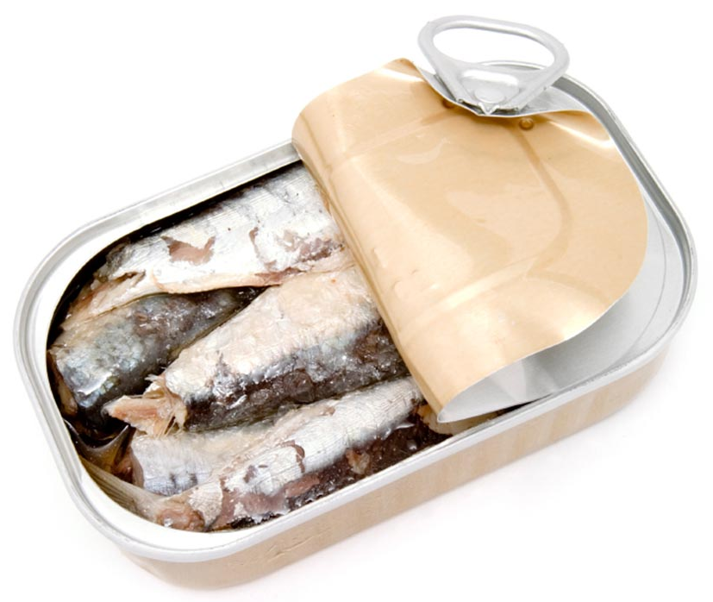
Vitamin D
Fish liver oils have very high levels of vitamin D and oily fish, e.g. sardines, mackerel and fresh tuna, are also rich sources.
Egg yolk, liver and butter contain smaller amounts of vitamin D. Many low fat spreads and some breakfast cereals are also fortified voluntarily, as is skimmed-milk powder.

Slide 16
Vitamin D supplementation
The Recommended Nutrient Intake (RNI) proposed by SACN for all people aged 4 and above is 10 µg/day. SACN have also produces supplementation advice.
Between late March/early April and September, the majority of people aged 5 years and above will probably obtain sufficient vitamin D from sunlight when they are outdoors, alongside foods that naturally contain or are fortified with vitamin D. As such, they might choose not to take a vitamin D supplement during these months.
From October to March everyone over the age of five will need to rely on dietary sources of vitamin D. Since vitamin D is found only in a small number of foods, it might be difficult to get enough from foods that naturally contain vitamin D and/or fortified foods alone. So everyone, should consider taking a daily supplement containing 10 micrograms of vitamin D.
https://www.nutrition.org.uk/nutritioninthenews/new-reports/983-newvitamind.html

Slide 17
Vitamin D supplementation
There are further recommendations that:
People with very little or no sunshine exposure and p eople from minority ethnic groups with dark skin should take a daily supplement containing 10 micrograms vitamin D throughout the year.
All breastfed infants 0 – 1 years - as a precaution, it is recommended that infants from birth to one year of age, whether exclusively or partially breastfed, should be given a daily supplement containing 8.5 to10 micrograms of vitamin D.
Infants fed infant formula should not be given a vitamin D supplement unless they are receiving less than 500mls (about a pint) of formula a day.
All children aged 1 to 4 years of age should be given a daily supplement containing 10 micrograms of vitamin D.
https://www.nutrition.org.uk/nutritioninthenews/new-reports/983-newvitamind.html

Slide 18
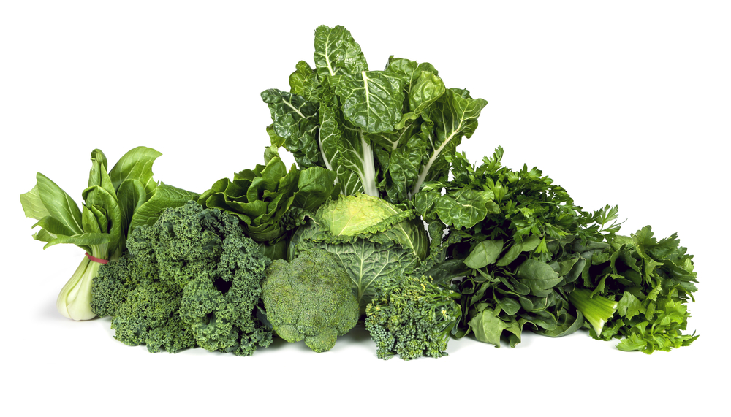
Vitamin K
There are at least three vitamin K-dependent proteins present in bone.
People with osteoporosis have been shown to have low blood levels of vitamin K, and low vitamin K intake and impaired vitamin K status are associated with lower bone mass and higher risk of hip fracture in older men and women.
The main sources of vitamin K are green leafy vegetables, meat and dairy products.

Slide 19
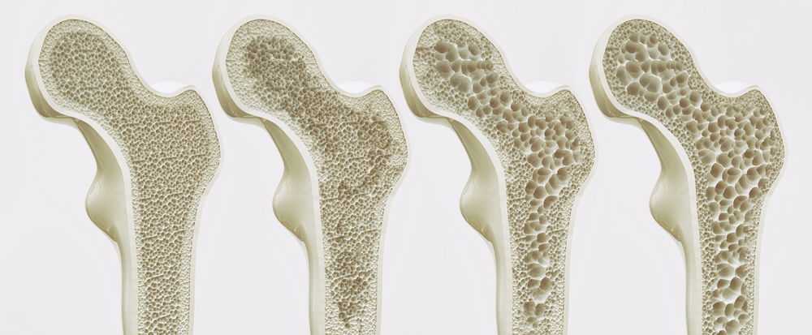
Osteoporosis
As a person gets older, some loss of calcium from bone is normal, but severe loss results in gaps in the structure of bone. This causes the bones to become weak, brittle and to break easily.
This condition is known as osteoporosis.
All bones can be affected by osteoporosis, but fractures are most common in the wrist, back and hip.
Osteoporosis most frequently affects older women who have gone through the menopause, but it can affect men and younger women.

Slide 20
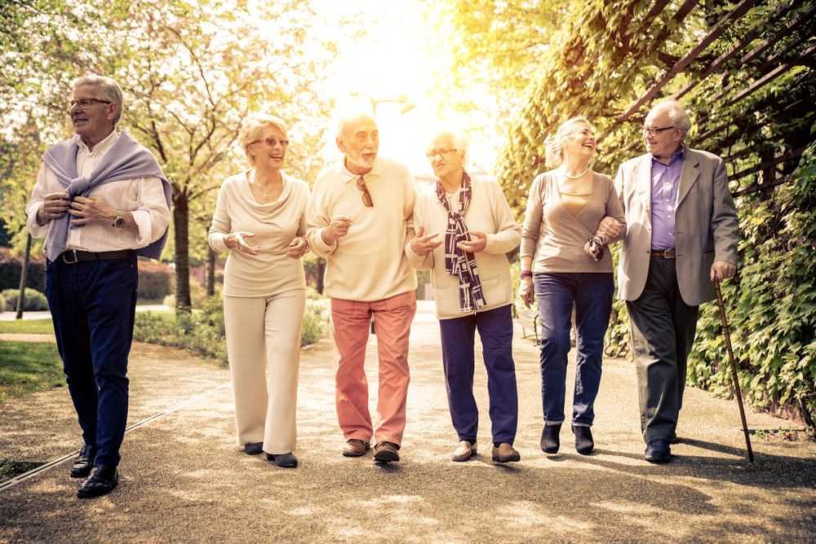
Osteoporosis
Weight bearing activity such as walking, reduces the risk of osteoporosis. Exercise during childhood and adolescence helps to strengthen developing bones.
Regular exercise throughout life is also important to keep bones strong.

Slide 21
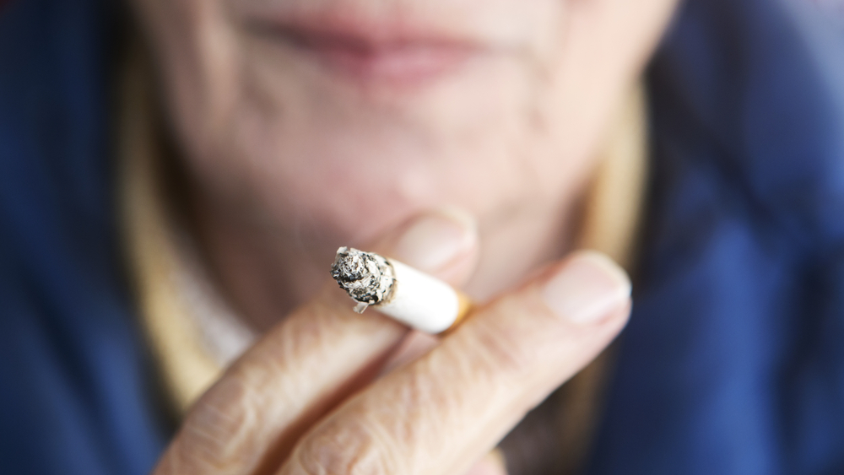
Osteoporosis
There are a number of other factors that are involved in osteoporosis:
smoking and high alcohol intake increase the rate of bone loss and the risk of osteoporosis;
osteoporosis is more common in people who are underweight;
early menopause increases the risk of osteoporosis.

Slide 22
Quiz - Kahoot
Open the link below on the main screen and get students to log onto kahoot.it on their tablets or smartphones. They can then enter the code (that will come up on the main screen when you start the game) and their own nickname. They can then play along with the quiz choosing the multiple choice answers that correspond with the questions on the main screen. There will then be a leaderboard of the scores after each question and at the end.
https://play.kahoot.it/#/?quizId=f20c001d-aefa-4b87-9244-0d29346d7866

Slide 23
Bone health through life
For further information, go to:
www.foodafactoflife.org.uk
This resource meets the Guidelines for producers and users of school education resources about food.

