Slide 1
Occasions

Slide 2
Many special occasions involve food.
What celebrations or festivals can you name?

Slide 3
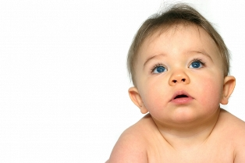
The celebration may be for:
a birth;

Slide 4
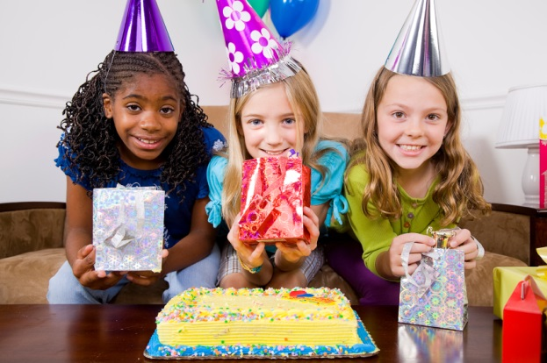
The celebration may be for:
a birthday;

Slide 5
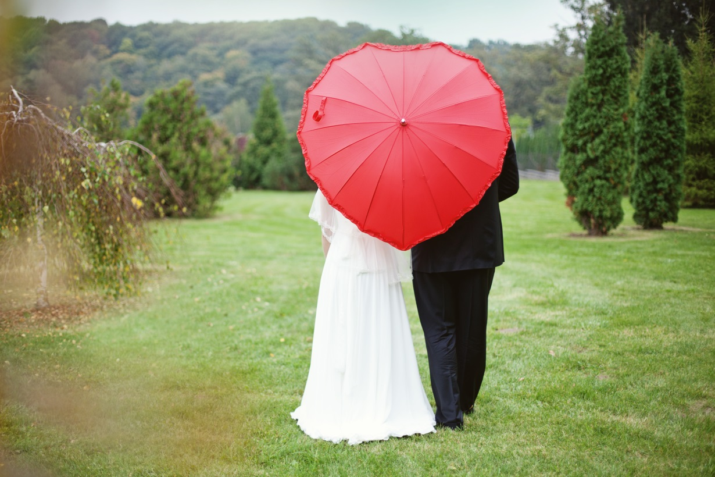
The celebration may be for:
a wedding;
an anniversary;

Slide 6

The celebration may be for:
a new job;
doing well at school;
Valentine's day.

Slide 7
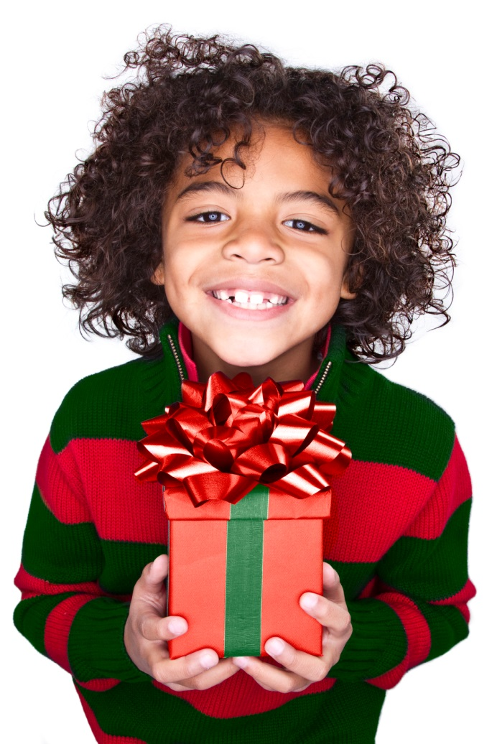
The celebration may be religious:
Passover;
Christmas;

Slide 8
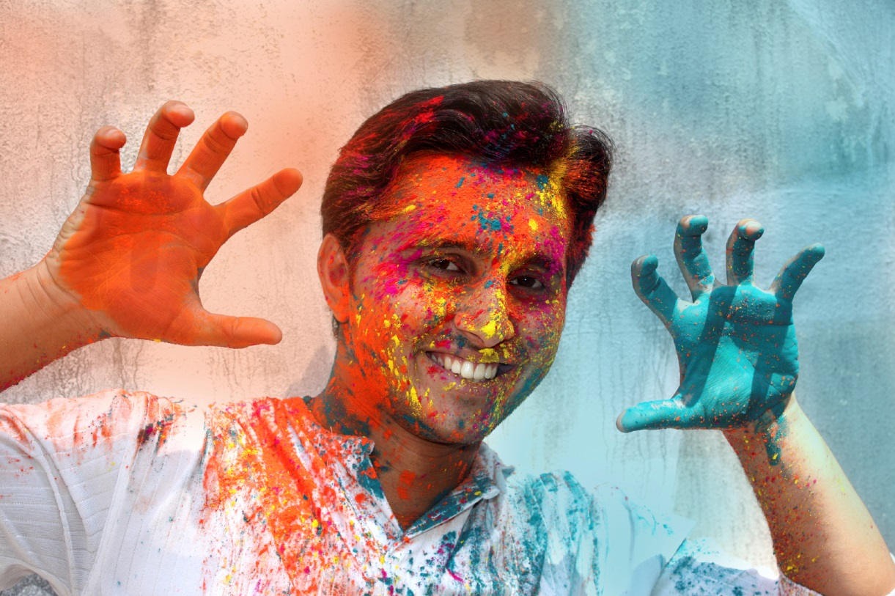
The celebration may be religious:
Diwali;
Eid-ul-fitr;
Easter.

Slide 9
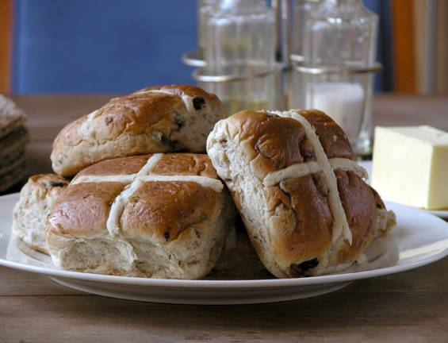
The celebration may be religious:
Easter.

Slide 10
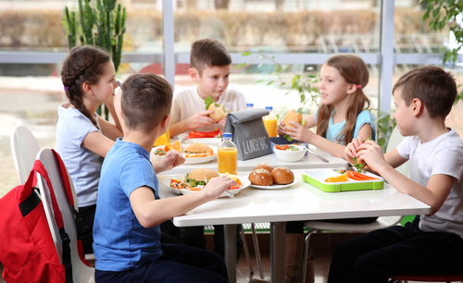
What occasions can you name?

Slide 11
Occasions
For further information, go to:
www.foodafactoflife.org.uk
This resource meets the Guidelines for producers and users of school education resources about food.

