Slide 1
Yogurt

Slide 2
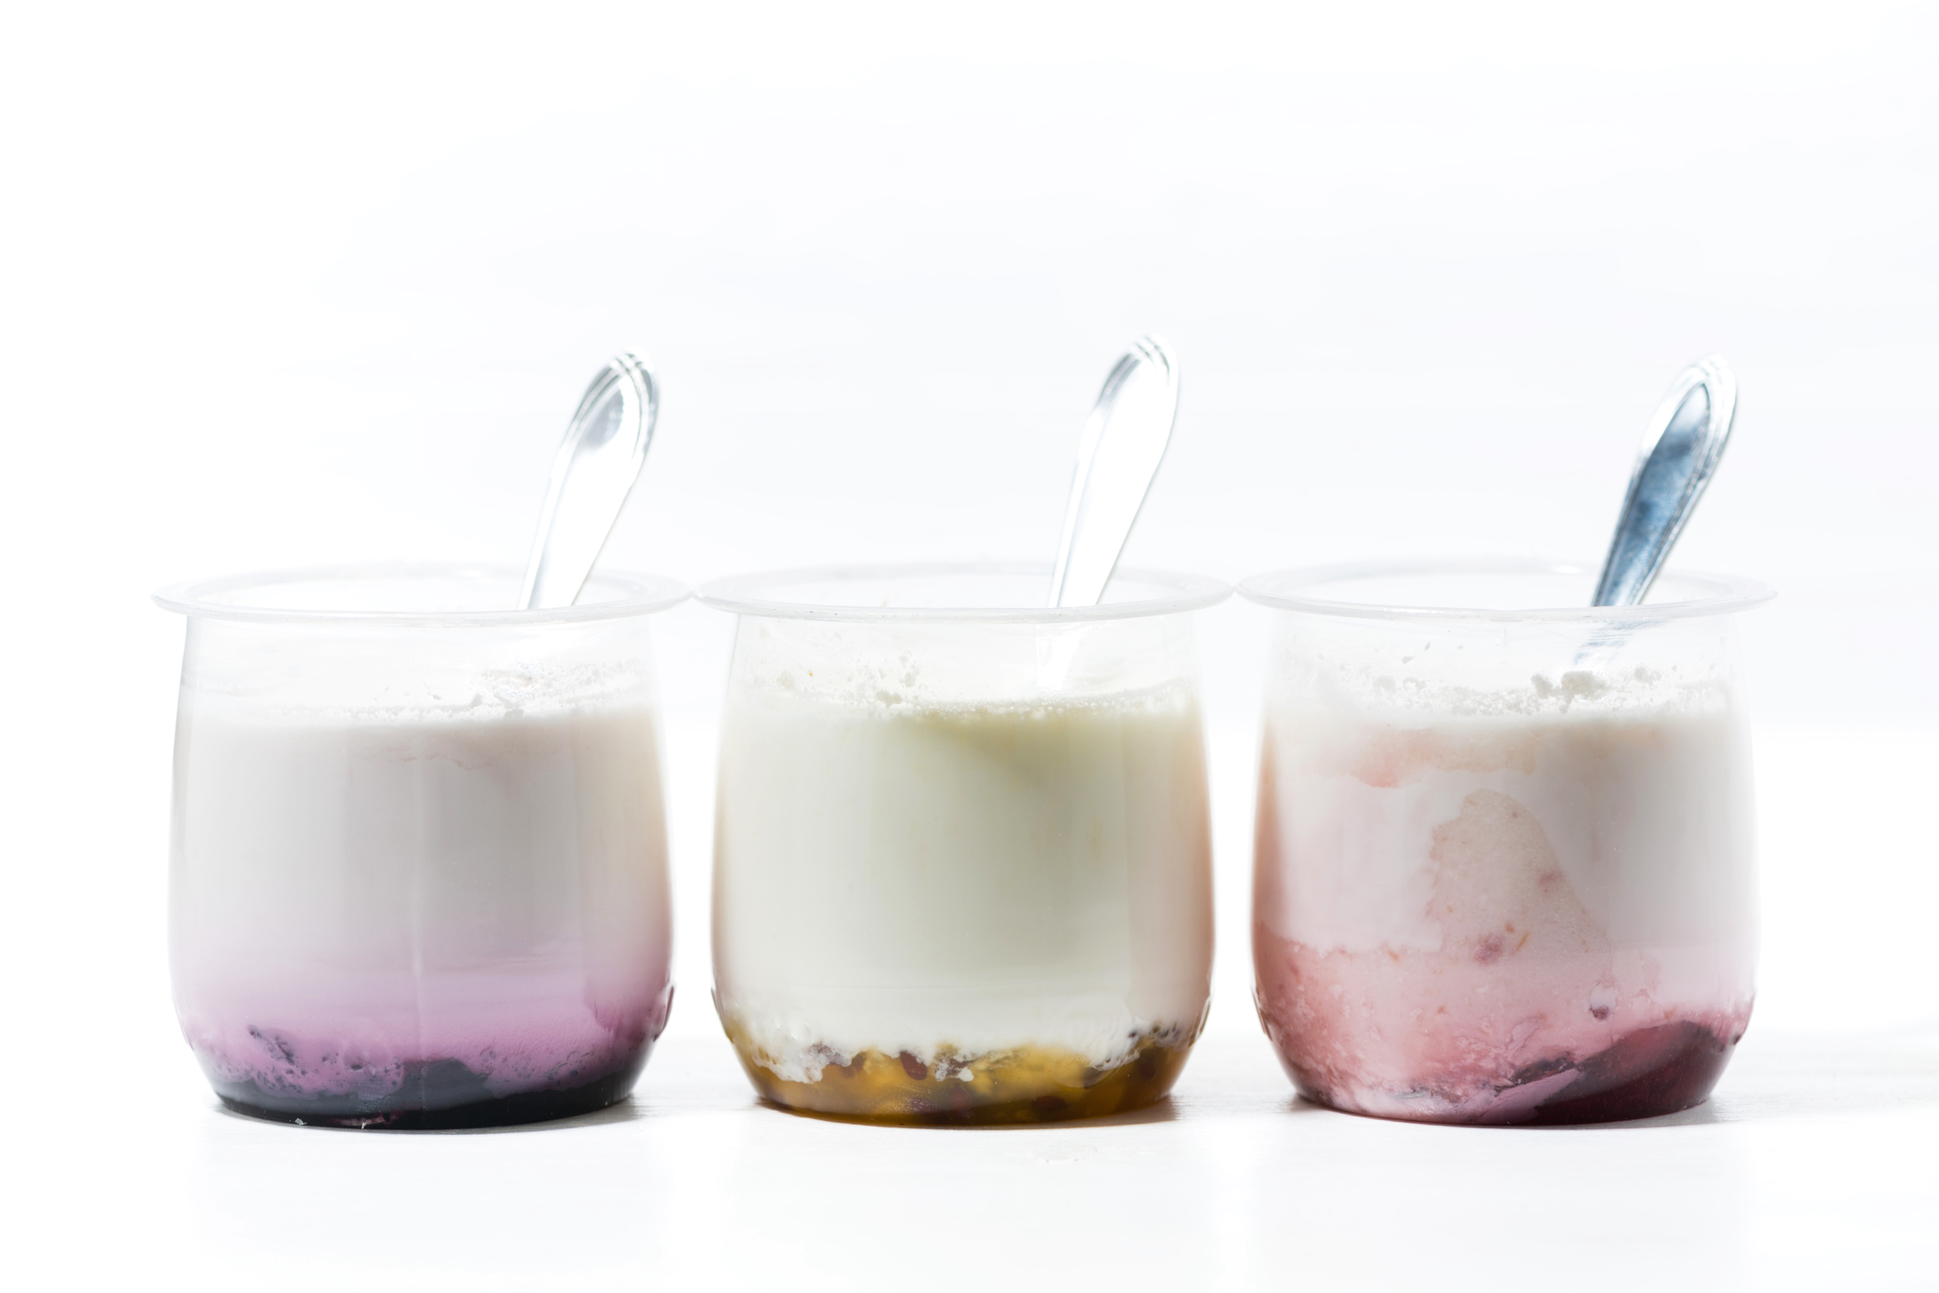
Overview
This presentation gives an overview and explanation of:
how yogurt is processed;
different types of yogurt and their use in dishes;
yogurt in our diet;
food and drink made with yogurt.

Slide 3

Processing
Milk is pasteurised (heated through to stop potentially harmful bacteria growing) and then homogenised. Homogenisation is a process which evenly distributes the fat in milk and makes yogurt smooth and creamy.
The milk is incubated and harmless bacteria are added. The bacteria convert the naturally occurring sugar in milk (lactose) into lactic acid, which causes the milk to thicken, giving yogurt its characteristic consistency and tangy taste.

Slide 4
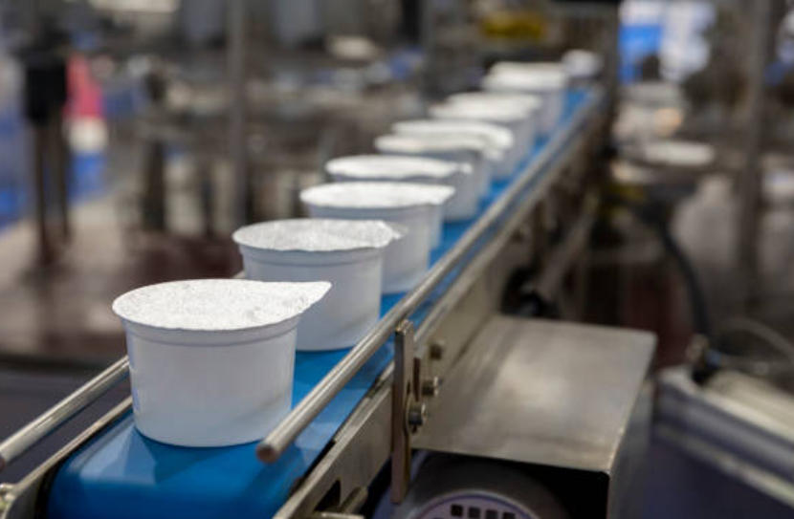
Processing
The yogurt is left to settle until it reaches the desired level of acidity. It is then cooled down and fruit or flavourings can be added before being packaged.

Slide 5
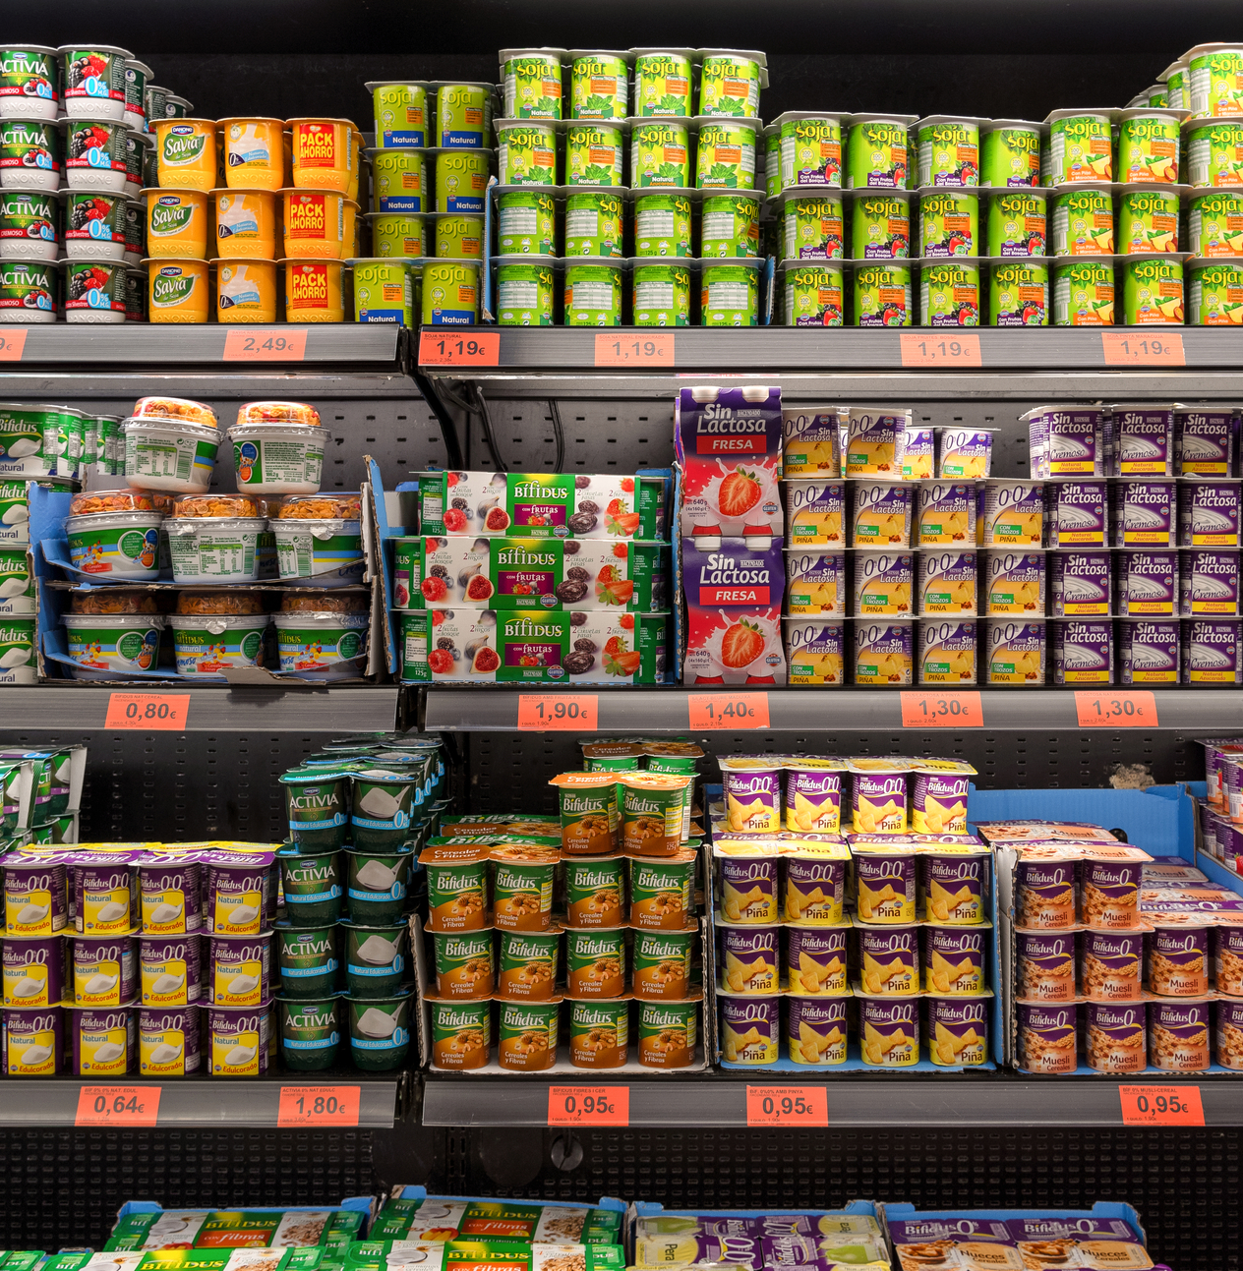
Types of yogurt
Plain – yogurt at its simplest, with no additional ingredients.
Flavoured – with added sugar, honey, natural flavours, extracts, syrups, whole or pureed fruit and/or cereals.
Low-fat – contains no more than 3g of fat per 100g of yogurt.
Light – contains 30% less of a specific nutrient (for example, sugar or fat) compared to a range of similar products.
Fat-free – contains no more than 0.5g fat per 100g yogurt.
Concentrated – yogurts in which the protein content has increased to a minimum of 5.6g per 100g (a standard fruit-flavoured yogurt contains around 4g protein per 100g). This is achieved by a number of different methods, including straining.
Kefir – a fermented milk drink, similar to a thin yogurt, that is made from kefir grains.

Slide 6
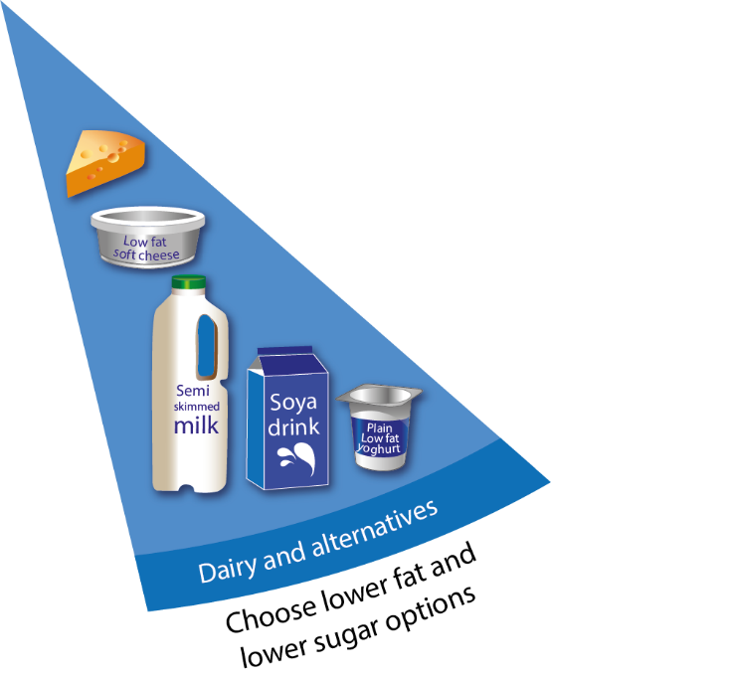
Yogurt in the diet
Yogurt falls into the ‘dairy and alternatives’ portion of the Eatwell Guide.
It is recommended that we choose lower fat and lower sugar options from this group.
This group also contains milk and cheese (and alternatives)
This group contains products with important nutrients such as calcium, iodine and protein.

Slide 7
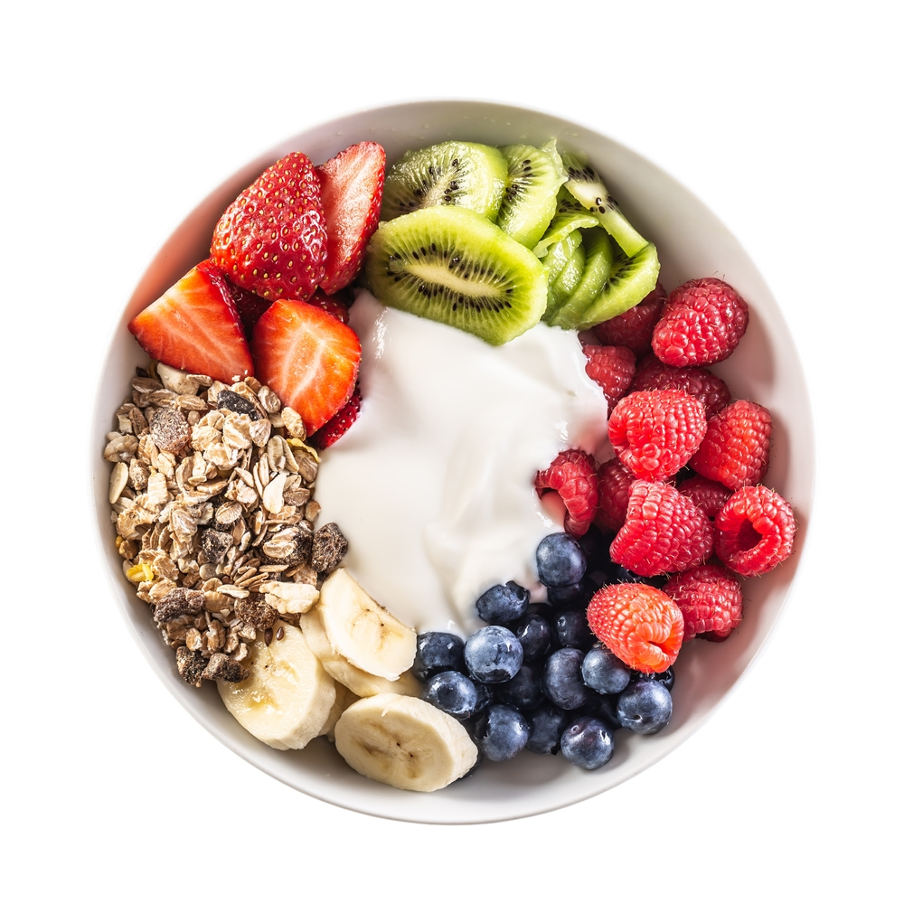
Nutrients in yogurt
Yogurt* is high in protein and iodine and is a source of riboflavin and calcium.
Protein is important for the development and maintenance of healthy muscles and bones.
Iodine is rare elsewhere in the typical UK diet and contributes to normal brain function.
Riboflavin (vitamin B₂) is one of a group of B vitamins. It can act as an antioxidant and contribute to the immune system, as well as healthy skin and hair.
Dairy is an important source of calcium, which helps to maintain bone health.
*Data from McCance and Widdowson Composition of Foods Integrated Dataset (2021) for whole milk, plain yogurt. Amounts may vary for flavoured, sweetened or otherwise altered yogurts.

Slide 8
Cooking with yogurt
Preparation
Shop-bought yogurts are ready to use straight from the container. If yogurts are to be used in cooking, it is best to bring to room temperature first. Sometimes when cold yogurt is added straight to a dish, it can curdle and separate, due to the extreme temperature change. Yogurts made with whole milk are best to cook with, as they are more stable and less likely to curdle.
Storage
Keep all live yogurts in an airtight container in the fridge, for up to 4 days, or in line with the ‘use by’ date on the tub. After this date has expired, the yogurt will start to taste increasingly acidic. Long-life yogurt can be kept for longer than live yogurt – again, check the ‘use by’ date.

Slide 9
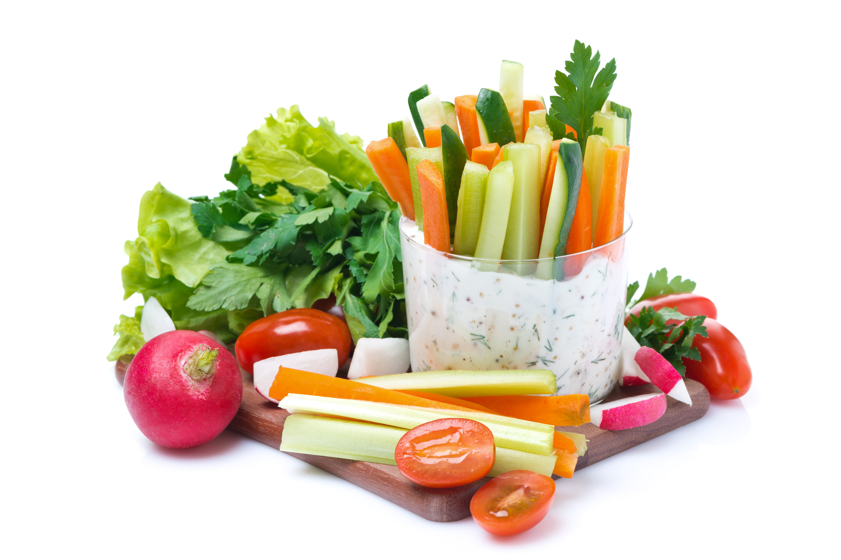


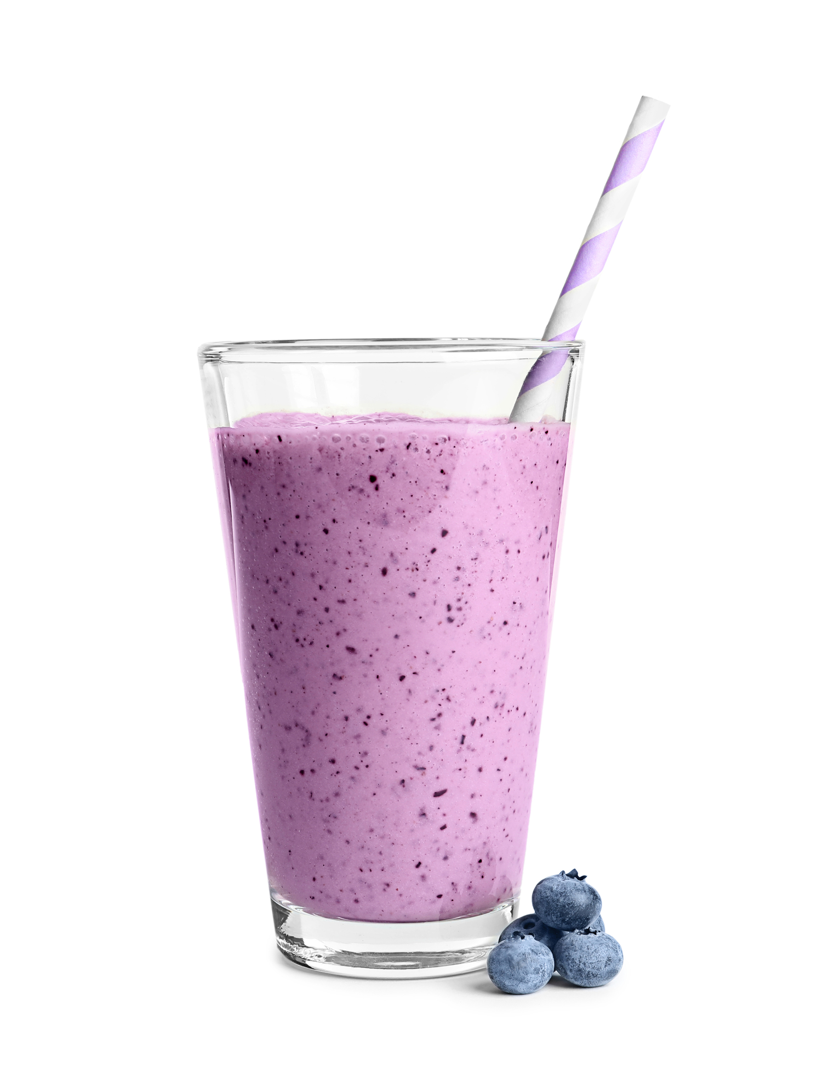
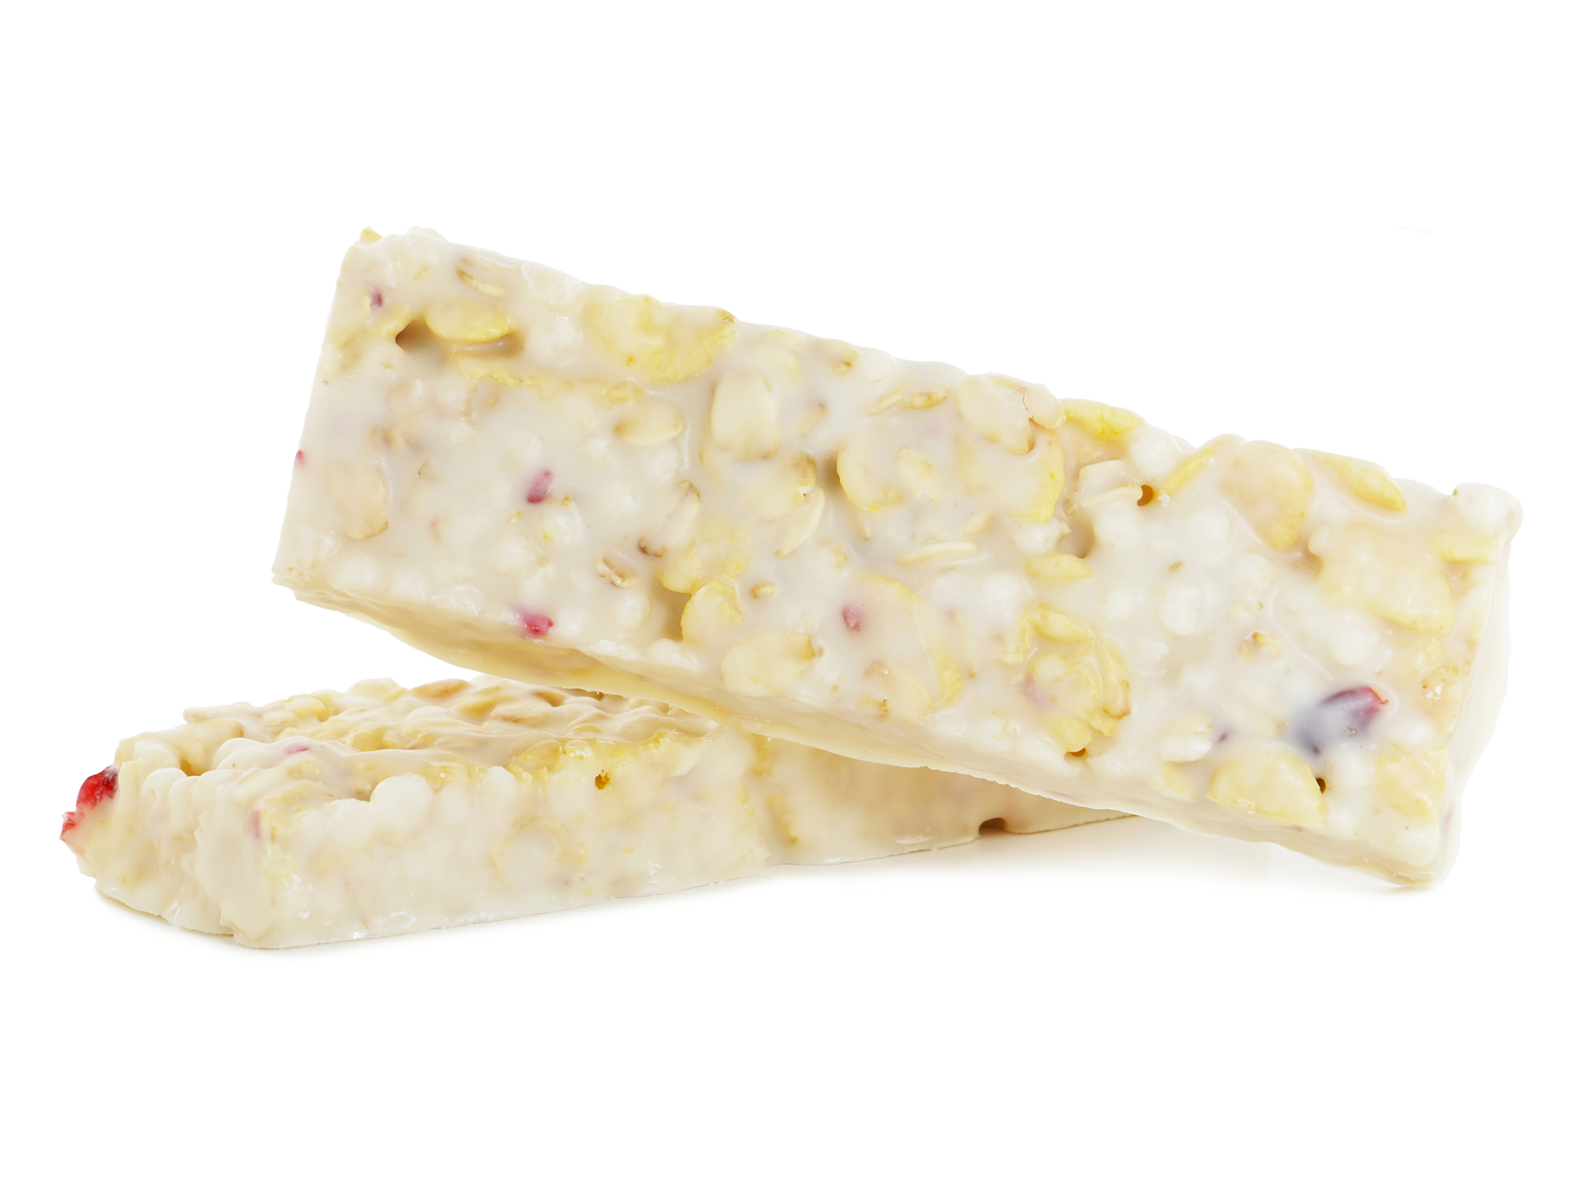
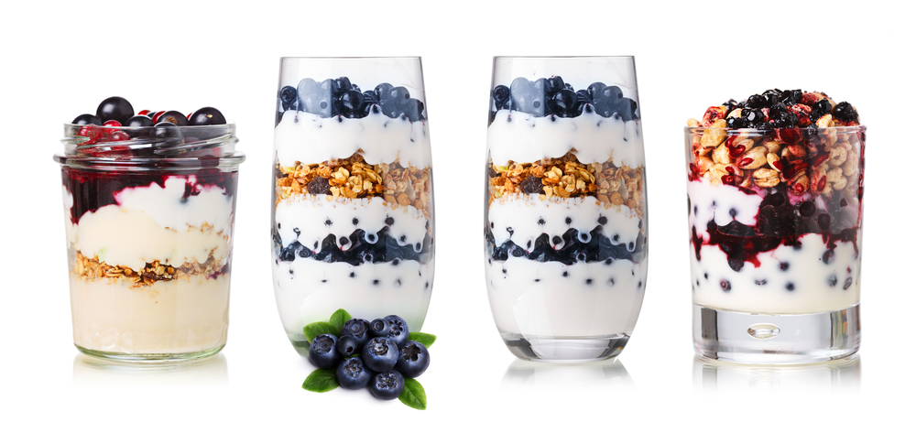
Foods and drink made with yogurt

Slide 10
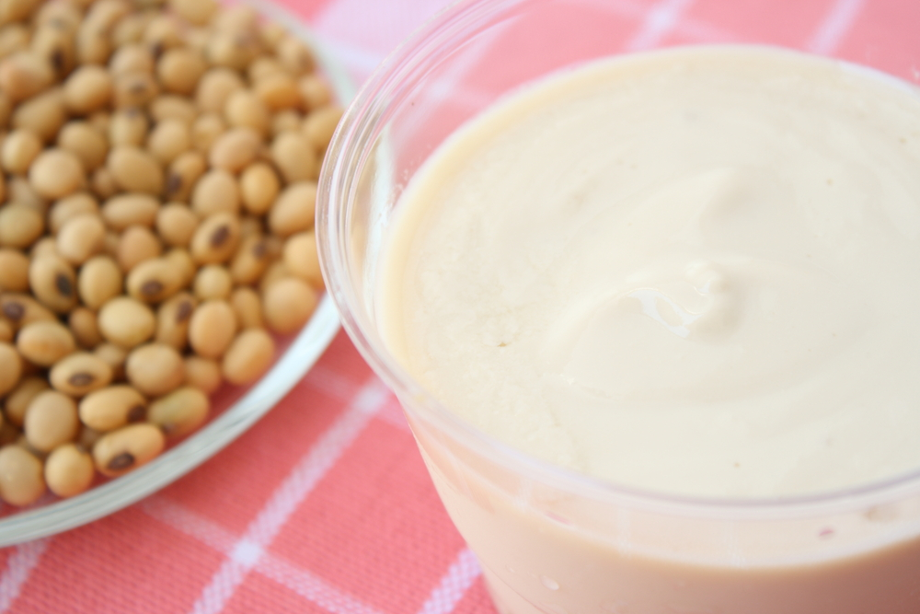
Yogurt alternatives
There are non-dairy yogurt alternatives available to buy. These can be made from plant sources such as soya, almonds, oats and coconuts.
The nutrient content of these alternatives can vary between brands and is often dependent on fortification for nutrients like calcium or iodine, which are less likely to be present naturally.
Check the back-of-pack nutrition labels when you are in store and keep an eye out for nutrient claims on front-of-pack. If you are opting for an alternative, look out for those fortified with calcium, and ideally other nutrients such as iodine.

Slide 11
Yogurt
For further information, go to:
www.foodafactoflife.org.uk
This resource meets the Guidelines for producers and users of school education resources about food.

