Slide 1
Food tests

Slide 2
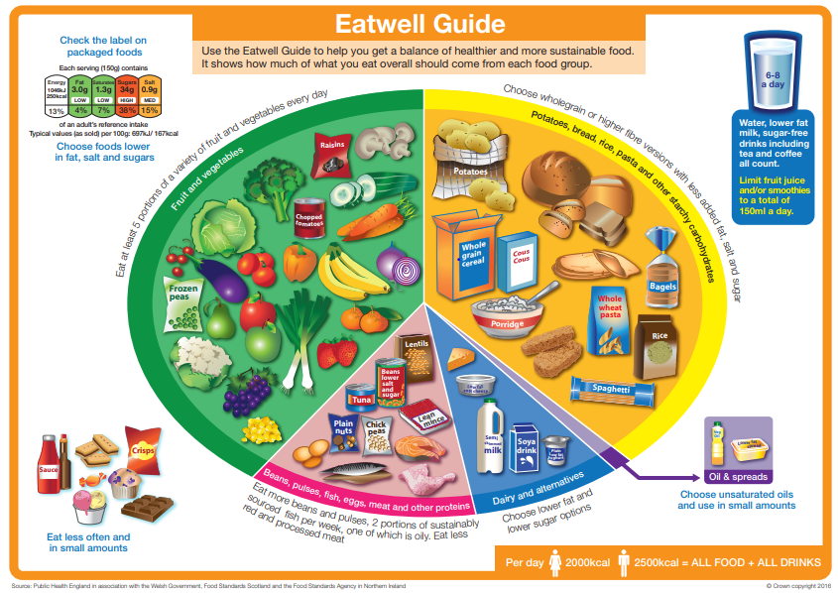
Starter
Name the main food groups shown in the Eatwell Guide.
Write down five foods that you think would fit into each of the food groups.
Extension:
Pick three of the foods and write down the main nutrient found in them. How might you test if that nutrient is present in the food?

Slide 3
Mix and match
Protein
Stops our intestines from getting blocked up preventing constipation.
Calcium (mineral)
Needed for energy.
Lipids (fat)
Needed to build and repair our muscles.
Carbohydrate
Needed to keep us warm and are a store of energy.
Needed to hydrate us and help food move through the digestive system.
Help maintain healthy teeth and bones.
Fibre
Water

Slide 4
Mix and match
Calcium (mineral)
Fibre
Carbohydrate
Help maintain healthy teeth and bones.
Stops our intestines from getting blocked up, preventing constipation.
Needed for energy.
Protein
Water
Lipids (fat)
Needed to build and repair our muscles.
Needed to hydrate us and help food move through the digestive system.
Needed to keep us warm and are a store of energy.

Slide 5

Fill in the gaps
Watch the following video and fill in the gaps on the worksheet provided.
Before conducting a food test, you need to ___________ your food using a ___________ and ___________. You then add the food to a ___________ filled with ___________ water, stir and ___________ out the solution. Of the four tests:
The ___________ test is for sugars;
The ___________ test is for starch;
The Biuret test is for ___________;
The Sudan III test is for ___________.
Video used with the kind permission of Cognito

Slide 6
Fill in the gaps
Before conducting a food test, you need to break up your food using a pestle and mortar. You then add the food to a beaker filled with distilled water, stir and filter out the solution.
Of the four tests:
The Benedict’s test is for sugars;
The iodine test is for starch;
The Biuret test is for proteins;
The Sudan III test is for lipids.
Video used with the kind permission of Cognito

Slide 7
Equipment required
Foods to be tested
A pestle and mortar
A stirring rod
A filter funnel and filter paper
5 x beaker, 250ml
A conical flask
4 x test tube
Benedict’s solution
Biuret solution
Sudan III stain solution
A Bunsen burner, tripod and gauze to heat water
A heatproof mat
A thermometer

Slide 8
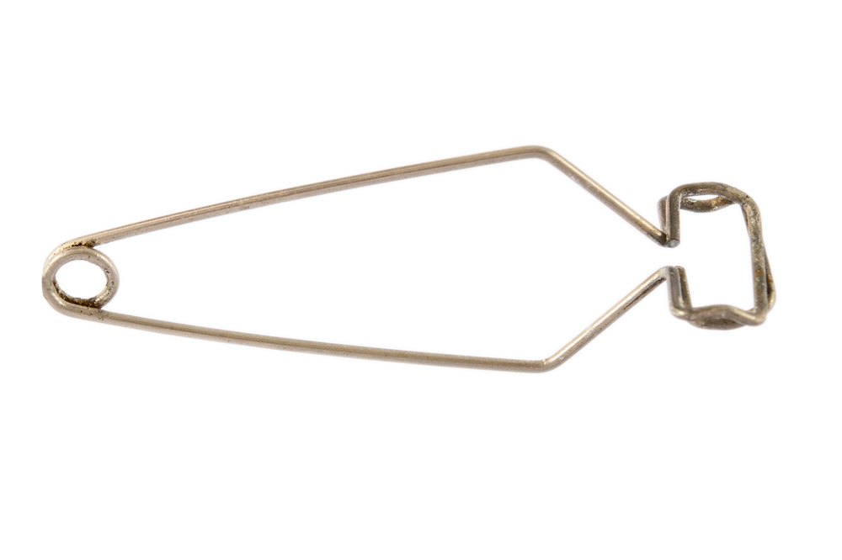
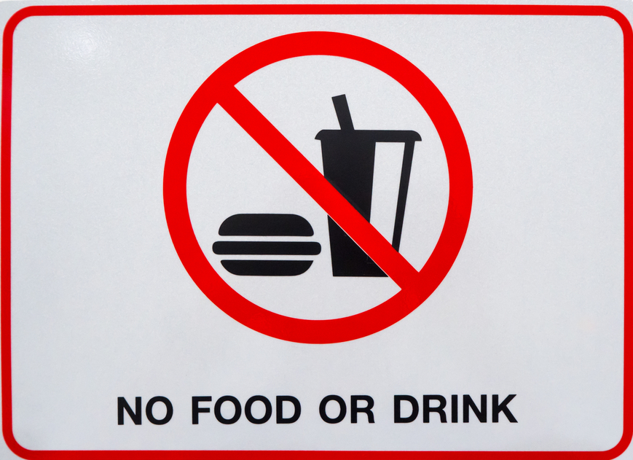
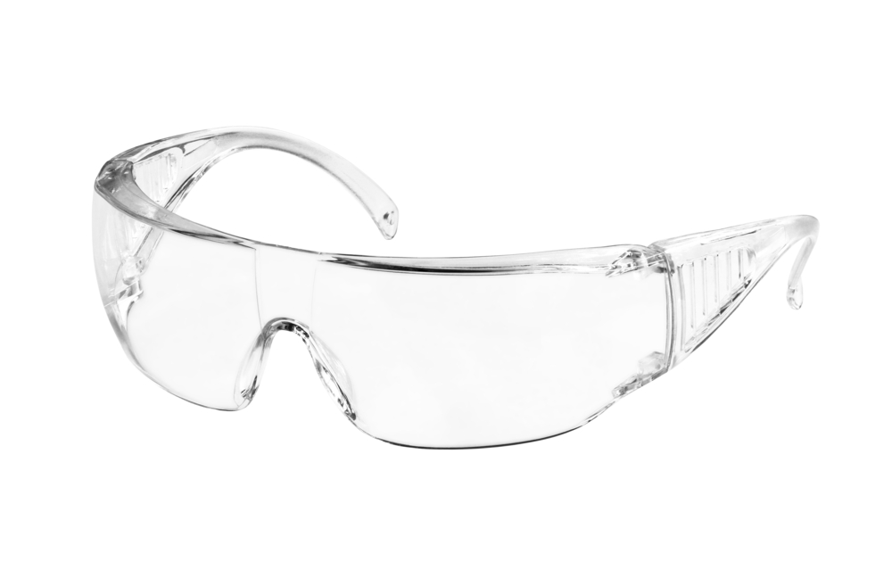

Turn and talk – how are we going to stay safe during this practical?
Wear safety goggles
Use test tube holders
No eating or drinking
Keep desks/benches tidy and make sure bags are not trip hazards

Slide 9
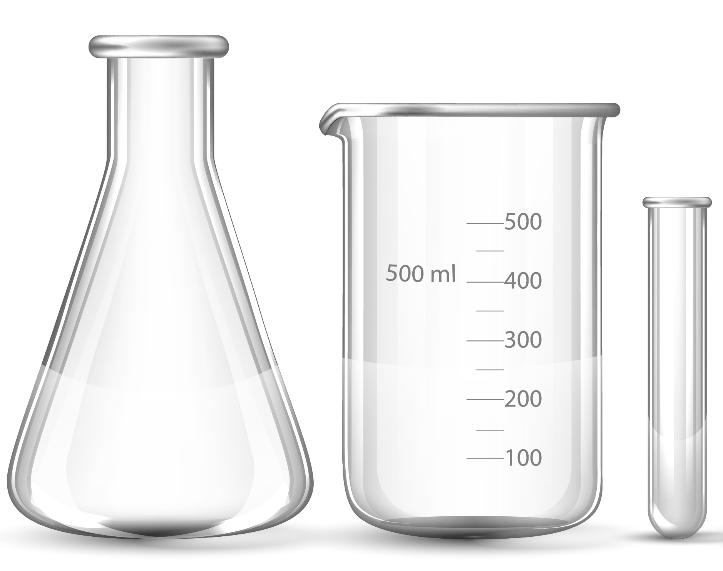
Prepare your food sample
Use a pestle & mortar to grind the food sample
Add a spatula of the food to a boiling tube & label
Add 8cm³ of distilled water
Stopper the tube & shake well
Place the solution into a water bath for 2 minutes
Cool & allow to settle in a test tube rack
Once a food sample is prepared, follow the instructions on the sheet.
Use ONE food and do all four tests. Don’t throw away the food sample after preparing.
Then, start again by preparing a second food sample.

Slide 10
Testing for starch
1 Place a small amount of food on the spotting tile.
2 Add a few drops of iodine solution to the food on the spotting tile.
3 Orange iodine solution turns blue–black if starch is present.
4 Repeat steps 1–3 for other types of food.
5 Record all your results in a results table.

Slide 11
Testing for lipid (fats)
1 Place a small amount of food into a test tube.
2 Add a few drops of ethanol to the test tube.
3 Shake the test tube and leave for one minute.
4 Pour the solution into a test tube of water.
5 Ethanol added to a solution gives a cloudy white layer if a lipid is present.
6 Repeat steps 1–5 for other types of food.
7 Record all your results in a results table.

Slide 12
Testing for protein
1 Place a small amount of food in a test tube.
2 Add 1 cm³ of Biuret reagent.
3 Blue Biuret reagent turns purple if protein is present.
4 Repeat steps 1–3 for other types of food.
5 Record all your results in a results table.

Slide 13
Testing for sugar
1 Place a small amount of food in a test tube.
2 Add enough Benedict’s solution to cover the food.
3 Place the test tube in a warm water bath for 10 minutes.
4 Blue Benedict’s solution turns brick red on heating if a sugar such as glucose is present.
5 Repeat steps 1–4 for other types of food.
6 Record all your results in a results table.

Slide 14
Copy out the following table
Food | Starch present? | Sugar present? | Protein present? | Lipid present?
White bread
Chicken
Canned pineapple
Cheese
Rice
Marshmallow
List the foods that showed a positive result for protein. Describe how you knew this was the case.
List the foods that showed a positive result for lipids. Describe how you knew this was the case.
Do the foods that contain sugar also contain starch? Use your results to justify your answer.

Slide 15
Extension
A student uses Benedict’s solution to test different foods for sugar. Each food is tested under the same conditions and the results are presented in the following table.
Suggest an explanation for these results.
Food tested | Final colour of Benedict’s solution
A | brick red
B | blue
C | yellow
D | green

Slide 16
Nutrient testing for | Chemical used to test | Colour before | Colour after if present
Starch (carbohydrate)
Sugar – glucose (carbohydrate)
Lipids
Protein

Slide 17
Nutrient testing for | Chemical used to test | Colour before | Colour after if present
Starch (carbohydrate) | Iodine | orange/red | blue/black
Sugar – glucose (carbohydrate) | Benedict’s solution (water bath) | blue | orange/red
Lipids | Ethanol | clear | cloudy
Protein | Biuret solution (Sodium hydroxide + copper sulfate) | blue | purple

Slide 18
Key words
Key word​ | Meaning​
Benedict’s solution | A blue solution containing a carbonate, citrate, and sulfate.
Biuret solution | A solution made up of sodium hydroxide and copper sulfate.
Glucose | The main type of sugar in the blood.
Lipid | Large molecules made from smaller units of fatty acids and glycerol.
Protein | Compounds made up of amino acid molecules.
Starch | A carbohydrate that is one of the primary sources of food energy.

Slide 19
Teachers’ guide

Slide 20
Lesson structure
Starter: Display pictures of different foods for students to identify the main nutrients in that food. (5 minutes)
Think, Pair, Share: Match the nutrient with their definition and photo (5 minutes). Discuss with the class.
Fill in gaps: Watch the video and review (10 mins)
In the main lesson practical, students test for the presence of starch, lipids, sugar, and protein in foods provided. Give handout to follow and leave slide 5 on screen (30 minutes)
Exit ticket: Table (and marked) (5 minutes)
Homework: Students write a report to describe how a drinks company can provide evidence that a new drink is nutritionally better than an existing drink.

Slide 21
Teaching about food tests
Describe the simple food tests for starch, simple (reducing) sugars, protein, and lipids.
Use appropriate techniques, apparatus, and materials during fieldwork and laboratory work, paying attention to health and safety.
Interpret the results of the practical work carried out.

Slide 22
Talking about the science of food tests
During a demonstration, explain:
The importance of practical safety during the food tests practical.
The Biuret solution is made up of potassium hydroxide and copper sulfate.
The importance of using food tests in industry.

Slide 23
Running a food test practical classroom
Common misconceptions:
Each food only has one nutrient in them – overcome this by tasking students to carry out multiple food tests on one item of food.
All foods have the same positive result – repeat the idea that different food tests have different positive and negative results. Highlight these on their practical instruction sheet.
You have to reprepare the sample for each test – before getting the class to prepare food samples, explain that you will be pipetting from the main prepared sample so can do all four test with one sample. ENSURE students don’t throw away the prepared sample after the first food test.

Slide 24
Running a food test practical classroom
Common pitfalls:
Confusion around the different tests – start by getting everyone to prepare the food sample. Then stop the class at that point and discuss what needs to be done next. This stops having to follow too many instructions at once.
Time – this can be a difficult practical to do in the time, but preparing one food and carrying out all four tests means even the students who work more slowly during practicals can complete the four food tests on at least one food. You can also print the table to save time for students to copy the table down (this may be a good differentiation strategy for some pupils).

Slide 25
Running a food test practical classroom
Common pitfalls:
Bottlenecking in the classroom – one risk with the food test practical is that students will bottleneck in one area of the classroom, all trying to do the same test at the same time, which can waste time and reduce safety.
One way to run the practical is to divide the classroom into ‘stations’. Each station will have a sign e.g., ‘test for Protein’ to direct the students to it and will then contain all of the equipment needed for the practical. This can be set up during the starter task if there is no time to set up in advance.
It is useful to set up a number of stations for preparing a food sample or put a pestle and mortar on the students’ desks to use one each.
Then divide the class into groups with an order of doing each food test, as shown in the next slide.

Slide 26
Running a food test practical classroom
Group 1: Starch → Glucose → Lipids → Protein
Group 2: Glucose → Lipids → Protein → Starch
Group 3: Lipids → Protein → Starch → Glucose
Group 4: Protein → Starch → Glucose →Lipids

Slide 27
Tests and positive results
Test For | Reagent | Positive test
Starch | Iodine Solution | Turns blue-black
Protein | Biuret Solution | Purple precipitate
Lipids | Ethanol | Cloudy
Glucose | Benedict’s Solution | Orange/red precipitate

Slide 28
Homework task
Using the key words below, explain how you would test a food solution of a breakfast cereal for the presence of starch, sugar, and protein (6 marks).
Key words:
Iodine
Benedict’s solution
Ethanol
Biuret solution
Positive result
Negative result

Slide 29
Food tests
For further information, go to:
www.foodafactoflife.org.uk
This science pack is one of a series of resources produced for the pHood Futures project, supported by the Royal Society of Chemistry.
This resource meets the Guidelines for producers and users of school education resources about food.

