Slide 1
The olfactory system

Slide 2




Using your senses
There are five senses used when tasting food and drink:
sight;
smell;
taste;
hearing;
touch.
The senses help to develop food preferences (likes and dislikes) and evaluate foods through preference or discrimination tests.

Slide 3
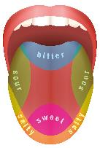
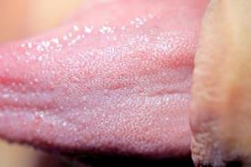
Taste receptors
The classical "taste map" is an over simplification.
Sensitivity to all tastes is distributed across the whole tongue (and indeed other regions of the mouth where there are taste buds), but some areas are more responsive to certain tastes than others.
Our tongues are covered with taste buds, which are designed to sense chemicals in the mouth. Most taste buds are located in the top outer edges of the tongue, but there are also receptors at the back of the tongue as well as on the walls of the mouth and at the back of the throat. As we chew food, it dissolves and enters the taste buds, triggering nerve impulses that are transmitted to the brain.

Slide 4
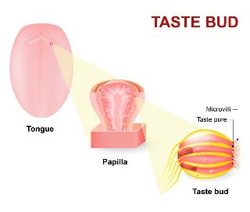
Taste receptors
Human tongues are covered with 2,000 to 10,000 taste buds, and each bud contains between 50 and 100 taste receptor cells. Taste buds are activated very quickly; a salty or sweet taste that touches a taste bud for even one tenth of a second will trigger a neural impulse.
On average, taste buds live for about 5 days, after which new taste buds are created to replace them.
As we get older, the rate of creation decreases making us less sensitive to taste.

Slide 5

Taste receptors
The area of the sensory cortex that responds to taste is in a very similar location to the area that responds to smell, a fact that helps explain why the sense of smell also contributes to our experience of the things we eat.

Slide 6
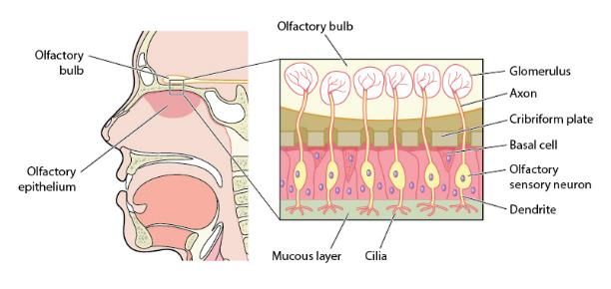
The olfactory system
The olfactory system is the sensory system used for olfaction, or the sense of smell.

Slide 7
The olfactory system
As we breathe in air through our nostrils, we inhale airborne chemical molecules, which are detected by the 10 million to 20 million receptor cells embedded in the olfactory membrane of the upper nasal passage.
The olfactory receptor cells are topped with tentacle-like protrusions that contain receptor proteins.
When an odour receptor is stimulated, the membrane sends neural messages up the olfactory nerve to the brain.

Slide 8
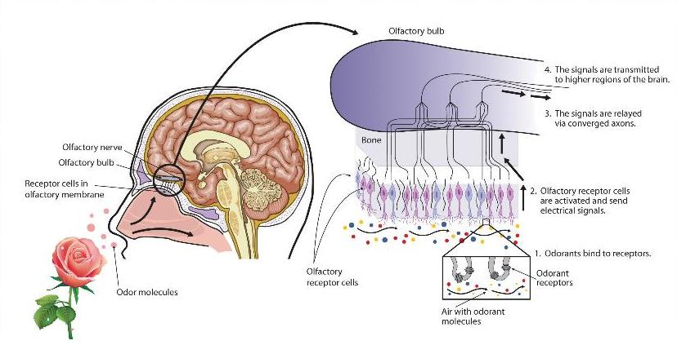
The olfactory system

Slide 9
The olfactory system
For further information, go to:
www.foodafactoflife.org.uk
This resource meets the Guidelines for producers and users of school education resources about food.

