Slide 1
Plant-based diets – expanding pupil learning experiences
16/06/2022

Slide 2

The Future of food education
The British Nutrition Foundation is undertaking work to explore what a future, modern food education, that is relevant to young people and society, might look like and contain.
The project has the following elements:
1. A teacher and pupil survey, exploring current and future practice – results are here.
2. A half-day consensus-building event – recordings, presentations and recommendations are here.
3. The development of new recipes that are more inclusive of our diverse culture and society – recipes so far are here.
4. The provision of teacher training, based on the outcomes of the work above.
The British Nutrition Foundation would like to gratefully acknowledge the financial support provided by the All Saints Educational Trust for this work.

Slide 3
Covered in today’s webinar
How can a plant-based diet be defined?
Plant-based diets and the Eatwell Guide.
Widening young people’s understanding of food and cultures around the world.
Opportunities for pupils to use ingredients that they are initially familiar with, but then extended over time to broaden their learning experiences, handling, cooking, and tasting a variety of ingredients.
Resources, recipes, and support from Food – a fact of life and the British Nutrition Foundation.
This webinar forms part of the British Nutrition Foundation’s work around the ‘Future of food education’.

Slide 4
‘Plant-based’ diets: Nutrition & Sustainability
Ewen Trafford
Nutrition Education Officer

Slide 5
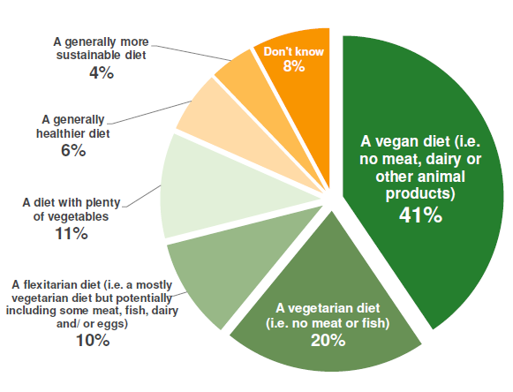

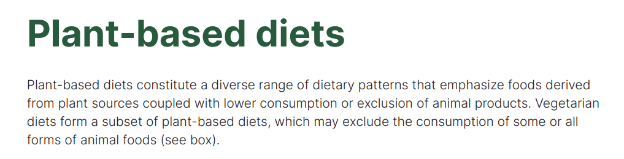
Defining ‘plant based’
Plant based or plant-based diets currently have no legal definition.
No accepted definition of a ‘plant-based diet’ and if this can contain foods of animal origin or not.
Could an alternative term such as ‘plant rich’ help avoid confusion?
Source: BNF/YouGov survey (November 2020) of 2,018 adults from across Britain. Figures have been weighted and are representative of all GB adults (aged 18+) https://www.nutrition.org.uk/news/2020/majority-unlikely-to-go-plant-based-in-the-new-year-bnf-survey-reveals/
Notes:
Plant based can be confusing to define
For nutrition research need to be talking about same thing
Makes research difficult if people report plant-based diets because cannot quantify
Plant rich or Plant forward
Survey: 41% thought plant based was vegan
59% some animal products but different amounts
‘Flexitarian’

Slide 6
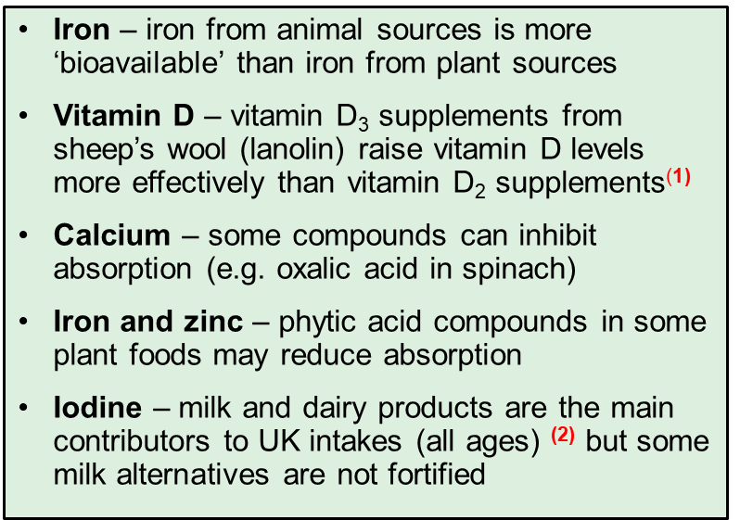





Plant-based diets – key nutrients
Restricting or eliminating animal source foods from the diet may make it more difficult to get adequate amounts of some nutrients if not eating a diverse diet.
Iron
Vitamin D
Calcium
Zinc
Iodine
Sources: (1) Tripkovic et al (2017) American J Clin Nutr 106:481-490 (2) National Diet and Nutrition Survey, years 9 to 11 (2016/2017 to 2018/2019)
Notes:
You can get nutrients required but some watchouts if reducing or eliminating animal products
There is now some supplements D3 made from lichen

Slide 7
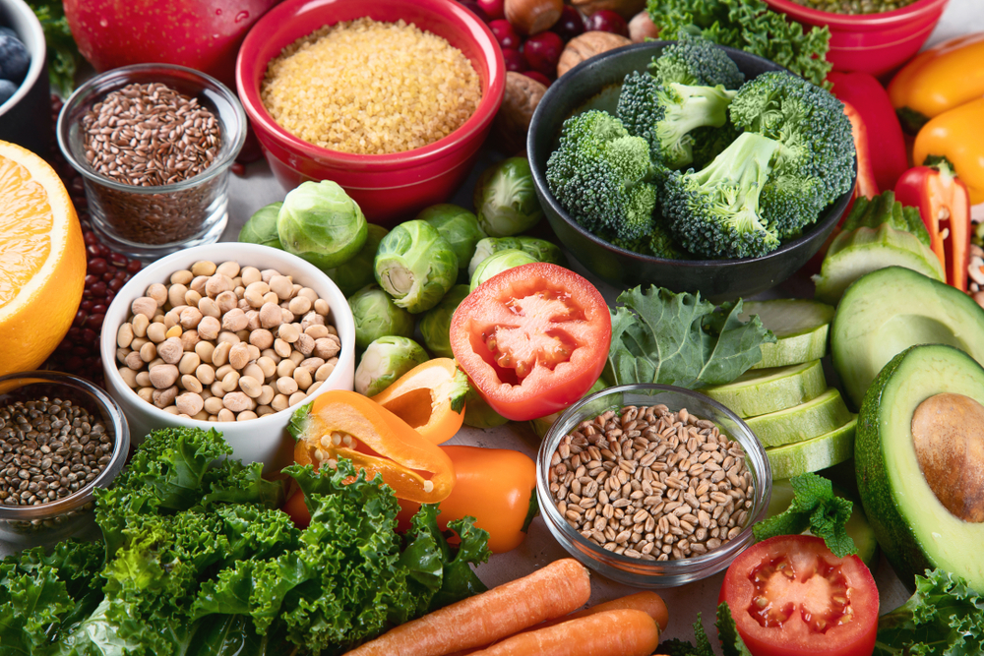
Vegan and vegetarian diets
Tips for a healthy vegan/vegetarian diet:
Check dairy alternatives to see if they are fortified with important nutrients.
Include vitamin B12 fortified foods (e.g. breakfast cereals).
Include a source of vitamin C with plant-based iron sources to increase absorption.
Vegan calcium sources include fortified dairy alternatives, calcium-set tofu, bread (non-wholemeal), dried fruits.
Notes:
If supplements, contact doctor or paediatrician for advice
Particular caution around iodine supplements from seaweed

Slide 8
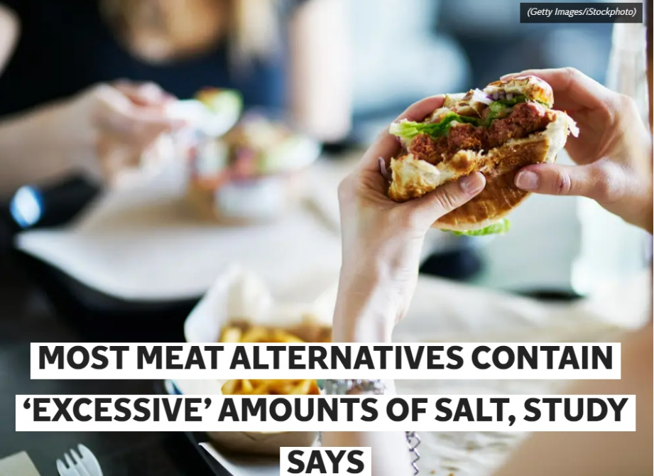
Plant-based diets and nutrition
More than just protein!
Overall nutrient composition of plant-based alternatives, including essential nutrients. (e.g. iron, zinc, calcium, iodine, vitamin B12)
Consider nutrients to limit (e.g. salt).
Analysis of meat alternatives and meat products on UK market¹ found that alternatives generally had:
Lower calories, fat, saturates, and higher fibre;
Lower protein and higher salt.
Source: https://www.independent.co.uk/life-style/food-and-drink/vegan-vegetarian-alternatives-meat-salt-b1965247.html
Notes:
Often concern about low protein quantity or quality but this is quite easily achieved with a balanced diet and a range of protein sources
Consider that some alternatives aren’t automatically healthy (health halo)
Analysis of 207 plant-based meat alternatives (PBMA) and 226 meat products on UK market (January 2020) found PBMAs generally had:

Slide 9
Sustainability

Slide 10

Why dietary change is needed
People
1 in 5 deaths globally is due to a poor diet
2 billion adults are overweight, but 500 million are underweight.
Planet
Food production is the largest cause of global environmental change.
19-37% of greenhouse gases *
70% of freshwater
About 40% of land use
* Depending on source. Several estimates have been published and appear in the scientific literature.

Slide 11

What is a healthier and more sustainable diet?
Healthy
Affordable
Nutritionally adequate
Healthier and more sustainable diet
Accessible
Low environmental impact
Culturally acceptable
Notes:
A lot of debate exists around what a healthier and more sustainable diet should and (should not) contain…
Many factors can make choices difficult
Do your best with the information and choices available – no perfect answers
‘Sustainability’ scores? (eco-score, France)

Slide 12

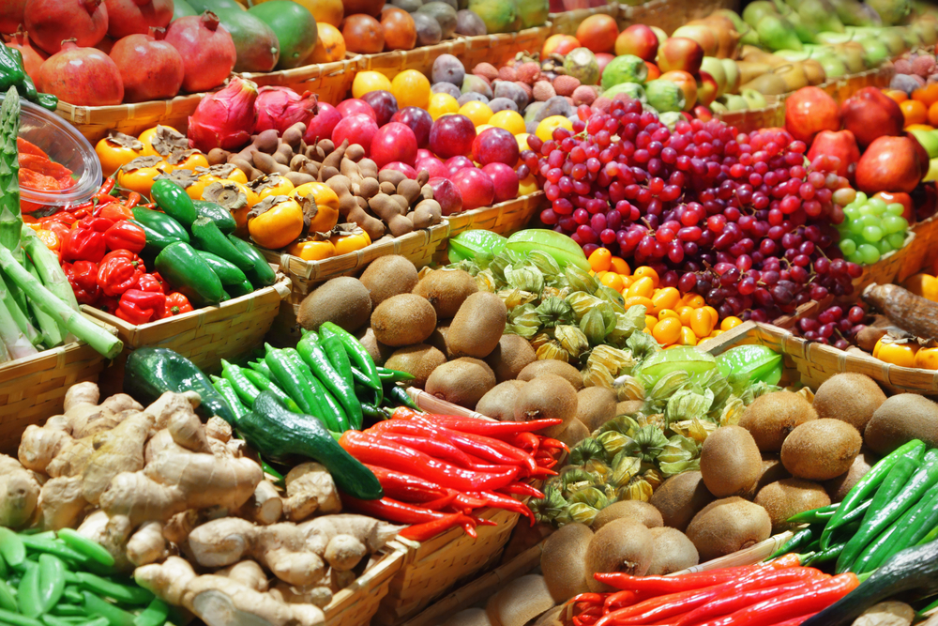
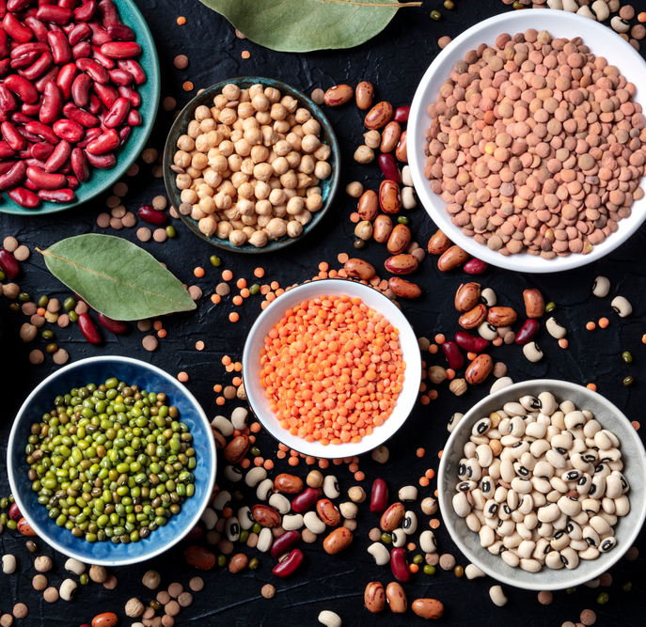

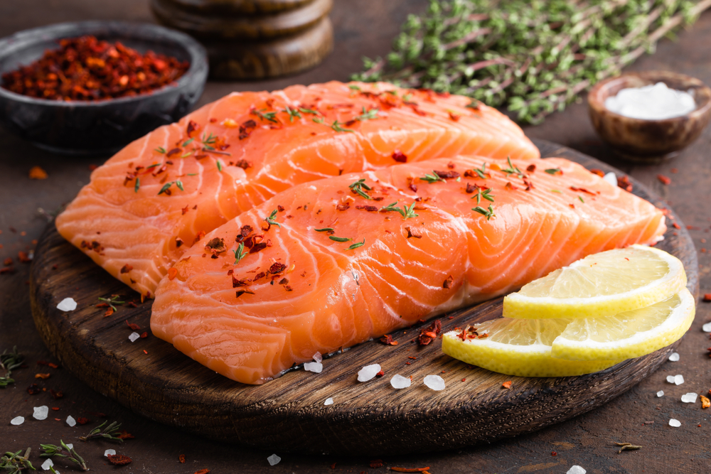

Sustainability – six key actions
Eat a more plant-rich diet
Get at least 5 fruit and veg a day
Vary your protein intake
Limit foods high in fat, salt, sugar
Choose sustainable fish and seafood
Waste less food and drinks
Notes:
Top 4 have relations to plant based

Slide 13
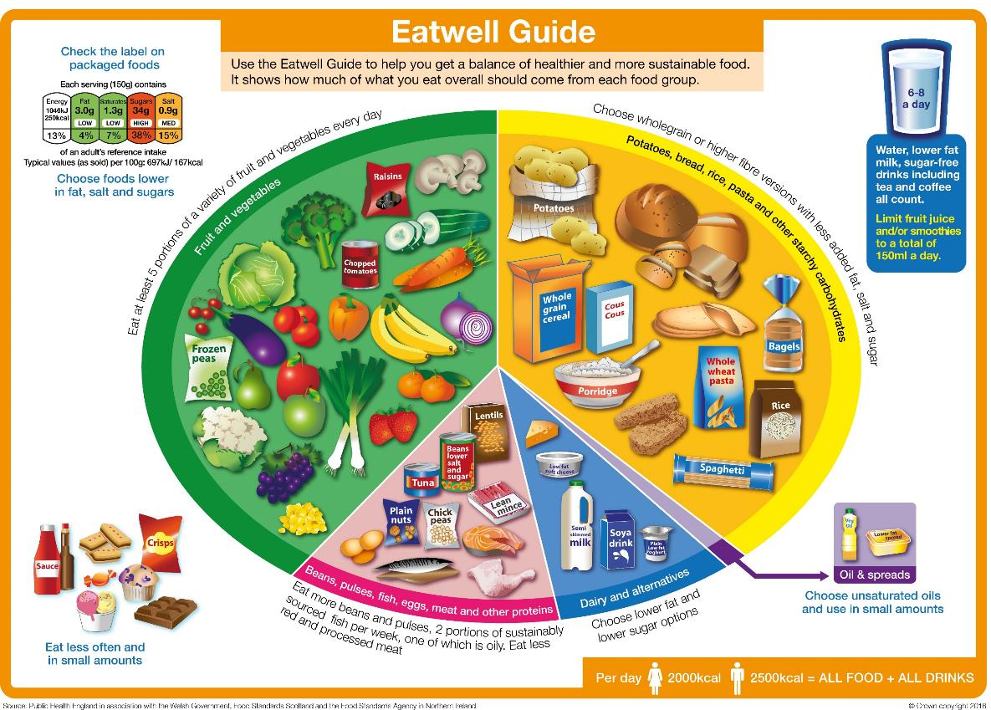
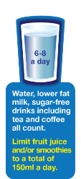
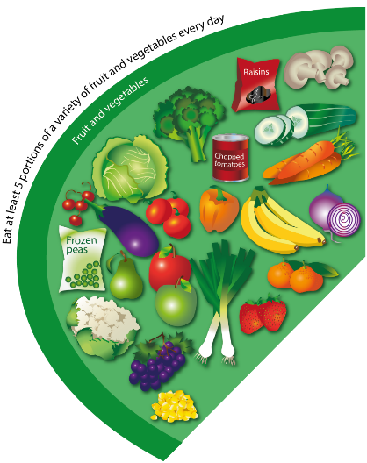
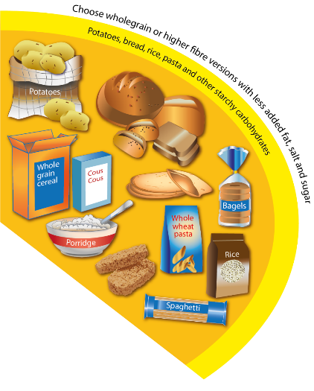
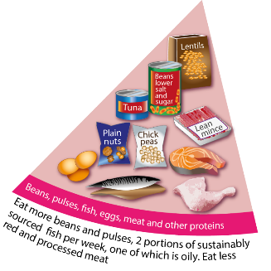
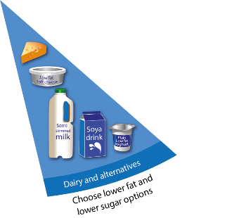

Plant-based diets and the Eatwell Guide
Government advice and other healthy dietary patterns are mainly ‘plant-based’ but can still include meat, fish, dairy, and eggs in moderation.
Following the UK Eatwell Guide more closely would deliver benefits for the UK population:
30% lower GHG emissions
4-7% lower water use
7% lower mortality risk
Source: Scheelbeek et al. (2020) BMJ Open;10:e037554
Notes:
Eating pattern familiar in the UK and includes nutrient-rich animal source foods in moderation
30% of people already achieve at least 5 out of 9 recommendations, but only 0.1% achieve all 9

Slide 14
Plant-based diets and the Eatwell Guide
Fruit and vegetables:
5 A DAY
Key vitamins and minerals
Whole group of plant origin
Starchy carbohydrates:
Fibre
Nutrients (fortification)
Whole group of plant origin
Oils & spreads
Plant oils/spreads usually lower in saturates
Dairy and alternatives
Alternatives often lower in fat
Check for fortification
Proteins
Alternative sources (e.g. beans, lentils)
Also contain fibre (not in animal-based sources)
Watch out for nutrients found in animal products (e.g. B12)
Notes:
Eating pattern familiar in the UK and includes nutrient-rich animal source foods in moderation
30% of people already achieve at least 5 out of 9 recommendations, but only 0.1% achieve all 9
Palm oil and coconut oil are exceptions to fats

Slide 15
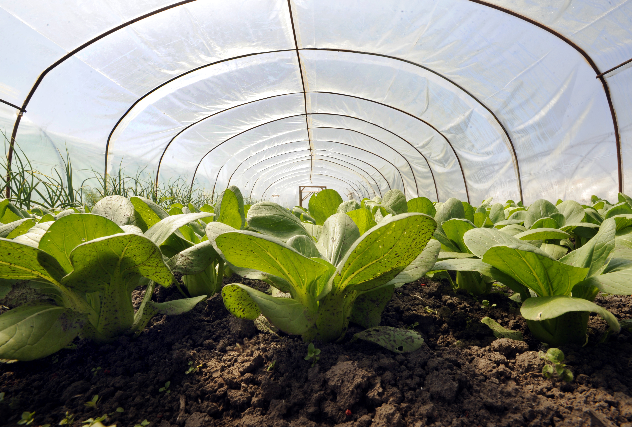
Summary
There is no agreed definition of what the term ‘plant-based’ means.
Public confusion – many people are confused about meaning of ‘plant based’.
More than just protein - need to consider overall nutritional composition of plant-based alternatives.
The Eatwell Guide provides a mainly ‘plant-based’ style of eating that could have both health and environmental benefits.

Slide 16
Diversity and inclusion in Schemes of Work
Know your pupils!
Know and understand the local community, e.g. what are the challenges that young people are facing?
Understand what young people (and their families) want to make in food lessons. Not just cakes though!
Ensure recipes and practical activities build on knowledge and skill.
Incorporate different flavours, ingredients and culinary techniques and experiences to widen young people’s understanding of food and cultures around the world.
Encourage pupils to share their personal experiences around food culture, ingredients and recipes with the class or school community.
Consider healthy, sustainable diets – nutrition.org.uk
Did you know?
Some food and drink-related traditions are currently recognised by UNESCO and its Representative List of the Intangible Cultural Heritage of Humanity

Slide 17
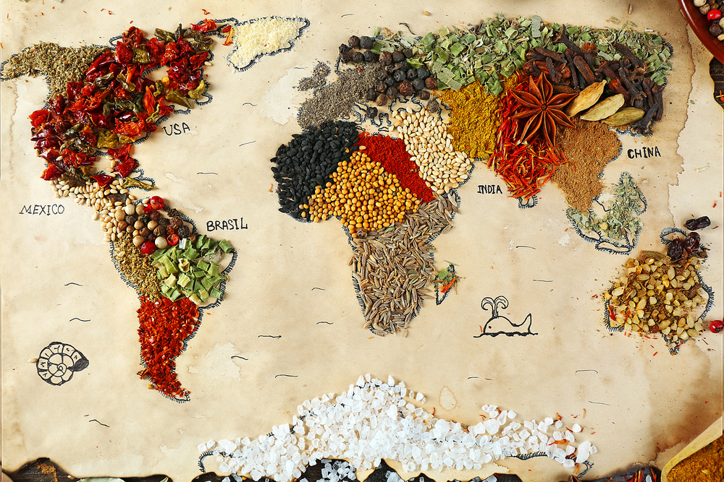
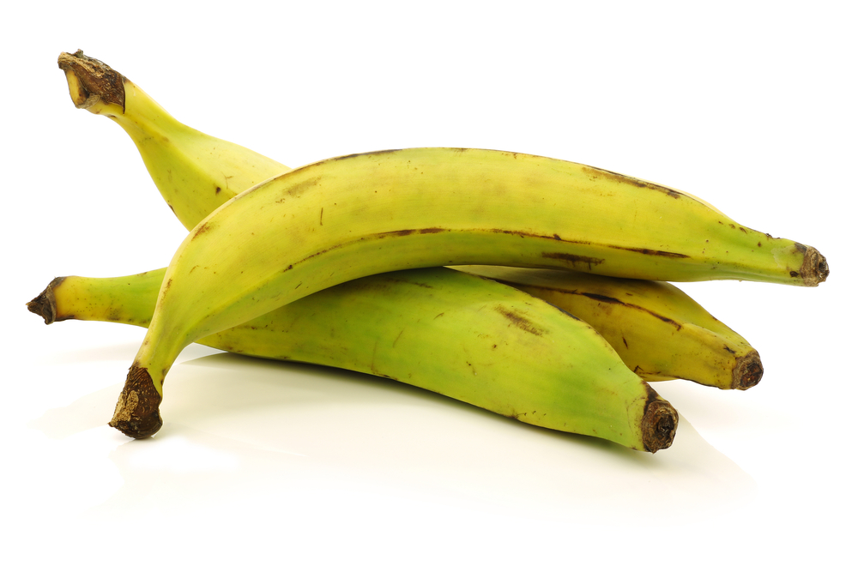
In the classroom
Consider the following:
time and budget available;
pupils - practical skills;
equipment available;
provision/availability of ingredients e.g. spices or herbs that may not be used often, vegetables that might not be readily available in your area;
involving the school/local community – there may be an ‘expert’ in a particular cuisine that could offer guidance and/or input to the lesson;
sharing the success of your pupils work through school social media, newsletters and special events such as open evening and options.

Slide 18
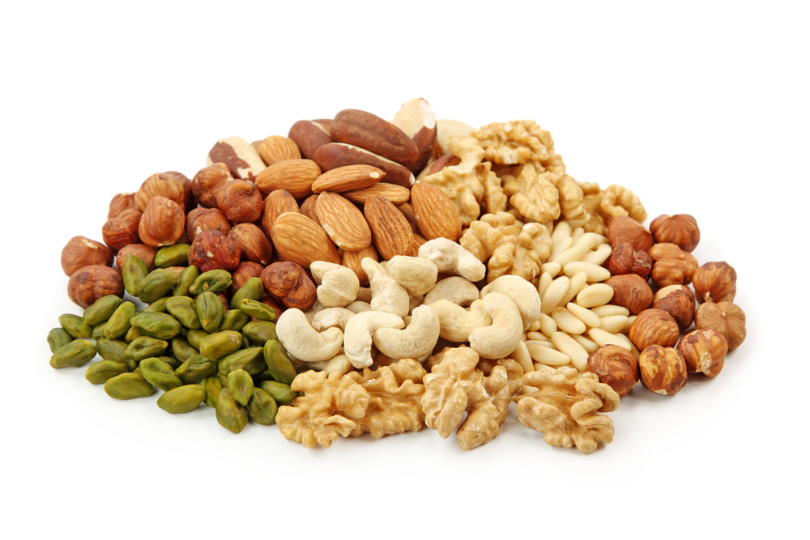

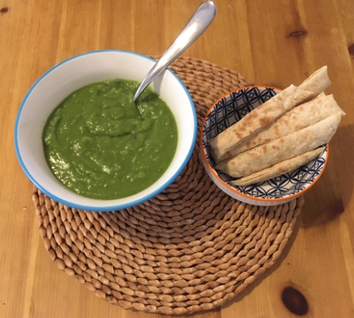
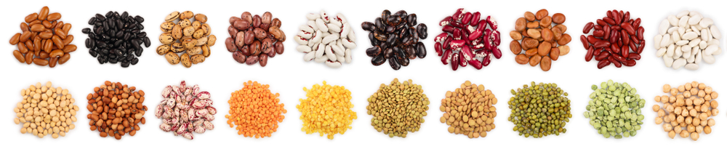
Plant-based proteins – try something new
Beans, peas and lentils
Pea protein
Seitan
Soy meat alternatives
Tofu
Tempeh

Slide 19


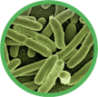

Other alternative protein sources
Fungal
Insects*
Bacterial
Cultured meat
*allergen risk from chitin found in the exoskeletons of insects and certain hard structures in invertebrates and fish

Slide 20

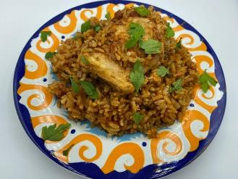
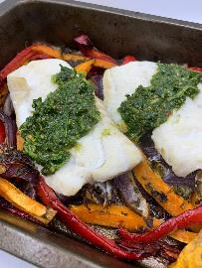
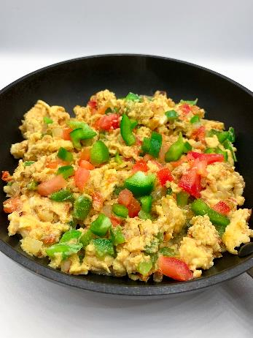

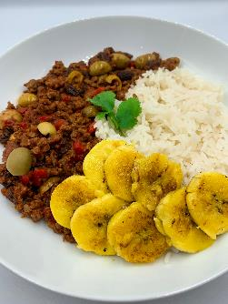
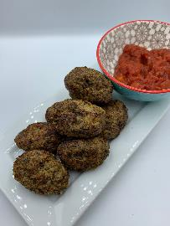
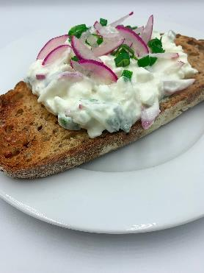
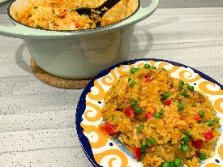
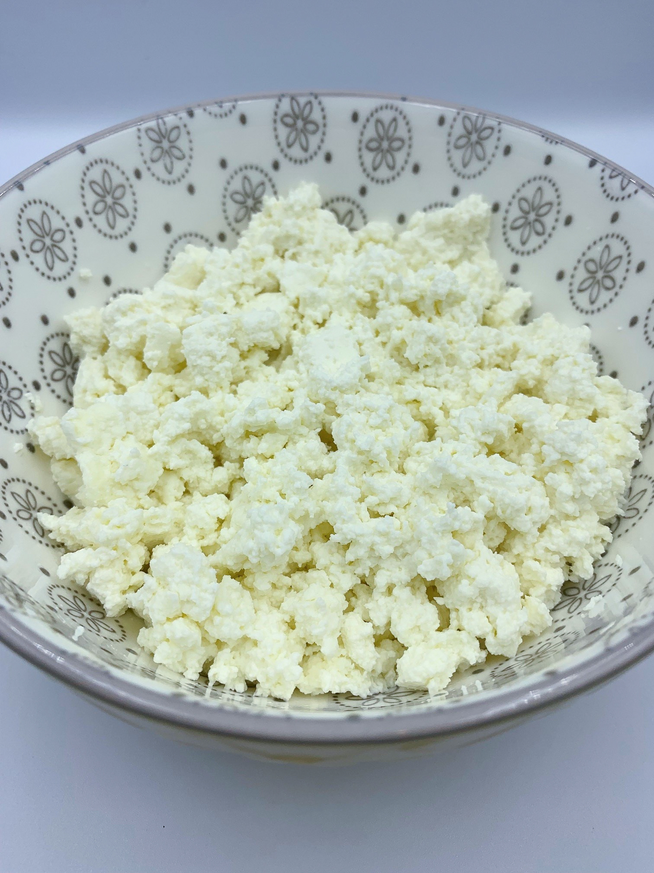
What else?
A plant-based diet can still include some meat, fish, dairy, eggs and other protein sources.
Global cuisine recipes

Slide 21
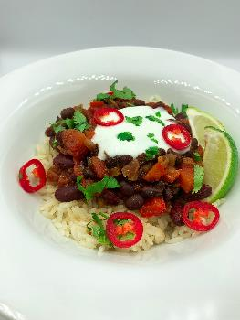
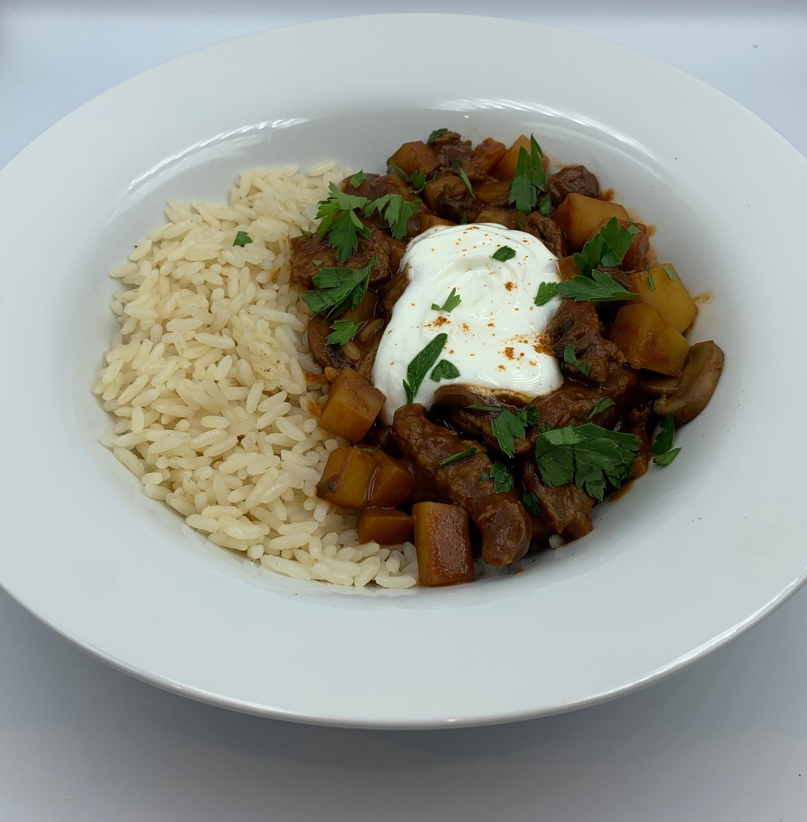
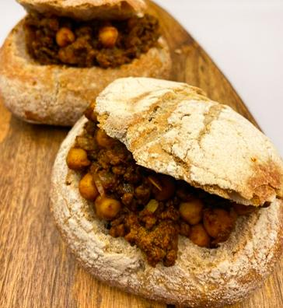
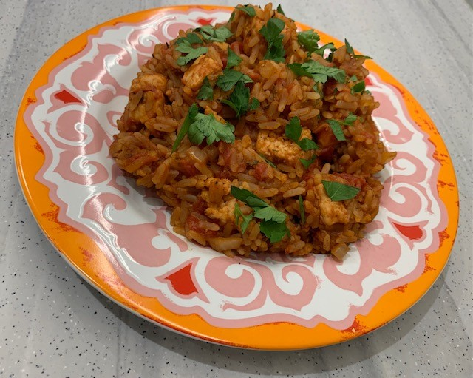
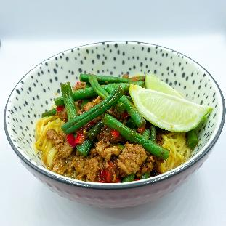
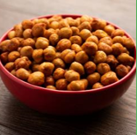
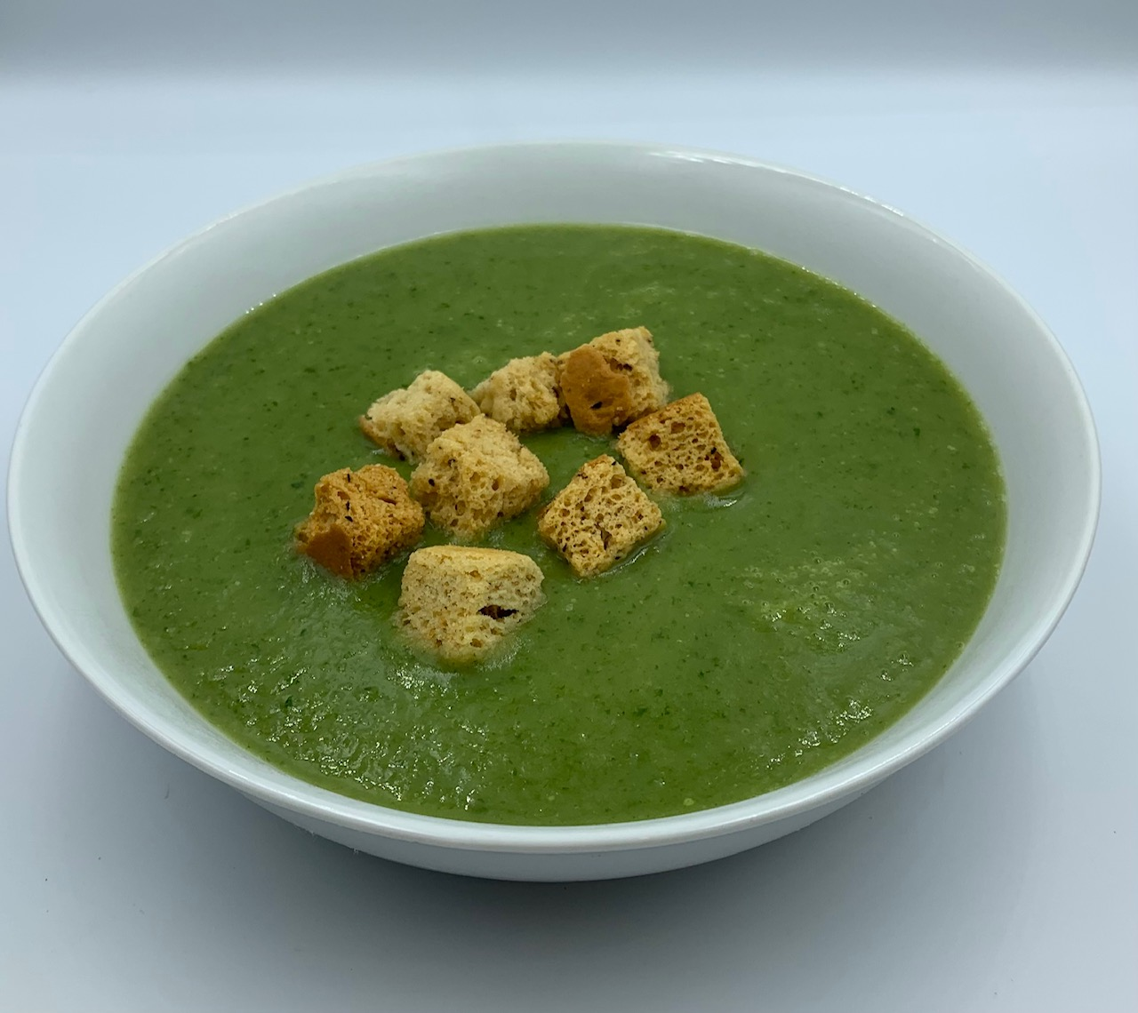
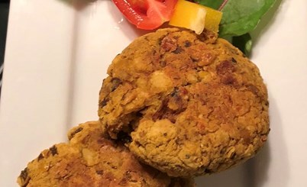
Practicalities
First and foremost, remember pupil choice!
Provide options for pupils to use alternatives.
Swap half the meat for beans or lentils in recipes.
Consider buying in bulk.
Task pupils to work in groups or pairs to reduce the cost.
Provide herbs and spices for your pupils to use.
Run tasting and sensory testing sessions so that pupils can try ingredients or dishes that may be unfamiliar to them.
Be creative with leftovers to reduce food waste, e.g. roasted chickpeas or asparagus end soup!
Adapt recipes to use different ingredients, e.g. chickpea muffins or avocado and chocolate cake.
Try a BoF pie ….

Slide 22
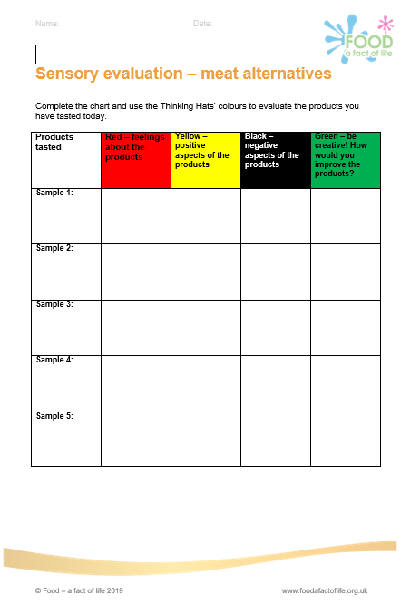
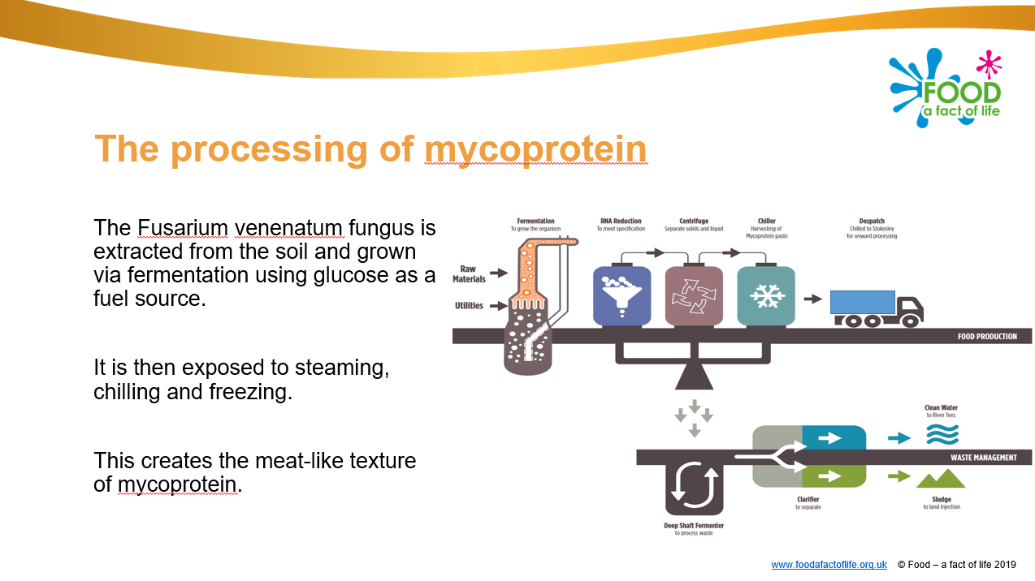
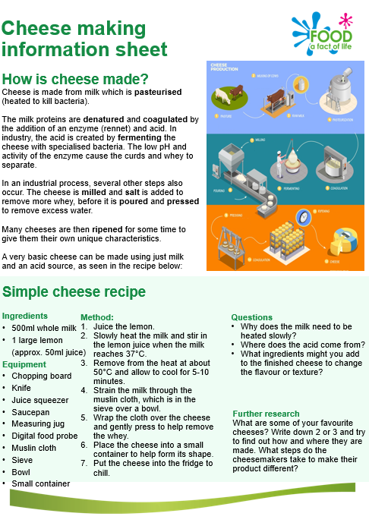
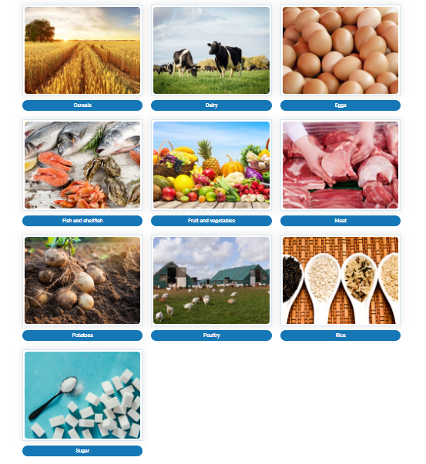
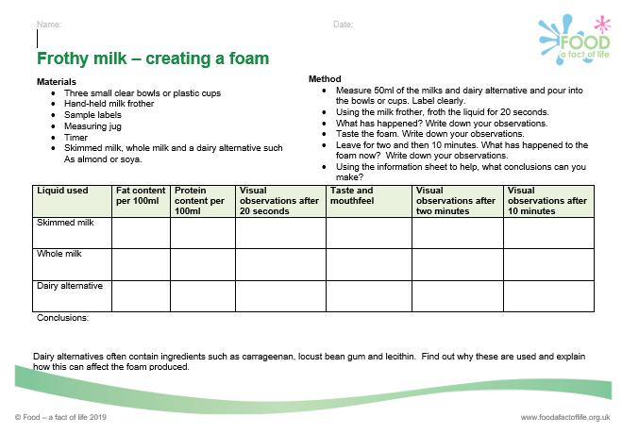
Food – fact of life resources
Food commodities resources
Cereals
Dairy
Eggs
Fish and shellfish
Fruit and vegetables
Meat
Potatoes
Poultry
Rice
Beans and pulses to come
Mycoprotein resources
Cheese making and frothy milk
Thinking hat evaluation

Slide 23
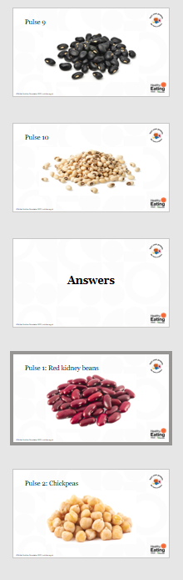
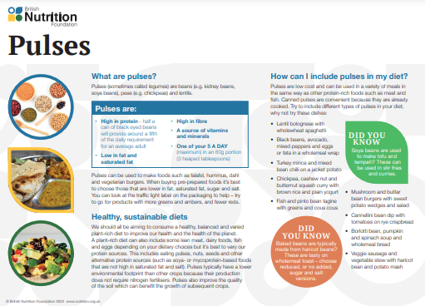
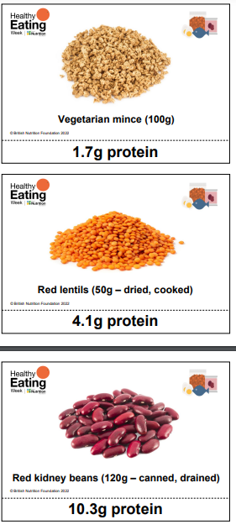
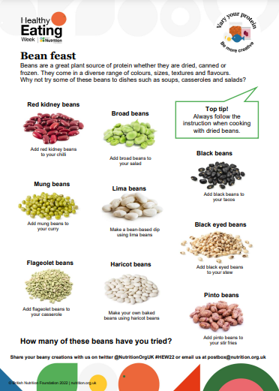
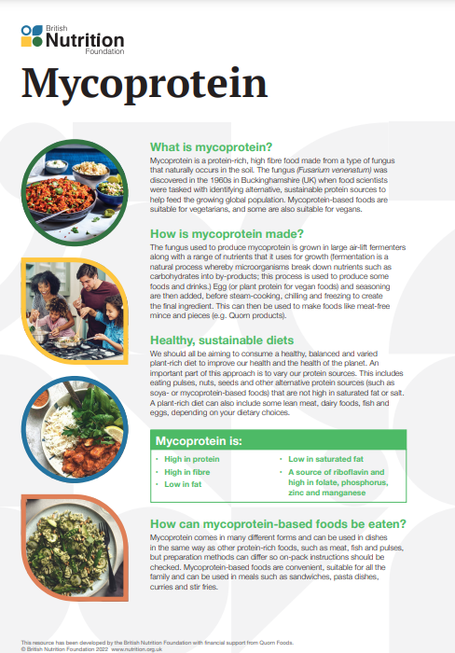
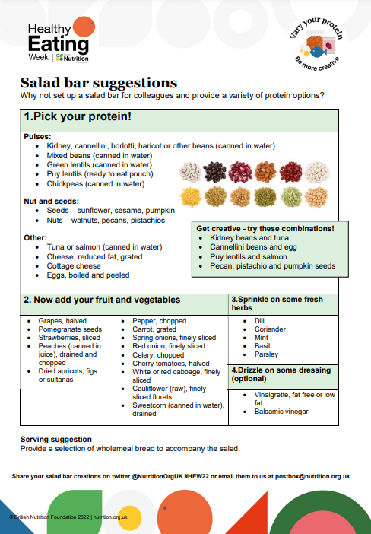
Healthy Eating Week resources
HEW 2022 resources

Slide 24
Plant-based diets – expanding pupil learning experiences
For further information, go to:
www.foodafactoflife.org.uk
This webinar forms part of the British Nutrition Foundation’s work around the ‘Future of food education’, supported by the All Saints Educational Trust.

