Slide 1
Cooking social story

Slide 2
What does this social story cover?
Cooking uses a range of food skills
Get ready to cook
Have the recipe ready
Get the ingredients ready
Get the equipment ready
Be safe
Get cooking!
Serve and enjoy
Wash and tidy-up
Store leftovers safely

Slide 3
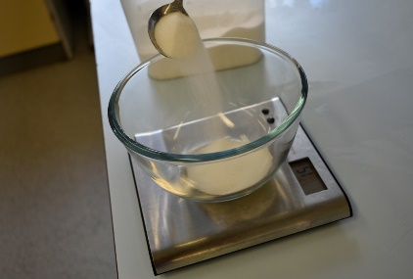
1. Cooking uses a range of food skills
Weigh

Slide 4
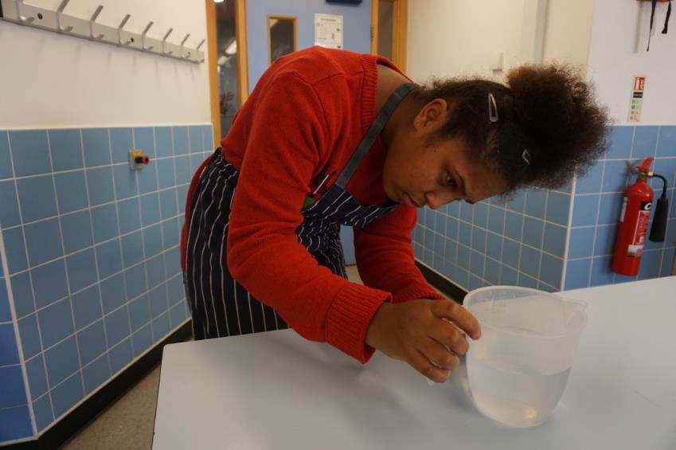
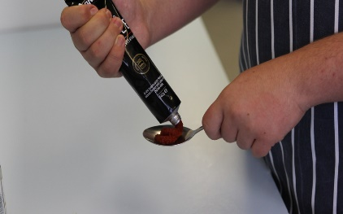
Cooking skills
Measure

Slide 5
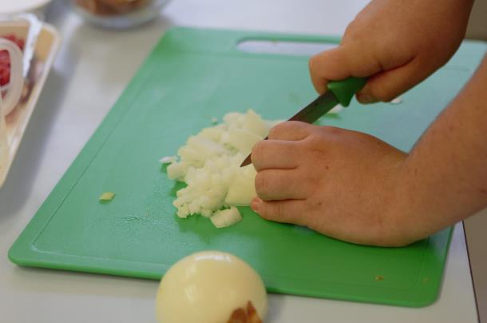
Cooking skills
Cut – claw grip

Slide 6
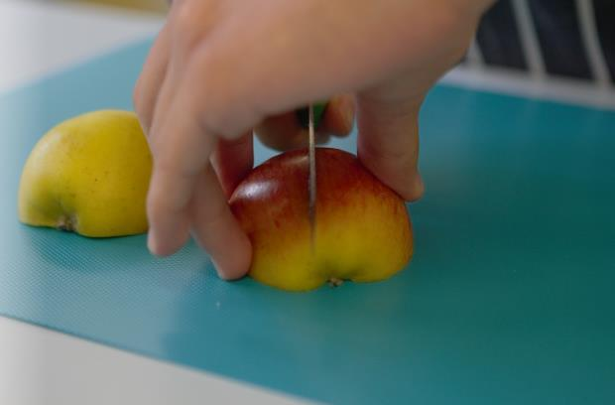
Cooking skills
Cut – bridge hold

Slide 7
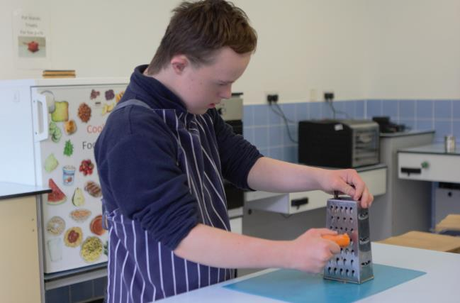
Cooking skills
Grate

Slide 8
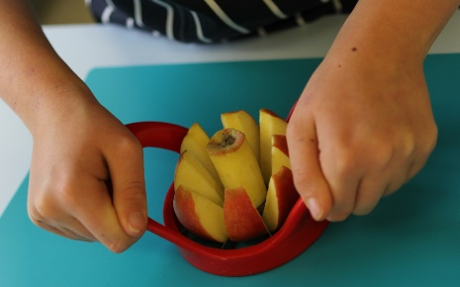
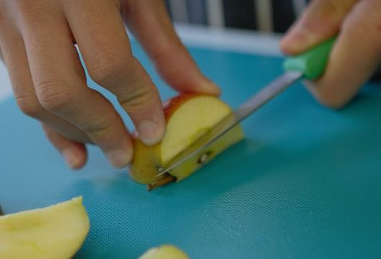
Cooking skills
Core

Slide 9
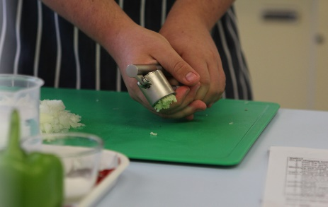
Cooking skills
Crush

Slide 10
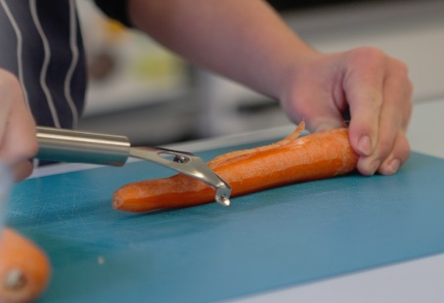
Cooking skills
Peel

Slide 11
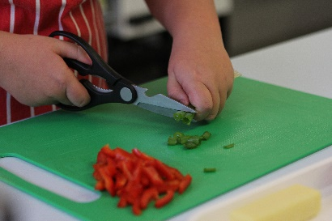
Cooking skills
Snip

Slide 12
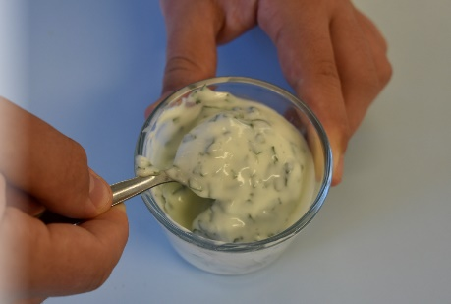
Cooking skills
Mix

Slide 13
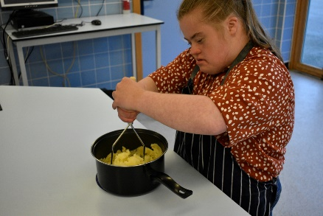
Cooking skills
Mash

Slide 14
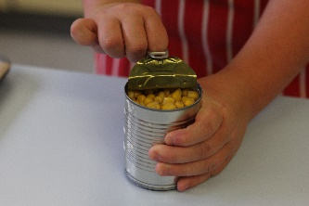
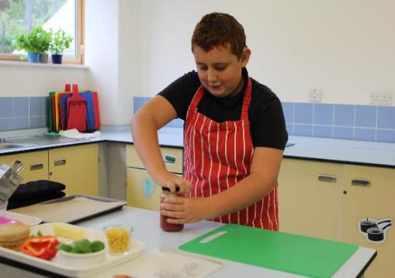
Cooking skills
Opening jars, bottles, packets and cans

Slide 15
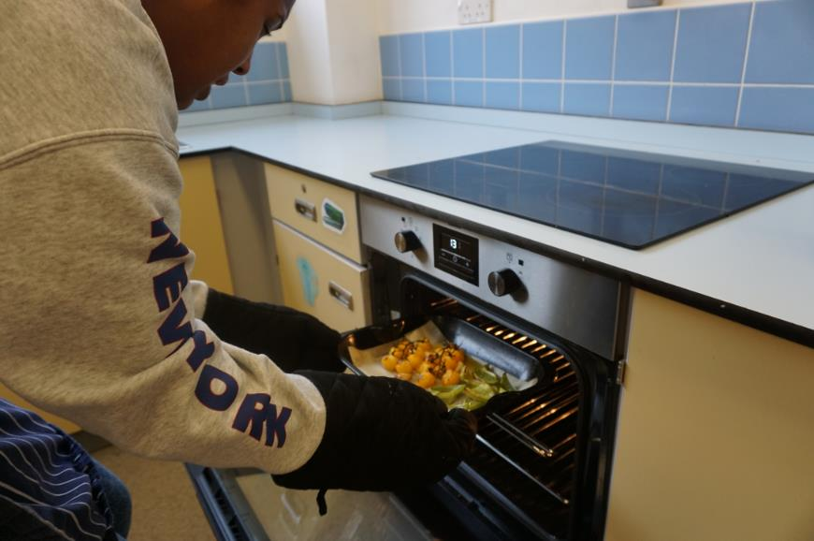
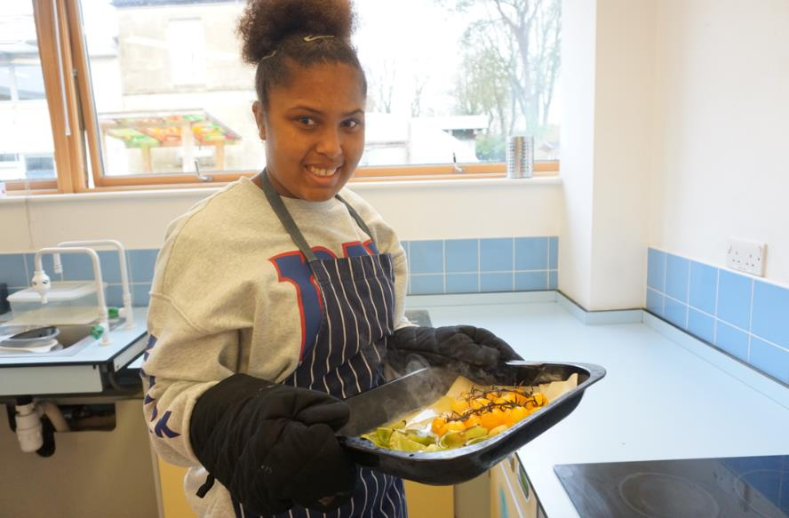
Baking or roasting food in the oven

Slide 16
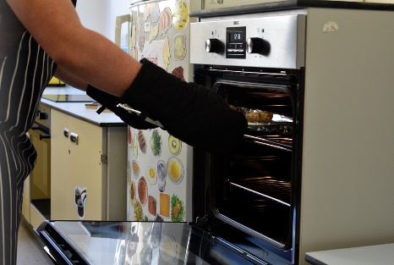
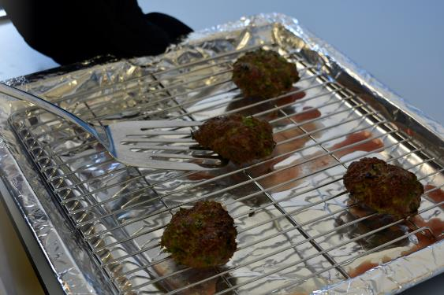
Grilling food

Slide 17
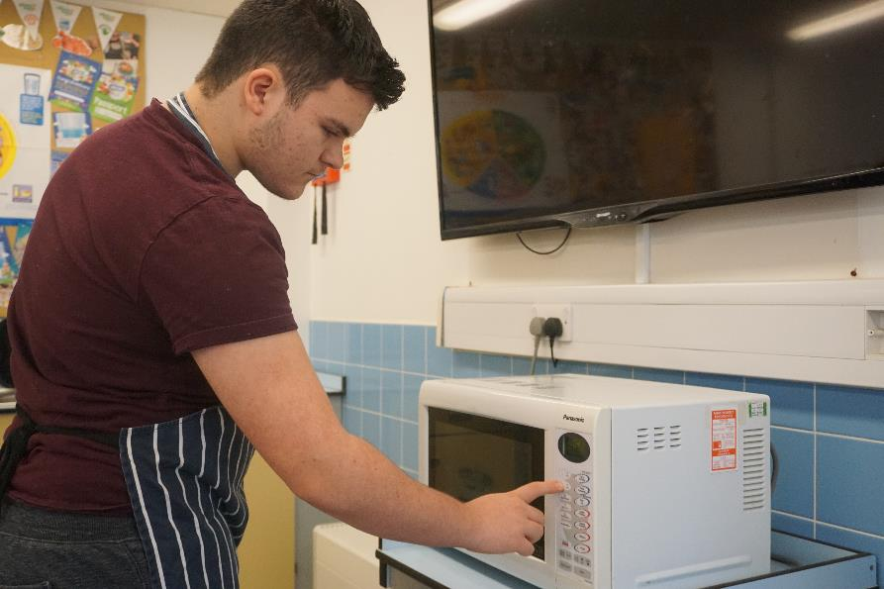
Cooking food in the microwave

Slide 18
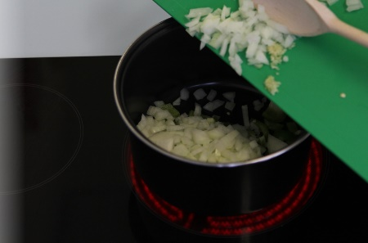
Cooking food on the hob
Fry

Slide 19
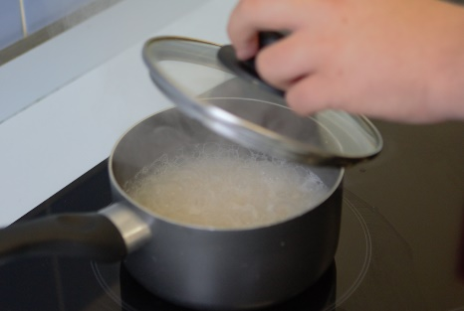
Cooking food on the hob
Boil

Slide 20
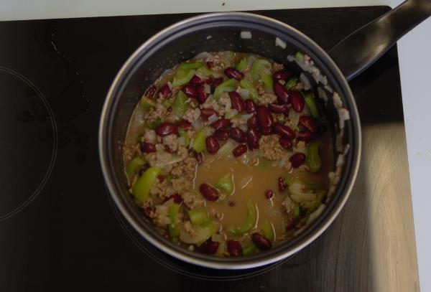
Cooking food on the hob
Simmer

Slide 21
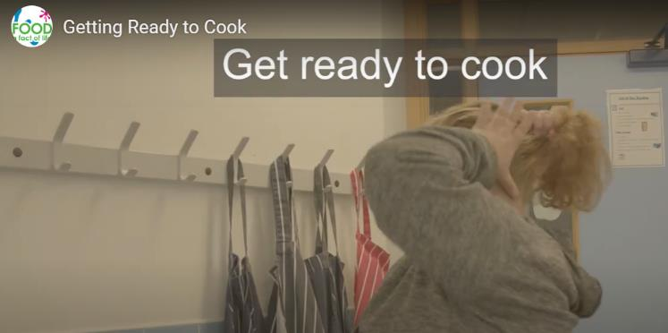
2. Get ready to cook
Click on the image to watch the video.

Slide 22

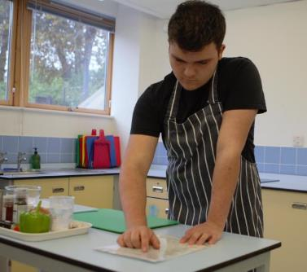
3. Have the recipe ready

Slide 23

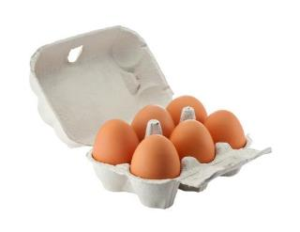
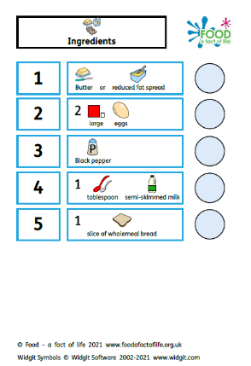
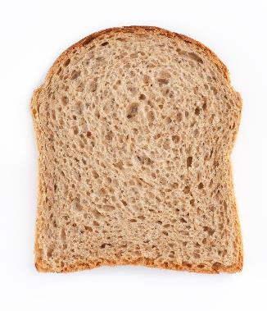

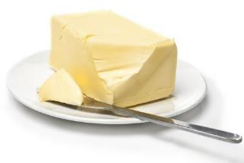
4. Get the ingredients ready

Slide 24

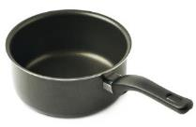
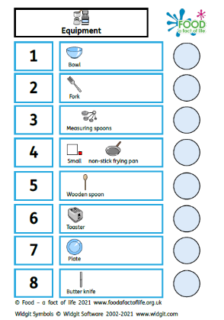






5. Get the equipment ready

Slide 25
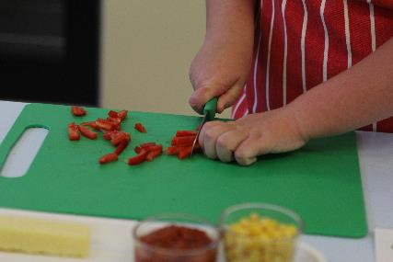
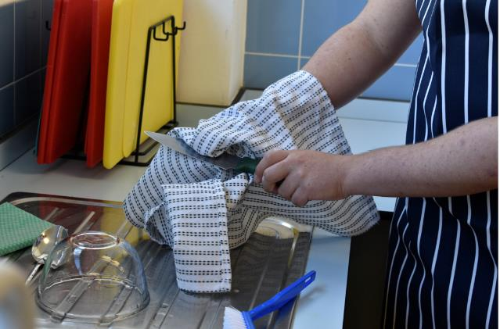

6. Be safe
Be careful of sharp knives

Slide 26
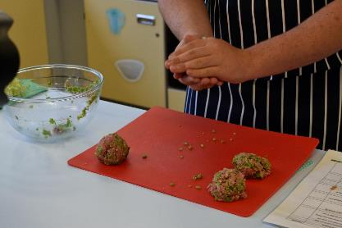
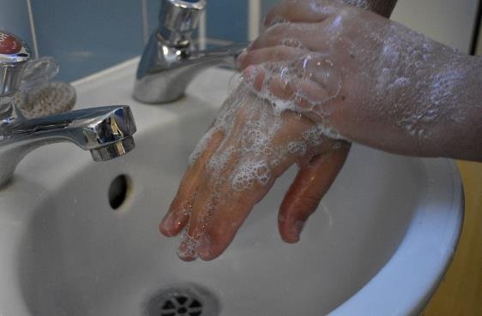
Be safe
Use a red board for raw meat
Wash hands after touching raw meat

Slide 27
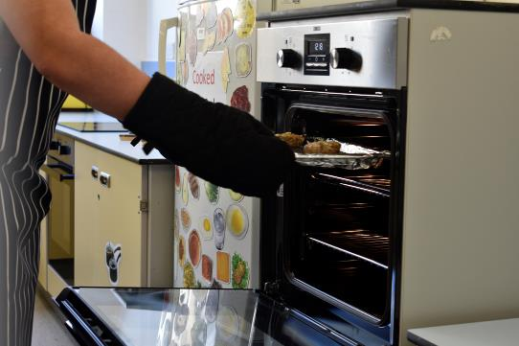
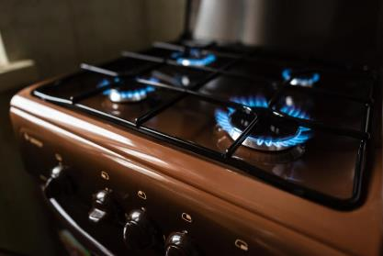
Be safe
Be careful of hot equipment

Slide 28
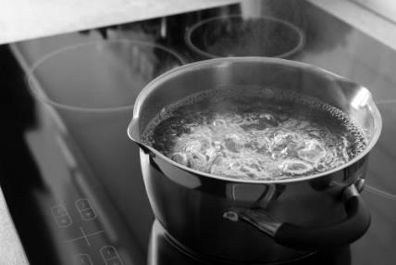

Be safe
Be careful of hot liquid

Slide 29

Be safe
Wipe up spillages

Slide 30

7. Get cooking!
Now it is time to get cooking!

Slide 31
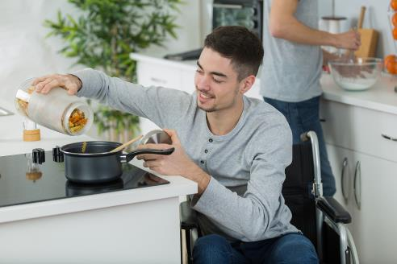
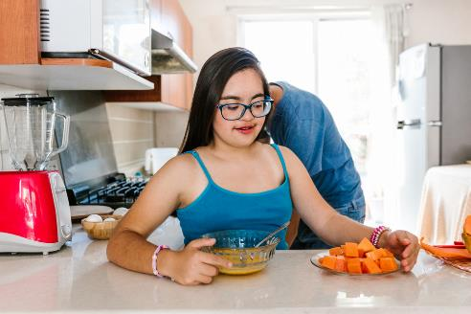
Get cooking!

Slide 32
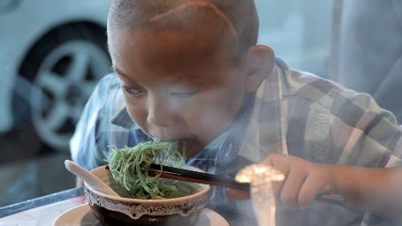
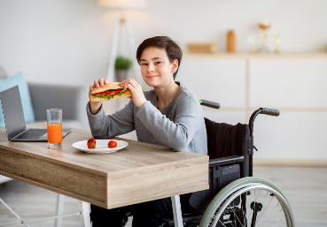

8. Serve
Serve and enjoy!

Slide 33
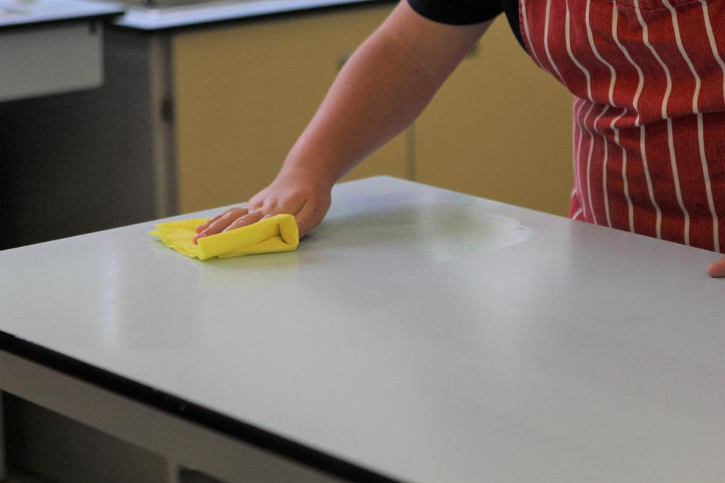
9. Wash and tidy up
Wipe the surfaces

Slide 34
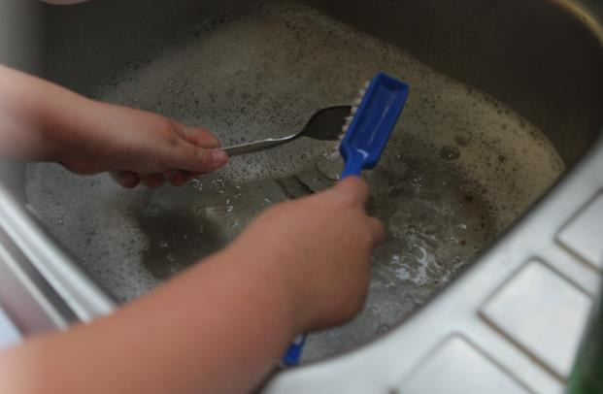
9. Wash and tidy up
Wash up

Slide 35
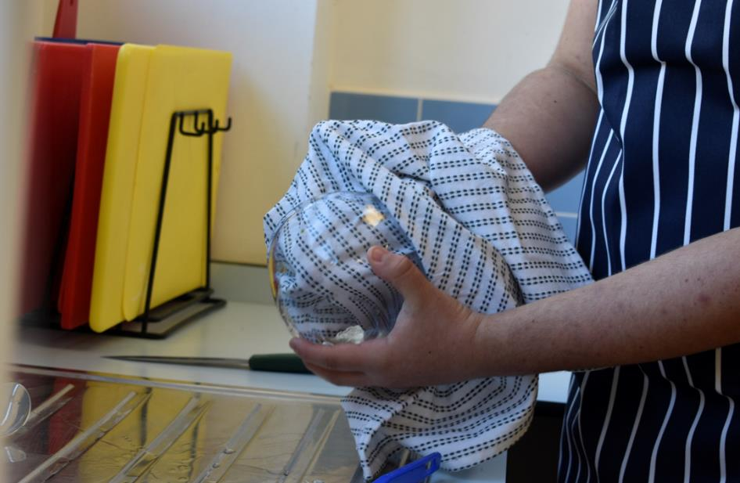
9. Wash and tidy up
Dry up

Slide 36
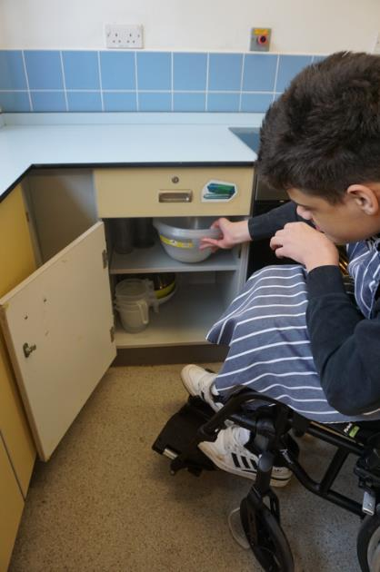
9. Wash and tidy up
Put away

Slide 37
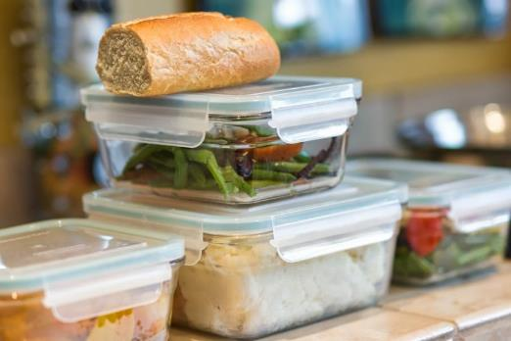
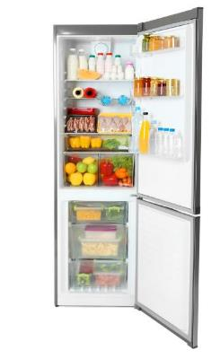
10. Store leftovers safely

Slide 38
What did this social story cover?
Cooking uses a range of food skills
Getting ready to cook
Have the recipe ready
Get the ingredients ready
Get the equipment ready
Be safe
Get cooking!
Serve and enjoy
Wash and tidy-up
Store leftovers safely

Slide 39


The story continues – let’s eat!

Slide 40
Cooking social story
For further information, go to:
www.foodafactoflife.org.uk
This resource meets the Guidelines for producers and users of school education resources about food.

