Slide 1
Successful gluten free cooking in school
15/11/23

Slide 2

Successful Gluten Free
Cooking & Baking in Schools
Niamh McAnulty
@a_glutenfree_mummy

Slide 3


Agenda
Introduction
Coeliac Disease, Wheat Allergy or Non-Coeliac Gluten Intolerance
Prevalence
Reading Labels
Oats
Hidden Gluten
Risk Assessment / Student Safety
Practicalities in the Home Economics Kitchen
Hints, Tips & Tricks for Success
A

Slide 4

Introduction
Home Economics & Religious Education Teacher (Qualified in 2010)
Postgraduate – SEN – 2016

Slide 5
Introduction
I teach Home Economics to all year groups, 1st year to 6th year.
I also work closely with autistic students in Le Chéile, our autism classroom, where I teach L2LP, specifically Personal Care, Life Skills, Food Preparation & Cookery.
I run an Instagram account called a_glutenfree_mummy through which I share gluten free recipes, product & restaurant recommendations, new gluten free product finds, etc. https://www.instagram.com/a_glutenfree_mummy/?hl=en

Slide 6
Introduction
I was diagnosed with non-coeliac gluten sensitivity in 2013, following 5 years of medical investigations, hospitalisations & surgeries trying to identify the cause of debilitating abdominal pain.
In recent years, I’ve become increasingly sensitive to even traces of gluten/wheat. Within minutes of being glutened I begin vomiting, which is typically followed by days/weeks of vertigo-like symptoms.

Slide 7
Introduction
In October of this year, I had slow anaphylactic reaction after eating out in a restaurant. At first, I had my ‘typical’ reaction of vomiting, headache, dizziness, but over the next two days I developed a rash (itchy, red hives on neck & chest) & then swelling of eyes & cheeks. I was prescribed an EpiPen as a result.
My GP believes that the severity of this reaction is indicative of a wheat allergy, and I am currently awaiting an appointment with an immunologist to confirm this.

Slide 8
Coeliac Disease, Wheat Allergy, or Non-Coeliac Gluten Intolerance?

Slide 9
Coeliac Disease
Coeliac disease is a serious illness where the body’s immune system attacks itself when gluten is eaten. This causes damage to the lining of the gut & means that the body cannot properly absorb nutrients from food.
Coeliac disease is not a food allergy or intolerance, it is an autoimmune disease.

Slide 10
Wheat Allergy
If you have a wheat allergy, exposure to a wheat protein primes your immune system for an allergic reaction. You can develop an allergy to any of the four classes of wheat proteins — albumin, globulin, gliadin and gluten. An allergic reaction is triggered by the immune system & usually occurs within seconds or minutes of eating. A wheat allergy is sometimes confused with coeliac disease, but these conditions differ. A wheat allergy occurs when your body produces antibodies to proteins found in wheat. In coeliac disease, a specific protein in wheat — gluten — causes a different kind of abnormal immune system reaction.

Slide 11
Non-Coeliac Gluten Intolerance
The difference between gluten intolerance / sensitivity and coeliac disease is that the latter is an autoimmune disease, and can result in damage to the lining of the gut and malnutrition. Gluten intolerance is less serious, but symptoms can still be very unpleasant and affect your quality of life. People with non-coeliac gluten intolerance experience symptoms similar to those of coeliac disease, but it is not clear how the immune system might be involved because no antibodies are produced, & there does not appear to be damage to the gut lining.

Slide 12
Prevalence
Coeliac Disease

Slide 13
Prevalence
According to Coeliac UK, it is thought that 1 in 100 people in the UK (& Ireland) has coeliac disease but only 36% of these people are diagnosed. It is estimated that there are nearly half a million people who have coeliac disease but aren’t yet diagnosed.
If a first-degree family member (such as mother, father, sister or brother) has the condition then the chances of having it increase to 1 in 10.

Slide 14
Reading Labels

Slide 15
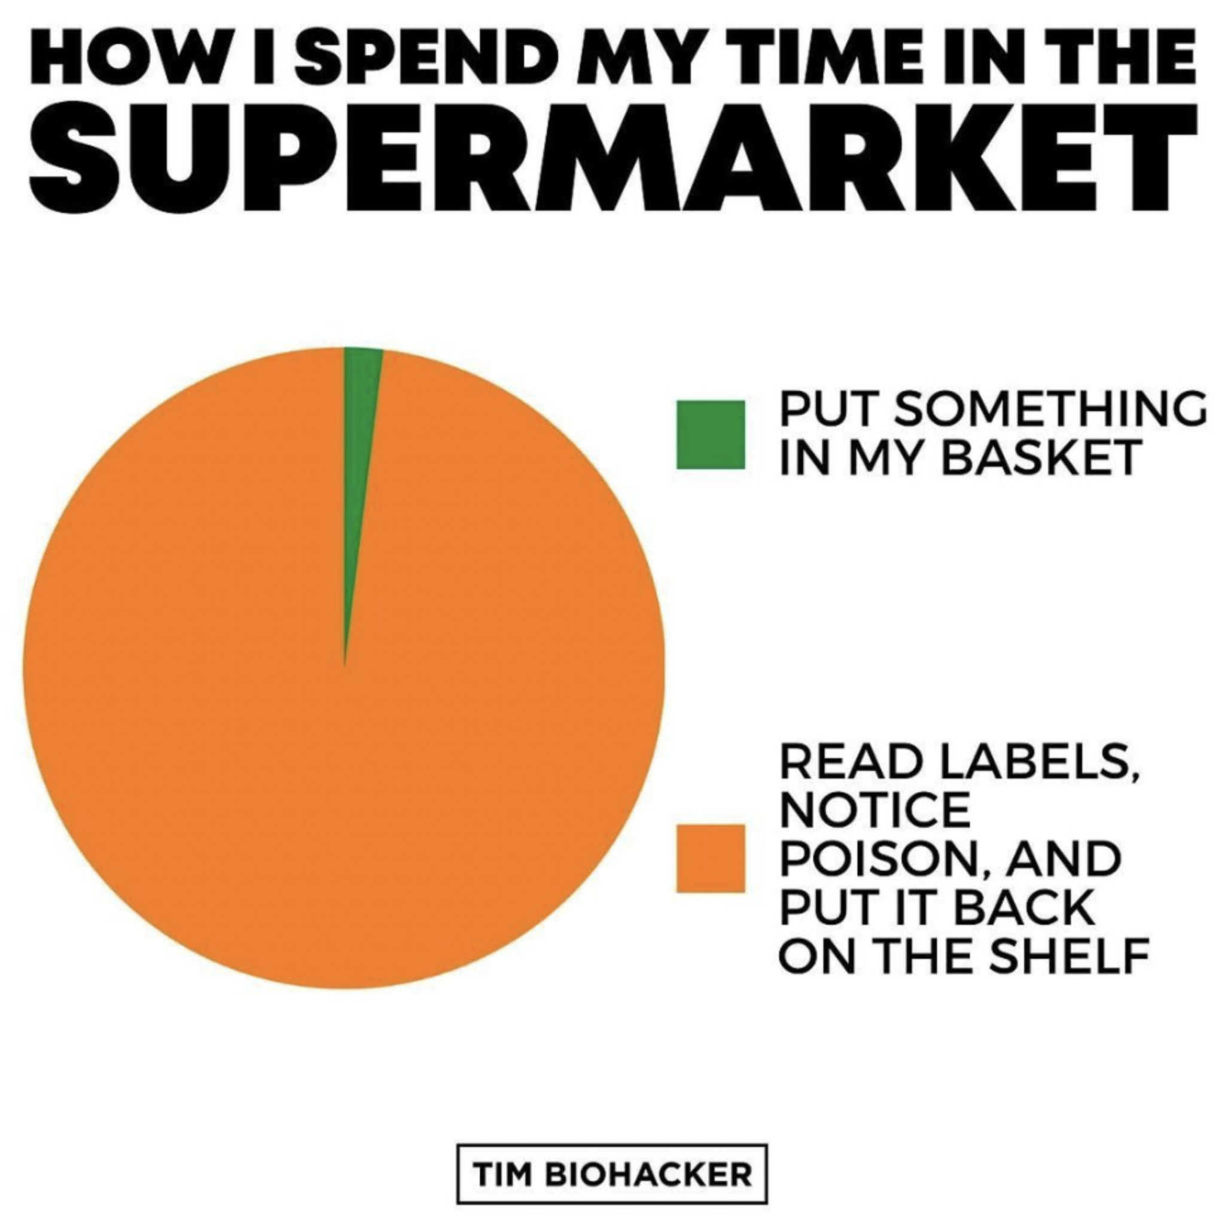

Slide 16
Reading Labels
There is a law that covers the use of the labelling term gluten free. When you see gluten free on a label, you know these foods are suitable on a gluten free diet.
The term 'gluten free' is covered by law & can only be used on foods which contain 20 parts per million (ppm) or less of gluten. You might see this on specialist substitute products like breads, flour & crackers, as well as processed foods made from naturally gluten free ingredients such as soups, sausages & ready meals. Uncontaminated oat products can also be labelled gluten free.

Slide 17
Ingredients
Under EU & UK labelling laws, all deliberately used ingredients must be listed in the ingredients list in order of their amount (greatest first). Gluten containing ingredients are one of the 14 listed allergens that must be emphasised in the ingredients list, therefore if something containing gluten is used as an ingredient, it must be listed & clearly emphasised, for example in bold lettering, in the ingredients list, no matter how little of it is used.
Manufacturers will name the specific grain used, so you will see these words on the ingredients list if they are in the product: wheat, rye, barley, oats, spelt.

Slide 18

Crossed Grain Symbol
Food products that have the Crossed Grain symbol on the packaging are gluten free & safe for people with coeliac disease.

Slide 19
“May Contain” Labelling
In the UK, manufacturers are given guidance by the Food Standards Agency on when to label a product with a ‘may contain’ statement. They may use labelling such as:
may contain traces of gluten
made in factory also handling wheat
When you see one of these statements on a product, the manufacturer has decided that there is a risk that the product could be contaminated with gluten.

Slide 20
“May Contain” Labelling
Since December 2014, all food on sale in Ireland is covered by the EU Allergen Labelling Regulation. This legislation does not cover cross-contamination where trace amounts of gluten accidently get into foods at some point during the manufacturing process. In Ireland, food manufacturers do not legally have to put a “May Contain” label on food products that are produced on the same line/in the same facility as gluten-containing ingredients. The use of a “May Contain” label is at the discretion of the food manufacturer. This is the same for the United Kingdom.

Slide 21
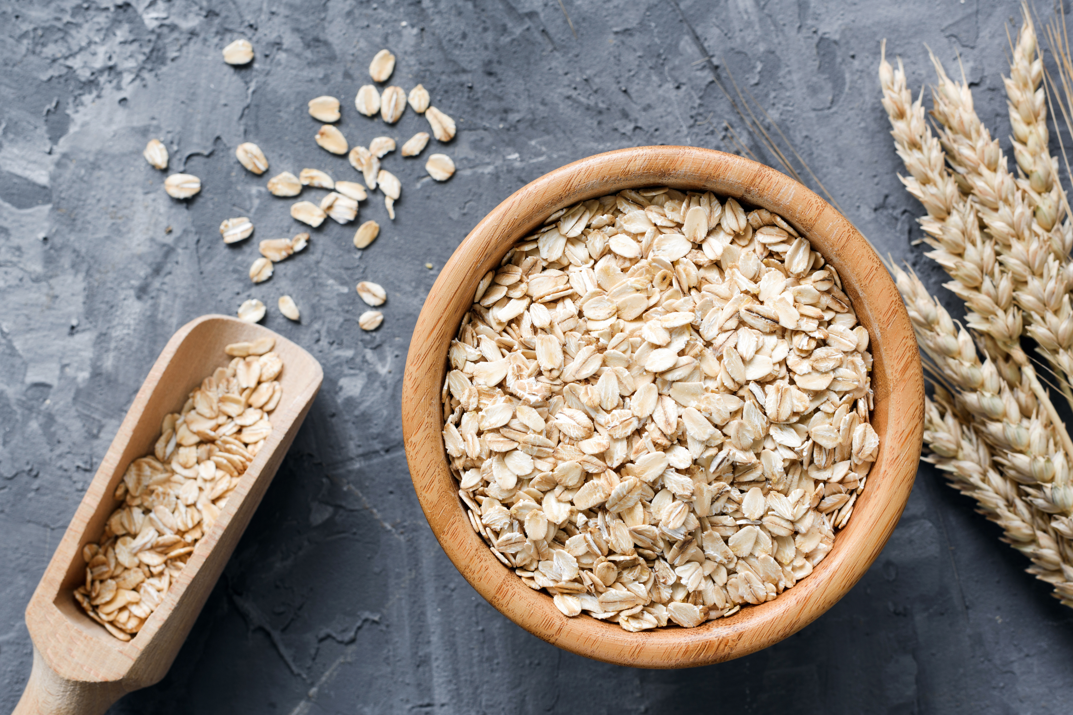
Oats
Oats don't contain gluten but they are often prepared in an environment where wheat may be present so it's best to check the label and only purchase gluten-free oats.
Oats contain avenin which is a protein similar to gluten. Research has shown that most people with coeliac disease can tolerate gluten free oats with no problems, though some people may be sensitive to gluten free oats.

Slide 22
Hidden Gluten
Gluten Free Cooking & Baking

Slide 23
Naturally Gluten Free
Fresh meat and poultry, fish and seafood, most dairy products and all unprocessed fruit and vegetables are naturally gluten free.
The key is that they are whole foods and not processed in some way that could involve a gluten-containing ingredient; a fresh chicken is 100% safe, but breaded chicken nuggets almost certainly are not. Beans and legumes, nuts, herbs and spices are also fine in a natural state, but you will need to check the labelling if they are in a processed form, such as a canned lentil soup.

Slide 24
Hidden Gluten
Know how to check ingredients and labelling
Some products specifically warn of the presence of gluten, but others do not, so you have to know the names of the potential sources. Wheat is produced under many other names, including: kamut, bulgur wheat, triticale, durum, einkorn, farina, faro, semola and couscous. Gluten from wheat, barley or rye is also present in many other derivatives, from brewer’s yeast to soy sauce. Oats are naturally gluten free, but cross-contamination is a common problem so look for a gluten free guarantee and label.

Slide 25
Hidden Gluten
Soy sauce and teriyaki sauce – Traditionally made with fermented wheat and soy.
Corn flakes and crisp rice cereal – Some popular brands are made with malt from barley.#
Soup thickened with “roux” – Roux is a mixture of fat and flour.
Salad dressings – May contain malt vinegar, soy sauce, or flour.

Slide 26
Hidden Gluten
Marinades and barbeque sauces – May contain malt vinegar, soy sauce, or flour.
Taco seasonings – Certain brands contain wheat.
Vinegar – Fermented vinegars made from gluten-containing grains need to be avoided. Malt vinegar is fermented and made from barley.

Slide 27
Hidden Gluten
Specialty ketchup – Some brands may use additional ingredients like malt vinegar or miso, which may not be gluten-free.
Mustard – Wheat flour could be added as a thickener or bulking agent in some specialty mustards.
Stock cubes/pots.

Slide 28
Hidden Gluten
Soups – Wheat flour may be added as a thickener.
Sausages – Could contain rusk, a twice-baked, gluten-containing bread that is used as a cereal filler in some types of sausages.
Sliced deli meats – They may contain added ingredients that could contain gluten as thickeners.

Slide 29
Hidden Gluten
Chips – Potatoes are naturally gluten free but chips many restaurants fry chips in the same oil as gluten-containing foods. Frozen chips could also contain wheat flour.
Nuts – Plain, packaged nuts don’t typically contain gluten, but flavoured/seasoned likely do.
Crisps – may contain flavourings derived from wheat or barley.
Some milkshakes – If a milkshake is made with malt, it contains barley.

Slide 30
Hidden Gluten
Energy bars/granola bars – Many are made with oats and are often not labelled gluten free.
Chocolate – Some additives (including emulsifiers and flavourings) in certain chocolates or fillings could contain gluten.
Ice cream – some ice creams may contain gluten from additives, starches or flavourings that include gluten.

Slide 31
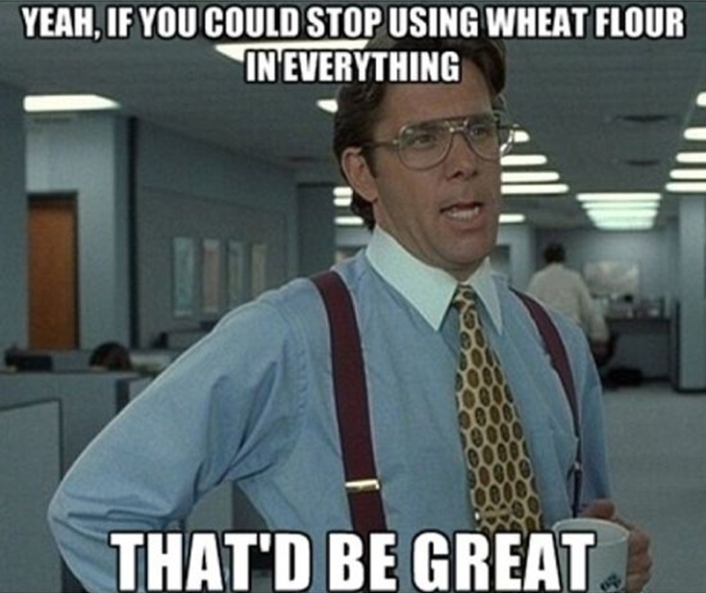

Slide 32
Risk Assessment / Student Safety

Slide 33
Symptoms of Coeliac Disease
The symptoms of coeliac disease vary from person to person & can range from very mild to severe.
This makes the condition very frustrating for sufferers because it can be hard to pinpoint.
Coeliac disease is known as a 'multi system' disorder – symptoms can affect any area of the body. Symptoms differ between individuals in terms of type and severity.

Slide 34
Symptoms of Coeliac Disease
severe or occasional diarrhoea, excessive wind and/or constipation
persistent or unexplained nausea and vomiting
recurrent stomach pain, cramping or bloating
any combination of iron, vitamin B12 or folic acid deficiency
anaemia
tiredness
sudden or unexpected weight loss (but not in all cases)

Slide 35
Symptoms of Coeliac Disease
mouth ulcers
skin rash (dermatitis herpetiformis)
tooth enamel problems
liver abnormalities
unexplained subfertility
repeated miscarriages
neurological (nerve) problems such as ataxia (loss of coordination, poor balance) and peripheral neuropathy (numbness and tingling in the hands and feet)

Slide 36
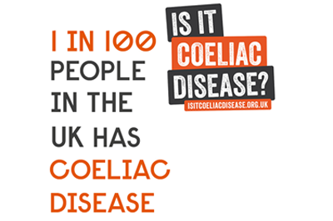
If you (or a student) suspect you may have coeliac disease, discuss your concerns with your GP.
Do not remove gluten from your diet until you are diagnosed by a healthcare
professional.

Slide 37
Symptoms of a Wheat Allergy
As mentioned earlier, a wheat allergy is an allergic reaction to foods containing wheat. Allergic reactions can be caused by eating wheat and also, in some cases, by inhaling wheat flour.
Avoiding wheat is the primary treatment for wheat allergy. Medications may be necessary to manage allergic reactions if you accidentally eat wheat.

Slide 38
Symptoms of a Wheat Allergy
A child or adult with a wheat allergy is likely to develop signs and symptoms within minutes to hours after eating something containing wheat.
Wheat allergy signs and symptoms include:
Swelling, itching or irritation of the mouth or throat
Hives, itchy rash or swelling of the skin
Nasal congestion

Slide 39
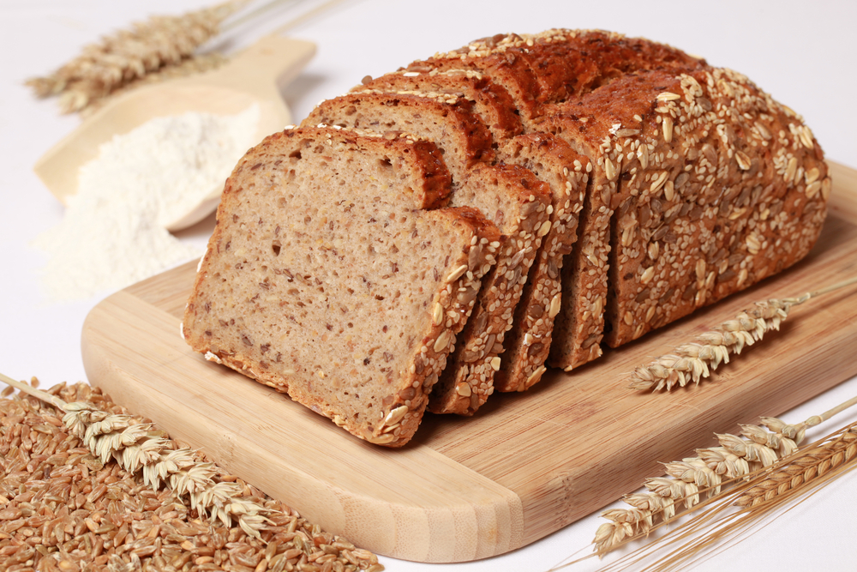
Symptoms of a Wheat Allergy
Headache
Difficulty breathing
Cramps, nausea or vomiting
Diarrhoea
Anaphylaxis

Slide 40

Symptoms of Gluten Intolerance
Gluten intolerance can affect everyone in different ways, but common symptoms may include:
Bloating, gas and stomach ache
Constipation or diarrhoea
Skin rashes or eczema
Exhaustion, dizziness or headaches after eating
Some have reported depression and aching joints

Slide 41

Symptoms of Gluten Intolerance
Symptoms usually develop a few hours or days after eating gluten and, according to the NHS and Allergy UK, are sometimes not triggered by 'trace' amounts of gluten (unlike coeliac disease or a wheat allergy).

Slide 42
Practicalities in the Home Economics Kitchen
Gluten Free Cooking & Baking

Slide 43
Preventing Cross Contamination in the Home Economics Kitchen
Even tiny amounts of gluten may cause people with coeliac disease to have symptoms in the short term, and gut damage long term. In the case of a student with a wheat allergy, the onset of symptoms will likely be more immediate.
To help to prevent cross contamination in the Home Economics classroom, the following steps should be followed:
Wipe down surfaces with hot soapy water
Clean pots and pans with washing up liquid and hot water

Slide 44
Preventing Cross Contamination in the Home Economics Kitchen
Consider keeping separate cloths and tea towels for the gluten free student/s
Keep separate bread boards and chopping boards for gluten free and gluten containing foods
Use a separate toaster or toaster bags
Use a separate fryer / air fryer for frying gluten free foods
Use different butter knives or dishes and jam spoons to prevent breadcrumbs from getting into condiments. Alternatively label gluten free items in the fridge e.g. jam, butter, etc.

Slide 45
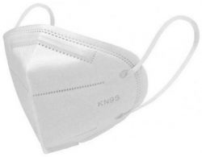
Recommendations
Students with coeliac disease/gluten intolerance/wheat allergy should consider wearing a mask when working in an environment where wheat flour (etc.) is being used. This is because flour particles will be airborne, and by breathing in the flour particles some will inevitably end up being ingested (breathing in, swallowing). Flour can remain airborne for up to 24 hours, depending on the quantity being used and ventilation.

Slide 46

Recommendations
In an ideal world, Home Economics departments might consider only using gluten free flour blends within the classroom, if there is a student with CD/etc. However, this will depend on a number of factors including school funding / agreement from school management/parents/students, etc.
Ensure the classroom is well ventilated when wheat flour is being used (extractor fans, open windows & doors).

Slide 47
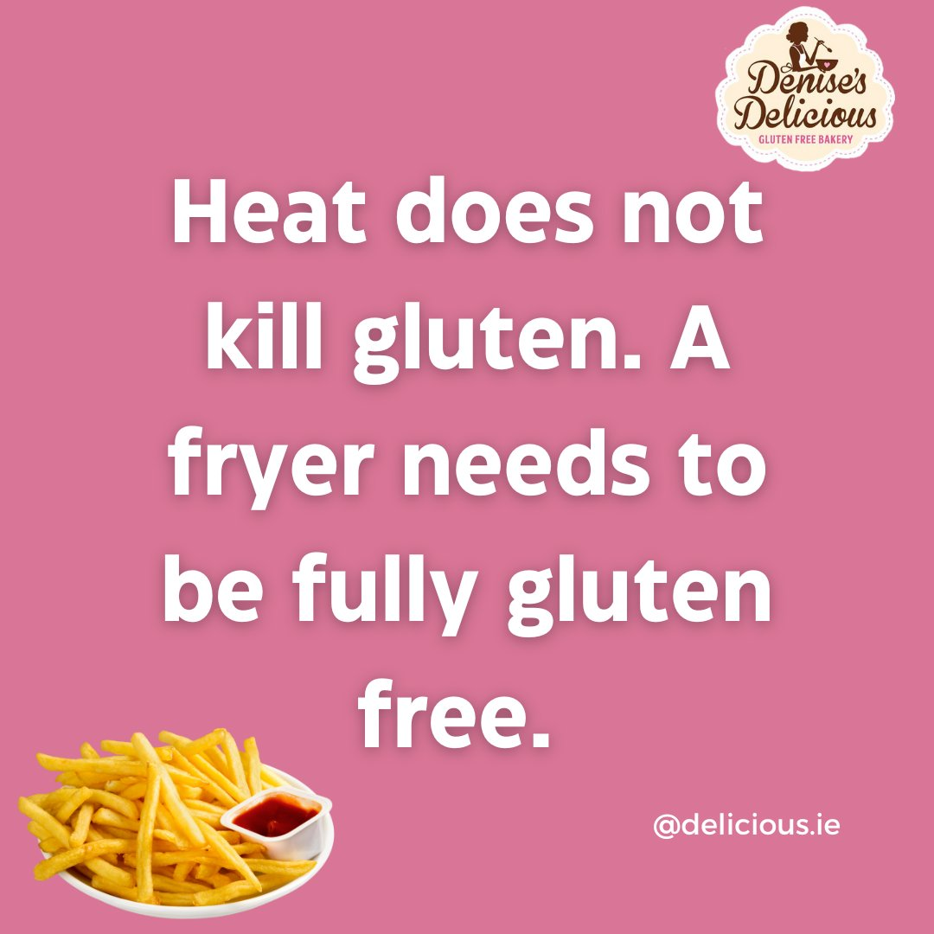
Recommendations
It is well know within the gluten free community that gluten free foods (e.g. gluten free chips) are not safe to eat if they have been cooked in the same oil as gluten containing foods. However, it is also important to remember that gluten free foods baked in the same oven as gluten containing foods can be cross contaminated with gluten (convection/circulation of hot air/flour particles).
Source

Slide 48
Recommendations
For this reason, ideally one oven in the classroom should be dedicated solely to gluten free baking. Should this not be a possibility, all gluten free foods baked/cooked in the an oven that has previously been used to bake/cook gluten containing foods should be well covered. Gluten free foods should not be baked/cooked in the same oven at the same time as gluten containing foods, to minimise the risk of cross contamination.
Source

Slide 49
Hints, Tips & Tricks for Success
Troubleshooting Gluten Free Baking

Slide 50
The Role of Gluten in Baking
Gluten is a protein found in grains including wheat, barley & rye. When (conventional wheat) flour is mixed with water, the gluten proteins form a network that gives structure to baked goods. One of the properties of gluten is elasticity. Elasticity allows conventional dough to stretch & rise in the oven, giving bread, cake & pastry the correct texture.

Slide 51
What to Expect with Gluten Free Baking
Therefore, without gluten, bread, cake & pastry can be dry & crumbly. They are unlikely to rise as desired, resulting in a dense & heavy texture. This means that when you’re baking without gluten, you’ll have to adjust your recipes for the final product to be as close as possible to the traditional one (unless you are using a recipe designed specifically for gluten free flour blends).

Slide 52
Tip 1: Use a Gluten Free Flour Blend
There is no individual gluten free flour that can be used as an all-purpose gluten free flour. So instead of a single gluten free flour, to make most gluten free baking recipes, you'll need a blend of a few different flours, & gluten free recipes that were developed to make the best use of that blend. While making your own gluten-free flour blend is possible, using a pre-mixed blend can help simplify the baking process.

Slide 53
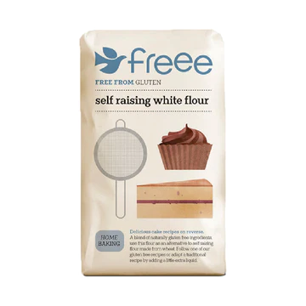
Tip 1: Use a Gluten Free Flour Blend
Gluten free flour blends are specially formulated to provide the ideal ratio of ingredients for gluten free baking. In addition, it often includes gum or starches that help bind the ingredients together and give the baked goods a more traditional texture.

Slide 54

Xanthan Gum
Xanthan gum (E415) is a type of starch produced by fermentation (the same process used to make yogurt, cheese & wine).
Xanthan gum is used to improve the texture & shelf life of gluten free products. It mimics gluten in terms of elasticity, & it helps to keep baked products moist & soft.
If you’d like to like to learn more about xanthan gum, follow the link What is xanthan gum? | BBC Good Food

Slide 55
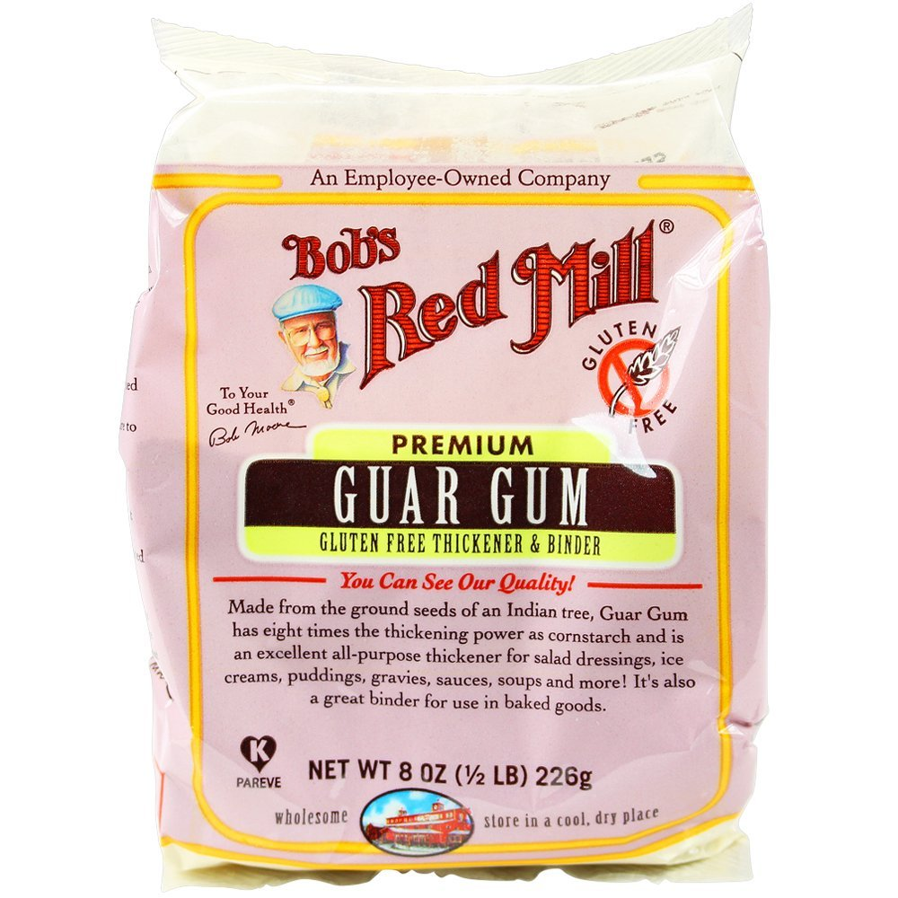
Guar Gum
Guar gum comes from the seeds of guar beans (Cyamopsis Tetragonolobus). It acts as a thickener & bulks out food. If you're baking with flours that don't have gluten in them, adding guar gum to the recipe can help add some elasticity to your dough.

Slide 56
Tip 2: Bake at the Right Temperature
Baking temperature is important for all types of baking, but it’s especially critical in gluten-free baking. This is because gluten-free flour doesn’t contain the proteins that help trap heat and moisture, so baked goods can dry out quickly if they’re overcooked. As a general rule, bake gluten-free goods at a lower temperature than you would conventional wheat-based recipes. This will help prevent them from drying out or becoming overcooked.

Slide 57
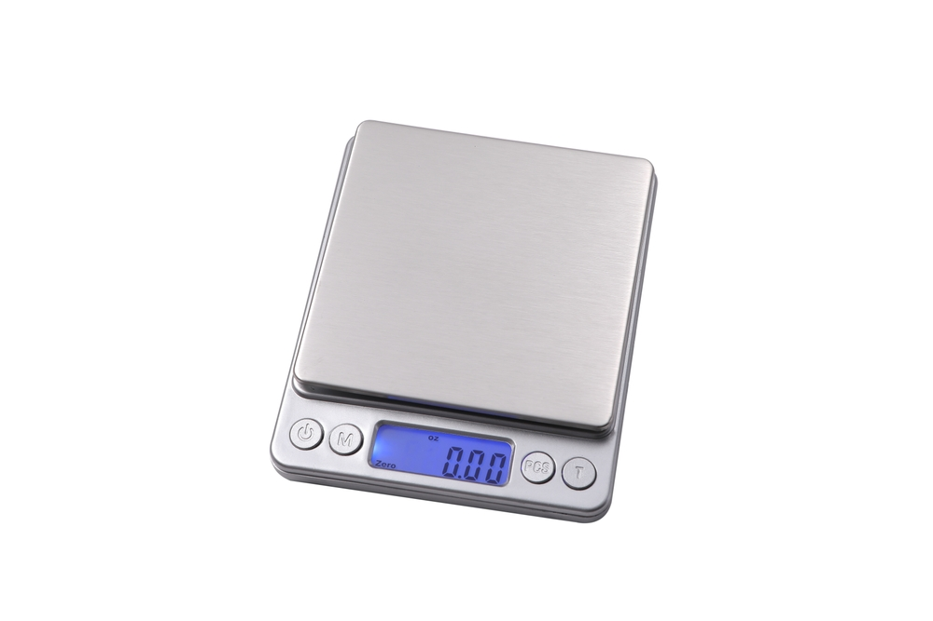
Tip 3: Measure Accurately
When baking gluten free, be precise when measuring your ingredients. This is because gluten free flour blends often have different ratios of flour to starch, which can impact the texture of your final product. Use a scale to measure your ingredients for best results rather than measuring cups.

Slide 58
Tip 4: Don’t Overmix
Gluten free doughs and batters are much more delicate than their traditional counterparts. As such, it’s important not to overmix them. Overmixing can result in tough, rubbery baked goods. So when stirring gluten-free batters or doughs, do so until everything is just combined. Then stop.

Slide 59
Tip 5: Bake Until Done
Gluten free flour blends tend to absorb more liquid than wheat flours, so gluten free baking recipes may require more liquid. This in turn can affect baking times, so gluten free baked goods often take longer to bake than their traditional counterparts.
Be sure to bake them until they are golden brown and spring back when lightly pressed, or test it with a toothpick in the centre of the cakes to see if it comes out dry. This way, you can be sure that they are cooked all the way through.

Slide 60
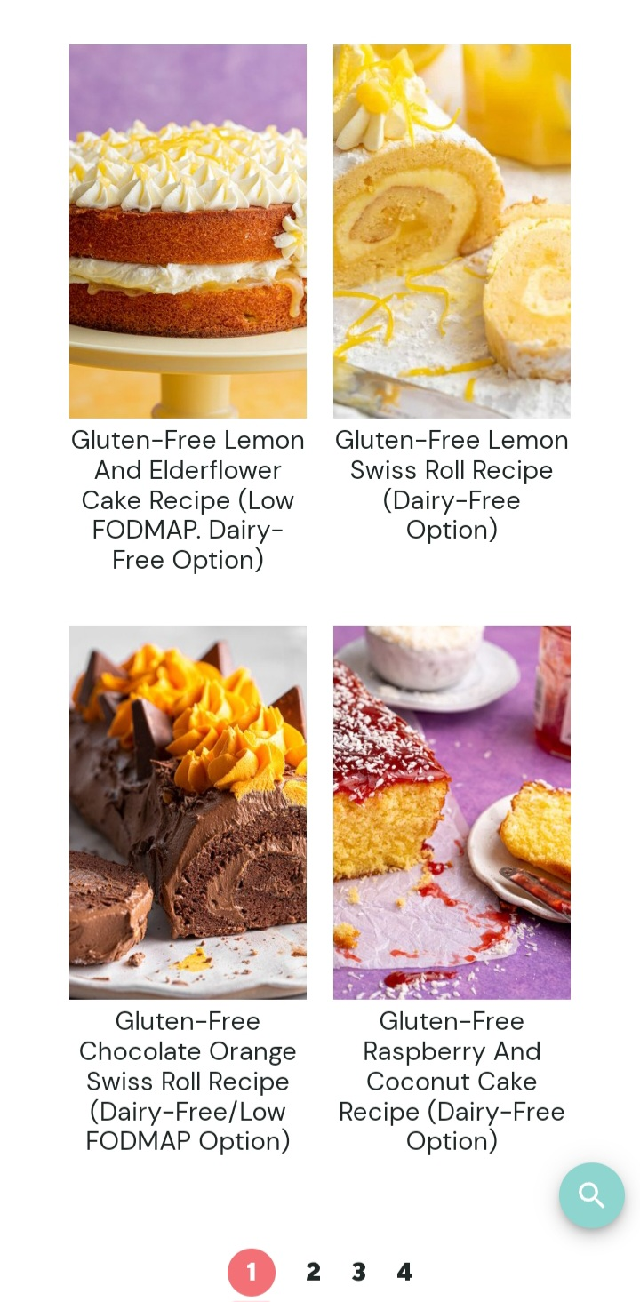
Tip 6: Use Gluten Free Recipes
To ensure success when baking gluten free, it is best to use recipes that have been specifically designed, tried & tested, for gluten free baking.
Recommendations:
https://glutenfreecuppatea.co.uk/
Freee | Gluten Free Products and Recipes (freee-foods.co.uk)
https://glutenfreemummy.com/

Slide 61
Thank you
Niamh McAnulty
​
niamh.87.mcm@gmail.com
www.glutenfreemummy.com
@a_glutenfree_mummy
https://www.instagram.com/a_glutenfree_mummy/?hl=en

Slide 62
Sources of Information
https://www.coeliac.org.uk/home/
https://coeliac.ie/
https://glutenfreeonashoestring.com/gluten-free-baking-beginners-guide/
https://www.schaer.com/en-uk

Slide 63
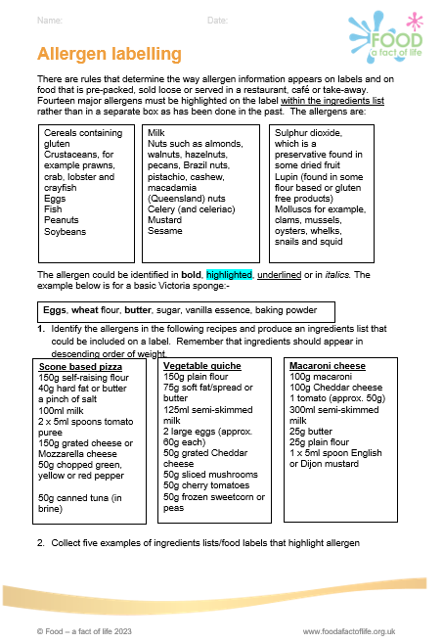
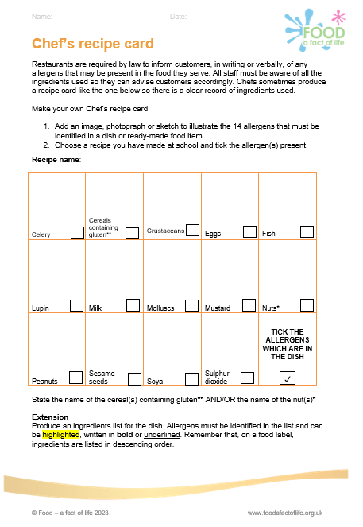
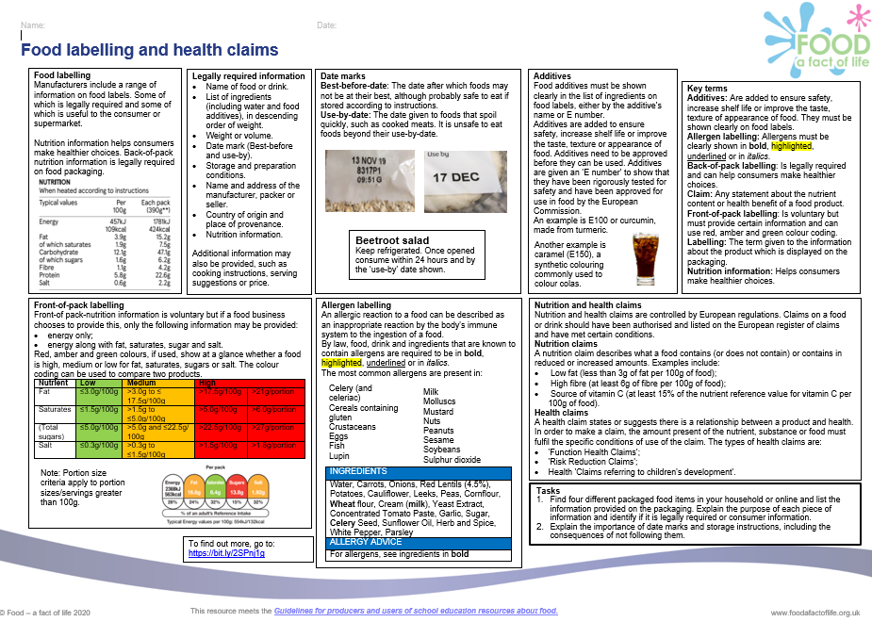
Adverse reactions to food – pupil resources
11-14 years
14-16 years, including food labelling
Knowledge organisers – 11-14 years and 14-16 years

Slide 64
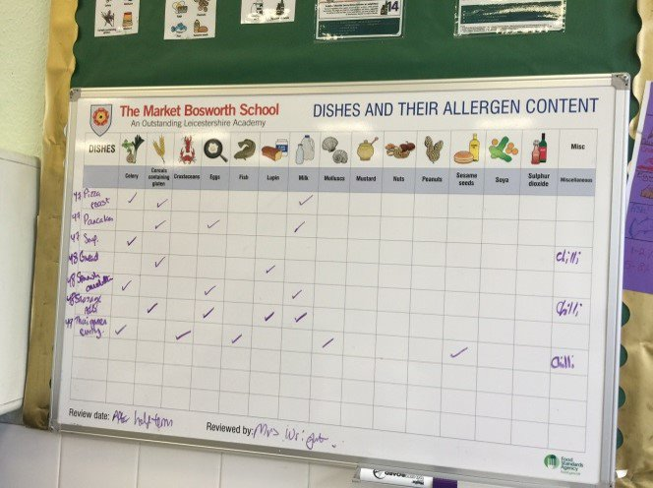
Classroom management
Good food hygiene and safety practices – risk assessments
Characteristics of good practice
FSA Food allergy and intolerance training
Adverse reactions to food and the management of allergens in the classroom – webinar recording
FSA Food allergy and intolerance information
Food Standards Authority Ireland
FSA Allergen chart

Slide 65
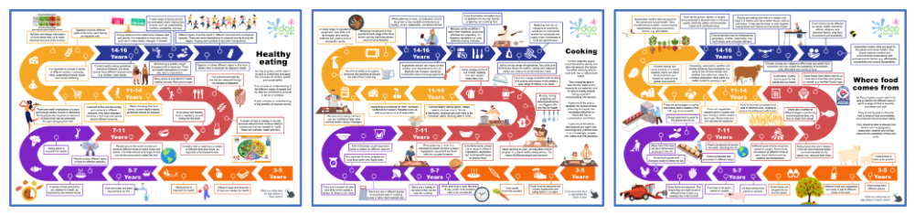
New! – FFL Roadmaps
Food - a fact of life is proud to present our very own roadmaps for the food curriculum. Each roadmap covers the key topics at each age phase, accompanied by our Key facts. Each Key fact shows progression on the topics as pupils move through each age phase. They are a visual guide to food and nutrition education from 3-16 years and are a way of representing what pupils should learn and the sequence. There are printable and interactive versions!

Slide 66

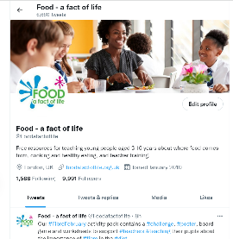
Keep up to date with our free resources and training
Education News (monthly email update)
Sign up on the homepage: www.foodafactoflife.org.uk
PPD newsletter (find out about upcoming FFL training)
https://www.foodafactoflife.org.uk/professional-development/
Follow us on Twitter @Foodafactoflife
https://twitter.com/foodafactoflife
Keep in touch:
education@nutrition.org.uk
BNF news https://www.nutrition.org.uk

Slide 67
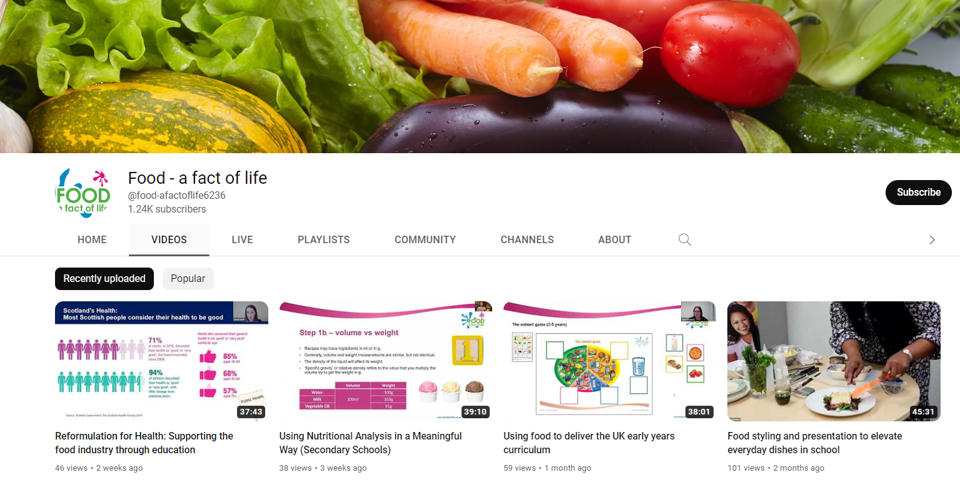
More training…
Hands-on interactive conferences
Saturday 18 November 2023– CAFRE, Northern Ireland
Saturday 27 January 2024 – Harper Adams University, Shropshire
FREE online modular courses:
Functional properties of food
Sensory science
Food spoilage, hygiene and safety
Characteristics of teaching food and nutrition education- primary, secondary and pupils with additional needs
FFL webinar recordings
To find out more and to book, go to https://www.foodafactoflife.org.uk/training/

Slide 68
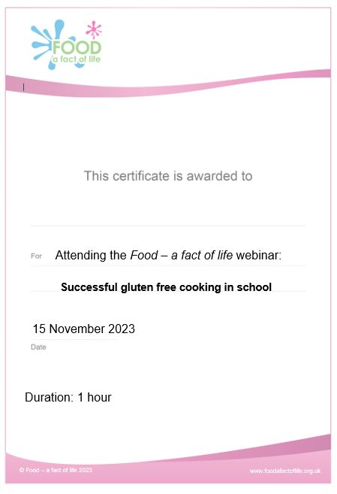
Thank you
Please complete the webinar evaluation. You should be automatically redirected to the evaluation when the webinar finishes.
Successful gluten free cooking in school
You will receive a link to the certificate once you have completed the evaluation. Please download the certificate, add your name and print it out for your records.

Slide 69
Successful gluten free cooking in school
For further information, go to:
www.foodafactoflife.org.uk
education@nutrition.org.uk

