Slide 1
Food skills, recipes and diversity Middle Eastern cuisines
23 March 2022

Slide 2
Housekeeping and overview
Turn off mobile phone (pop on vibrate)
You should have all your equipment and ingredients ready/handy
Get ready to cook!
Chat box – feel free to use to ask questions and share info/links and ideas
Camera on – we want to see your food skills
Help and direction (please don’t take as criticism!)
Feel free to ask questions and engage!
Feedback – it’s good to get your views!
Enjoy!
Good food hygiene and safety practices - are you ready to cook?
Long hair tied up.
Jumpers removed/long sleeves rolled up.
Nail varnish and jewellery/watches removed.
Thoroughly washed and dried hands.
Clean apron on.

Slide 3
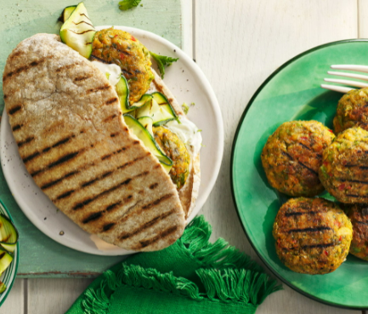
Welcome
As part of the British Nutrition Foundation’s work around a ‘modern, diverse food and nutrition education’ we asked students what was important to them about the recipes they cooked at school.
Students responded that they want dishes that are:
tasty, healthy, family/everyday recipes;
most significantly they want them to be dishes from around the world that are - modern, diverse and reflect different cultures.
The British Nutrition Foundation is grateful for the support from the All Saints Educational Trust for this work.

Slide 4


Introductions
A quick hello to the rest of the group!
@foodafactoflife

Slide 5
Session aims
During the session we will:
make two recipes from around the world that are new to Food – a fact of life;
use traditional ingredients and consider alternatives;
develop, acquire and secure practical food skills using recipes that are suitable and practical for schools and their budgets, promote healthier eating, reflect more global cuisine, and encourage dialogue around culture and inclusivity;
consider planning and implementing practical activities in the secondary classroom;
demonstrate good food hygiene and safety practices;
provide links to Food – a fact of life.

Slide 6
Programme
16.45 Registration
17.00 Welcome and introductions:
Please be prepared to introduce yourself in the chat box
17.10 Practical food skills, recipes and diversity
17.20 Simit bread: demonstration, activity and review
17.50 Ful medames: activity and review
18.25 Review and next steps
18.30 Finish – evaluation, certificate and voucher

Slide 7
Diversity and inclusion in Schemes of Work
Know your pupils!
Know and understand the local community, e.g. what are the challenges that young people are facing?
Understand what young people (and their families) want to make in food lessons. Not just cakes though!
Ensure recipes and practical activities build on knowledge and skill.
Incorporate different flavours, ingredients and culinary techniques and experiences to widen young people’s understanding of food and cultures around the world.
Encourage pupils to share their personal experiences around food culture, ingredients and recipes with the class or school community.
Consider healthy, sustainable diets – nutrition.org.uk
Did you know?
Some food and drink-related traditions are currently recognised by UNESCO and its Representative List of the Intangible Cultural Heritage of Humanity

Slide 8
Context
Learning intent
Food skills
Lesson length
First … consider the following …
Remember pupil voice!
Then … choose recipes that pupils could make

Slide 9
Learning intent
What is the lesson for?
Aims: what will pupils be able to do? Broad terms. Apply knowledge to make informed decisions … Develop practical food skills …
Objectives: statements that define measurable outcomes. State the function of yeast in bread making; adapt and follow recipes; describe food hygiene messages
What do you want them to know/apply?
How will you know what they’ve learned? (Name, list, sort, describe, justify …)
What do you want them to be able to do?
How will they demonstrate this? (Chop, slice, grate, mix …)

Slide 10
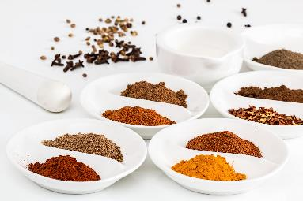
In the classroom
Consider the following:
time and budget available;
pupils - practical skills;
equipment available;
provision/availability of ingredients e.g. spices or herbs that may not be used often, vegetables that might not be readily available in your area;
involving the school/local community – there may be an ‘expert’ in a particular cuisine that could offer guidance and/or input to the lesson;
sharing the success of your pupils work through school social media, newsletters and special events such as open evening and options.

Slide 11
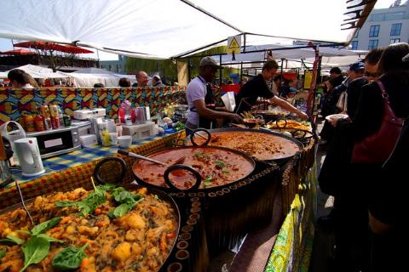
Generation Z and food culture
Globalisation has been changing the food we eat and the ways we eat those foods. But it is not new!
Food cultures are moving, and globalisation has made a wide range of cuisines more accessible.
Food culture is no longer tied down to where it originated from and can spread far and wide.
Trends:
Street food
Fusion food
Travel – trying a wider variety of cuisines
Notes:
Gen Z = born in 1997 or later - makes up a quarter of all the people going out to eat – high spending power. Organics/sustainability/plant based all feature.
A strong theme in Gen Z eating habits is authenticity and exploring exciting flavours from all over the world. Some of this may come from growing up in the same households as Gen X and Millennial foodies.
Gen Z brought up as 'digital natives' - they see and experience food around the globe – heritage and authenticity are key words.
Food trade has played a significant role in the history of globalisation, as it has allowed for cultural exchange for thousands of years. From the transporting of spices along the Silk Road, to the potatoes being imported from the Andes to Ireland in 1589 by Sir Walter Raleigh.
e.g. Italian coffee culture – worldwide verses local culture e.g. snakes, spiders

Slide 12
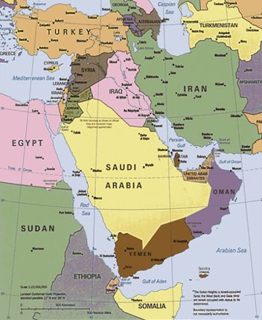
Middle Eastern cuisine
The Middle East is a region that is bordered by Asia to the east, Europe to the northwest, Africa to the southwest, and the Mediterranean Sea to the west.
There is no definitive list of Middle Eastern countries, but the following are generally accepted as the core group:
Bahrain, Iran, Iraq, Israel, Jordan, Kuwait, Lebanon, Oman, Palestine, Qatar, Saudi Arabia, Syria, Turkey, United Arab Emirates, Yemen. Often Egypt is also included and sometimes Cyprus.
Each country of the Middle East has its own defining set of ingredients, influences, and techniques.

Slide 13
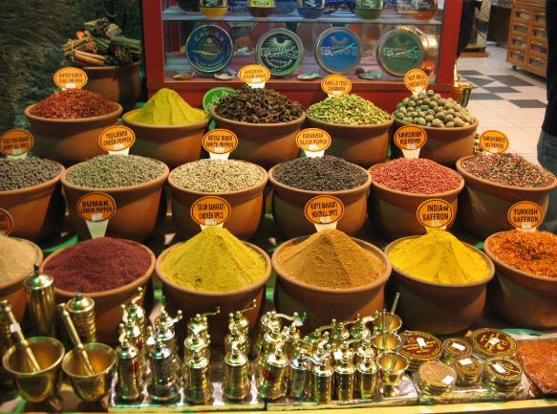
History
Early civilizations in the Middle East were among the first to keep farm animals and cultivate plants, including wheat, sheep, goats, and cattle. They also developed the process of fermentation, which is used worldwide to leaven bread, make alcohol, and create unique flavours.
Geographically the region is at the crossroads between Europe, Asia, the Caucasus and North Africa leading to exchange of food and recipes over the centuries.
Spices, ingredients, and new dishes were all exchanged, shaping the food of the Middle East and surrounding areas.
Notes:
At a geographic crossroad between Asia, Africa and Europe, the area served as the trading hub between empires on the famous Silk Road. Along this route, diverse goods were traded, permanently transforming the cuisines of participating areas.
The culinary traditions of Middle East are greatly influenced by the Mediterranean climate, the ancient religions, and Europe, Africa, and Asia through the trade routes that have been used for centuries. The cuisine still carries the marks of foreign invasions, trade exchanges and all the travels that happened through this place.
While figs, nuts, and dates were introduced here by the invaders, spices like cumin, turmeric, and garlic came from the far east. The Mongols brought dumplings and okra came from Africa.
Migration, over the generations, from Syria, Egypt, Lebanon and Palestine have put falafel and hummus on dining tables across the West, while regional specialties such as kibbeh are now regular features around the world. Also popular now in the trends towards vegetarian/vegan diets and healthy eating.

Slide 14
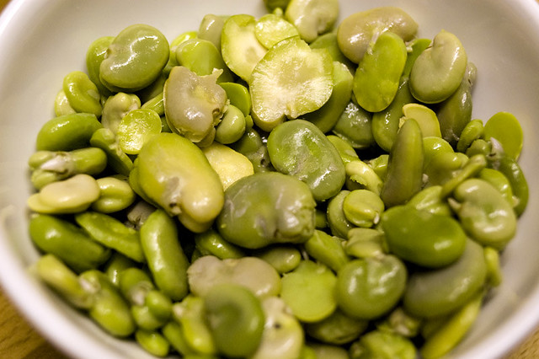
History and religion
Local ingredients and religion have played key roles in shaping the food in the region.
Dates, fava beans, chickpeas, and barley are staples as locally sourced ingredients, while lamb and mutton became the predominant meat because of religious laws banning pork.
Religious practices in the area also paved the way for a worldwide drink - coffee. The stimulating drink was brewed to help people stay awake for evening worships, particularly during Ramadan.
With the holy shrines of Christianity, Islam and Judaism located in the Middle East, millions of pilgrims visit the region every year and enjoy the food and culture.

Slide 15
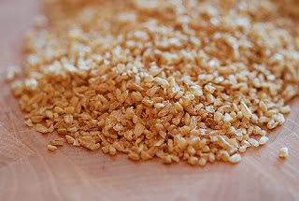
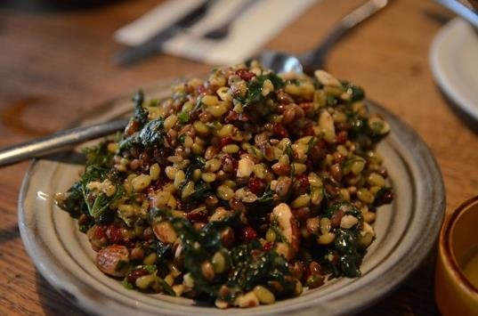
Staple food
Grains form the basis of the Middle Eastern diet where wheat and rice are considered staple foods. Barley is also widely used in the region and maize has become more popular in some areas.
In addition to bread, wheat is also used in burghul and couscous.
Burghul is cracked wheat made by partially cooking wheat grains in water, drying them in an oven (or in the sun), and breaking them into pieces. It is typically cooked in water with flavourings.
Freekeh is another common grain, made from immature green wheat.
Different types of rice are grown and eaten in the region, often being served with grilled meats and stews.
Burghul
Freekeh

Slide 16
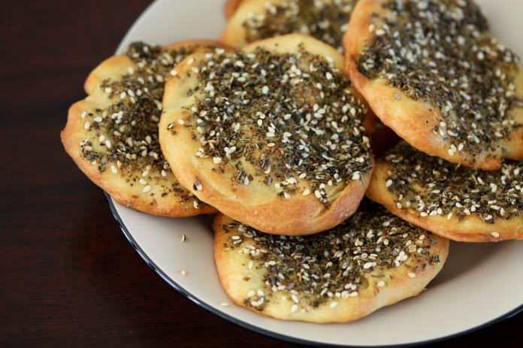
Bread
Fresh baked bread is very popular and is often eaten with meals. The most popular type of bread is pitta, one of the oldest types of bread in the world.
Pitta is also known as Arabic bread, Lebanese bread, or Syrian bread. Pitta is a leavened and flat type of bread and differs from country to country in terms of cooking technique and shaping.
Manaeesh is one of the most common flatbread recipes in Middle Eastern cuisine. It is a type of flatbread mixed with soft white cheese, za’atar (a traditional spice blend), and olive oil.
This bread is crispy on the sides and soft in the middle. It’s a great breakfast and lunch dish that is made in the size of a small pizza.
Manaeesh

Slide 17
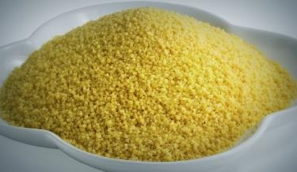
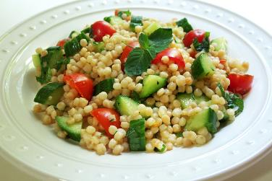
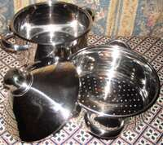
Couscous
Although couscous looks like a grain, it is actually a pasta. It is made with semolina flour from durum wheat, mixed with water.
There are three different types of couscous:
Moroccan, which is the smallest;
Israeli or pearl couscous, about the size of peppercorns; and
Lebanese, the largest of the three.
Most of the couscous used in the UK is 'quick cook' and requires only a few minutes steeping in boiling water.
Traditional couscous is made in a Moroccan pot called a couscoussier and requires three steamings.
Notes:
Quick cook couscous -
Grind
Before the durum wheat grains can be processed into couscous, they are ground. The whole is sieved, yielding a coarse wheat flour (the semolina).
Moisturizing
In a mixer, one third of water is added to two-thirds of the semolina. The whole is mixed for 3 minutes, making the flour absorb the water and swell to form a coarse paste.
Shaping
The dough is put into a slightly sloping rotating drum, where it turns, in about 7 minutes, into dough balls of different sizes. At the end of the rotating drum, the large lumps within the dough are sieved out.
Steaming
In order to make the starch in the dough balls gelatinize, the dough balls are steamed in a steam cooker for about 15 minutes, at a temperature of 100°C.
Cutting
Because the couscous sticks together during steaming, the whole mixture is cut by with large blades.
Drying
To prolong the shelf life of the couscous, a centrifuge is used to remove 22% of the moisture from the couscous. This process will take about 18 minutes. By using this method, a moisture content of approximately 12% is obtained. This amount of moisture is necessary to prevent the product from becoming dehydrated when packaged.
Cooling
After being placed on a oscillating conveyor, the couscous grains are guided to a cooling chamber, where they are cooled for two minutes.
Sorting
The cooled couscous can now be sorted according to size, by using a shaking sieve. This step allows for the fine and medium couscous grains to be separated from each other. Too small or too large couscous grains are kept apart so that they can be processed again.
Packing
After optionally being stored temporarily in storage silos, the couscous is filled by a packaging machine in bags or boxes. The packages are placed in cardboard boxes or wrapped in plastic, after which they are ready for transportation.

Slide 18
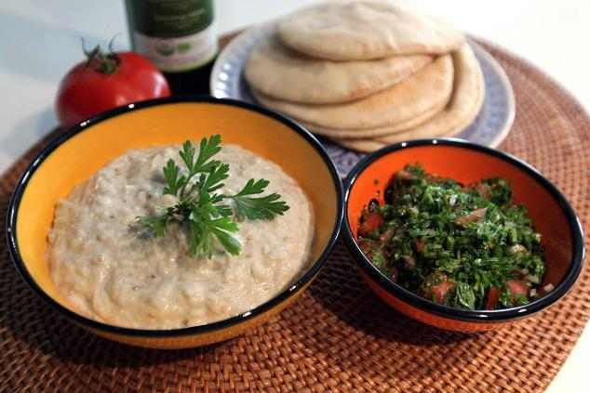
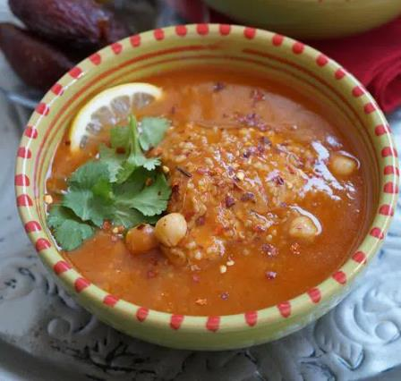
Popular dishes from the region
Frik soup is a common dish in Middle Eastern cuisine, especially in Jordan, Egypt, Lebanon, and Syria. This soup is made from freekeh which is dried, roasted and cleaned. Tomatoes, chickpeas, and local spices are added to chicken, beef, mutton, or lamb and is served with lemon.
Baba ganoush is a vegetarian favourite. It is a smooth and creamy dip made with roasted aubergine and tahini, ideal for dipping pita, flatbread or vegetables.

Slide 19
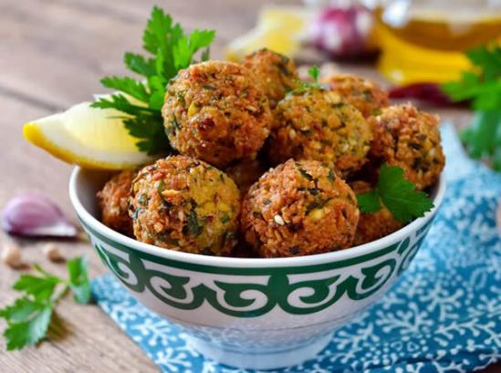
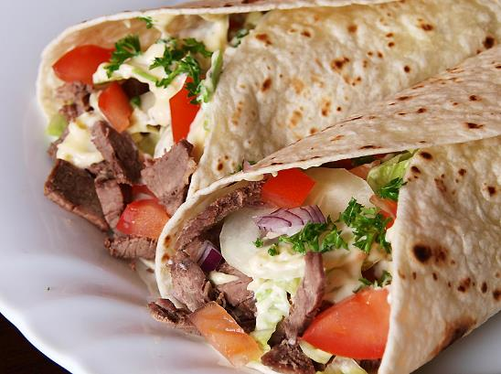
Street food and snacks of the region
Falafels (a fried chickpea ball often served in pita bread with salad and sauce) and shawarmas (sliced meat often in a wrap with salad and sauce) are two of the best known Middle Eastern foods. They are popular throughout the world and can be bought in restaurants and on the streets.
Falafels originated in Egypt where they were made with fava beans. As the snack spread northwards fava beans were replaced with chickpeas.
Falafels are made from mashed dried chickpeas mixed with onions and herbs. The mixture is shaped into meatball-size balls and deep fried.

Slide 20
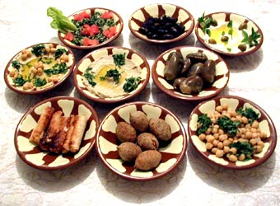
Meze
Meze (also spelled mezze) is popular throughout the Middle East – it means small plates. Meze often makes up an entire meal, combining both cold and hot, vegetarian and meat items.
Mezzes may include baba ganoush, hummus, kibbeh and salads such as tabouleh or fattoush. Flatbreads, olives, pickles, and nuts typically accompany a mezze.
Other dishes vary depending on the region and include grilled calamari, octopus salad, Tulum cheese, stuffed vine leaves, pinto beans in olive oil, and many more.

Slide 21
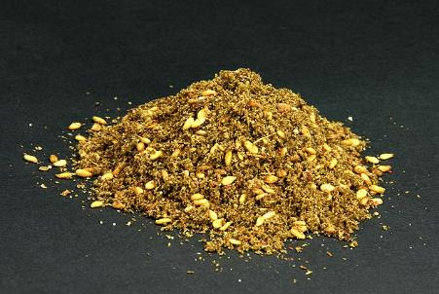
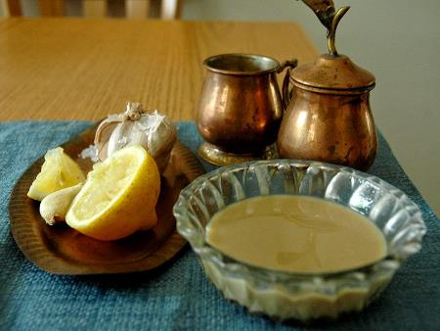
Ingredients
Za’atar. A common Middle Eastern spice blend, also means “wild thyme.” The thyme is crushed together with sumac and sesame seeds* to form the spice blend, but there are many variations depending on the region.
Tahini. A paste made from ground, hulled sesame seeds, and oil. Sesame seeds* are also common in Middle Eastern cooking, particularly in sweet pastries and bread.
Barberries are small red berries similar to cranberries. They grow in the same areas as saffron and the two are often used together. They are used to flavour rice pilaff and often in stuffing for chicken dishes. The berries are also very high in pectin so are often used in jams or jellies.
*Check the list of ingredients for any potential allergens and consider alternatives. For more information on allergens.
Notes:
The 14 allergens are: celery, cereals containing gluten (such as barley and oats), crustaceans (such as prawns, crabs and lobsters), eggs, fish, lupin, milk, molluscs (such as mussels and oysters), mustard, peanuts, sesame, soybeans, sulphur dioxide and sulphites (at a concentration of more than ten parts per million) and tree nuts (such as almonds, hazelnuts, walnuts, brazil nuts, cashews, pecans, pistachios and macadamia nuts).

Slide 22
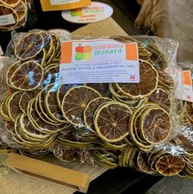
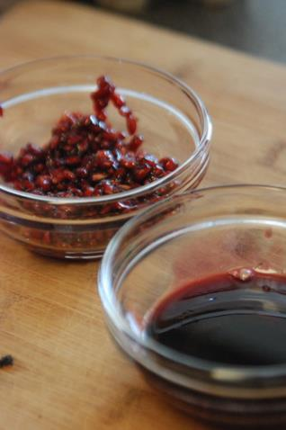
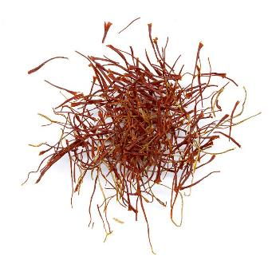
Ingedients
Dried limes (limoo amani) also known as black lime is a lime which has been dried and is used whole, sliced or ground. They add a smoky, sour flavour to dishes and are often used is soups and stews.
Pomegranate molasses. Pomegranate molasses is, made by boiling and reducing pomegranate juice with a little sugar and lemon juice. This makes a thickened syrup with a much stronger flavour. It can be used in dishes, in a marinade or glaze.
Saffron. The delicate threads of saffron provide flavour to numerous Middle Eastern dishes - from delicious Persian rice with almonds and raisins to roasted lamb.

Slide 23
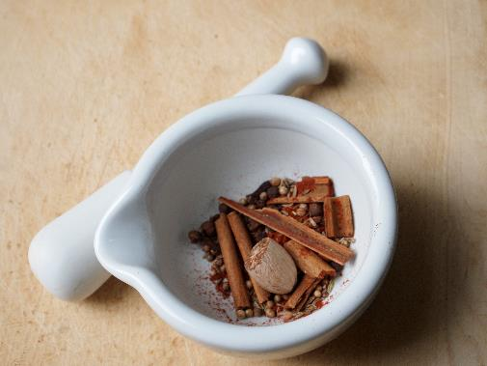
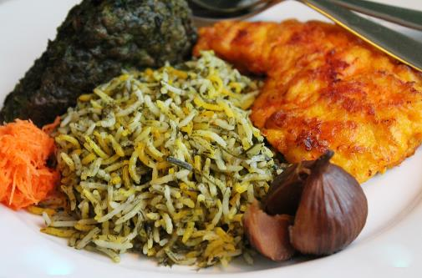
Did you know?
Bahārāt means spices in Arabic.
It refers to a combination of spices whose exact blend can differ by country and region (and sometimes even by household).
Usually, the blend includes black pepper, cardamom, cumin, cloves, coriander, cinnamon, nutmeg, and paprika.
Persian New Year, (20 March 2022) known as Nowruz is celebrated throughout Iran and Central Asia when families gather to prepare festive dishes and welcome the beginning of spring.
The first meal is always fish with herb rice – fresh herbs are also added to bean and noodle soup or a frittata (Kuku sabzi), both served on the first day of the festival.

Slide 24
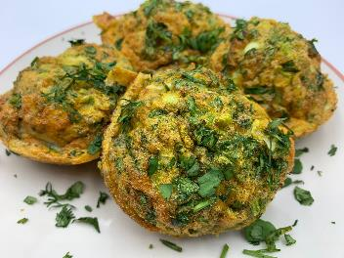
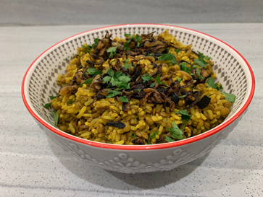
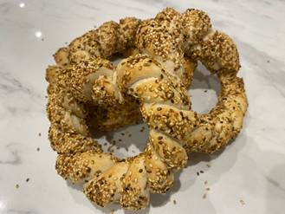
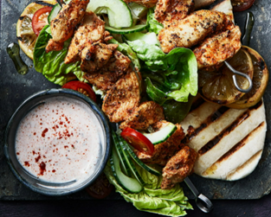
The recipes
Recipes that will be available on the Food – a fact of life website:
Black bean and red pepper shakshuka
Chicken shawarma flatbreads with yogurt
Chicken shish kebabs
Ful medames
Ful medames dip with quick flatbreads
Herby Persian frittata
Middle Eastern rice (Mejadra)
Middle Eastern style baked eggs
Pea and mint falafel
Simit bread

Slide 25
Simit bread
Why are we doing this?
Learning in lesson: focus on skill/knowledge, not recipe.
Medium complexity recipe from a world cuisine that would work well in the secondary classroom.
Made and cooked within an hour, ideal for shorter lessons.
Demonstrates a wide range of basic food skills.
Uses ingredients that are easy to source, inexpensive and stored at ambient temperatures.
Nutrition science: Starchy carbohydrates in the diet.
Food science: Gluten formation, the effect of cooking (coagulation, dextrinisation), Maillard reaction.
Maths: Weighing, measuring, dividing, time, temperature.
English: Reading and following a recipe, following written and verbal instructions.

Slide 26
Simit bread
Ingredients
250g strong white flour
1 x 7g sachet fast action dried yeast
1 x 5ml spoon sugar
1 x 5ml spoon salt
150ml warm water
50g sesame seeds*
50ml molasses
50ml water
Method
5. Add enough warm water to flour mixture to make a soft dough. Mix with a spoon at first and then use one hand to bring together as a dough. Use the other hand to hold onto the bowl.
6. Knead the dough firmly for ten minutes.
7. Cut the dough into eight equal pieces. Roll each piece into a long sausage, approximately 30cm in length.
8. Squeeze the ends of two strands together. Twist the strands over each other and then loop into a ring. Squeeze the ends together to secure. Repeat with the remaining strands to create four twisted bread rings.
9. Dip one of the bread rings into the molasses and water mixture, turning over so that both sides are covered.
10. Dip the ring into the sesame seeds, again turning over to make sure that both sides are well covered. Place on the lined baking tray.
11. Repeat with the remaining rings.
12. Place the baking tray into a COLD oven and turn up the temperature immediately to the highest setting.
13. Remove from oven after approximately 15 – 20 minutes and cool on a cooling rack.
Method
Line a baking tray with greaseproof paper.
Gently dry fry the sesame seeds in a frying pan over a low heat for 3-5 minutes, until lightly toasted. Remove from the heat and spread on a large plate.
Mix the molasses and 50ml water in a bowl large enough to dip the shaped simit bread in.
Sieve the flour, yeast, sugar and salt into a large mixing bowl. Stir well.

Slide 27
Simit bread - review
Skills and knowledge developed and demonstrated | Practicalities in the secondary classroom | Alternatives – ingredients, cooking methods …
Practical food skills: Weigh, measure, sift, mix, knead, portion and divide, form and shape, bake, glaze.
Nutrition science: Starchy carbohydrates in the diet
Food science: The effect of cooking: coagulation dextrinisation
Sensory science: Testing, tasting and evaluation.
Maths: Weighing, measuring, dividing, time, temperature.
English: Reading and following a recipe, following written and verbal instructions.
Ingredients (purchase, storage, providing)
Equipment
Demonstration area
Baking (safe use of oven)
Shaping and forming – ‘production line’
Different flours – e.g. wholemeal, seeded
Use alternative toppings – be aware of allergies
Add spices/herbs - chilli powder, cayenne pepper,
chopped fresh basil
Gluten free flour
Fill with white cheese (such as feta) and tomatoes or homemade soft cheese
Make kaşarlı simit – form the dough into a ‘canoe’ shape and fill with cheese and heat in the oven

Slide 28
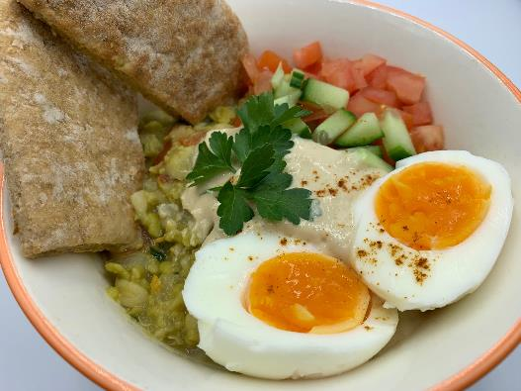
Ful medames
Why are we doing this?
Learning in lesson: focus on skill/knowledge, not recipe.
A medium-high complexity recipe (when made with sauce and garnish).
Made and cooked within an hour, ideal for shorter lessons.
Demonstrates a wide range of basic food skills but can be extended to allow for differentiation.
Uses ingredients that are easy to source, inexpensive and stored at mostly ambient temperatures.
Nutrition science: Protein sources (eggs), vegetables and pulses in the diet.
Food science: Heat transfer, coagulation.
Maths: Weighing, measuring, time, temperature.
English: Reading and following a recipe, following written and verbal instructions.

Slide 29
Ful medames
Ingredients
1 small onion
1 garlic clove
1 tomato
Spray oil
½ x 5ml spoon ground cumin
1 x 300g can fava beans or broad beans
1 lemon or 2 x 15ml spoons lemon juice
100ml water
1–2 eggs per person
Wholemeal pitta bread
Tahini sauce - optional
50g tahini*
35ml water
2 x 5ml spoons lemon juice
Garnish – optional
10g fresh parsley
1 tomato
¼ cucumber
Cayenne pepper
Method
Prepare the ingredients:
  peel and dice the onion;
  peel and crush the garlic;
  dice the tomato;
  drain and rinse the beans.
Place the eggs in a pan of cold water. Bring to the boil and cook for ten minutes. After ten minutes, remove from the heat and run the eggs under cold water. Peel and cut in half.
Spray a small saucepan with oil. Add the chopped onion and half the garlic and fry gently for 2-3 minutes.
Add the ground cumin, beans, diced tomato, 2 x 15 spoons lemon juice and 100ml water.
Bring to the boil and then simmer for 10 to 15 minutes.
Remove from the heat and roughly mash the beans with a fork or potato masher.
Method – Tahini sauce (optional)
Place the tahini, remaining garlic, 35ml water and 2 x 5ml spoons lemon juice in a small bowl.
Whisk together until smooth. The mixture might split initially but will become smooth with further mixing.

Slide 30
Ful medames - review
Skills and knowledge developed and demonstrated | Practicalities in the secondary classroom | Alternatives – ingredients, cooking methods …
 | Use of allergenic ingredients – risk assessment, parental/carer permissions, alternative ingredients
Nutrition science: Protein sources (eggs), vegetables and pulses in the diet.
Food science: Heat transfer, coagulation.
Sensory science: Testing, tasting and evaluation.
Maths: Weighing, measuring, time, temperature.
English: Reading and following a recipe, following written and verbal instructions.
Different varieties of beans
Dried beans
Try different spices – cayenne pepper for a kick!
Use cumin seeds instead of ground
Make flatbreads or pitta bread
Make a quick dip version using tahini or yogurt/cream cheese
Safe use of the hob and heat control

Slide 31

Food – a fact of life: How can we help?
Food – fact of life website.
Resources for 3 – 16 years.
Progressive approach.
Supporting teaching about healthy eating, cooking, where food comes from.
Curriculum compliant.
Tried and tested recipes.
My dashboard – store collections of recipes and resources in your own online area.
Personal and professional development (PPD) for teachers.
www.foodafactoflife.org.uk

Slide 32

Good practice guidance
Characteristics of good practice in teaching food and nutrition education in primary and secondary schools, as well as supporting pupils with additional needs.
Guides to help food and nutrition teachers across the UK to become even better teachers. The guides exemplify characteristics of good practice.
There are also free online training courses based on the ‘Characteristics’ guides.
https://www.foodafactoflife.org.uk/professional-development/ffl-training/

Slide 33
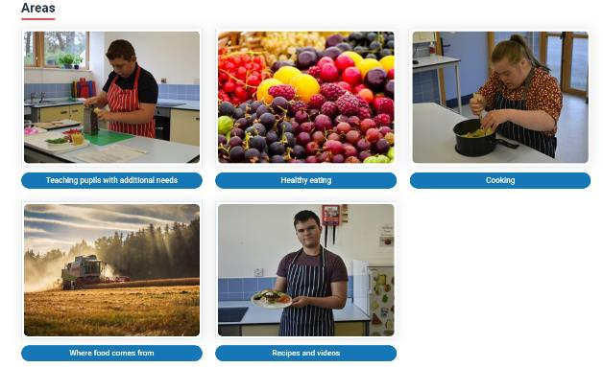
Resources to support pupils with additional needs
A framework and structure for teaching around the key themes of Healthy eating, Cooking and Where food comes from.
Nine key areas.
All resources fully editable.
Peer-to-peer recipe videos and recipes with Widgit© Symbols.
New! Resources to support developing skills for independent living.
Pupils with additional needs

Slide 34
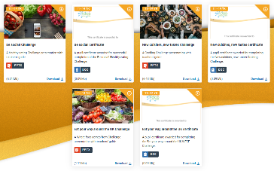
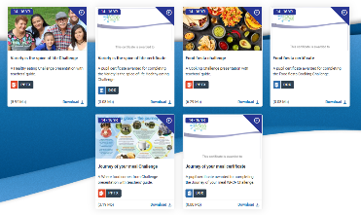
Challenge activities
The Challenges cover Healthy eating, Cooking and Where food comes from and provide a wide range of activities that teachers can select depending on their pupils’ needs, age and abilities, and the time available.
there are 12 Challenges developed to be used with nursery, primary or secondary pupils;
each Challenge presentation comprises:
  slides to present the Challenge to the class, including images, information and questions/tasks to stimulate pupil discussion and planning;
  a teachers' guide with opportunities for learning and a variety of pupil activities that can be completed individually or in groups.
11-14 years and 14-16 years

Slide 35
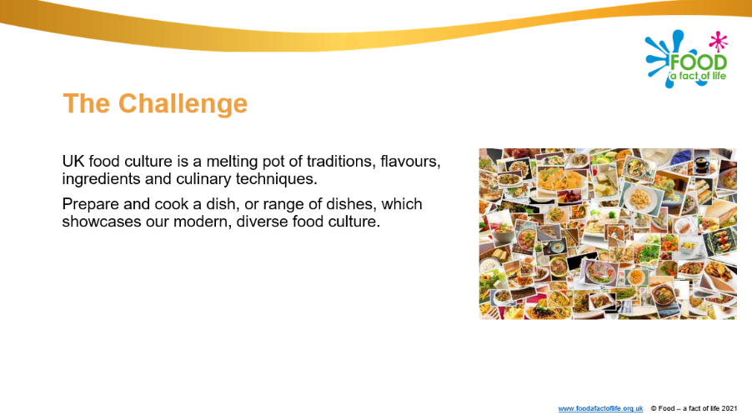
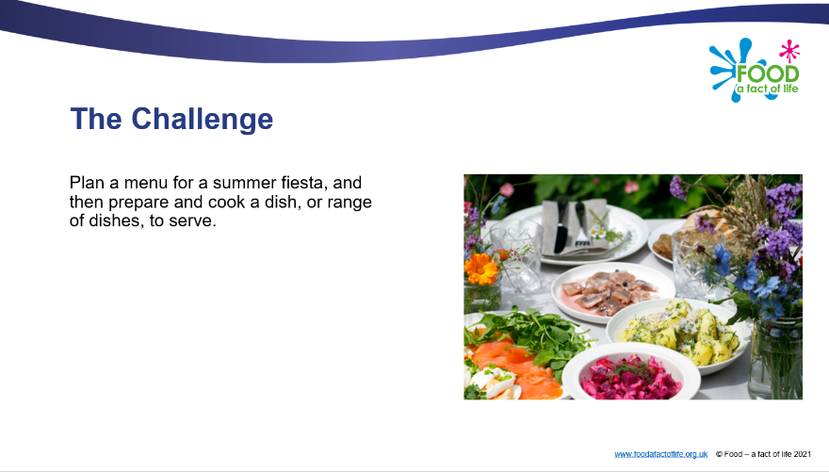
Diverse food culture Challenges
11-14 years and 14-16 years

Slide 36

Whole school support
Encouraging a whole school approach– food policies, provision, breakfast clubs and healthy lunchboxes.
Parental engagement activities and resources – breakfast, eat well, healthy lunchboxes, healthy hydration, physical activity and sleep.
Curriculum, qualifications and frameworks.
Guidelines for producers and users of school education resources about food.
BNF Healthy Eating Week 13-17 June 2022 Register now!
Careers in food.

Slide 37

Professional development
Training (conferences, workshops, webinars, online modular)
PPD Toolkit (primary and secondary) – your professional development, good practice, room design)
Teaching and learning – planning and teaching; teacher knowledge and skills; resources; curriculum
PPD newsletter – sign-up!

Slide 38
Other FFL resources
Classroom resources and activities | Teaching and learning | Personal and professional development (PPD)
Bread activity pack Fibre activity pack Harvest activity pack Knowledge organisers 11-14 and 14-16 Nutritional analysis Quizzes 11-14 Quizzes 14-16 Remote learning resources Videos – cooking Videos – where food comes from | Good food hygiene and safety practices Planning sheets Resources and presentations Resources to support UK examination specifications Schemes of Work Teaching and learning videos Practical food skill progression and complexity rating | FFL training PPD toolkit Schemes of Work and lesson planning – advice and support Teacher knowledge and skills
Links to resources that focus on topics covered in today’s workshop can be found in your joining instructions.

Slide 39
Thank you for joining!
For further information, go to:
www.foodafactoflife.org.uk

