Slide 1
Simple spring rolls
Complexity: medium

Slide 2
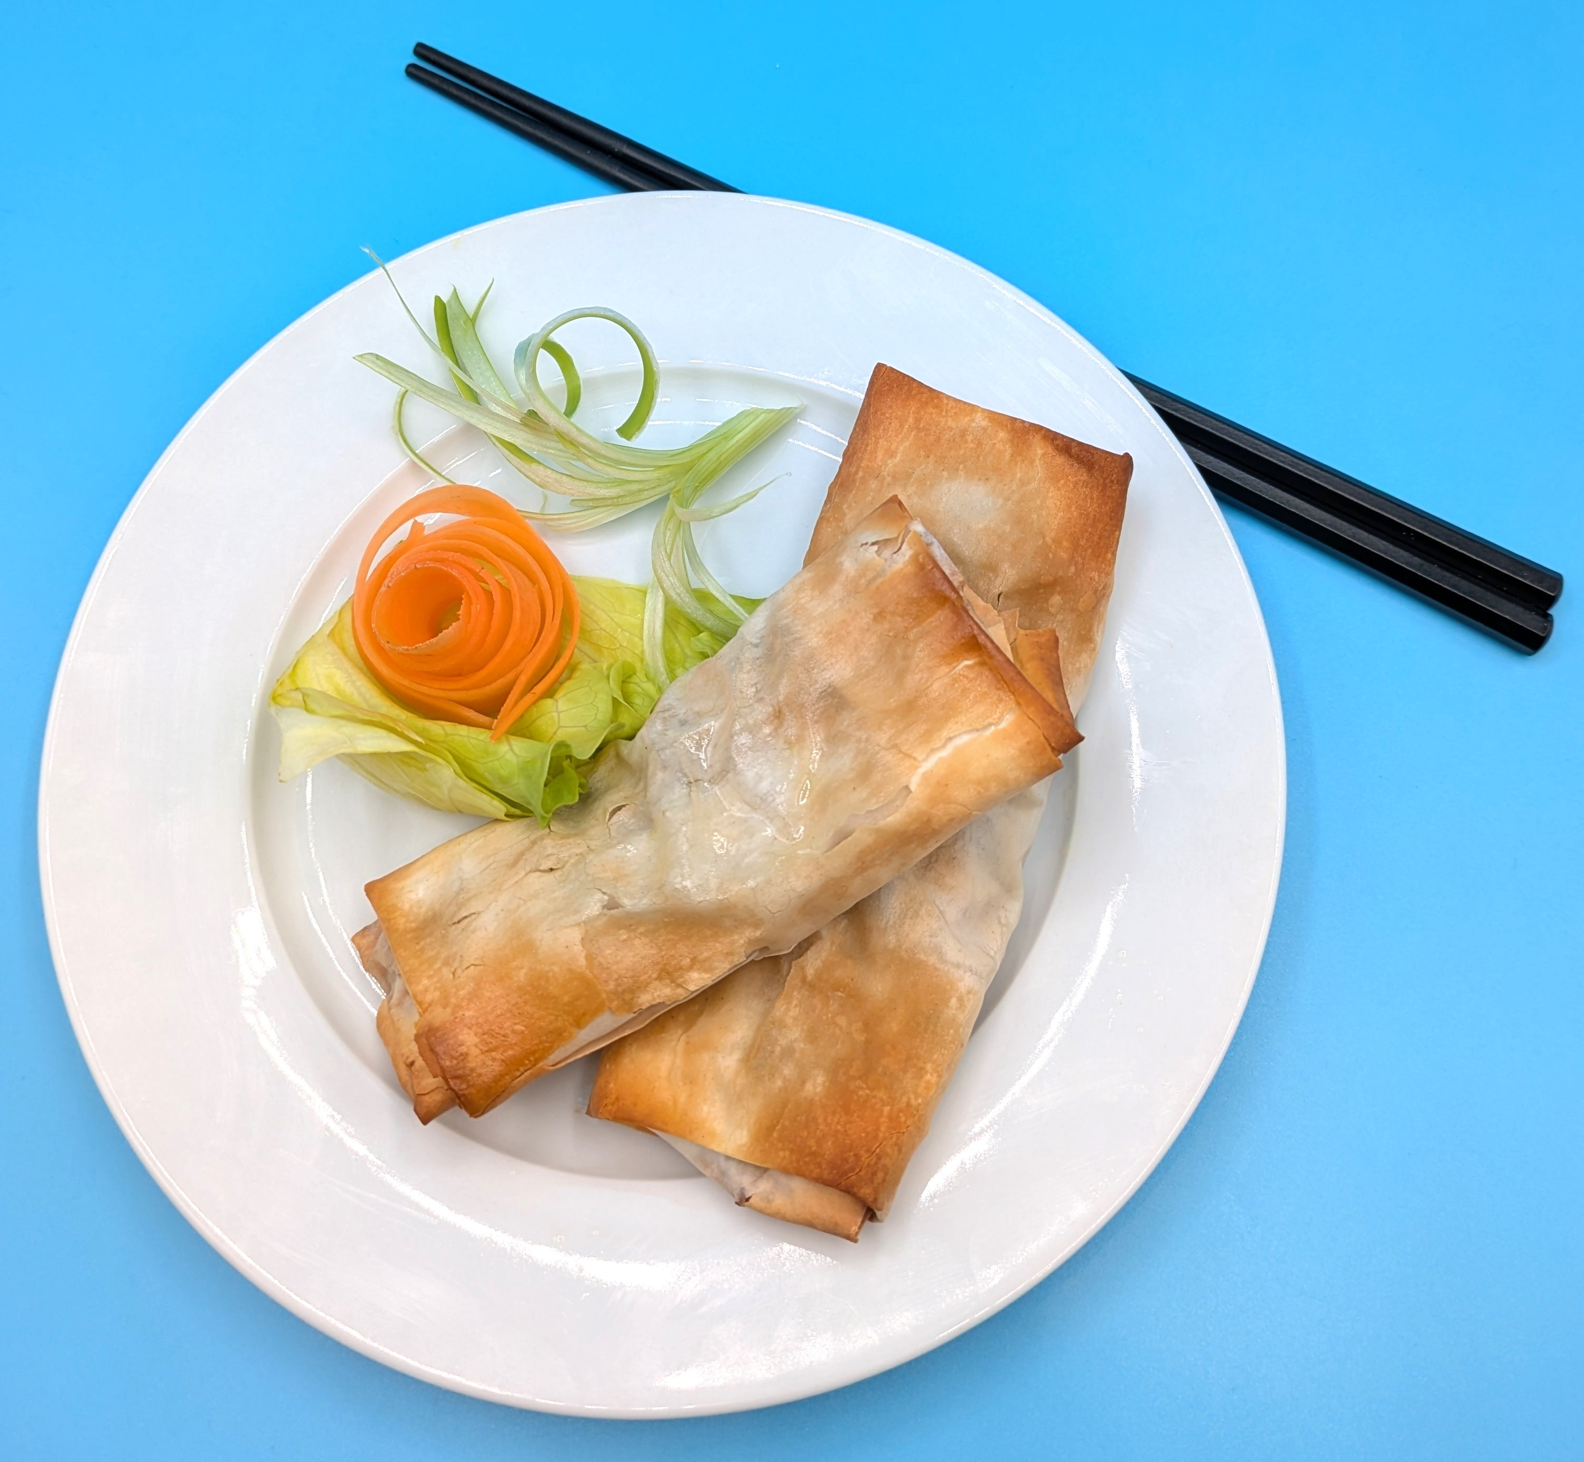
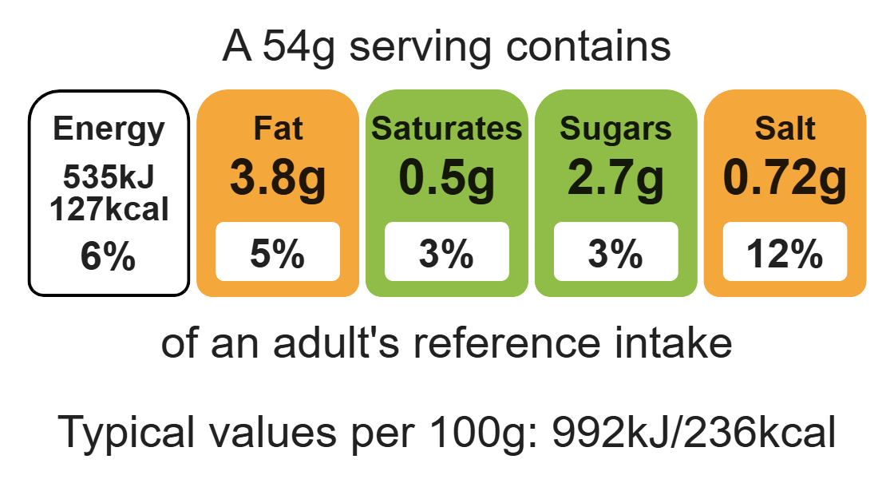
Nutritional analysis
Serves 2

Slide 3
Starter activity
True or false?
Oven gloves should only be worn to take food out of the oven?
We should eat two portions of fish per week?
The bridge cut is used to slice vegetables?

Slide 4
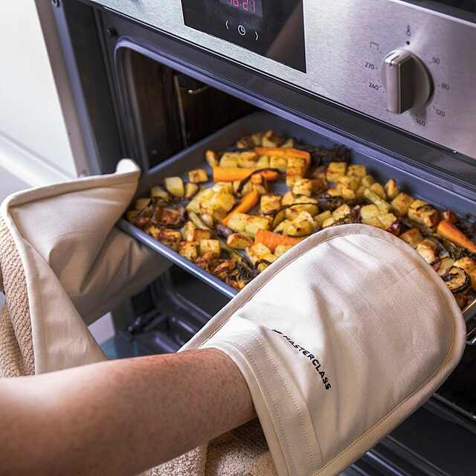
Starter activity
True or false?
Oven gloves should only be worn to take food out of the oven?
False; oven gloves should be worn to place food in and take out of the oven. The oven will be hot.
2. We should eat two portions of fish per week?
True; one of which should be oily.
The bridge cut is used to slice vegetables?
False; the claw grip is used to slice vegetables.

Slide 5
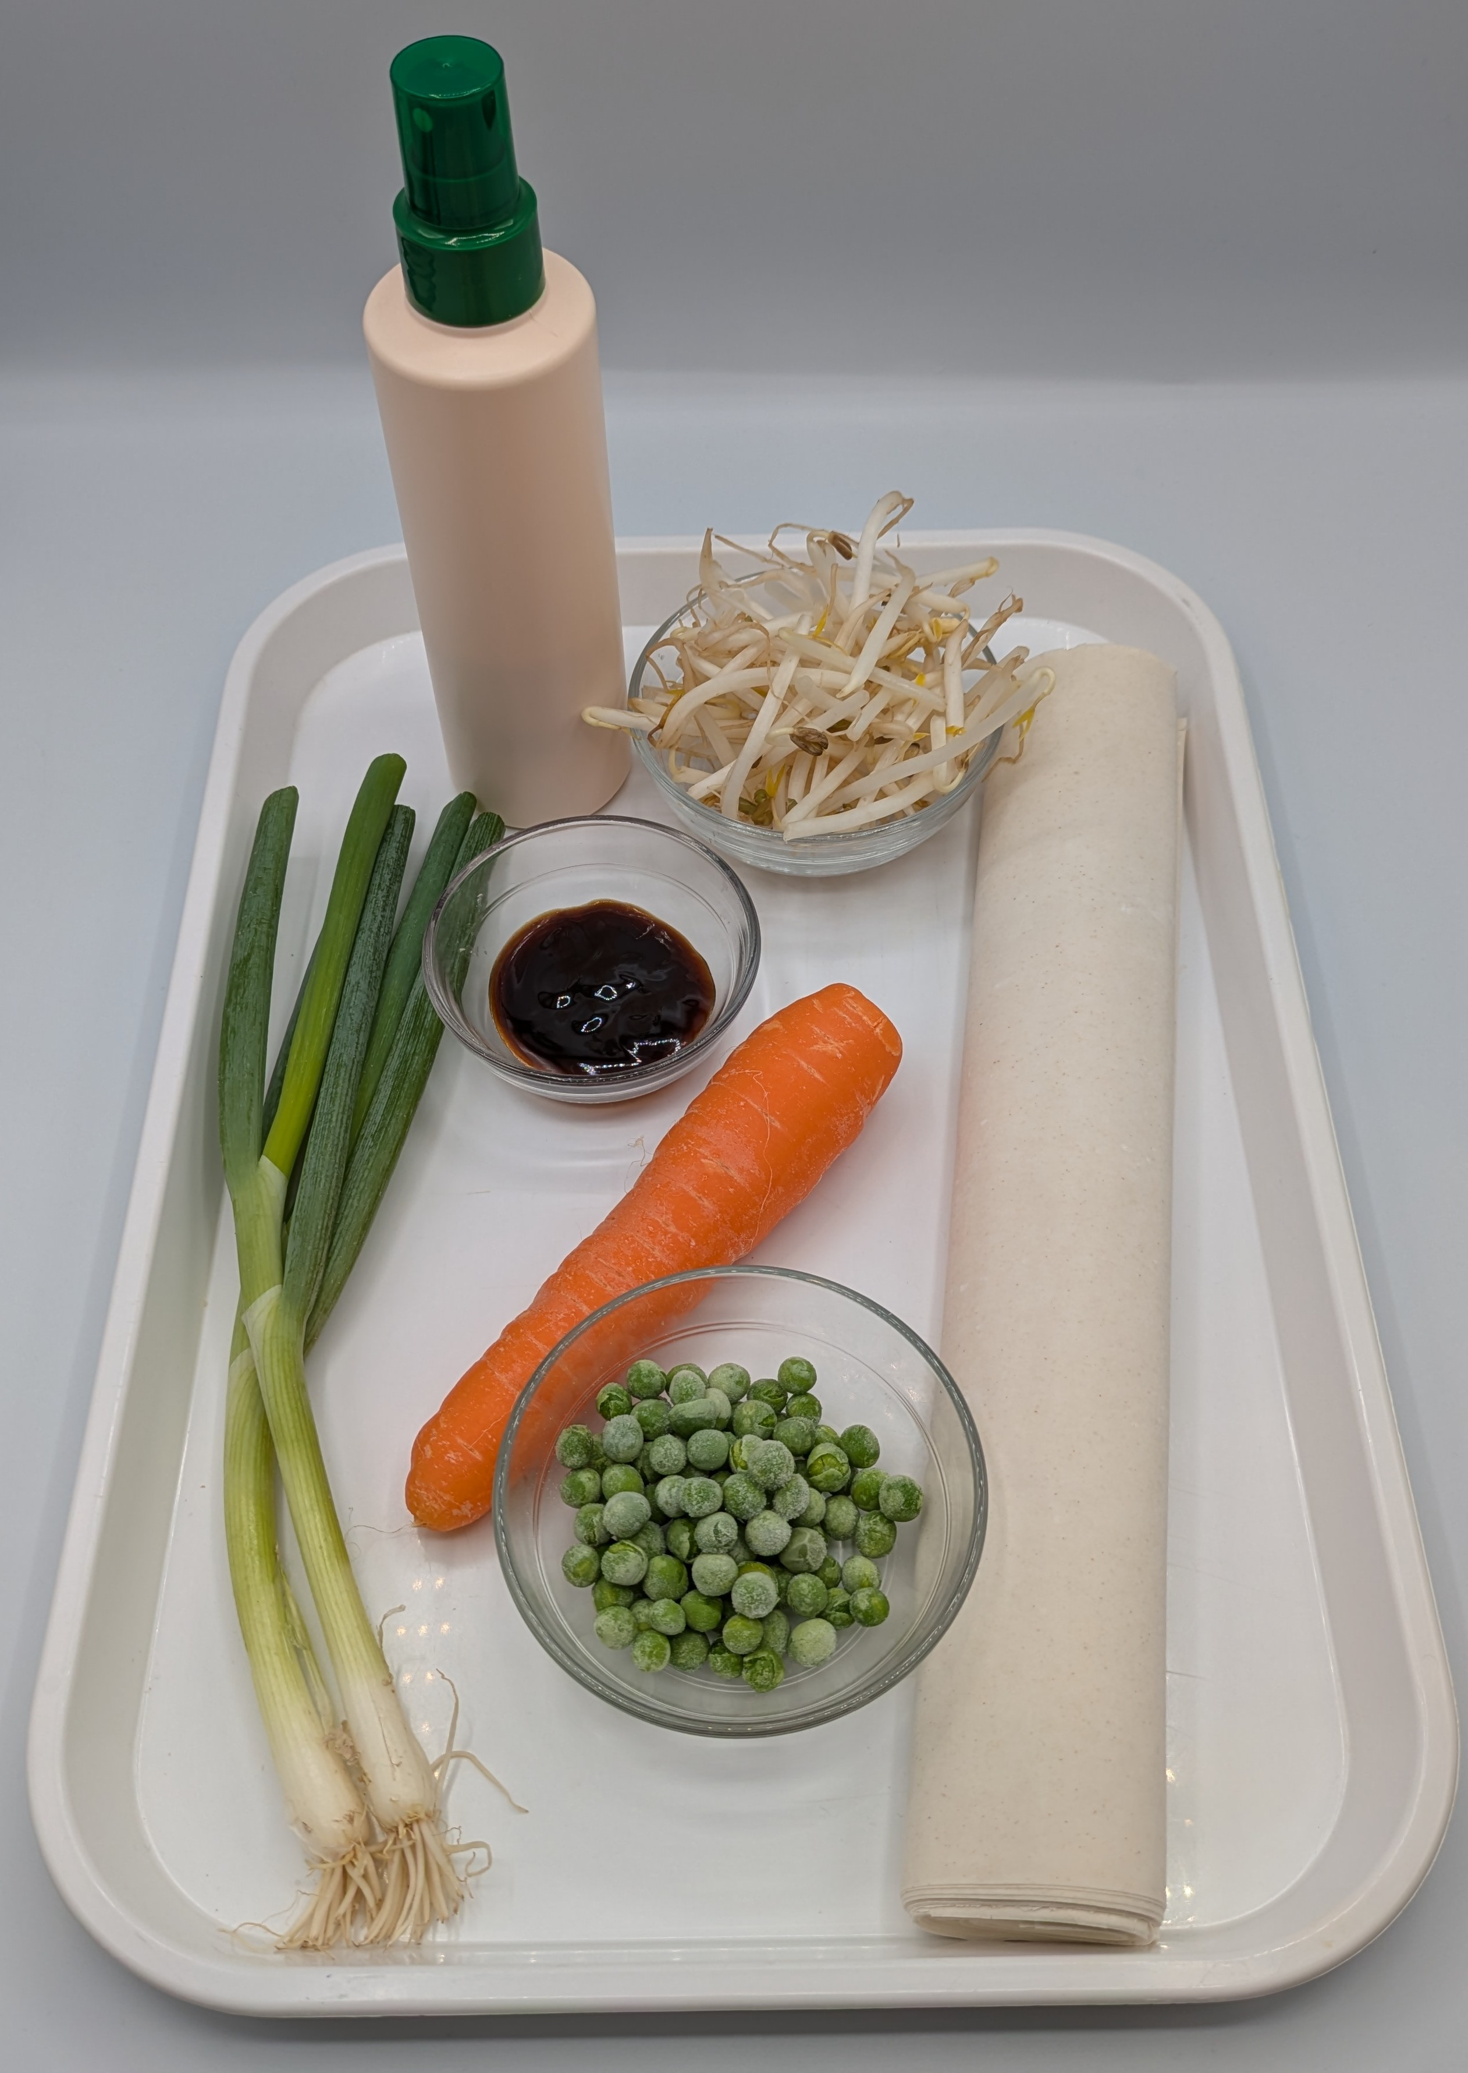

Ingredients (serves 2)
1 carrot
2 spring onions
40g beansprouts
25g frozen peas
1 x 15ml spoon oyster sauce
4 filo pastry sheets
1x 15ml spoon oil or spray oil
Check for any food allergy, intolerance, special dietary requirement or religious/cultural reasons for not handling or eating the ingredients in this recipe.

Slide 6
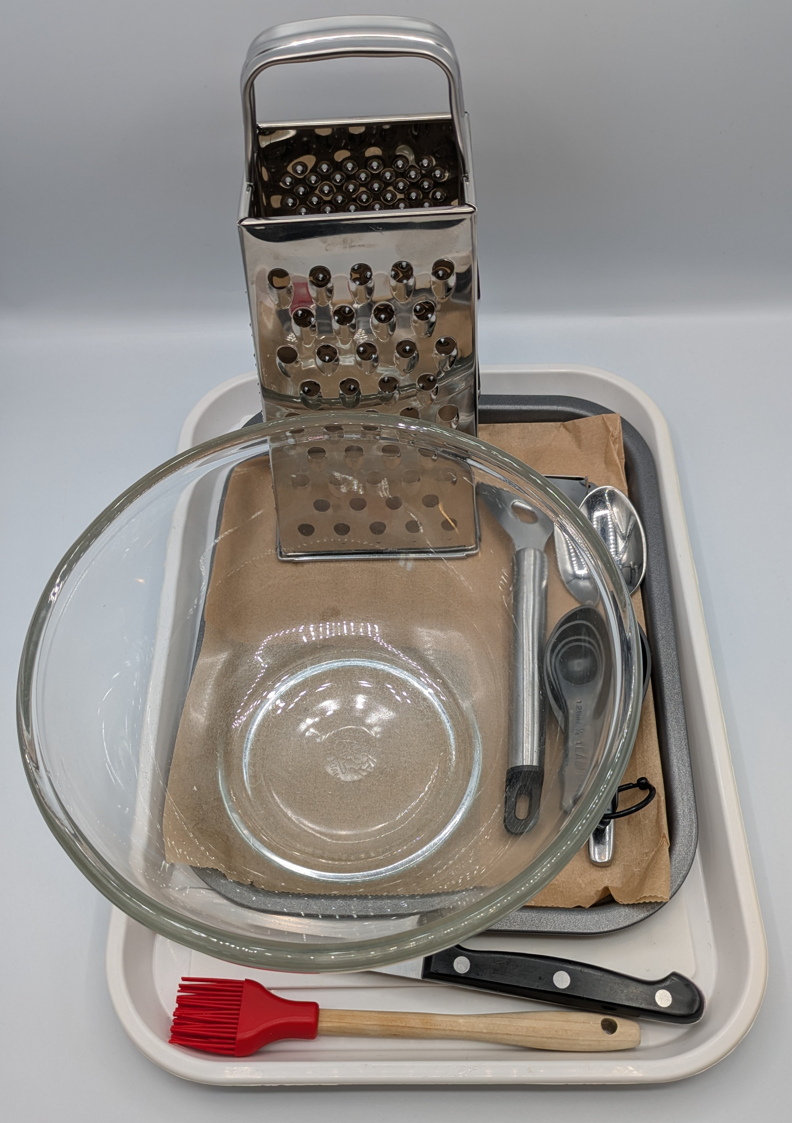
Equipment
Chopping board
Sharp knife
Vegetable peeler
Grater
Mixing bowl
Measuring spoons
Metal spoon
Baking tray
Pastry brush

Slide 7
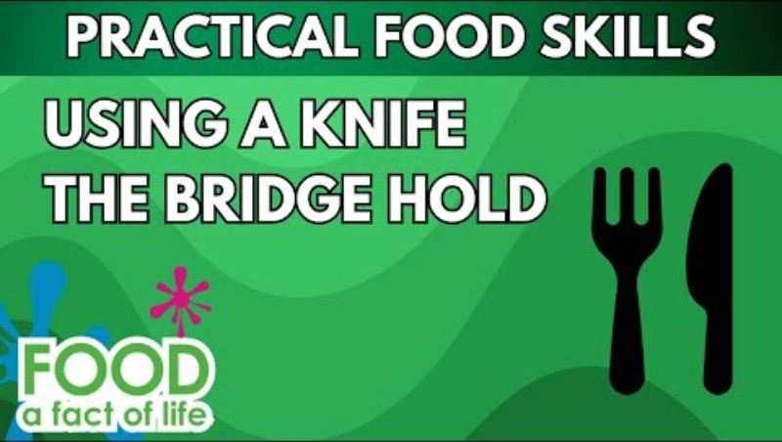
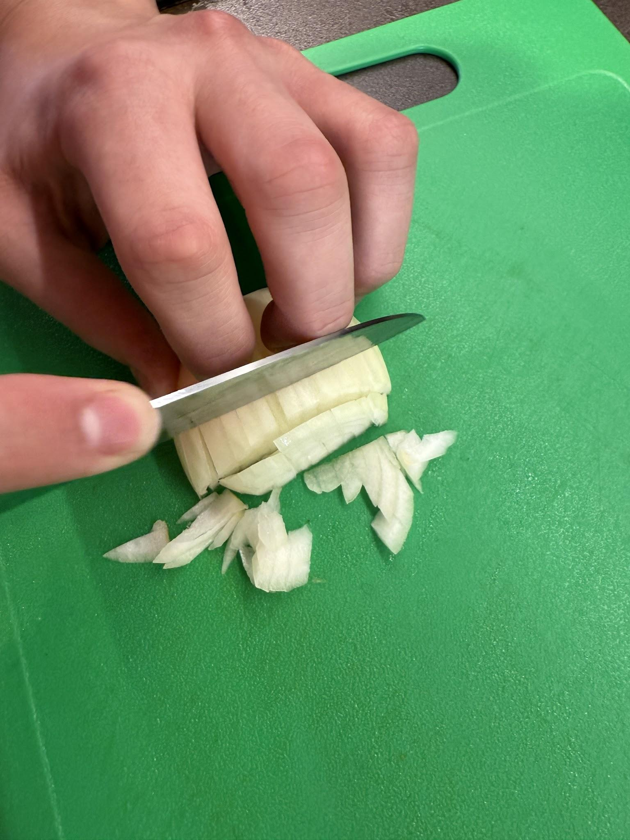
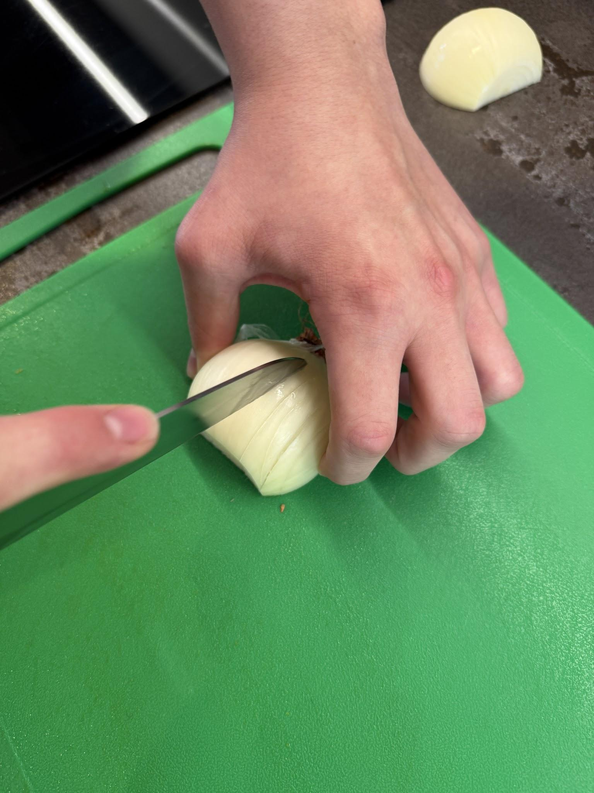
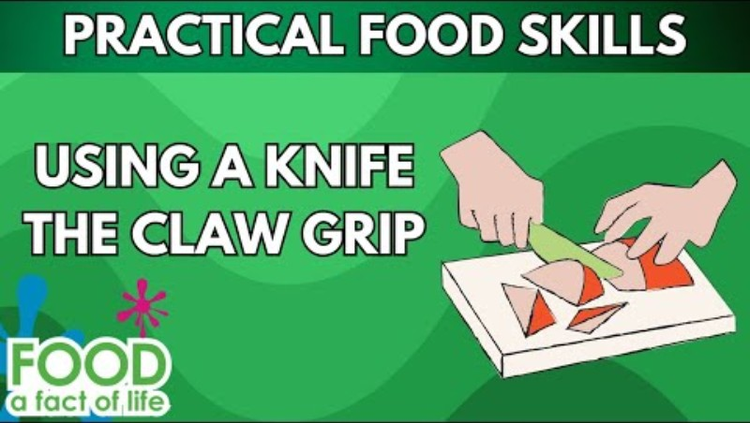
Food skills
Click below to watch the bridge hold.
Weigh
Measure
Grate
Cut
Chop
Dice and trim
Stir and combine
Portion
Divide
Fold
Glaze and coat
Bake
Click below to watch the claw grip.

Slide 8
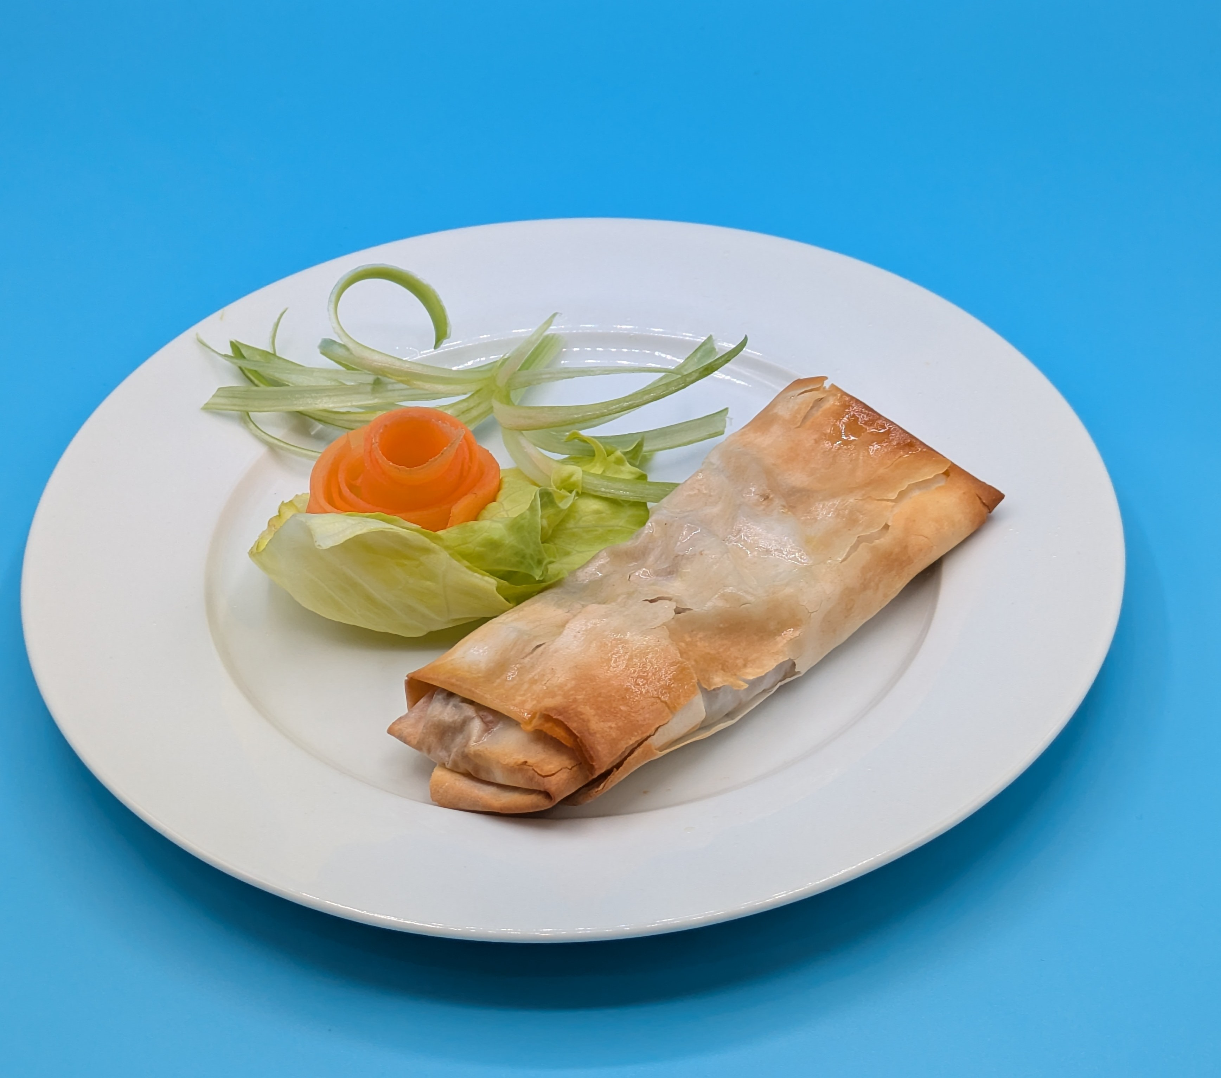
Method
Preheat the oven to 200°C or gas mark 6.
Prepare the spring roll filling:
top, tail, peel and grate the carrot;
slice the spring onions into rings.
In a large mixing bowl add the grated carrot, spring onions, beansprouts, peas and oyster sauce.
Mix the ingredients together.
Place the filo pastry sheets on the work surface.
Halve the pastry sheet and work on one half at a time.
Spoon a little vegetable mixture along the top edge.
Fold over twice.
Fold in the two edges.
Continue to roll up the spring roll.
Place on the baking tray.
Brush with a little oil or spray with oil.
Bake for 15 minutes, until golden.

Slide 9
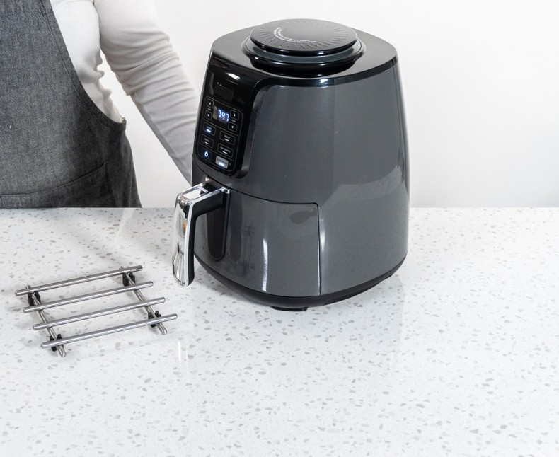
Top tips
Reduce food waste: Try adding different vegetables that need to be used up, e.g. finely diced celery, peppers, cabbage.
Focus on fibre: Sprinkle seeds on top of the spring rolls before you bake them. Be ingredient aware!
The spring rolls could also be cooked using an air-fryer for 15 minutes at 180°C.

Slide 10
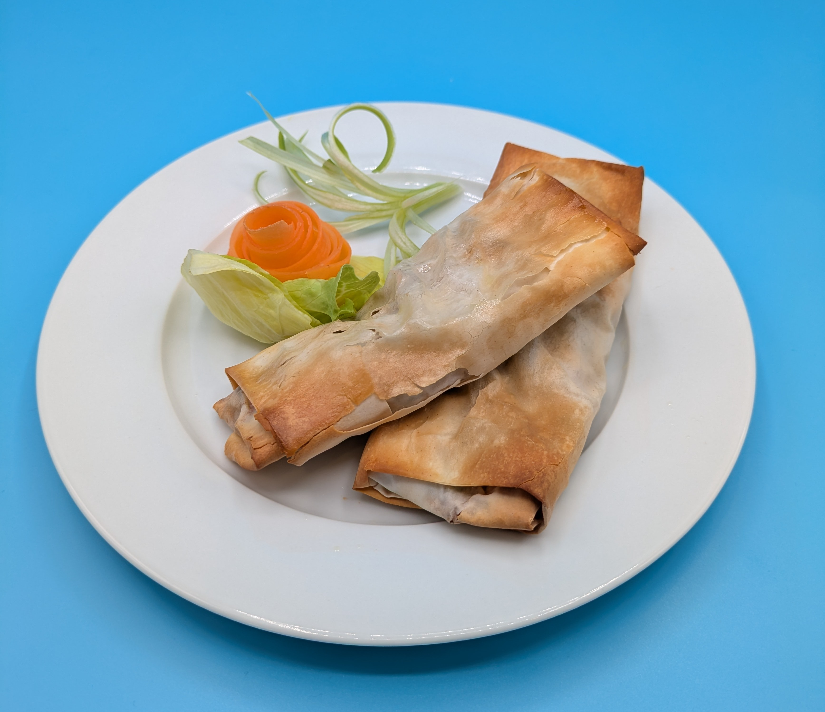
Food science
Glazing
The oil is added to the pastry. When heated this creates a glossy appearance and crispy texture.
Dextrinisation
The starch in the flour (in the pastry) turns to dextrin, causing it to go golden brown under the application of dry heat.

Slide 11
Plenary
Evaluate your simple spring rolls, using the hedonic rating test. Consider how the results can be used to make and justify changes to the recipe.
Hedonic rating test
Name | Dislike very much | Dislike | Neutral | Like | Like very much | Comments
Ask three people to test your dish.

Slide 12

Example responses
Evaluate your simple spring rolls, using the hedonic rating test. Consider how the results can be used to make and justify changes to the recipe.
Hedonic rating test
Name | Dislike very much | Dislike | Neutral | Like | Like very much
Billy
Sofia
Macy
Ask three people to test your dish.

Slide 13
Example responses
Evaluate your simple spring rolls, using the hedonic rating test. Consider how the results can be used to make and justify changes to the recipe.
Hedonic rating test
The dish was mostly liked, no dislikes. It had a good flavour.
The shape was good, I will keep using this method.
People preferred different cooking of veg, some liked crunchy and others not. I will cook for a little longer next time.
Name | Comments
Billy | They tasted great and I liked the oyster sauce flavour. They were well shaped.
Sofia | They had a lovely smell and I liked how crunchy they were.
Macy | The vegtables were a bit crunchy and needed more flavour.

Slide 14
Looking for more…
Extend the learning of your pupils with our principles of making pastry information and worksheet.
This worksheet challenges your pupils to understand the science behind pastry making and identify common faults when making pastry.
If you are looking for a more complex recipe that uses filo pastry, why not try this lesson from the Food – a fact of life Schemes of Work, where pupils make samosas.

Slide 15
Simple spring rolls
For further information, go to:
www.foodafactoflife.org.uk
This resource meets the Guidelines for producers and users of school education resources about food.

