Slide 1
Fruity muffins
Complexity: low-medium

Slide 2
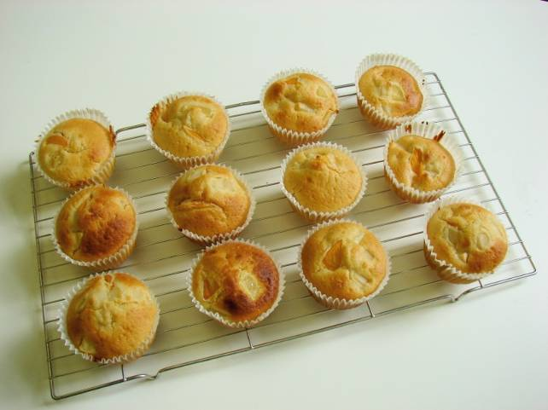

Slide 3
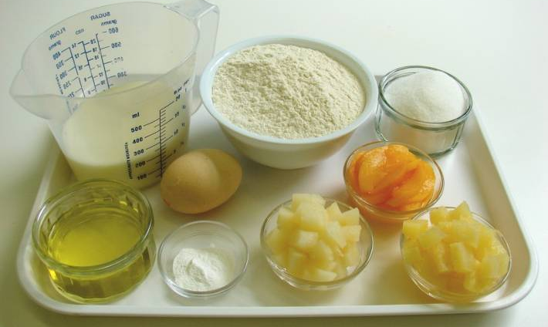
Ingredients
250g self raising flour
2 x 5ml spoons baking powder
100g caster sugar
230ml semi-skimmed milk
1 egg
60ml oil
150g canned fruit, drained

Slide 4
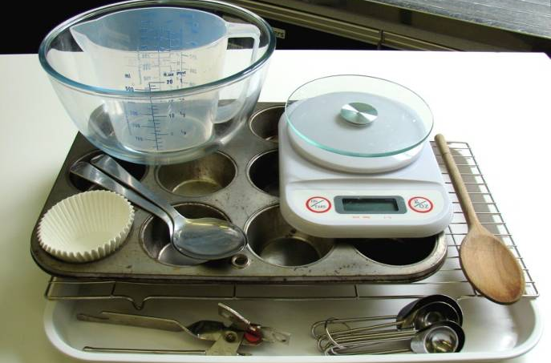
Equipment
Can opener
2 spoons
Cooling rack
12 muffin cases
Muffin tin
Weighing scales
Measuring spoons
Measuring jug
Mixing bowl
Wooden spoon

Slide 5
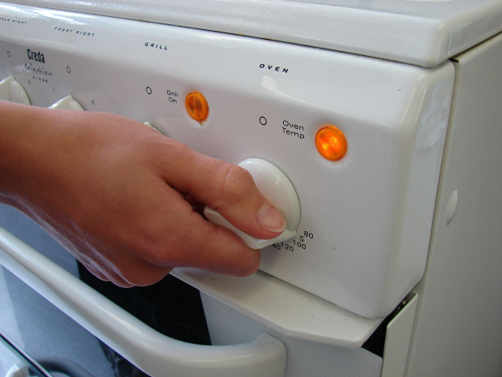
Method
Preheat oven to 180°C or gas mark 4.

Slide 6
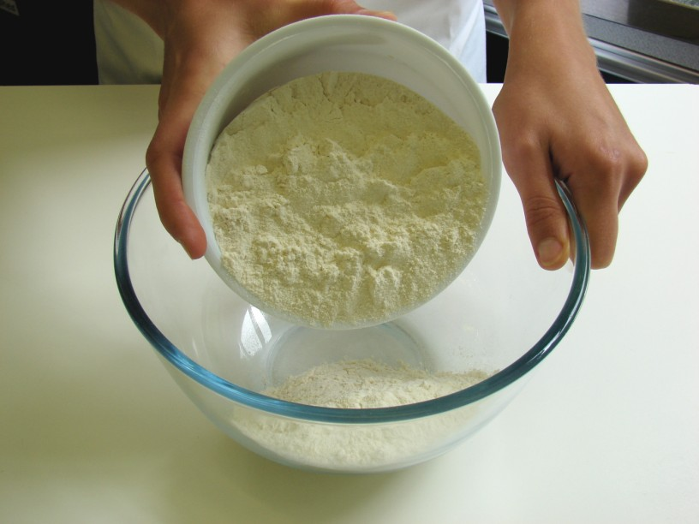
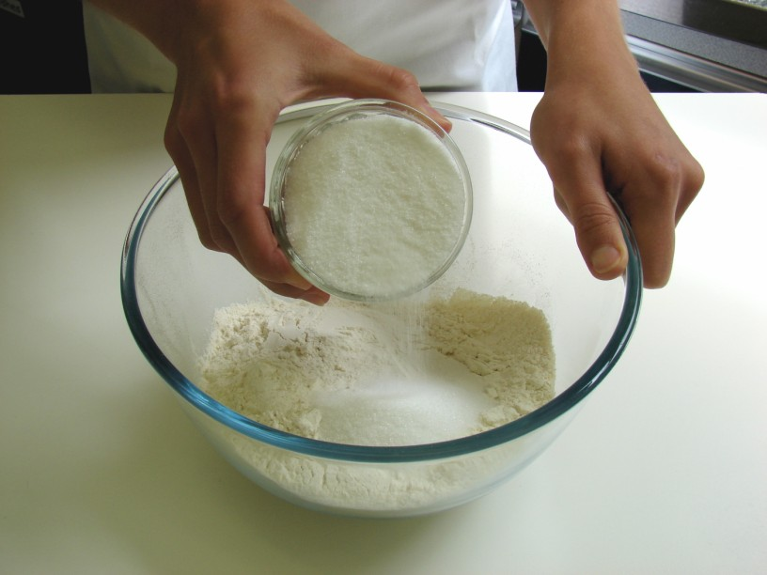
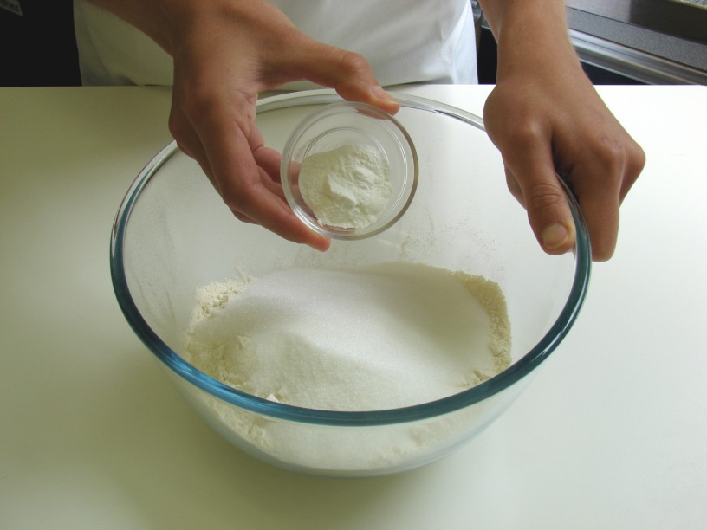
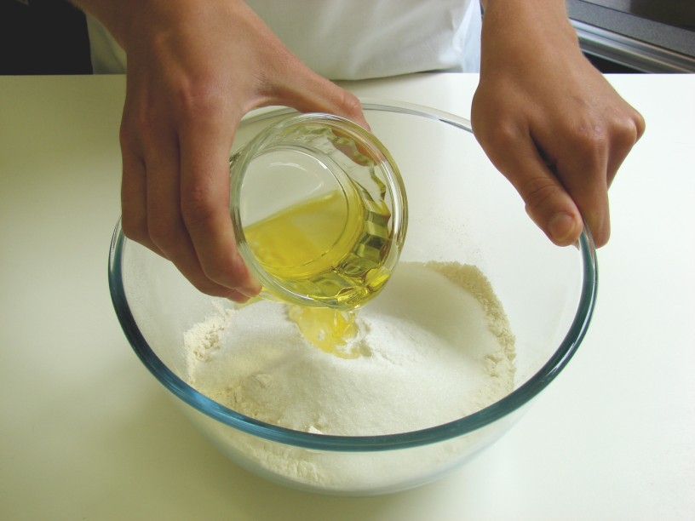
Add the flour, sugar, baking powder and oil.

Slide 7
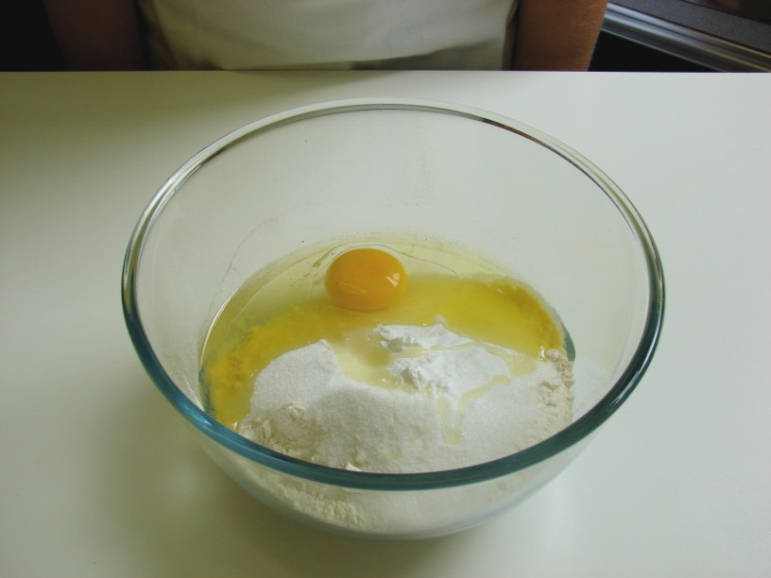
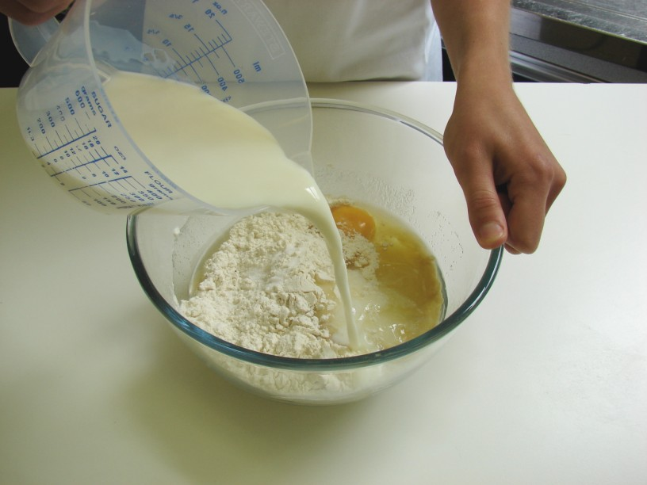
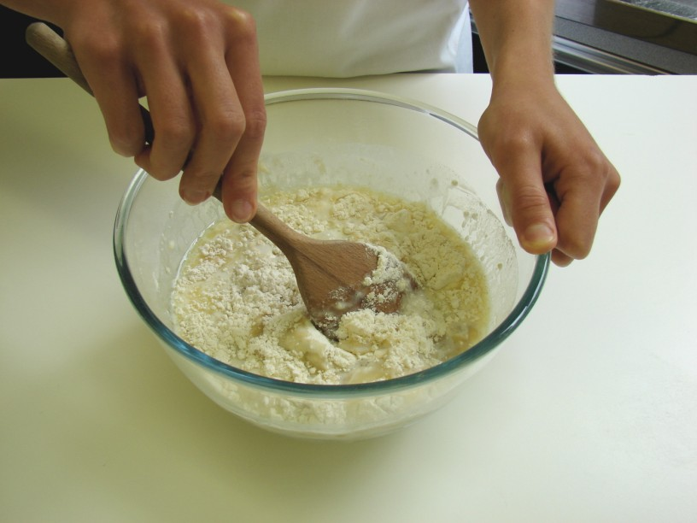
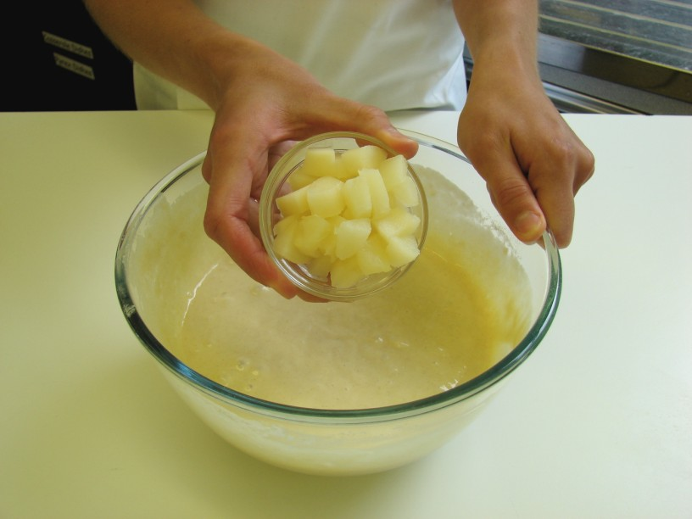
Add the egg and milk, then mix together to form a smooth batter.

Slide 8
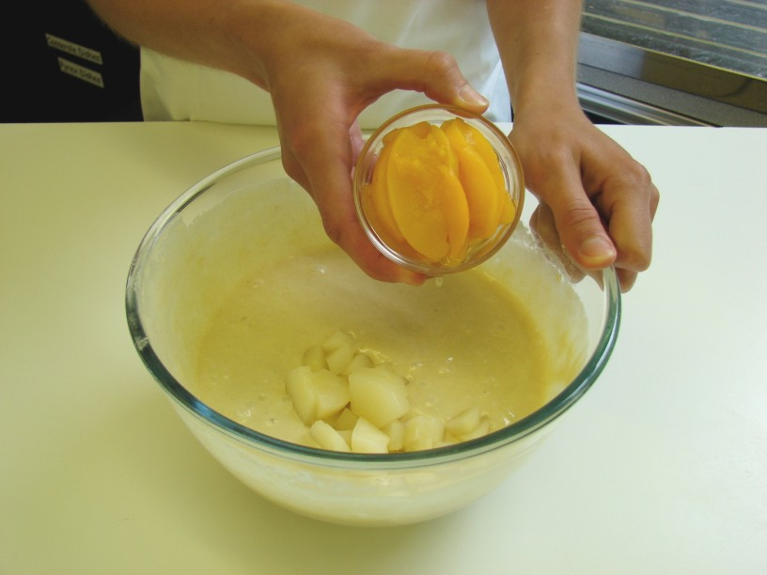
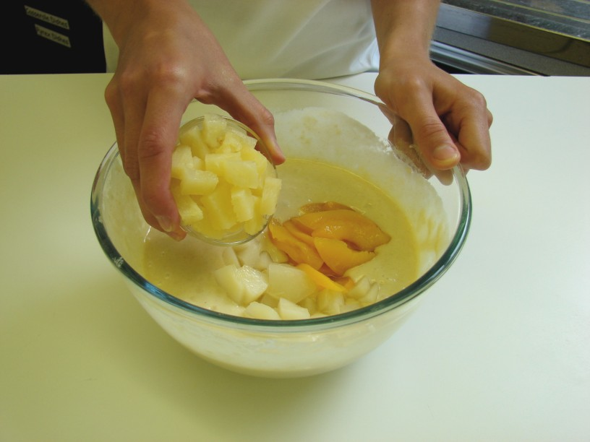
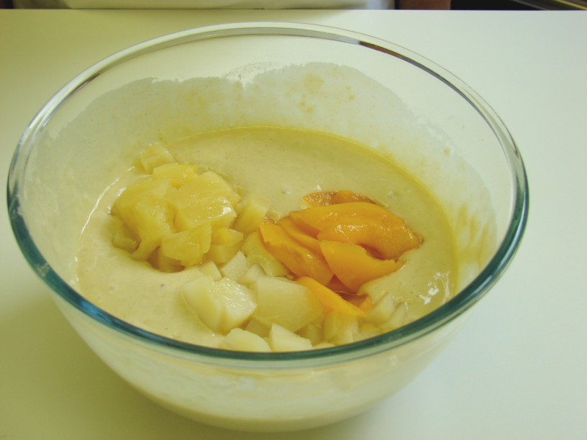
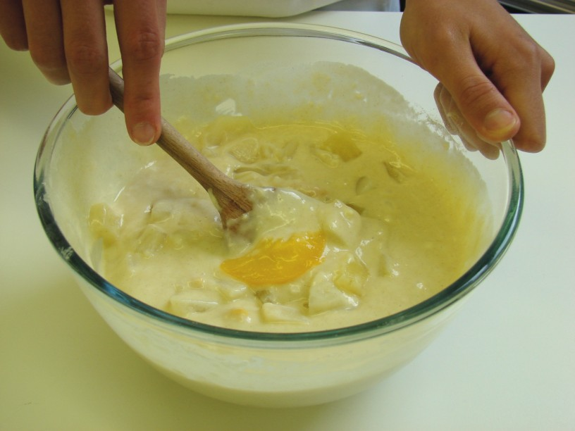
Stir in the fruit.

Slide 9
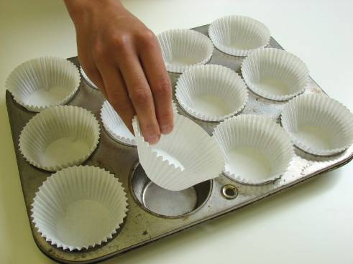
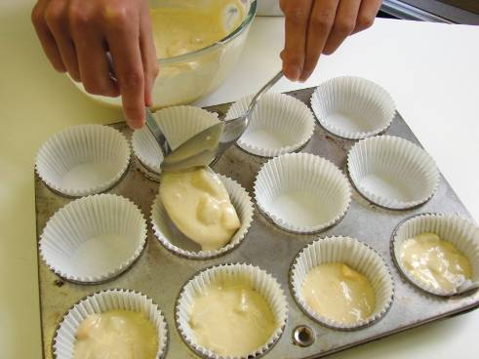
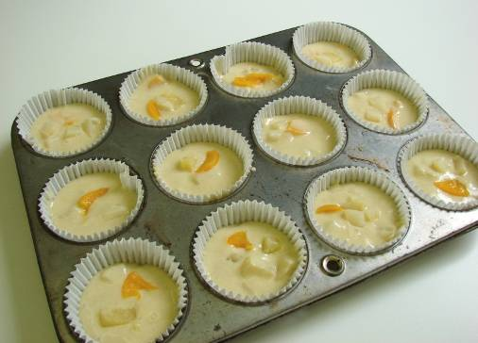
Divide the mixture equally between the muffin cases using 2 spoons.

Slide 10
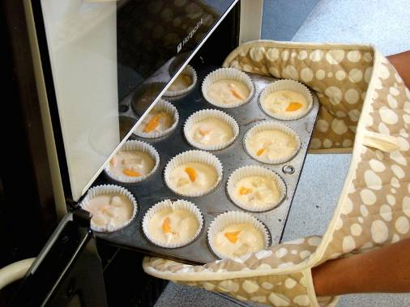
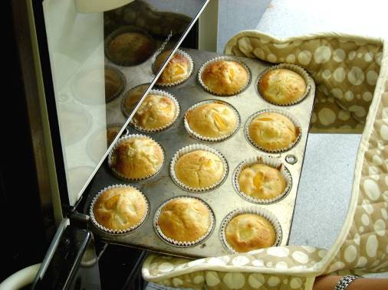
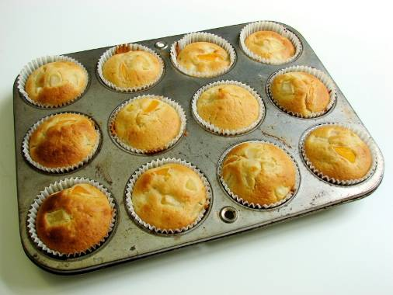
Bake for 20 – 25 minutes, until golden.

Slide 11
Allow to cool on a cooling rack.

Slide 12
Top tips
Food skills
Vary the type of fruit you use. Try bananas, cherries or blueberries. Go for fresh, frozen, canned or dried fruits.
Experiment with different spices, such as cinnamon, ginger or mixed spice.
Weigh.
Measure.
Mix, stir and combine.
Drain.
Divide.
Bake.

Slide 13
Fruity muffins
For further information, go to:
www.foodafactoflife.org.uk

