Slide 1
Minestrone soup
Complexity: medium

Slide 2
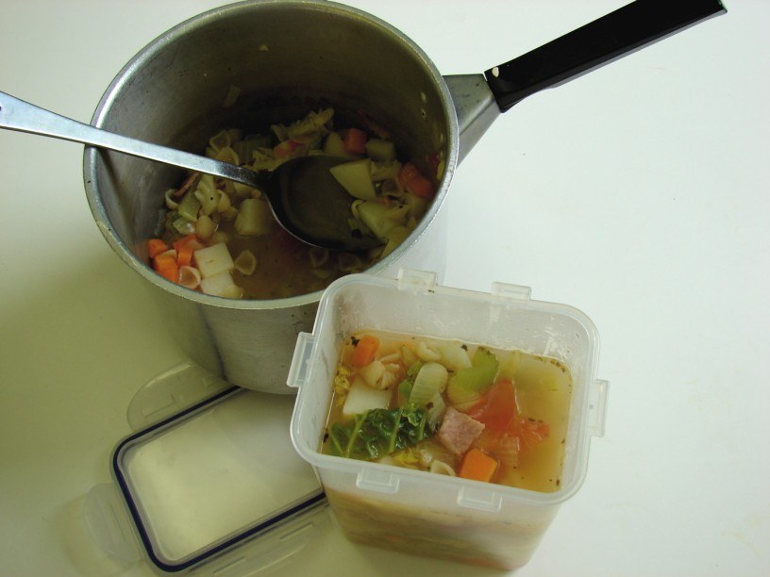

Slide 3
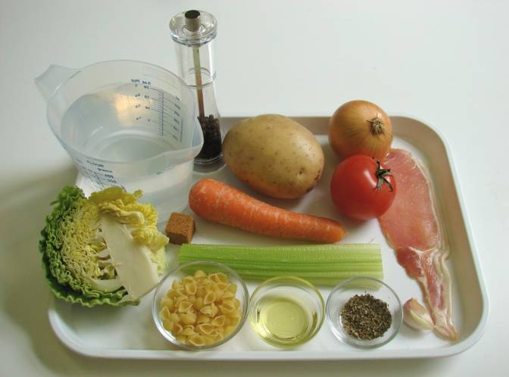
Ingredients
1 clove of garlic
¼ cabbage
1 onion
1 rasher of bacon
1 carrot
1 stick of celery
1 potato
1 stock cube
800ml boiling water
1 x 5ml mixed herbs
Black pepper
25g small pasta shapes or broken spaghetti

Slide 4
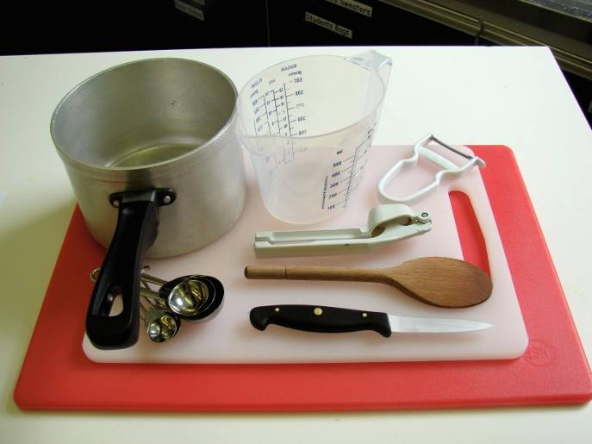
Equipment
Garlic press
2 chopping boards
2 knives
Measuring spoons, saucepan
Peeler
Wooden spoon
Measuring jug

Slide 5
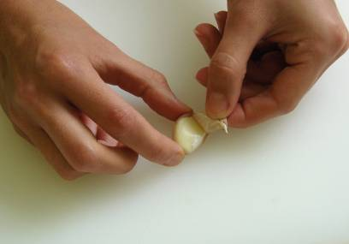
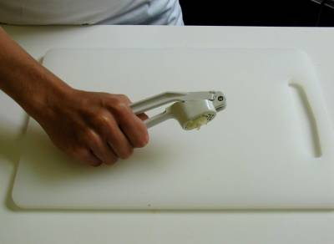
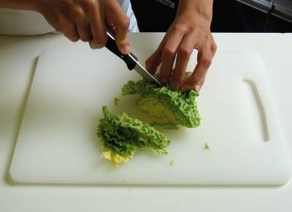
Method
Prepare the vegetables and bacon:
peel and crush the garlic and shred the cabbage;

Slide 6
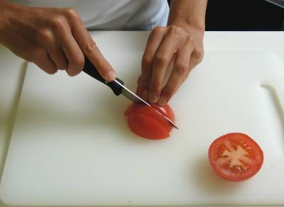
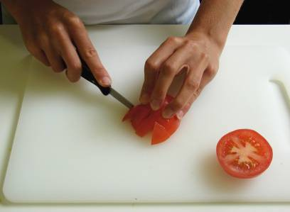
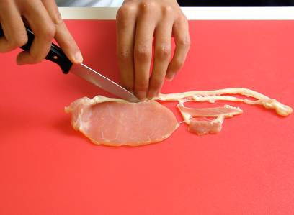
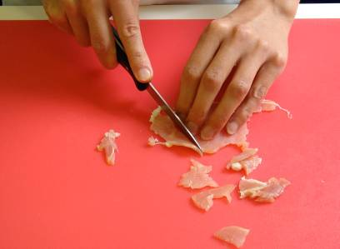
peel and chop the onion;
chop the bacon, with a clean knife on a clean chopping board.

Slide 7
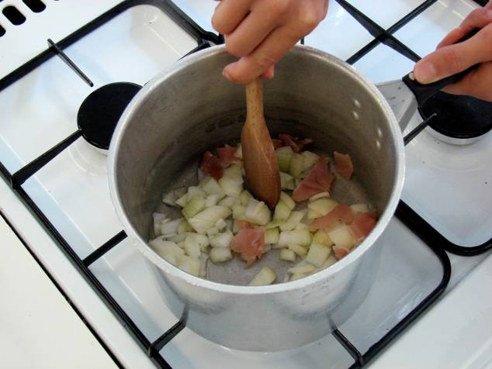
Fry the onion, garlic and bacon in the oil for 2 minutes.

Slide 8
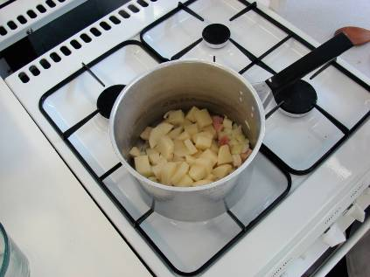
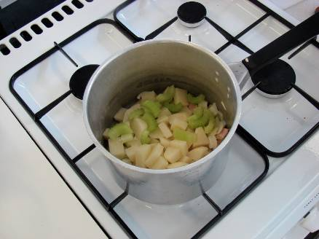
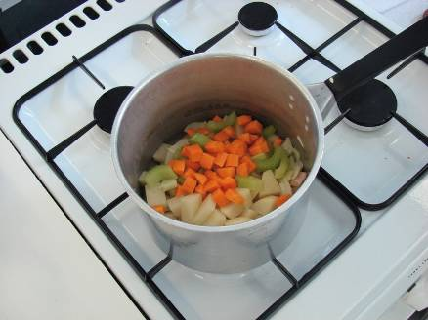
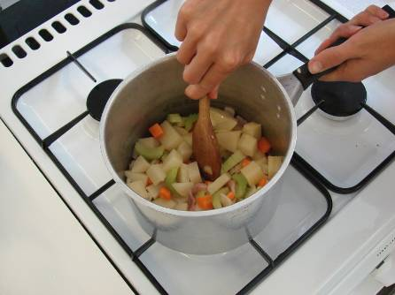
Stir in the potato, celery and carrot.

Slide 9
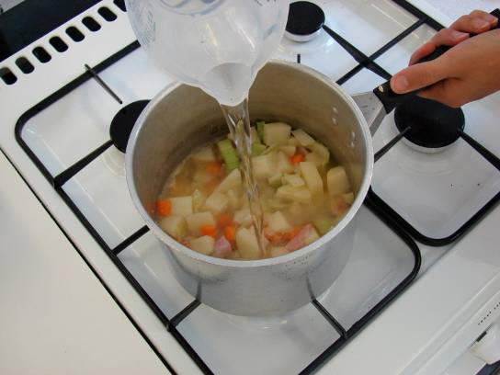
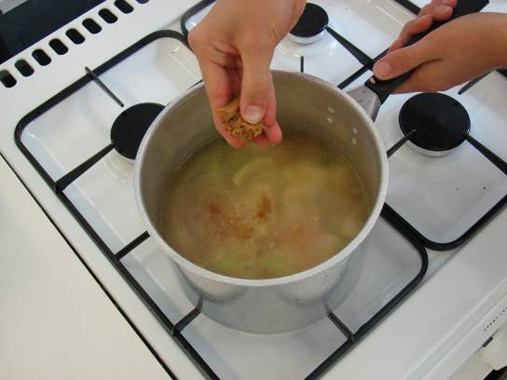
Add the stock.

Slide 10
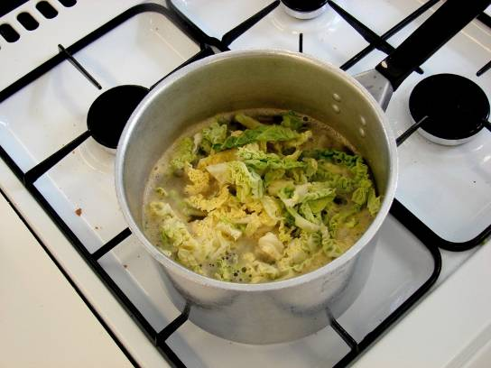
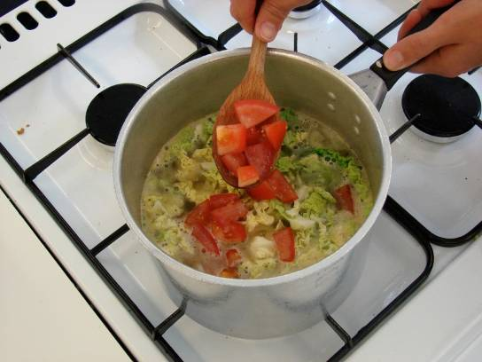
Stir in the finely shredded cabbage and sliced tomato.

Slide 11
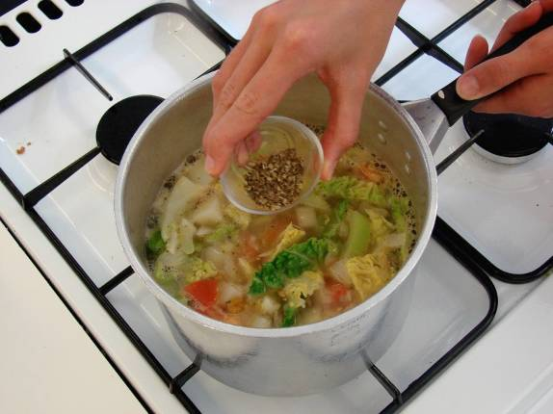
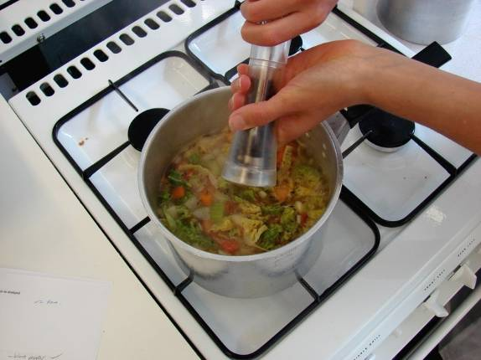
Add the mixed herbs and black pepper, bring to the boil and then simmer for 10 minutes.

Slide 12
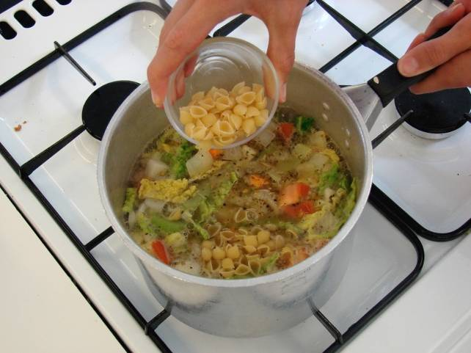
Add the pasta and allow to simmer for a further 10 minutes.

Slide 13
Serve.

Slide 14
Top tips
Food skills
Serve with a sprinkle of parmesan cheese.
Try different types of vegetables – use what is in season.
Add 2 x 15ml spoons of cannellini beans.
Try using different herbs and spices.
Weigh.
Measure.
Peel.
Chop.
Fry.
Boil and simmer.

Slide 15
Minestrone soup
For further information, go to:
www.foodafactoflife.org.uk

