Slide 1
Spicy tomato soup
Complexity: low-medium

Slide 2
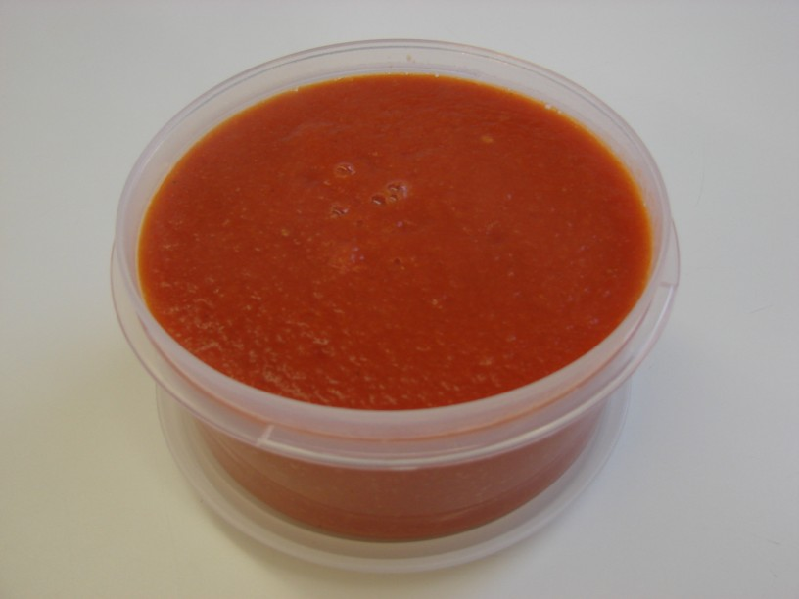

Slide 3
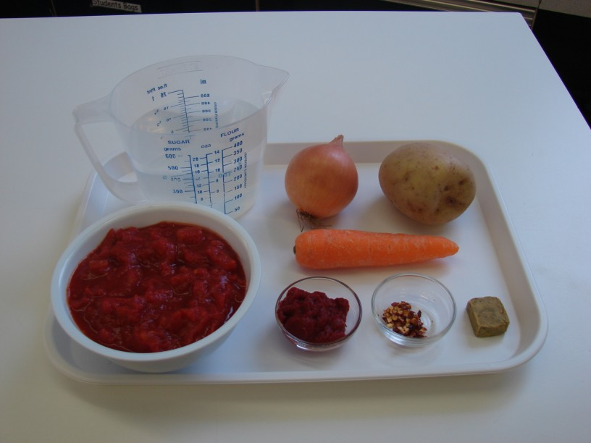
Ingredients
1 onion
1 carrot
1 potato
1 x can chopped tomatoes (400g)
500ml water
1 stock cube
½ 5ml spoon dried chilli flakes
1 x 15ml spoon tomato puree

Slide 4
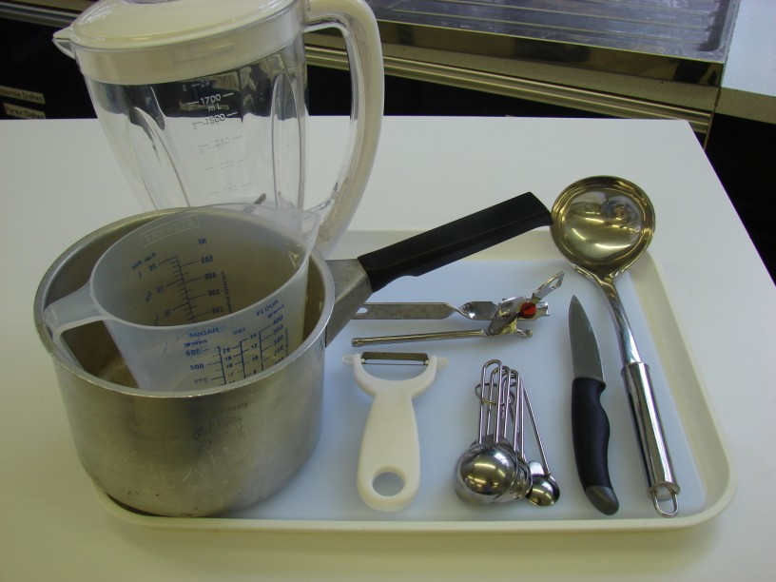
Equipment
Chopping board
Knife
Peeler
Saucepan
Can opener
Measuring spoons
Wooden spoon
Liquidiser
Ladle

Slide 5
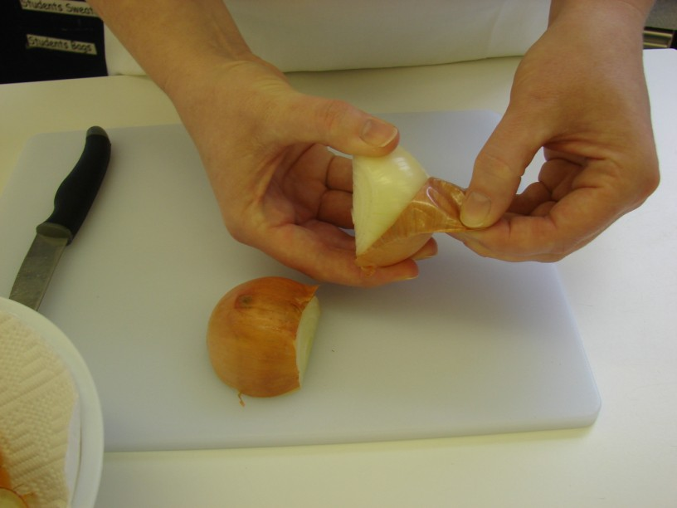
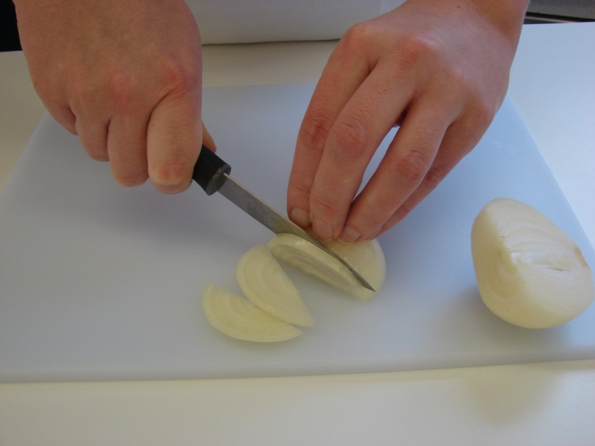
Method
Prepare the vegetables:
peel and slice the onion;

Slide 6
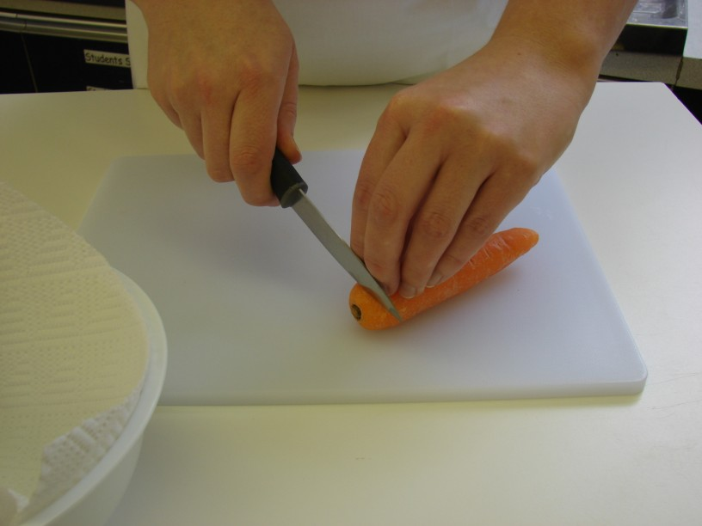
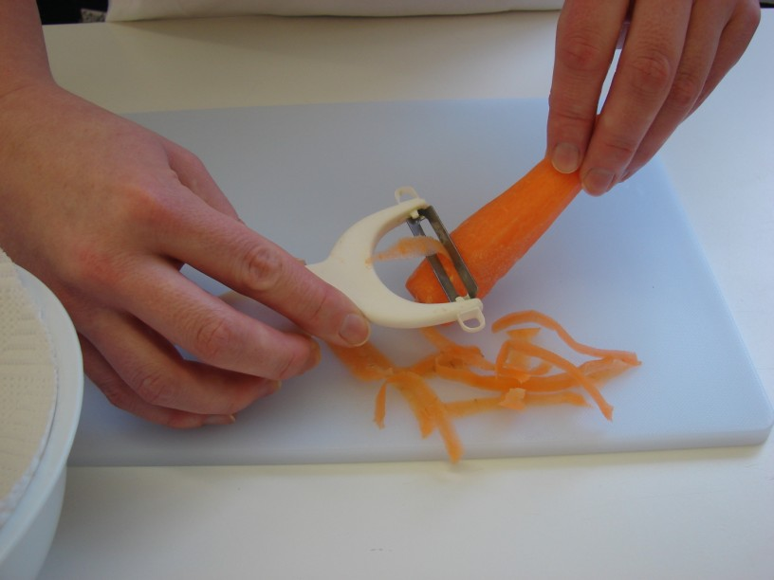
top and tail, peel and slice the carrot;

Slide 7
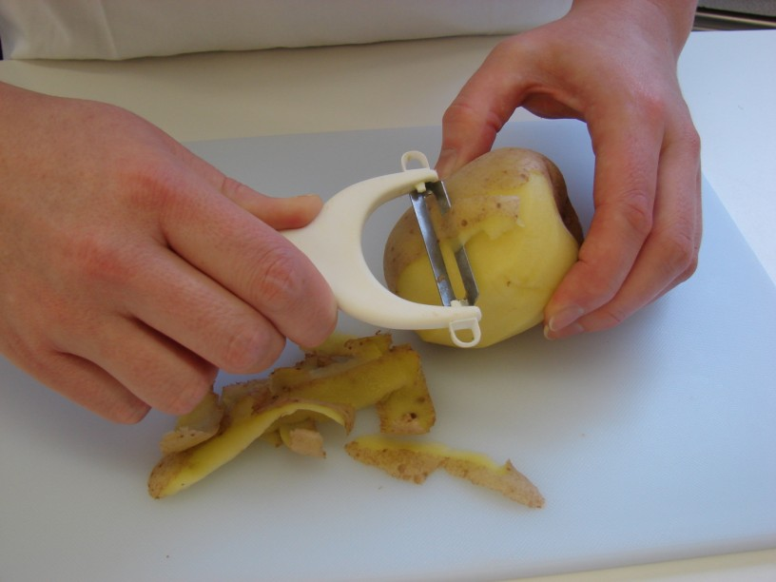
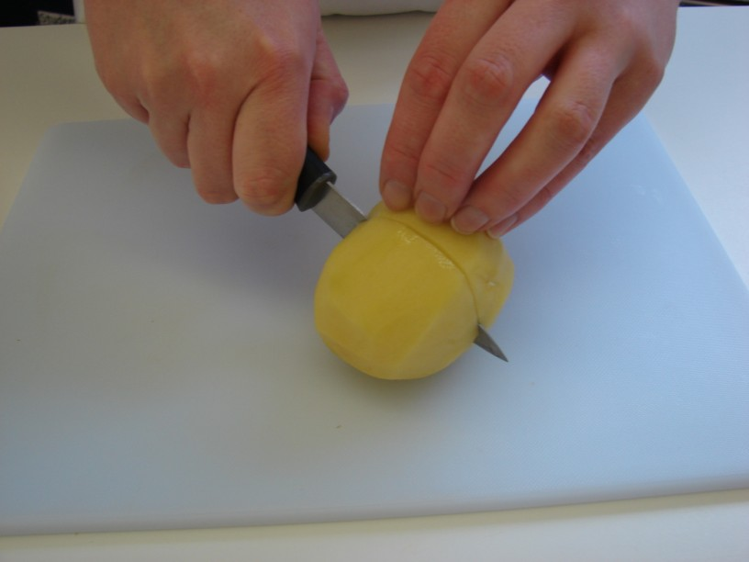
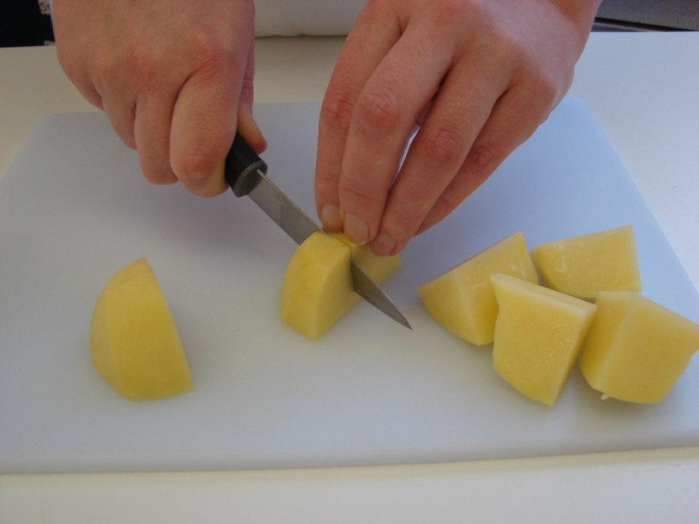
Peel and cut the potato into 8.

Slide 8
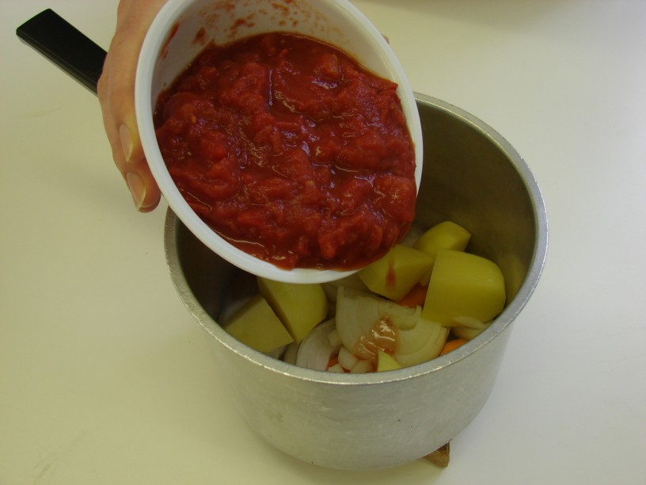
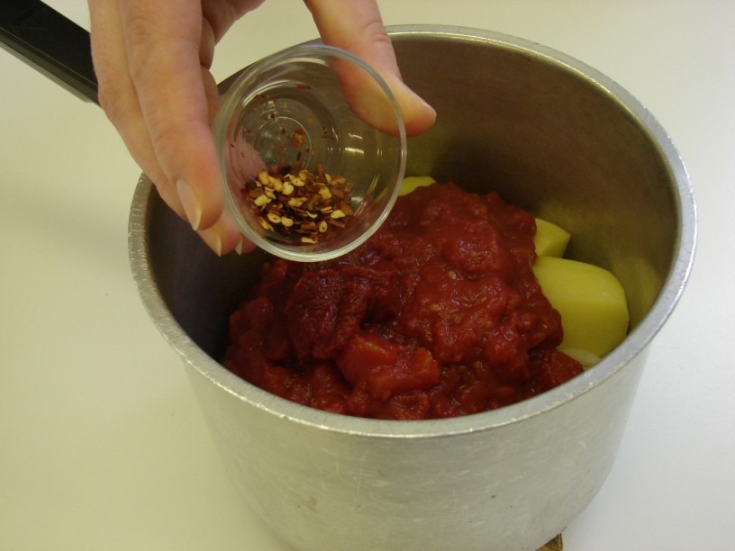
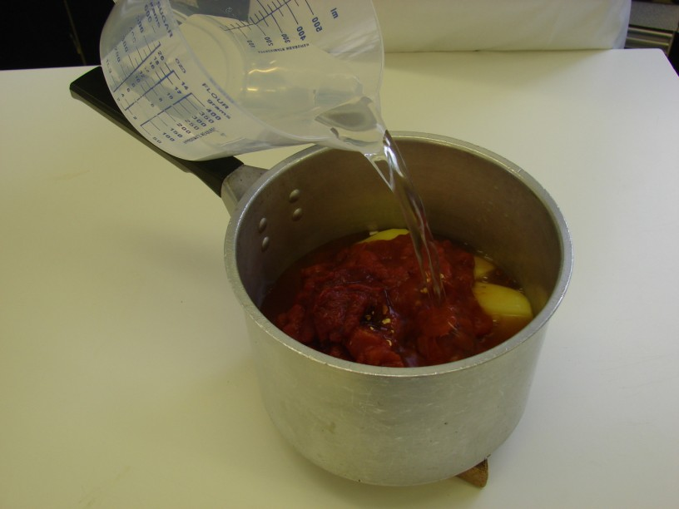
Put all the ingredients into a saucepan.

Slide 9
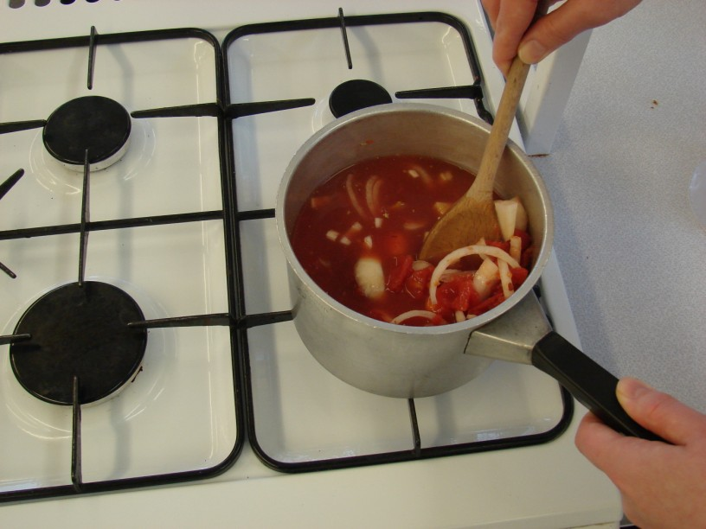
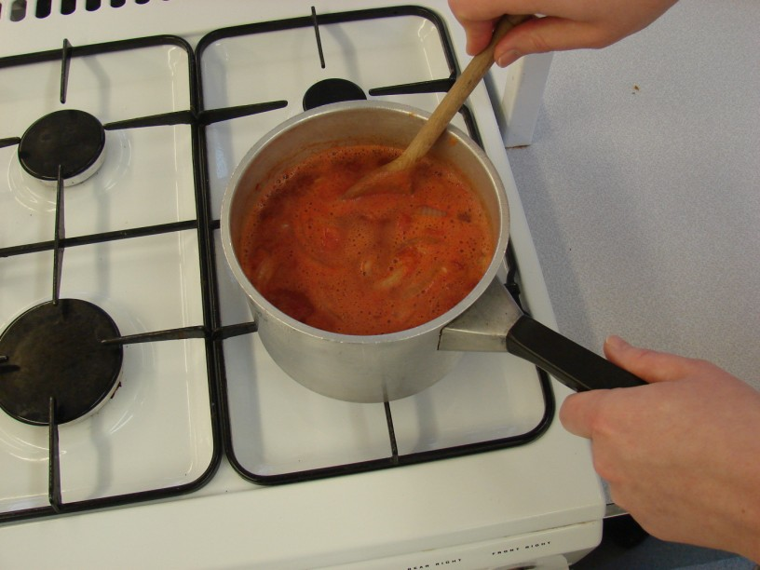
Stir everything together, bring to the boil and then simmer for 20 minutes.

Slide 10
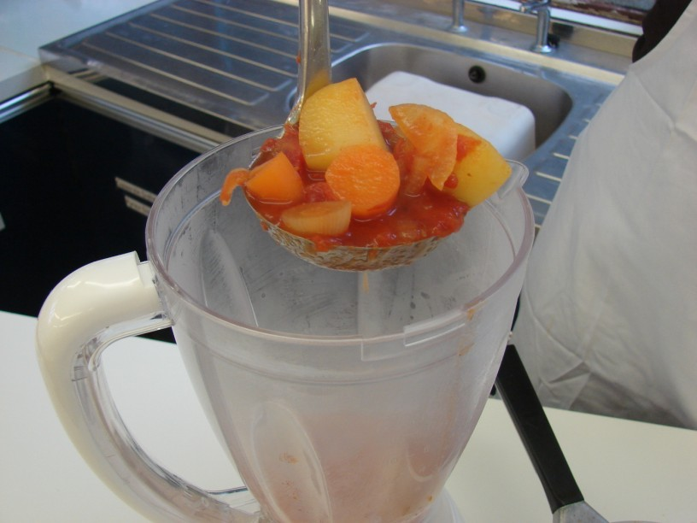
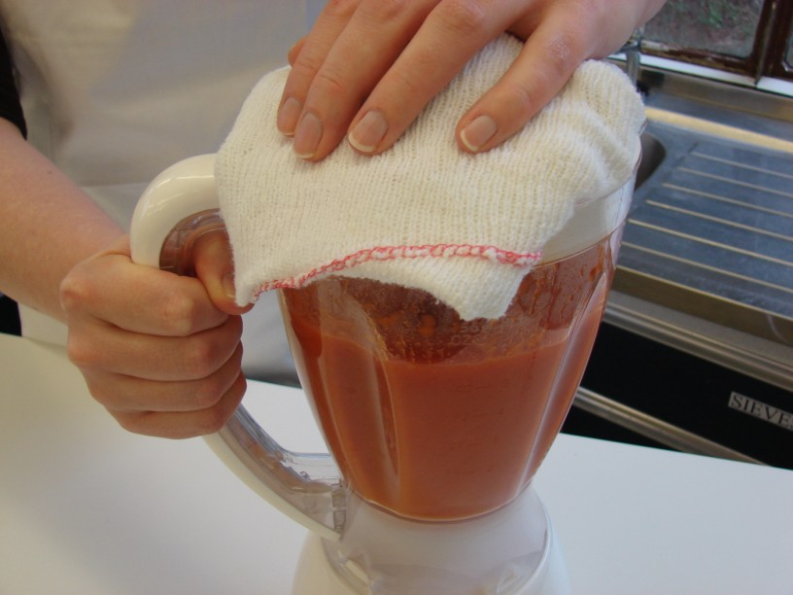
Ladle the mixture into the liquidiser and blend until smooth.

Slide 11
Serve.

Slide 12
Top tips
Food skills
Place a cloth over the liquidiser to prevent any soup from splashing out.
Use a range of different vegetables, e.g. leeks, peppers, mushrooms.
Serve with wholegrain bread.
Use different herbs and spices e.g. basil, mixed herbs, paprika.
Measure.
Peel.
Slice, trim and cut.
Stir.
Simmer and boil.
Blend.

Slide 13
Spicy tomato soup
For further information, go to:
www.foodafactoflife.org.uk

