Slide 1
Tropical granola bars
Complexity: low-medium

Slide 2
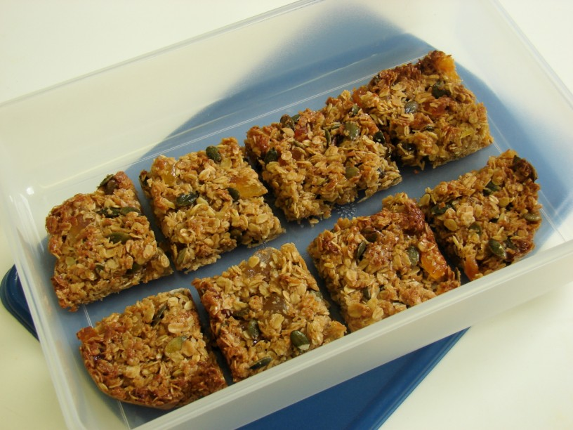

Slide 3
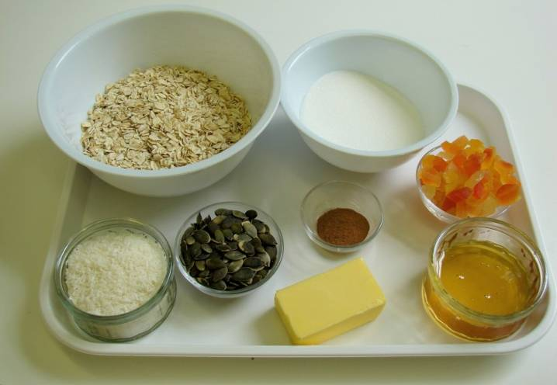
Ingredients
50g butter or hard baking fat
100g sugar
2 x 15ml spoon honey
150g jumbo oats
1x 5ml spoon cinnamon
40g pumpkin seeds
40g desiccated coconut
75g tropical dried fruit

Slide 4
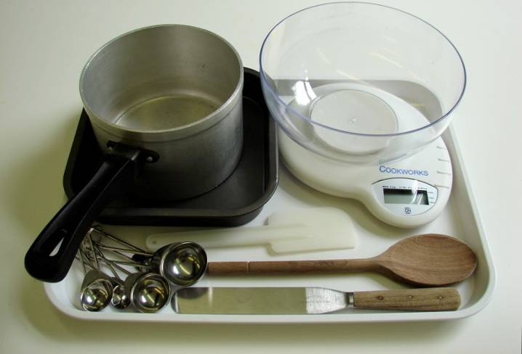
Equipment
Weighing scales
Measuring spoons
Saucepan
Wooden spoon
Baking tin
Spatula
Palette knife

Slide 5
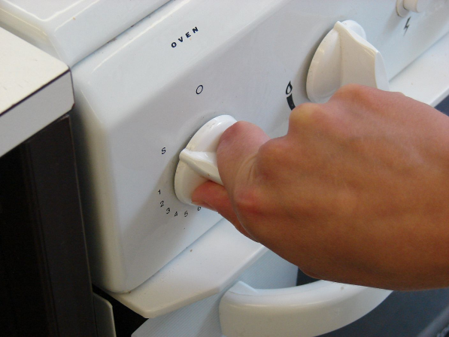
Method
Preheat the oven to 180°C or gas mark 4.

Slide 6
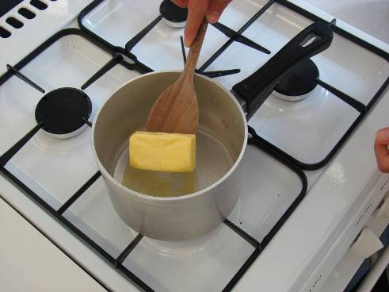
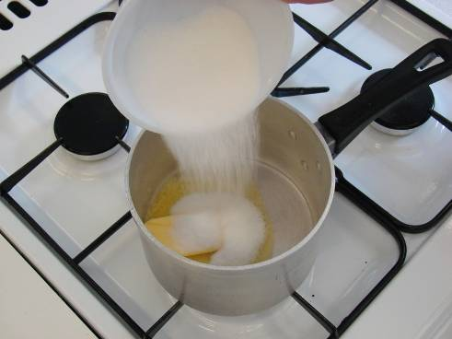
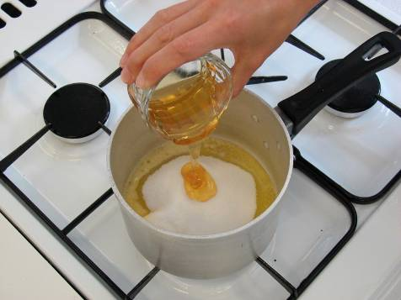
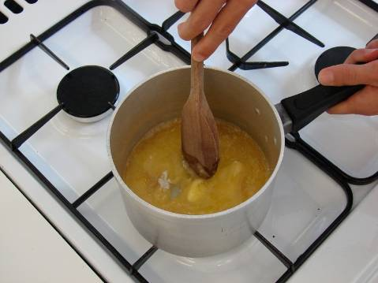
Place the butter or baking fat, sugar and honey into a saucepan and gently heat until the butter or baking fat has melted.

Slide 7
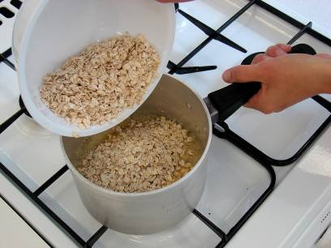
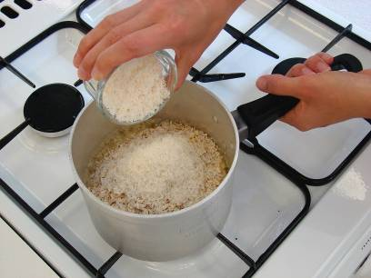
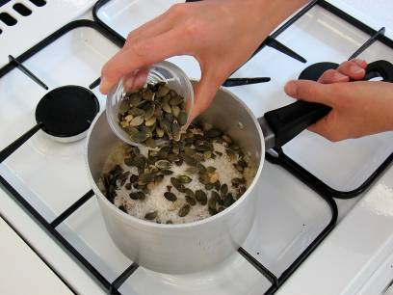
Add the oats, coconut and pumpkin seeds.

Slide 8
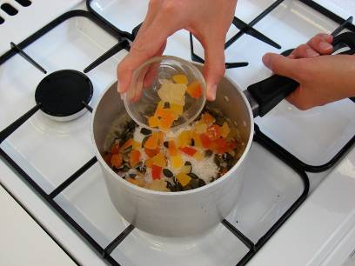
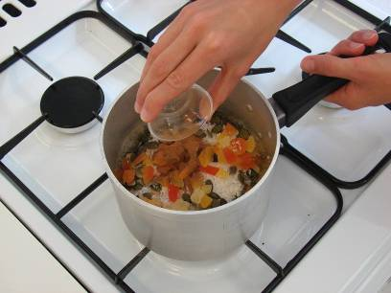
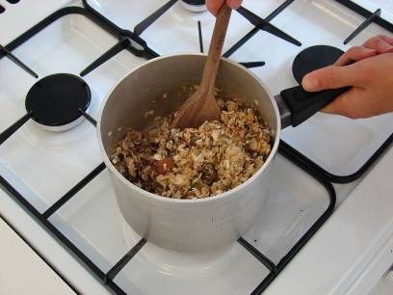
Add the dried fruit and cinnamon, then stir all the ingredients together.

Slide 9
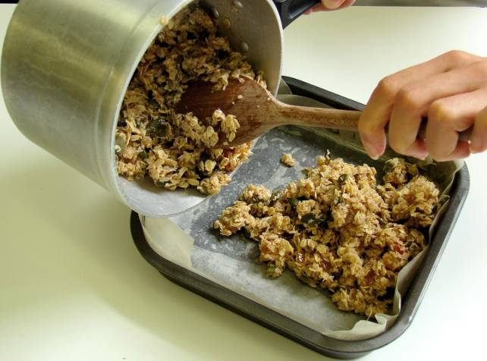
Pour the mixture into a non-stick (or lined) baking tin.

Slide 10
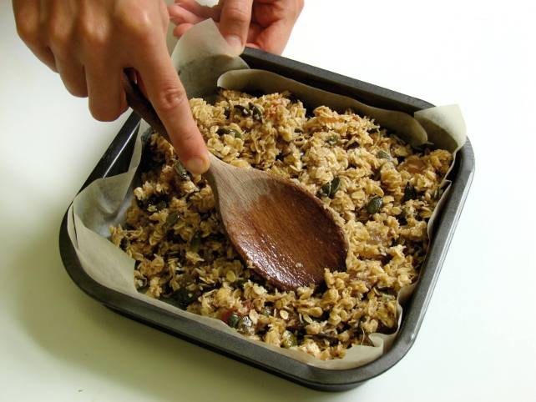
Pat down the mixture in the baking tin.

Slide 11
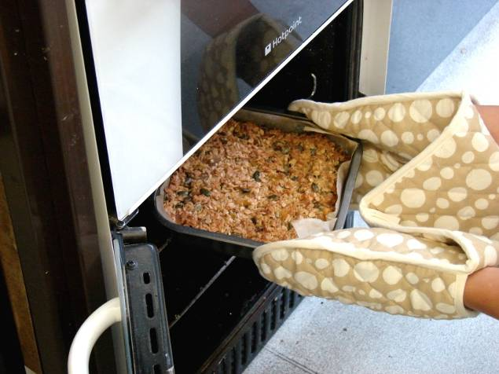
Bake for 20 minutes, until lightly browned.

Slide 12
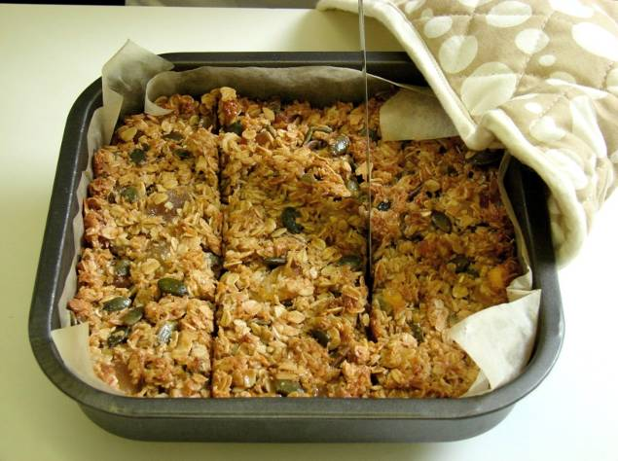
Remove from the oven and cut into ‘bars’ in the baking tin while hot.

Slide 13
Top tips
Food skills
Try adding a different type of breakfast cereal, instead of oats.
Add 1 x 5ml spoon ginger or mixed spice to the oat mixture instead of cinnamon.
You could add a few chopped nuts.
Try adding half an apple or half a mashed banana instead of the tropical fruit and coconut.
Weigh.
Measure.
Melt.
Stir.
Bake.

Slide 14
Tropical granola bars
For further information, go to:
www.foodafactoflife.org.uk

