Slide 1
Vegetable soup
Complexity: medium

Slide 2
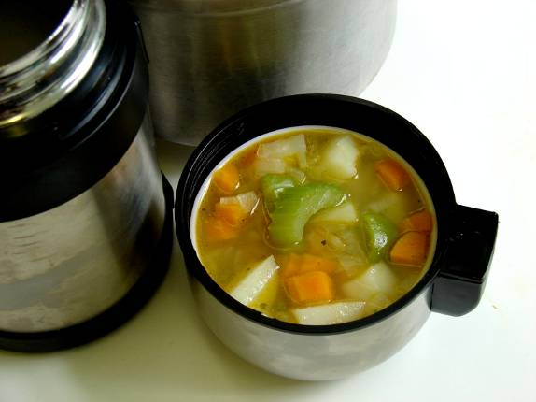

Slide 3
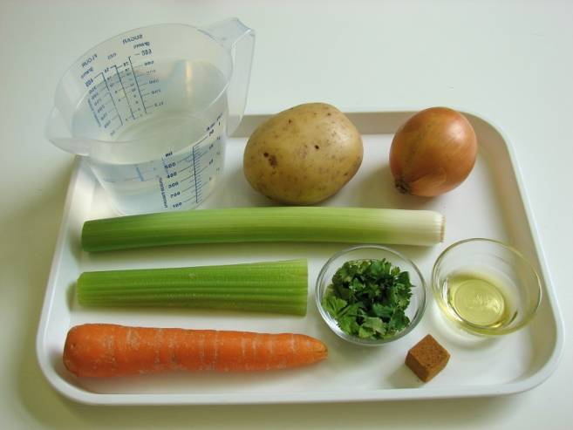
Ingredients
1 onion
1 carrot
1 leek
1 potato
1 celery stick
1x 10ml spoon oil
600ml stock (water and stock cube)
1 x 15ml spoon coriander, chopped

Slide 4
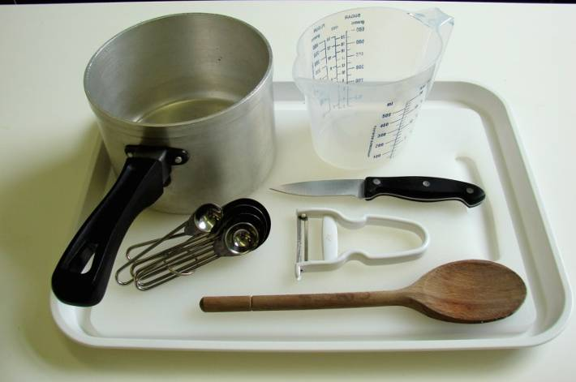
Equipment
Chopping board
Knife
Vegetable peeler
Measuring spoons
Saucepan
Wooden spoon
Measuring jug

Slide 5
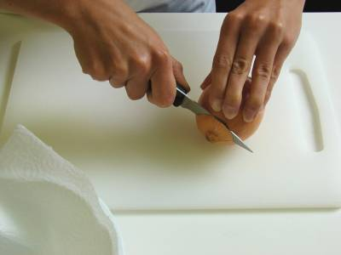
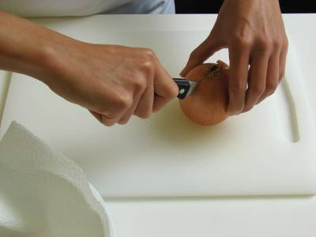
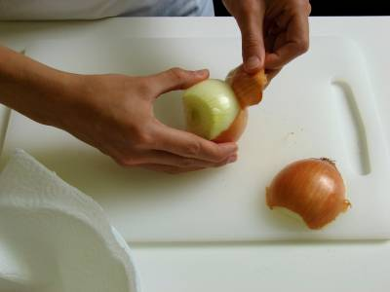
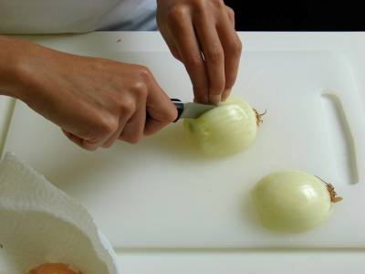
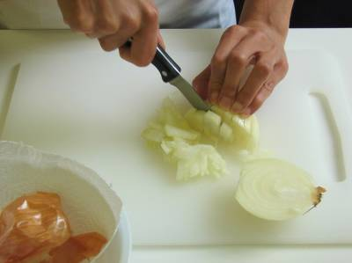
Method
Peel and chop the onion.

Slide 6
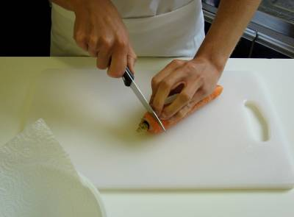
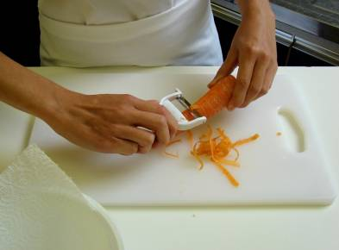
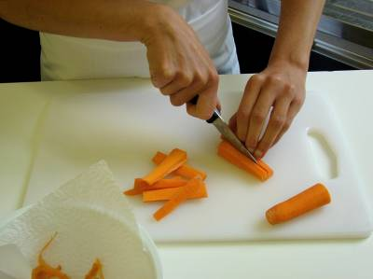
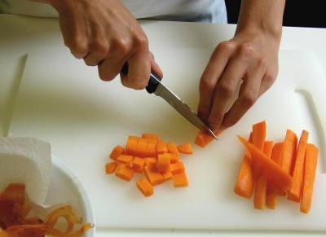
Top and tail the carrot, then peel and dice.

Slide 7
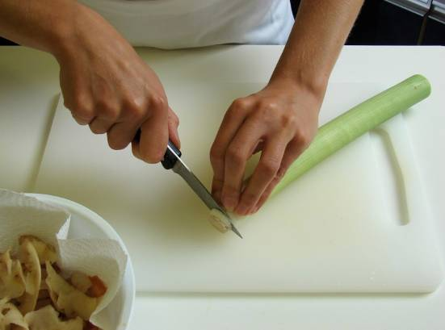
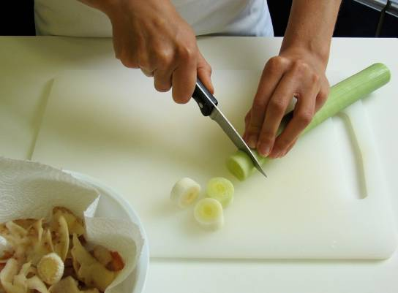
Top and tail the leek, then slice.

Slide 8
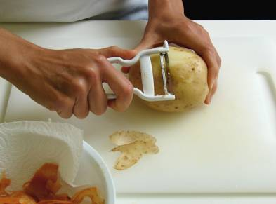
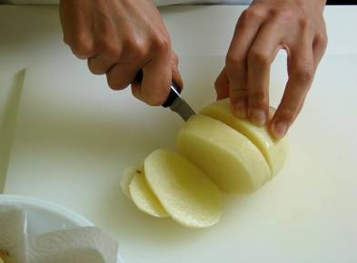
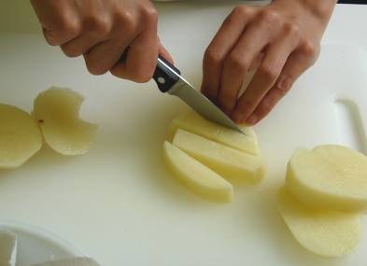
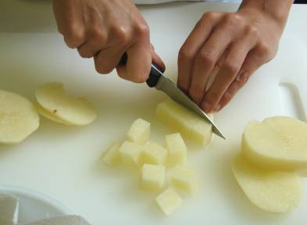
Peel and cube the potato.

Slide 9
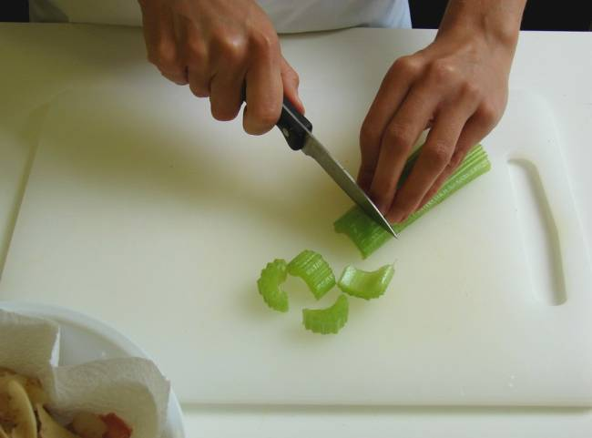
Slice the celery.

Slide 10
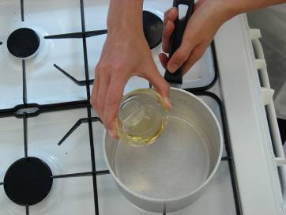
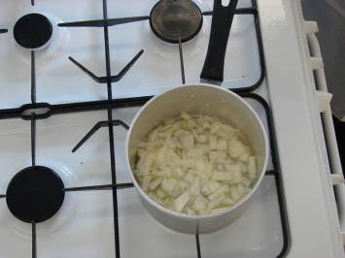
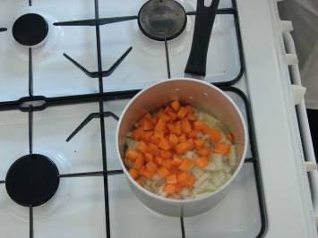
Heat the oil in a saucepan and add the onion and carrot.

Slide 11
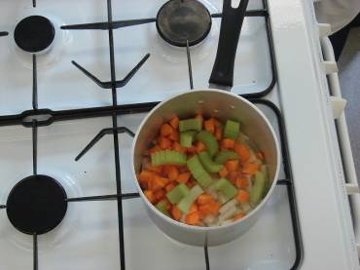
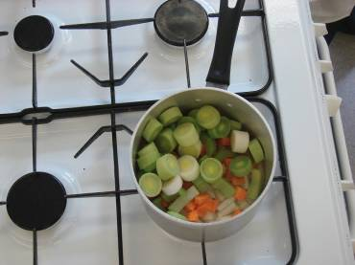
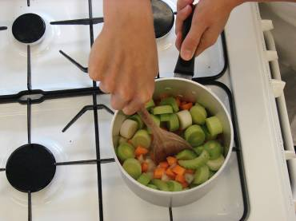
Immediately add the celery and leeks (but not the potatoes) and fry everything for 5 minutes.

Slide 12
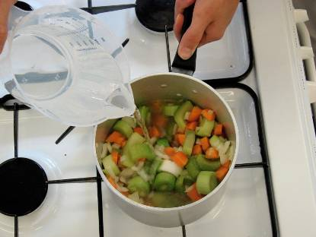
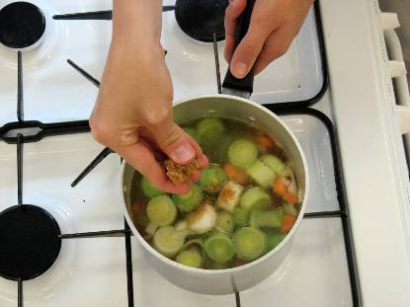
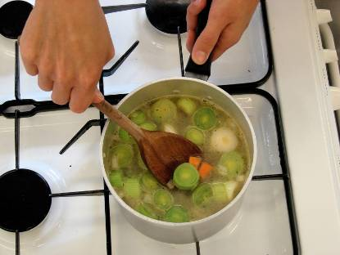
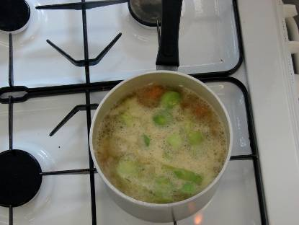
Add the stock to the saucepan and bring to the boil.

Slide 13
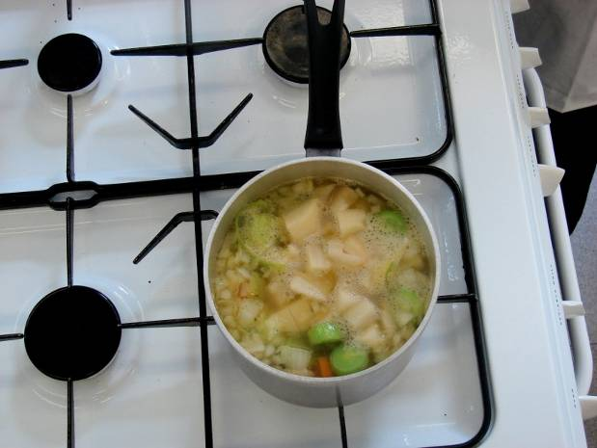
Add the potatoes and simmer for 20 minutes.

Slide 14
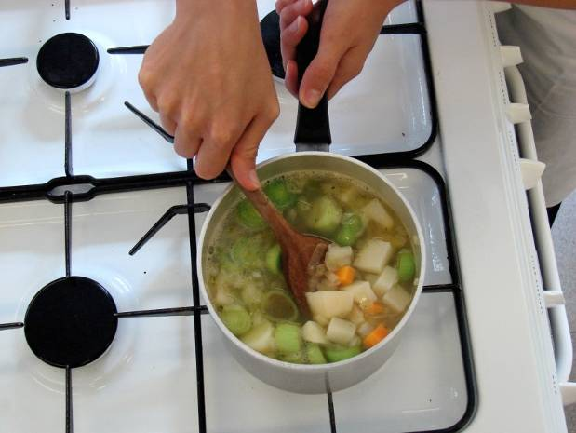
Stir in the chopped coriander and serve.

Slide 15
Top tips
Food skills
Try using a sweet potato.
Vary the types of vegetables used depending on what is in season.
Add canned or frozen sweetcorn or a can of beans.
If you have a blender, blend the soup.
Try adding different herbs and spices.
Measure.
Peel.
Trim, dice, slice and chop.
Fry.
Boil and simmer.

Slide 16
Vegetable soup
For further information, go to:
www.foodafactoflife.org.uk

