Slide 1
Courgette and cheese muffins
Complexity: low-medium

Slide 2
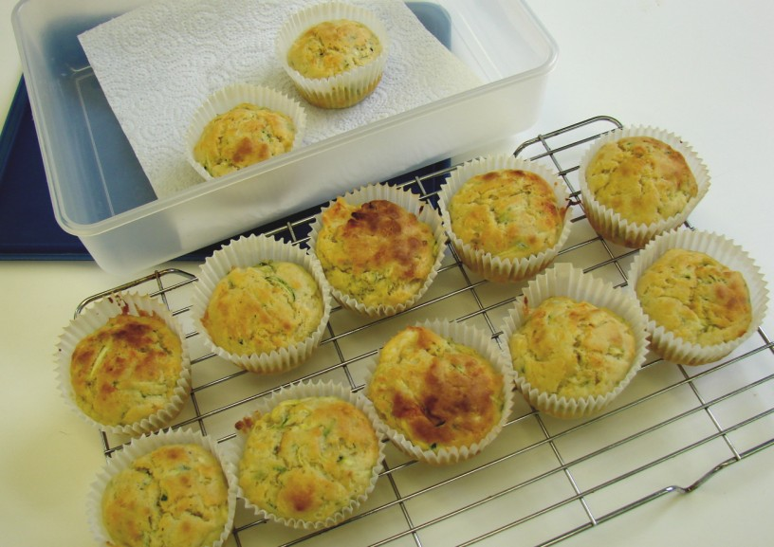

Slide 3
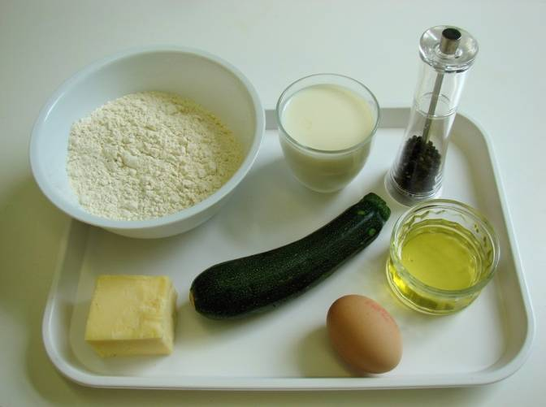
Ingredients
1 small courgette
100g cheddar cheese
225g self raising flour
50ml oil
175ml semi-skimmed milk
1 egg
Black pepper

Slide 4
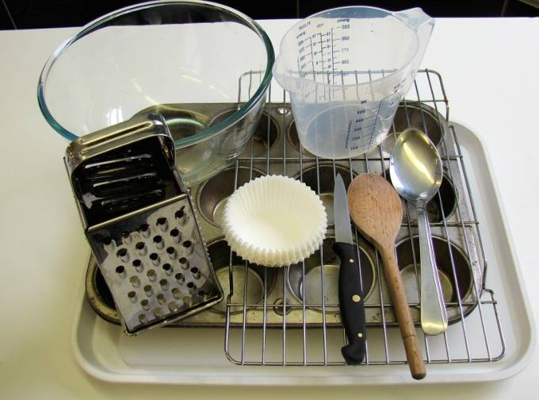
Equipment
Wooden spoon
2 spoons
Cooling rack
12 muffin cases
Muffin tin
Chopping board
Knife
Grater
Measuring jug
Mixing bowl

Slide 5
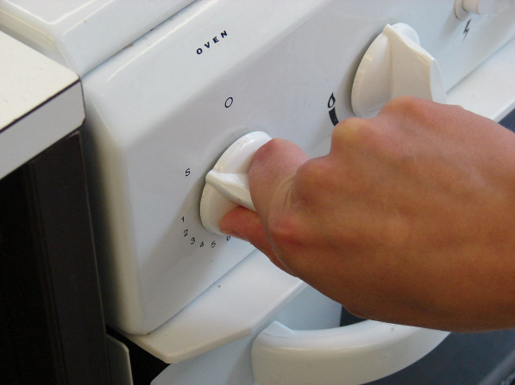
Method
Preheat oven to 200°C or gas mark 6.

Slide 6
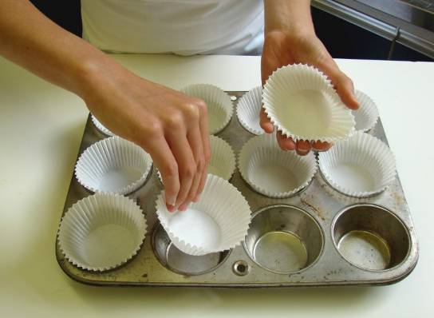
Place the muffin cases in the muffin tin.

Slide 7
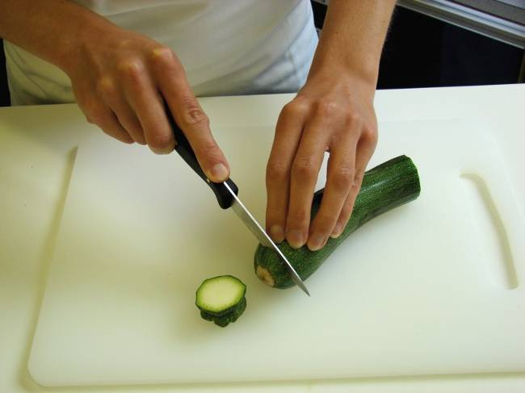
Cut the ends of the courgette.

Slide 8
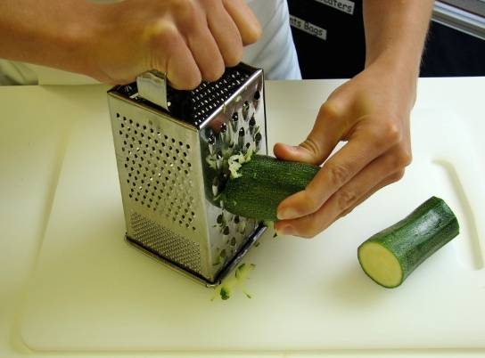
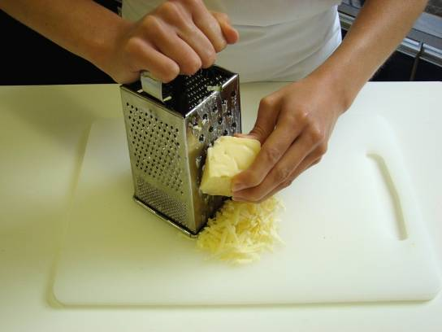
Grate the courgette and cheese.

Slide 9
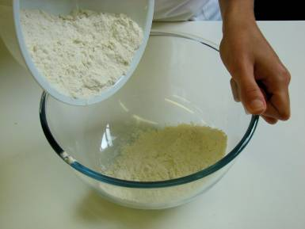
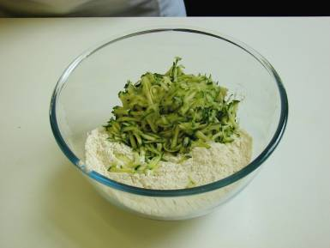
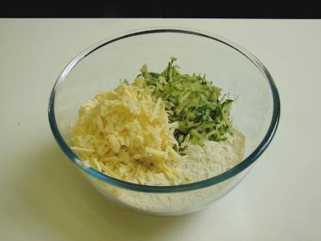
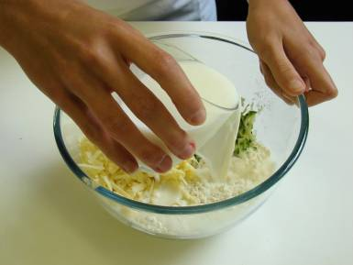
Add the flour, courgette, cheese and milk.

Slide 10
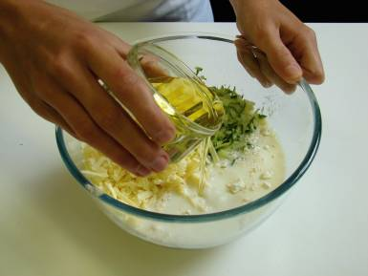
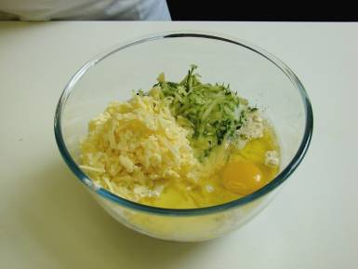
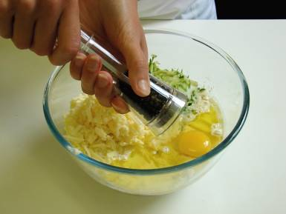
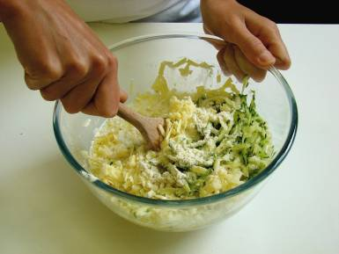
Add the oil, egg and a grind of black pepper, than mix to form a smooth batter.

Slide 11
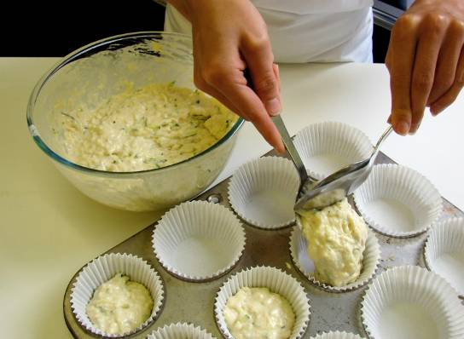
Divide the mixture equally between the muffin cases using 2 spoons.

Slide 12
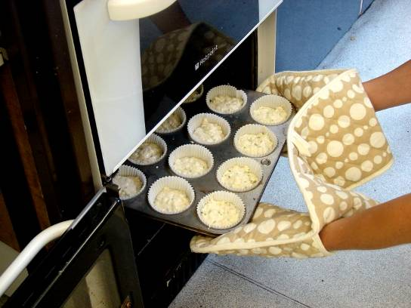
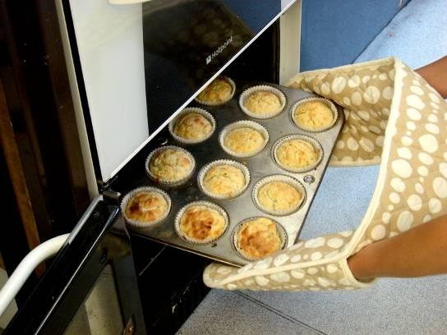
Bake for 20 minutes, until golden.

Slide 13
Allow to cool on a cooling rack.

Slide 14
Top tips
Food skills
Try using a grated carrot instead of courgette.
Add finely sliced chilli or ginger for a different flavour.
Crumble in a little crispy grilled bacon.
Try different types of cheese e.g. feta, edam.
Try adding a little mustard.
Weigh.
Measure.
Grate.
Cut.
Mix, stir and combine.
Divide.
Bake.

Slide 15
Courgette and cheese muffins
For further information, go to:
www.foodafactoflife.org.uk

