Slide 1
Croque-monsieur
Complexity: low-medium

Slide 2
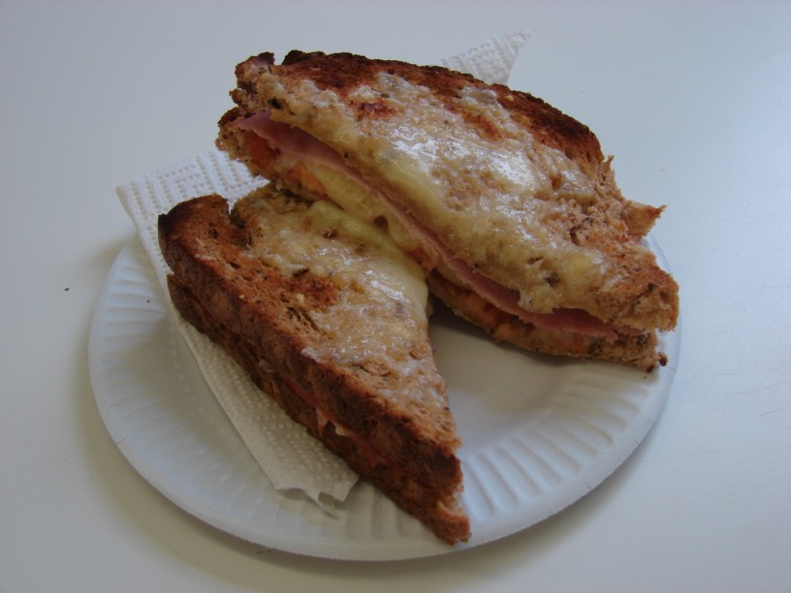

Slide 3
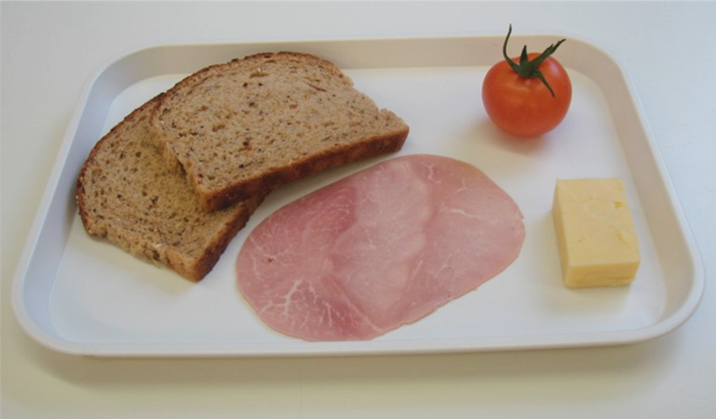
Ingredients
30g hard cheese
(e.g. Cheddar, Edam, Gruyere)
1 tomato
2 slices of bread,
preferably wholegrain
1 slice ham

Slide 4
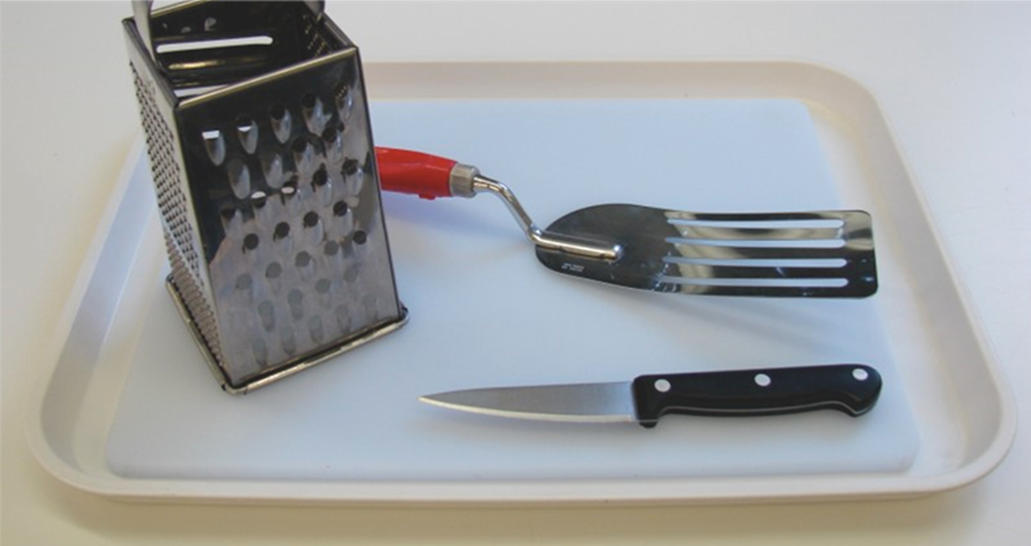
Equipment
Chopping board
Grater
Fish slice
Knife

Slide 5
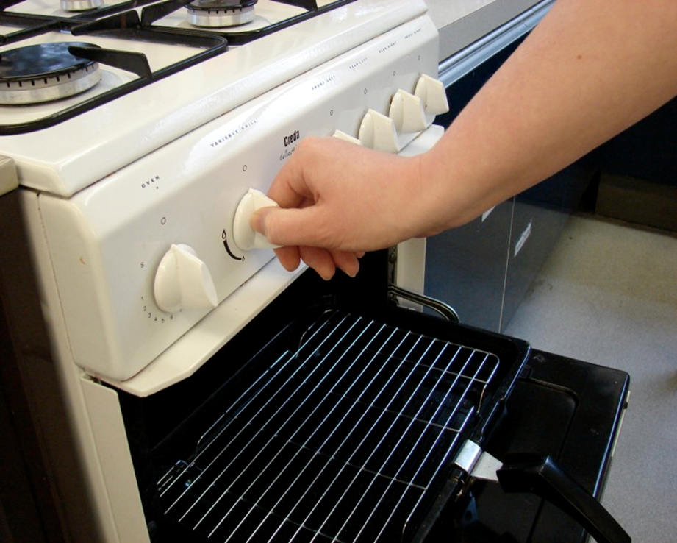
Method
Preheat the grill.

Slide 6
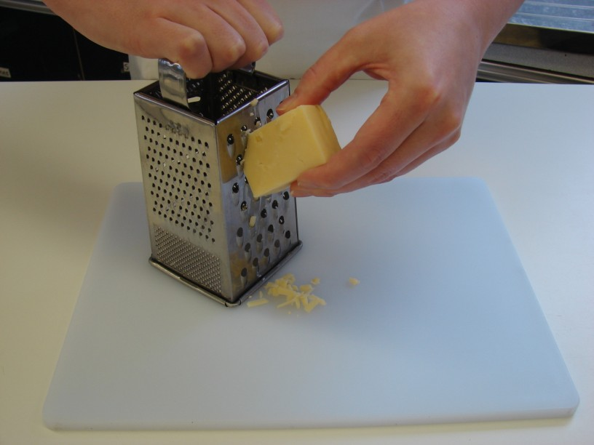
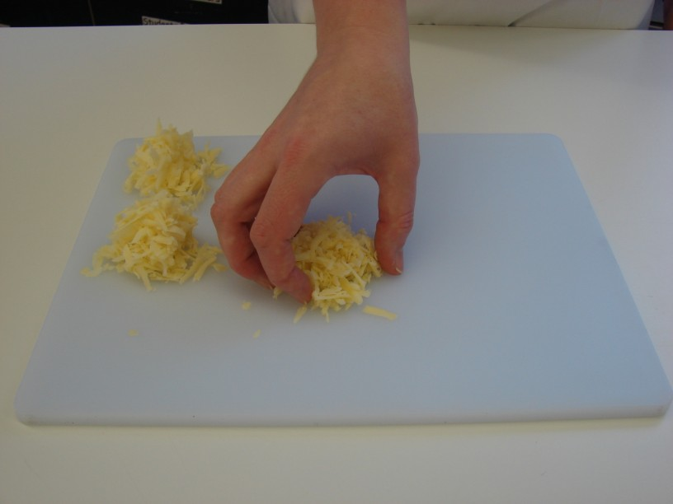
Grate cheese on a chopping board – divide into 3.

Slide 7
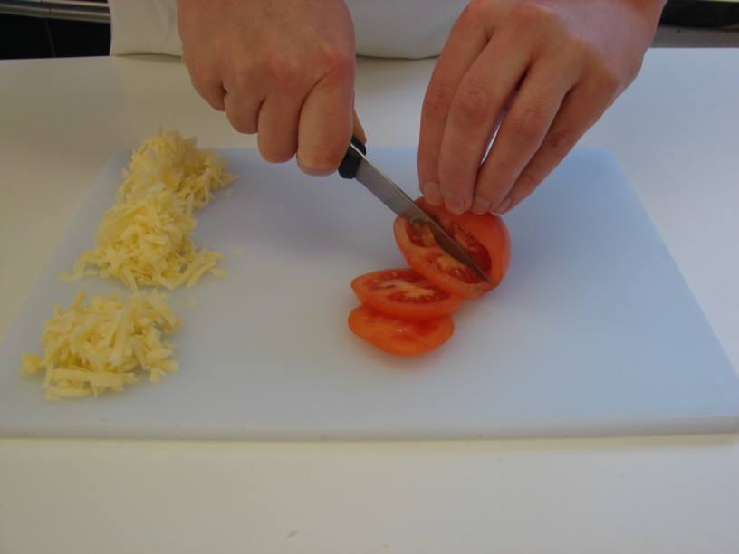
Slice the tomato.

Slide 8
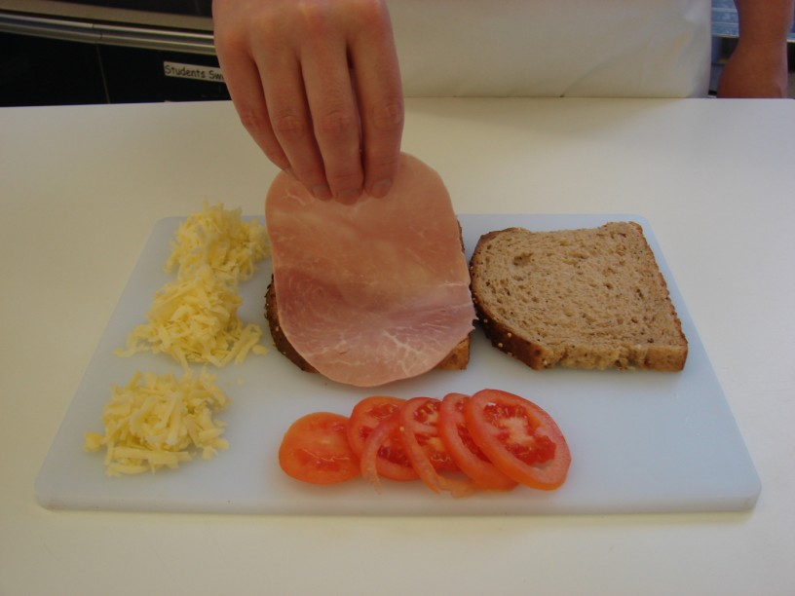
Place the slices of bread on the chopping board and lay the ham over one slice of bread.

Slide 9
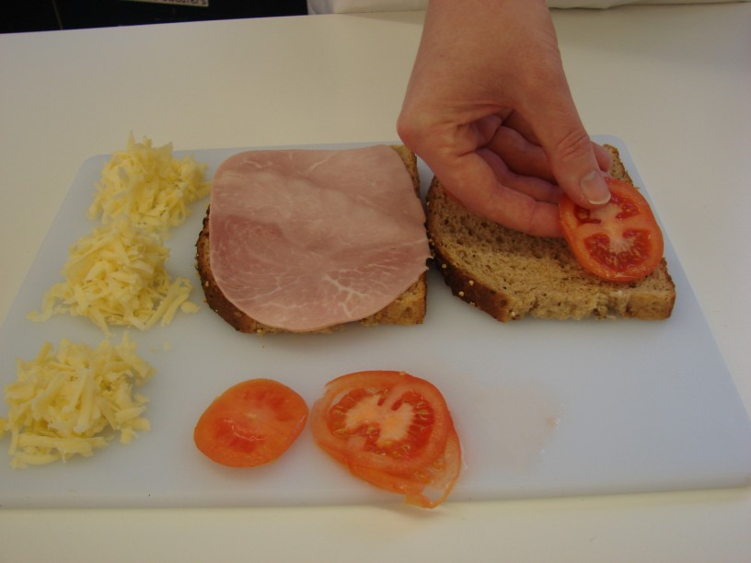
Arrange the tomato over the other slice of bread.

Slide 10
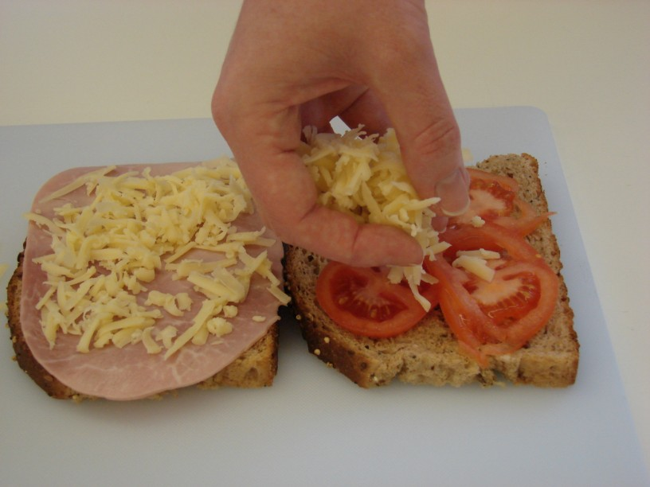
Sprinkle a portion of cheese over both slices of bread.

Slide 11
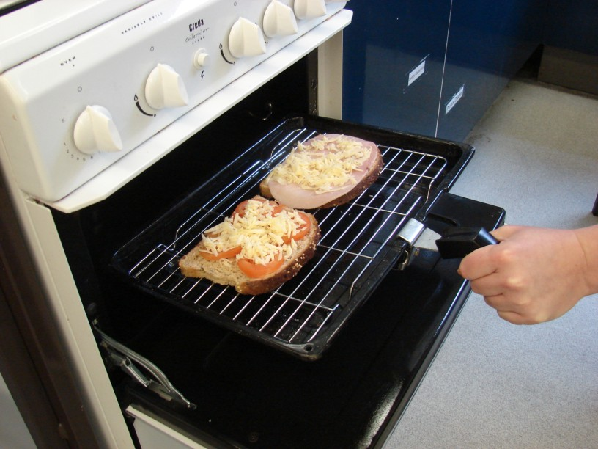
Place the sandwich under the hot grill.

Slide 12
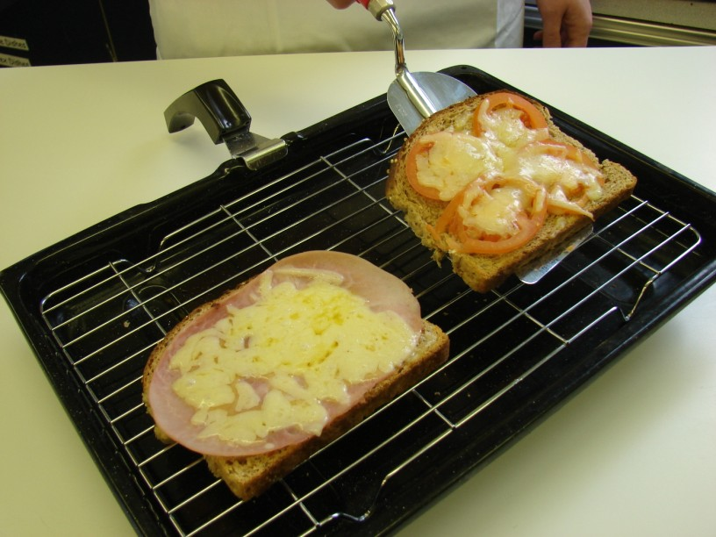
When the cheese is bubbling hot, remove from the grill.

Slide 13
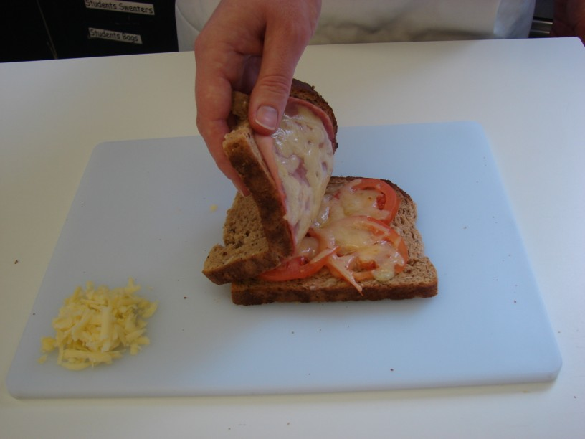
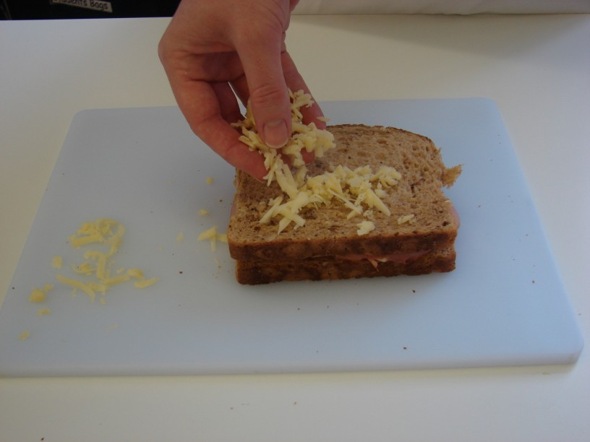
Press the 2 slices of bread together, and sprinkle the remaining cheese on top.

Slide 14
Place under the grill until the cheese is melted and golden.

Slide 15
Top tips
Food skills
Use different types of bread, e.g. ciabatta, bagel, wholemeal loaf.
Try adding different varieties of cheese, e.g. Mozzarella, Cheddar, Edam, Brie.
Go for fruit and vegetables, e.g. mushrooms, pineapple, peppers.
Weigh.
Slice.
Grate.
Grill.

Slide 16
Croque-monsieur
For further information, go to:
www.foodafactoflife.org.uk

