Slide 1
Dippy divers
Complexity: low-medium

Slide 2
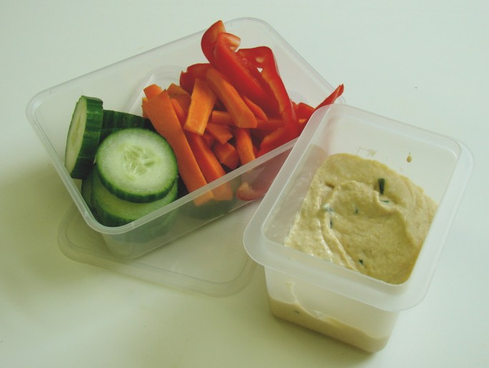

Slide 3
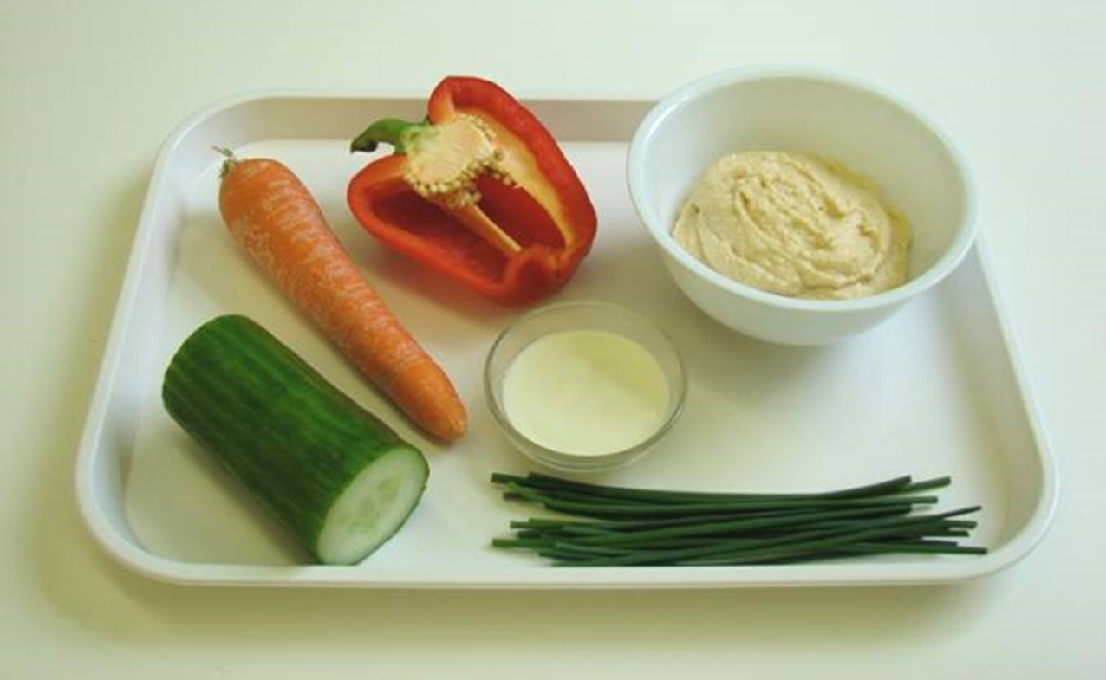
Ingredients
1 carrot
½ red or yellow pepper
¼ cucumber
4 x 15ml spoons hummus
1 x 15 ml spoon plain yogurt
Handful of fresh chives

Slide 4
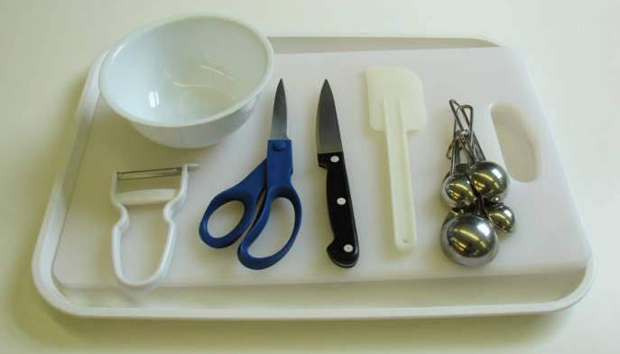
Equipment
Knife
Chopping board
Vegetable peeler
Measuring spoon
Small bowl
Kitchen scissors
Spatula

Slide 5
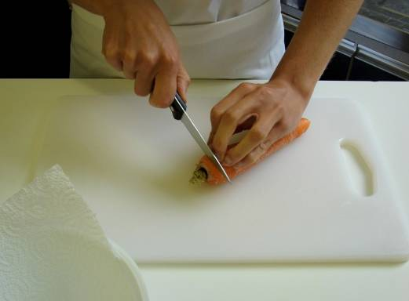
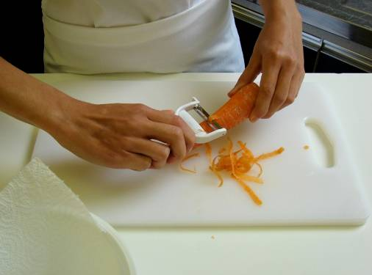
Method
Top and tail the carrot, then peel.

Slide 6
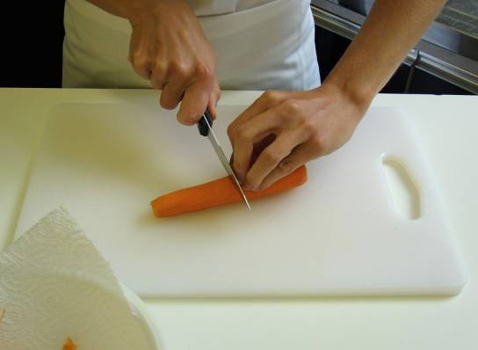
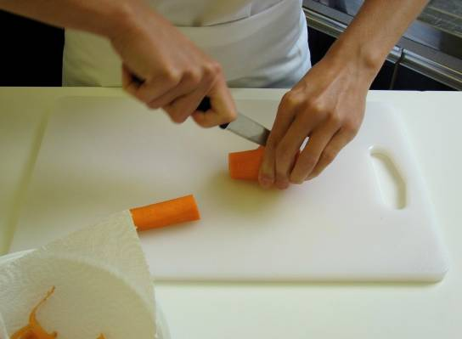
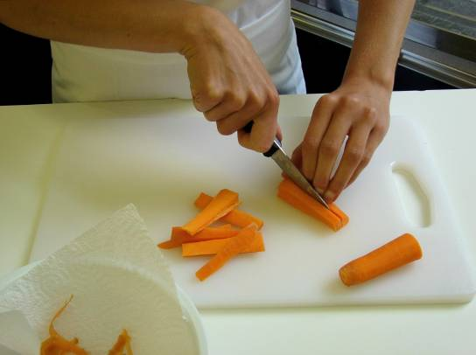
Slice the carrot into sticks

Slide 7
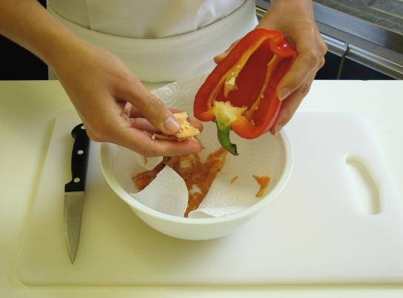
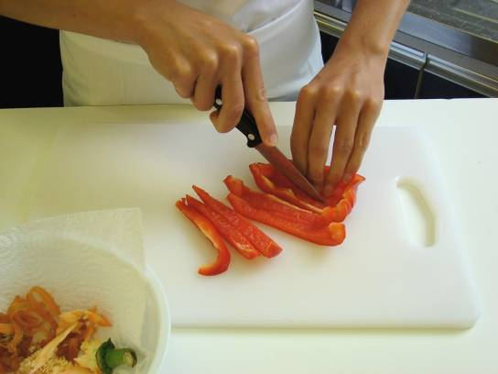
Remove the seeds from the pepper, and slice into strips.

Slide 8
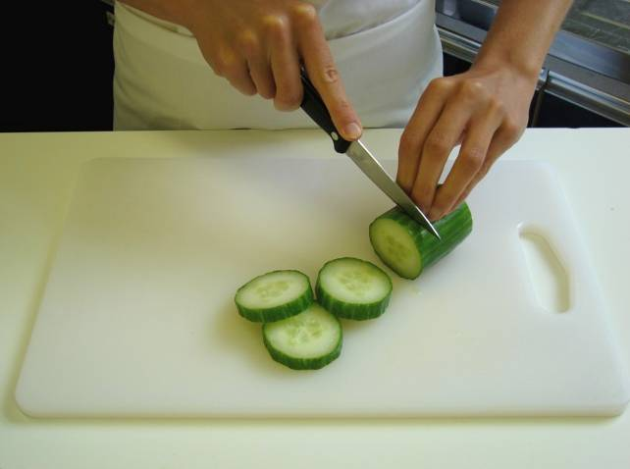
Cut the cucumber into thick slices.

Slide 9
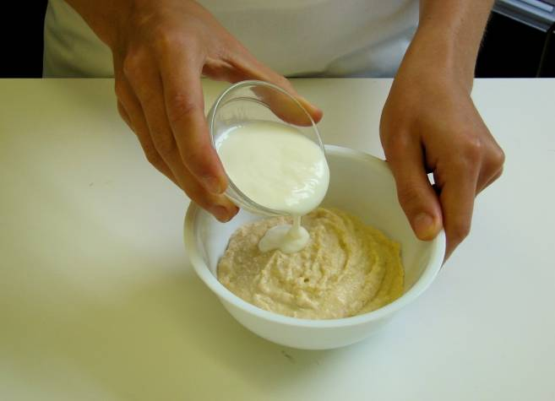
Place the hummus and yogurt together in the small bowl.

Slide 10
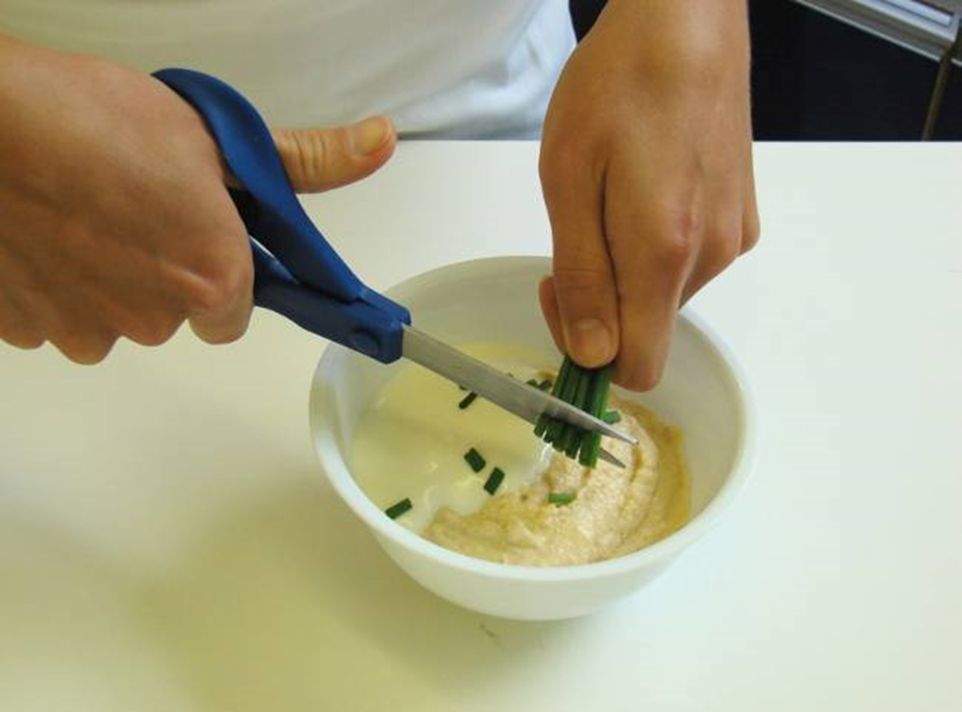
Snip the chives into the bowl

Slide 11
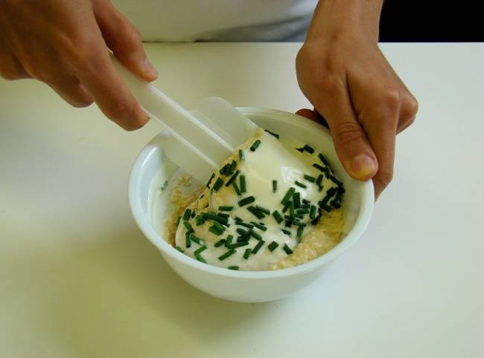
Stir everything together.

Slide 12
Serve the dip, surrounded by the vegetables.

Slide 13
Top tips
Food skills
Use different types of vegetables, e.g. spring onion, celery, broccoli.
Add other types of herbs, such as parsley and coriander, or perhaps add lemon and chilli.
Make a dip using 100g low fat cream cheese and 2 x 15ml spoons of tomato sauce.
Wash all the vegetables before using them.
Measure.
Cut, slice and trim.
Snip.
Mix, stir and combine.

Slide 14
Dippy divers
For further information, go to:
www.foodafactoflife.org.uk

