Slide 1
Fruit fusion
Complexity: low-medium

Slide 2
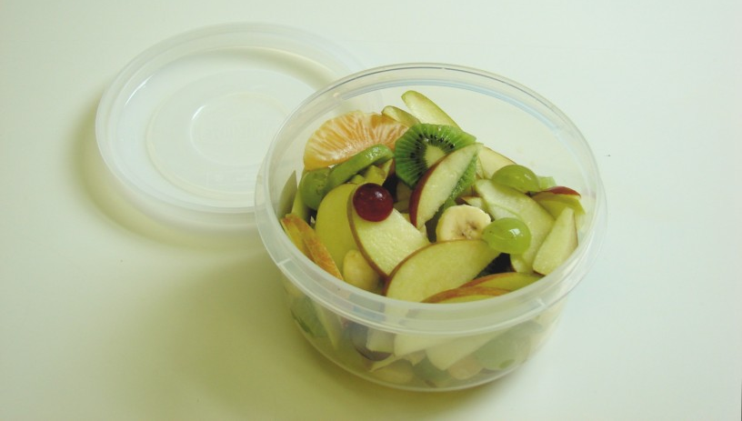

Slide 3
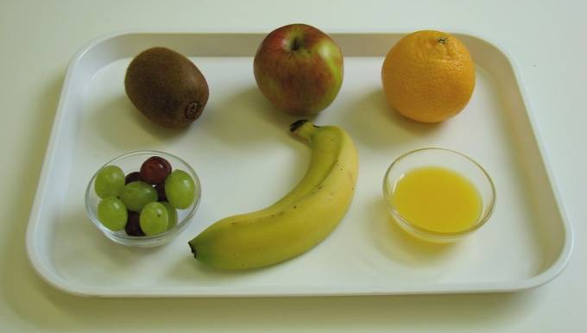
Ingredients
1 clementine
6 red grapes
6 green grapes
1 kiwi fruit
1 banana
1 apple
2 x 15ml spoons orange juice

Slide 4
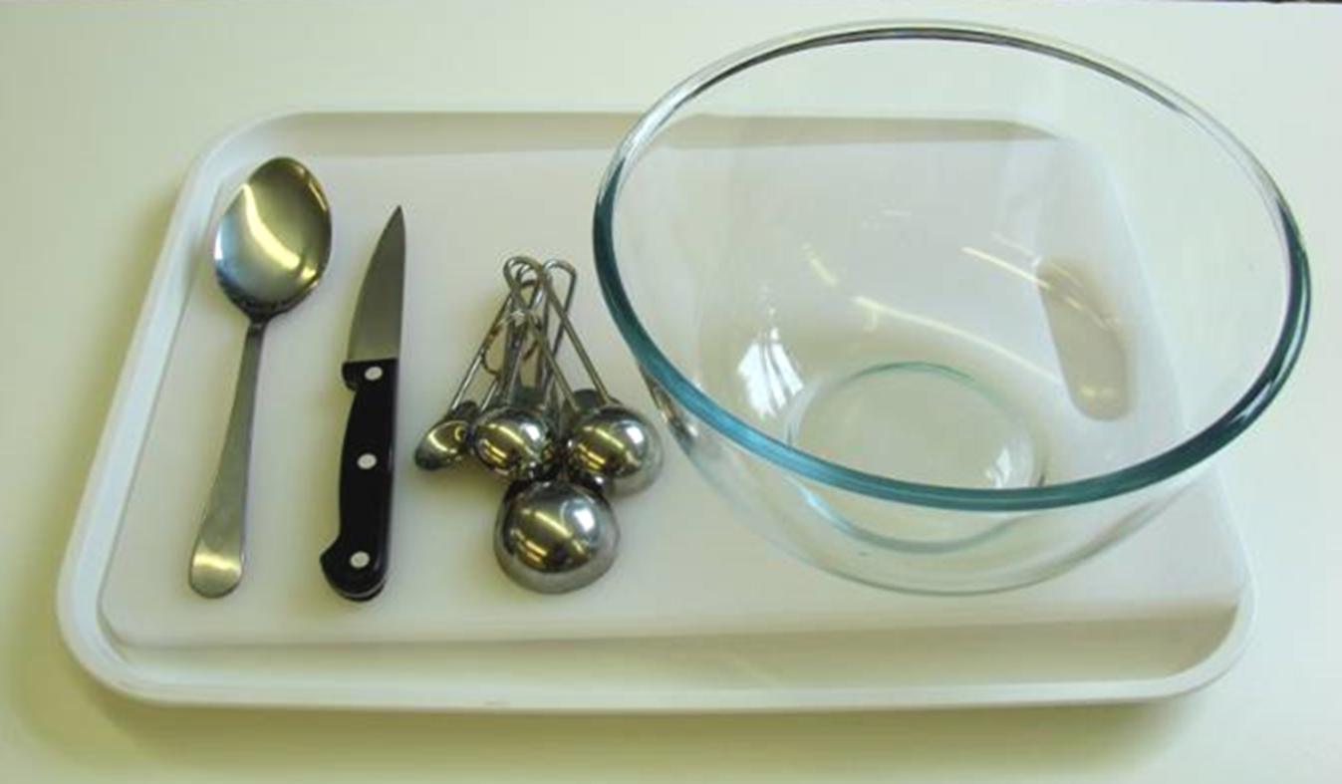
Equipment
Knife
Chopping board
Bowl
Measuring spoons
Spoon

Slide 5
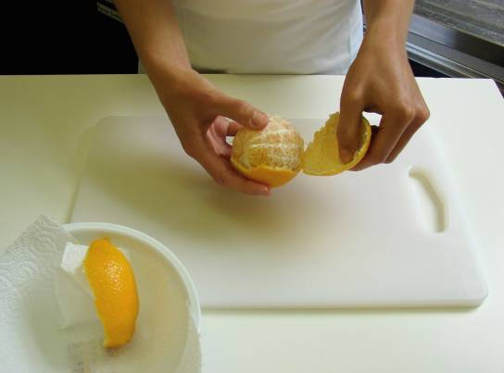
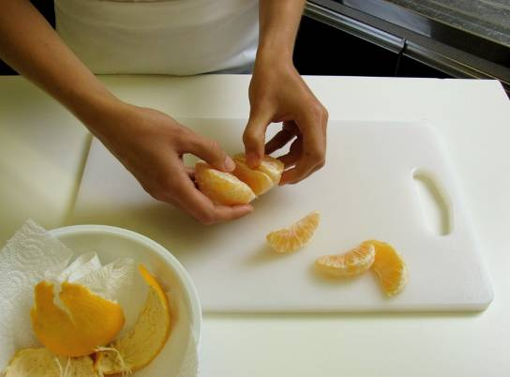
Method
Peel the clementine and separate into segments.

Slide 6
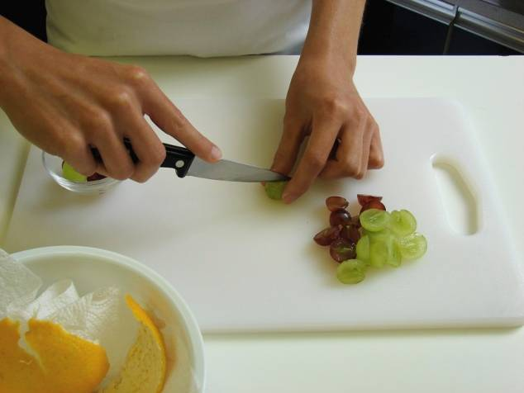
Cut the grapes in half and remove any seeds.

Slide 7
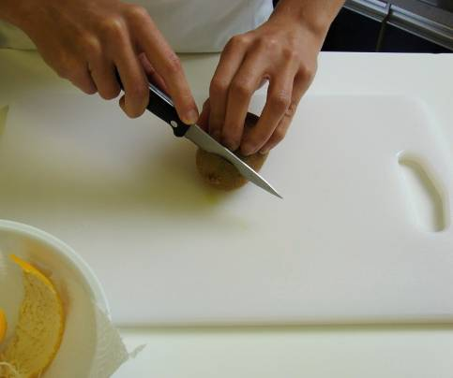
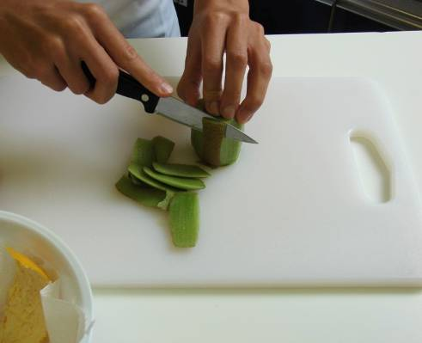
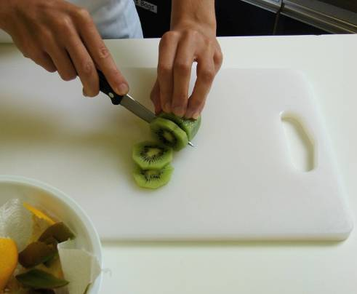
Peel the kiwi fruit and slice.

Slide 8
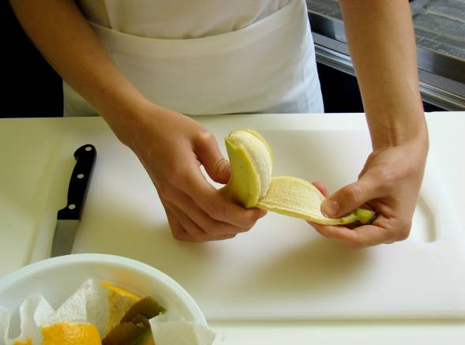
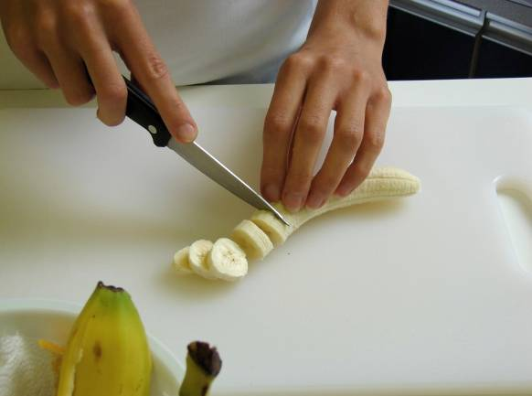
Peel the banana and slice.

Slide 9
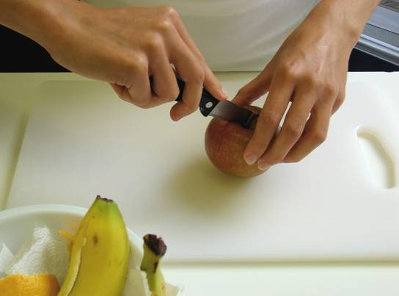
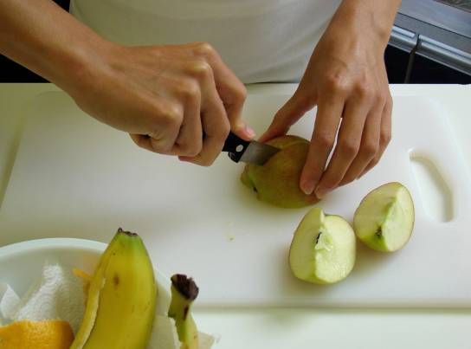
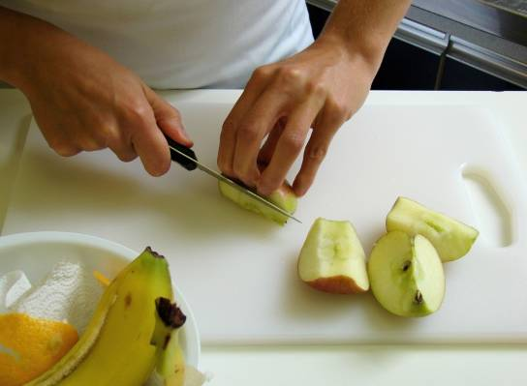
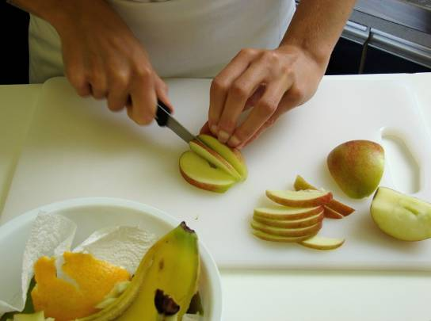
Quarter the apple, remove the core and slice.

Slide 10
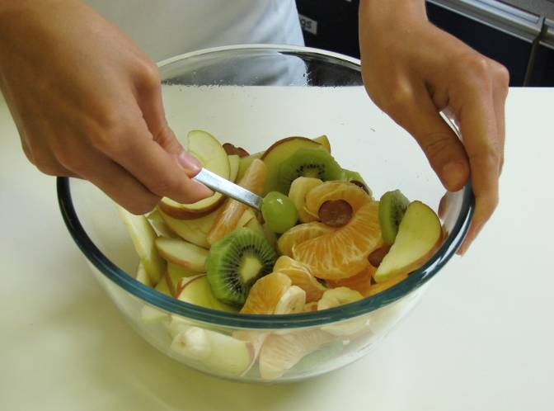
Place all the fruit in a bowl.

Slide 11
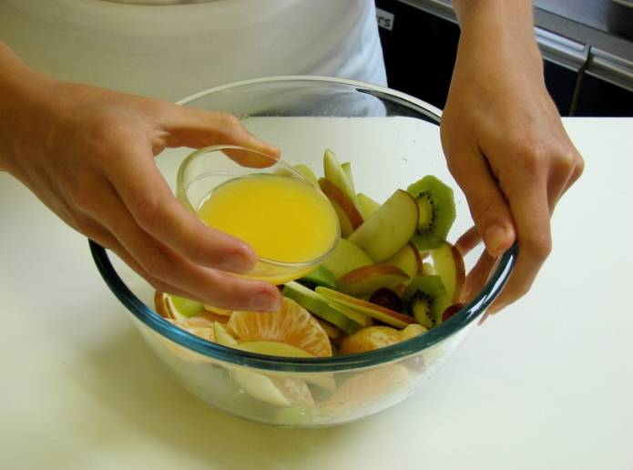
Add the orange juice and mix together.

Slide 12
Serve.

Slide 13
Top tips
Food skills
Try using different types of fruit such as sliced peaches, chunks of fresh mango or canned pineapple pieces.
Use other types of fruit juice instead of orange juice.
Cut the fruit into very small, even sized pieces to make a fruit cocktails.
Wash the grapes and apple before using them.
Measure
Peel.
Cut and slice.
Core.
Mix.

Slide 14
Fruit fusion
For further information, go to:
www.foodafactoflife.org.uk

